Slide 1
Connecting Europe Facility (CEF) support for railways 2018-EU-TM-0063-S Harald Reisinger (Project Coordinator / RNE CIO)

Slide 2
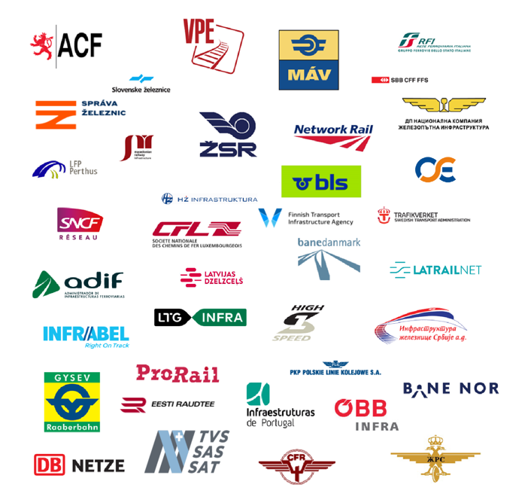
RailNetEurope (RNE) Introduction
Full Members:
RailNetEurope
was established in 2004
currently has 38 Full Members and 11 Associate Members
is an umbrella organisation of Infrastructure Managers (IMs)/Allocation Bodies (ABs)
facilitates international rail traffic
delivers solutions and tools for international infrastructure management
provides information on the European railway infrastructure
Associate Members:

Slide 3
Project Applicants
Project Co-ordinator:
RailNetEurope
Project Co-Beneficiaries (IMs):
SNCF Reseau
DB Netz
OEBB
ADIF
Infrabel SA
SZ Infra
HZ Infra
Banedenmark
Project Duration:
Start: 01/01/2019
End: 31/12/2022
Prolongation is under discussion
Project Budget:
28,77 Million

Slide 4
Project Organisation (2018-EU-TM-0063-S - Implementing Telematics Applications for European Interoperability)
Overall Project Coordinator
Harald Reisinger
Financial Issues
Reporting
Legal Issues
Administration
Activity Lead | Project Coordination | Implementing TAF/TAP TSI | Capacity Management TimeTable Redesign | Train Running Tracking and Tracing
RNE | Participating | Participating | Participating | Participating
ÖBB | Participating | Participating | Participating | Participating
SŽ | Participating |  | Participating
Infrabel | Participating |  | Participating | Participating
HŽ | Participating |  | Participating
ADIF | Participating | Participating | Participating | Participating
Banedanmark | Participating |  | Participating
SNCF Réseau | Participating | Participating | Participating | Participating
DB Netz | Participating |  | Participating

Slide 5
Implementing TAF/TAP TSI
Increased data quality and quantity of Telematics Reference Files
Merging or linking sector Reference Files with each other such as TAF/TAP Reference Files, RFC Customer Information System (CIP), Rail Facility Portal
Using RNE Big Data for replicating functions and services based on sector Reference Files
Increase in the number of rail companies using the common Reference Files

Slide 6
Big Data Framework Overview
Infrastructure Information Sources
(IMs, RFC, ERA, RUs, …)
Common Data
(Infrastructure Information including Points, Segments)
Business Data
(Path Information, TimeTable, Train Run, TCRs, Charging Information, RFC)
Corridor Definitions
RINF
Other Infrastructure Data

Slide 7
Capacity Management - TimeTable Redesign
Upgrade of Path Coordination System (PCS)
Connecting national railway systems based on TAP/TAF TSI adaptations to European Path Coordination System (PCS)
Coordinating and Publication of Temporary Capacity Restrictions
Defining a Capacity Broker for Short Term Capacity Request

Slide 8
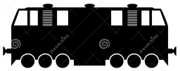
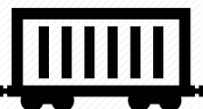
High Level Vision and Outlook
Train Run
Digital Train 2.0
Train Performance Management
Capacity
Allocation
PCS Mandatory Interface
Annual Request
Late
Request
Rolling Planning
Short term Request
Capacity Broker (Ad-Hoc Request)
!
Capacity based on Topology
European Capacity Management Tool
Capacity Supply
Digitalisation of the Network Statement
Rail Facilities Portal
Digital Infrastructure Data Big Data 2.0
Ground Topology

Slide 9
High Level Vision and Outlook
Train Run
Digital Train Information
Digital Train 2.0
Train Performance Management
Capacity
Allocation
PCS Mandatory Interface
Annual Request
Late
Request
Rolling Planning
Short term Request
Digital Capacity Management
Capacity Broker (Ad-Hoc Request)
!
Capacity based on Topology
European Capacity Management Tool
Capacity Supply
Digital Infrastructure Information
Digitalisation of the Network Statement
Rail Facilities Portal
Digital Infrastructure Data Big Data 2.0
Ground Topology

Slide 10
Thank you for your attention

