Slide 1
LIFE 2020 Call for Proposals from NGOs on the European Green Deal (LIFE 2020 NGO4GD) Virtual Information Session, 12 January 2021
Executive Agency for SMEs (EASME)

Slide 2
Applying successfully for LIFE: the financial side
Maryam Ghandi and Sylvie Kiekens
Financial Officers

Slide 3
ESTABLISHING THE PROJECT BUDGET: GENERAL REMARKS
Read the model grant agreement and guidelines for applicants
Be realistic when estimating the costs!
Lump sum funding grant – budgeted eligible costs will be evaluated and converted into lump sums at revision stage
There will be no costs reporting!
Payments are dependent on performance!

Slide 4
FINANCIAL APPLICATION FORMS (F0-F5)
The grant takes the form of a single lump sum contribution to cover all eligible costs of the action:
Grant based on a pre-fixed lump sum amount, not on the reimbursement of actual costs.
The lump sum must be an approximation of the beneficiaries’ actual costs.
Overall lump sum contribution cannot exceed 300.000 EUR nor can it be more than 60% of total estimated eligible costs.
The estimated budget summary (F0) consists of budgeted eligible costs per cost category for each work package. This information is extracted automatically from the form F1 to F5.

Slide 5
ESTIMATED BUDGET – SUMMARY (F0)
Applicants are required to provide, per work package, the total estimated eligible costs in the correct cost category (F-forms):
Estimated personnel costs should be calculated on the basis of pre-defined unit costs and
indirect costs are calculated by applying a flat-rate of 7% to the amount of the total eligible direct costs.
Round costs to the nearest EUR
No VAT to be included unless it cannot be recovered

Slide 6
ESTIMATED BUDGET – SUMMARY (F0)

Slide 7
THE CATEGORIES OF ELIGIBLE COSTS COVERED BY THE LUMP SUM CONTRIBUTIONS
Direct personnel costs
Travel and subsistence costs;
External assistance;
Durable goods (depreciation costs);
Consumables
Other direct costs
Indirect costs calculated on the basis of the standard flat rate of 7 % of the total eligible direct costs.

Slide 8
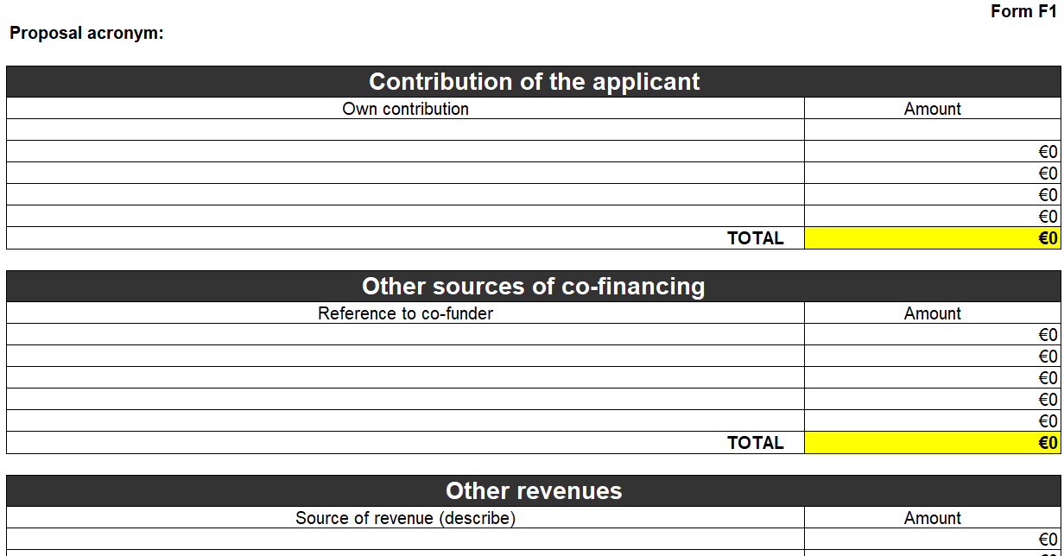
FINANCIAL CONTRIBUTIONS (F1)
Contribution of the applicant
Other sources of co-financing (specifically for the project)
Other revenues (e.g. income from the project)

Slide 9
PERSONNEL COST (F2)
Only costs related to employees /personnel with an equivalent appointing act (e.g. secondment) or contracts with natural persons (e.g. consultancy/civil contracts) which are assigned to the project
Ensure that tasks are carried out by the appropriate staff level.
Based on pre-defined unit costs per country:
Applied to all personnel necessary to carry out the action, regardless of the staff category.

Slide 10
PERSONNEL COST (F2)

Slide 11
PERSONNEL COST – Volunteers (F2)
Volunteer = person working on a non-compulsory basis for an organisation without payment.
Only accepted if:
they comply with the relevant national legislation,
they are part of a structured approach within the project and their role is clearly explained,
a reliable system to register the time they worked for the project will be put in place.
Shall take the form of a unit cost per day.
2 limitations:
The Union Contribution shall be limited to the estimated eligible costs other than those covering volunteers’ work.
The value of the volunteers’ work is limited to 50% of the funding sources of the action.

Slide 12
TRAVEL AND SUBSISTENCE (F3)
Indicate the corresponding type of destination: national, inside EU, International outside EU.
Purpose must be clearly described and linked with the activities
Average cost per travel per person
Charged in accordance with the internal rules of the beneficiary (e.g. fixed subsistence rates or actual subsistence costs)

Slide 13
TRAVEL AND SUBSISTENCE (F3)

Slide 14
EQUIPMENT AND DEPRECIATION (F4)
Provide a clear description of each item and provide the link with the activities.
Indicate the estimated purchase cost of the item
Only if really necessary for the implementation.
Eligible at 100%, if the organisation complies with all conditions set in the Grant Agreement.
➔ Certify compliance by signing a certificate that has to be included with the proposal.
Be sure to award contracts taking into account :
To tender offering best value for money/lowest price
No conflict of interest

Slide 15
EQUIPMENT AND DEPRECIATION (F4)

Slide 16
OTHER DIRECT COSTS (F5)
Select the type: rental costs, external assistance/subcontracting, consumables or other costs.
Provide a clear description of each item and explain the link with the activities.
Indicate the estimated purchase cost of the item
Only if really necessary for the implementation.
Resulting directly from requirements imposed by the grant agreement.
Be sure to award contracts taking into account :
To tender offering best value for money/lowest price
No conflict of interest

Slide 17
OTHER DIRECT COSTS (F5)

Slide 18
HIGHLIGHTS FINANCIAL VIABILITY
The financial viability of the applicant and its capacity to manage large EU grants are assessed on the basis of the financial information provided with the "simplified financial statement" of the applicant.
The financial viability check will also be used to assess whether a financial guarantee would be required to cover fully or partially the EU pre-financing payment to the project.

Slide 19
HIGHLIGHTS AFFILIATED ENTITIES
Entities affiliated to the applicant are not eligible to receive funding under this Call for proposals

Slide 20
REMEMBER
Be clear and precise – applications are only evaluated on what is submitted (not on the potential of the idea)
Read the call documents
!!! START EARLY!!!

