Slide 1
CITIES TRANSITION TO CARBON NEUTRALITY BY 2050 THE EXAMPLE OF DUBLIN
Suzanne Fitzpatrick
Communications Manager
Codema – Dublin’s Energy Agency
Notes:
Good morning everyone and thanks for your time today and in particular thanks to the Commission and the Covenant of Mayors office for this opportunity to talk to you all today about the TOMORROW project and how it is helping us to develop the Dublin Energy Transition Roadmap. And before I jump right in and tell you all about the TOMORROW project itself and what we’re trying to achieve with the roadmap, I’ll just firstly give you a sense of what Codema is and what we do, especially for those you who may not have heard of us before…

Slide 2
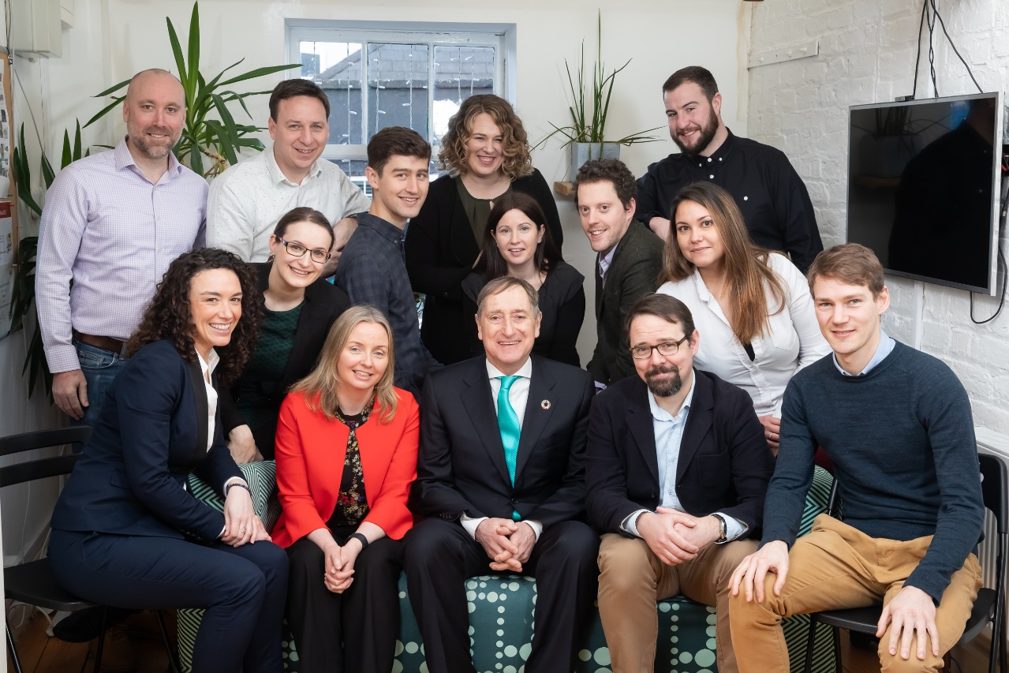
About Codema
Founded in 1997 as not-for-profit organisation
Energy Agency to 4 Dublin Municipalities
Work with the 4 Councils to improve energy use and reduce CO2 in Dublin – transition Dublin to a healthy, sustainable carbon neutral region
Notes:
So Codema is the energy agency for Dublin & we were set up well over 20 years ago now in 1997. We act as the dedicated energy agency for the four municipalities in Dublin and we also work with a range of other stakeholders across the region, with the ultimate aim of transitioning Dublin to a healthy, sustainable & carbon-neutral capital city.

Slide 3
What do we do?
Energy Monitoring & Management
Energy Performance Contracting
Energy Planning & Policy
District Heating
Project Management & Funding
Awareness, Communication and Engagement
Notes:
And just very quickly to give you a sense of the areas that we work in – so we cover everything from energy monitoring & mgt of municipal buildings, EPC, energy planning such as the development of the DREM for the entire county, developing the first DH projects in the region, and we also lead or are partners in a number of national and European projects, such as the TOMORROW project for example. Then last, but not least, we also work on projects that focus on awareness, communication and engagement of climate mitigation and the energy transition – and it’s within this context that we are involved in developing the Dublin Energy Transition Roadmap through the TOMORROW project.

Slide 4
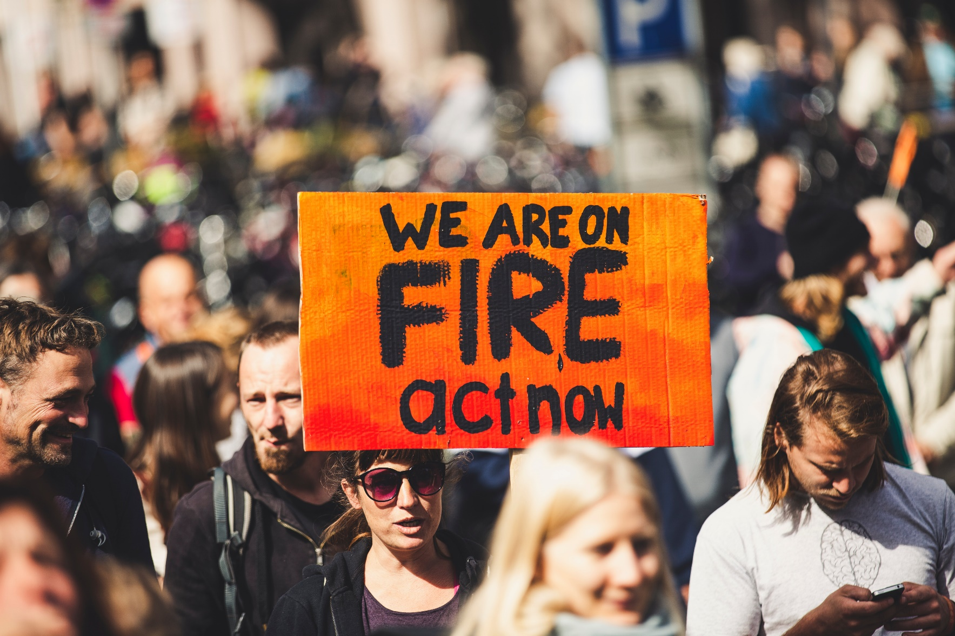
THE CONTEXT
Cities in the frontline
Paris Agreement
New - Climate culture
New – Covenant for climate-neutral Europe
New - EU Climate Pact
Social demand for a transition towards a resource efficient system and a clean and healthy environment is growing stronger!
Notes:
And just to give some context to the need for initiatives like the TOMORROW project – this is in response to a very clear social demand from citizens to be able to live and work in cities that are healthy, vibrant and sustainable. And we can see that reflected in things like the Paris Agreement and through the new European Green Deal and the new chapter of the CoM, which launched back in April and is inviting EU cities to scale up their ambition and support Europe’s journey to climate-neutrality. And within that, Covenant Signatories are now committing to organise a “local climate pact” and this is exactly what TOMORROW is supporting cities to do: to engage with the community so that they can be empowered to define and drive the transition.

Slide 5
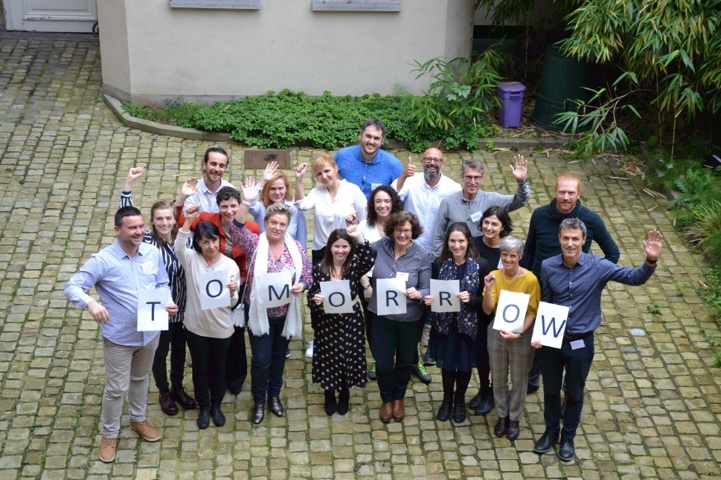
AIM OF THE PROJECT
Leading the energy transition bottom up!
Empowering local authorities to lead the transition towards low-carbon, resilient and more liveable cities
Six cities will develop 2050 transition roadmaps together with citizens and other local stakeholders and serve as pilot for the transition of European territories
Notes:
So what is the TOMORROW project all about and what does it set out to do? Well the TOMORROW project is funded through the Horizon 2020 programme and aims to empower local authorities to lead the transition towards low-carbon, resilient and more liveable cities. The TOMORROW project will support Dublin and five other pilot cities to develop energy transition roadmaps towards 2050 together with citizens and other local stakeholders and act as a pilot for the energy transition across European towns and cities.

Slide 6
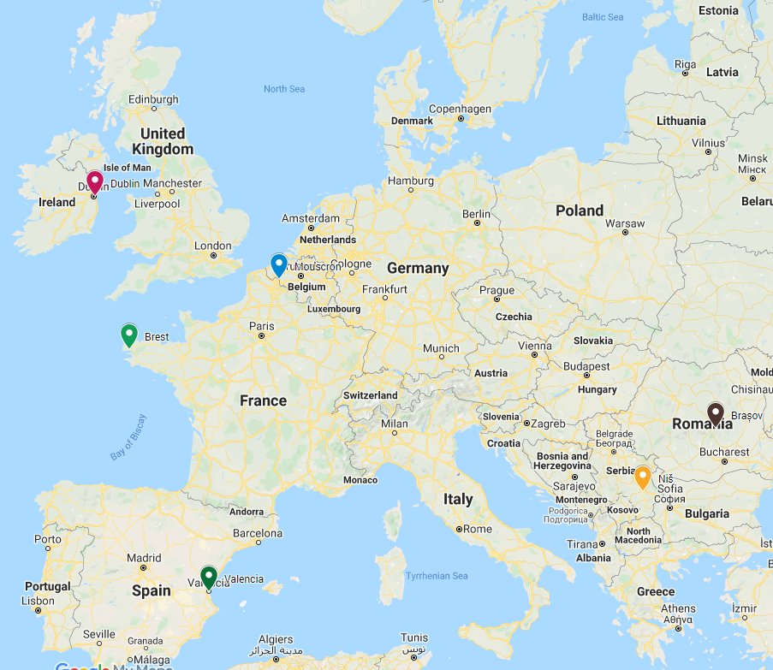
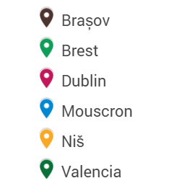
Notes:
So you can see the six pilot cities there on the map that are involved in the project, so it’s Codema obviously representing Dublin in our capacity as the local energy agency, with the other 5 cities being Brasov in Romania, Brest in France, Mouscron in Belgium, Nis in Serbia and Valencia in Spain. And we also have the support of DRIFT (the Dutch Research Inst for Transitions) who are guiding us on the energy transition management process and of course Energy Cities who are acting as overall co-ordinators for the project.

Slide 7
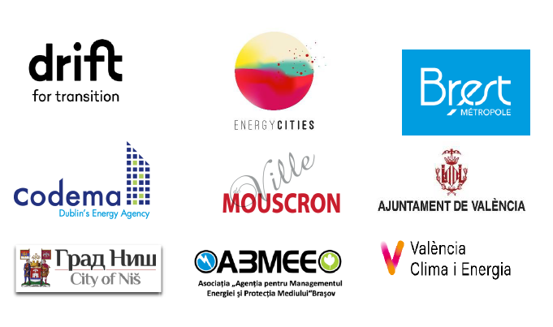
THE PARTNERS
Six pilot cities
Brasov (Brasov Energy Agency), Romania
Brest (Brest-Metropolis, Pays de Brest), France
Dublin (Dublin’s energy agency), Ireland
Mouscron (City of Mouscron), Belgium
Niš (City of Niš), Serbia
Valencia (City of Valencia, Valencia Climate Obersvatory), Spain
Methodological support
DRIFT
Coordination and guidance
ENERGY CITIES

Slide 8
MAIN ACTIONS
From September 2019 to August 2022 we will:
Review exsiting methods & approaches
Train cities in transition management & innovative engagement processes
Develop a methodological toolbox
Manage an energy transition community of practice
Co-design cities’ transition roadmaps
Develop an EU narrative for zero-carbon cities
Notes:
And in terms of the main actions that will be carried out over the 3 years of the project, this includes everything from training and educating the pilot cities on the transition management process, innovative engagement techniques for reaching out to stakeholders and citizens, setting up and managing an energy transition community of practice, co-designing the cities transition roadmaps and developing a shared narrative for zero-carbon cities across the EU.

Slide 9
WHAT WE’VE DONE SO FAR
Visits to lighthouse cities
Methodology workbook
Preparation of local action / work plans
Start of the engagement phases in pilot cities
Peer-review of pilot cities actions
Organisation of Learning Relays
Creation of a community of practice
Very challenging during COVID times...
Notes:
So what have we done so far since the project began in September 2019? Well we’ve had some some really inspiring visits to lighthouse cities such as Leuven and Ghent in Belgium and Nantes in France (lucky enough – visit – before Covid). Each city has prepared its own work plan for their transition roadmap, which have been peer-viewed by the other pilot cities, and has begun the stakeholder engagement process in their city and setting up a transition city. The project has also organised learning relays and set up a community of practice for other cities to learn from this project and also to share their own experience. And it’s obviously been very challenging during the pandemic where we were no longer able to visit the pilot or lighthouse cities or have physical workshops but despite all that we have made some really good progress and have adapted very well to this new online world.

Slide 10
LEARNINGS FOR DUBLIN
Identified our system needs
Learned about the Transition Management Process: It’s not just about kilo-watt hours or tCO2, need a fundamental change in our culture, structures & practices!
Identified the frontrunners we need to involve in this transition community
Developed our Work Plan and Marketing Strategy to create the Dublin Energy Transition Roadmap
Learning from Pilot Cities and Lighthouse Cities
Notes:
And specifically for Dublin in terms of the progress and learnings we’ve made within the project: so we’ve been able to identify our system needs and what needs to change in Dublin – and I suppose a key learning from the transition mgt process within TOMORROW is that it’s not just about reducing kilowatt hours or tonnes of CO2, what we need is a fundamental change in our culture, structures & practices. We’ve also learned from the pilot and lighthouse cities along the way and mapped out the actors or stakeholders that we need to involve in this transition community. And last but not least we’ve also developed our work plan setting out the key milestones and processes that we need to carry out to develop the DETR.

Slide 11
Dublin Energy Transition Roadmap
Notes:
So I’m going to focus now on what exactly the Dublin Energy Transition Roadmap is and what it sets out to do.

Slide 12
What is the Dublin Energy Transition Roadmap?
The Dublin Energy Transition Roadmap aims to…
…bring all actors that are necessary for Dublin’s energy transition together to develop a shared vision, collaborating on and developing a clear set of actions to meet our 2030 and 2050 targets, that are then disseminated to a wider network across the Dublin region.
Notes:
So very simply, the roadmap aims to bring all the actors or s/holders that are necessary for Dublin’s energy transition together to develop a shared vision and to collaborate and agree on a clear set of actions in order to meet our 2030 and 2050 targets.

Slide 13
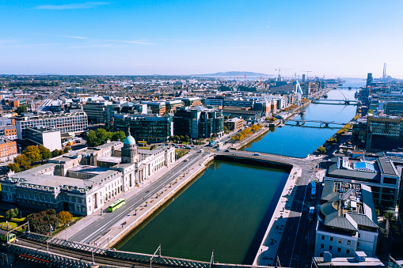
Spotlight on: Dublin
Dublin Region: Divided into 4 different municipal or local authority regions – Dublin City, Dún-Laoghaire Rathdown Fingal & South Dublin
Population of over 1.3M & over 516,000 households
Pre-Covid: One of fastest growing economies in Europe
Dublin’s energy demand is increasing – e.g. increased building construction, data centres
Notes:
And just to give you an overview of the Dublin Region itself, it’s divided into 4 different municipal regions (list them) with a total population of just over 1.3M people and roughly 516,000 households. And prior to the pandemic, we had one of the fastest growing economies in Europe, with a growing energy demand – so for e.g. with increased building construction and we’ve a large number of data centres in the region.

Slide 14
The Benefits of Low-Carbon Cities…

Slide 15
Low-Carbon Dublin
Increased Innovation
Increased Employment
Increased Attractiveness
Improved Public Health
Cheaper Energy
Increased Productivity
Greater Equality
Notes:
Innovation – development of new technologies, new solutions, through collaboration between sectors who don’t usually work together
Employment – retrofitting, EV charging, new urban heating infrastructures like district heating,
Attractiveness- cheaper cleaner energy supply, happier healthier more productive work-force
Healthier city – less air pollution and healthier indoor environments
Which also lead to increased productivity, along with less time spent stuck in traffic commuting
Greater equality – better living conditions for all and low-cost or free transport means for those reliant on cycle infrastructure and public transport

Slide 16
Notes:
And in terms of the why of the Dublin Energy Transition Roadmap, or the rationale behind why we need a roadmap like this. This is something that our own team has put a lot of thought into when we were first starting this process and the collective answer that we came up with essentially is that nobody can do this on their own, no single individual or sector is going to be able to transform Dublin into this healthy, sustainable city or has all the answers. So the local authorities can’t do it on their own, we in Codema can’t do it all on our own, however by motivating all those key sectors (local communities, businesses, transport sector, etc.) to work together towards the same goal and take ownership of the transition, we believe that’s our best chance of achieving a carbon-neutral Dublin and meeting our 2030 and 2050 targets.

Slide 17
Scale of the challenge
Need to save/sink CO2 equivalent of taking 57,000 cars off Dublin’s roads….
EVERY YEAR FOR 30 YEARS
Notes:
And just to give you a sense of the challenge that we’re facing in terms of reducing Dublin’s carbon emissions, we would need to save/sink the CO2 equivalent of taking 57,000 cars off Dublin’s roads every year for the next 30 years in order to make Dublin carbon neutral. So the challenge that we’re facing is immense…

Slide 18
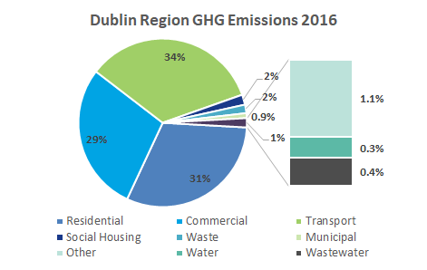
Notes:
And you can see from this chart here that it’s the Transport, Residential and Commercial sectors that account for the majority of GHG emissions within Dublin so we need be actively working with and bringing these sectors together to agree on decide the best pathways for a carbon neutral Dublin.

Slide 19
Local Authority Climate Action
Dublin Municipalities:
Have each developed their Climate Change Action Plans, with the support of Codema
Only account for 3% of emissions in the entire Dublin Region
Notes:
And in terms of the 4 municipalities in Dublin, we helped them to develop their own Climate Change Action Plans, which each have over 100 very ambitious actions that they want to carry out between now and 2030. But the local authorities only account for 3% of total emissions in the Dublin Region, and this is where the DETR comes in as it will help ourselves and the local authorities to engage and involve other key stakeholders to work together as a collaborative transition community to develop the Dublin roadmap and to commit to action in making the region carbon neutral by 2050.

Slide 20
We are developing the Dublin Energy Transition Roadmap to get us there…
Transition Team to Coordinate
Evidence-base to Inform
Engagement & Networking
Collaborative development
Cross-sector Commitment
Notes:
So it involves us setting up a transition team to co-ordinate the roadmap, the development of the evidence-base to inform stakeholders and citizens on the right pathways to take (so in the case of Codema, this will be the Dublin Region Energy Masterplan that our energy planning team is currently developing, and this will provide a solid evidence-base for the best pathways to take towards 2030 and 2050. It will involve engagement and coordination of key stakeholders across a range sectors to come together and collaboratively develop the DETR, and have cross-sector commitment to implementing the actions within the roadmap itself.

Slide 21
Overview of the approach
Evidence-base
(Technical Research bit)
Meaningful Engagement
(Social Science bit)
Realistic Roadmap achieved through Collaboration with buy-in across all Sectors
Notes:
So the overview of our approach in developing the roadmap is to combine the evidence-base – i.e. the master plan, with meaningful engagement with key stakeholders to develop a realistic roadmap which will be developed and implemented with collaboration and buy-in from all sectors.

Slide 22
So where are we now?
Notes:
So where are we now in this process and where do we need to get to.

Slide 23
HOW: FOUR PILLARS TO DRIVE THIS TRANSITION
COMMUNITY
COLLABORATION
COMMITMENT
COMMUNICATION
Notes:
We see this transition and the development of the roadmap being based around 4 key pillars – community (the transition roadmap needs to be more than just a plan, it needs to be a means to gather a “transition community” of motivated stakeholders), Collaboratiom (successful collaborative model with this community of stakeholders, to decide collectively on the best pathways forward to Dublin’s carbon-neutral transition), Commitment (put in place a clear plan to create a successful transition roadmap, with stakeholders from key sectors (e.g. business, transport, etc.) committing to action) and Communication (successful public engagement campaign to ensure that citizens feel empowered in the transition)

Slide 24
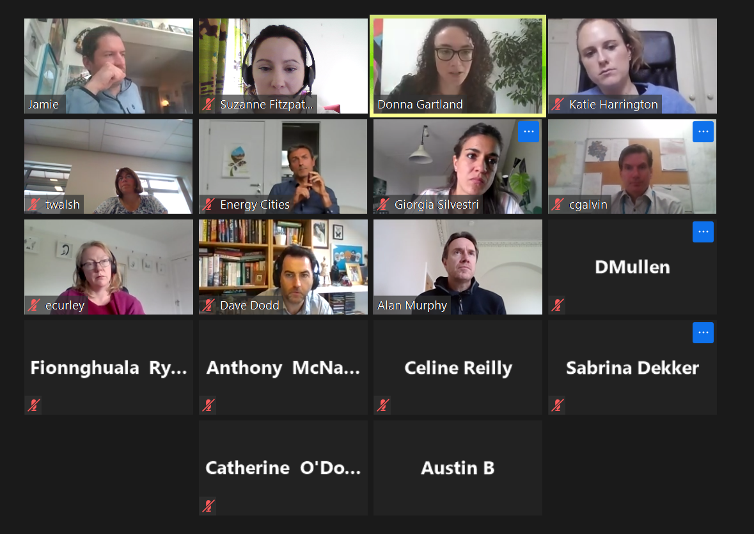
The Transition Team to Date
Codema staff & Representatives from the 4 Dublin Local Authorities, the Dublin Climate Action Regional Office and Smart Dublin
Notes:
So we’ve already set up our initial transition team to coordinate the roadmap process, which comprises of ourselves in Codema, the 4 DLAs, Smart Dublin and the Dublin Climate Action Regional Office.

Slide 25
External Organisations
Notes:
But we know that the local authorities themselves only account for 3% of the total emissions in Dublin, so we’re currently in the process of widening out this team to include frontrunners in areas such as communities, business, other government/public bodies, transport organisations, the energy sector and education and research institutes, so hopefully this graph here on the screen gives you a sense of how this will work and how each sector frontrunner will link in with their own network in developing the roadmap.

Slide 27
Who are the Transition Team?
A group of people who will….
…use their passion, expertise and agency for the successful creation of Dublin's Energy Transition Roadmap to 2050
…aligning their work, knowledge and expertise with the roadmap process, informing their network as to how they can collaborate, taking ownership of the roadmap process
Notes:
And by forming this wider Transition Team, our aim to is bring a group of people together who will use their passion, expertise and motivation for the successful development of the roadmap and will also inform and reach out to their own networks to get other stakeholders involved and take ownership of the roadmap process.

Slide 28
Codema’s role in the process
Codema will…
…drive the process forward through facilitation ensuring collaborators are informed, engaged and aligned in working towards building the roadmap
…recognising the needs of the “collaborators” and potential information gaps in the team, ensuring that we use our internal expertise to address this, as well as creating a space that responds to these needs and cultivates a fair, inclusive, respectful and creative learning environment primed for innovative thinking and knowledge-sharing
Notes:
So to look at how we can go about creating a space and workshops that foster this- I thought it was best to recap on the Urban Transition manual and the transition management process- which this presentation is going to be grounded in. We have seven steps…read them….and I thought it was important to make sure that what DRIFT is saying aligns with other literature within the space of stakeholder engagement and consensus building.

Slide 29
Our Vision for the Transition Team
Increase their knowledge of Dublin’s energy sector
Develop a deeper understanding of potential pathways to 2030 & 2050
Reach a consensus on the best pathways forward
Feel empowered to take ownership of the action plan
Feel pride in the process with motivation to share the experience and plan with their network
Notes:
And by getting involved in the transition team, we will help stakeholders to increase their knowledge of the energy sector in Dublin, develop a deeper understanding and collectively reach consensus on the best pathways to 2030 and 2050, feel empowered to take ownership of their actions within the roadmap, and be able to act as ambassadors for the roadmap and motivate other stakeholders in their network to get involved.

Slide 30
We want to cultivate a space that inspires…
Commitment
Dialogue
Shared purpose
Respect
Co-creation
“Yes, and”
Transparency
Business as “unusual”
Open-mindedness
Creativity
Momentum

Slide 31
What will they do?
Develop Shared Purpose
Agree on Problem Framing
Visioning
Idea generation
Action plan
Implementation
Notes:
And what exactly are we asking our transition team to do? So we will organise a number of creatively-facilitated workshops between now and next year which will explore a number of areas such as developing a shared purpose for the roadmap and agreeing on problem framing, visioning and idea generation, and of course identifying actions for the roadmap itself and looking at how these actions will be implemented and monitored once the roadmap is developed.

Slide 32
Notes:
And you can see from this timeline, that we’re at the stage now where we are recruiting frontrunners across a range of sectors to join the team so that they can act as leaders/motivators within their own sector.

Slide 33
Citizen participation is key!
Citizen Engagement Campaign
Local Citizens’ Assembly workshop – replicating national success
Building on existing initiatives (e.g. Sustainable Energy Communities, Home Energy Saving Kit, Green Clubs Initiative)
Notes:
But central to Dublin’s transition are the citizens who live, work and visit the region so they need to be involved and empowered so we will develop and roll out a branded public engagement campaign, to drive awareness and understanding of the need to transition, we want to develop a local citizens assembly-style programme and base this on the structure of our national Citizens Assembly which has been held up as best-practice in terms of democratic processes and public participation, and recruitment of citizen and community leaders through channels such as the Sustainable Energy Communities programme (for which Codema is regional coordinator), local GAA clubs, Tidy Towns, etc. to act as influencers and motivators in neighbourhoods throughout Dublin

Slide 34
The End Result…
Notes:
So what does the end result look like? We want the final output to be a collaborative, long-lasting and impactful roadmap…

Slide 35
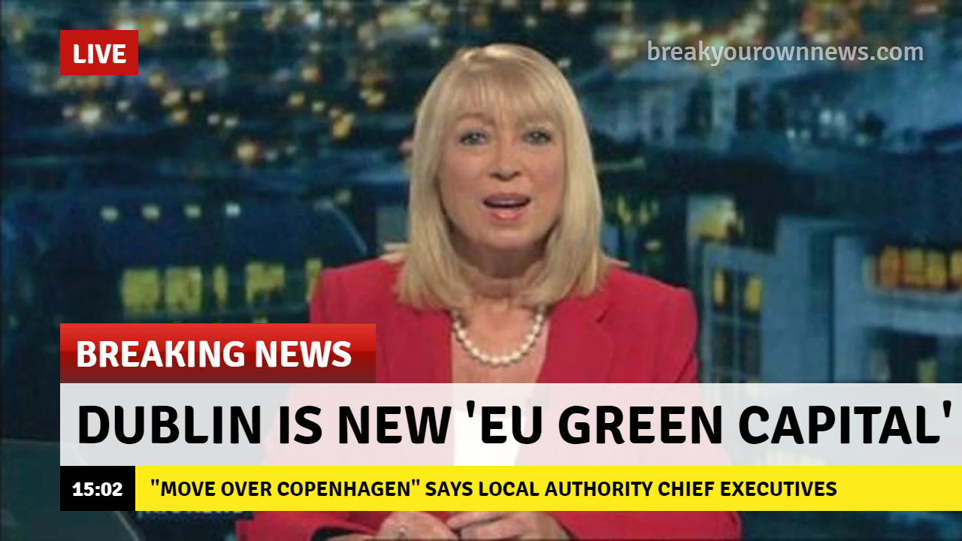
Notes:
…that takes Dublin from being a climate laggard to a climate leader – and gives the Scandinavian cities a run for their money at the same time!!!

Slide 36
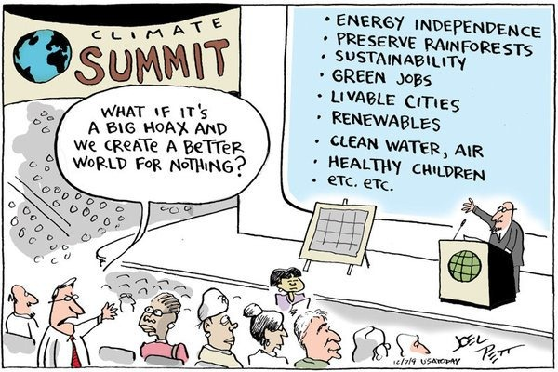
Notes:
…and gives us all these wonderful benefits that come with developing Dublin as a leading carbon-neutral capital.

Slide 37
WHAT’S IN IT FOR YOU?
TOMORROW’s methodology to drive meaningful discussions around your city’s energy transition and decarbonisation
TOMORROW’s Learning Relays and Master Classes
TOMORROW’s community of practice on energy transition
https://energy-cities/TOMORROWCommunity
Support in the development of your city’s 2050 transition roadmap
www.citiesoftomorrow.eu
Notes:
And just finally to say that Codema has really benefited from being part of the TOMORROW project and I really don’t think we could have made this kind of progress with our roadmap without the support of Energy Cities, DRIFT and the other pilot cities. So if you also want to learn from the project or share your own experiences, there’s lots of ways that you can get involved as you can see on the screen such as joining the TOMORROW community of practice or participating in one of the master classes or relays.

Slide 38
Suzanne Fitzpatrick: suzanne.fitzpatrick@codema.ie TOMORROW: contact@citiesoftomorrow .eu
Notes:
So thank you all for your time, my contact details are there on the screen if anyone wants to get in touch (I’ll be happy to follow up) - I’ll leave you now with what is hopefully a very inspiring video about the Dublin Energy Transition Roadmap and what it sets out to do and I’m more than happy to take any questions after that – so I might ask the organisers if they can play the video now…

