Slide 1

Covenant of Mayors Investment Forum
Evolving Regions – Social innovation
for targeted investments in regional climate action”
Jürgen Schultze, TU Dortmund University

Slide 2
Take Aways
Value of regional climate adaptation & cooperation for focused investments
Special focus on small urban and rural areas, often the white spot of adaptation
Full adaptation (value) chain including funding and investments options
Stakeholder developed roadmap as an investment plan
20.04.2021
Evolving Regions

Slide 3
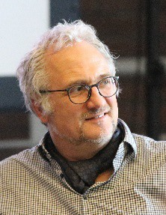
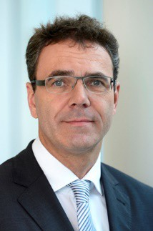
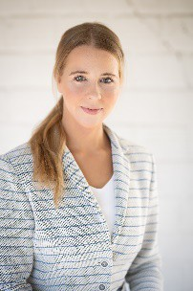
Making Investments better from a 360⁰ Perspective
The process manager´s perspective:
Jürgen Schultze
Take Aways
Value of regional climate adaptation & cooperation for focused investments
Special focus on small urban and rural areas, often the white spot of adaptation
Full adaptation (value) chain including funding and investments options
Stakeholder developed roadmap as an investment plan
The Banker´s
and funder´s perspective
Thomas Kull
The regional manager´s perspective
Leona Eichel
20.04.2021
Evolving Regions
3

Slide 4
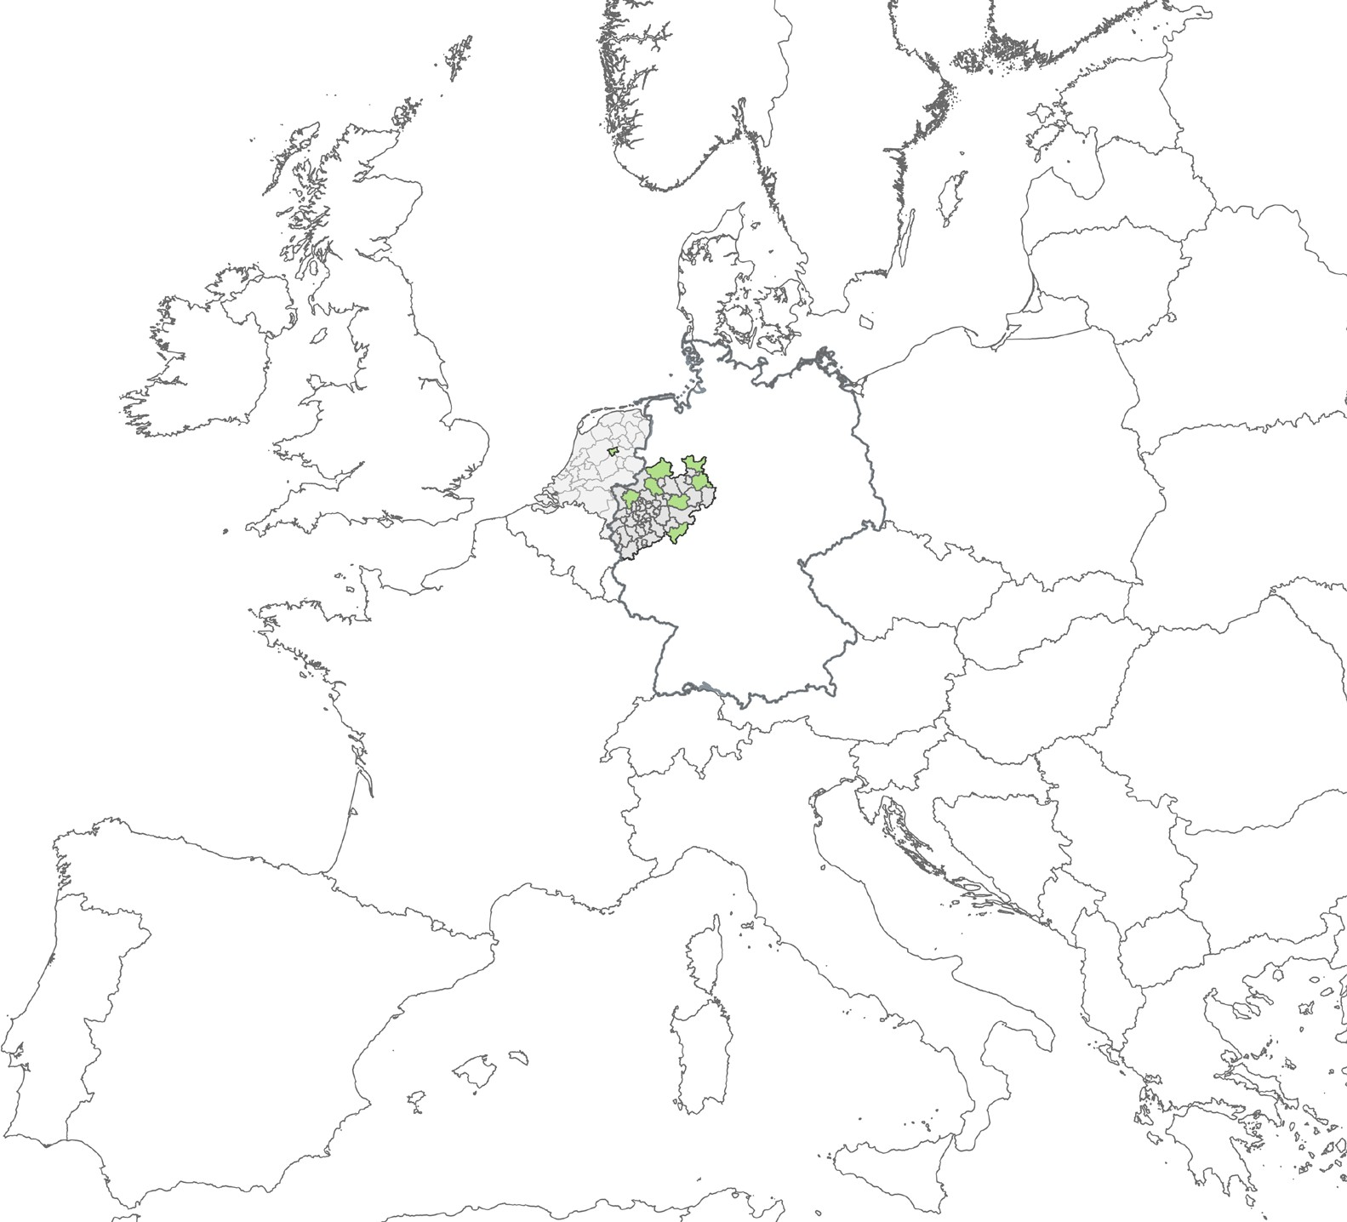


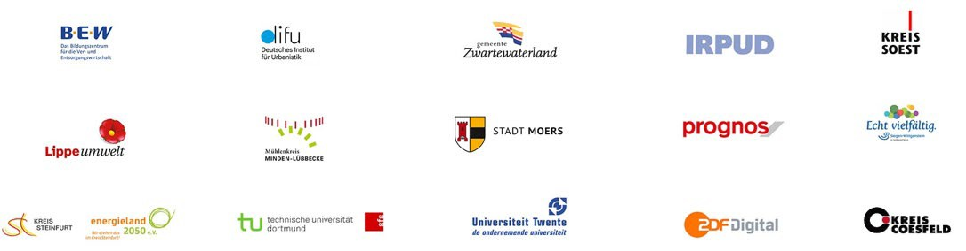
Evolving Regions is …
The project LIFE Roll-outClimAdapt is funded by the EU‘s LIFE environmental programme and co-financed by
MULNV NRW.
Project duration: 01/07/19 – 31/03/23
8 Partner regions in Germany and Netherland
District of Wesel
District of Siegen-Wittgenstein District of Minden-Lübbecke District of Lippe
Gemeente Zwartewaterland/Kampen
District of Steinfurt District of Soest District of Coesfeld
7 Partner institutions– a transdisciplinary setting
TU Dortmund University, Social Research Centre
TU Dortmund University, Institute for Spatial Planning German Institute of Urban Affairs (difu)
PROGNOS AG
BEW Bildungszentrum University of Twente ZDF Digital
NRW- Environment Minister Ursula Heinen-Esser :
„ Evolving Regions is the flagship for climate change adaptation in rural areas for NRW“
20.04.2021
Evolving Regions
4

Slide 5
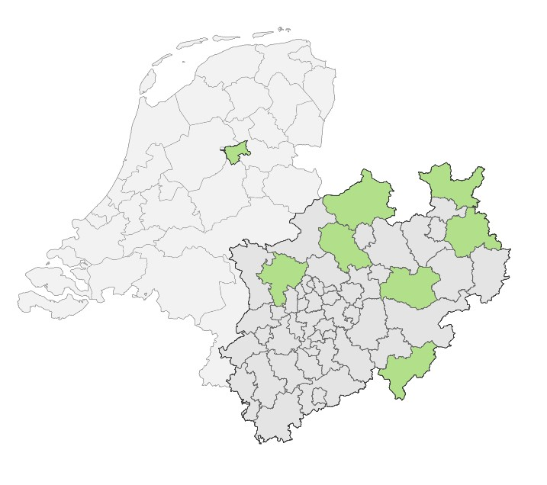
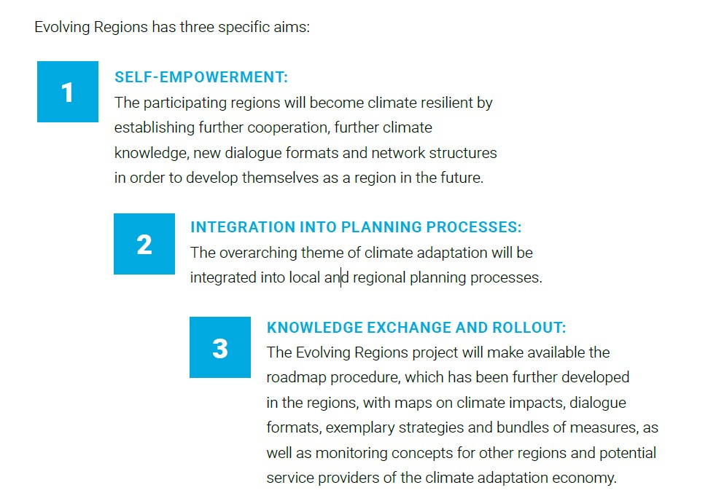

Evolving Regions: overarching aims
How can regions and municipalities adapt to the complex climate change challenges?
20.04.2021 Evolving Regions
5

Slide 6
Structure of the Project
Interregional Exchange
Mainstreaming and Transfer
Regional Process
Monitoring
20.04.2021
Evolving Regions
6

Slide 7
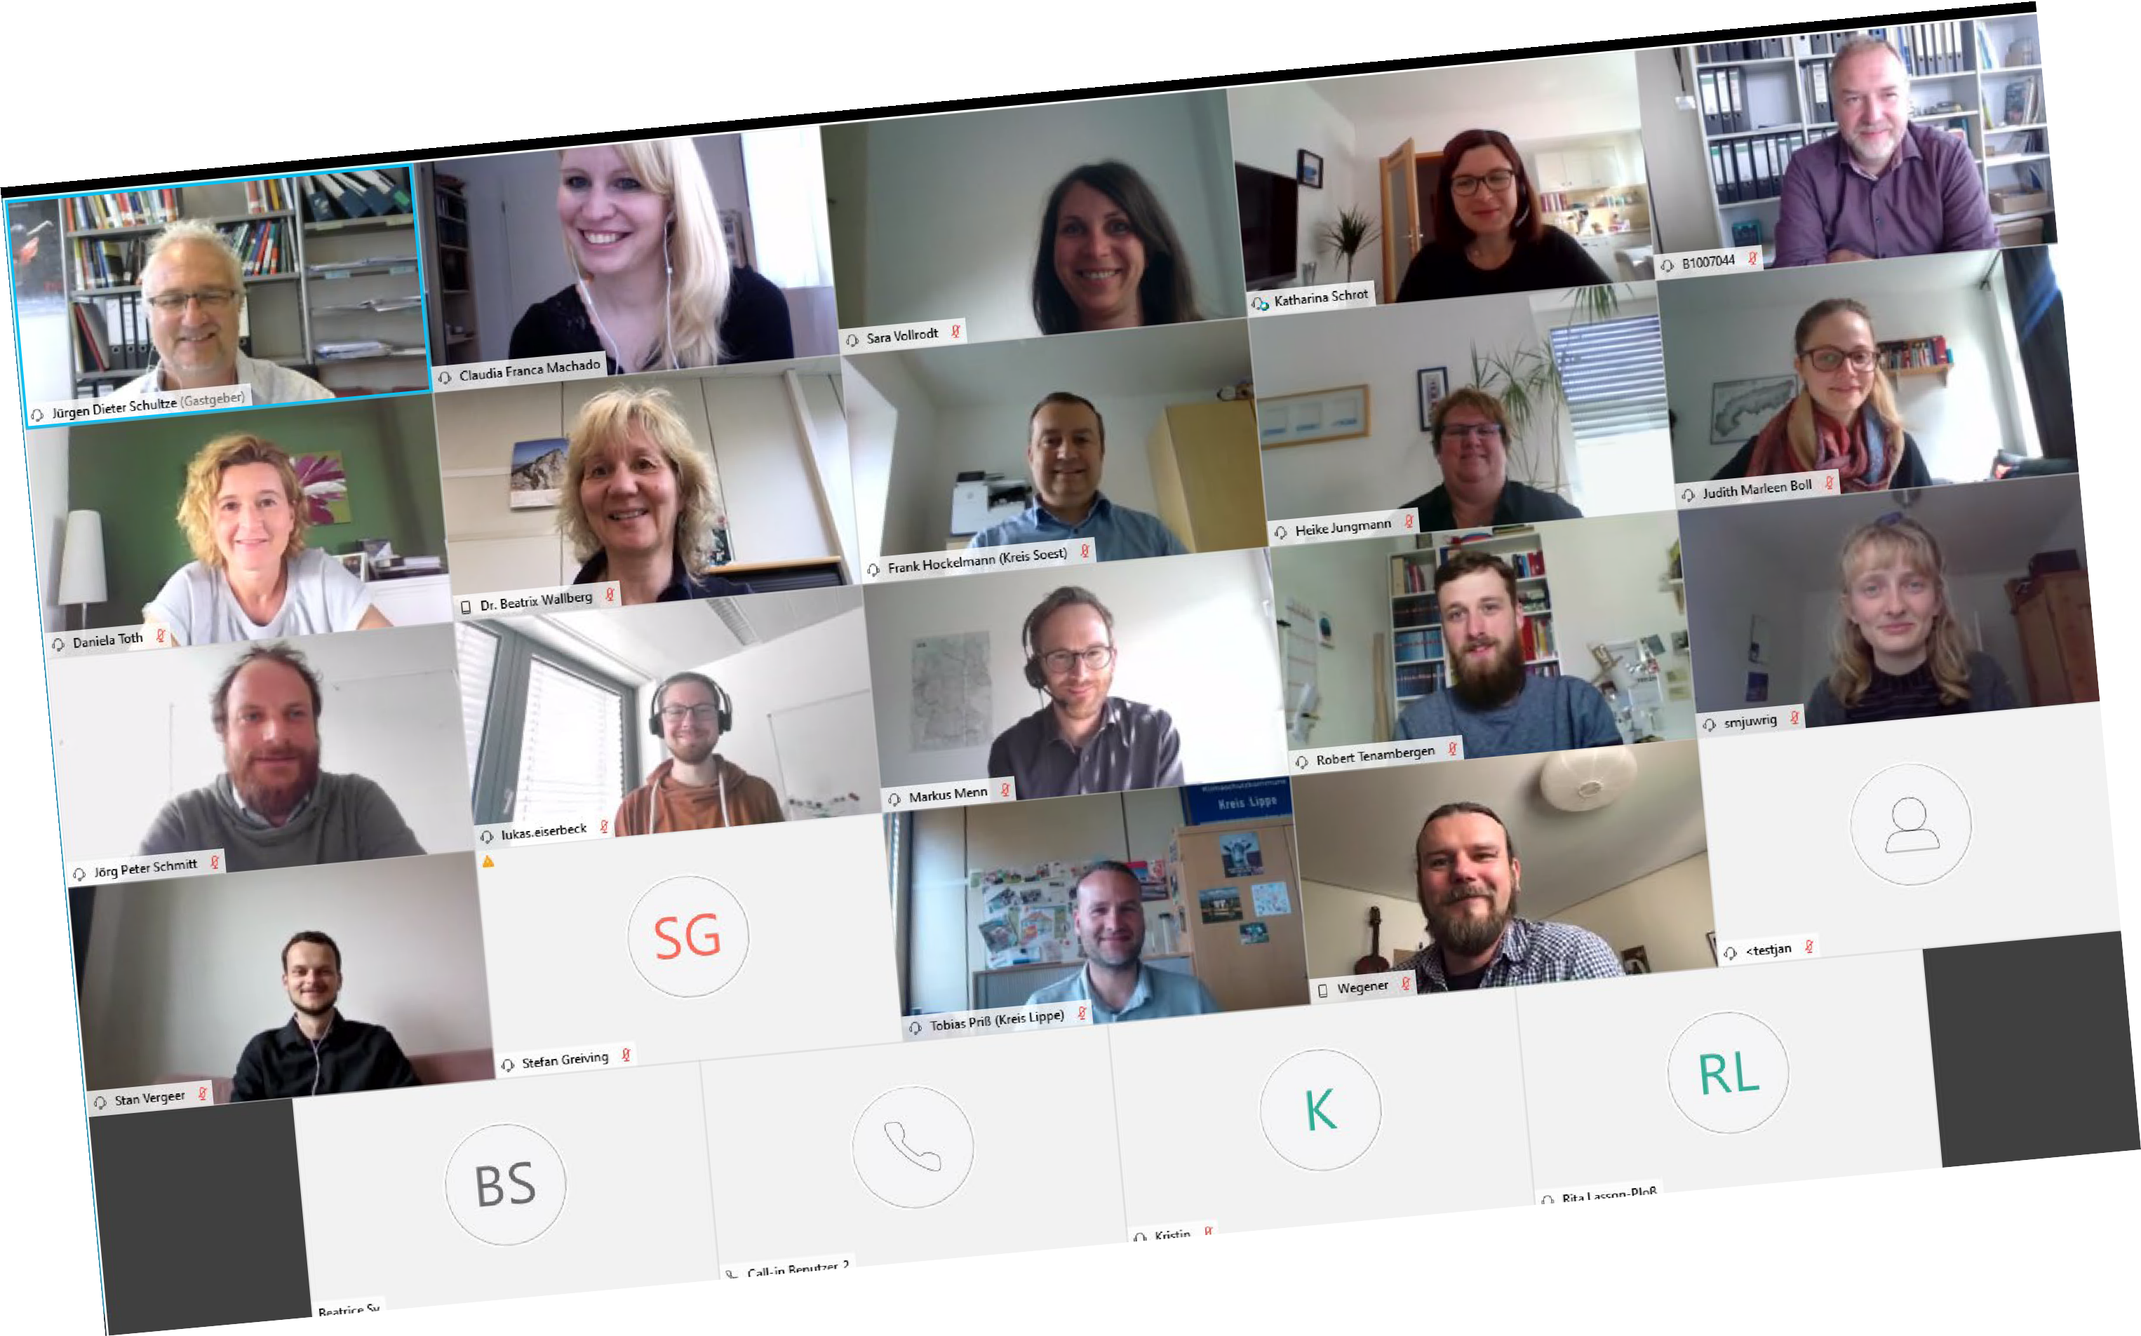
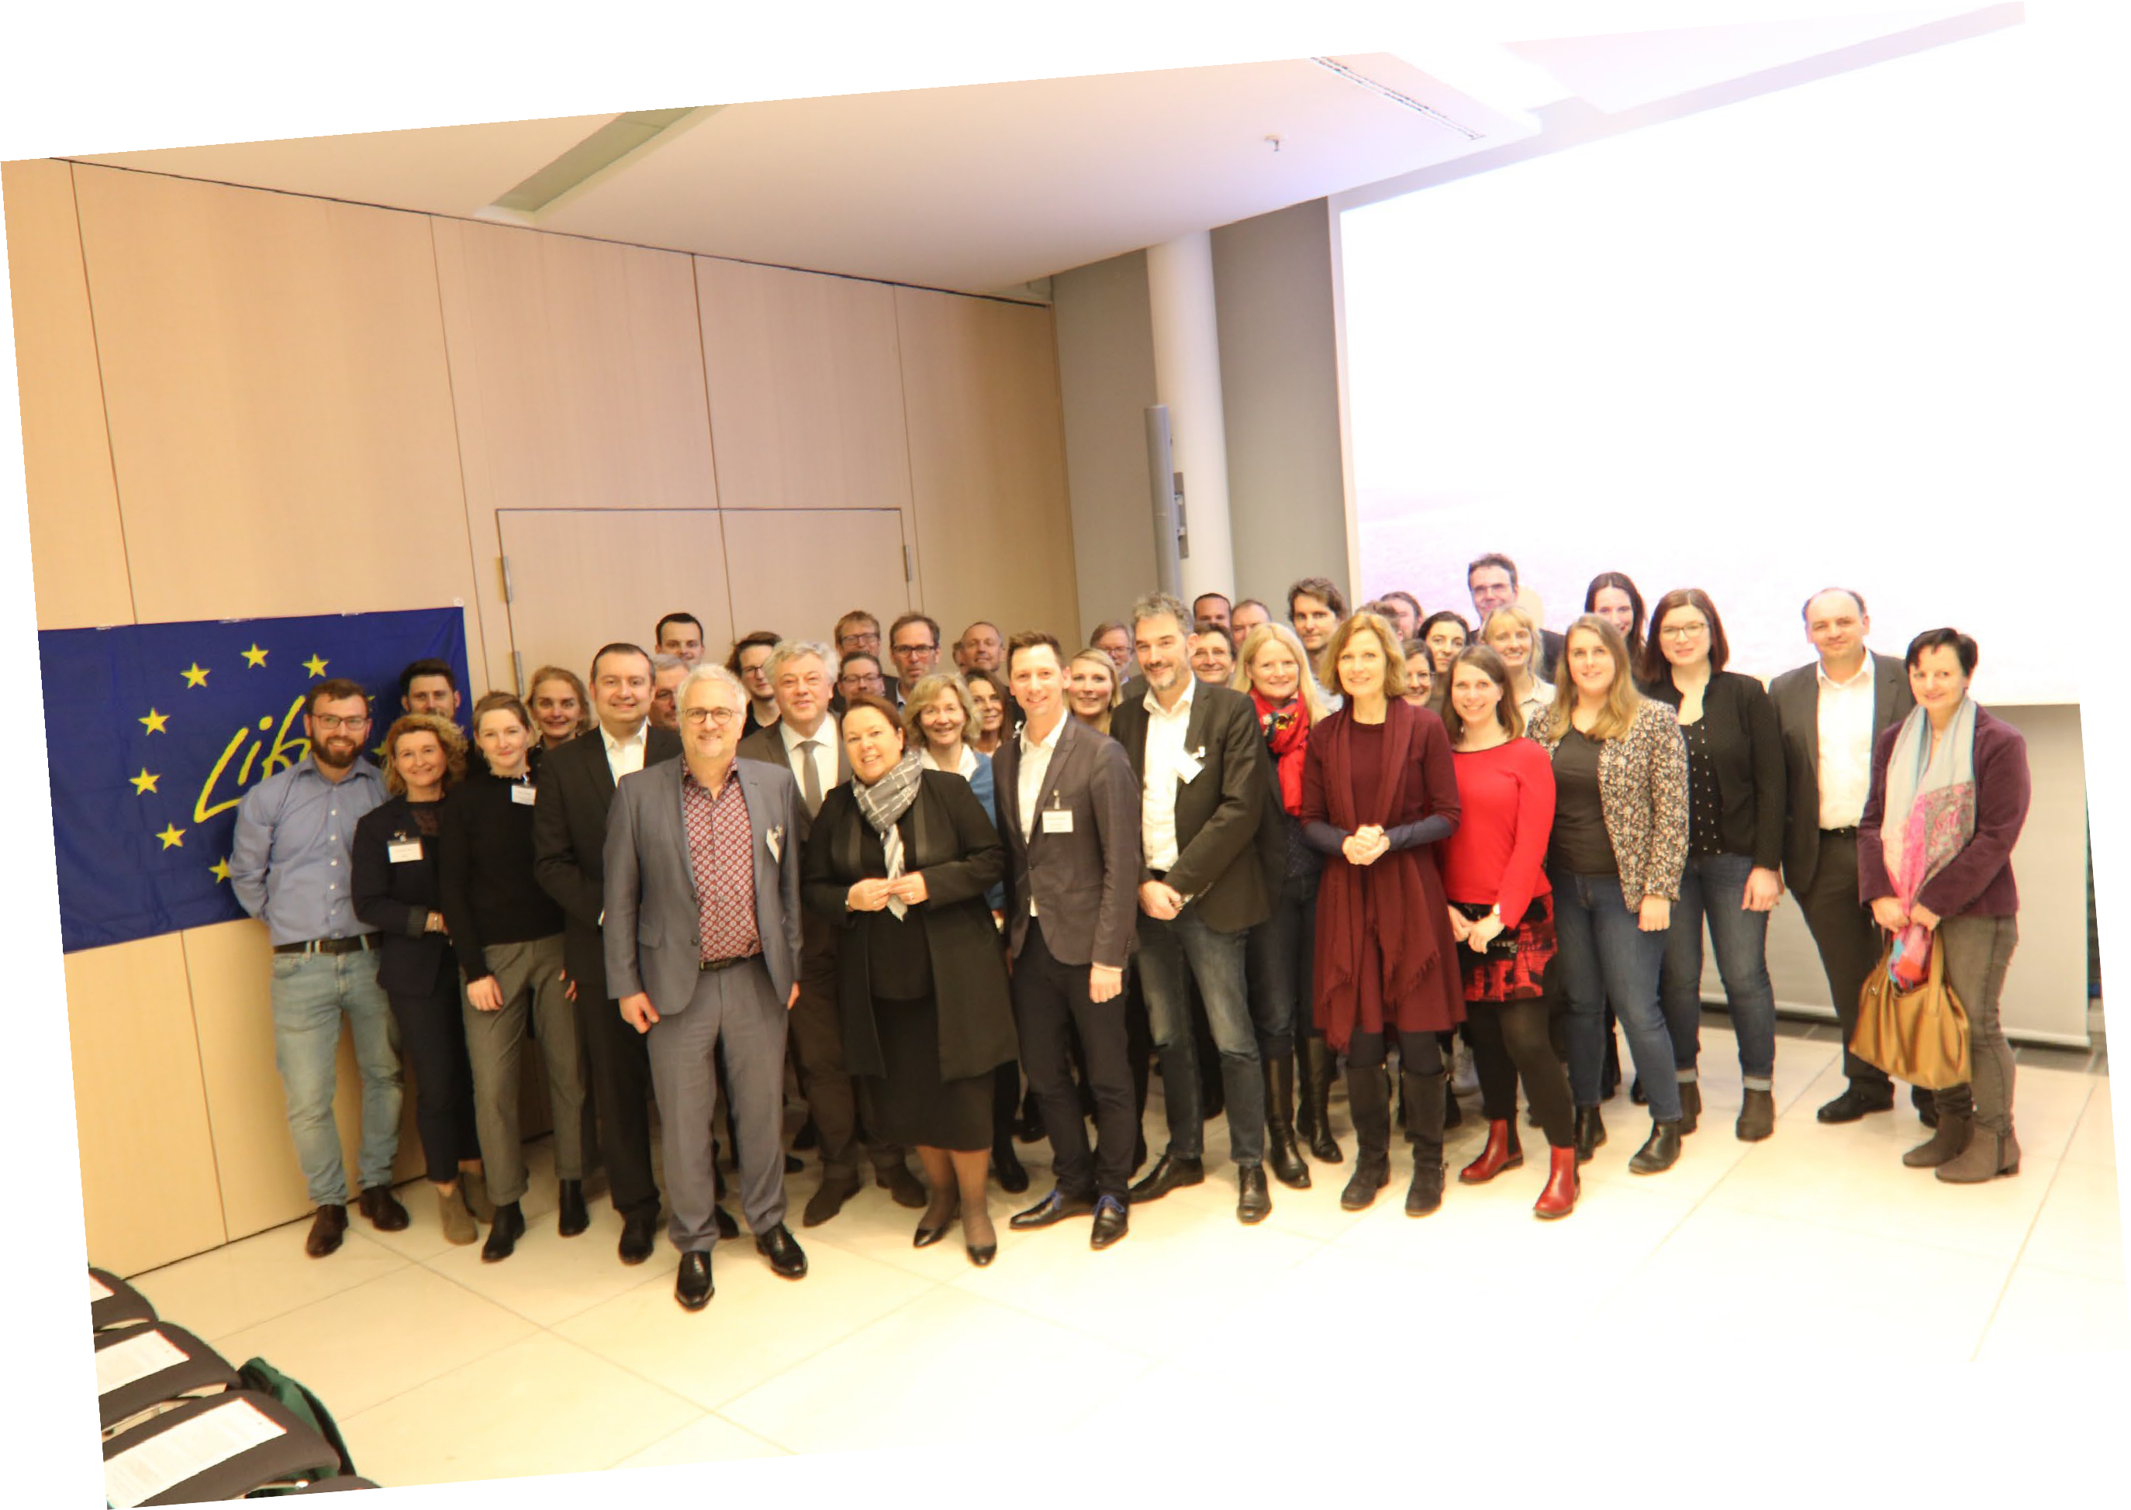
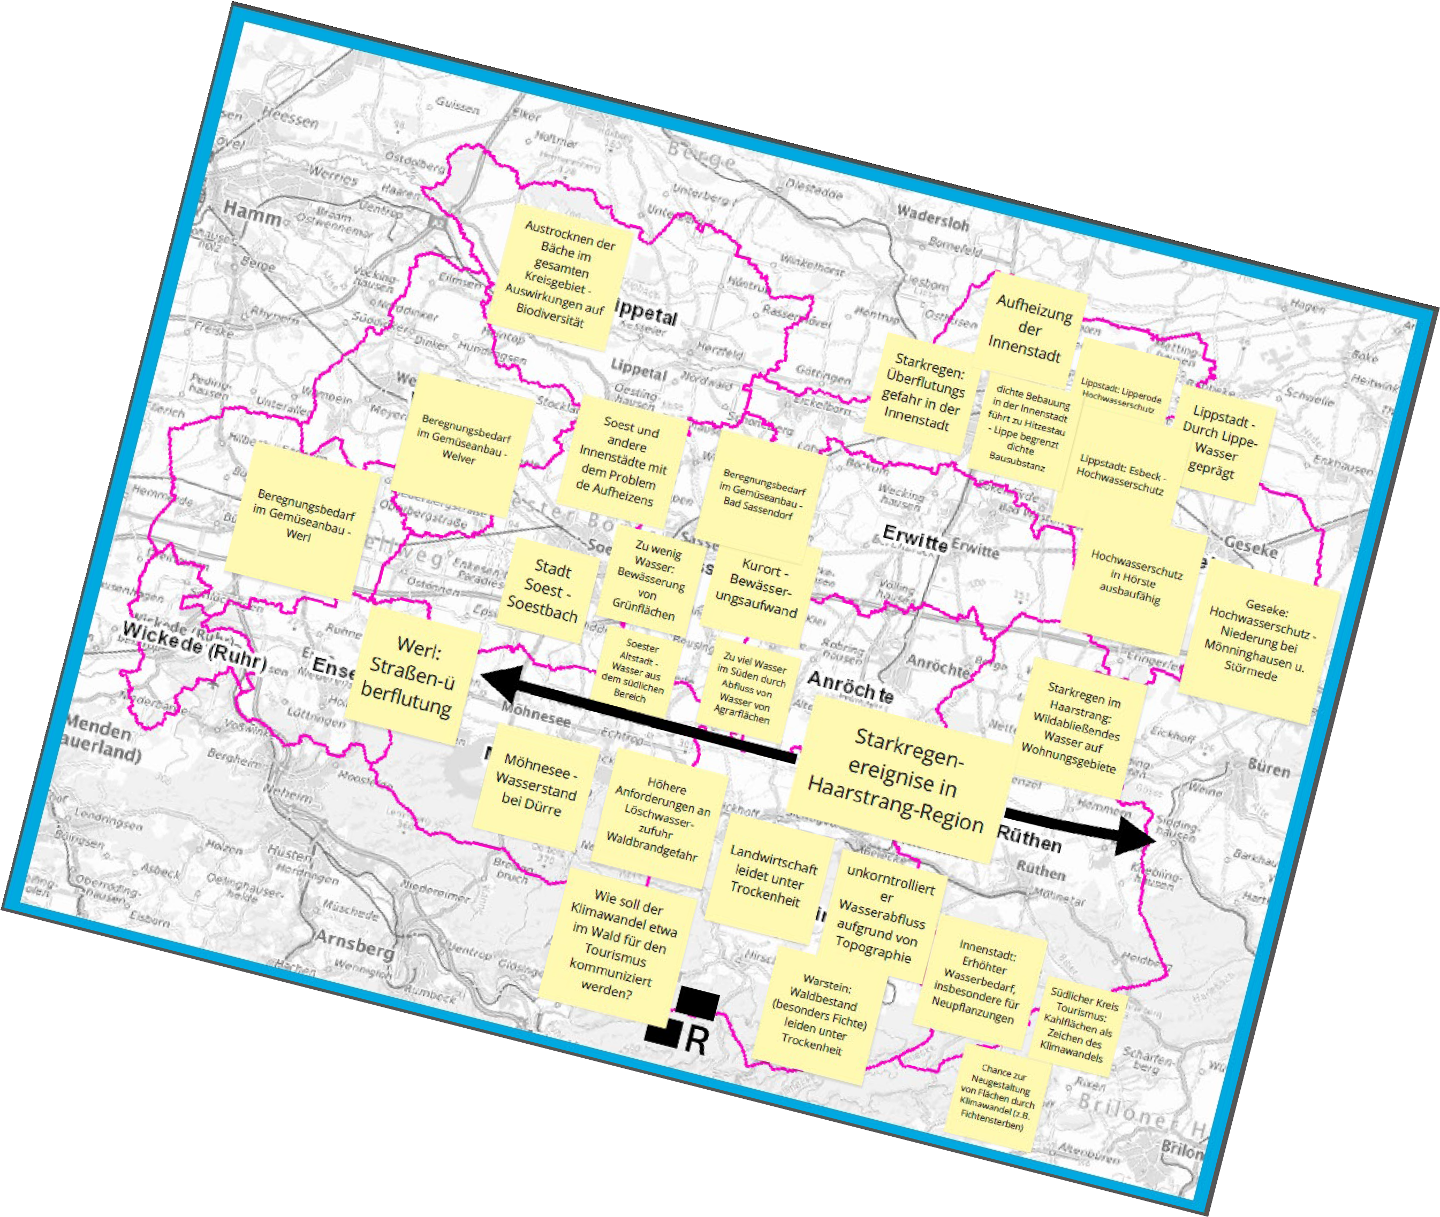
Evolving Regions
7

Slide 8
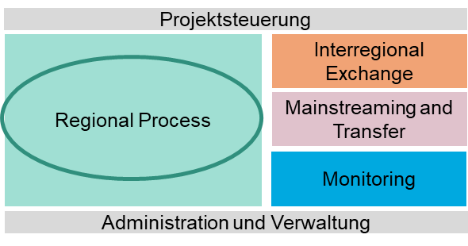
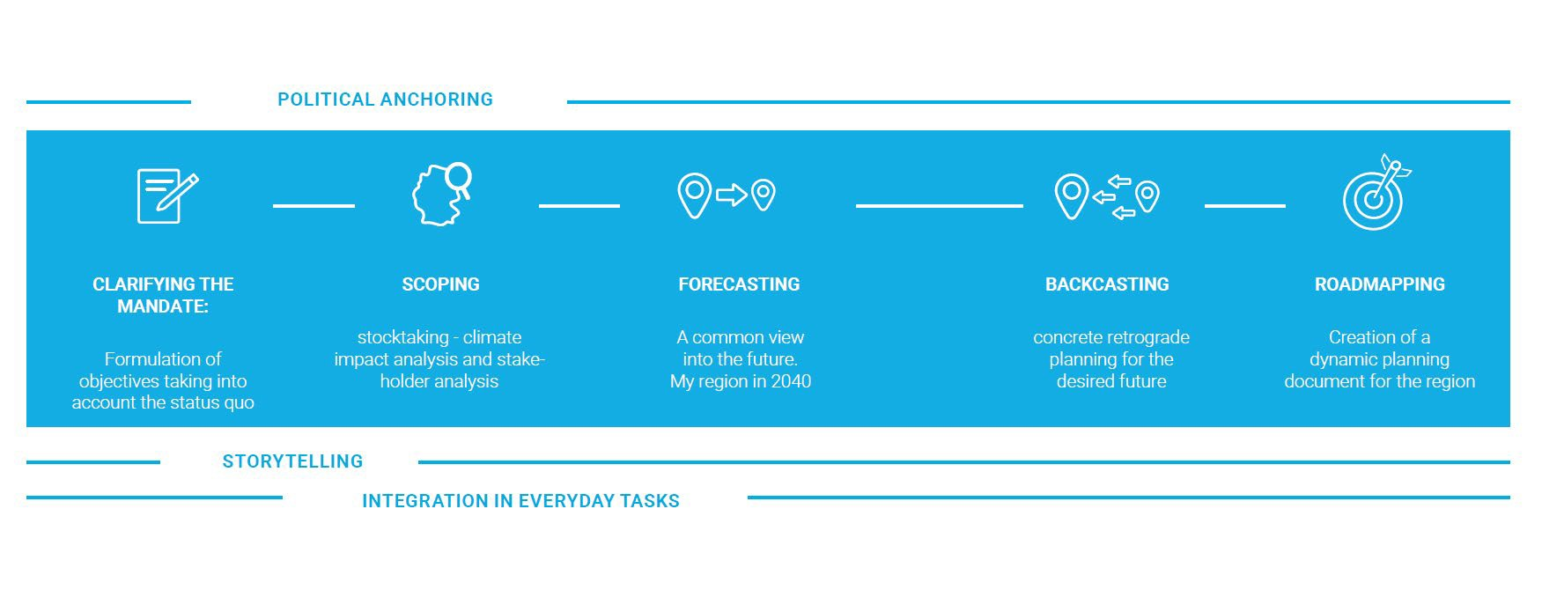
From A-Z: A complete climate adaptation cycle
€
Financing
20.04.2021
Evolving Regions

Slide 9
From A-Z: A complete climate adaptation cycle
€
Financing
20.04.2021
Evolving Regions

Slide 10


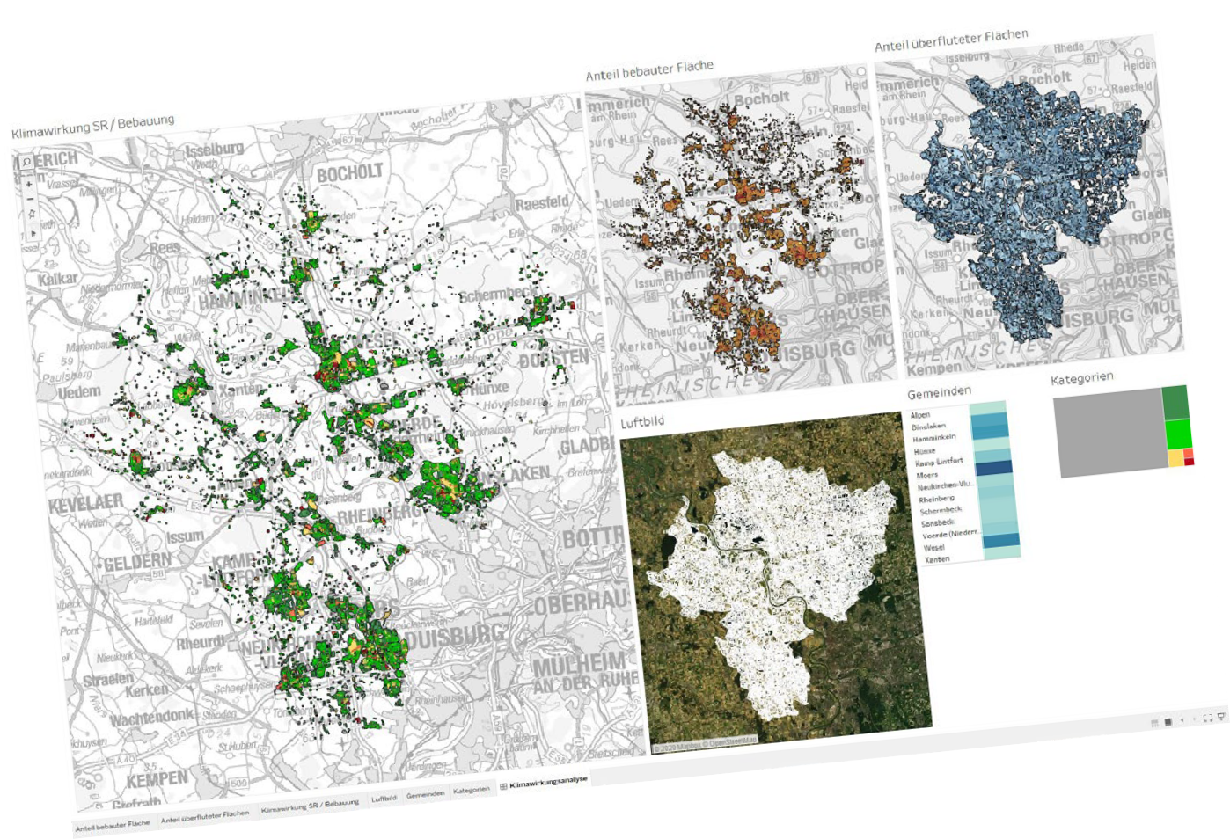



Evidence Based Scoping Dialogue
€
Financing
20.04.2021
Evolving Regions

Slide 11
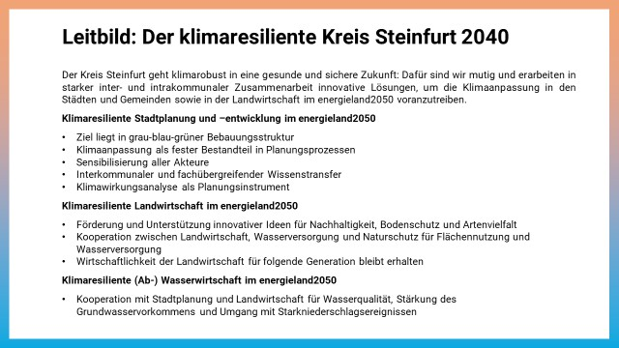



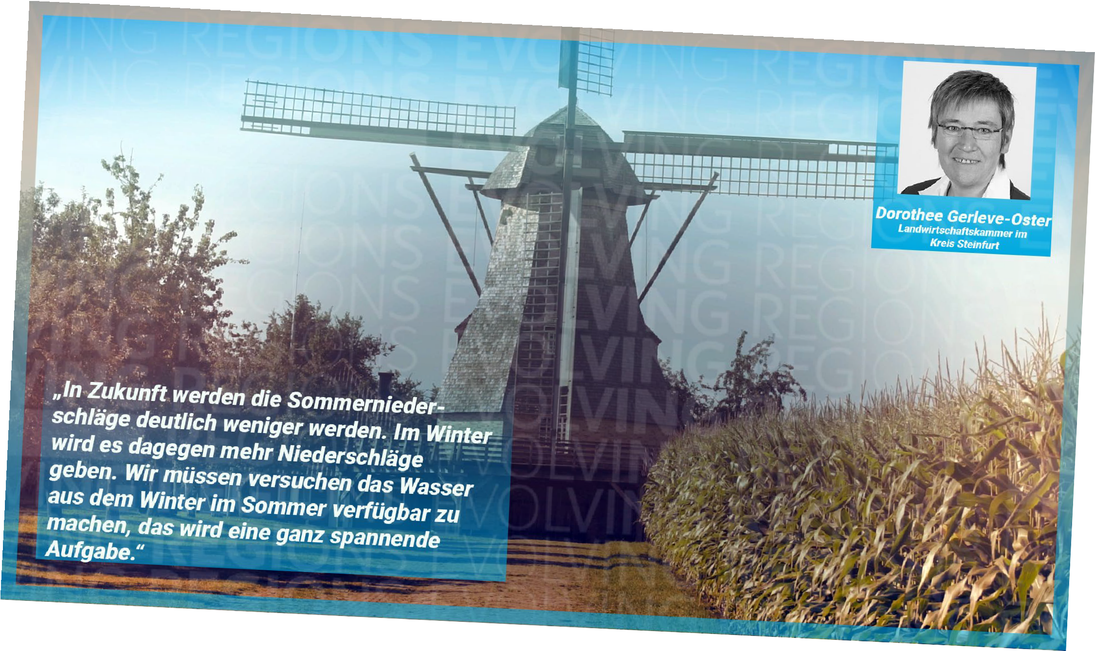
Forecasting: Future, evidence, regional missions
€
Financing
20.04.2021
Evolving Regions

Slide 12
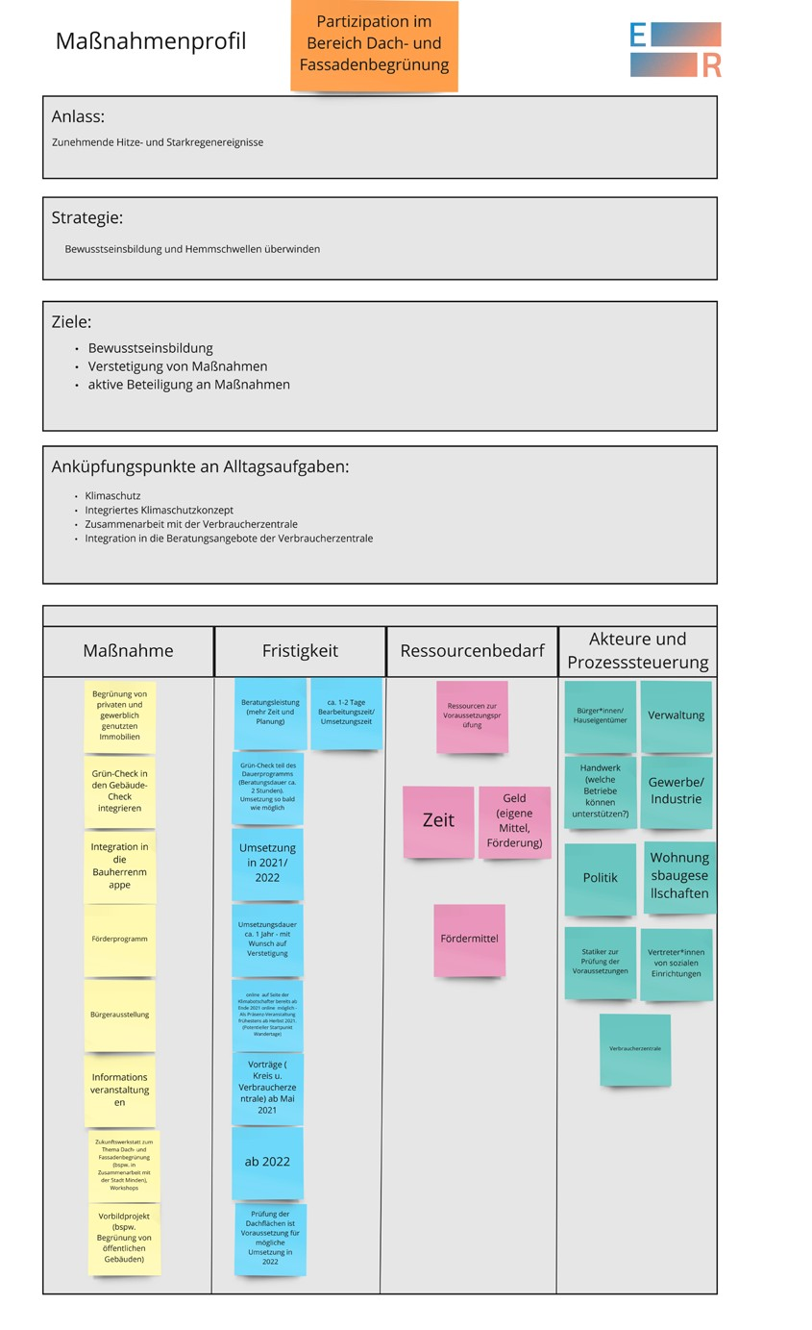
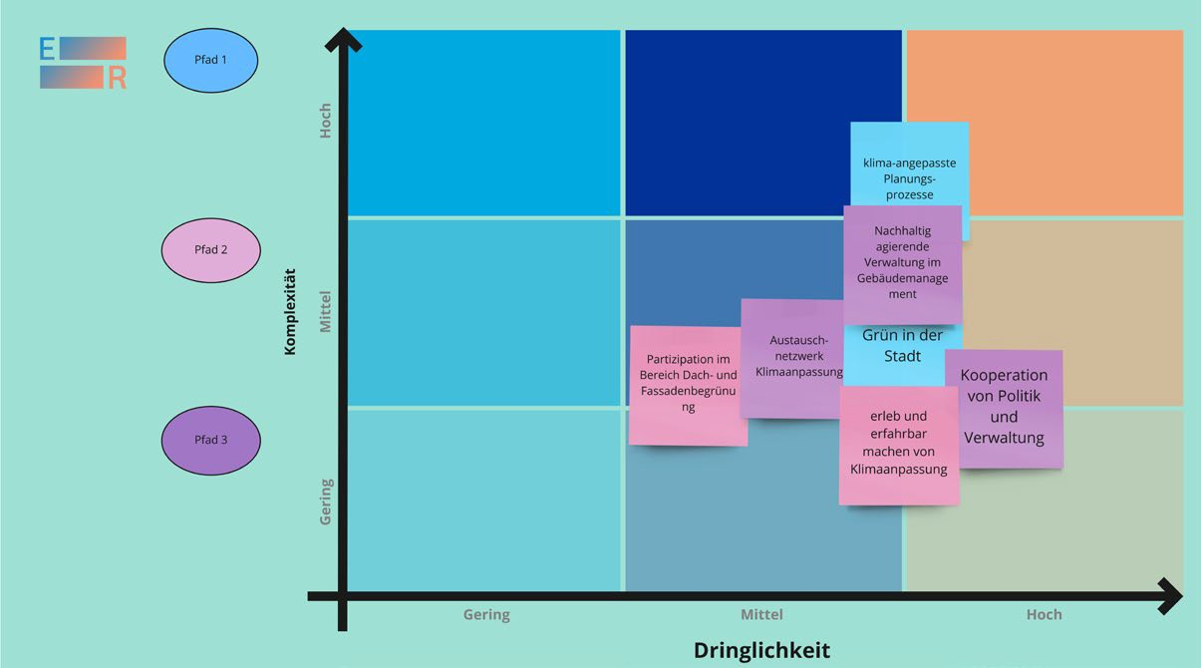

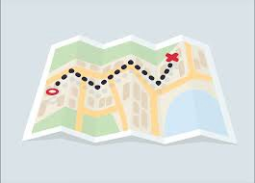
Back from a shared Future: Different pathways
Different Adaptation pathways
€
Financing
20.04.2021
Evolving Regions

Slide 13
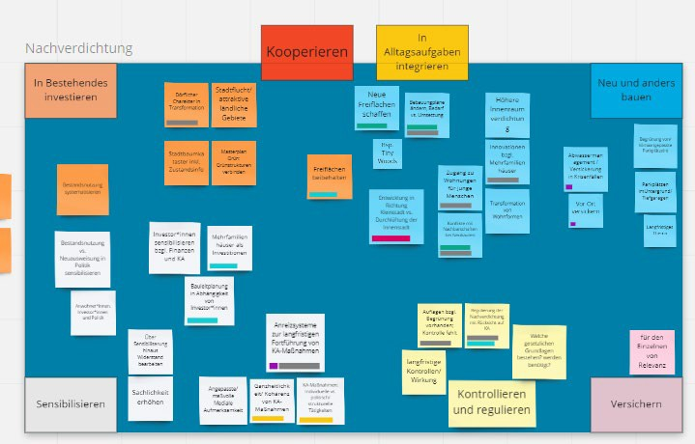
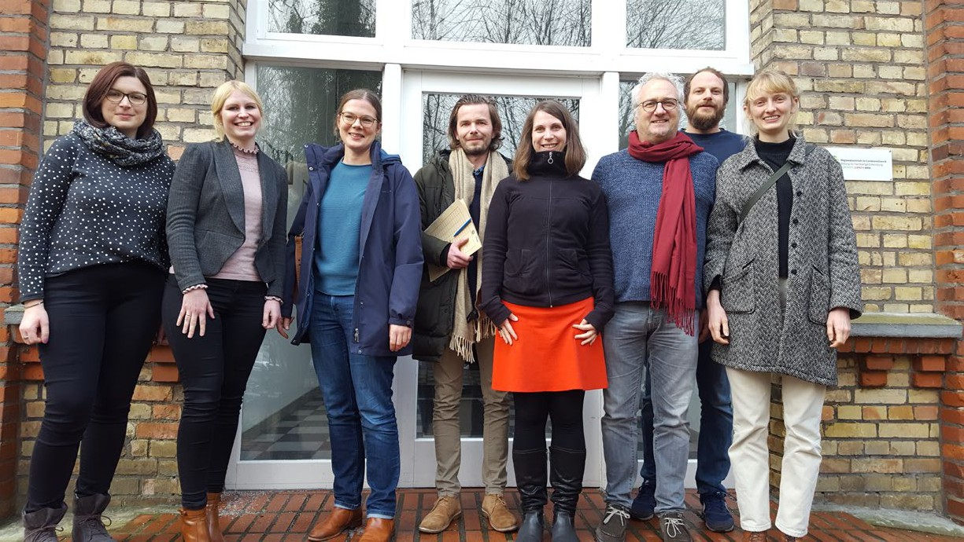
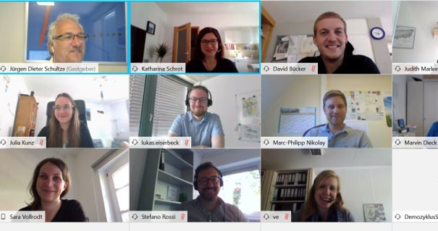
vision-guided co-devepment between regional stakeholders empowered by dialogue formats
€
Financing
20.04.2021
Evolving Regions

Slide 14

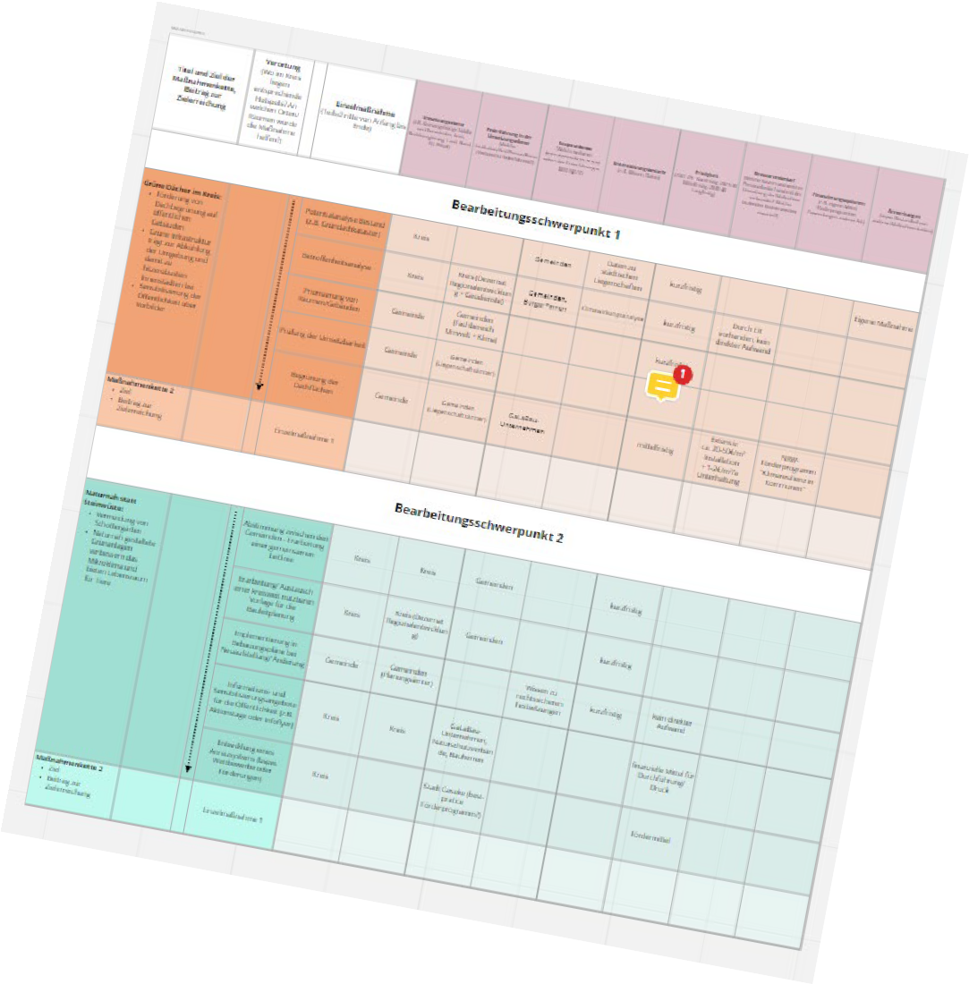
From A-Z: A complete climate adaptation cycle
Financing:
Essential part of the stakeholder integrated meassure development (push)
Orientation for measure development (pull)
Concerted roadmap as regional adaptation investment plan
Consulting and exploration for funding
€
Financing
20.04.2021
Evolving Regions

Slide 15
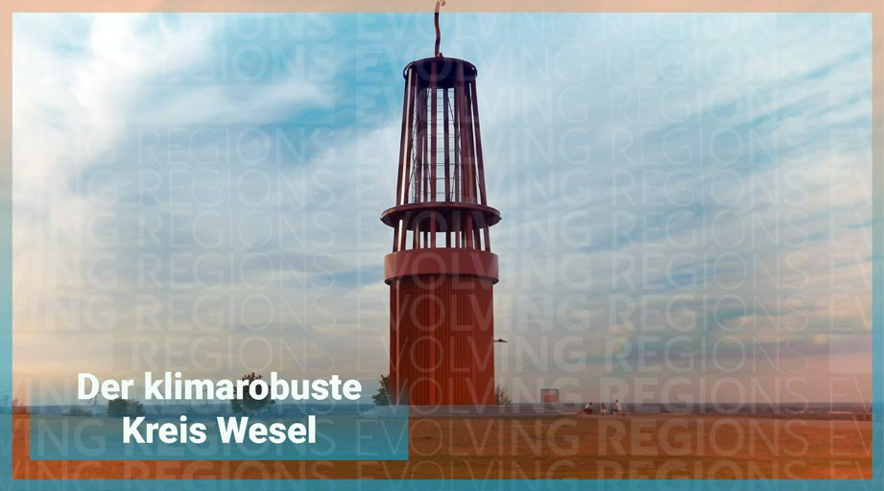
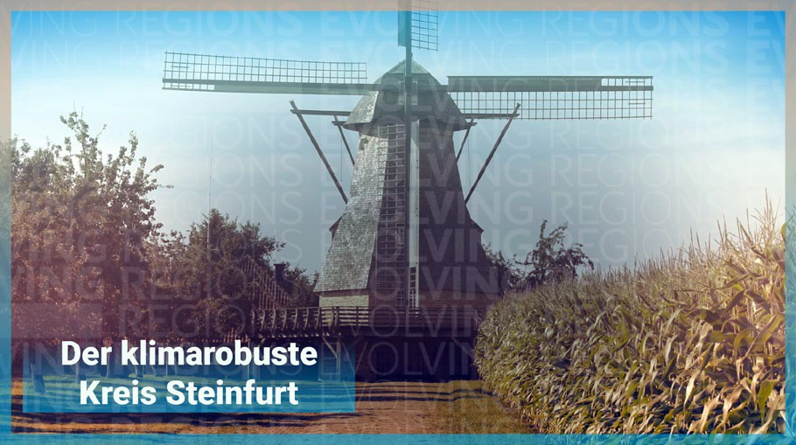
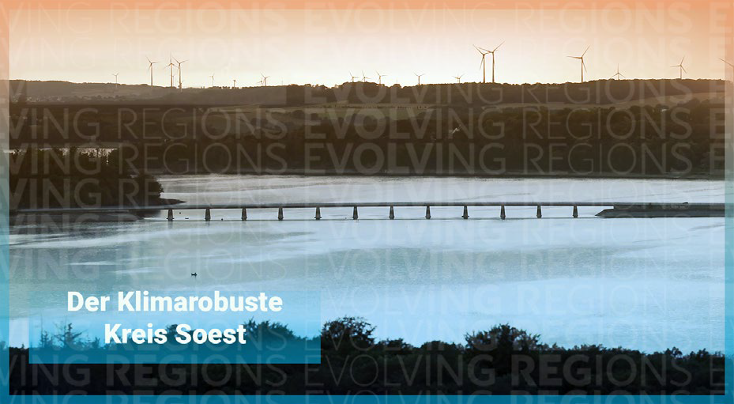
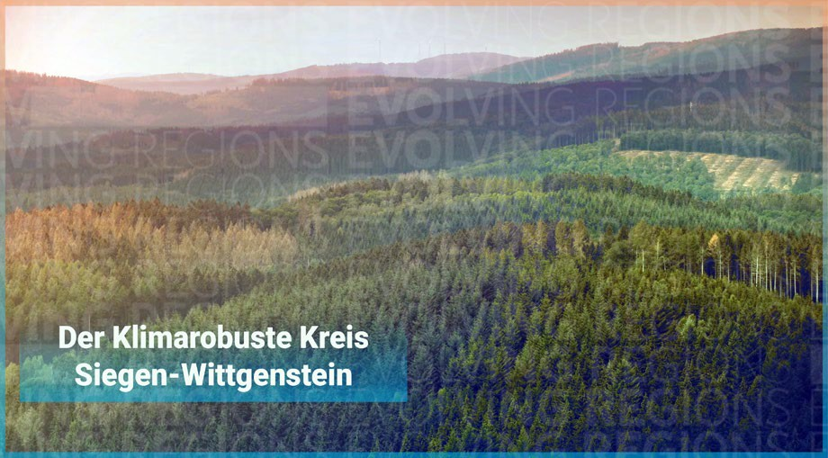
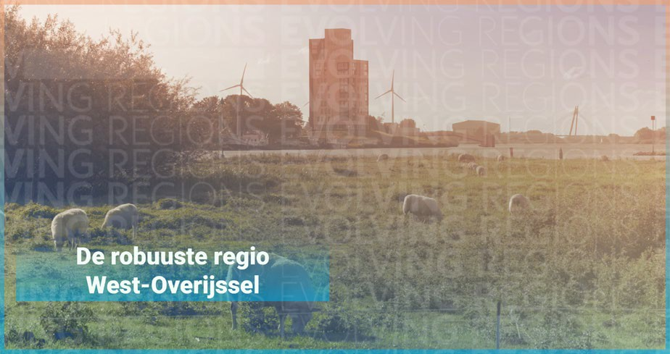
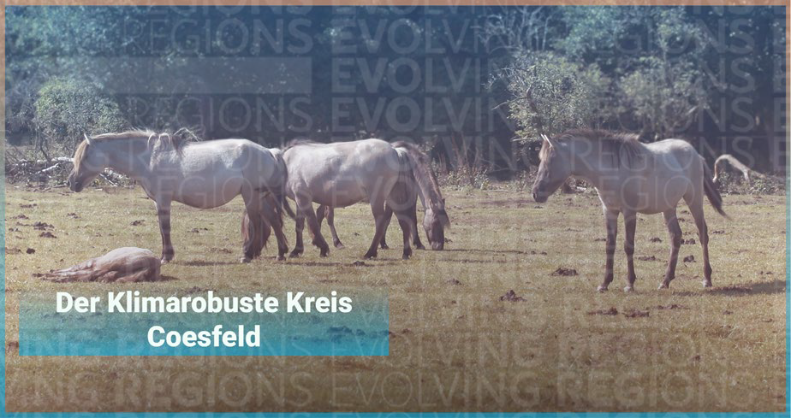
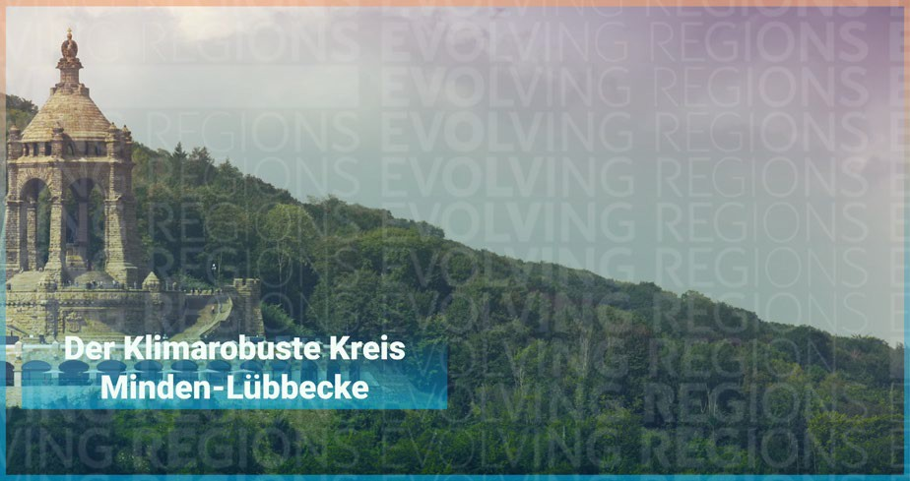
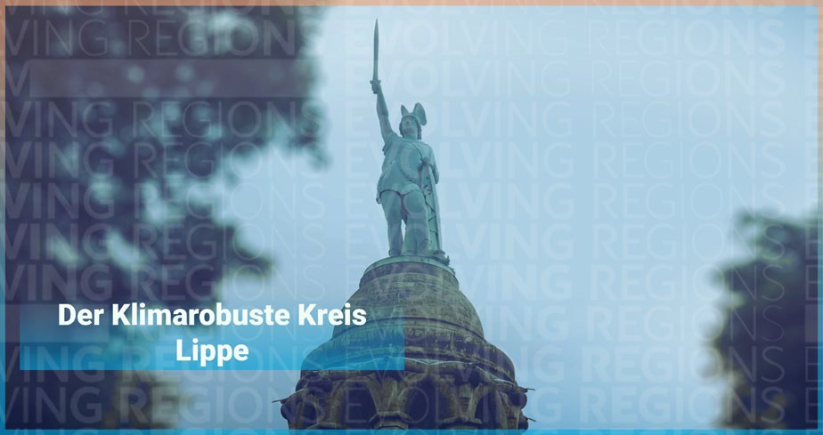
What did we achieve so far?
Online workshops in Wesel, Steinfurt, Soest, Siegen-Wittgenstein
Mutual Exchange Rivus (NL) + ER NRW
Start of the first dialogue phase in Coesfeld, Minden-Lübbecke, Lippe
20.04.2021
Evolving Regions

Slide 16
Structure of the Project
Interregional Exchange
Mainstreaming and Transfer
Regional Process
Monitoring
20.04.2021
Evolving Regions

Slide 17
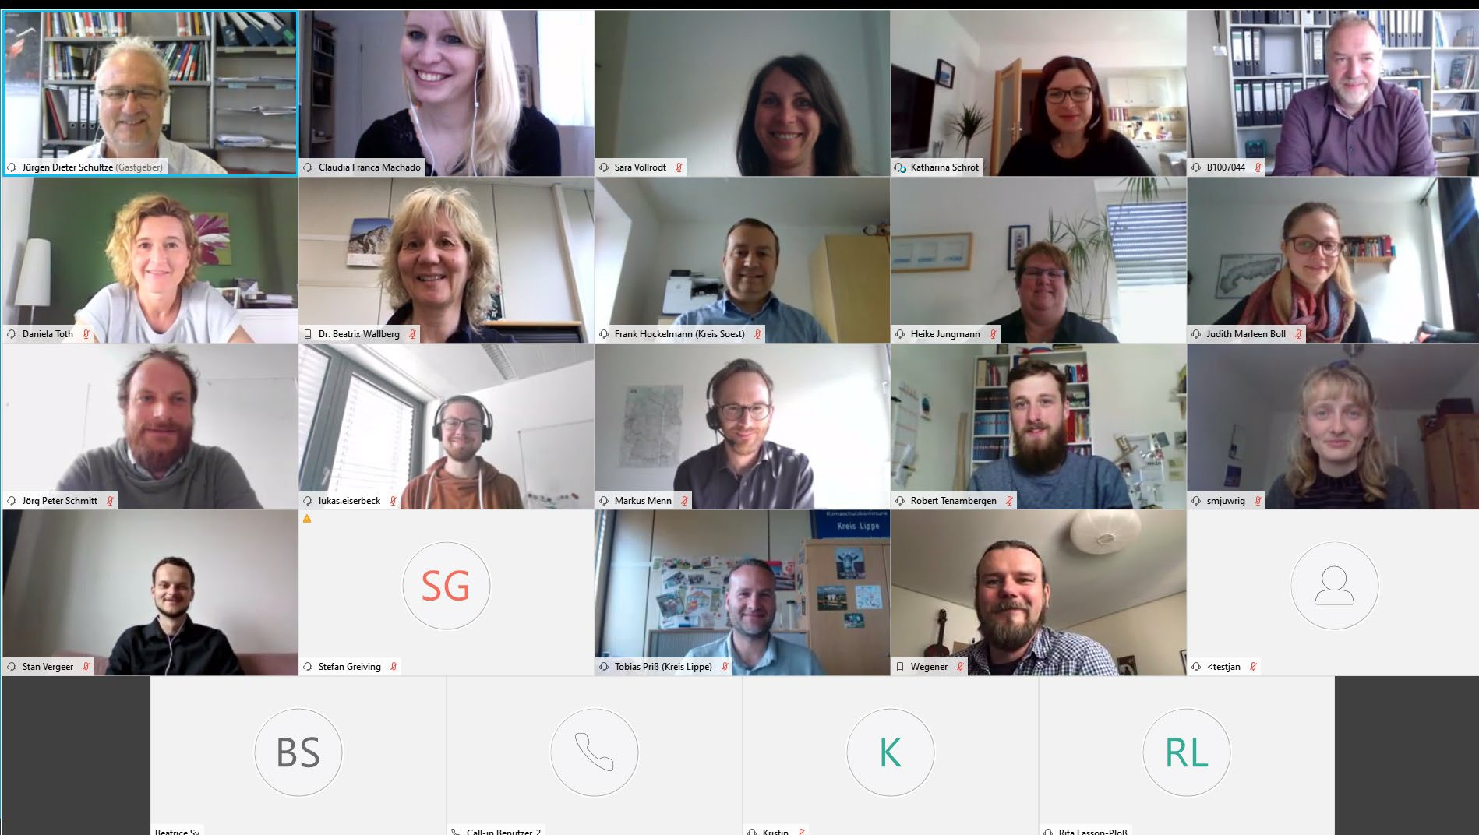
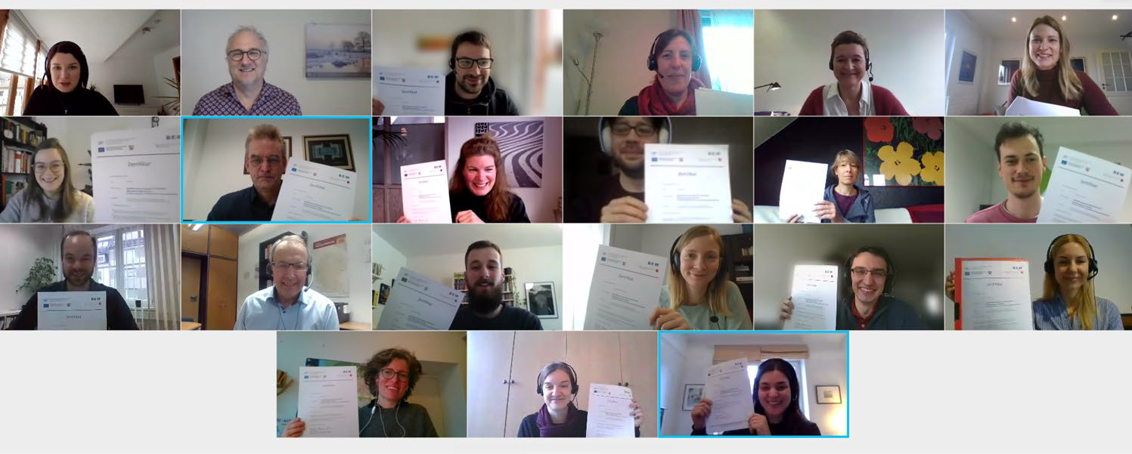
What did we achieve so far?
Projektsteuerung
Regional Process
Interregional Exchange
Mainstreaming and Transfer
Monitoring
Administration und Verwaltung
Regular partner region meeting for exchange among each other and on overarching project activities
23 certified consultants that took part in the consultants training course
20.04.2021
Evolving Regions

Slide 18

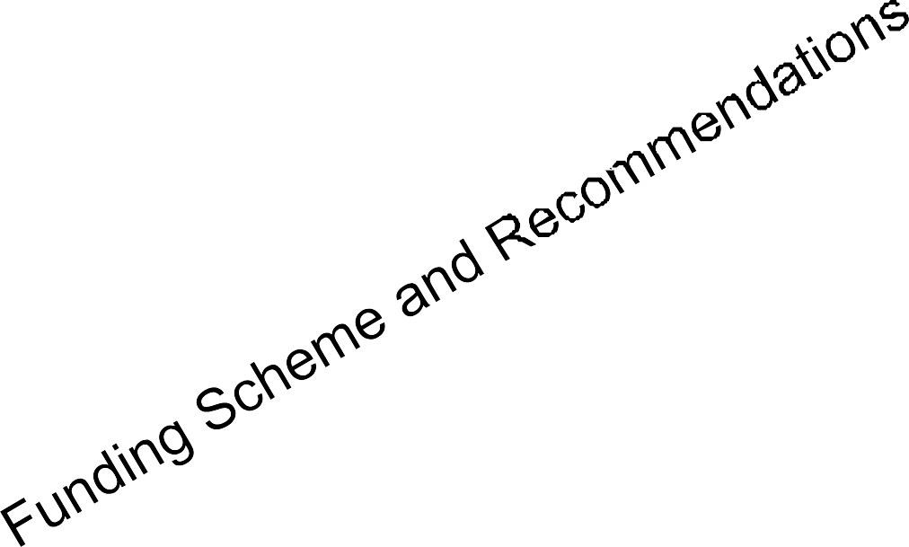
Leverage points of Evolving Regions
Capacity building in the participating regions
Contribution to an adaptation market
-> consultants training with certificate 2020 + upcoming 2021 + regional budget
Strengthen municipalities and institutional consultants
-> learning labs in 2021/2022
International exchange and knowledge transfer
-> three transnational workshops and two conferences in 2022
Storytelling in https://evolvingregions.com/ and news @EvolvingRegions
20.04.2021
Evolving Regions

Slide 19

NRW.BANK Relationship Management for Public Sector Clients
Thomas Kull Direktor
The Banker´s
and funder´s perspective
Thomas Kull
NRW.BANK
Leiter Kundenbetreuung Öffentliche Kunden 40188 Düsseldorf
19
| June 15/16, 2021 | Public Sector Clients | Thomas Kull +49 211 91741 1605 thomas.kull@nrwbank.de

Slide 20
NRW.BANK Relationship Management for Public Sector Clients
Advising municipalities and municipal enterprises in North Rhine-Westphalia, the largest German federal state, on promotion and financing issues (including the integration of KfW funding or from other sources for projects in NRW)
Coordination of NRW.BANK's product units relevant for our public sector clients
Events as a platform for discussing current municipal issues (large scale events like Municipal Finance Market Forum NRW, Public Utilities Forum, as well as smaller exchange formats like topic related workshops)
Pooling of expert knowledge in relevant cross-sectoral topics such as energy, transport and digitalization
Accompanying resource-oriented future topics such as achieving climate protection goals
20
| June 15/16, 2021 | Public Sector Clients | Thomas Kull +49 211 91741 1605 thomas.kull@nrwbank.de

Slide 21
Support from NRW.BANK
Strategy
Public Grants
Debt Financing
Information
Planning
Cooperation
Project outlines
Research
Overview
Selection
Implementation
Promotional programmes
Loans
Network partners and local stakeholders
NRW.BANK: Optimisation of the funding structure
21
| June 15/16, 2021 | Public Sector Clients | Thomas Kull +49 211 91741 1605 thomas.kull@nrwbank.de

Slide 22
Current Assessment of Available Funding
(Infrastructure-) Investment in climate adaption measures
Broad range of funding options at attractive conditions available
Funding of related personnel costs
Financing of external advisors linked to infrastructure investments normally included the overall project financing structure
Internal staff costs normally – with some exceptions – excluded from attractive external funding
Municipal budgets
Every investment and its financing needs to be included in the annual budget, which is approved by the municipal council and permitted by the supervisory authority
Thus, early and close coordination with the municipal treasury is advisable
22
| June 15/16, 2021 | Public Sector Clients | Thomas Kull +49 211 91741 1605 thomas.kull@nrwbank.de

Slide 23
Leona Aileen Eichel
Climate protection and climate adaptation manager
District Minden-Lübbecke

Slide 24
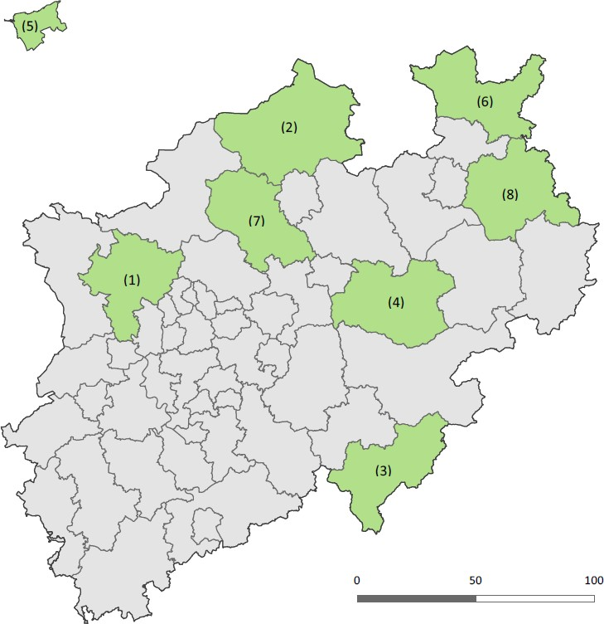
Minden-Lübbecke is part of Evolving Regions (ER)
I.
District Minden-Lübbecke located in the north-east corner of North Rhine-Westphalia (population 310.000)
Rural region, 65% agricultural area
Objective: Improving the resilience of the regions to the effects of climate change
II. III.
Three thematic areas in Evolving Regions
Agriculture and Forestry
Climate-sensitive species & habitats Climate-resilient urban and village design
16.06.2021
Evolving Regions

Slide 25
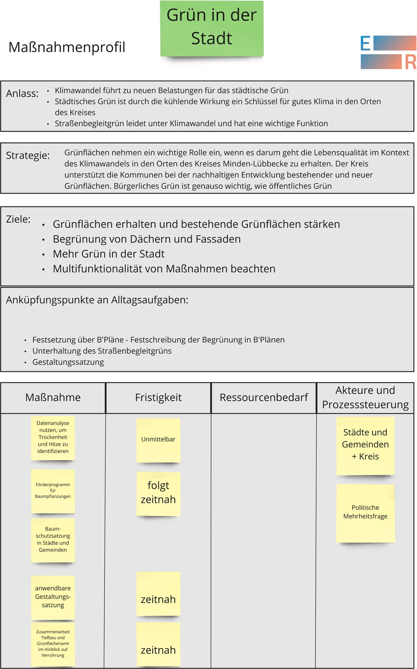
Regional Process – Evolving Regions
Each region in Evolving Regions goes through a Regional Process: Several workshops in 3 regional subject areas
First workshops Minden-Lübbecke:
Climate-resilient urban and village design
I.
II. III.
Development of visions and first measures Structuring in measure profiles
Reasons, strategies, targets, connection with everyday tasks, deadlines, resource requirements & stakeholders
Participants develop 2 profiles for green roofs and facades (local planning & civic participation)
IV.
Goal: Embedding of funding opportunities for green roofs & facade greening in ER
16.06.2021
Evolving Regions

Slide 26

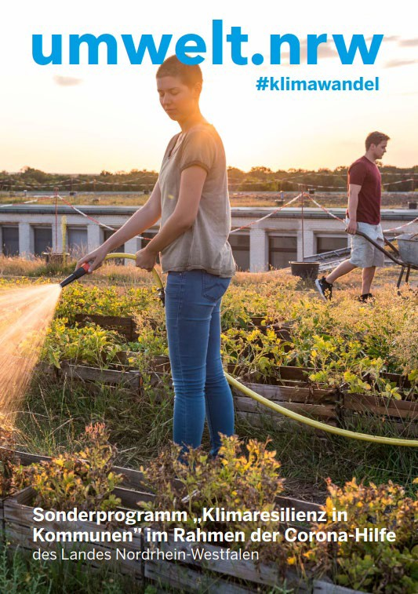
Funding program for roof and facade greening
Special program "Climate Resilience in Municipalities" by the Ministry for the Environment of North Rhine-Westphalia → offered the chance of financial implementation for Minden- Lübbecke
The district of Minden-Lübbecke sets up a funding program for roof and facade greening in the amount of 300,000 euros for owners of privately and commercially used buildings (final recipients)
With this funding program, Minden-Lübbecke offers a grant of a maximum of 50% of the expenses recognized as eligible
Eligible for funding are material & investment expenditures for structural or technical measures as well as external services by specialists
Figure 1: Ministry of Environment, Agriculture, Nature and consumer protection of the state of North Rhine-Westphalia 2020
16.06.2021
Evolving Regions

Slide 27





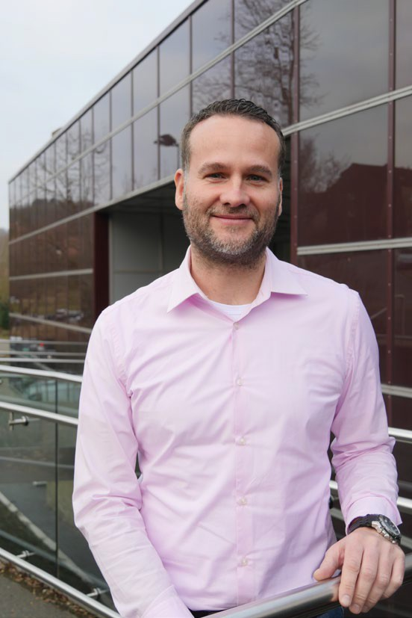
ER-Synergies
Synergies Districts Minden-Lübbecke & Lippe
Cooperation in the field of public relations
Cooperation in the application process
Cooperation in drawing up the funding guidelines
“Climate change knows no borders. Therefore, it is also important at the local level to tackle climate change adaptation measures together with the districts in the region and to support one another. The common goals make it possible to distribute the necessary tasks between different people and to complement each other in order to be able to optimally use the available forces. As a result, the application for the special climate resilience program by the districts of Minden-Lübbecke and Lippe could be initiated in a particularly effective and well-founded manner.
Leona Aileen Eichel Regional promotor Evolving Regions in the Minden-Lübbecke District
The program itself fits perfectly into the strategy for climate change adaptation, which is given a unique framework in North Rhine-Westphalia through Evolving Regions.”
Tobias Priß
Regional promotor Evolving Regions in the Lippe District
Tobias Priß, regional promotor Lippe
16.06.2021
Evolving Regions

Slide 28
ER-Consultancy Service
I.
On the basis of Evolving Regions Minden-Lübbecke was able to tender a consultancy service for the project
II. Consultant was assigned in May to take over 1 regional subject (Agriculture and Forestry) within the Regional Process of Minden- Lübbecke starting at the end of june
III.
Supports the ER-Team & regional promotor
IV. Establishes a network of regional stakeholders
16.06.2021
Evolving Regions

Slide 29

Flagship Evolving Regions
Provides „climate effects analysis“
-> focussing measures & financies
Roadmap (catalog of measures) at the end of the process
-> orientation and investment plan
Builds synergies & networks between regions
Calls the regions attention to funding programmes
Creates measures eligible for funding
Supports the region with consultancy services

Slide 30
Thank you
Thomas Kull
NRW.BANK
Mail: thomas.kull@nrwbank.de Tel: .: +49 211 91741 1605
Jürgen Schultze
TU Dortmund/sfs
Mail: juergen.schultze@tu-dortmund.de Tel: +49 231 755 90245
www.evolvingregions.com @EvolvingRegions
Leona Aileen Eichel
District Minden-Lübbecke
Mail: L.Eichel@minden-luebbecke.de Tel: 0571 807 23221

