Slide 1
LIFE21-27 REPORTING Guidance on Frequent Errors
CINEA 31.10.2023

Slide 2
Important Guidance Documents
Your Grant Agreement
Annotated Grant Agreement
Personnel Cost Calculation table
Notes:
Ensure that you have the latest version of
- the Annotated Grant Agreement (new version expected in November !)
- the Calculation table (new version end of October!)

Slide 3
REPA ADDITIONAL PRE-FINANCING PAYMENTS

Slide 4
Request for Additional Pre-financing
Consumption of the previous pre-financing amount
Do not indicate the amount of eligible costs consumed during the reporting period
Indicate the amount in terms of EU contribution i.e. total eligible costs consumed up till reporting x EU funding rate (see Art.5.3 of grant agreement)

Slide 5
Request for Additional Pre-financing
Personnel costs calculation - ex-ante checks
Do not use the LIFE14-20 rules to calculate your costs as there are important changes (e.g. 215 days) !
Calculate costs according to the new LIFE21-27 grant agreement and annotated grant agreement rules (see Art. 6) – provide the requested info in a clear & structured way (incl. own tables for salary costs if any)

Slide 6
Request for Additional Pre-financing
Procurement – ex-ante checks
Provide only the requested info/documents in a clear and structured way demonstrating that (internal/public) procurement procedures were followed (value for money /no conflict of interest/ no salami slicing)

Slide 7
REPA INTERIM & FINAL PAYMENTS

Slide 8
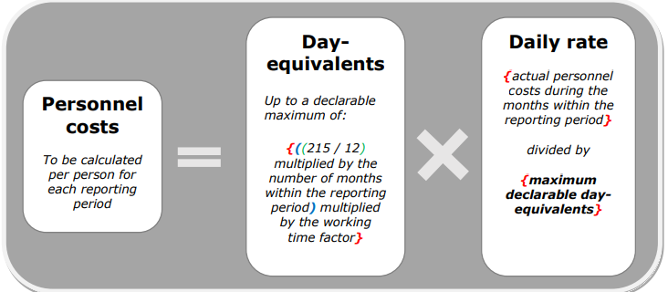
Personnel Costs – Employees A.1
REMINDER

Slide 9
Personnel Costs – Employees A.1
Calculation of the daily rate
Do not calculate the daily rate by dividing total personnel cost by the productive time (total days worked) taken from the timesheets
Calculate the daily rate by dividing the actual personnel cost incurred during the months within the reporting period by the maximum declarable day equivalents (rounded to the nearest half) that are calculated as follows:
{((215 / 12) multiplied by the number of months within the reporting period) multiplied by the working time factor}
!!! Do not remove parental or sick leave from the 215 days !

Slide 10
Personnel Costs - Employees
Calculation of eligible personnel costs
Do not use the pro-rata or a fixed percentage of the salary cost registered in your accounting system.
Do not declare costs for days that are not covered by time registered in a timesheet/time registration system
Do not declare more than 215 equivalent days per year (or the pro-rata)
The eligible costs are calculated by multiplying the daily rate with the day equivalents worked by the person for the action during the entire reporting period

Slide 11
Eligible Costs – Personnel - Employees
Eligible Salary Cost
Do not use the total salary cost as registered in your accounting system if it includes ineligible components
Do not calculate the total salary cost by multiplying the contractual monthly rate with the number of months worked in the action (unless this is the actual amount incurred)
Calculate the total eligible salary cost by taking the actual amounts registered in the payroll/accounting system and :
Remove non-eligible components
Apply pro-rata for accruals
Check the eligibility conditions of bonusses, supplementary payments, …
Notes:
Check the Annotated Grant Agreement

Slide 12
Personnel Costs
Time registration
Timesheets are not regularly (i.e. monthly) or correctly signed/dated by the staff member and the supervisor (e.g. signed at end of project, copy/paste of electronic signature)
Time is not related to the action or does not concern time actually worked (sick leave, parental leave, …)
Time relates to ‘funding sources’ rather than actual time worked on the action. Time in the timesheet/time declaration document is not in line with the time registered in the online time registration system of the beneficiary.

Slide 13
Personnel Costs – Natural/Seconded Persons
Compliance with the same working conditions as employees if to be considered under ‘personnel cost’
Employees are obliged to work 3 days per week in the office of the beneficiary while the natural/seconded person is allowed to work fulltime from abroad
The natural person is paid based on delivered output and not based on time worked like employees
The total cost of hiring a natural person with the same competencies/role/tasks as one of the employees is twice as expensive

Slide 14
Personnel Costs – Natural/Seconded Persons
Cost eligibility rules
Do not add an administrative fee to the costs that need to be reimbursed to the entity seconding the person. Only the remuneration cost is eligible.

Slide 15
Personnel Costs – SME Owner
Cost eligibility rules
The owner of an SME that is a beneficiary in the project is charging costs under the ‘natural person’ cost category as the owner signed a ‘non-employee’ type of contract based on an hourly rate for each hour worked. Note that SME owners of an SME that is a beneficiary in the project can only charge the costs for the hours/days worked based on unit costs.

Slide 16
Maximum grant amount
REMINDER :
Ineligible costs, either detected by CINEA at interim/final payment stage OR by auditors after the interim/final payment are deducted from the REQUESTED EU Contribution. Take this in consideration when you finalise your financial statement/payment request in the system.
The system will calculate the maximum amount that can be requested but it is up to you to maintain that amount or to lower it. There is no need to limit the requested EU contribution to the amount fixed in the grant agreement as the system will make sure that payments never exceed that amount.

Slide 17
Thank you
© European Union 2023

