Slide 1
Drafting and Submitting your proposal
Paul GRANDEAU
UNIT B.4 - CEF Energy and Renewable Energy Financing Mechanism
Virtual Info Day
26 January 2023

Slide 2
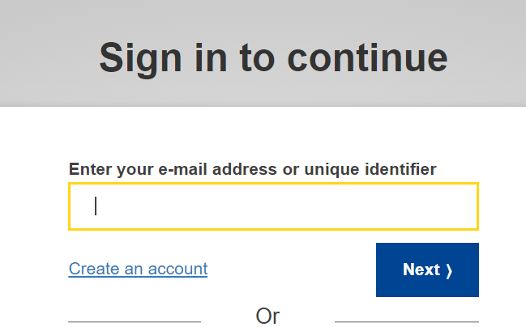
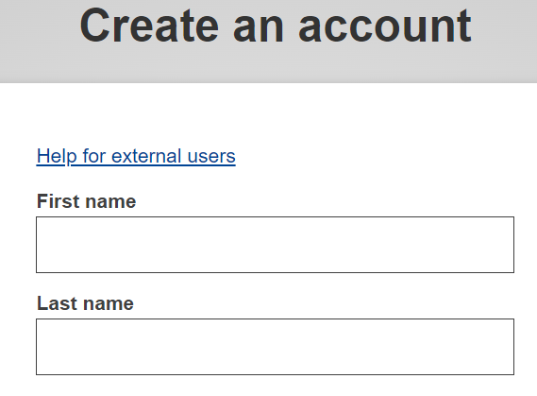
Before starting your application
Before starting an application, you must create a EU login account by following this link.
Click the “create an account” button and fill in your details accordingly.
A confirmation email will be sent to you, describing the next steps. Your EU login will allow you to login and submit an application on the CB RES submission platform.
Follow this link for additional guidance on EU login.
1.
2.
3.

Slide 3
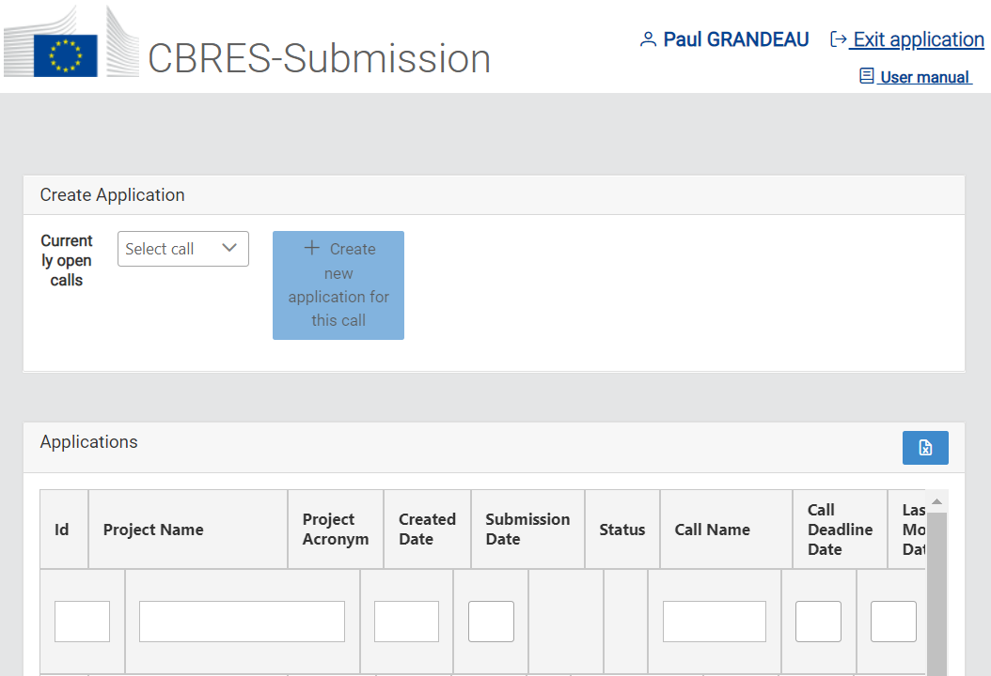
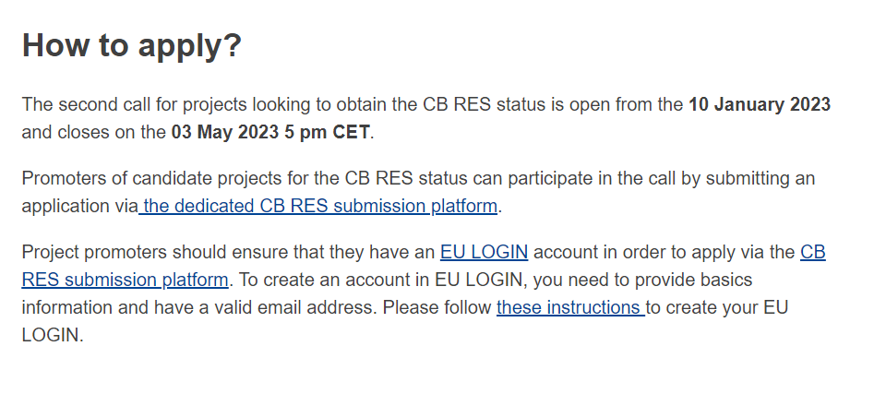
To access the Submission Platform
.
Apply from the call landing page on the CINEA website. It will directly you directly to the submission platform.

Slide 4
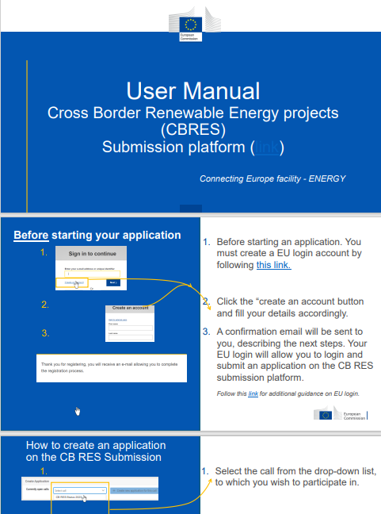
Consult the User Manual for step-by-step guidance

Slide 5
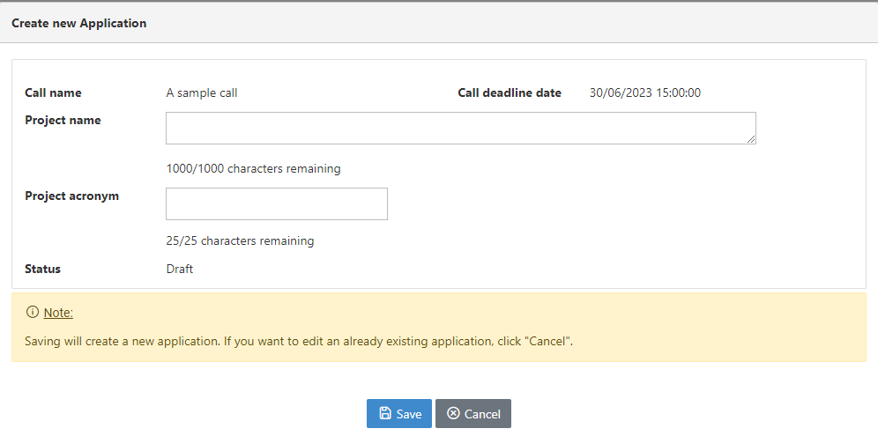
How to create an application on the CB RES Submission
1.
Select the call from the drop-down list, to which you wish to participate in.
Click the “create a new application” button.
A window will pop-up, fill-in your project name and acronym; then click “Save”.
CB RES Status 2023
2.
CB RES Status
3.

Slide 6
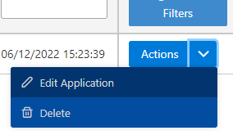
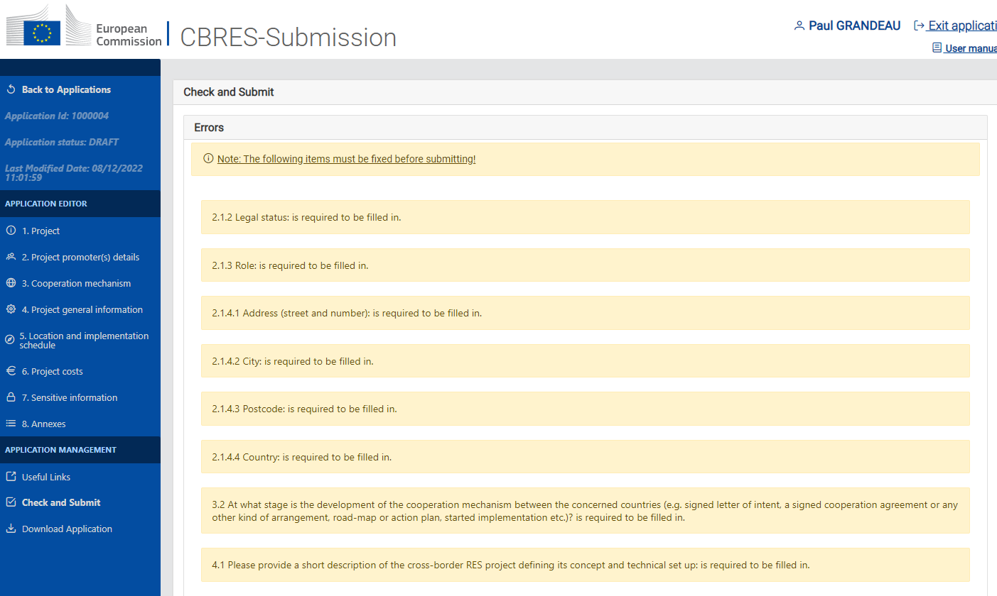
Edit/Fill-in your application
1.
Select the drop-down arrow and click on “Edit Application” or click directly on your project ID.
A new page will appear, with each section of your application.
Click on a section to edit its contents.
OR
2.
3.

Slide 7
Edit / Fill-in each section of the application Click on the section button to be directed to the section’s explanatory slide(s).
1. Project
5. Location and Implementation schedule
2. Project promoter(s) details
6. Project costs
3. Cooperation Mechanism
7. Sensitive information
Useful Links
4. Project general Information
8. Annexes
Check and Submit

Slide 8
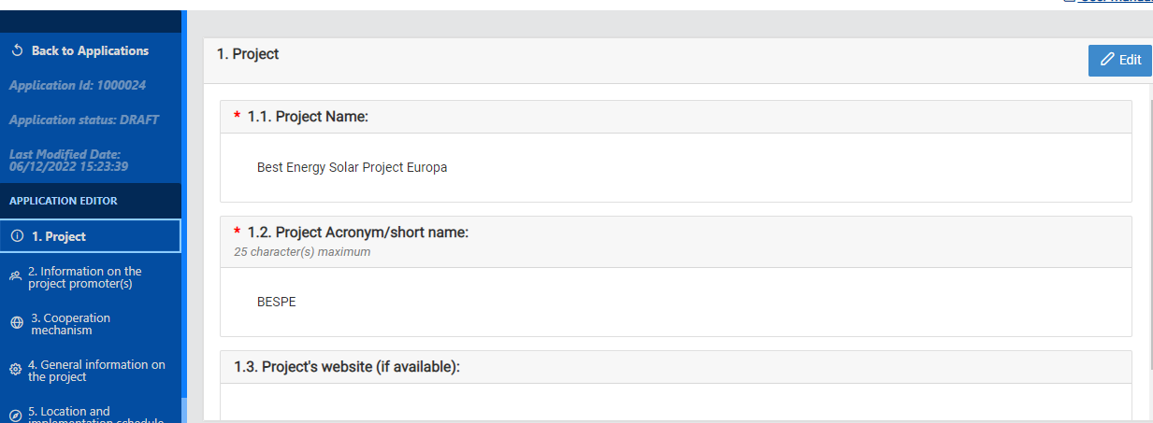
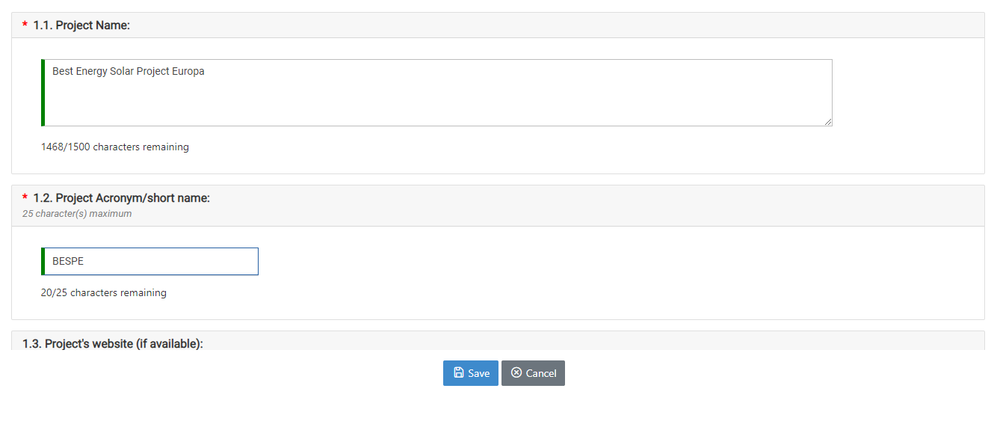
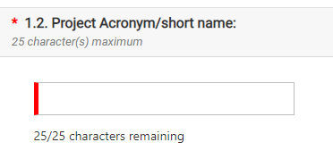
1. Project
1.
Click on “Edit” to fill-in/edit the section.
A window will pop-up to edit the information. Remember to click the “Save” button before moving to the next section.
Incomplete sections are marked in red.
2.

Slide 9
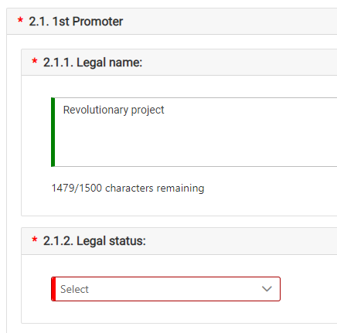
2. Project promoter(s) details
1.
Click on the “add” button to add the details of a project promoter.
A window will pop-up. Fill-in the boxes accordingly. Red boxes are mandatory.
For section 2.1.5 you can add as many contact points as you wish. Remember to click the “Save” button before moving to the next section.
2.
3.

Slide 10
Click on “Edit” to fill-in/edit the section.
A window will pop-up to edit the information. Remember to click the “Save” button before moving to the next section.
Incomplete sections are marked in red.
3. Cooperation Mechanism
1.
2.

Slide 11
3. Cooperation Mechanism (2)
In section 3.1, you will be asked to select the cooperation agreement chosen for your project as per Directive 2018/2001 (EU).
Important
If your project concerns statistical transfers between Member States or a joint support scheme. Note that you are not asked to fill sections 5 and 6, and the edition for these section will be disabled.
If you select joint projects, you will have to complete sections 5 and 6.

Slide 12
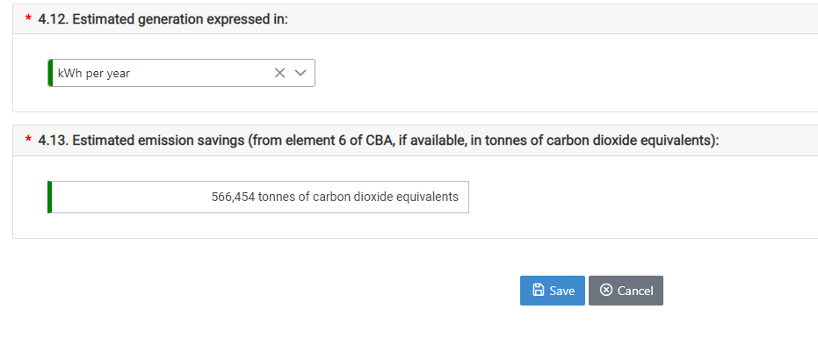
4. Project General Information
Click on “Edit” to fill-in/edit the section.
A window will pop-up to edit the information. Remember to click the “Save” button before moving to the next section.
Incomplete sections are marked in red.
1.
2.

Slide 13
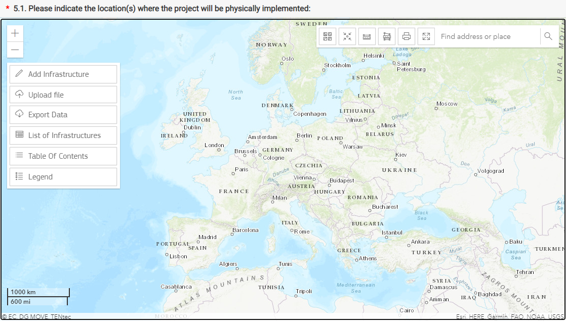
5. Location and Implementation schedule
Section 5.1 requires you to map the location of your project on a GIS interface.
Using this dialogue box you can either manually add infrastructure on the GIS map or upload directly a file. You can also export the data you have submitted here.
1.

Slide 14
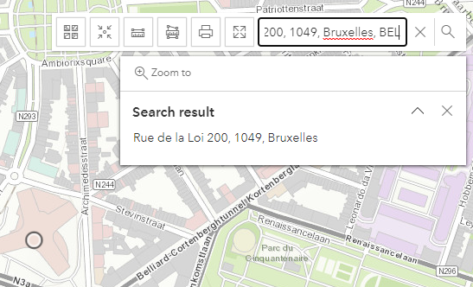
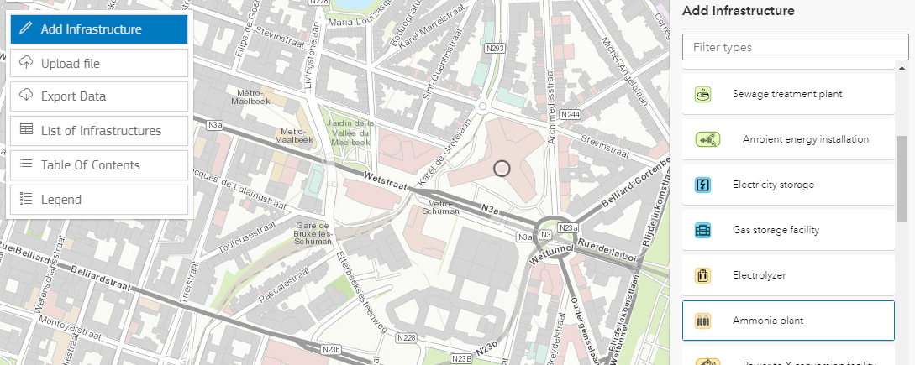
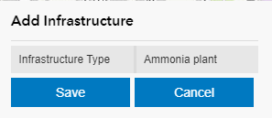
5. Location and Implementation schedule
You may search the exact location of your project in the search box.
Then, you can add infrastructure directly on the map. You will be able to add point infrastructures; line infrastructures; polygon infrastructures.
Remember to click “Save”, before adding additional project features.
2.
3.
4.

Slide 15
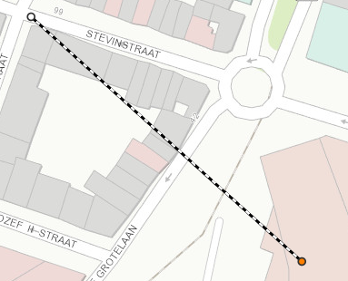
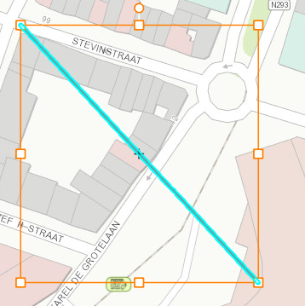
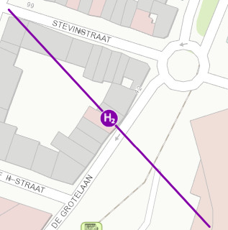
5. Location and Implementation schedule
5.
To add a point infrastructure. Select it in the drop-down list and double click on the desired location and save.
To add a line infrastructure. Select it in the drop down list. Click once to initiate the line, another time to add a point on the line. Double click the final point to validate the line, and click “Save”.
6.

Slide 16
5. Location and Implementation schedule
To add a polygon infrastructure. Select it in the drop-down list.
Drag your mouse, and click to add a point to the polygon.
Double click to finish the polygon and press “Save”.
The polygon infrastructure will appear on the map.
7.

Slide 17
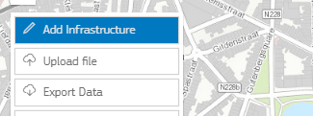
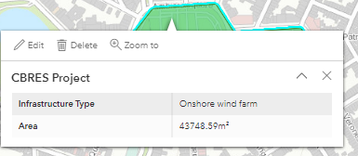
5. Location and Implementation schedule
8.
To edit an infrastructure. Undo the “Add infrastructure button”. Select the desired element. A window will pop-up.
For the other questions of Section 5. Click on “Edit” to fill-in/edit the section 5.2. Remember to “Save” before moving to the next section.
If questions in section 5.2 do not appear it means that you did not select a joint project cooperation mechanism is section 3.1(see slide 8).
9.

Slide 18
6. Project costs
1.
Click on “Edit” to fill-in/edit the section.
A window will pop-up to edit the information. Remember to click the “Save” button before moving to the next section. Incomplete sections are marked in red.
If questions in section 5.2 do not appear it means that you did not select a joint project cooperation mechanism is section 3.1(see slide 8).
2.

Slide 19
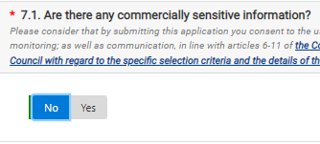
7. Sensitive information
1.
Click on “Edit” to fill-in/edit the section.
If you selected “No” in question 7.1, you will not be able to reply to respond to questions 7.2 and 7.3.
Remember to click the “Save” button before moving to the next section
2.
3.

Slide 20
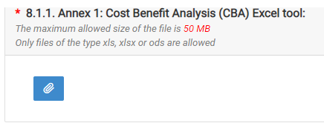
8. Annexes
1.
Section 8. “Annexes”, enables you to upload the mandatory annexes for your application. You may find the template of the annexes to submit in the “call documents” section of the call page.
For each annex submission, make sure that your template is in the adequate file type and size. Click on the thumbnail to upload a file.
Remember to “Save”
2.
3.

Slide 21
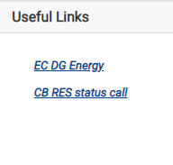
Useful Links
The useful links tab lists all the relevant links of the call, such as the link to the call page where you can find annex templates, and the link to DG Energy webpage.

Slide 22
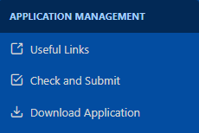
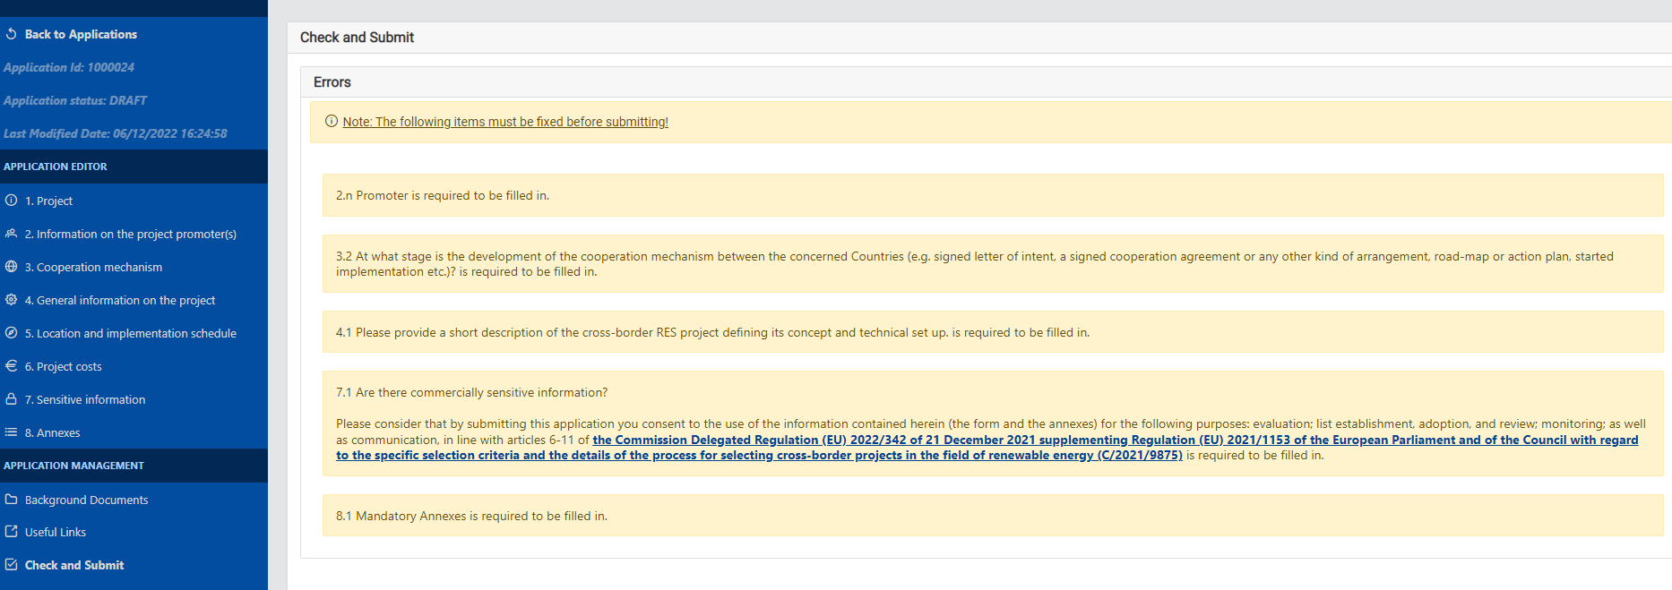
Before submitting your application
Check and Submit
1.
Before submitting you can download your application in a Word file to check that all fields have been well completed. You can also download this World file at any time.
Fields marked in yellow in the “Check and Submit ” section highlight the incomplete sections, required to submit your application.
2.

Slide 23
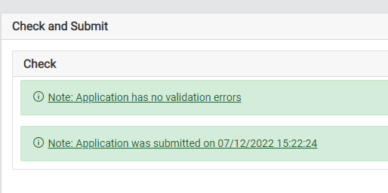
Submitting your application
Check and Submit
1.
Once you think that you application is complete press the “Submit” button.
Allow yourself some time to complete the application. Prefer to submit it a few hours before the deadline to avoid technical issues.
A green message will confirm your submission. And you can close the submission window.
2.

Slide 24
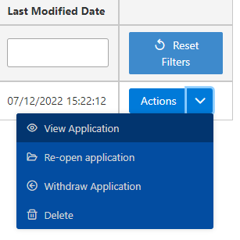
Can I amend/view my application post-submission?
Once you have submitted your application, you can always go back to the submission platform and view/amend your application.
Click on the drop-down arrow to select you desired action
You can amend your application as many times as you want, as long as it is before the call deadline.
You can also withdraw your application and start a new one.
1.
2.

Slide 25
Recommendations
Provide project specific data
In justified cases, where project specific data is not available or could not be produced at this stage, projects can use generic data derived from similar projects implemented in similar conditions referring to the same RES sector and technology.
Data sources must be verifiable, reliable and robust
The calculation must be sound and correct

Slide 26
Applicant’s checklist
Deadline: Are you on track to submit your proposal by 3 May 2023 at 17:00 (Brussels time)?
Don't forget to submit your application before the deadline, verify that your proposal was correctly submitted
Don’t leave submission for the last day!
…submit all mandatory annexes
Proof read your proposal
Do one last check to ensure that your proposal is clear and easy to follow and explains issues, including local context, that may be evident to you
Make sure that your proposal is precise and clearly responds to the questions asked

Slide 27
Thank you
© European Union 2020
Unless otherwise noted the reuse of this presentation is authorised under the CC BY 4.0 license. For any use or reproduction of elements that are not owned by the EU, permission may need to be sought directly from the respective right holders.
Slide xx: element concerned, source: e.g. Fotolia.com; Slide xx: element concerned, source: e.g. iStock.com
Notes:
Update/add/delete parts of the copy right notice where appropriate.
More information: https://myintracomm.ec.europa.eu/corp/intellectual-property/Documents/2019_Reuse-guidelines%28CC-BY%29.pdf

