Slide 1
LIFE Integrated Project
„Implementation of Air Quality Plan for Małopolska Region – Małopolska in a healthy atmosphere”
Tomasz Pietrusiak Deputy Director of Environment Department The Marshal's Office of the Małopolska Region

Slide 2
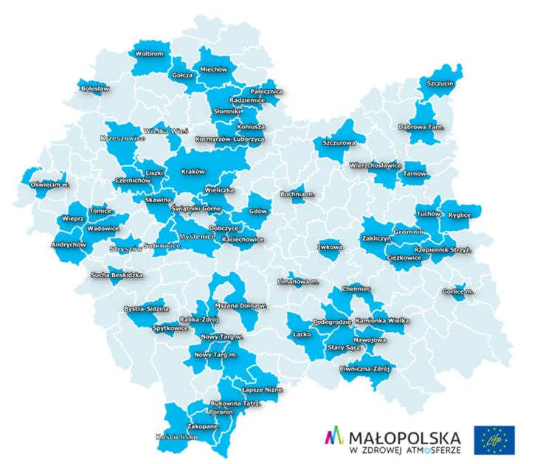
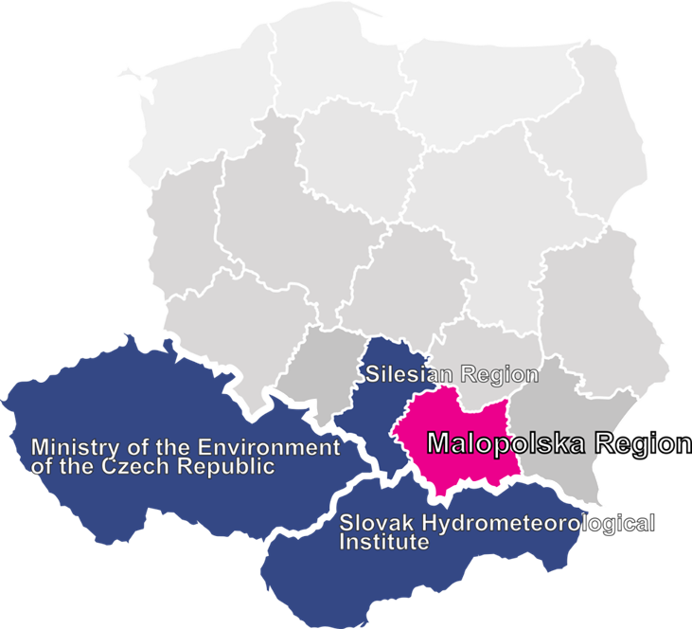
LIFE-IP MAŁOPOLSKA
The main goal: acceleration of the Air Quality Plan implementation
69 partners:
62 municipalities including Krakow
Silesian Region
Krakow Smog Alert (NGO), KAPE National Energy Conservation Agency
Ministry of the Environment of the Czech Republic, Slovak Hydrometeorological Institute, VITO
Duration: Oct 2015 – Dec 2023
Budget: EUR 16.8 million

Slide 3
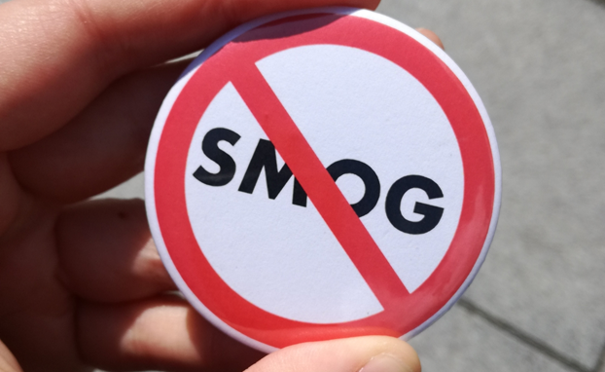
LIFE-IP MAŁOPOLSKA
Supporting the implementation of Air Quality Plan
The network of Eco-managers
Excellence Center
Support for the implementation of a ban on the use of solid fuels for heating in Krakow
International modeling of air pollution in the Malopolska Region, Slovakia and the Czech Republic
Regional media campaign to promote clean air

Slide 4
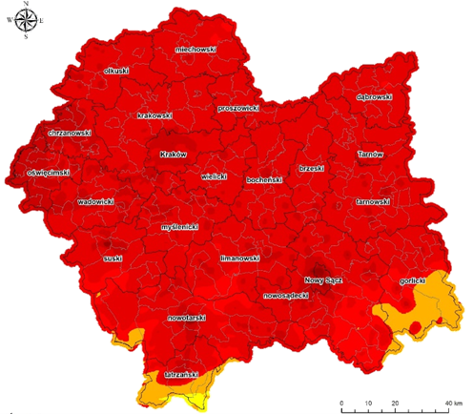
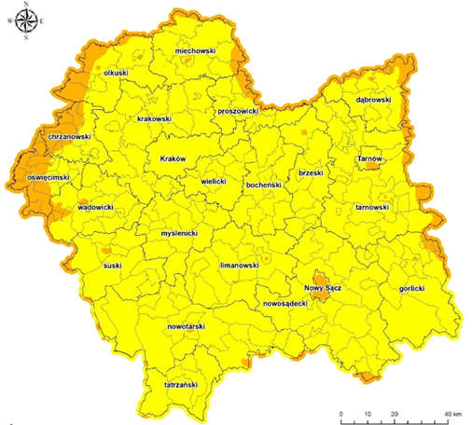
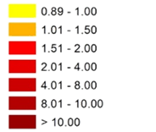
New Air Quality Plan for the Małopolska Region
2018
AQP came into force on the 27th of October 2020
The aims of the AQP are:
To implement the Anti-smog resolutions (an obligation to replace out-of-class boilers by 2023 in Małopolska Region)
To achieve the limit values of:
- PM10 and PM2.5 in 2023
- Benzo(a)pyrene and nitrogene dioxide in 2026
2026
Annual average
concentration
of benzo(a)pyrene [ng/m3]

Slide 5
Anti-smog resolution for Krakow
Anti-smog resolution for Krakow was adopted in January 2016
It bans the use of solid fuels (coal and wood) in boilers and space heaters in Krakow
Effective since September 2019
SOURCE: ANNUAL REPORTS FROM INSPECTORATE OF ENVIRONMENTAL PROTECION 2020, 2019, 2018
https://powietrze.gios.gov.pl/pjp/publications/card/25101
https://powietrze.gios.gov.pl/pjp/rwms/publications/card/1163
https://powietrze.gios.gov.pl/pjp/publications/card/14060

Slide 6
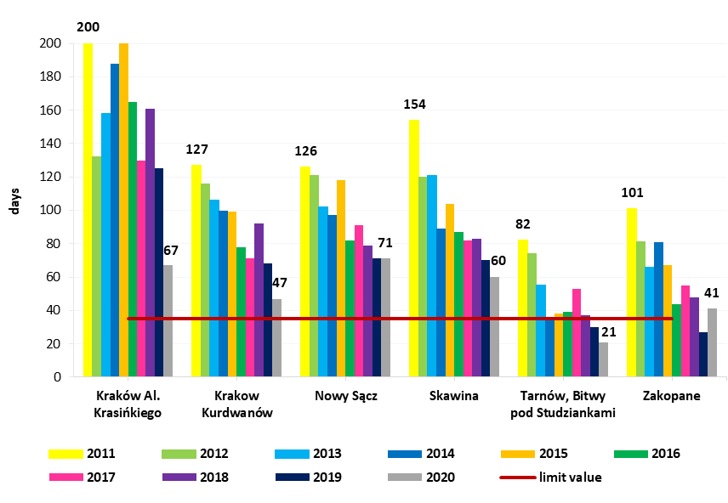
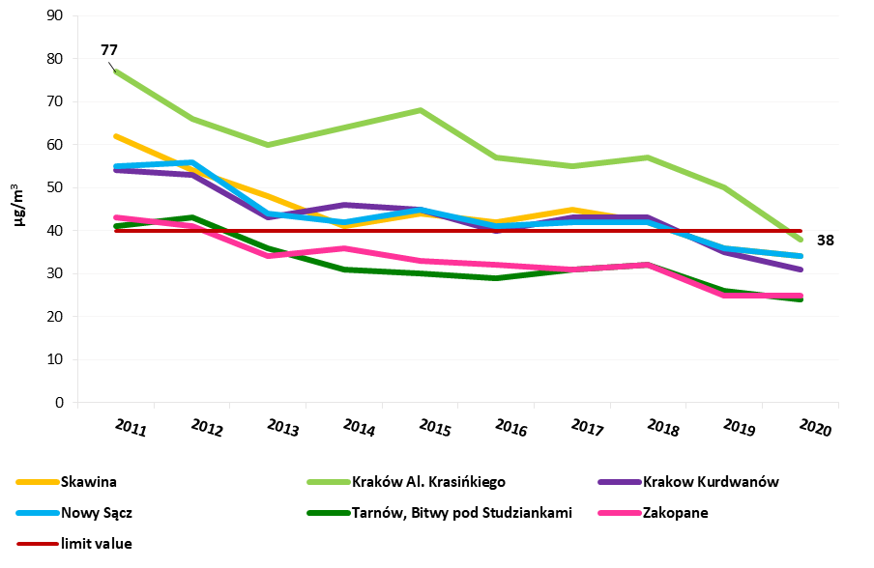
Anti-smog resolution for Małopolska
Anti-smog resolution for Malopolska was adopted in January 2017. It came into force in July 2017.
Allows to install new solid fuel boilers or space heaters only when they comply with ecodesign emission standards.
Bans the use of the worst quality coal or wood with moisture content above 20%.
All existing boilers which do not comply with class 3 (EN 303-5:2012) have to be replaced until the end of 2022 and boilers class 3 and class 4
until the end of 2026
The number of days with the PM10 daily limit exceeded at stations in the Małopolska Region between 2011-2020
Annual average PM10 concentration at stations in the Małopolska Region between 2011-2020

Slide 7
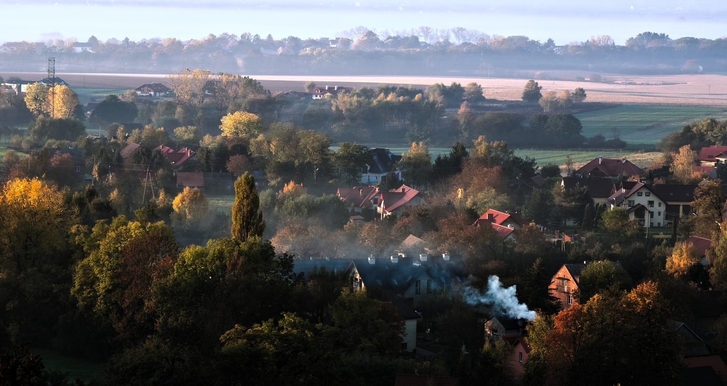
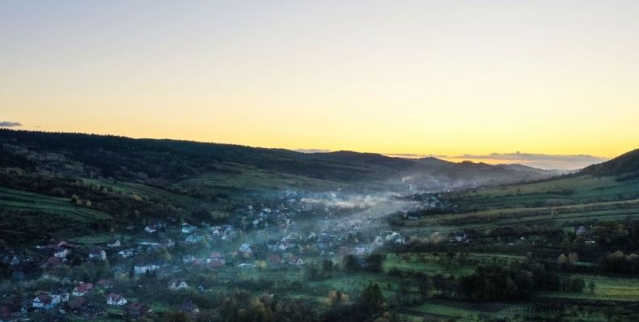
Local anti-smog resolutions
Adopted by 7 municipalities and more municipalities expected in near future
A total ban on coal burning from 2030
A ban on the installation of new coal-fired boilers from 2022 and elimination of existing ones to 2030
Keeping the other deadlines and requirements of the current anti-smog resolution for Małopolska

Slide 8
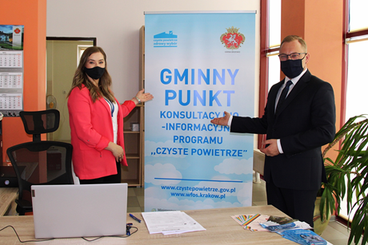
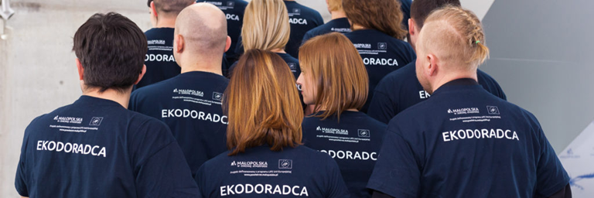
ACTIONS IN MUNICIPALITIES
67 Eco-managers employed under LIFE-IP Project in municipalities (104 in total Eco-managers)
The Clean Air Programme information points in 175 municipalities in Malopolska - aimed to replace old heating sources
Local education and information campaigns to promote clean air
Meetings, lectures and educational contests in cooperation with opinion making groups
(media, priests, NGOs, doctors, teachers)

Slide 9
Visit our website:
www.powietrze.malopolska.pl/en/

