Slide 1
The CB RES programme and framework
Beatrice CODA, Head of Unit B4,
CEF Energy CINEA
Virtual Info Day
26 January 2023

Slide 2
EU financing: key financial mechanisms for the energy sector managed by CINEA
REPowerEU
Green Energy Transition
Renewable Energy Financing Mechanism
HORIZON Europe
CEF Energy
LIFE Clean Energy Transition
Notes:
RePowerEU
According to the Commission investment needs analysis, implementing the full potential to reduce dependence on Russian fossil fuel imports to zero would require EUR 300 billion from now until 2030. This investment needs to complement the Fit-for-55 proposals.
The Recovery and Resilience Facility (RRF) will play a critical role in addressing these needs via different measures, including the REPowerEU chapters, as part of the national Recovery and Resilience Plans (RRPs).
Clean Energy Transition
At least 30% of the EU budget for 2021-2027 is allocated to climate (up from 20% in 2014-2020).
Recovery and Resilience Facility: the climate-related investment in the 26 approved RRPs are approximately EUR 200 billion, above the 37% obligation set by the RRF Regulation. The largest part of the climate investments allocation is dedicated to clean energy, energy efficiency and building renovation measures (around EUR 88bn).
Cohesion policy also provides significant support to energy efficiency, renewable energy and energy infrastructure. During 2014-20, EUR 27.5 billion was allocated for investment recognised as a priority under REPowerEU
InvestEU programme: By July 2022, already around EUR 1.6 billion of the EU guarantee under the “Sustainable Infrastructure Window” was allocated, including for investment in solar photovoltaic, wind energy and energy efficiency
The Horizon Europe programme allocated EUR 15 billion to support research and innovation in renewable energy technologies, energy efficiency, electrification of heating and cooling and digitalisation of the energy system.
CEF Energy is financing the better interconnection of energy networks towards a single EU energy market and the clean energy transition. Since 2014 CEF Energy had supported 154 projects with a total of EUR 5.7 billion.
LIFE Clean Energy Transition (CET): in May 2022, the LIFE CET Call for proposals was published, making available EUR 98 million for energy efficiency and clean energy projects.

Slide 3
Connecting Europe Facility (CEF) 2021- 2027
Develop and modernise the trans-European networks in the fields of transport, energy and digital
Emphasis on synergies among sectors
€33.71 billion
Push the decarbonisation commitments
* Including CEF Digital managed by HaDEA

Slide 4
Connecting Europe Facility (CEF) 2021- 2027
CEF Energy
CEF Digital
€5.84 billion for:
PCIs: Projects of Common Interest
CB RES: Cross-border projects in the field of renewable energy
CEF Transport
€33.71 billion

Slide 5
CEF ENERGY CB RES programme
Budget
Up to 15% of the total CEF energy budget (875m€), subject to market uptake.
Legal Basis
Renewable Energy Directive – (EU) 2018/2001 (RED II)
CEF Regulation - No 2021/1153
Commission Delegated Regulation (EU) 2022/342
Commission SWD (2021) 429

Slide 6
Objectives of the CEF-E window for cross-border projects in the field of renewable energy (CB RES)
Joint planning, development & cost effective exploitation of renewables and EU target achievement
Facilitate RES integration through energy storage and conversion facilities
Promoting cooperation between Member States and also 3rd countries based on mechanisms in RED II
Contribute to strategic uptake of innovative renewables technologies
Contribute to the EU's Long Term decarbonisation Strategy
Notes:
In the context of cross-border cooperation in renewables, the cross-border projects under CEF shall contribute to few main objectives, spelled out in the CEF Regulation.
These projects should help MS in the EU target achievement by providing a more cost-effective option in parallel to the national measures for support for RES. Furthermore, they should facilitate RES integration and should contribute to the uptake of innovative RES technologies. Lastly, these projects also contribute to the long-term decarbonisation objectives of the EU.

Slide 7
CB RES Process
Application for CB RES Status
Publication of the CB RES list
Projects with status are eligible for future calls for Works and Studies funding
Eligible projects include:
Renewables generation based on any renewable energy source
All sectors – electricity, transport, Heating & Cooling
Storage / IT systems/ grid connection, provided it forms an integral part of the project, effectively enable the integration of and are ancillary to a renewables generation facility
Note also:
No pre-defined capacity thresholds, locations or technology type in CEF regulation

Slide 8
Today’s info day: Call for the CB RES Status
Call for status: status offers increased visibility for your project and is a pre-condition for participation in CEF calls for technical studies and works
End of 2023: calls for technical studies and works
Notes:
So today’s info day is to introduce the call for getting the ‘status’ of cross-border projects in the field of renewable energy. Getting the ‘status’ means becoming part of the ‘list’ of cross-border renewable energy projects
The ‘status’ of cross-border renewable energy project increases the visibility and possibly the public acceptance of your project. Furthermore, it constitutes a pre-condition for participation to the future CEF calls for technical studies and works.
Based on the first list of projects that will be adopted under this call, CINEA will launch at the end of 2022 a CEF call for technical studies and works.
As already mentioned, more information on the call and the related selection process, and on the sector of cross border renewables all together, will be provided by my colleagues from DG ENER in the next presentations.
<Change slide>

Slide 9
Three projects acquired the CB RES status in the 2022 call
Goerlitz-Zgorzelec
Cross-border zero carbon district heating
ELWIND
Hybrid Offshore project in the Baltic
CICERONE
Cross-border European Green hydrogen value chain

Slide 10
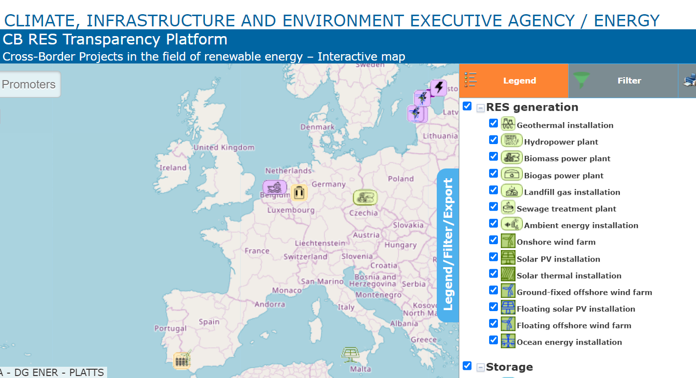
CB RES Transparency Platform
Link

Slide 11
Funding is also available for Preparatory Studies
No CB RES status is required. This is designed to provide financial support to overcome obstacles which prevent cooperation projects from going ahead, such as:
technology surveys
cost linked to cooperation mechanism implementation
cost estimation reports
environmental survey
Next call for preparatory studies should open in September 2023 (tbc)
A recording of the Info previous day is also available following this link.

Slide 12
Thank you
© European Union 2020
Unless otherwise noted the reuse of this presentation is authorised under the CC BY 4.0 license. For any use or reproduction of elements that are not owned by the EU, permission may need to be sought directly from the respective right holders.
Slide xx: element concerned, source: e.g. Fotolia.com; Slide xx: element concerned, source: e.g. iStock.com
Notes:
Update/add/delete parts of the copy right notice where appropriate.
More information: https://myintracomm.ec.europa.eu/corp/intellectual-property/Documents/2019_Reuse-guidelines%28CC-BY%29.pdf

