Slide 1
LIFE 2020 Call for Proposals from NGOs on the European Green Deal (LIFE 2020 NGO4GD) Virtual Information Session, 12 January 2021
Executive Agency for SMEs (EASME)
Presenter: Joëlle Noirfalisse, Senior Project Advisor

Slide 2
Special features of the LIFE 2020 NGO4GD Call for Proposals
Mono beneficiary grant, no partnership, no affiliate
Action grants to deliver tangible results in strengthening knowledge and empowering civil society to support an inclusive implementation of the European GD at national and/or sub-national level
Projects must take place on an EU MS territory
Maximum project duration of 24 months
Lump sum of 300 000 EUR each maximum
Maximum co-financing rate 60% of total eligible costs. Remaining 40% to be covered fully by own contribution or by co-financers
Specific eligibility criteria

Slide 3
Eligibility criteria (1)
be a non-profit making legal person;
be independent, in particular from government, other public authorities, and from political or commercial interests;
be primarily active in the areas of environment and/or climate action and have an environmental/climate objective which is aimed at:
a. the public good, and/or
b. sustainable development, and /or
c. the development, implementation and enforcement of environmental and/or climate policy and legislation;
be established (legally registered) in one of the European Union Member States.
be established (legally registered) before 1 January 2018.

Slide 4
Eligibility criteria (2)
Be operating at national level. In the case of applicants established in larger European Union Member States, this criterion can be met if the applicant operates at least at regional level (*).
Have a total revenue equal to at least € 700 000 as taken from the profit and loss account of the 2019 statements and/or an average number of permanent staff of at least 10 in 2019.
have recorded a negative trend in revenues for 2020 of at least 10% as compared to the average revenues of the previous two years OR a revenue loss of at least € 100 000;
An applicant CANNOT BE a recipient of a LIFE NGO Operating Grant.
(*) Larger EU MS are here defined on the basis of their total population in 2019. A MS with a total population in 2019 above 25 million will be considered as large. This includes Germany, France, Italy, Spain, Poland and the UK.

Slide 5
Supporting documents
Registration document: Register(s) of Companies, Official Gazette, etc.
Statutes of the NGO (or equivalent)
Annual Activity Report of the previous year
Audited financial statements (balance sheet and profit & loss account) for 2018, 2019 and 2020.
If audited accounts are not required by law and/or in case the 2020 accounts are still provisional, a self-declaration certifying the validity of the accounts signed by a legal representative as per model.
"LIFE Simplified Financial Statements“ completed for 2018, 2019 and 2020.

Slide 6
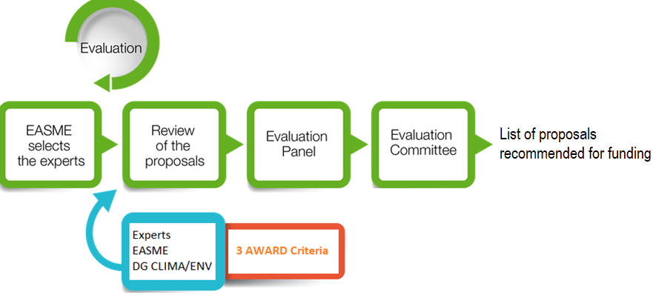
The evaluation process
The list of proposals recommended for funding will be established with due consideration to the geographical balance by ensuring that at least the best passing proposal per EU Member State is included.

Slide 7
Evaluation criteria
Award Criteria | Min. pass score | Max. score
AW1: Technical coherence and quality of the proposal in relation to the specific needs addressed | 22 | 45
AW2: Comprehensiveness and relevance of the approach in relation to the needs identified | 15 | 30
AW3: Financial coherence and quality (including value for money) | 12 | 25
Overall (pass) scores(*) | 55 | 100
(*) a project proposal has to reach at least the minimum pass score for each award criteria and also the sum of scores for criteria for which a minimum score has been fixed has to be equivalent to 55 points or more.

Slide 8
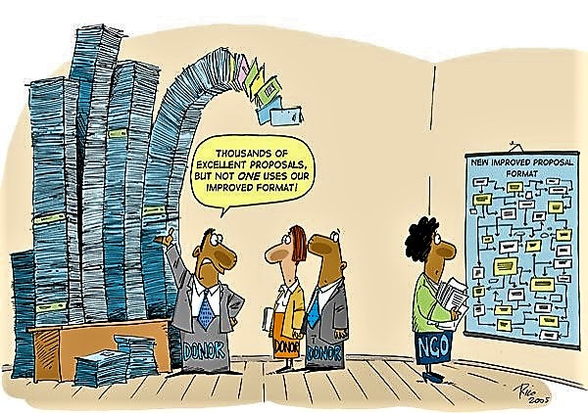
How to apply?
Simplified set of Application Forms:
Technical forms A and B in Word
Financial forms F in Excel

Slide 9
Application Forms - General
Format and page/character limitations must be respected. No additional information will be taken in consideration for the purpose of evaluation
Predefined texts of declarations cannot be modified
Instructions embedded can be deleted
Ensure coherence across all forms
Starting date not before August 2021

Slide 10
Administrative information Forms A
Largely administrative BUT pay particular attention to:
Form A1: contact person and their contact details.
Form A2: description of the competences/activities of the applicant organisation. It will be used, along with the annual activity report, to assess the geographical scope of intervention of the organisation (national, regional) as well as its technical reliability.
Form A3 (coordinating beneficiary declaration) & Form A4 (co-financers declaration - if relevant) must be signed and returned.

Slide 11
Technical information Form B1
Structured, concise and clear
Solid analysis of the problem, state of play and solution proposed (baseline)
Specific objectives of the action and how it will contribute to the objectives of the call for proposals
Relevant stakeholders and their involvement identified

Slide 12
Technical information Forms B2 to B4
Max 5 Work Packages
Logical sequence of WP/activities clearly linked to project description
Expected results and qualitative/quantitative estimations of projects impacts
Main deliverables and key milestones
Expected internal and/or external risks and constraints and how they would be overcome

Slide 13
Technical information Forms B2 to B4 (continued)
Clear strategy on how to sustain and multiply impacts
Project management and monitoring/evaluation
Project carbon footprint reduction and green procurement
Justification for means required in relation to main activities/expected results (Form B3 in full coherence with Form B2 and Forms F )

Slide 14
Where and when to submit a proposal?
Strongly recommended to submit the proposal in English
Forms included in the application pack ONLY.
Submission by email ONLY:
EASME-LIFE-2020-NGO4GD@ec.europa.eu
One single pdf document with technical and financial forms (readable, printable in black and white in A4 format)
Financial forms in Excel format in addition to pdf version
Supporting documents to be attached to the same email in format specified
Deadline:
Wednesday 31 March 2021 – 17:00 CET (Brussels)

Slide 15
Thank you!

