Slide 1
Methodological guidelines for communication with landowners and land users One Nature project (LIFE-IP:N2K: Revisited, LIFE17/IPE/CZ/000005) Bronislav Farkač
IP comms workout
Online, 9th March 2022

Slide 2
Management of the Natura 2000 sites brings benefits to nature and people.

Slide 3
Methodological guidelines for communication Sources
International academic literature and good practice
Our research
Survey conducted in all regional offices of Nature Conservation Agency (NCA)
Focus groups in 4 regional offices of NCA
Individual in-depth interviews with landowners and land-users in 4 regions managed by NCA
Direct experience of personnel from NCA regional offices -> „First-hand stories“
Feedback and by skilled personnel from NCA directorate and from regional offices of NCA
Update based on feedback

Slide 4
Methodological guidelines for communication Structure of the final text
General principles in communication regarding management in protected areas (PAs)
Communication with various categories of landowners and land users
Private land-owners and smallholder farmers
Agricultural companies , forest companies (state or private)
Municipalities
NGOs
Legislation regarding cooperation with landowners and land users
Concluding main points – „Ten Commandments“
+ Examples of international research and good practice
+ „First-hand“ stories provided by NCA regional offices

Slide 5
Methodological guidelines for communication Main principles
Trust as crucial concept for functioning communication and cooperation
Preparatory phase and first contact
Explaining and harmonizing of different interests
Development of long-term ties
Feedback and positive evaluation
Competence and first-hand knowledge of NCA personnel

Slide 6
Recording negotiations with stakeholders One Nature project (LIFE-IP:N2K: Revisited, LIFE17/IPE/CZ/000005) Martina Kobyláková
Ip comms workout
Online, 9th March 2022

Slide 7
Recording negotiations with stakeholders Purpose
Unified database of records representing the history of negotiations with stakeholders
Ensuring continuity and consistency of communication
Data accessible to colleagues conducting negotiations with the same stakeholders
Facilitation of passing agenda to new colleagues
Identification of problematic localities

Slide 8
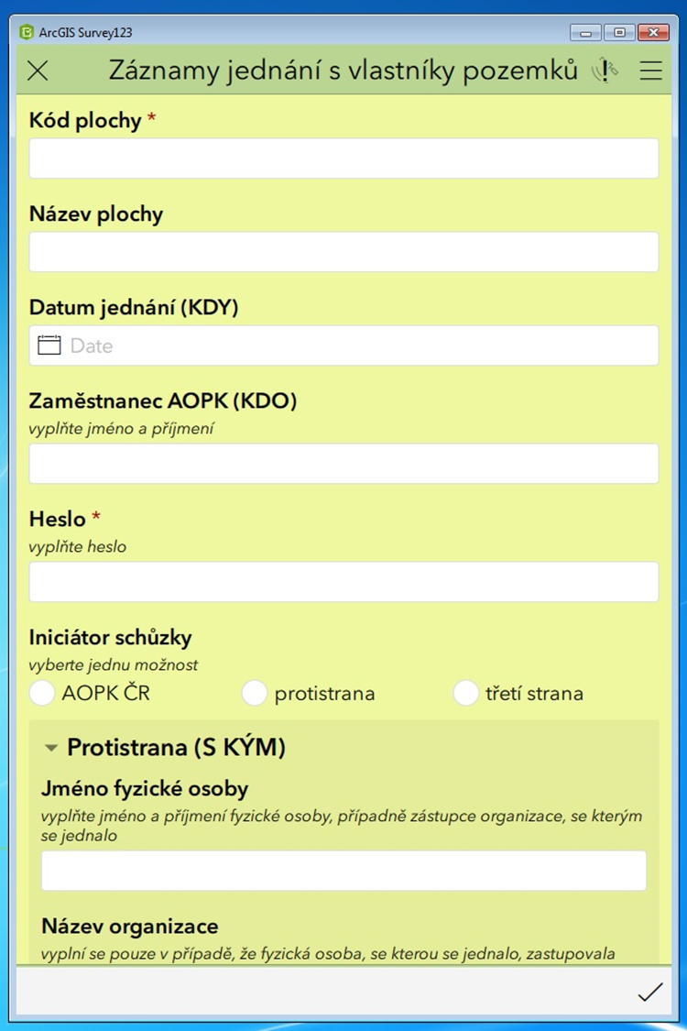
Recording negotiations with stakeholders What data do we collect?
Time and date of the negotiations
Parties involved
Subject of the negotiations and its location
Results of the negotiations
Contacts
Attachments
How?
ArcGIS Survey 123 application
Map application

Slide 9
Thank you for your attention.

