Slide 1

LIFE Operating grants for NGOs
Framework Partnership Agreements and Specific Grant Agreements for funding in 2020 and 2021
Information session - 21 March 2019 - Brussels
WELCOME

Slide 2

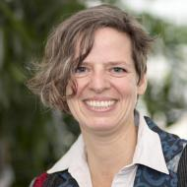
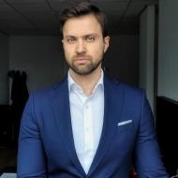


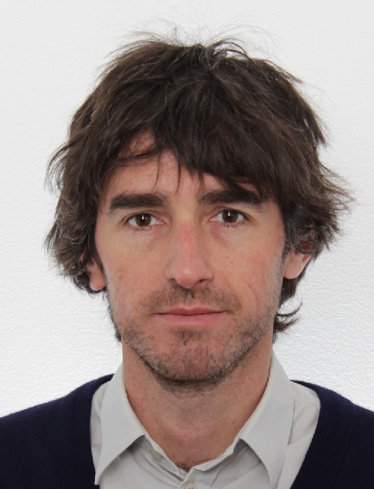

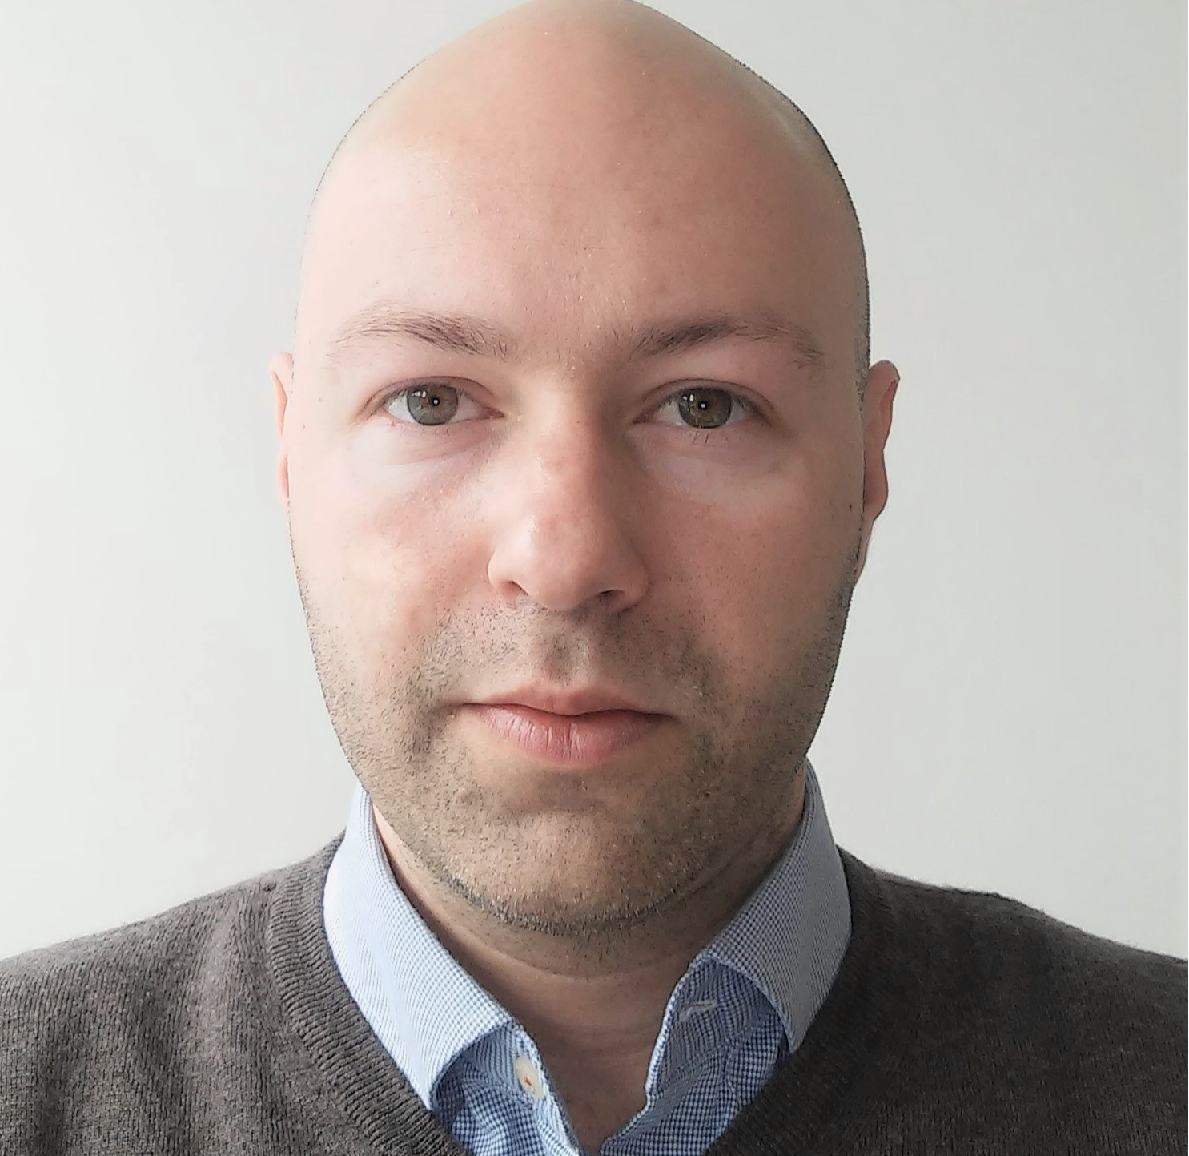
EASME LIFE NGO team
Unit C.1.7
Lorenzina Bruno
Senior financial officer
Georgios Georgiadis Fabio Leone Financial officer Financial officer
Anita Prtenjaca Greg Ziakas
Financial officer Financial officer
Unit B.3
Astrid Geiger
Head of Sector
Eva Paparatti
Project adviser Manuel Montero Ramírez
Project adviser

Slide 3
Astrid Geiger, Head of Sector

Slide 5





Since 1992
Contribute to the implementation, update and development of the EU environmental and climate policy and legislation
3.5 billion euros - 2014-2020
Notes:
The only EU financial instrument specifically targeting the environment.
Since 1992 initiative of a
4262 projects so far
contribute to:
implementation
updating
development
of EU environmental and climate policy and legislation by co-financing projects with European added value
2014-2020: Total budget of €3.5 billion
LIFE is a catalyst: it provides a platform for the development and exchange of best practices and knowledge thereby improving, catalysing and accelerating changes;
LIFE is the ideal instrument to show to regional and national authorities the benefits of investing in the environment sector and incentivising them to develop strategic frameworks for spending

Slide 6

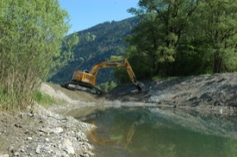

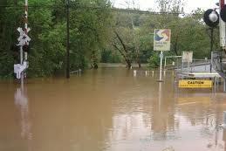
LIFE strands
Next Call: 4 April
Traditional Projects:
  Pilot, demonstration and best practice projects
  information, awareness, and dissemination projects
Integrated Projects
  implementing action plans of Member States
Capacity Building Projects
  helping Member States to improve LIFE participation
NGO Operating Grants
Notes:
Traditional:
Mainly SME, NGO, public administrations active in the field of environment and climate protection;
Pursuit of general and specific objectives of the 6 priority areas;
Sub-programmes environment and climate change;
1 to 5 beneficiaries;
EU contribution: €500,000 to €1.5 million;
60%; NAT: for priority habitat/species: 75%.
IPs
Public administrations and other entities active in the fields of:
river basin management, air quality, waste management and prevention, framework actions on nature, GHG strategies, low carbon economy
big scale: putting into place national action/management plans
2 to 10 beneficiaries
EU contribution: 60%, € 8 to 12 million; about 3 IPs per Member State.
Additionally raised funding for even larger scale – e.g. from Regional Funds, Common Agricultural Funds or other public

Slide 7
NGO operating grants – why?
The LIFE Regulation aims at promoting better environmental and climate governance as a specific objective of the priority areas of Governance & Information on
The environment and on
The climate
by supporting a broad range of NGOs.
LIFE Regulation, Preamble and Articles 12(d) and 16(d)

Slide 8
Who do we look for?
Non-governmental organisations – independent from political or commercial interest
NGOs with a network or structure that allows access to EU institutions
NGOs with a network or structure representing civil society
Not-for-profit organisations
NGOs with an environmental and/or climate mission
European added value
Tip: Read carefully eligibility and award criteria

Slide 9
Twofold role of the NGOs:
1) Bottom-up
Shaping EU policies:
  Channelling members' views to the EU
  Alert policy makers about new issues to be addressed
  Participate in consultative groups or expert panels
  Information input to policy formulation

Slide 10
Twofold role of the NGOs:
2) Top-down
Supporting implementation of EU Climate & Environmental policy
  Feedback to Commission on problems of implementation
  Alarms or intervention in case of break of legislation/regulation in the Member States
  Campaigns, exchange of best practice, awareness raising and citizen participation
  Preparing the grounds for policy acceptance

Slide 11
7th EAP: environmental/climate goals
Key objectives:
to protect, conserve and enhance the Union’s natural capital
to turn the Union into a resource-efficient, green, and competitive low-carbon economy
to safeguard the Union's citizens from environment-related pressures and risks to health and wellbeing
Horizontal priority objectives:
to make the Union's cities more sustainable
to help the Union address international environmental and climate challenges more effectively

Slide 12
7th EAP: enablers
Four so called "enablers" will help Europe deliver on these goals:
better implementation of legislation
better information by improving the knowledge base
more and wiser investment for environment and climate policy
full integration of environmental requirements and considerations into other policies

Slide 13
Eva Paparatti, Project Adviser

Slide 14
Previous FPA Call (2017)
  Indicative budget: 22.4m€ for 2 years
  54 applications received
  Average shares:
    Environment policy ~ 60%
    Climate action policy ~ 40%
  Total requested EU contribution:
  ~ € 32m

Slide 15
Previous FPA Call - results
  Applications were of very high quality: funded ones reached min. 70/80 in award evaluation
  34 NGOs were selected to be funded in 2018 and 2019
  Average grant: 330,000€ EU funding
  From 2015 to 2017, the average EU funding decreased from 50% to 43% of eligible costs

Slide 16
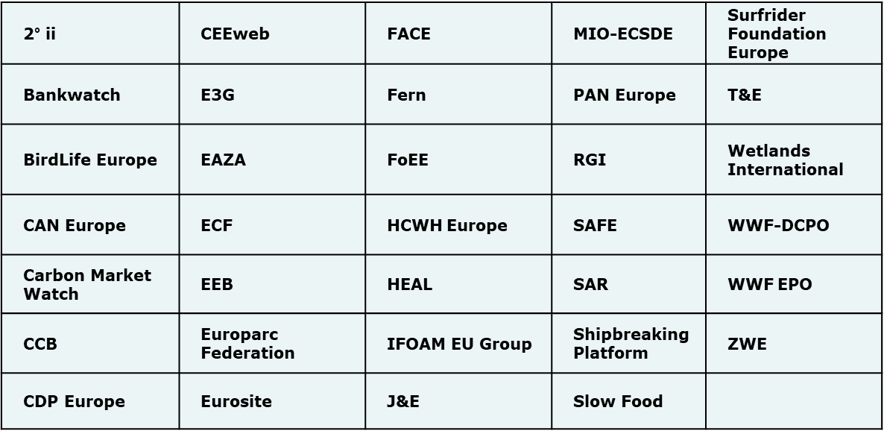
NGOs currently funded

Slide 17
Call 2019 - FPA
1st step: two-year framework partnership agreement
  Focus on two-year strategy
  Including an outline of activities
    already known or based on experience from previous years
    distinguished between the 2 years
  Financial details will be requested at SGA stage. Finances only matter for:
    financial viability
    budget cut-off
    in case of proposals with equal score - percentage of EU funding requested compared to total eligible costs
  No revisions for the FPA

Slide 18
Call 2019 - SGA
2nd step: specific grant agreements – invitation for proposals and contract for each financial year (2020 and 2021)
  Annual work plan (from FPA)
  Detailed budget
Limited award criteria
Revision phase
NEW: Current call covers FPA and SGA

Slide 19
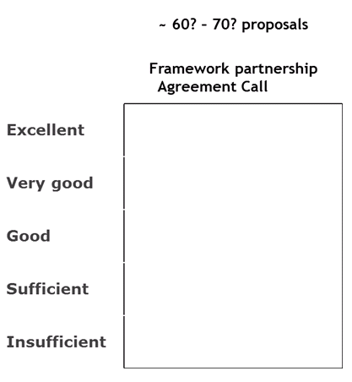
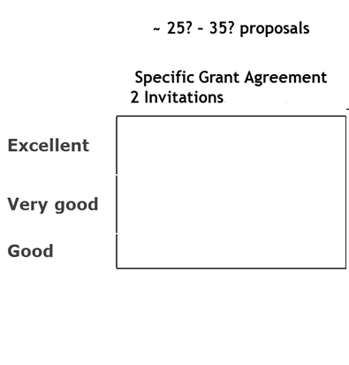


From FPA to SGA

Slide 20
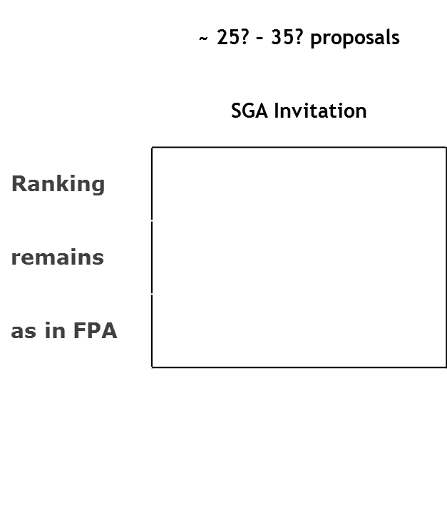
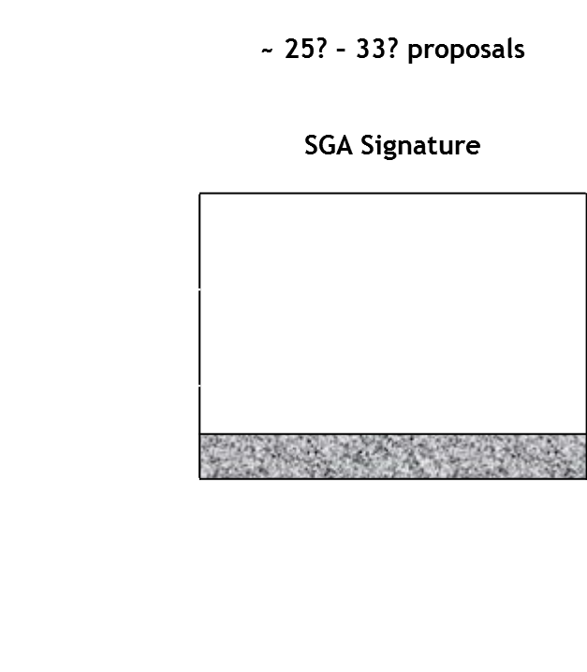
From SGA call to SGA signatures
Failing/not submitted
Revision

Slide 21
Calendar Call for proposals for NGOs in 2019 (financial years 2020 and 2021)
a) | Publication of the present call for proposals | March 2019
b) | Closing date/deadline for submitting applications | 3 June 2019 (16h00 if hand-delivered)
c) | Notification of results/information to all applicants and invitation for 2020 work programmes | October 2019*
d) | Signature of the framework partnership agreements | October 2019*
e) | Deadline for submitting SGA proposals | Around one month from the invitation
f) | Notification of results for SGA proposals | December 2019*
g) | Revisions of the 2020 work programmes | December-January 2019-2020*
h) | Signature of the specific operating grant agreements | February-April 2020*

Slide 22

FPA Call 2019 - Budget
Indicative budget for this call: 2 x 12 million €
~ 35 NGOs are funded every year
Maximum EU funding: 60% of total eligible costs
700.000 € EU funding maximum per grant
Organisations under FPA 2017: EU requested funding limited to the amounts requested for 2018 and 2019

Slide 23

Evaluation
Pre-assessment by external experts (independent evaluations)
Final assessment by an Evaluation Committee (EASME, DG Environment and DG Climate Action)
Recommendation established in consensus

Slide 24

Admissibility and exclusion criteria – read the call!
Most important:
  Don't miss the deadline: 3 June 2019 – 16h00 for hand delivery
  Use the application forms
  The proposal must be complete
  It must include a hard copy and an electronic version (CDrom or USB stick)
  Please sign the declaration (form A1)

Slide 25

Who can apply? Eligibility criteria (1)
Applicants must be:
Non-profit legal entities
Independent from government/authorities, political parties and commercial organisations
Primarily active in field of environment and/or climate action with an environmental/climate objective (proof: statutes)
Aiming at the public good and sustainable development
Involved in the development, implementation and enforcement of Union environmental and/or climate policy and legislation

Slide 26
Who can apply? Eligibility criteria (2)
Applicants have to:
be legally established in one of the EU Member States
operate at Union level with a fixed structure and activities covering at least three EU Member States
  To this end, partnerships, networks and memberships are eligible if they are formally established as a legal entity (represented by a management board or other administrative forum). Loose co-operations or temporary partnerships are not eligible
NB: national NGOs are not targeted by this call

Slide 27
Selection criteria
  Operational capacity
  Assessment of professional competencies and qualifications based on CVs and recent activity reports
  Financial capacity
Assessment of the financial viability of the organisation based on auditor's certified accounts and annual statement to demonstrate stable and sufficient sources of co-funding throughout the two years

Slide 28
Award criteria
  Please note that award criteria have been restructured and simplified since the 2017 Call
Award criteria | Maximum score (pts)
Policy Relevance | 20
EU policy shaping | 20
EU policy implementation | 20
Sensor Function | 5
Organisational development | 15
 | Min. 45 of 80

Slide 29
Award criterion 1 - 20 points
"Policy Relevance": Relevance of the NGO's strategic plan for the Union’s environmental and climate action policies.
7th Environment Action Programme: thematic objectives and horizontal priority objectives
economy-wide action on climate and energy emission reductions/ Union's climate change adaptation strategy
EU added value of the work proposed
real impact measured against specific indicators
Explain the link between policy and strategy
Try to estimate impacts
Notes:
Main policy references:
Environment Action Programme (EAP) for the EU entitled "Living well, within the limits of our planet",
the circular economy action plan,
the Action plan on nature, people and the economy,
the European Commission Roadmap for a Resource Efficient Europe,
the EU strategy for a climate neutral Europe by 2050 and the EU Strategy on adaptation to climate change.
Communication from the Commission to the European Parliament, the Council, the European Economic and Social Committee and the Committee of the Regions 'Closing the loop - An EU action plan for the Circular Economy', http://eur-lex.europa.eu/legal-content/EN/TXT/?uri=CELEX%3A52015DC0614
Communication COM/2011/0571 final of 20 September 2011 from the Commission to the European Parliament, the Council, the European Economic and Social Committee and the Committee of the Regions, 'Roadmap to a Resource Efficient Europe', http://eur-lex.europa.eu/legal-content/EN/TXT/?uri=COM:2011:0571:FIN
http://eur-lex.europa.eu/legal-content/EN/TXT/PDF/?uri=CELEX:32013D1386&from=EN
There is no direct link between the number of thematic areas covered and the evaluation result. An applicant with high quality activities in a few areas will get a higher score than an applicant with medium quality activities in many areas.

Slide 30
Award criterion 2 -20 points
"EU Policy Shaping": Contribution of the NGO to shape, develop or update the Union's environmental and/or climate action policies.
in-depth understanding of the EU policy process
improving the knowledge and evidence base for Union environment and/or climate action policy
Improve integration and coherence with other policies
act as a channel between civil society and the EU level, providing coordinated policy input and
use appropriate means and channels to voice the concerns of EU citizens and to ensure their democratic representation vis a vis the relevant institutions
Notes:
The evaluation will assess the relevance of …

Slide 31
Award criterion 3 - 20 points
"EU policy implementation": Contribution of the NGO to implement and enforce the Union's policies
improve implementation and enforcement of the Union's environment and/or climate action legislation on local, Member State and/or European level
act as a channel between the EU level and civil society, promoting and ensuring acceptance of policy implementation
create leverage through awareness raising actions, media campaigns, as well as useful coordination and strategic cooperation with stakeholders, including other NGOs
identify obstacles to policy implementation at national/regional level, for policy feedback
help to secure investment for environment and/or climate action policies
Notes:
This theme is described in more detail here:
http://ec.europa.eu/clima/policies/international/negotiations/docs/eeas_26062013_en.pdf
The evaluation will assess the extent to which…

Slide 32
Award criterion 4 - 5 points
"Sensor Function": Relevance in addressing new and emerging environmental and/or climate-related issues
Detection of new/emerging issues/threats, their causes and possible effects
Capacity to propose solutions, to address the issues or to provide feedback for improved policy making
Notes:
The evaluation will assess extent to which …

Slide 33
Award criterion 5 - 15 points
"Organisational development": Potential to develop in order to become a more efficient stakeholder in the Union's policy process
analyse and describe the organisation's needs
propose a strategy that is appropriate to meet the identified needs; it will contribute to strengthening the organisation
endeavour to develop the NGO's grassroots or members base
convincing fundraising strategy based on the current situation, aimed to ensure the diversification and sustainability of the organisation
Assess the dependence of the NGO on the LIFE operating grant and propose convincing strategies to address this dependence
Notes:
The evaluation will assess how you intend to realise the actions:
…

Slide 34
Preparation of the proposal
  Guidelines, forms and FAQ available on the web
    A = administrative forms
    T = technical forms
    F = financial forms
  To submit:
    1 complete original + one copy
    1 CD/USB stick with full application
  Please send us an email once submitted (for our planning)
  Financial Guidelines are available at:
  https://ec.europa.eu/easme/en/section/life/life-contract-financial-aspects#inline-nav-3
Submission by email is not sufficient!

Slide 35
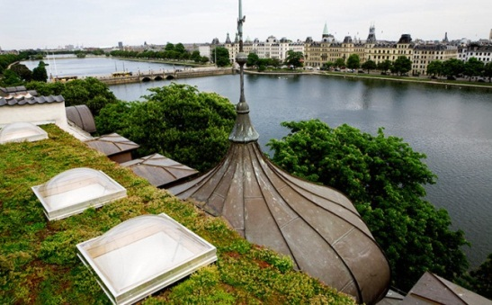
Section A
Administrative information
Form A1: Applicant declaration
Form A2: Applicant profile information
Form A3: Previous EU funding

Slide 36
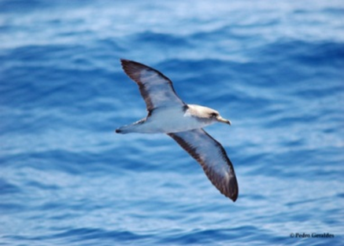
Section T
Please use English
Be clear – avoid jargon and acronyms (include a glossary if needed)
Provide proper background and context
2 parts: activities are separated according to the year of implementation (2020/2021)

Slide 37
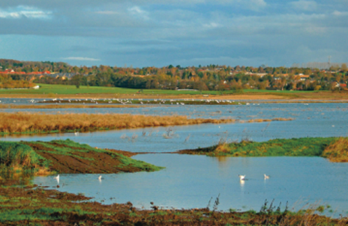
Forms T1, T2, T3
T1: List of all official member organisations per country
T2: Brief description of the nature, structure and activities of the applicant and members involved in the planned work
T3: Thematic priorities – main areas of work

Slide 38
Section T4: Strategy
Use only this form to describe your biennial strategic plan and activities during the 2 years (no other documents)
Max. length of whole section T4: 50 pages
Form T4.1: Summarise the biennial strategic plan, its objectives and expected results (core element of the proposal)
  Global description of the two-year strategy
  link it to the strategy of the NGO
  Main objectives
  Main expected outputs
  major activities/milestones as well as related medium term results/impacts – please quantify as much as possible; you may indicate ranges

Slide 39
Form T4.1 Summary (cont.)
EU added value of the work proposed
Policies addressed directly by your proposal (policy papers / directives / regulations)
A simple list is sufficient
Channels and means: describe structure(s) in place to facilitate access to relevant European institutions and to civil society
  – if you plan to set-up new structures during 2020-2021 please describe them (which, how,…)
  e.g. working groups /stakeholder groups / advisory committees of the European Commission / European Parliament / European Council or at Member State level
% of work related to environment & to climate action
for statistical purposes

Slide 40
Section T4.2 Strategic plan
Provide a detailed description of your biennial strategic plan by policy area and by financial year
Be concrete in developing this strategy and support it with an outline of accompanying actions
If many policy areas are covered, it is recommended to select the most relevant for the FPA
Link the policies to your strategy. It should become clear how you plan to contribute to the policies mentioned in section T4.1

Slide 41
Section T4.2 Strategic Plan (cont.)
Use the headings in form T4.2:
  Context and specific European policies addressed
  Objectives
  Activities
  Channels/means
  Description of capacities, expertise, infrastructure, tools in place to perform the work.
  Description of the staff and technical sub-contractors
  Expected results
  Contribution to expert groups, stakeholder consultations, position papers, etc.

Slide 42
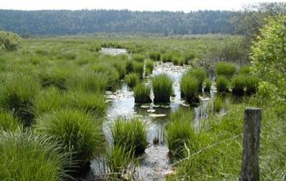
Section T4.3 Organisational development and capacity building
Describe the identified needs and development perspectives of your organisation in relation to the NGO operating grant
The description of your fundraising strategy should form a core element of the application
Provide a long-term view on economic sustainability, especially in relation to addressing any dependence of the LIFE operating grant

Slide 43
Section T4.3 (cont.)
Describe how the grant is expected to improve your organisation compared to the present situation in various aspects, e.g.:
  Organisational structure and staffing
  Better policy impact
  Strategic approach
  Financial management
  Dependency on operating grant
  Evaluation and reporting
  Internal communication
  Technical expertise
  Network enlargement/new members
  etc.

Slide 44

FPA evaluations: contacts during the evaluation
In the evaluation process you may be contacted by email in case of:
    Obvious clerical errors or minor omissions
    Need for further clarifying information
Reply is needed within 7 calendar days – the contact e-mail address indicated in form A2 should be active and checked on a regular basis
Main period for contacts: June/July – if you are on holidays, please identify a backup and put an out of office reply!
We must be strict with deadlines!

Slide 45
Lorenzina Bruno, Senior Financial Officer

Slide 46
Section F – Financial forms
Cover page
F-Form
  General data relates to the first financial year (2020)
  Financial data relates to year t0 and t-1
Budget overview
  Estimated budget for 2020 and 2021
  EU requested funding for 2021 ≤ 2020 (same amounts for both years recommended)
  Organisations under FPA2017: EU requested funding limited to the amounts requested for 2018 and 2019

Slide 47
Outlook on Financial Rules of SGA (1)
A detailed budget is only required for the SGA submission
Determination of final amount
  The budget cannot be increased (from FPA to SGA submission)
  EU funding % applied to eligible costs
Implementation contracts/subcontracting:
> 60.000€ ➔ request 3 offers
> 135.000€ ➔ publish a call
Best value for money principle to follow for procurement contracts
Usual practice of organisation to follow (accounting rules, salaries, reserve,..)

Slide 48
Outlook on Financial Rules of SGA (2)
Non-cumulative award:
  IMPORTANT: Applicants may receive only one operating grant per financial year from the budget of the European Union.
  Under no circumstances shall the same costs be financed twice by the Union budget.
Earliest start of expenditure:
  The start of the beneficiary's budgetary year
  Earliest start date is 01/01/2020
Co-financing:
  The EU will only co-fund part of the work programme (up to 60%)
  The applicant will have to cover its share for the eligible costs as well as all non-eligible costs

Slide 49
Financial Rules of SGA (3) – Eligible costs
Actually incurred by the beneficiary (not member organisation/affiliates)
Incurred during WP duration
Indicated in estimated budget (Annex III)
Linked to WP, in line with Annex I and necessary for its implementation
Identifiable and verifiable (accounting records of beneficiary and in line with applicable accounting standards of the country)
Complying with tax and social legislation requirements
Reasonable, justified and comply with principle of sound financial management (economy and efficiency)

Slide 50

If selected for SGA
60% pre-financing after reception of the signed grant agreement (in case financial capacity results is low, the beneficiary could receive a pre-financing in two instalments (2*30%) or submit a financial guarantee covering the 60% pre-financing amount)
40% after approval of the final reports (to be submitted at the latest 3 months after the end of the financial year)
EASME will follow-up on your work together with external experts (NEEMO)
Notes:
*If PFP in 2 instalments:
30% 1PFP after reception of signed of SGA
30% 2PFP afteer reception of interim report (technical and financial statement), 70% first pre-finaning consumption

Slide 51

Follow-up of grant activities by external monitors together with EASME
NEEMO Monitoring Team - Who are we?
NEEMO: consortium that monitors all LIFE projects
Not auditors
We advise but do not decide
Provide service to EC/EASME
Help beneficiaries/grantees
Notes:
*If PFP in 2 instalments:
30% 1PFP after reception of signed of SGA
30% 2PFP afteer reception of interim report (technical and financial statement), 70% first pre-finaning consumption

Slide 52

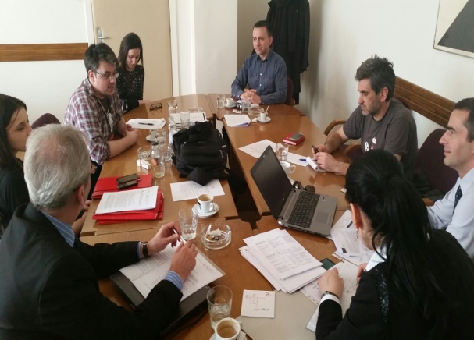

NEEMO monitoring team – what we do
Evaluations of NGOs’
Final reports
Monitoring visits to selected NGOs
Propose highlights
for LIFE brochure

Slide 53
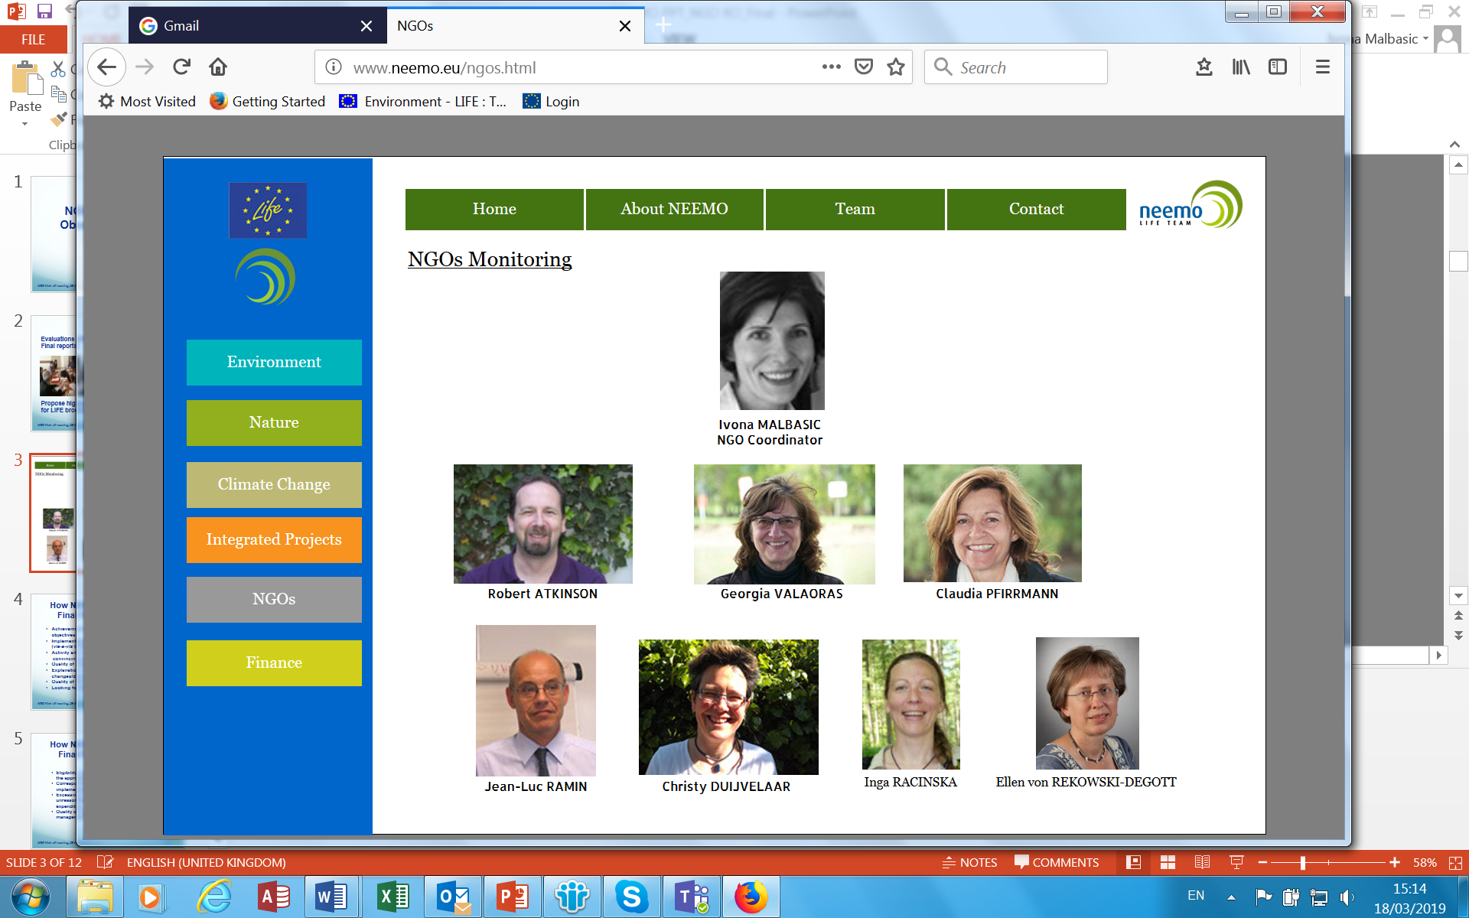
NGO monitoring team

Slide 54
Website & functional mailbox
https://ec.europa.eu/easme/en/section/life/calls-proposals
This presentation and the video recording will be put online there
For any questions please send an email to:
EASME-LIFE-NGO@ec.europa.eu

Slide 55


THANK YOU
FOR YOUR ATTENTION
Astrid Geiger, Head of Sector
Eva Paparatti, Project Adviser
Lorenzina Bruno, Senior Financial Officer
EASME Units B.3 and C.1.7 LIFE and CIP Eco-Innovation
astrid.geiger@ec.europa.eu eva.paparatti@ec.europa.eu lorenzina.bruno@ec.europa.eu
EASME on Twitter
@H2020EE • @H2020SME • @EEN_EU • @EU_ECOINNO

