Slide 1
The EU LIFE fund LIFE priorities linked to nature restoration Key information on how to apply
Sylvia Barova
Project advisor, EU LIFE Programme
CINEA D.2.2

Slide 2
What is the EU LIFE Programme
Nature and Biodiversity
Created in 1992 LIFE is the key European fund for nature conservation
Today LIFE programme as a whole constitutes a 100% contribution to the objectives and targets of the European Green Deal.
The only EU programme dedicated exclusively to the environment, nature conservation and climate action.
For the years 2021-2027, a budget of 5.43 billion €.
Circular Economy
and Quality of Life
Climate Change Mitigation and Adaptation
Clean Energy Transition
Notes:
Projects
• Develop and demonstrate eco-innovative techniques and approaches
• Promote best practices and behavioral changes
• Help to implement and enforce plans and strategies, in compliance with EU legislation.
• Catalyse the large-scale deployment of successful solutions
• Contributes to policies and legislation development, monitoring and enforcement
• Help Member States to improve their implementation
Project beneficiaries are:
Private enterprises
NGOs and civil society organisations
Public authorities

Slide 3
Types of activities funded under LIFE
Grants
Action grants:
Standard action projects (SAPs) (max 10 years)
Strategic Nature Projects (SNAPs) ( max 14 years)
Strategic Integrated Projects (SIPs)
Technical Assistance (TA)
Other actions (OA) – including Coordination and Support Actions (CSAs)
Operating grants for NGOs
Other Forms of Funding
Procurement
Prizes
Blending

Slide 4
LIFE Nature and Biodiversity
Saving endangered EU habitats and species
Identifying and expanding the Natura 2000 network
Boosting awareness of EU nature legislation
Improving knowledge of nature’s value to the economy, society and our well-being
Removing Invasive Alien Species
Reaching out to government, civil society, business
… and much more
More information of what had been achieved so far: Bringing nature back through LIFE

Slide 5
Standard Action Projects (SAPs) under Nature and Biodiversity sub-programme:
There are two topics under 2022 call:
LIFE-2022-SAP-NAT-NATURE – Nature and Biodiversity
SMART outcome-based implementation of EU nature legislation or targets of the EU Biodiversity Strategy for 2030
Topic budget: EUR 132 739 347
Funding rate: 60%-67%-75%
LIFE-2022-SAP-NAT-GOV – Nature Governance NEW from 2021 call
EU nature and biodiversity legislation-related compliance assurance, public participation and access to justice
Topic budget: EUR 3 000 000
Funding rate: 60%
Notes:
Traditional’ LIFE projects aimed to:
develop, demonstrate and promote innovative techniques, methods and approaches;
contribute to the knowledge base and to the application of best practices;
support the development, implementation, monitoring and enforcement of the relevant Union legislation and policy, including by improving governance at all levels, in particular through enhancing capacities of public and private actors and the involvement of civil society;
catalyse the large-scale deployment of successful technical and policy related solutions for implementing the relevant Union legislation and policy by replicating results, integrating related objectives into other policies and into public and private sector practices, mobilising investment and improving access to finance

Slide 6
 |  | EU policy priorities for Nature and Biodiversity
 |  | Priority 1: The extent to which the proposal contributes to the objectives of EU Nature and Biodiversity legislation in particular under the EU Birds and Habitats Directive (incl. Natura 2000) and Regulation 1143/2014 on Invasive Alien Species | Priority 2: The extent to which the proposal contributes to the targets of the EU Biodiversity Strategy for 2030 for a Trans-European Nature Network and the EU Restoration Plan
Two areas of intervention that require specific and measurable (SMART) outcome based objectives | Intervention area 1: "Space for nature": area-based conservation and restoration measures | Any proposal that falls into at least one of the two areas of intervention and at least one of the two policy priorities could be financed through a Standard Action Project under LIFE Nature and Biodiversity
 | Intervention area 2: "Safeguarding our species": measures targeting specific species

Slide 7
Policy priority area 1: EU Nature legislation
Priority is given to proposals for improving the conservation status or trends of species and habitats of EU importance, notably where such projects are implementing objectives and measures as outlined in national or regional Prioritized Action Frameworks ( PAFs). In particular:
“Space for Nature”: projects that focus their actions on the implementation of conservation objectives for existing Natura 2000 sites, notably where such conservation objectives are clearly established, improving the condition of species and habitats for which the sites are designated.
“Protecting our species”: projects that focus their activities on reducing mortality of these species (e.g. poisoning, illegal killing, by-catch), preventing stakeholder conflicts, improving acceptance and promoting co-existence with protected species.
In addition to the above, priority will also be given to certain habitats and species in unfavourable conservation status (including certain species listed in annex IV and V of the Habitats Directive), under the Biodiversity Strategy-related policy priority for “Implementing EU nature restoration targets for species and habitats”

Slide 8
EU co-funding rates for SAPs under LIFE Nature and Biodiversity (➔ indicated in the MAWP):
➔ Up to 75% of total eligible costs for projects that exclusively concern:
priority habitat or species as listed in the relevant annexes of the EU Habitats Directive Directive;
bird species considered as “priority for funding” by the Ornis Committee (EU Birds Directive);
habitat type or species listed in the annexes of the Habitats Directive, the conservation status of which has been assessed as unfavorable-bad and declining (U2-) in the most recent available EU- and national-level biogeographical region assessments;
habitat type or species (other than bird species) the EU-level threat status of which has been assessed as “endangered” or worse in the most up-to-date European species or habitats Red Lists
other habitat or species in territories not covered by the European Red Lists, the threat status of which has been assessed as “endangered” or worse in the most up-to date global IUCN Red Lists.
Applicants will need to argue in their proposal that all actions are clearly tailored towards benefiting habitats or species that qualify for 75% co-funding.
➔ Up to 67% EU co-funding for projects targeting both priority and non-priority habitats and/or species, provided priority species/habitats represent a clear focus of the project.
➔ Up to 60% of total eligible costs for all other projects.

Slide 9
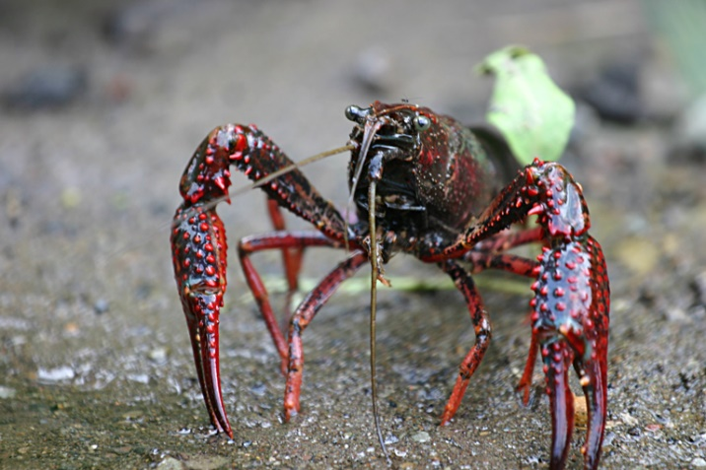
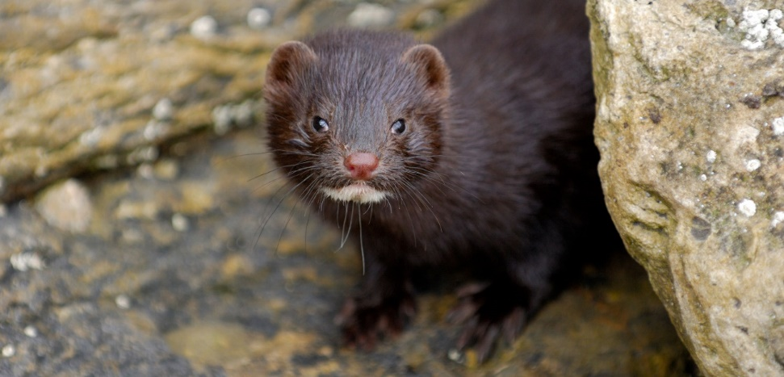
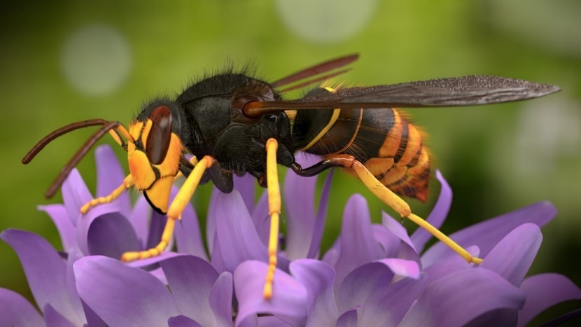
Policy priority area 1: IAS Regulation
Priority is given to proposals addressing:
invasive alien species included on the list of invasive alien species of Union concern pursuant to Article 4(1) of the Regulation (EU) No 1143/2014, and/or invasive alien species of Member State or regional concern pursuant to Articles 12 and 11 of the Regulation respectively; or
other invasive alien species that negatively affect the conservation status or trends of species and habitats of EU importance, other threatened species protected under EU legislation, or listed as threatened species in EU or global red lists (for species groups and/or regions not covered by EU Red lists).

Slide 10
Policy priority area 2: EU Biodiversity Strategy
Establishing a coherent network of protected areas
Implementing EU nature restoration targets for species and habitats
Restoring degraded and carbon-rich ecosystems; prevent and reduce the impact of natural disasters
Improving the health and resilience of managed forests
Reversing the decline of pollinators
Bringing nature back to agricultural land
Greening urban and peri-urban areas
Measuring and integrating the value of nature

Slide 11
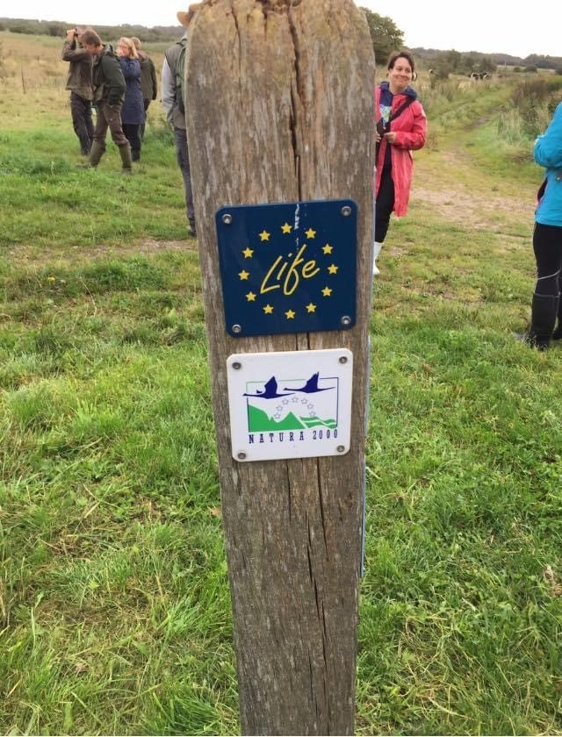
Policy priority area 2: EU Biodiversity Strategy
Establishing a coherent network of protected areas
Proposals focused on increasing the share of EU land or marine area under protection (within the definition of “protected areas” in the relevant EU Guidance under the Biodiversity Strategy).
In this context, priority is also given to the set-up of ecological corridors, such as green and blue infrastructure that reduce land or seascape fragmentation and pressures/ threats, and that directly contribute to the resilience, effective management, and connectivity of protected areas.
Proposals focused on increasing the share of EU land or marine area under strict protection (within the definition of “strictly protected areas” in the relevant EU Guidance under the Biodiversity Strategy).

Slide 12
Policy priority area 2: EU Biodiversity Strategy
Implementing EU nature restoration targets for species and habitats
According to the Biodiversity Strategy for 2030, “The Commission will request and support Member States to raise the level of implementation of existing legislation within clear deadlines. It will in particular request Member States to ensure no deterioration in conservation trends and status of all protected habitats and species by 2030. In addition, Member States will have to ensure that at least 30% of species and habitats not currently in favourable status are in that category or show a strong positive trend.”
Therefore, once Member States have submitted their commitments or pledges in relation to this target, projects that are focused on implementing any such national commitments or pledges, including through trans-national or trans-boundary approaches are given priority for LIFE support.

Slide 13
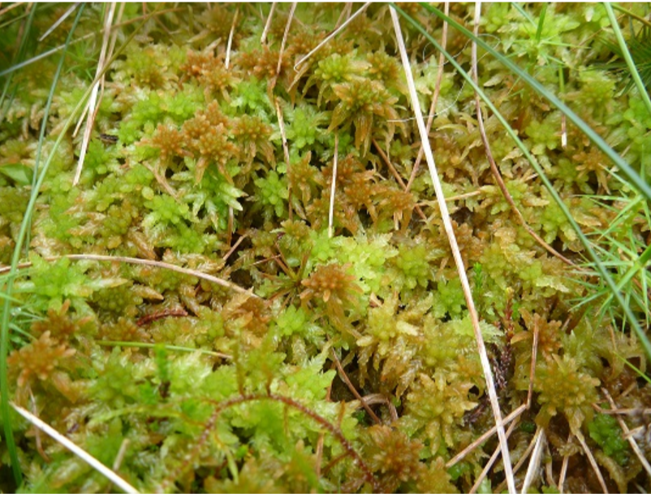
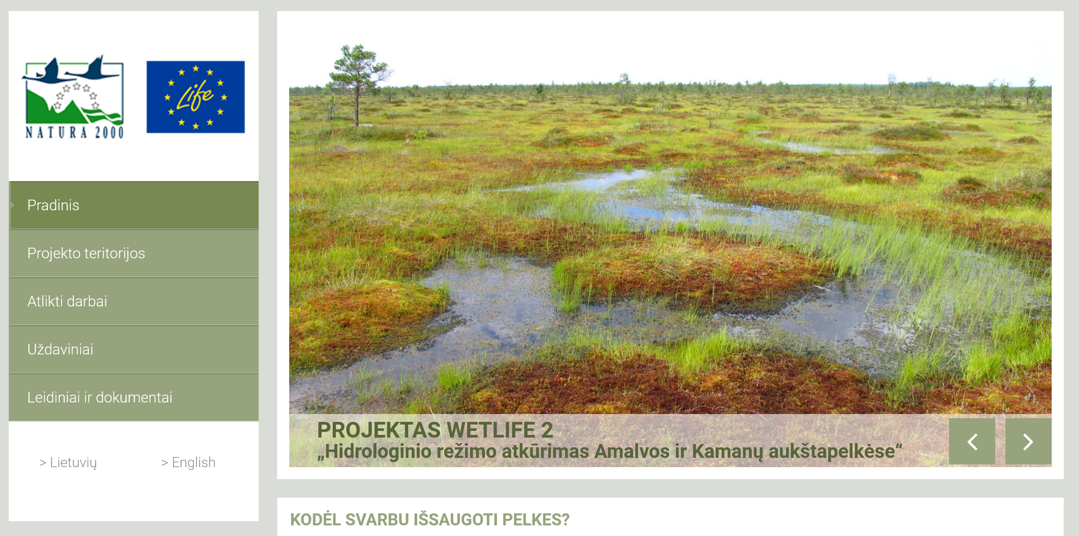
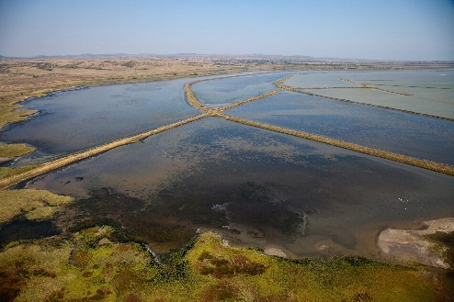
Policy priority area 2: EU Biodiversity Strategy
Restoring degraded and carbon-rich ecosystems; prevent and reduce the impact of natural disasters
Project proposals with a focus on restoring degraded and/or carbon-rich ecosystems are given priority for LIFE support. For forests, this includes proposals aimed at forest restoration to primary forest structure, composition and functioning.
Proposals with a focus on deploying Green and Blue Infrastructure in line with the EU guidance as well as other nature-based solutions and restoration actions that would help prevent or reduce the impact of natural disasters, including river restoration projects, are given priority for LIFE support.

Slide 14
Policy priority area 2: EU Biodiversity Strategy
Improving the health and resilience of managed forests
Project proposals for demonstrating “closer to nature forestry” practices, meaning practices that try to achieve management objectives with minimum necessary human intervention and combine conservation with productivity objectives, are given priority for LIFE support; these are also defined as continuous cover forestry, reduced impact logging, retention forestry, mimicking natural disturbances. EU guidelines developed pursuant to the Biodiversity Strategy for 2030, once available, will be the reference for closer-to-nature forestry.

Slide 15
Policy priority areas: EU Biodiversity Strategy
Reversing the decline of pollinators
Project proposals for the restoration of habitats where pollination by animals plays an important role, need to outline how the improvement of their associated pollinator communities is taken into account by the project activities.
Furthermore, even where proposals do not directly address pollinators, applicants are invited to measure the project’s success against, among others, the improvement of pollinator communities. Indicators for improvement could be based, for example, on measuring changes in the diversity or abundance of Apoidea, Syrphidae, Lepidoptera or any other relevant taxonomic groups.
Project proposals that have a positive impact on pollinator communities based on at least one of the above requirements are given priority for LIFE support.

Slide 16
Policy priority areas: EU Biodiversity Strategy
Bringing nature back to agricultural land
Project proposals that demonstrate innovative approaches to restoring high-biodiversity landscape features in agroecosystems that also bring benefits for farmers and communities (such as preventing soil erosion and depletion, filtering air and water, and supporting climate adaptation) and communicate such approaches, are given priority for LIFE support.
(LIFE funded actions must complement those to be financed under the CAP strategic plans, hence a focus on the demonstration of innovative approaches)

Slide 17
Policy priority areas: EU Biodiversity Strategy
Greening urban and peri-urban areas
Project proposals for the restoration of healthy and biodiverse ecosystems in urban green areas, as well as for the development of green infrastructure and nature-based solutions that bring about significant benefits for biodiversity while providing solutions to urban challenges and increasing access to nature, are given priority for LIFE support, especially if they implement biodiversity objectives and measures in urban greening plans.
Measuring and integrating the value of nature
Project proposals that lead to an effective accounting, measurement and integration of biodiversity values into public and private decision-making applying the guidance, methods, criteria and standards developed by the Commission are given priority for LIFE support.

Slide 18
EU nature and biodiversity legislation-related compliance assurance and access to justice
establishing new or, where in place, enhancing existing cross-border, national or regional networks of compliance assurance practitioners or experts; and/or establishing or, where in place, improving professional qualifications and training to improve compliance with binding EU legal instruments on nature and biodiversity, through promoting, checking and enforcing compliance, or
applying the polluter pays principle, using a mix of administrative law, criminal law and environmental liability; and/or
by developing and implementing strategies and policies and/or developing and using innovative tools and actions to promote, monitor and enforce compliance with binding EU instruments on nature and biodiversity, or ensure application of the polluter pays principles through environmental liability; and/or
improving relevant information systems operated by public authorities; and/or
engaging with citizens and others to promote and monitor compliance, and ensure application of environmental liability in relation to EU nature and biodiversity legislation.

Slide 19
To support the achievement of Union nature and biodiversity objectives by implementing coherent programs of action in the Member States in order to mainstream these objectives and priorities into other policies and financing instruments, including through coordinated implementation of the Prioritized Action Frameworks (PAF) established pursuant to Directive 92/43/EEC. The SNAPs will target the following strategies and plans: • Prioritized Action Frameworks (PAFs) under the EU Habitats Directive and; • Other plans or strategies that implement EU nature and/or biodiversity policy or legislation.
Strategic Nature Projects (SNAPs):

Slide 20
SNAPs: key issues to be considered
Depending on the needs of the given Members States (or regions) as identified in their PAFs or in other nature and biodiversity plans (which must be available by the time a full SNAP proposal is submitted), measures in a SNAP shall include the following:
institutional support and capacity building actions;
mobilization and coordination of additional finance, in particular from other EU funding instruments and programs.
In addition, SNAPs may also include concrete conservation measures, in particular if they cannot be supported through other EU funding programs.
The authorities competent for nature and biodiversity and responsible for PAF implementation, shall participate in the SNAP proposals, either as applicant or, in duly justified cases, as associated beneficiaries.

Slide 21
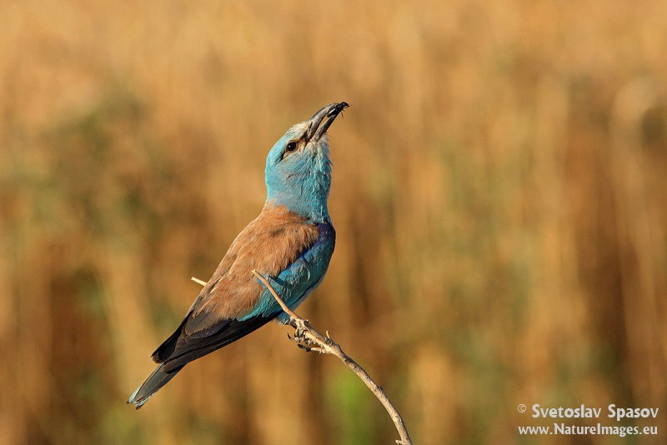
Thank you!
Find out more at: cinea.ec.europa/life_en
@LIFEprogramme
LIFE programme
LIFE programme
LIFE programme
lifeprogramme

