Slide 1
PREX

Slide 2
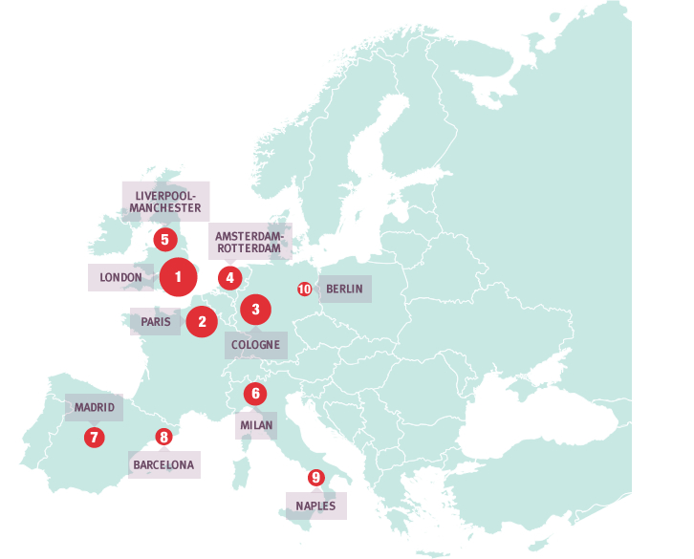
The AMB (Metropolitan Area of Barcelona) represents one of the largest metropolitan areas in Europe
and occupies the eighth position in terms of population.
(Source: Eurostat: metropolitan regions. Eurostat, 2012)

Slide 3

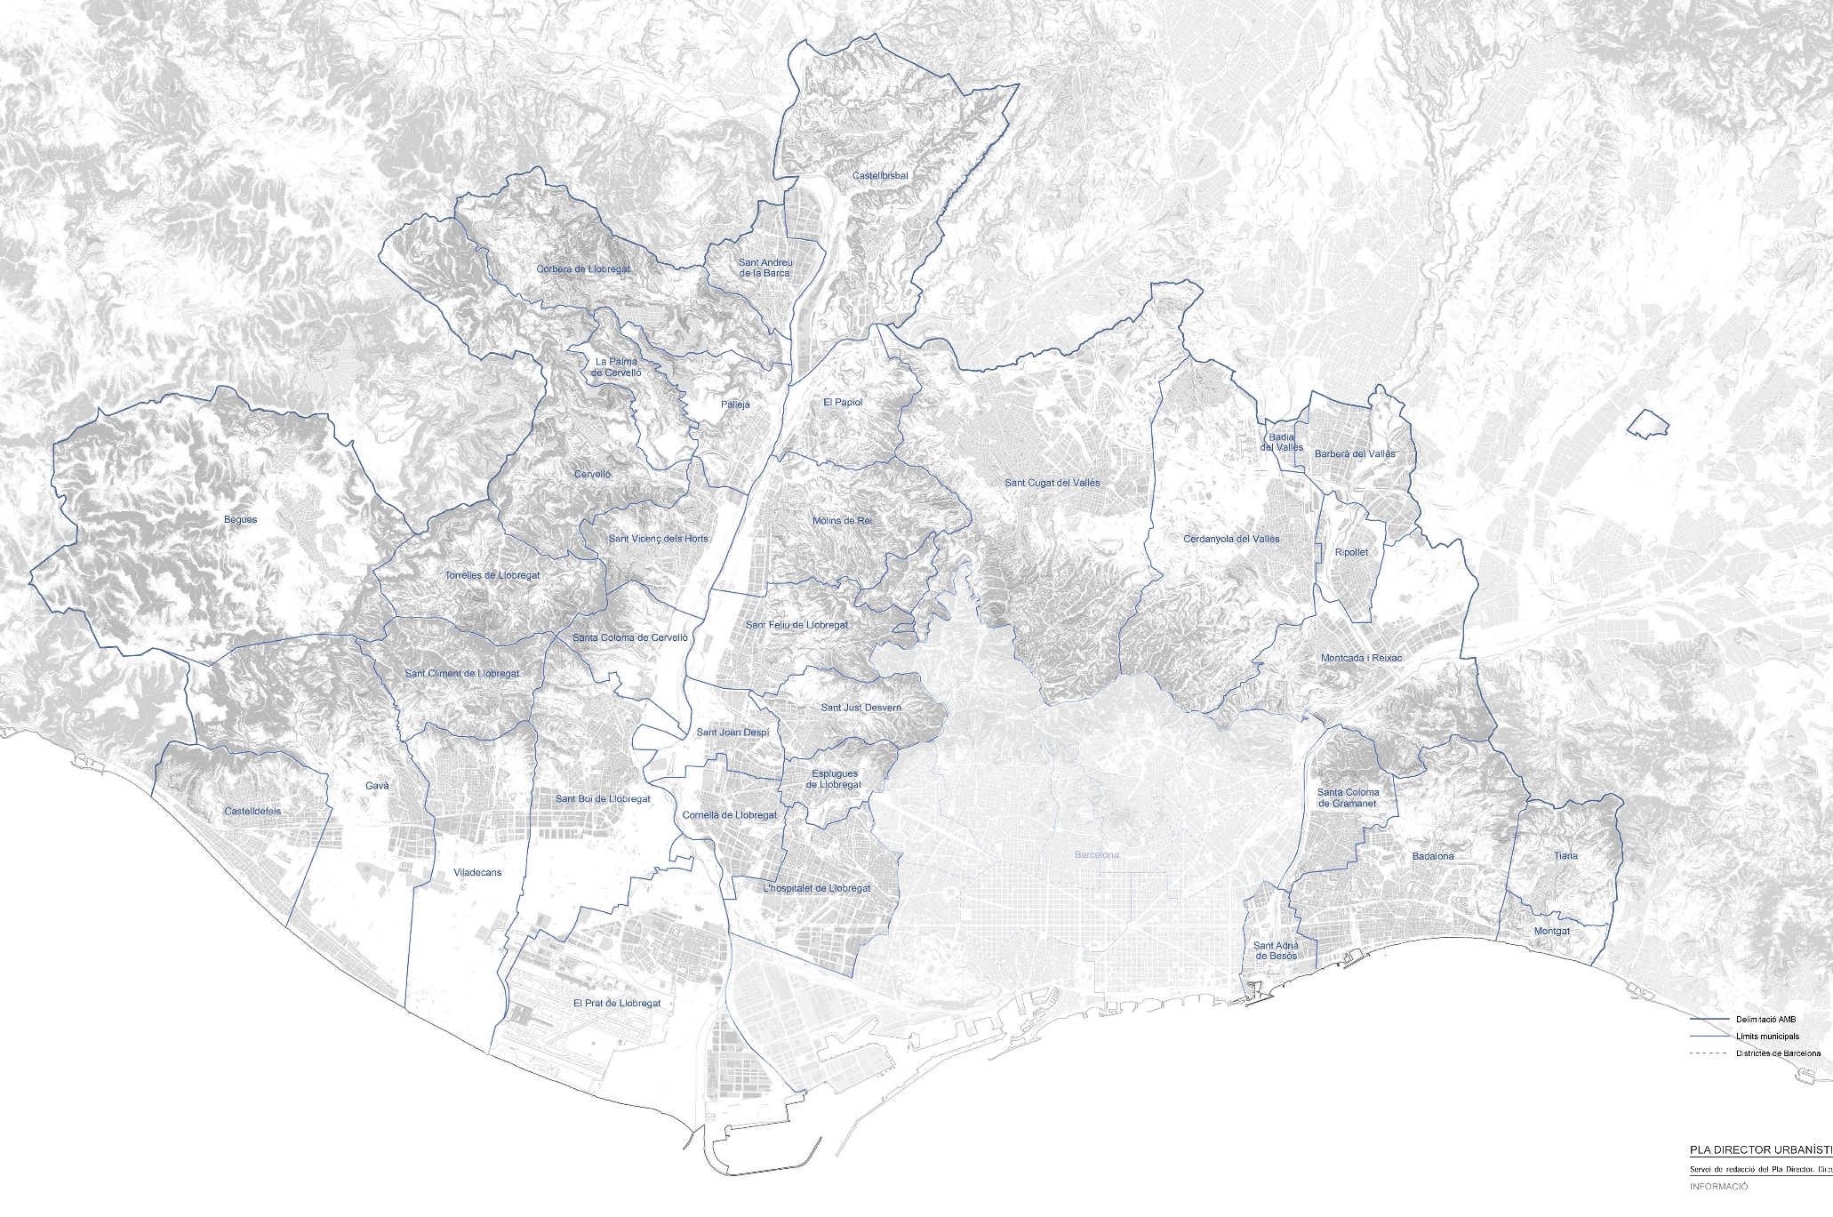
AMB 36 MUNICIPALITIES
CMH 35 MUNICIPALITIES + REGIONAL GOVERNMENT
01- ÀMBIT COMPETENCIAL

Slide 4
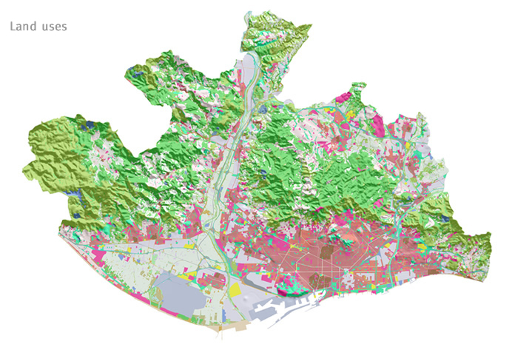
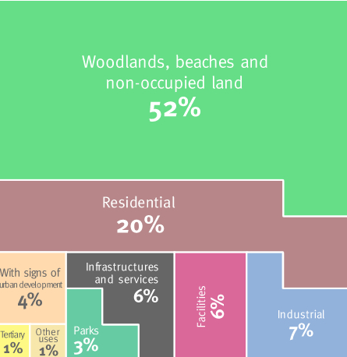

Slide 5
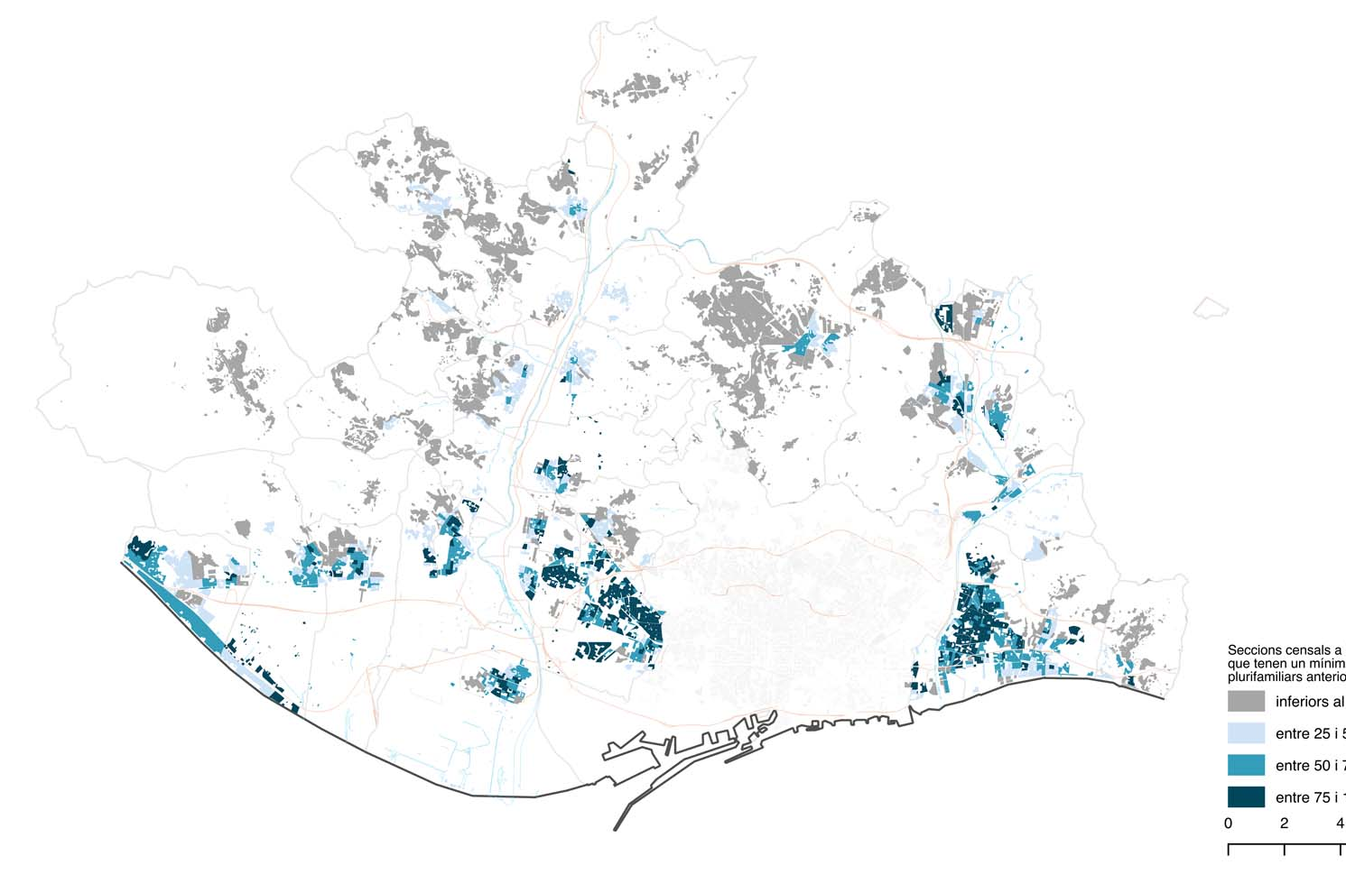
PERCENTAGE OF HOUSES IN MULTIFAMILY BUILDINGS BUILT BEFORE 1981
BY CENSUS SECTION
01- CARACTERÍSTIQUES
<25%
25% - 50%
50% - 75%
>75%

Slide 6
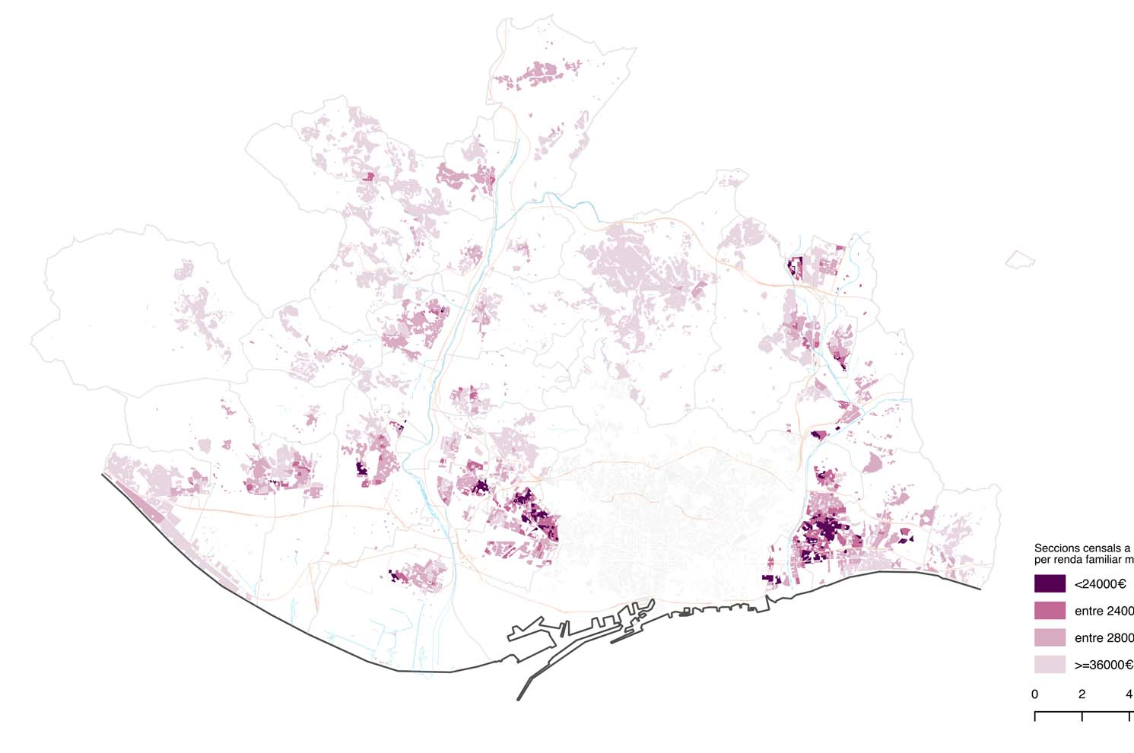
NET FAMILY INCOME BY CENSUS SECTION
02- RENDA
<24.000 €
<28.000 €
<36.000 €
>36.000 €

Slide 7
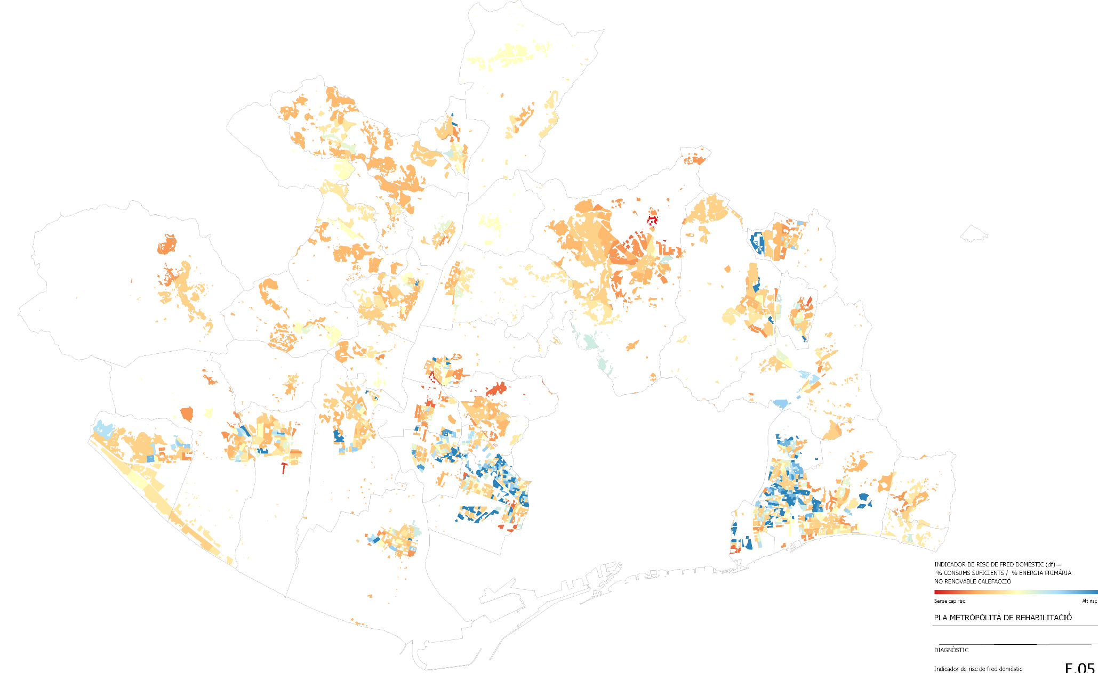
DOMESTIC COLD RISK INDICATOR BY CENSUS SECTION
03- CONSUMS

Slide 8
POTENTIAL NEED FOR RENOVATION

Slide 9
HOUSES BUILT BEFORE 1981 WITH A RENOVATION GRANT

Slide 10
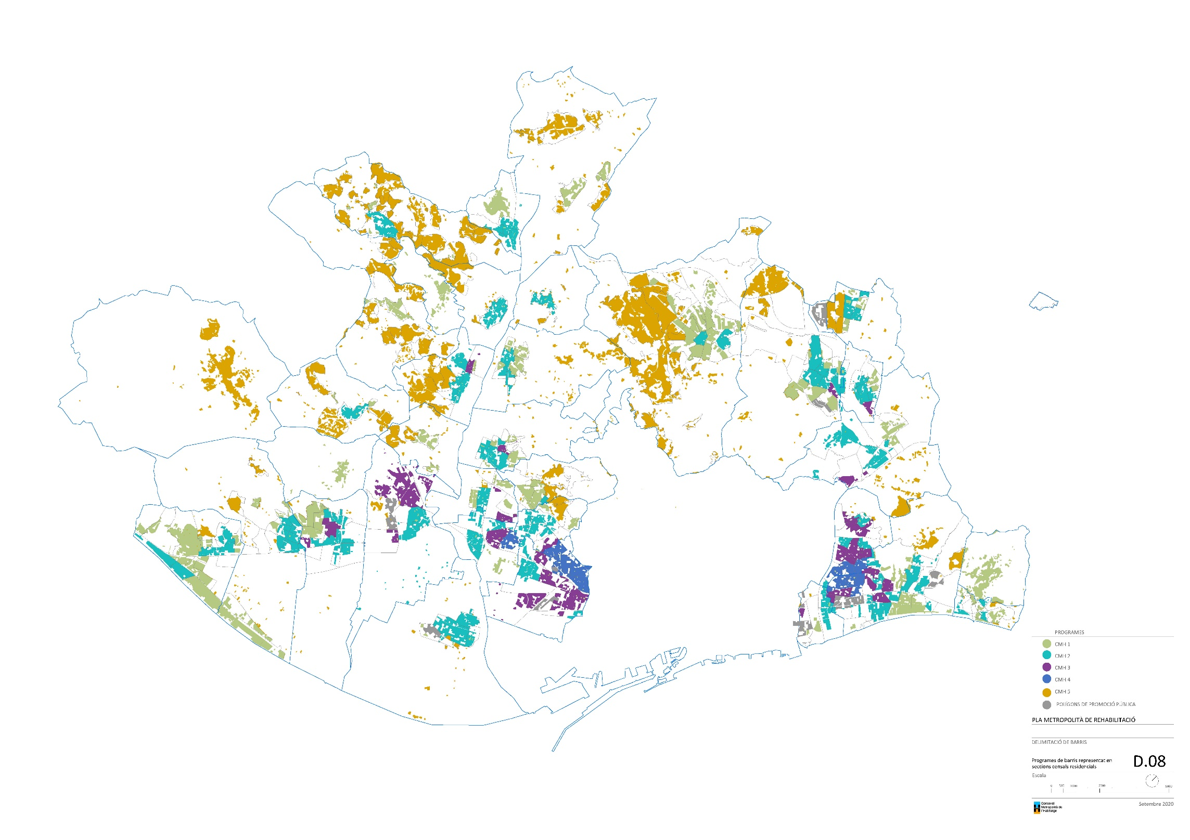
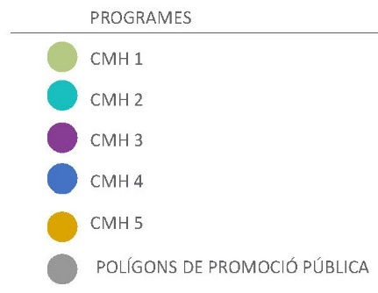
2- PROGRAMES

Slide 11
CMH – 1
> 36.000€
SUPPORT WEBSITE
TECHNICAL PROJECT GRANT (100%)
PUBLIC FINANCING (ACH-ICF)
35% GRANT (PREE)
2- PROGRAMES

Slide 12
CMH – 2
28.000€ - 36.000€
CMH1 + INFORMATION CAMPAIGN
2- PROGRAMES

Slide 13
CMH – 3
24.000€ - 28.000€
CMH2 + COMMUNITY MEDIATORS
2- PROGRAMES

Slide 14
CMH - 4
< 24.000€
PRIORITY AREAS FOR BUILDING RENOVATION (ACR)
2- PROGRAMES

Slide 15
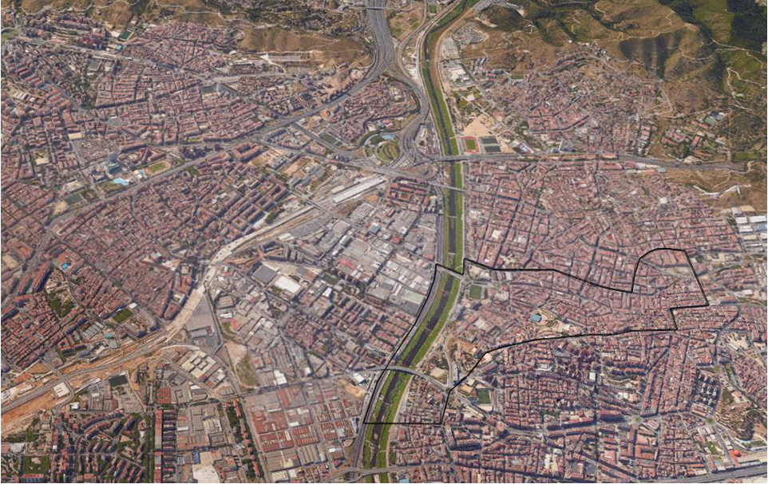

Slide 16
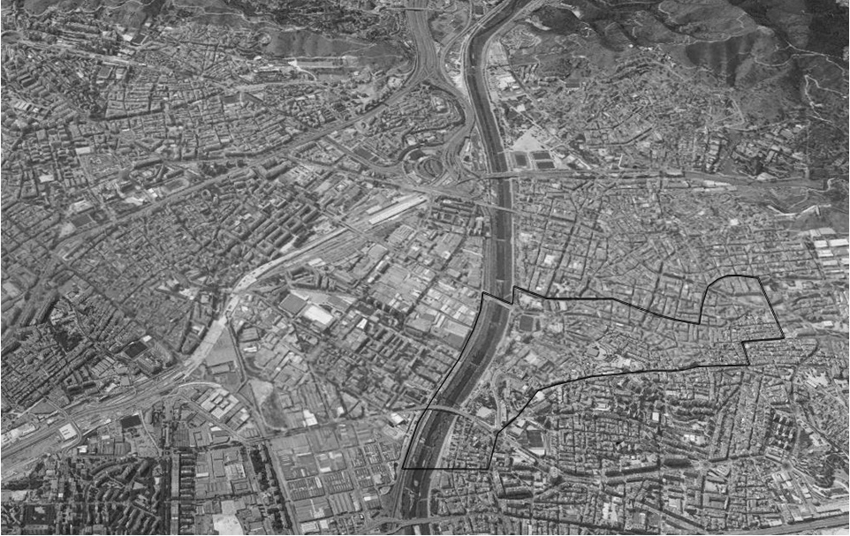
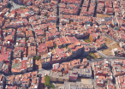

Slide 17


Slide 18
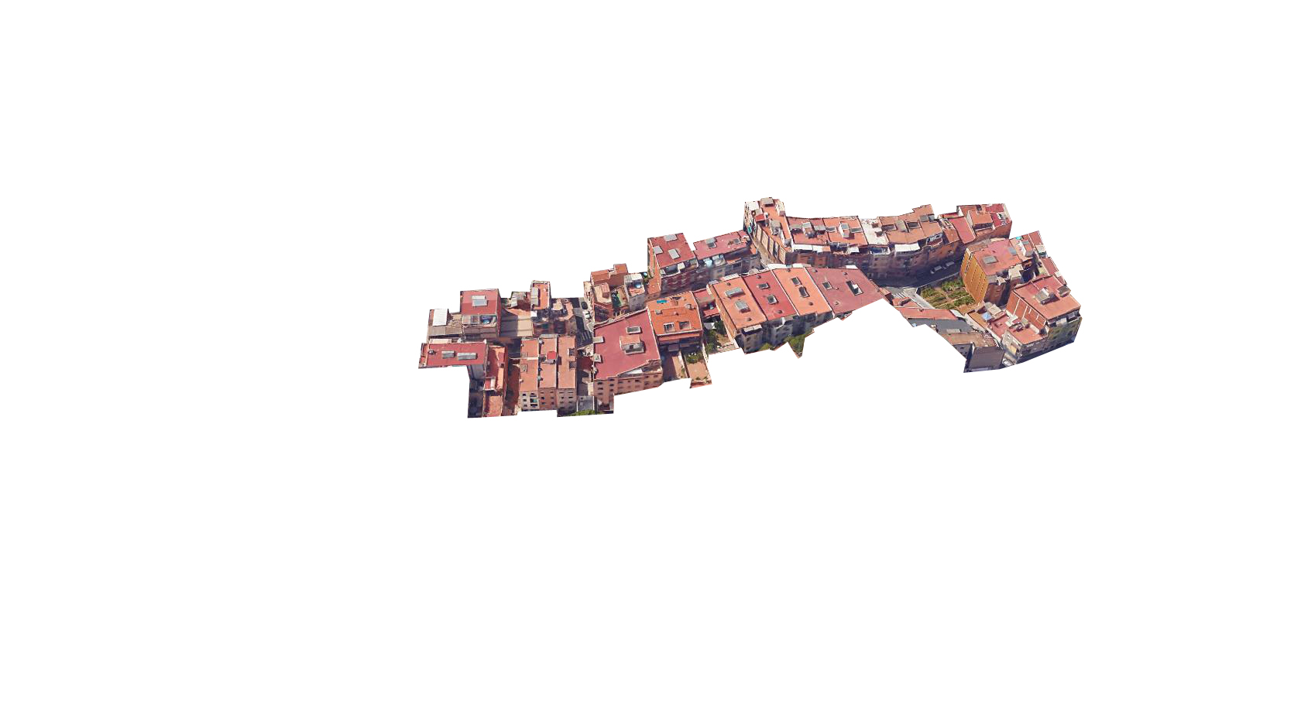
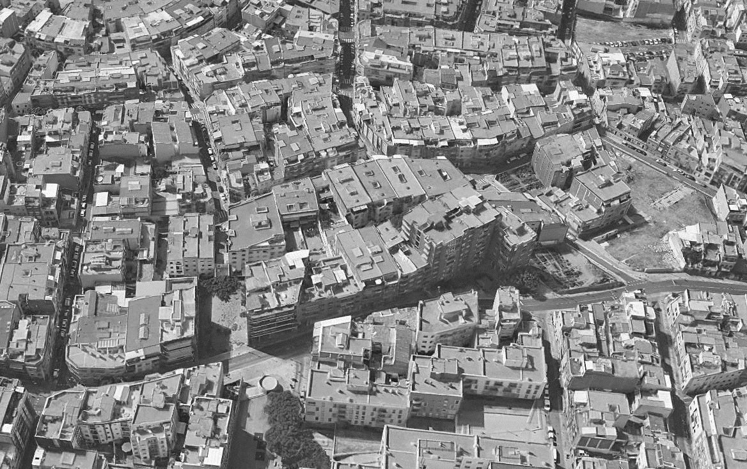

Slide 19
32 RESIDENTIAL BUILDINGS
386 FLATS
649 OWNERS
PERIOD OF CONSTRUCTION 1968-74
OWNERSHIP
RESIDENT OWNERS 44.5%
NON RESIDENT OWNERS 33.6%
BANKS, ETC 21.9%
PROJECTE
RESIDENT OWNERS
SPANISH 83%
OTHERS 17%
TENANTS
SPANISH 29%
OTHERS 71%

Slide 20
PRIORITY AREAS FOR BUILDING RENOVATION
RENOVATION OF PRIVATE BUILDINGS IS IN THE PUBLIC INTEREST
PUBLIC LEADERSHIP
PRIVATE OWNERSHIP
SO, PUBLIC-PRIVATE COOPERATION
TOWN PLANNING APPROACH
public tendering procedure for the TECHNICAL PROJECTS AND THE construction works
PUBLIC FINANCING
GRANTS
AGREEMENT BETWEEN CONDOMINIUM AND LOCAL AUTHORITY
EACH OWNER CHOOSES BETWEEN SEVERAL PAYMENT OPTIONS

Slide 21
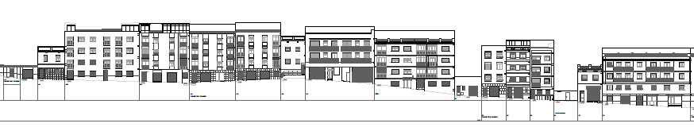
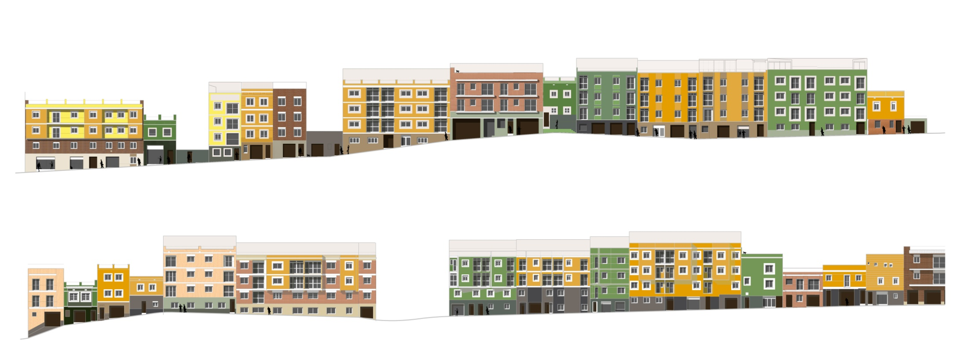
ARCHITECTURAL COMPETITION
PROJECTE

Slide 22
PROMOTING ENERGY RENOVATION
RESULTATS

Slide 23
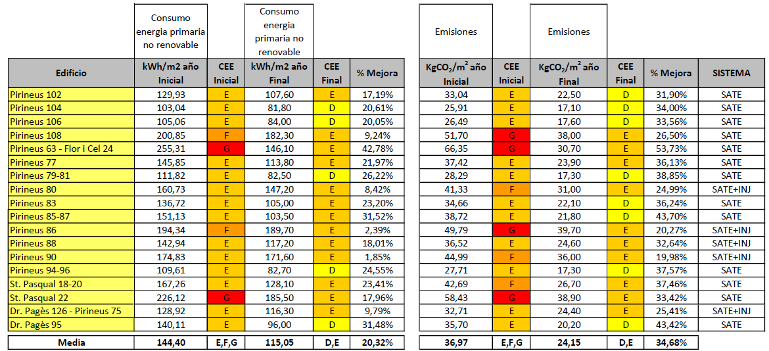
PROMOTING ENERGY RENOVATION
RESULTATS

Slide 24
FEES PER PROPERTY
RESULTATS

Slide 25
AVERAGE INVESTMENT PER HOUSE: IN HOUSES WITH NET INCOME <24,000 €
RESULTATS

Slide 26
PAYMENT OPTIONS
RESULTATS

Slide 27
EXPECTED DEFAULT
RESULTATS

Slide 28
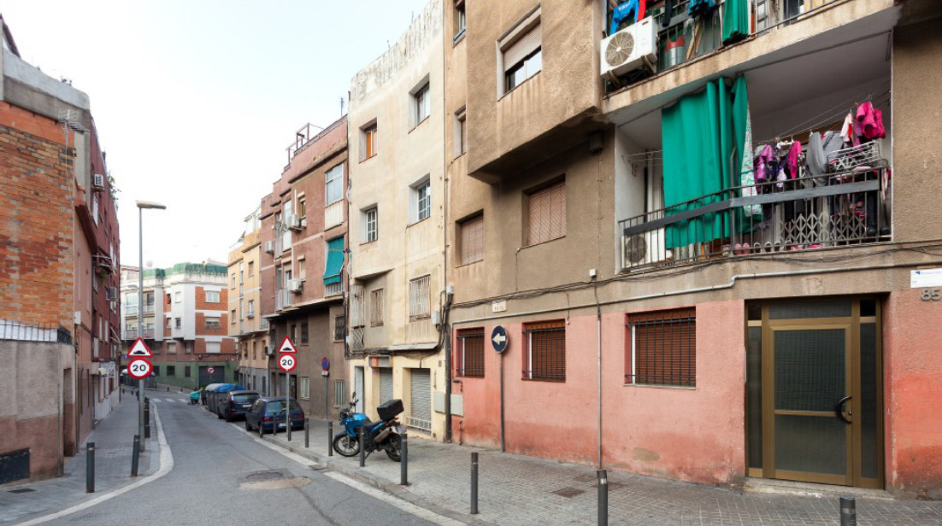

Slide 29
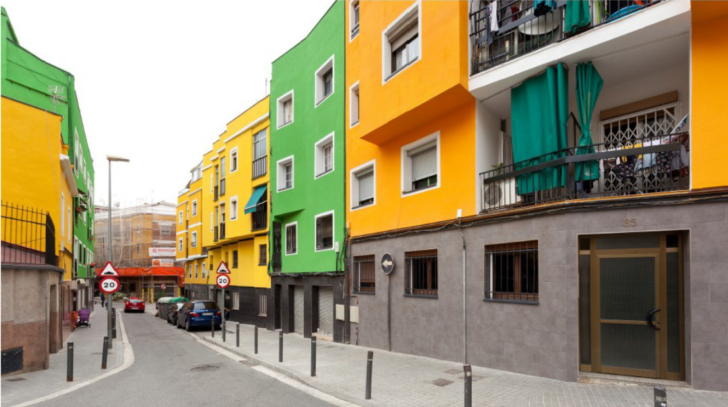

Slide 30
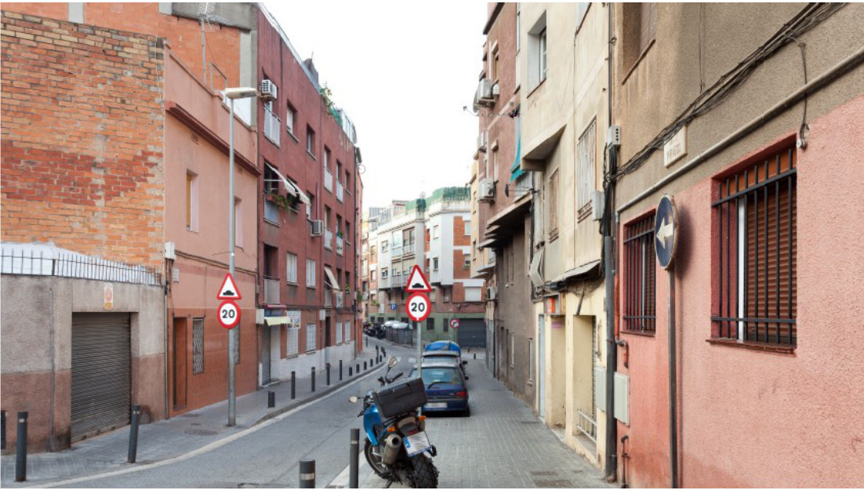

Slide 31
