Slide 1
^{GRASSLAND-HU LIFE IP} ^{THE SECRETS OF THE GRASSLANDS}
Viktória Laukó-Doró communication expert
Herman Ottó Institute Nonprofit Ltd.
^{09/03/2021}
A LIFE IP GRASSLAND-HU (LIFE17 IPE/HU/000018) project implemented with the support of the European Union's LIFE Program.
Notes:
I have lot of other projects dealing with environmental issues. One another here in HOI, and more other organizations.
I'm going to present you the progresson of the E actions.

Slide 2
GRASSLAND-HU LIFE IP
Long term conservation of Pannonian grasslands and related habitats through the implementation of Prioritized Action Framework (PAF) strategic measures
Project duration: 01/01/2019 – 31/12/2026
Coordinating Beneficiary: Herman Ottó Institute Nonprofit Ltd.
Associated Beneficiaries: 14 project partner (9 National Park Directorate)
The aim of the project is to improve the conservation status and long-term conservation of grassland habitats and associated species.
Notes:
Communicating the importance of grassland habitats and species to general public is essential to gain public support and subsequently the support of decision-makers for grassland conservation.
An external website designer worked with me and my colleagues to design the content and the visual appearance.

Slide 3
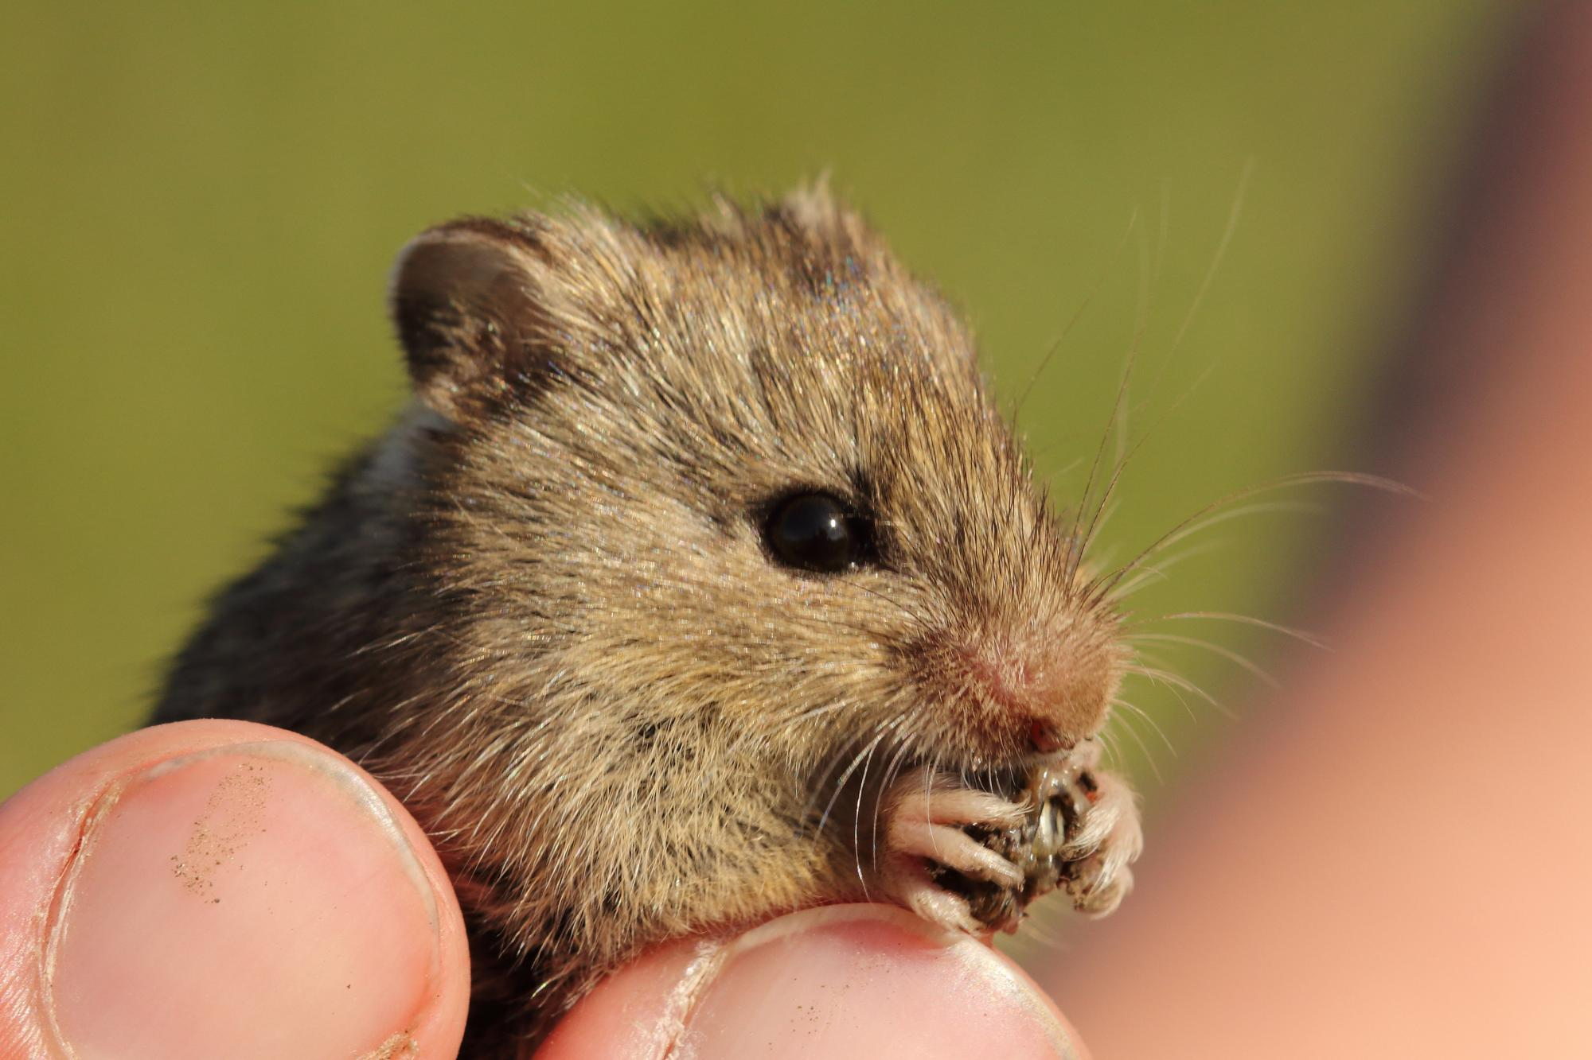
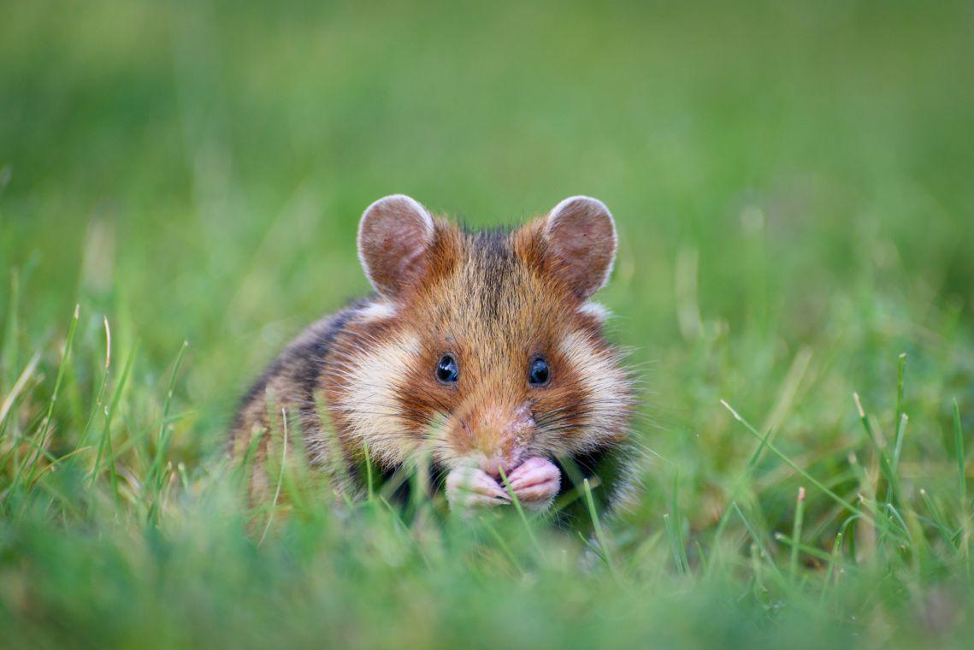
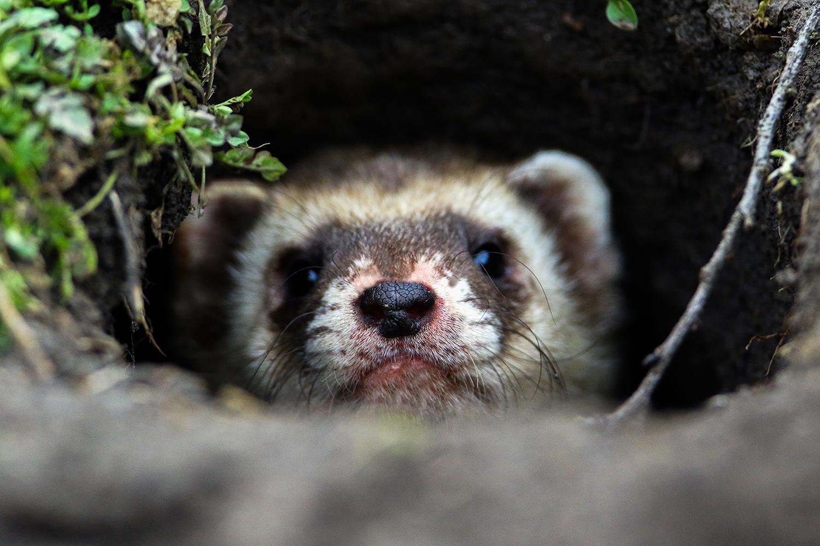
Communication tasks...
... when the target group is the population
Sensitization of the population
Get interest in the topic
Dissemination of knowledge, dispelling misconceptions
Expanding knowledge (sharing project results)
Creating commitment and emotional attachment to grassland habitats and related animal and plant species: "what I know, what I love, I want to protect"
Notes:
We delayed.
Within the framework of the Grassland-HU LIFE integrated project, Herman Ottó Institute Nonprofit Kft. and its project partners announce a photo contest, the aim of which is to present and promote the values of grassland habitats, typical plant and animal species.
The first theme of the photo contest, which aims to create a tradition, is to present the PLANT SPECIES of grassland habitats.
We have now 15 contestant and more than 50 photos.

Slide 4
Photo competition: The secrets of the grasslands I.
It was first announced in the summer of 2020 with the intent of creating a tradition.
The topic of the first year was the presentation of the plant species of grassland habitats
Both amateur and professional photographers could apply
2 months application period
No application fee
Applicants were required to indicate the location where the image was taken and the species shown in the image
- Jury: professionals and celebrities (photographers, bloggers, actresses)
The audience award was voted on by Facebook users
Communication channels:
GRASSLAND-HU webpage,
GRASSLAND-HU Facebook page (paid advertising),
Communication channels of the partners (Fb pages, webpages),
Press releases (opening, closing)
Notes:
We delayed.
Within the framework of the Grassland-HU LIFE integrated project, Herman Ottó Institute Nonprofit Kft. and its project partners announce a photo contest, the aim of which is to present and promote the values of grassland habitats, typical plant and animal species.
The first theme of the photo contest, which aims to create a tradition, is to present the PLANT SPECIES of grassland habitats.
We have now 15 contestant and more than 50 photos.

Slide 5
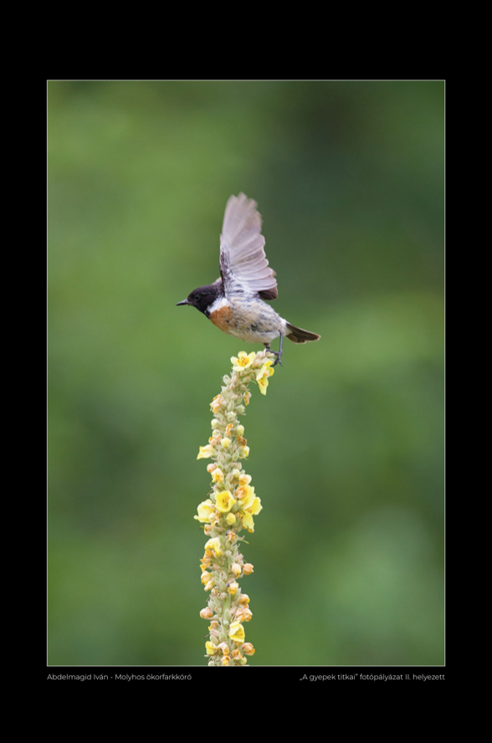
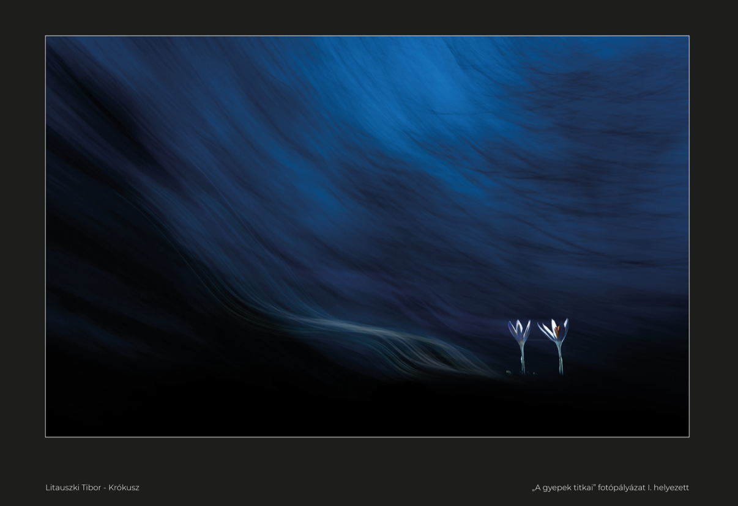
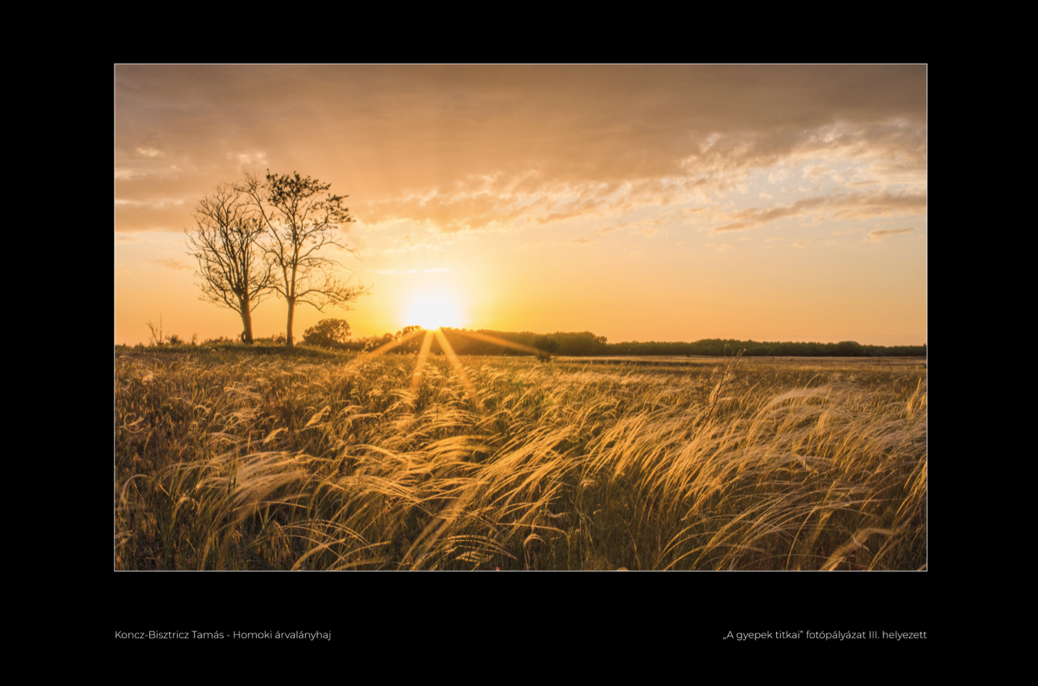
Photo competition: The secrets of the grasslands I.
Results:
149 applicants - 605 pictures (one applicant could send maximum 5 pictures)
Award ceremony and exhibition opening (press public)
Traveling exhibition of the best 30 pictures. The locations are provided by the
partners (national parks)
Media appearances: TV, radio, online 45 pcs
Traffic to the website and Fb site has increased significantly
Notes:
We delayed.
Within the framework of the Grassland-HU LIFE integrated project, Herman Ottó Institute Nonprofit Kft. and its project partners announce a photo contest, the aim of which is to present and promote the values of grassland habitats, typical plant and animal species.
The first theme of the photo contest, which aims to create a tradition, is to present the PLANT SPECIES of grassland habitats.
We have now 15 contestant and more than 50 photos.

Slide 6
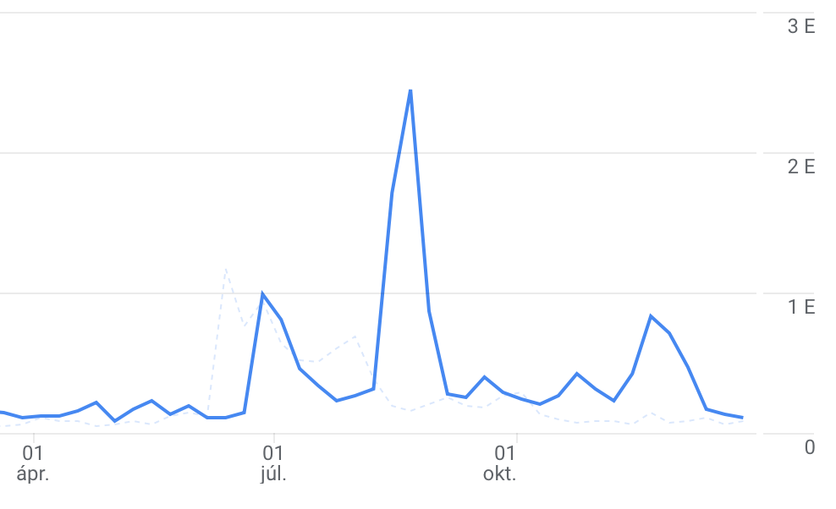
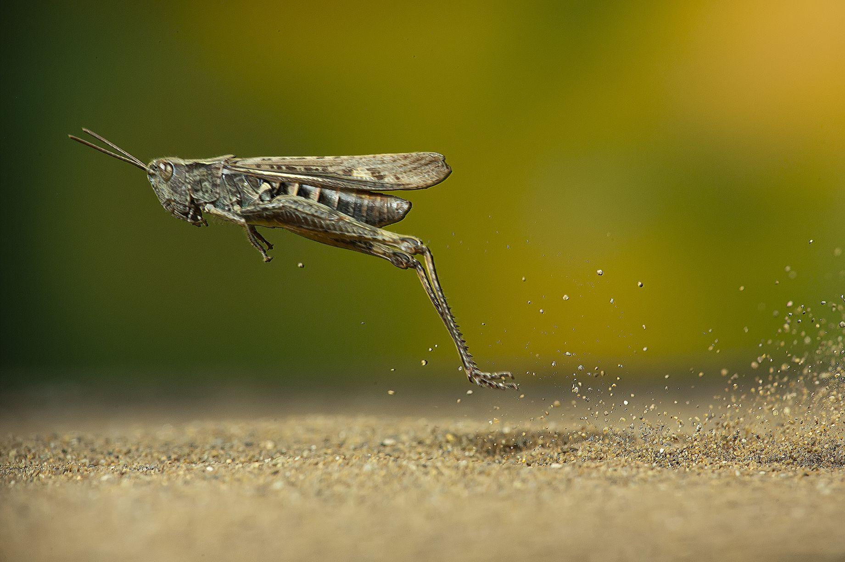
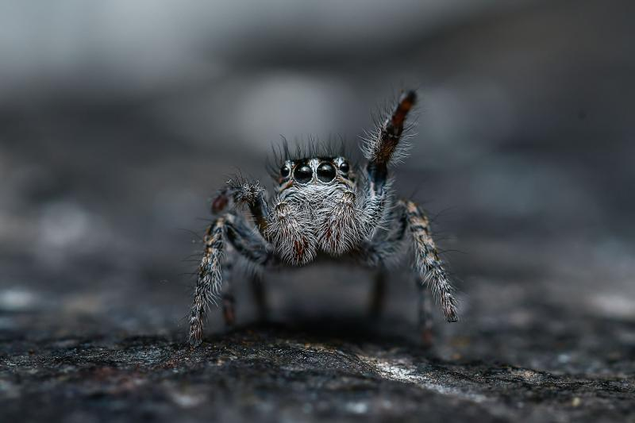
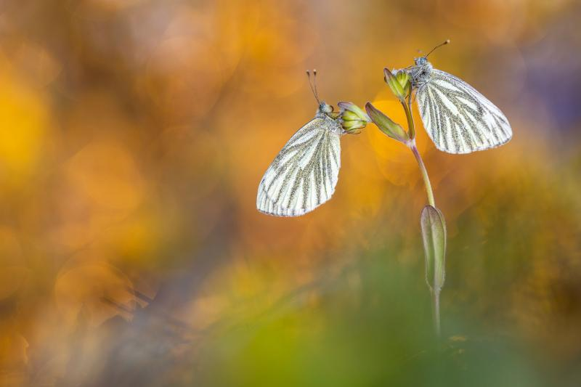
Photo competition: The secrets of the grasslands II.
The topic of the second year was the invertebrate species of grassland
habitats.
The methodology was the same.
The number of competitors has more than doubled!
Source: Google Analytics, 2021
323 applicants - 1165 pictures
The prestige of the photo competition has increased, and so has the popularity of GRASSLAND-HU LIFE IP
Notes:
We delayed.
Within the framework of the Grassland-HU LIFE integrated project, Herman Ottó Institute Nonprofit Kft. and its project partners announce a photo contest, the aim of which is to present and promote the values of grassland habitats, typical plant and animal species.
The first theme of the photo contest, which aims to create a tradition, is to present the PLANT SPECIES of grassland habitats.
We have now 15 contestant and more than 50 photos.

Slide 7
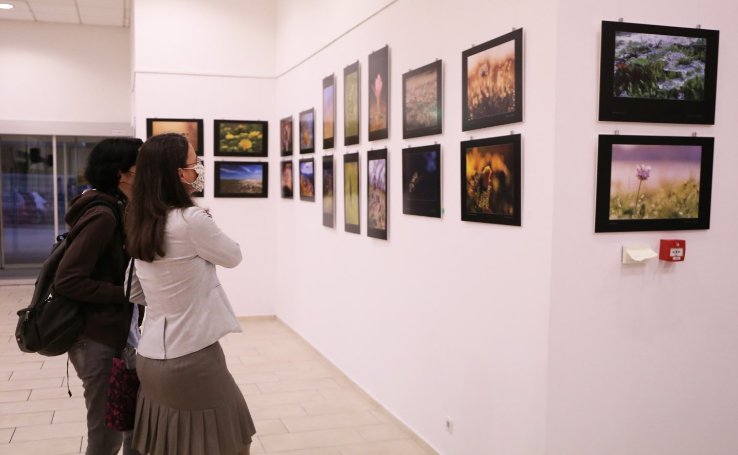
To be continue...
In 2022, we will be launching the photo competition for the third time.
This time the topic will be the bird species of grasslands.
Our goal is to deliver the pictures and their messages to more people,
so:
We are planning an outdoor exhibition in Budapest.
We will release a photo album of the best pictures - with descriptions of the species and grasslands in the pictures.
The species of the TOP 30 pictures will be presented in a Facebook post series.
+ We would like to organize an exhibition in Brussels from the pictures of the first 3 years, celebrating the 30th anniversary of the launch of the LIFE programs.
Notes:
We delayed.
Within the framework of the Grassland-HU LIFE integrated project, Herman Ottó Institute Nonprofit Kft. and its project partners announce a photo contest, the aim of which is to present and promote the values of grassland habitats, typical plant and animal species.
The first theme of the photo contest, which aims to create a tradition, is to present the PLANT SPECIES of grassland habitats.
We have now 15 contestant and more than 50 photos.

Slide 8
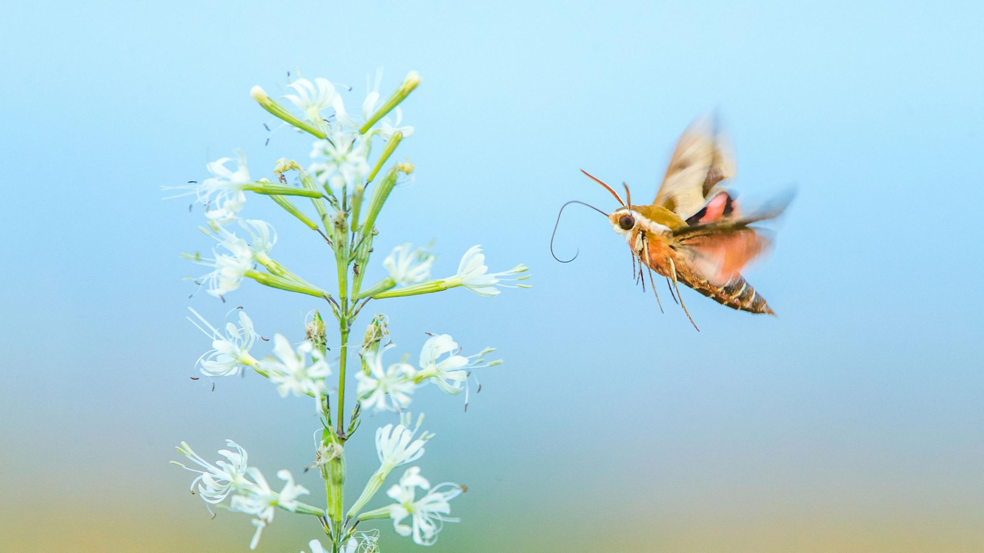
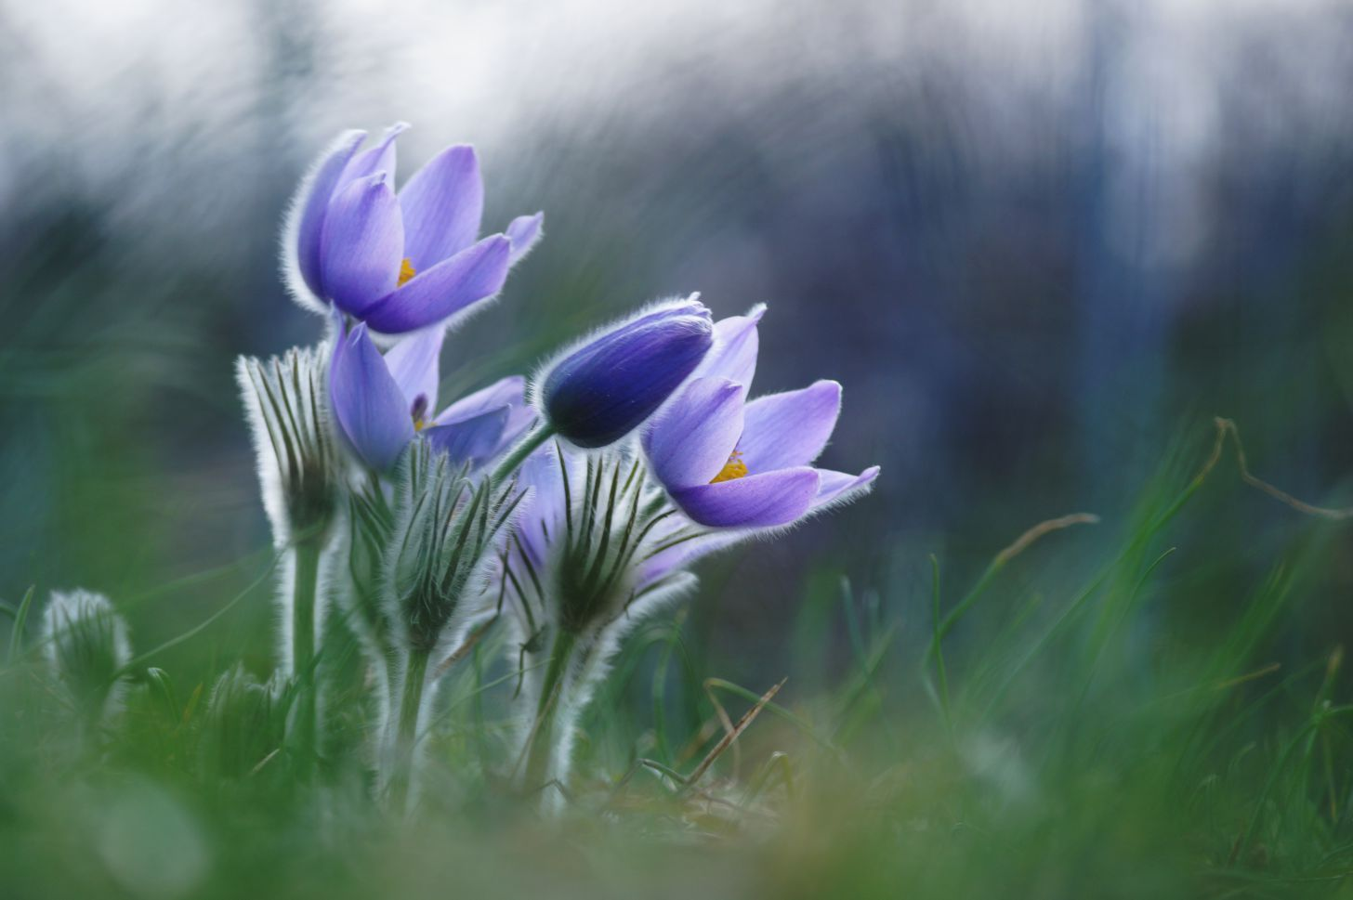
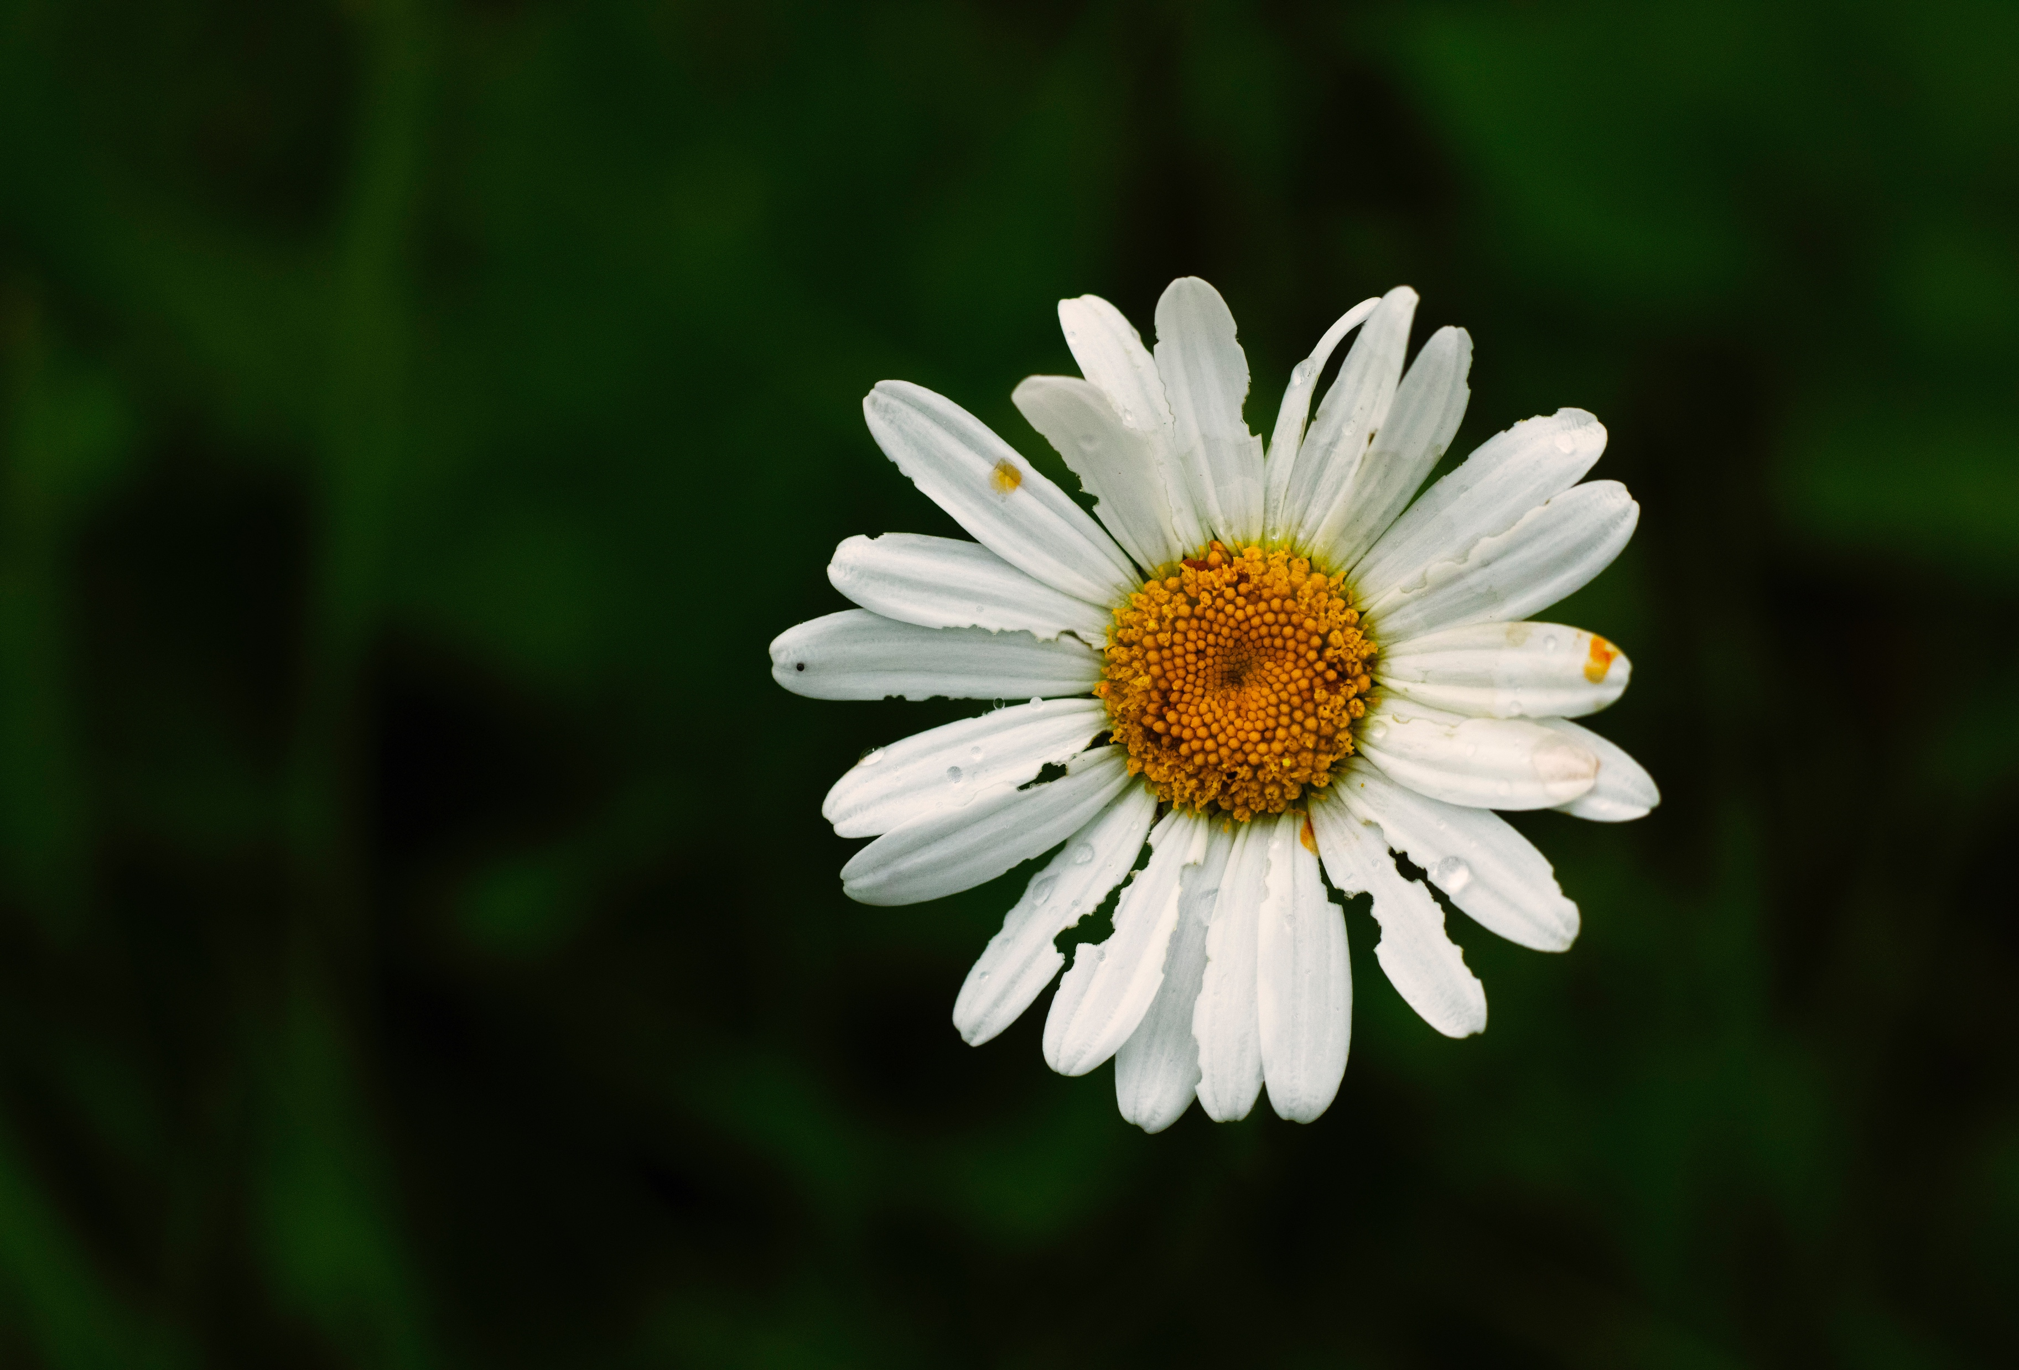
Thank you for your attention!
Contact:
Viktória Laukó-Doró
doro.viktoria@hoi.hu
06 30 343 5394
Notes:
If you have any question don't hesitate to ask!

