Slide 1
Cooperation Mechanism and requirements on the cost benefit analysis
Vasil STOYNOV, Unit C.1 Renewables and Energy System Integration Policy, DG Energy
Virtual Info Day
26 January 2023

Slide 2
What projects are eligible for financing ? (Art. 3 of Delegated Regulation)
Individual project
Physical cross-border with impact
e.g. dispatchable power in country A reducing grid congestion in country B
Multiple projects
Not necessarily physical cross-border impact
e.g. joint support scheme (usually in connection with statistical transfer)
Individual project
No physical cross-border impact
e.g. two distant countries jointly financing a wind offshore park

Slide 3
Eligible technologies, components and investments
Project concerns energy generation technologies based on any of the renewable energy sources listed in Directive (EU) 2018/2001 (art.2).
Any additional components (apart from RES generation) form an integral part of the project, enable the integration of and are ancillary to the RES generation.
(list of additional components: art 3 Commission Delegated Regulation (EU) 2022/342)
Notes:
‘energy from renewable sources’ or ‘renewable energy’ means energy from renewable non-fossil sources, namely wind, solar (solar thermal and solar photovoltaic) and geothermal energy, ambient energy, tide, wave and other ocean energy, hydropower, biomass, landfill gas, sewage treatment plant gas, and biogas;
Additional components: DA art. 3: Storage facilities; system and component integrating information and communication technologies; connection to the distribution or the transmission grid; conversion to renewable liquid and gaseous fuels of non-biological origin; Any other technologies, components or investments specified in the CEF work programmes and calls.

Slide 4
General criteria of eligibility (p. 2 of Part IV of Annex to the CEF Regulation)
Cooperation agreement or any other kind of arrangement
Cost savings or benefits […] in comparison to a similar project or renewable energy project implemented by one of the participating Member States alone
Potential overall benefits of cooperation outweigh its costs, […] as assessed on the basis of the cost-benefit analysis
Selection according to the procedure of p. 4 of Part IV of Annex
Socio-economic net benefits

Slide 5
Types of Cooperation mechanism Art. 4 of the delegated regulation supplementing the CEF Regulation
Joint support schemes
Art. 13 of RED II
Joint or partly coordinated national support schemes
Shared costs and benefits
Statistical transfer
Art. 8 of RED II
Statistical transfer of specified amount RES energy between MS
Agreed transfer price
Joint projects MS & MS
Art. 9 of RED II
Jointly implement projects
Shared costs and benefits
Joint projects
MS & 3rd country
Art. 11 of RED II
Jointly implement projects
Shared costs and benefits
Physical link needed

Slide 6
Letter of proof of Cooperation agreement
C.A
Written declaration of the participating Member States and, where relevant, third countries, expressing their willingness to conclude a cooperation agreement in order to set up the renewable energy cross-border project.
The declaration does not require a specific format, but it shall be signed by the Ministries of the participating Member States in charge of implementing the cooperation agreement.
→ In case of absence of existing declaration from the participating countries, promoters are welcome to use the recommended template.

Slide 7
Points of attention
The “cross-border” nature of a project may or may not be physical.
The cooperation agreement may be harder to set up than the technical part of the project, it is essential to work with Member States early on.

Slide 8
Socio-economic net benefits Art. 5 of the delegated regulation supplementing the CEF Regulation
Estimation of the socio-economic net benefits
Cost-benefit analysis (CBA) , covering all elements of p. 3 of Annex Part IV of the CEF Regulation.
Based on CBA methodology set out in the Commission staff working document (2021) 429.
Comparison to a similar project or renewable energy project.

Slide 9
Main points of the CBA methodology
Objective: determine whether projects applying for the list of CB RES projects create value from a holistic, societal perspective
Based on the 7 indicators in Annex Part IV of the CEF Regulation.
Some of the indicators – monetized, some of them – not.
End result of the CBA – a value of the net benefits (+ or - number in EUR)

Slide 10
Cost-benefit analysis
CB RES project
Counter
factual
Monetized benefits
Earnings by project developer
Positive, societal impacts
+ €
+ €
Benefits
Goal of the CBA
- €
- €
Do project benefits outweigh its cost from a wholistic, societal perspective?
Costs
=
=
Monetized costs
Implementation cost to project developer
Negative, societal impacts
NPV
NPV
Net-present value
+
-
Delta NPV
Socio-economic value of the project in comparison to its counterfactual

Slide 11
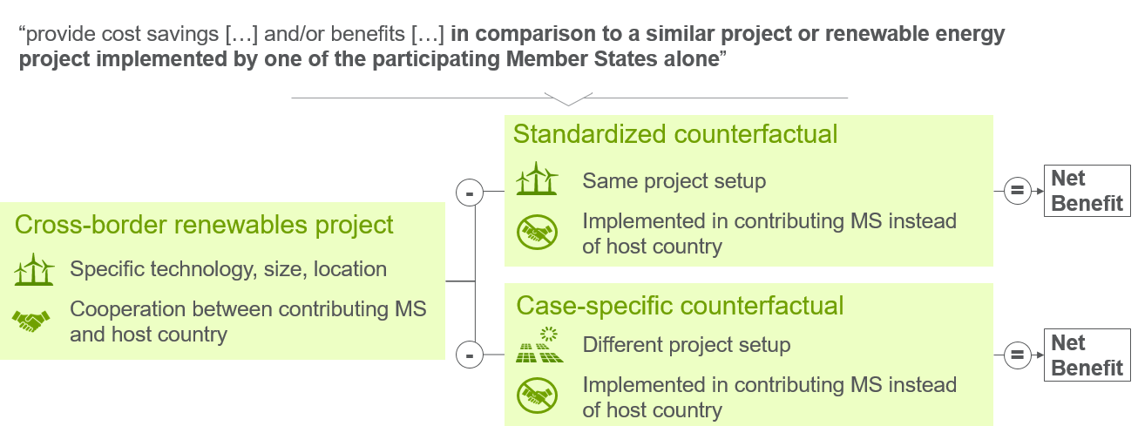
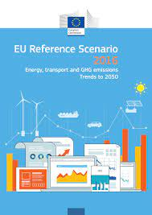
Counterfactual
Scenario for the assessment (link):

Slide 12
Cost-benefit analysis – element by element (1)
Cost of energy generation: How much it costs to produce the renewable energy?
Levelized cost of energy (LCOE), calculated by a formula, consistent with the Innovation Fund
System integration: How much it costs to the overall energy system to integrate the generated renewable energy?
Profile costs - the cost of providing backup capacity and flexibility to meet demand at all times/at peak.
Balancing costs – covering the short term fluctuations and uncertainty in RES generation
Grid-related costs – covering the general system operator network charges

Slide 13
Cost-benefit analysis – element by element (2)
3. Cost of support: How much is the transfer of public resources to the project promoter?
Indicator shall not be incorporated in the overall NPV.
4. GHG emissions: How much are the benefits of the project as a result of the reduced GHG emissions?
Using established GHG effects in CO2 equivalent terms
Establishing the avoided GHG emissions in CO2
Monetizing the avoided emissions by the cost of carbon estimates

Slide 14
Cost-benefit analysis – element by element (3)
5. Security of supply: Narrowed down to reduction of import dependency?
How much is the value of changes in energy imports in the primary energy consumption of the respective sector (electricity/transport/H&C)
6. Air and other local pollution: How much is impact of the project in terms of reduction of the air and other local pollution?
Using only air pollution, based on emissions of three major regional pollutants: NOx, PMx, and SO2
Using established emission factor (in kg/kWh) of these pollutants
Multiplying the decreased emissions by the economic unit cost of each pollutant (in EUR/t_NOx, EUR/t_PMx, EUR/t_SO2

Slide 15
Cost-benefit analysis – element by element (4)
7. Innovation:
How much are the benefits of
(i) technological innovation
(ii) policy innovation
Non-monetized element, qualitative description only

Slide 16
Thank you
© European Union 2020
Unless otherwise noted the reuse of this presentation is authorised under the CC BY 4.0 license. For any use or reproduction of elements that are not owned by the EU, permission may need to be sought directly from the respective right holders.
Slide xx: element concerned, source: e.g. Fotolia.com; Slide xx: element concerned, source: e.g. iStock.com
Notes:
Update/add/delete parts of the copy right notice where appropriate.
More information: https://myintracomm.ec.europa.eu/corp/intellectual-property/Documents/2019_Reuse-guidelines%28CC-BY%29.pdf

