Slide 1
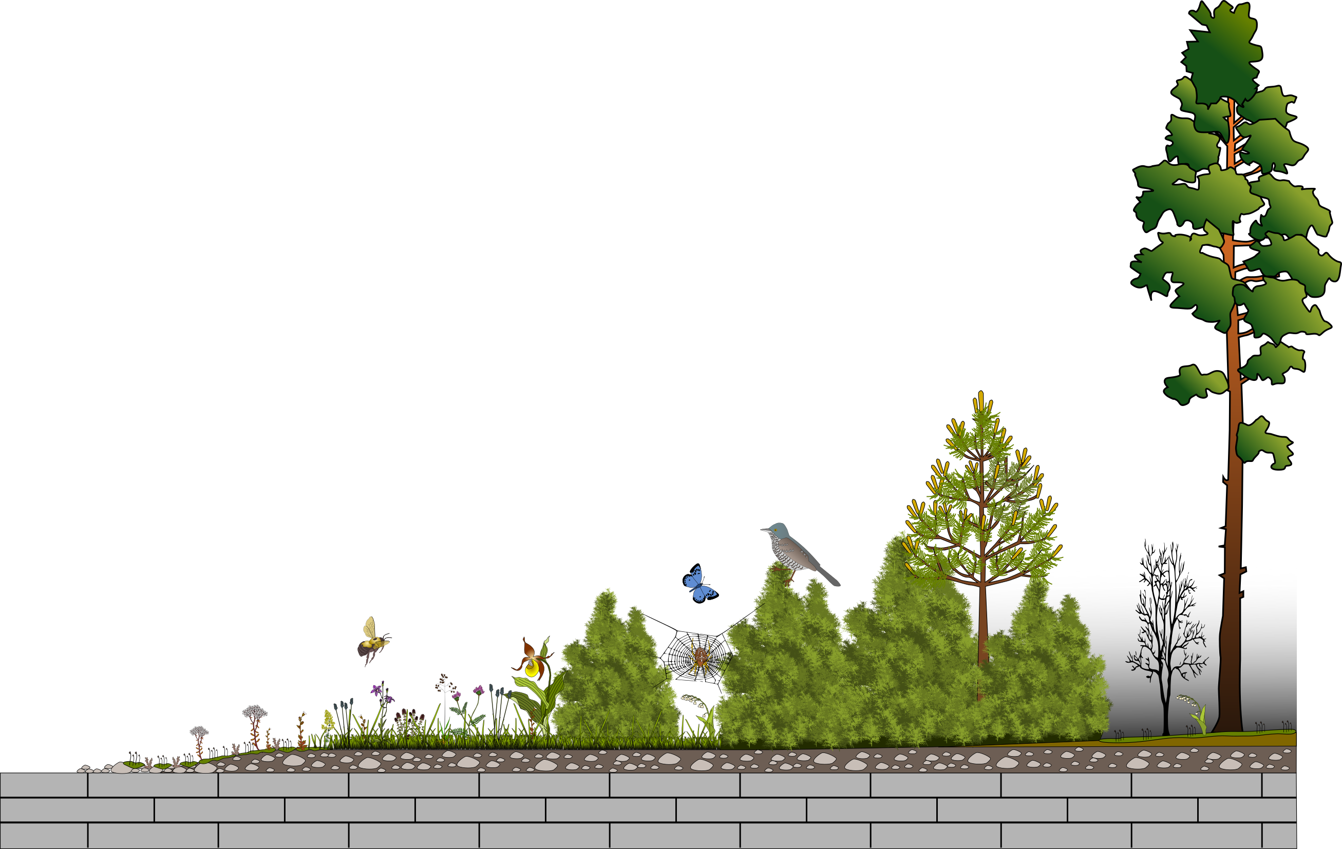
LIFE to Alvars
Restoration of Estonian alvar grasslands
Aveliina Helm
University of Tartu, Estonia
landscape.ut.ee

Slide 2
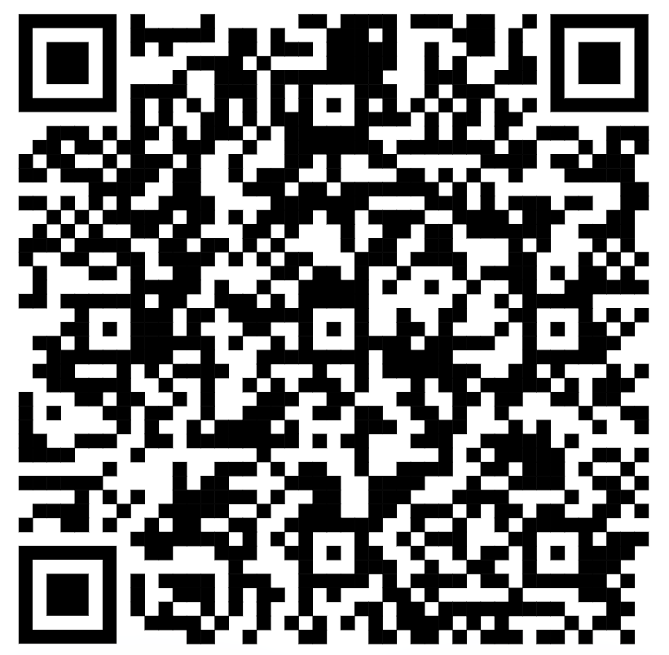
LIFE to alvars
Restoration of Estonian alvar grasslands
Large-scale calcareous grassland restoration in Estonia
2014-2019
https://landscape.ut.ee/restoration-of-alvar-grasslands

Slide 3
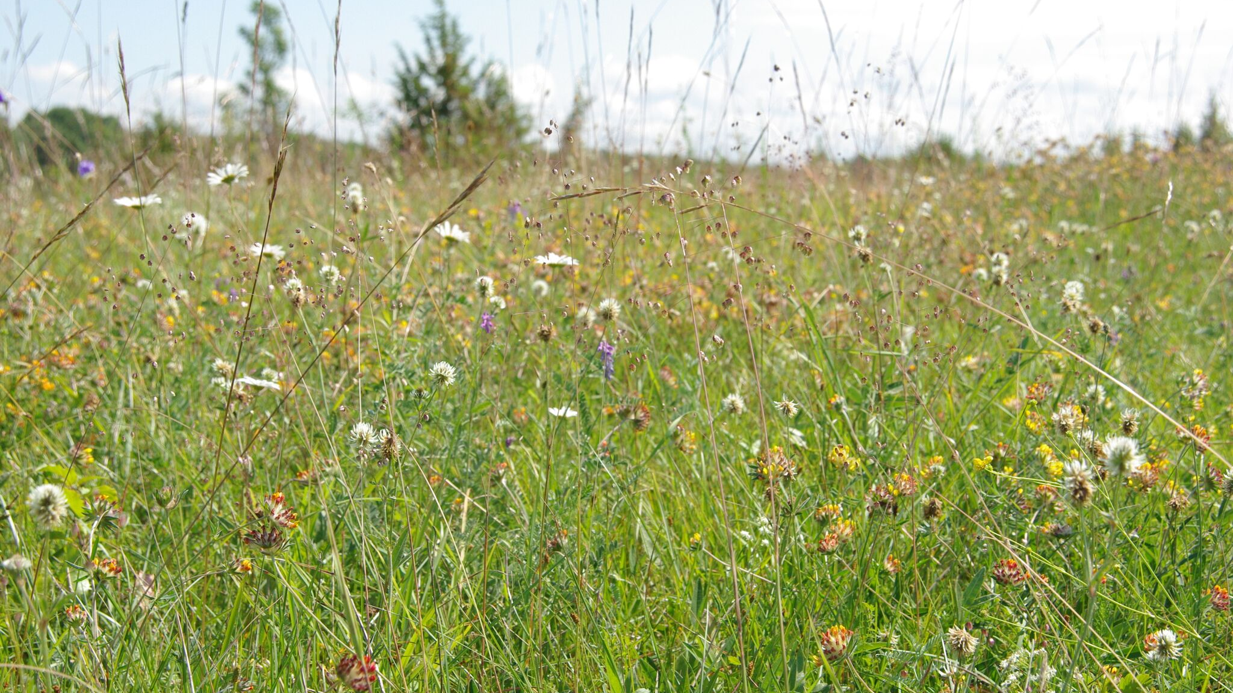
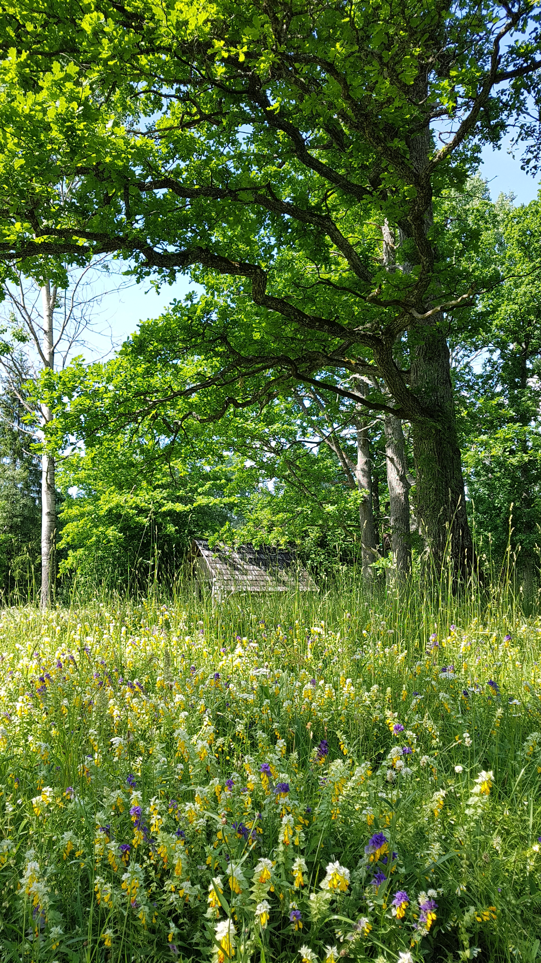
wooded meadows: 850 000 ha -> 750 ha
Kukk & Kull 1997; Helm & Toussaint 2020

Slide 4
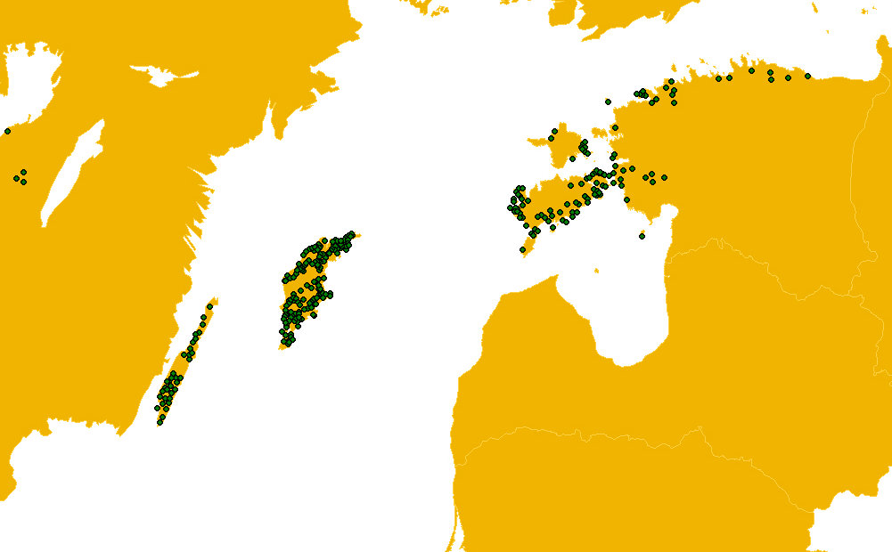
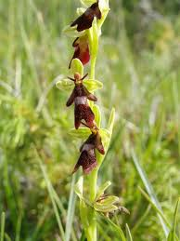
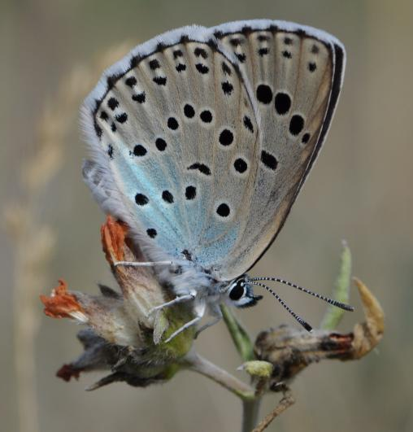
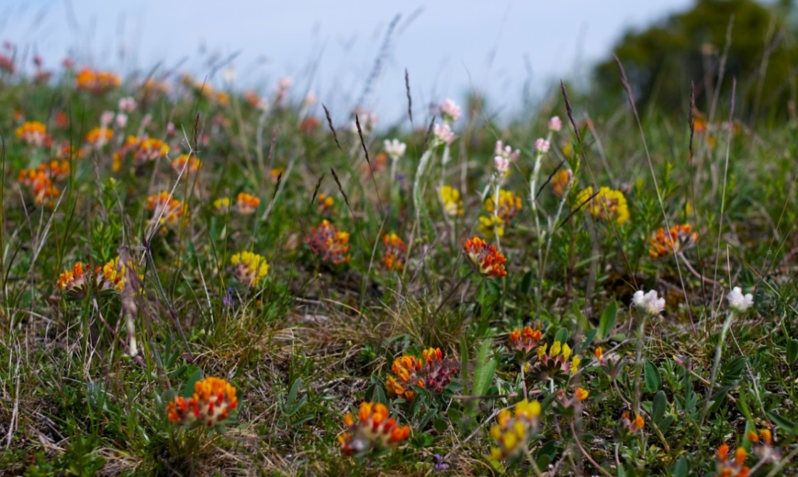
Alvar grasslands (6280*)

Slide 5
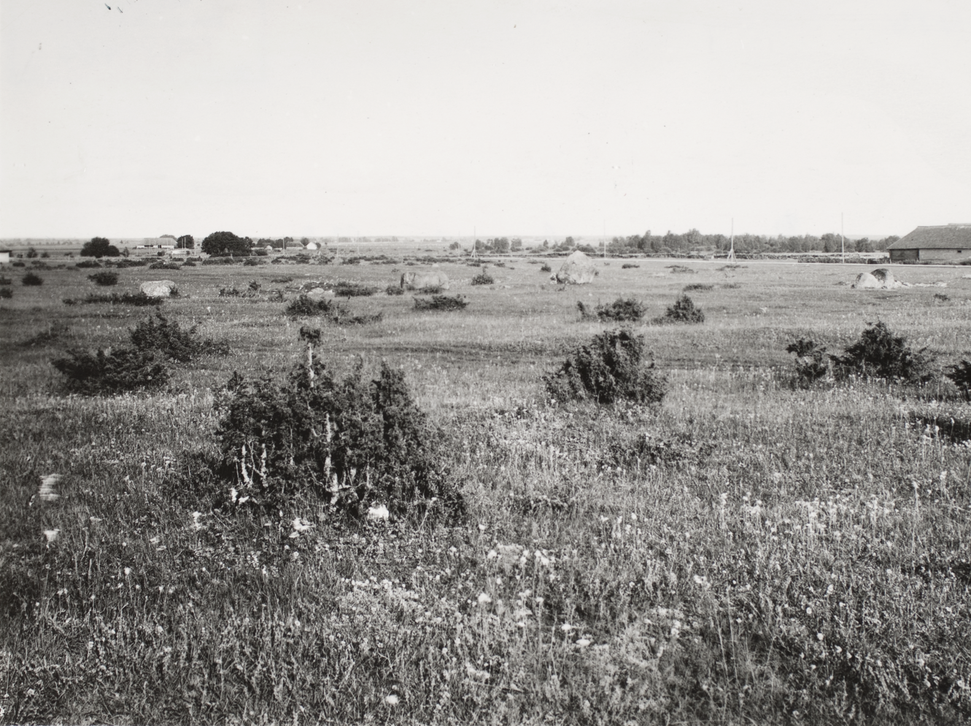
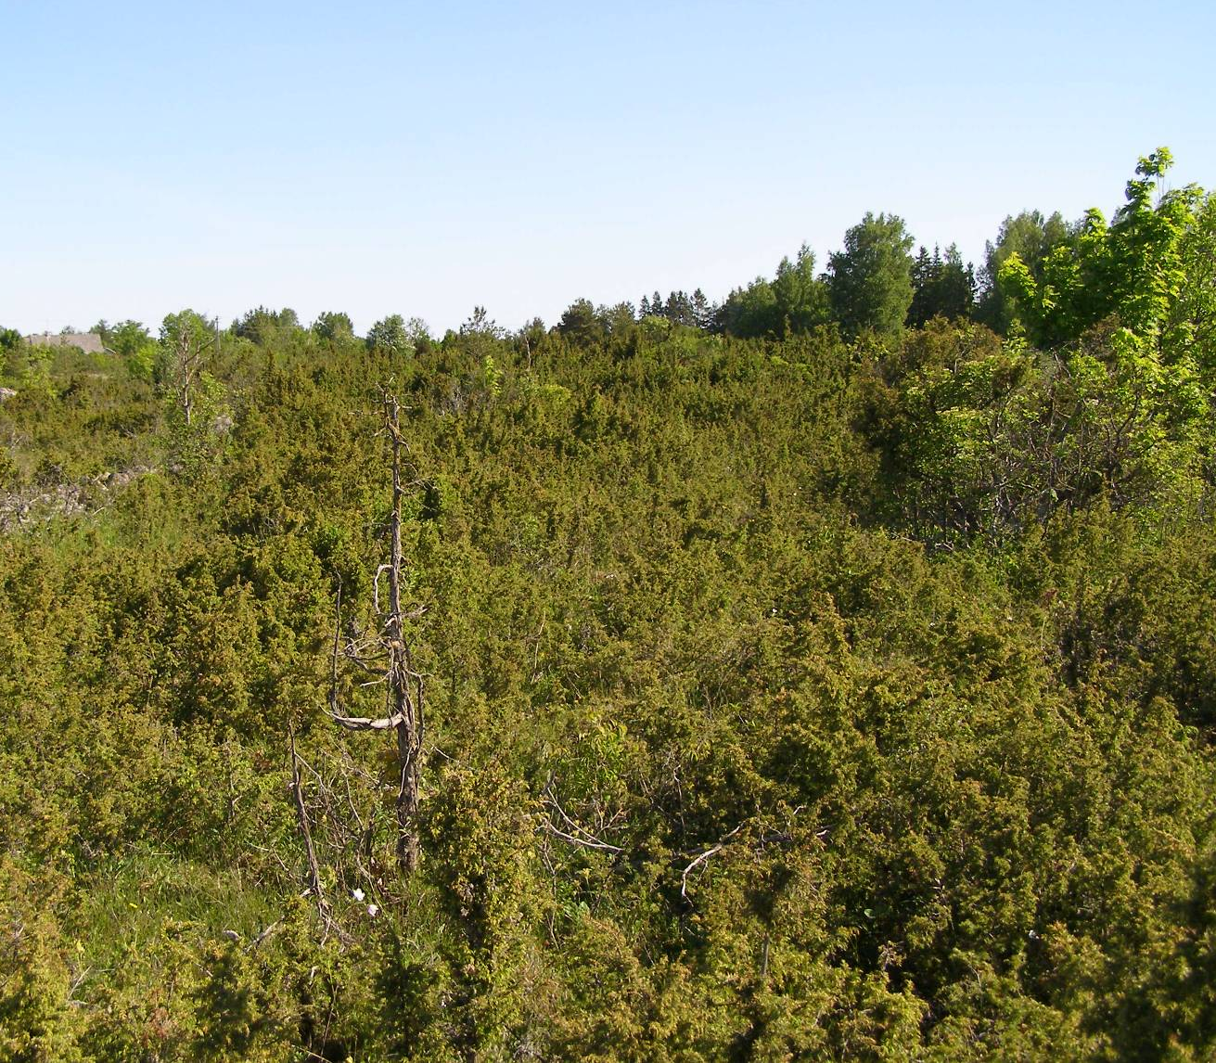
Alvar grasslands (6280*)
1923
2012
Notes:
Historical view to alvar grassland

Slide 6
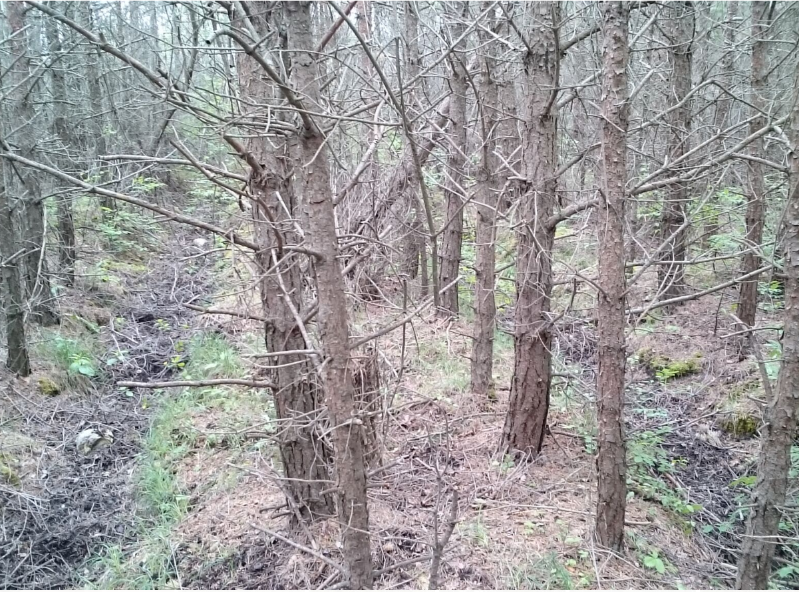
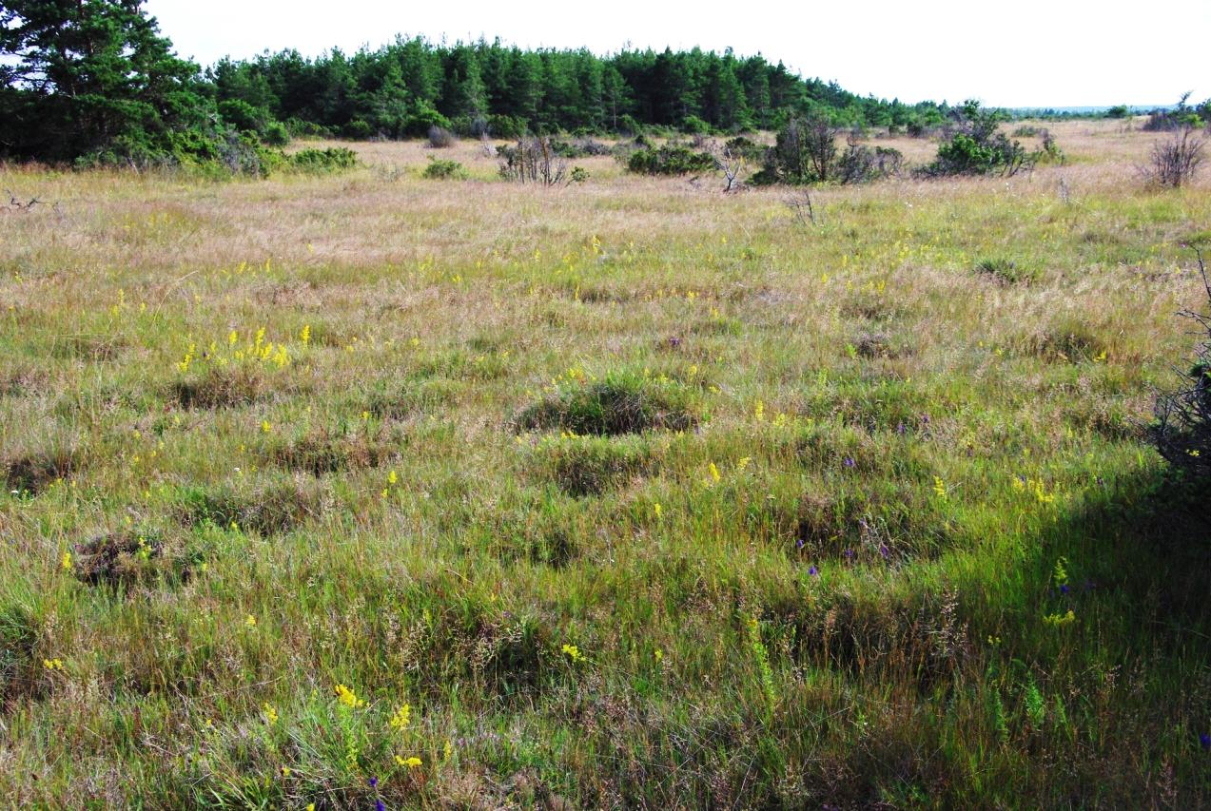
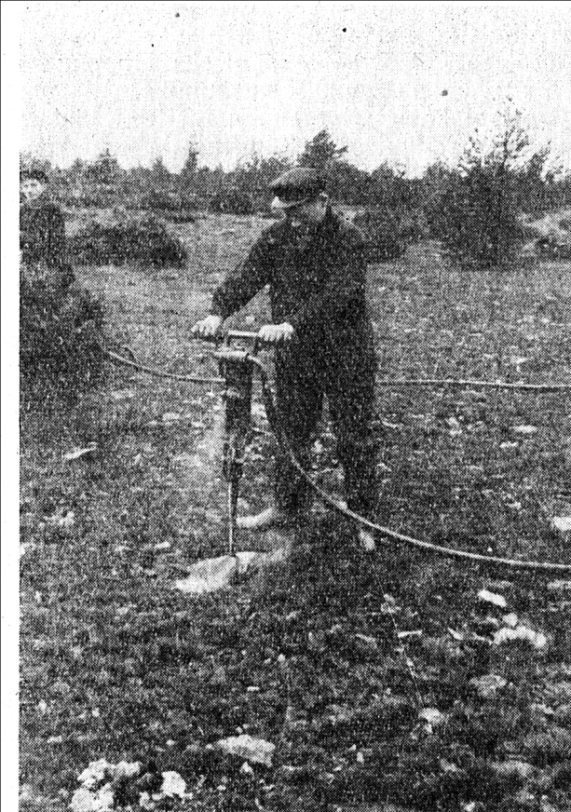
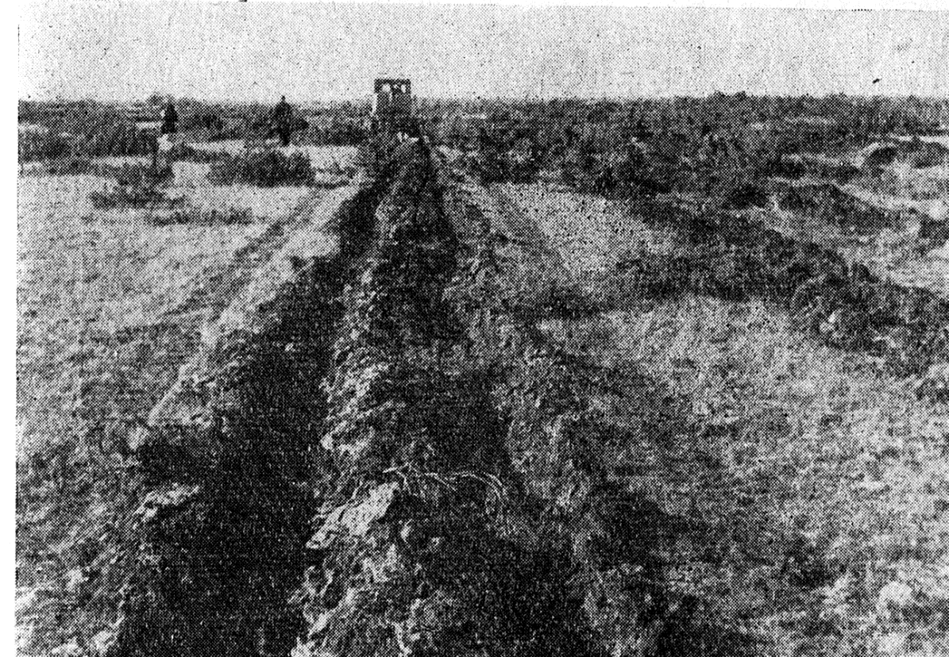
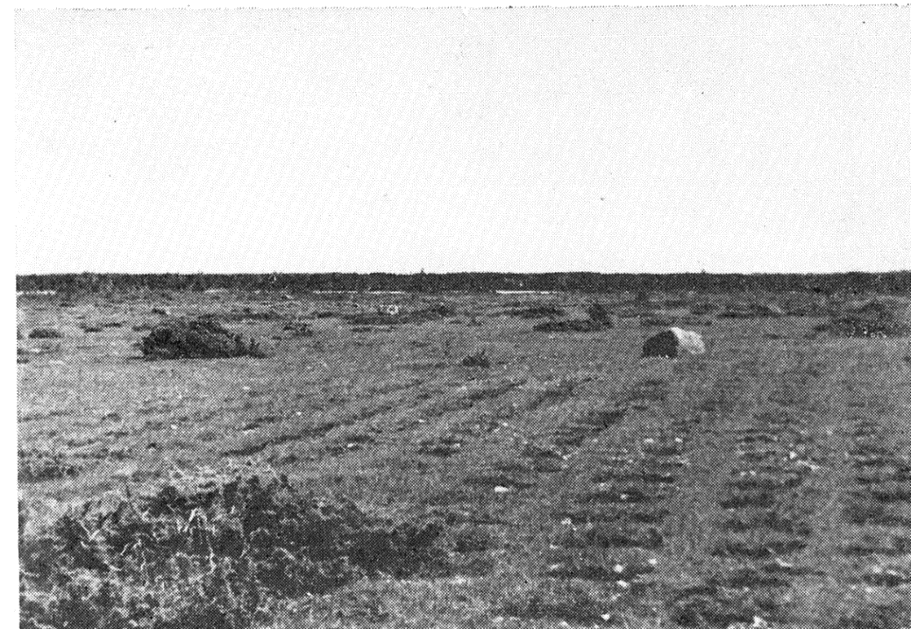
2012
2015
2012
1967
1967
1967

Slide 7
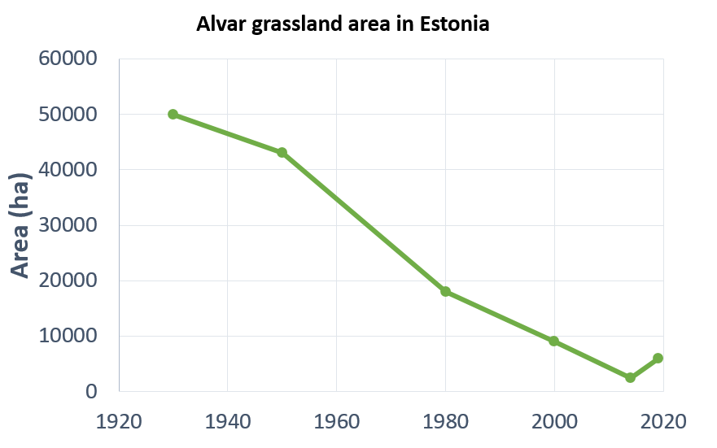
2012
2015
2012
1967
1967
1967

Slide 8
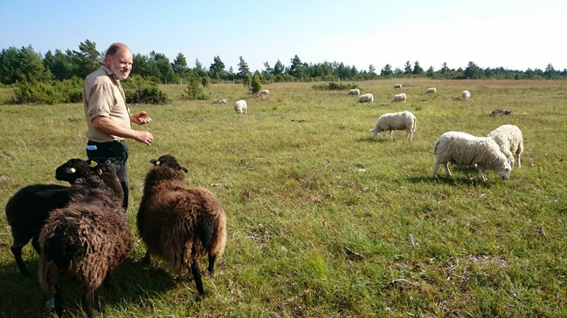
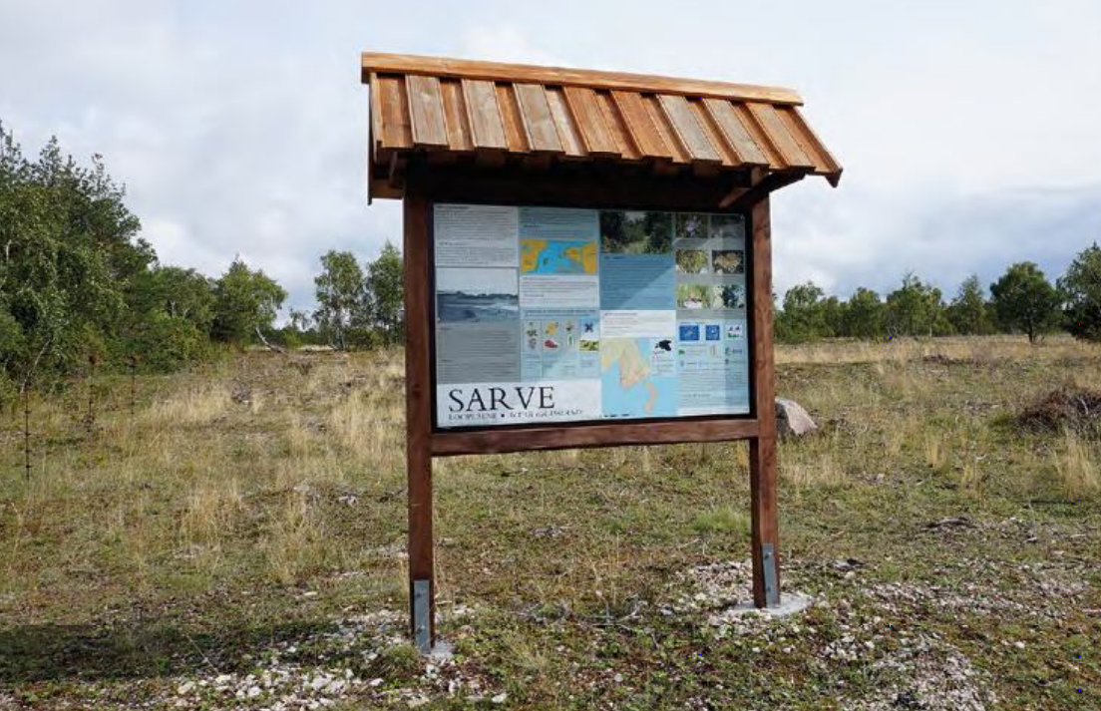
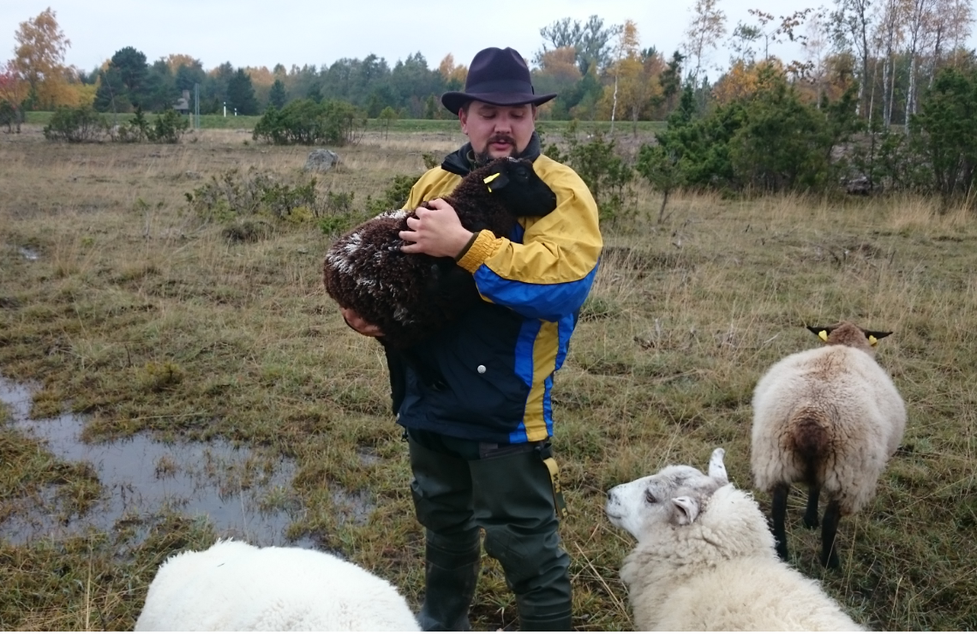
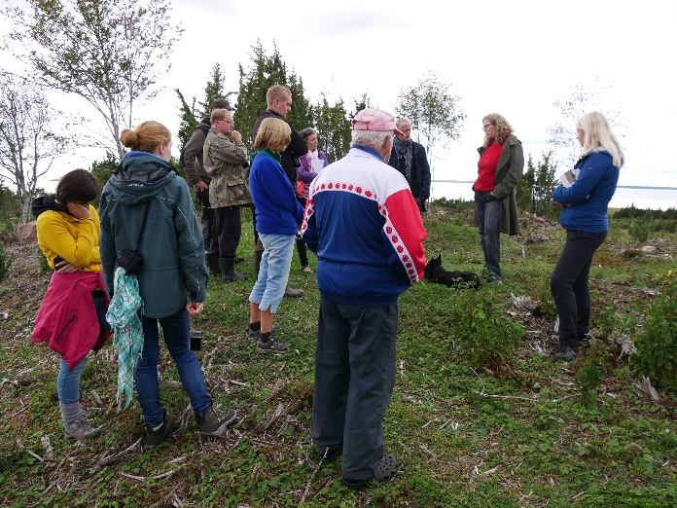
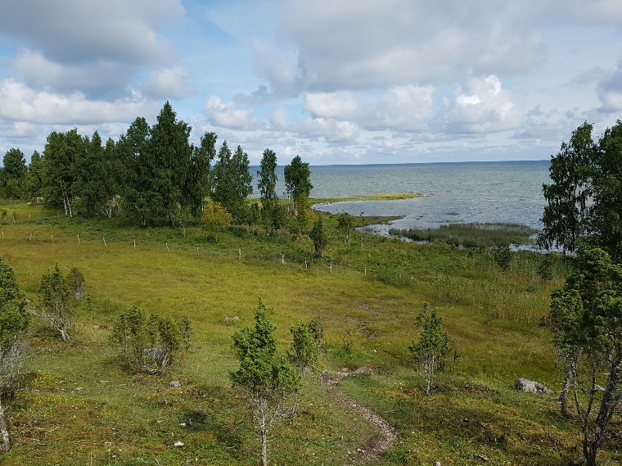
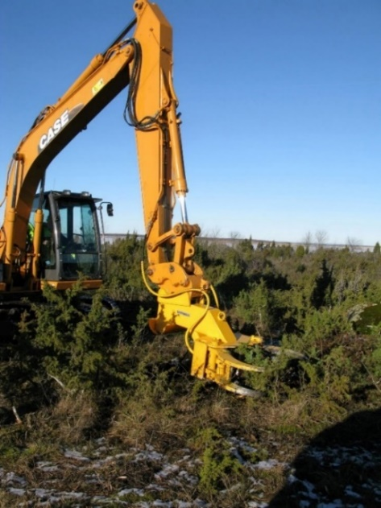
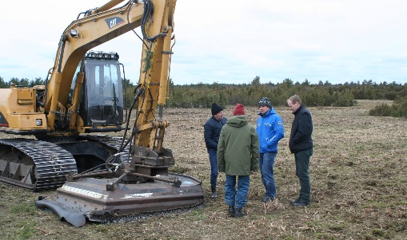
LIFE to Alvars: large-scale calcareous alvar grassland restoration in Estonia (LIFE13NAT/EE/000082)
restoration of 2500 ha of historical alvar grasslands
creation of infrastructure for subsequent grazing
introduction/exploration of effective large-scale restoration methods
preservation of cultural heritage
involvement of private landowners and awareness-raising about the value of semi-natural grasslands - more than 600 land-owners involved!
Read more: http://landscape.ut.ee/restoration-of-alvar-grasslands

Slide 9
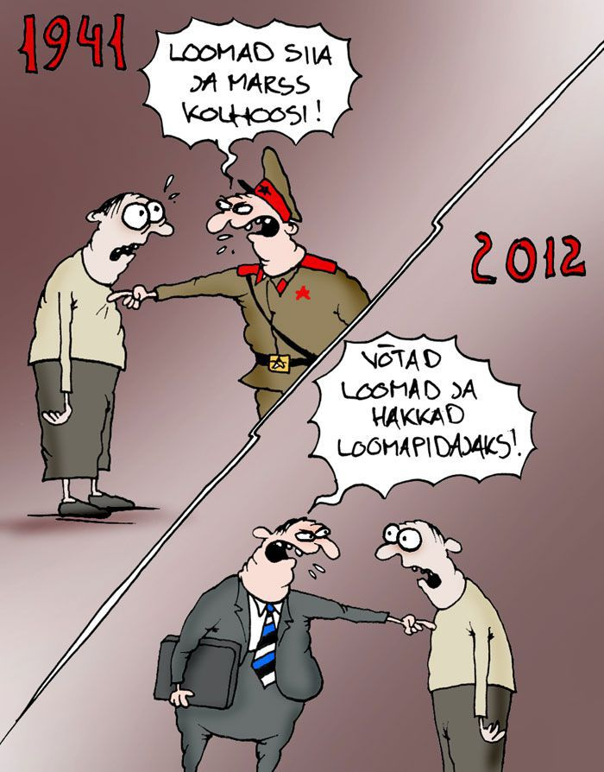
Postimees 21.09.2012
Editorial: Can citizens trust their country?
Give your animals and start marching towards kolkhoz!
Take animals and start farming!

Slide 10
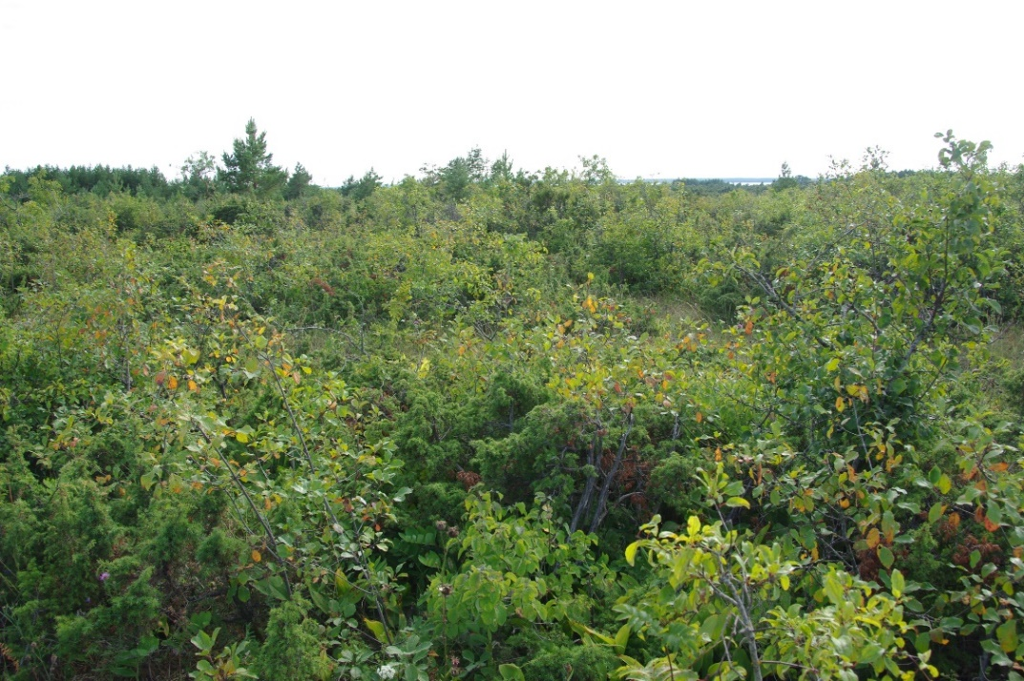
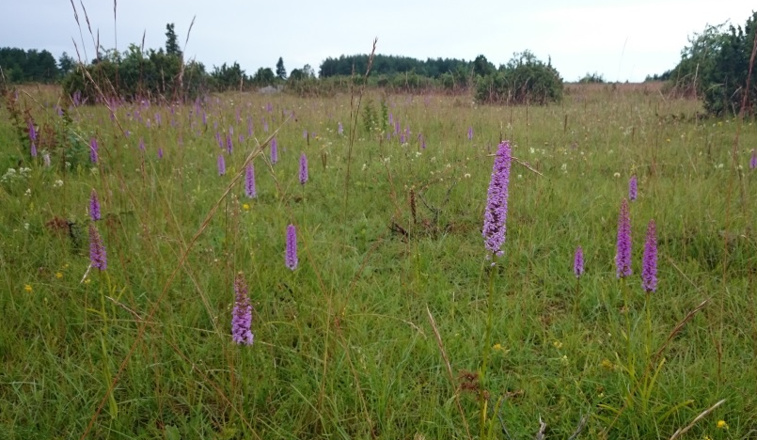
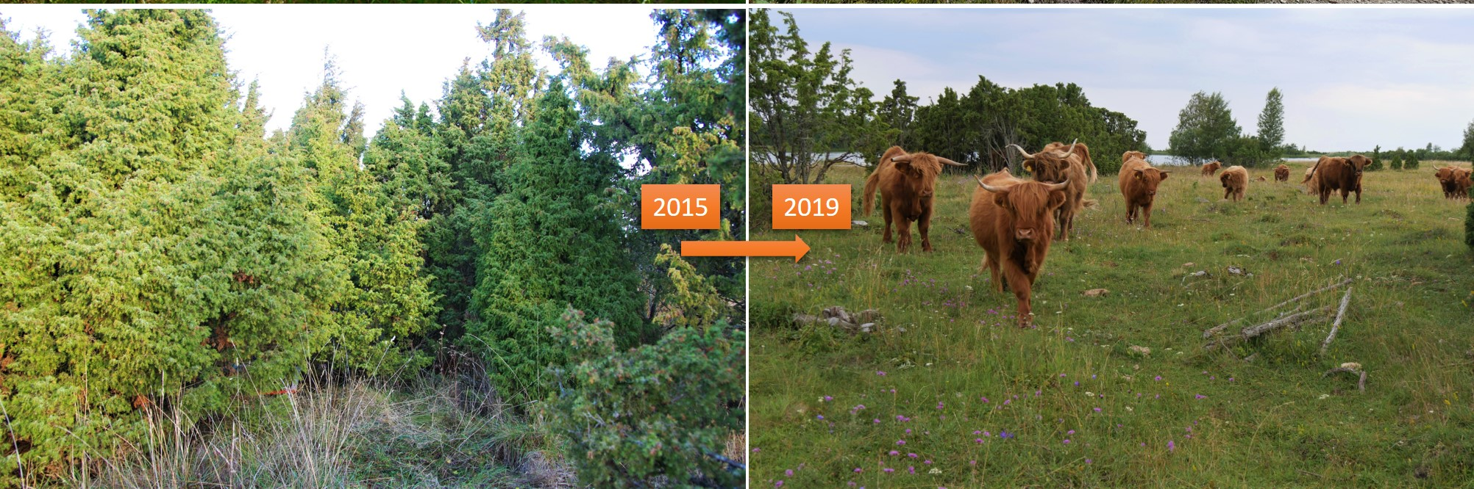
Lõetsa, Muhu
Koguva, Muhu
2014
2017
Türju, Saaremaa
Helm 2015 Journal of Applied Ecology

Slide 11
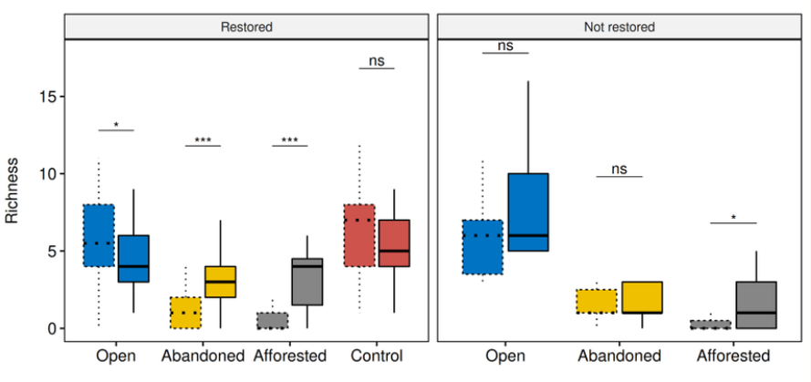
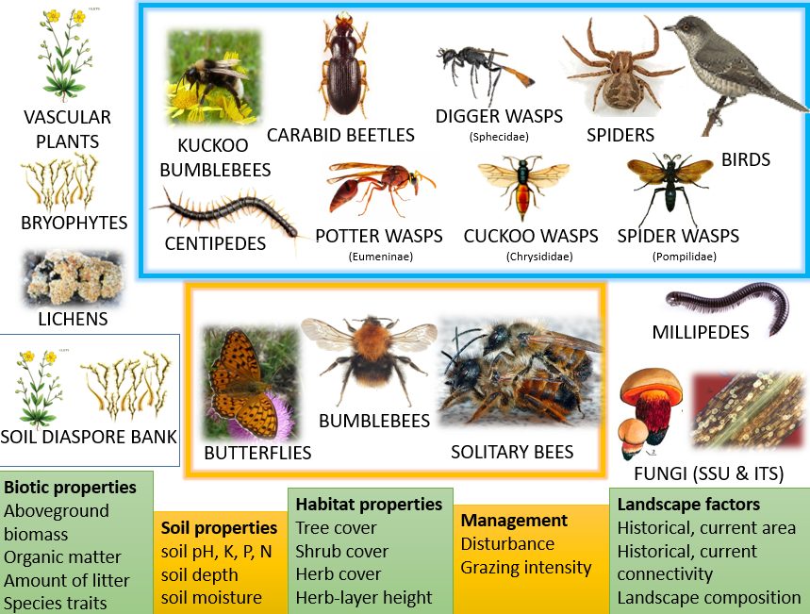
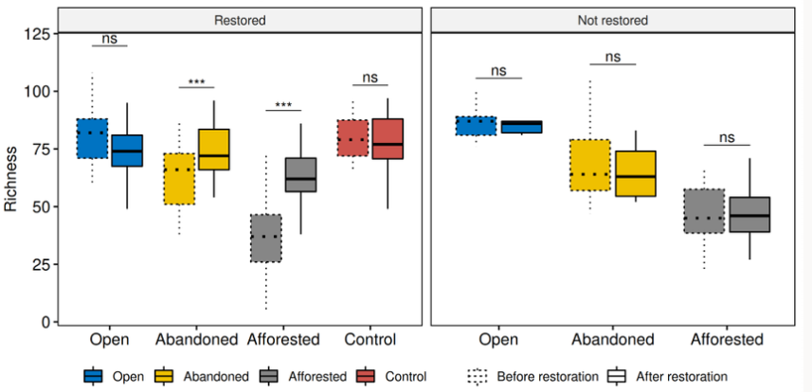
Butterflies
All taxa
Prangel et al. submitted; Helm et al. in prep; Helm et al. 2019

Slide 12
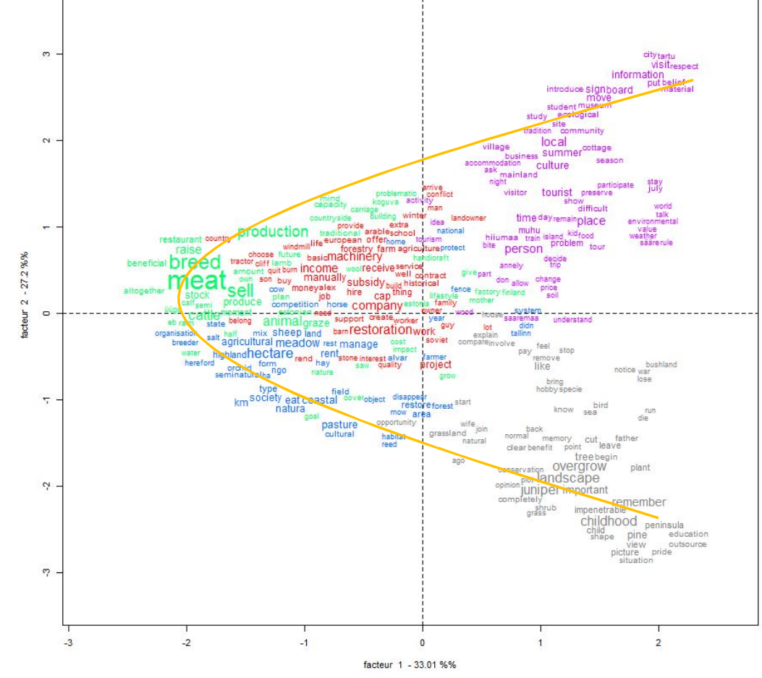
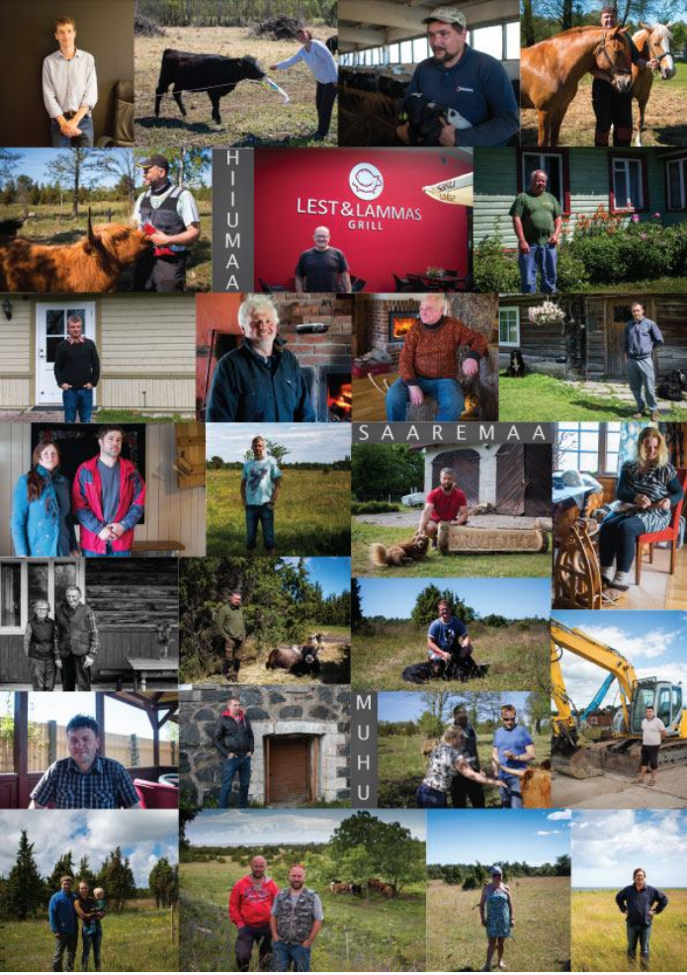
Recognizing and addressing different value systems
Tourism, summer, vacation
Farming, animals, restoration, machinery
Emotions, childhood memories
Hog 2017 - socio-economic monitoring of LIFE to Alvars project Available: https://landscape.ut.ee/restoration-of-alvar-grasslands

Slide 13
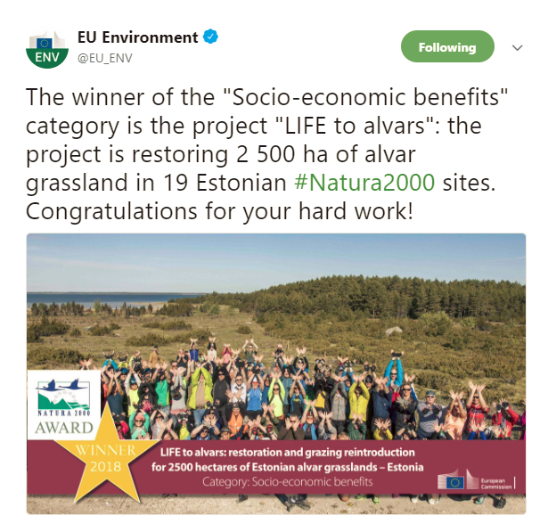
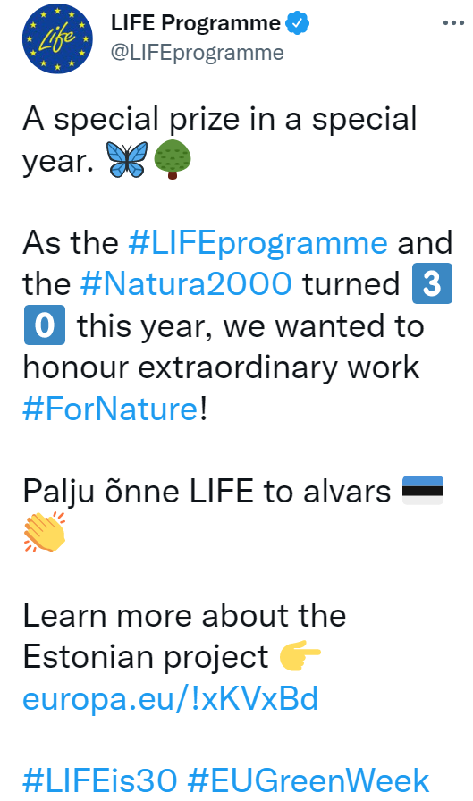
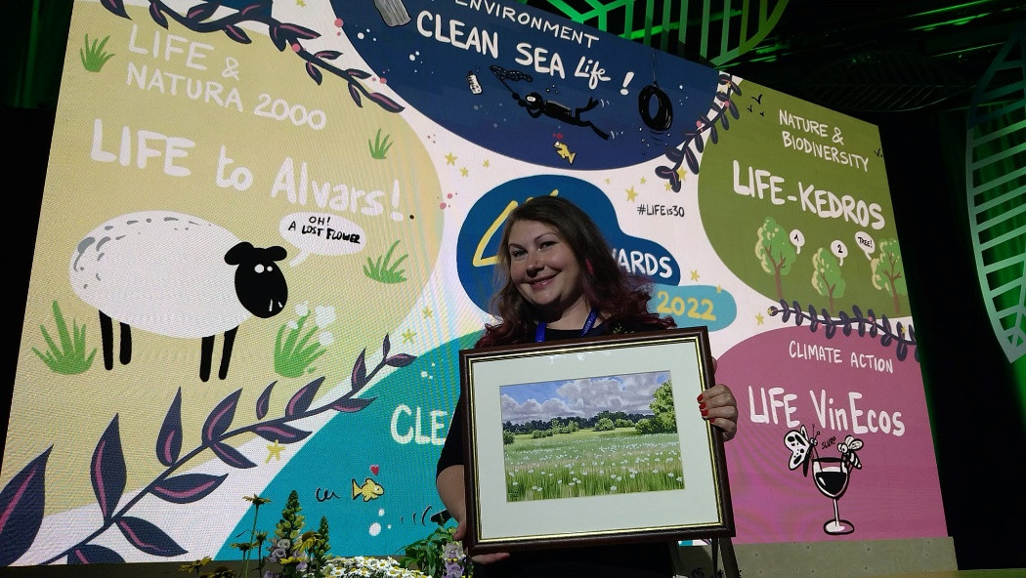
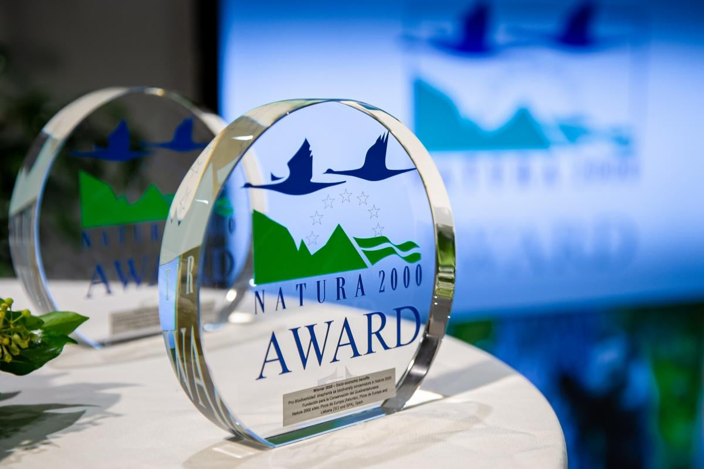
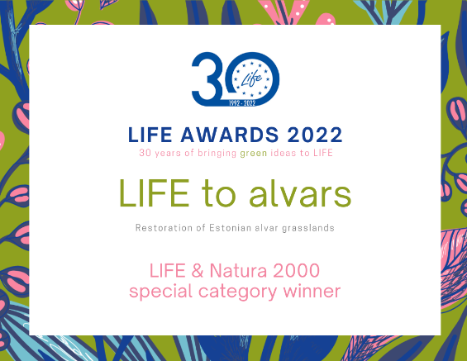
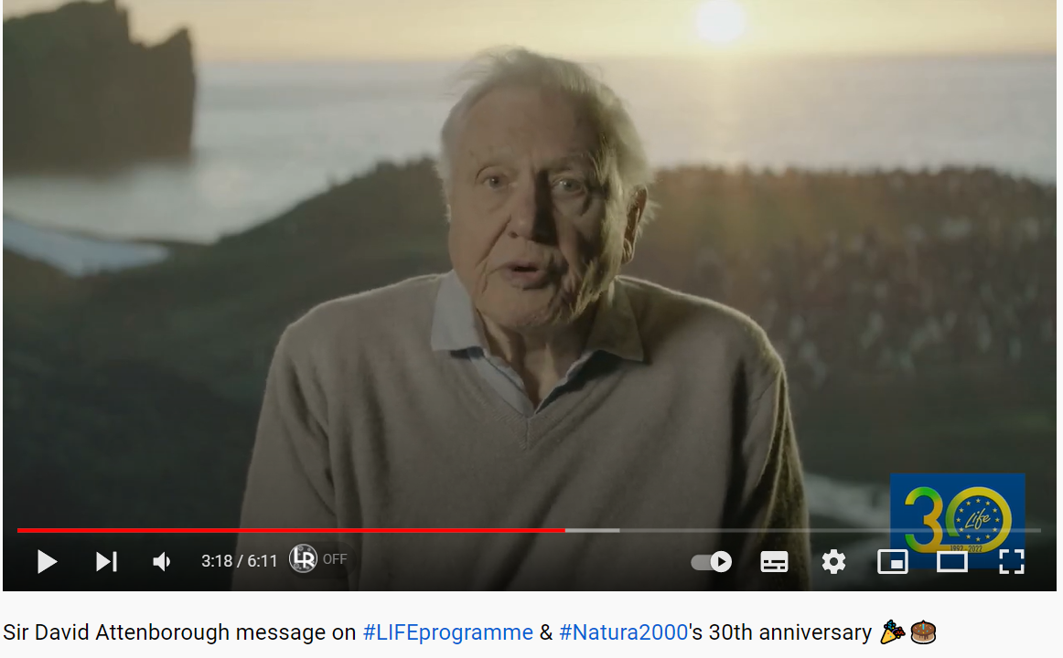

Slide 14
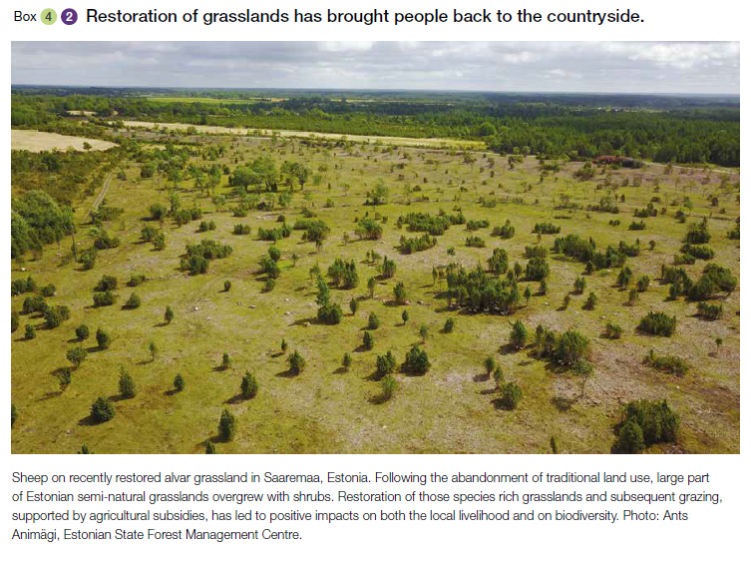
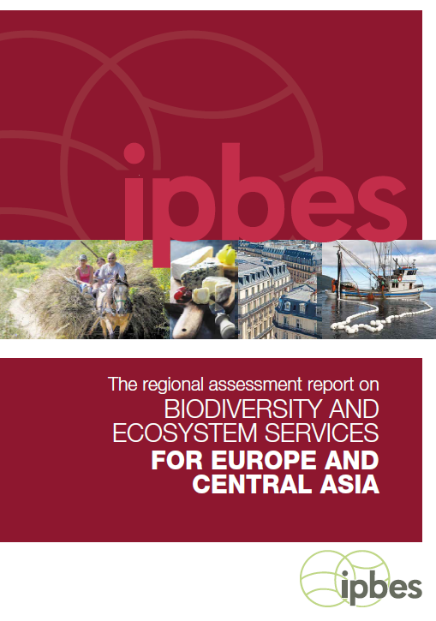
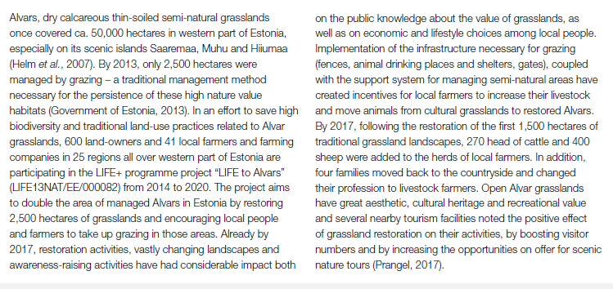

Slide 15
BIRTHBED OF NEW LIFE PROJECTS
WoodMeadowLIFE
- 2021-2026
- restoration of 700 hectares of wooded meadows in Estonia and Latvia
- see poster, Heidi and Kaidi
LIFE Connecting Meadows
- 2020-2025
- restoration of grasslands and linear landscape elements for improved connectivity in Muhu
- Annely Esko
LIFE-IP Project ForEst&FarmLand
- Update subsidy system for grasslands (results-based schemes)
- Restoration of grasslands
- Agro-ecological demo areas for intensive farmers

Slide 16
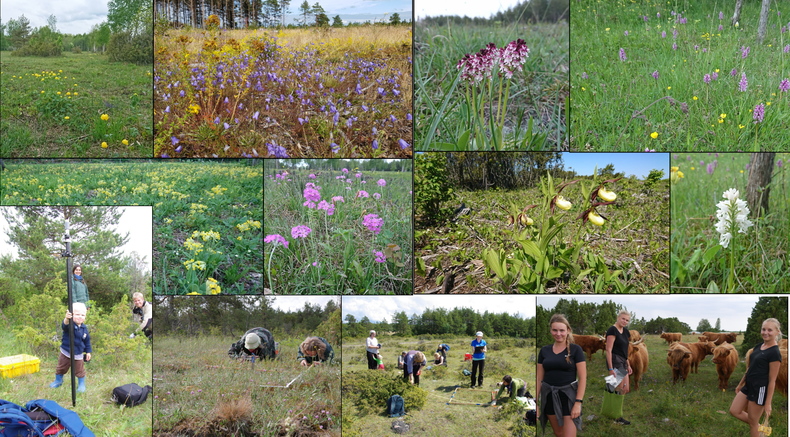

Slide 17
Find out more at:
https://life.envir.ee/elualvaritel
and
https://landscape.ut.ee/restoration-of-alvar-grasslands
https://www.facebook.com/lifetoalvars/
MORE RESULTS:
- Triin Reitalu, session S12.2 - Grassland restoration
- Elisabeth Prangel, poster
Keep in touch: Aveliina Helm - aveliina.helm@ut.ee
@aveliina
Notes:
Wrap-up conclusions
Thank-you (LIFE projects, technical team, SERE organisers, audience).
Reply to our feedback form on sli.do (#LIFEforEcoRestoration)
Follow-up on social media (info-session videos available in YouTube) and visit our website

