Slide 1
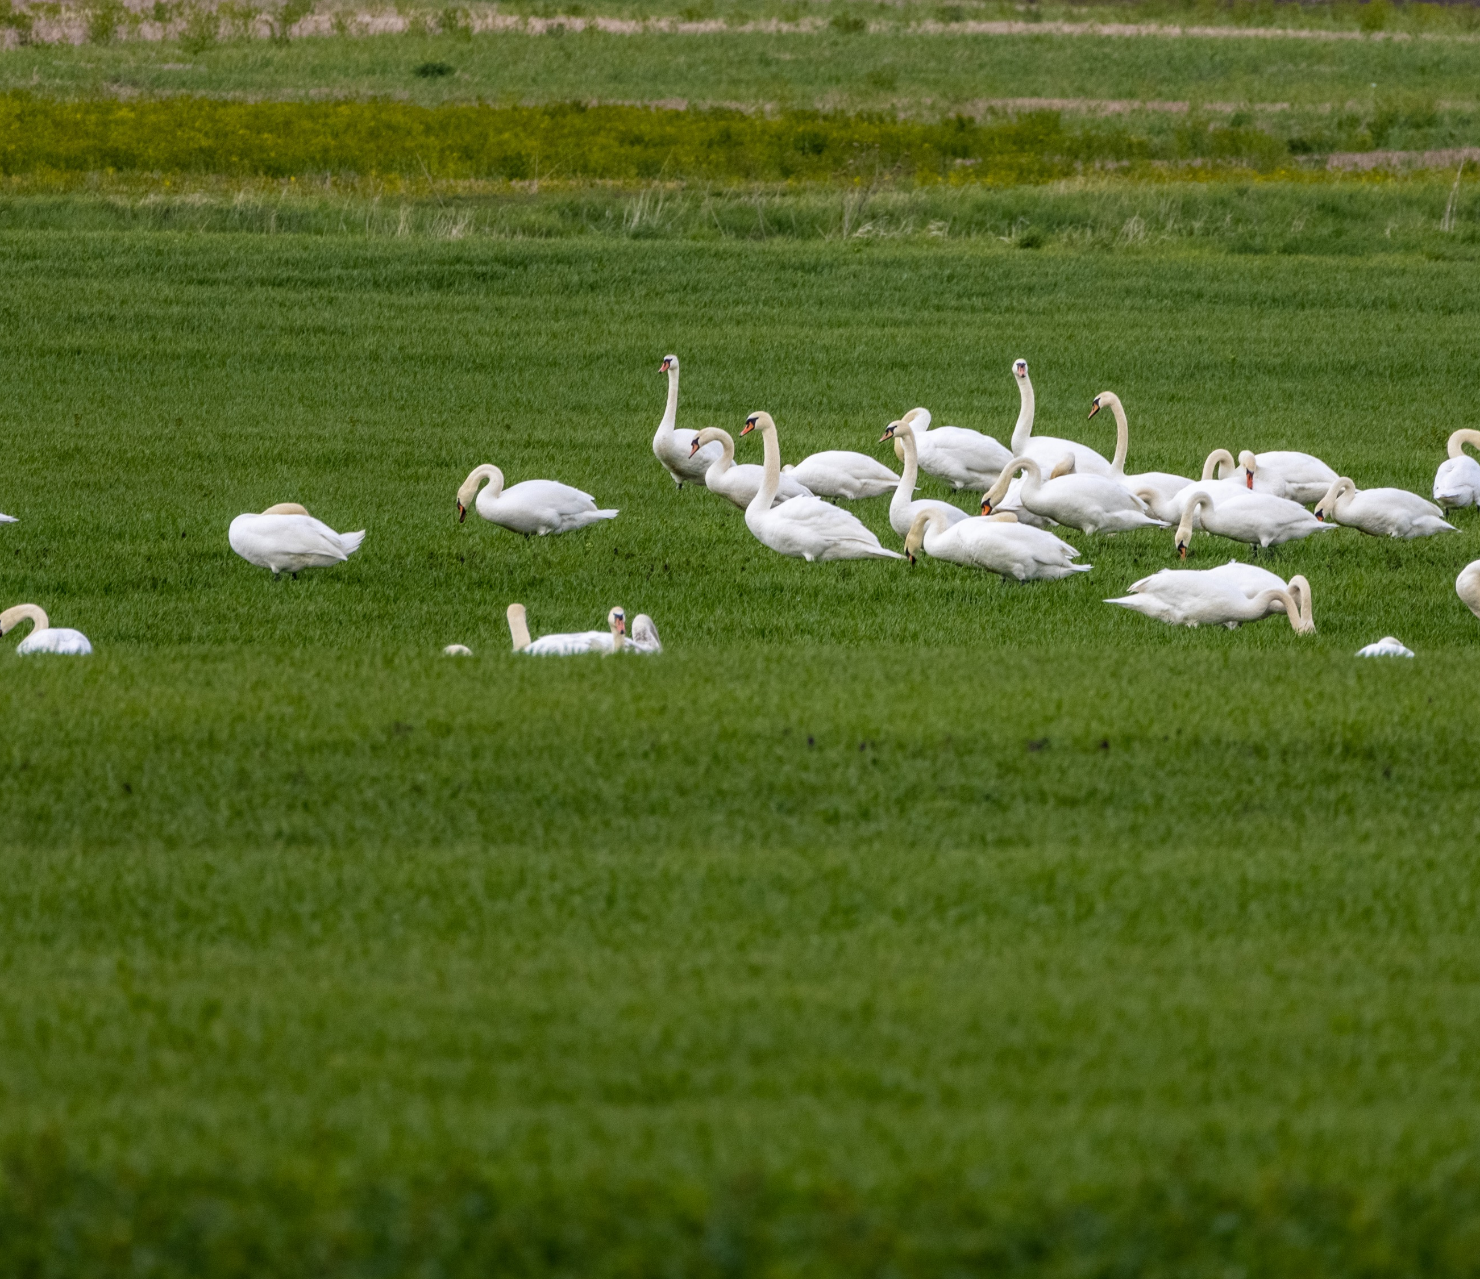
The best practice examples of communication activities
of LIFE integrated project “Optimizing the management of Natura 2000 network in Lithuania”

Slide 2
Alternative ways to reach the audience
Good Farmer’s Championship
Voluntary works of business enterprises in protected areas (part of Natura 2000)
Notes:
Sometimes there is a challenge to reach media attention with traditional press releases, therefore we are always searching for ways to reach our audience and to spread the message about Natura 2000 network and protected habitats and species in original ways targeting some specific group of people directly. Today I want to briefly represent our two successful initiatives – Good Farmers Championship and voluntary work in protected areas.

Slide 3
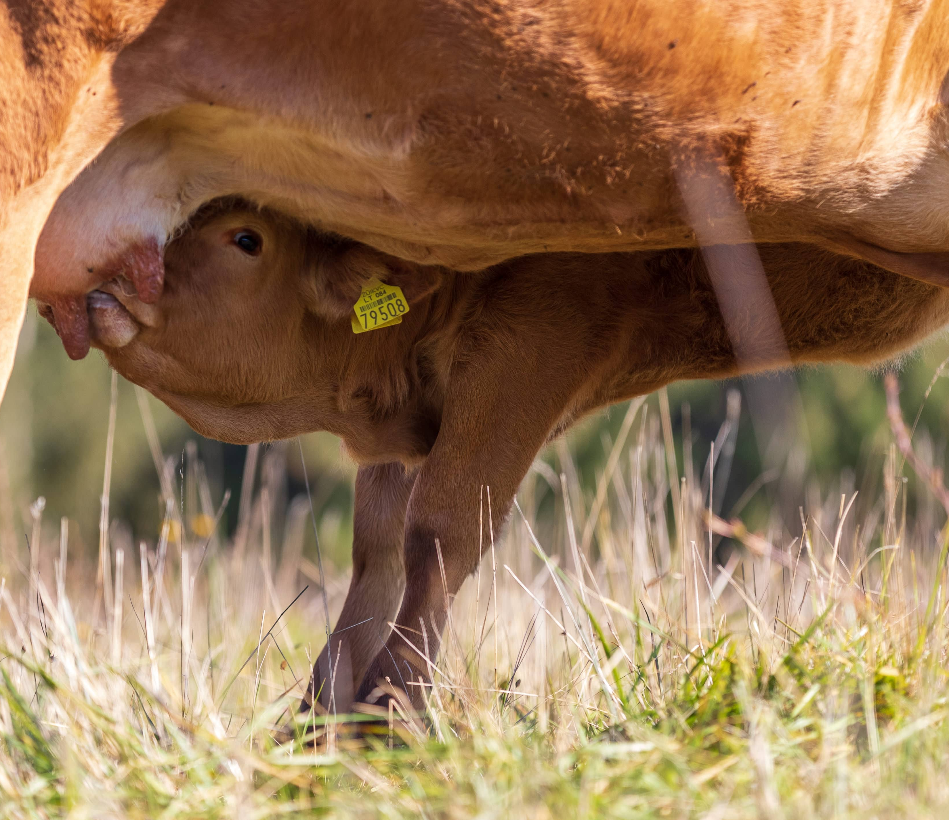
Good Farmer‘s Championship
Example was taken from Irish initiative “Farming for Nature”
The main aim of the championship was to promote an attitude that a good farmer our days is the one, who produces healthy products in environmentally-friendly way, protecting biodiversity and sharing his experience with the others.
The elderships which are the most active in declaring fields for agri-environmental measures were also honored.
Notes:
The championship had two parts – competition of farmers and of elderships.

Slide 4
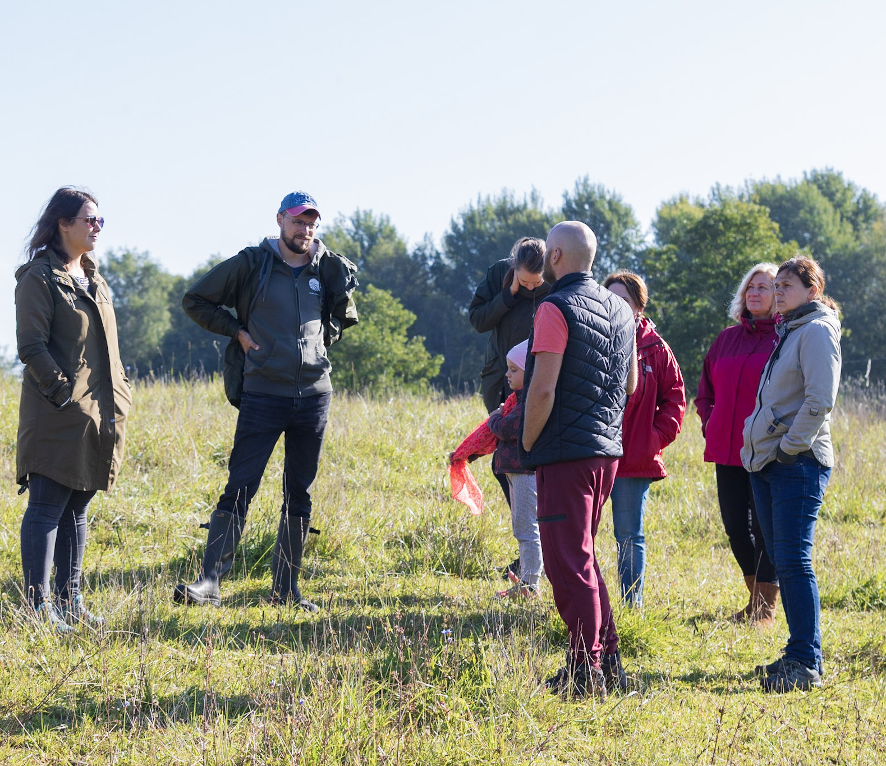
Good Farmer‘s Championship
Special commission by experts of agriculture and nature conservation formed (partly consisted of representatives of “Naturalit” project partners);
13 farms with highest score visited lively;
Eldeships rated according to statistics of declaration to agri-environmental measures supported by the government (Rural Development programme).
Notes:
The society, local community members and associations were invited to propose farmers’ candidacies to the organizers. After the deadline, all the candidates were evaluated and the best 13 farmers visited by a special commission of the championship, formed by experts of agriculture and nature conservation (commission consisted of representatives from “Naturalit” project partners: Ministry of Environment, Ministry of Agriculture, Environmental Projects management Agency, National Paying Agency and some other experts, coordinated by NGO Baltic Environmental Forum). Five best farms were selected and proclaimed ambassadors of the “Good Farmer‘s Championship“.
The last stage of the competition was a public vote for “Public favourite” nomination. Society could get acquainted with each of the ambassadors’ farm by watching a movie and reading interview, also there were radio broadcasts made in Lithuanian Public radio, where all the farms were presented. Voting lasted for a whole month and the winner was announced during the Award Ceremony. Representatives of the Presidency of the Republic of Lithuania and the Ministries of Agriculture and Environment were taking part and greeting the winners in the Award Ceremony.
The elderships which are the most active in declaring fields for agri-environmental measures were also honored in the Award Ceremony. The champion was announced the eldership where the biggest part of the territory in percentages was declared for agri-environmental measures. Another two were honored for reaching the biggest progress during the year 2021. The main aim of the eldership competition was to involve elderships into the process of talking with local farmers and motivating them to participate in agri-environmental measures of Rural Development Programme.

Slide 5
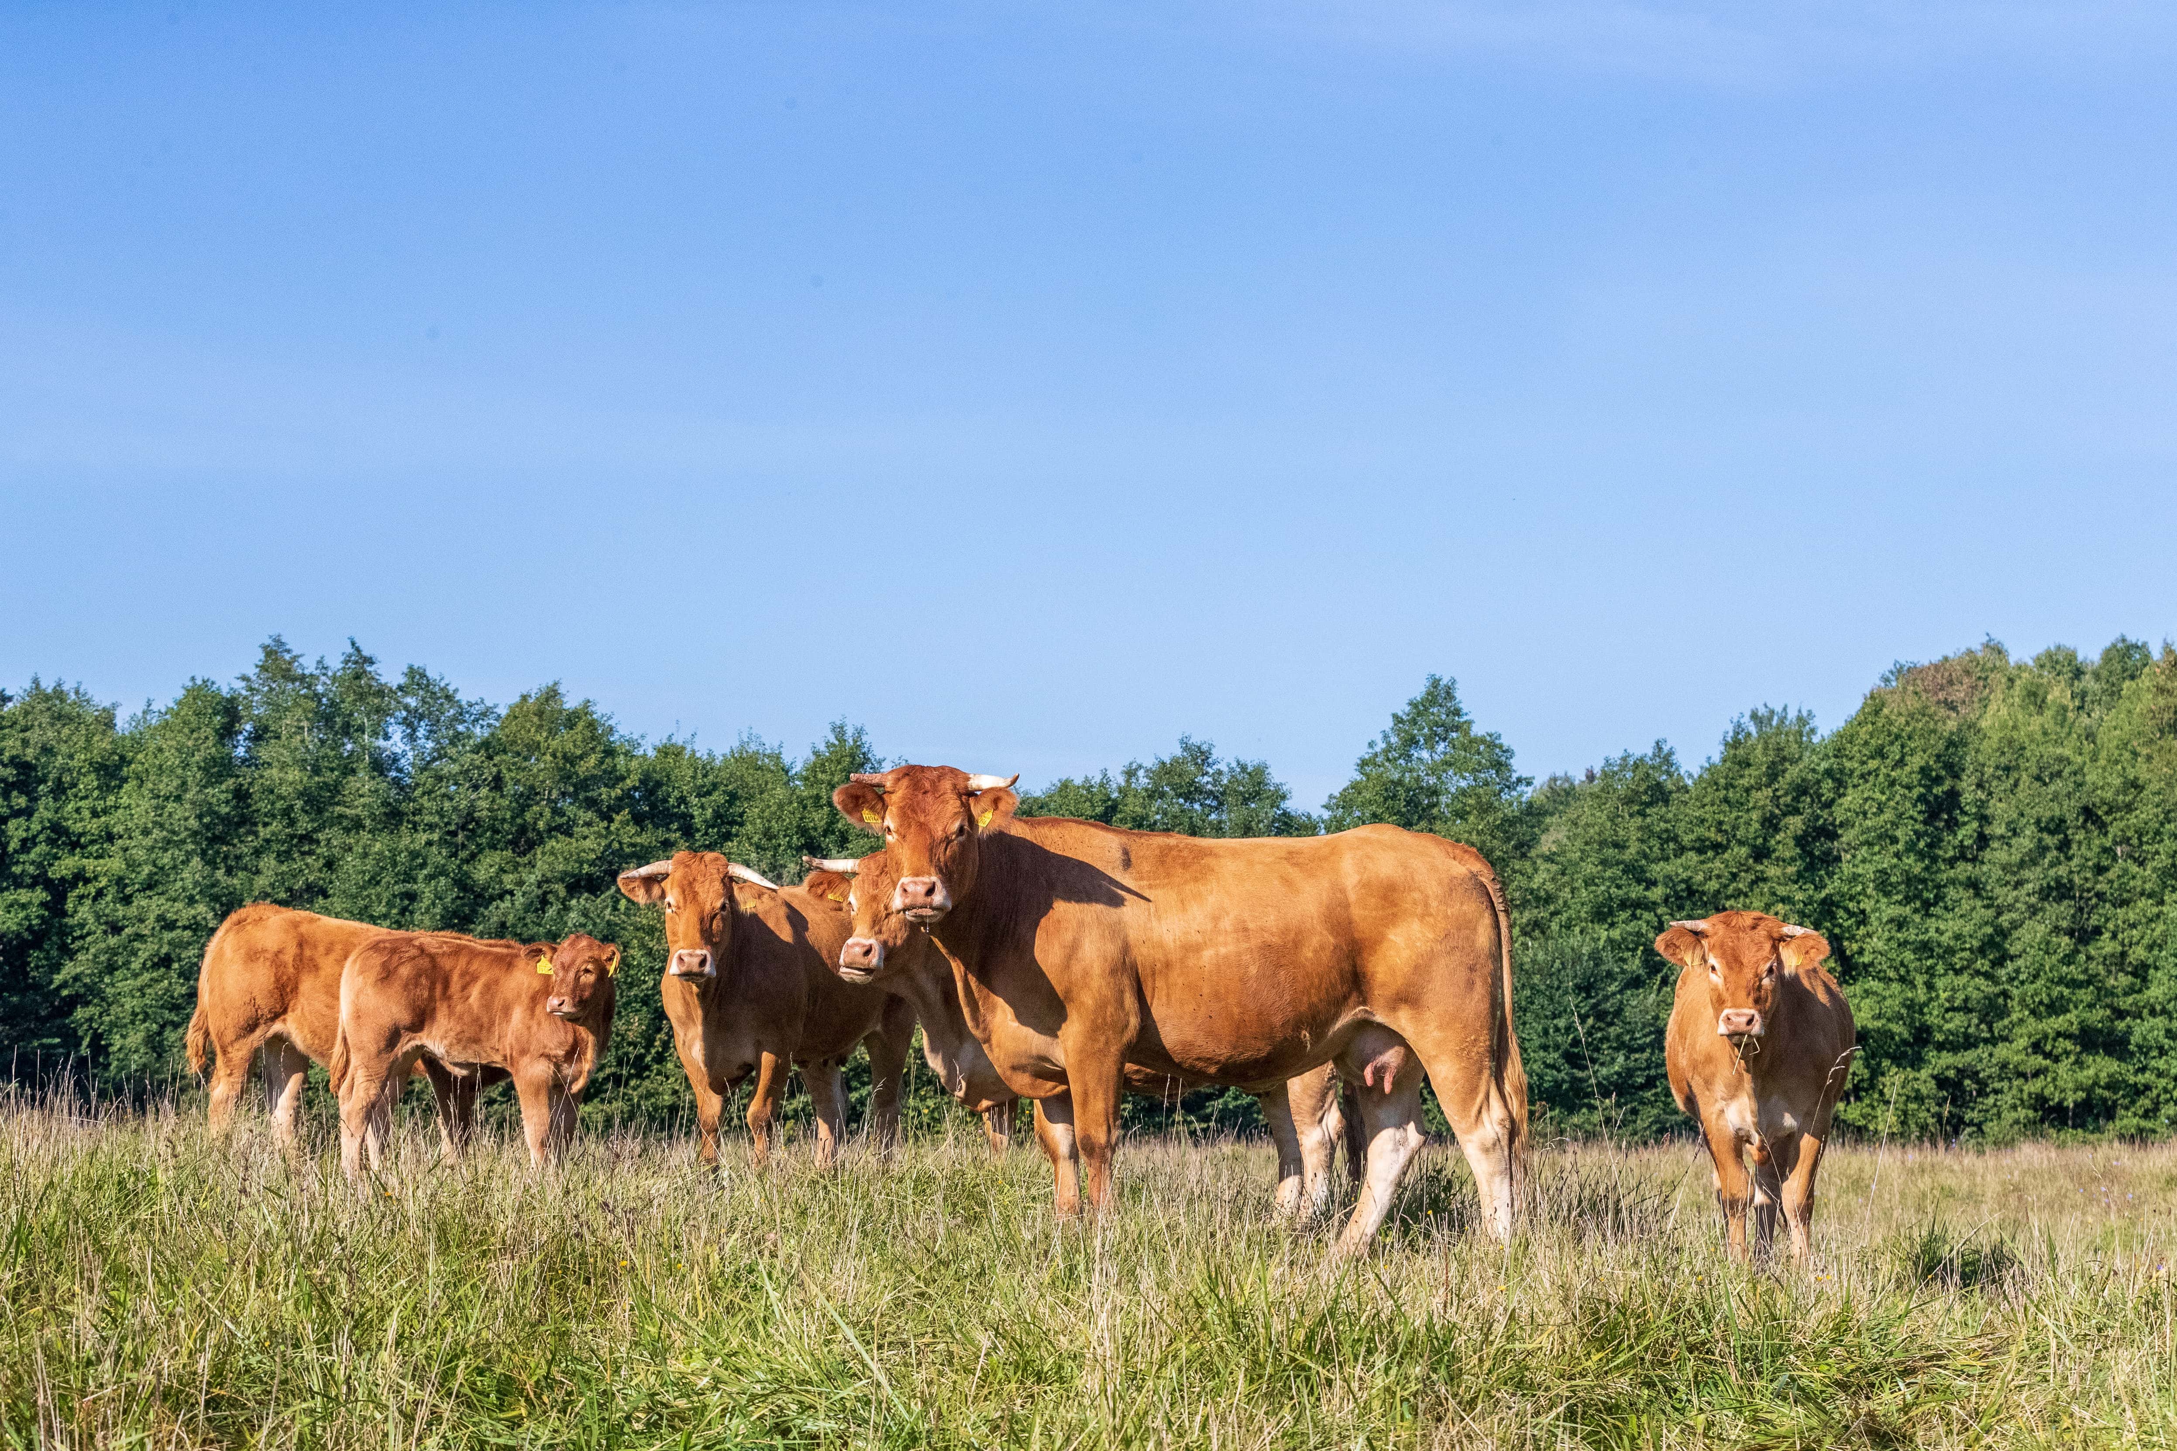
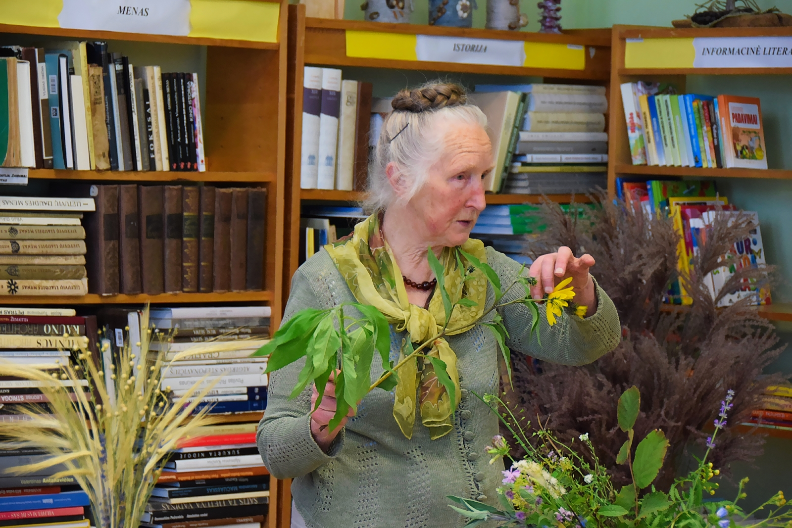
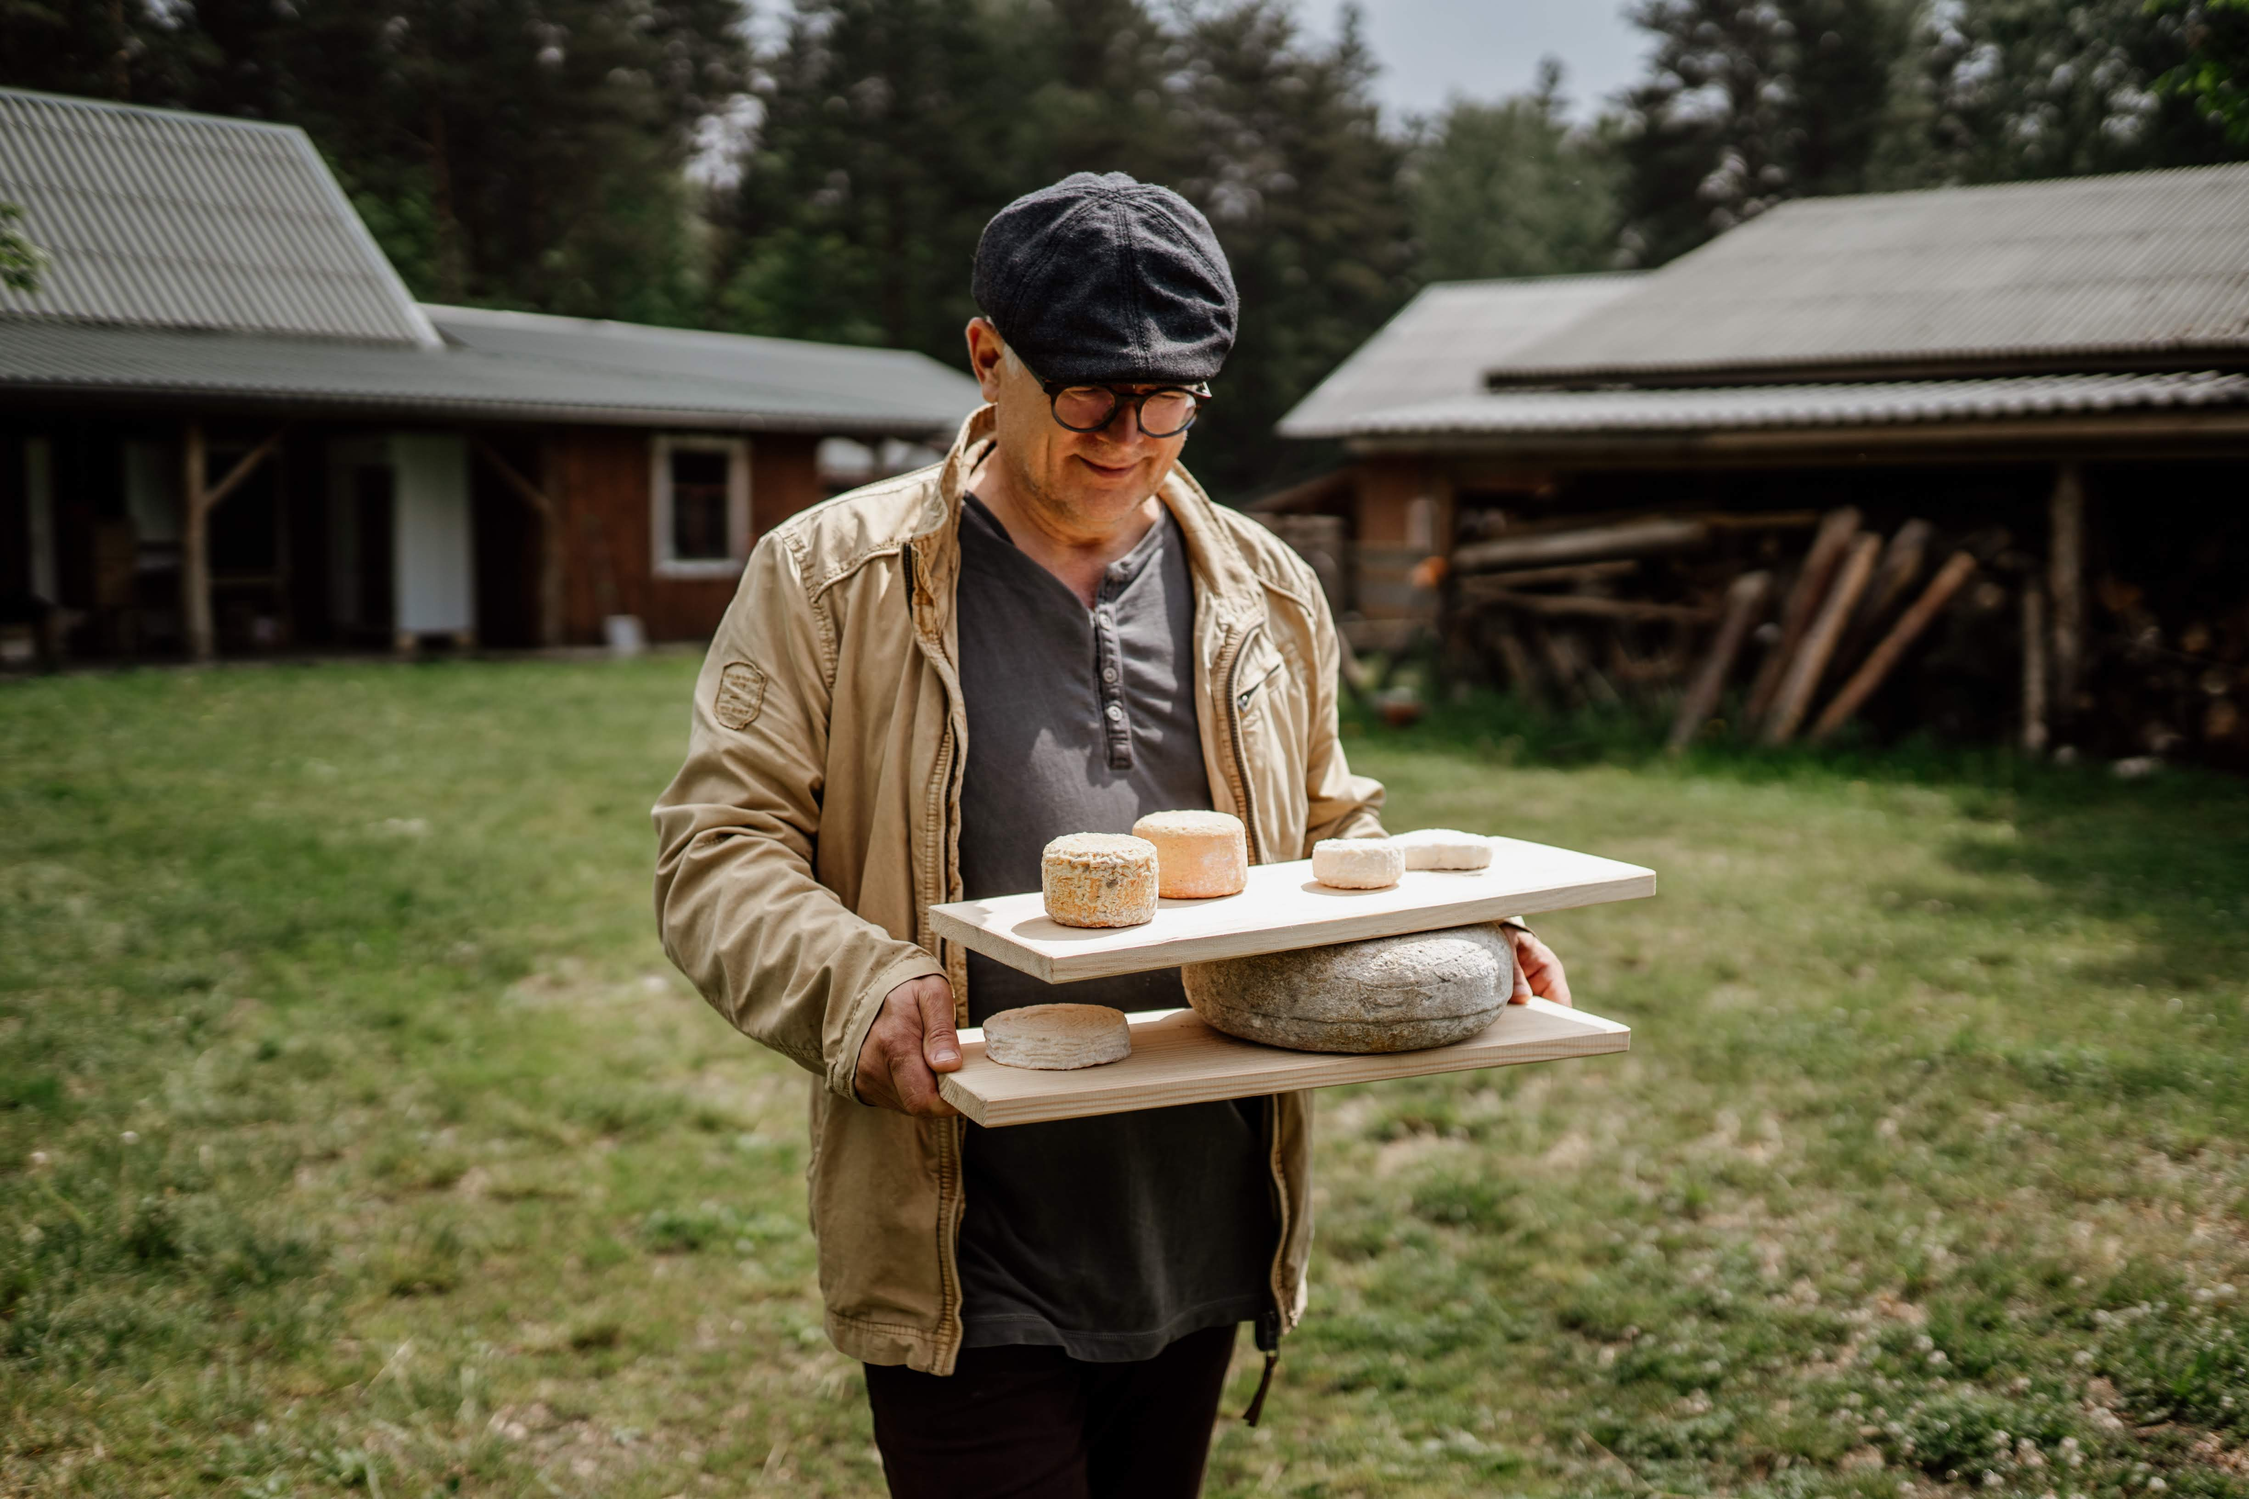
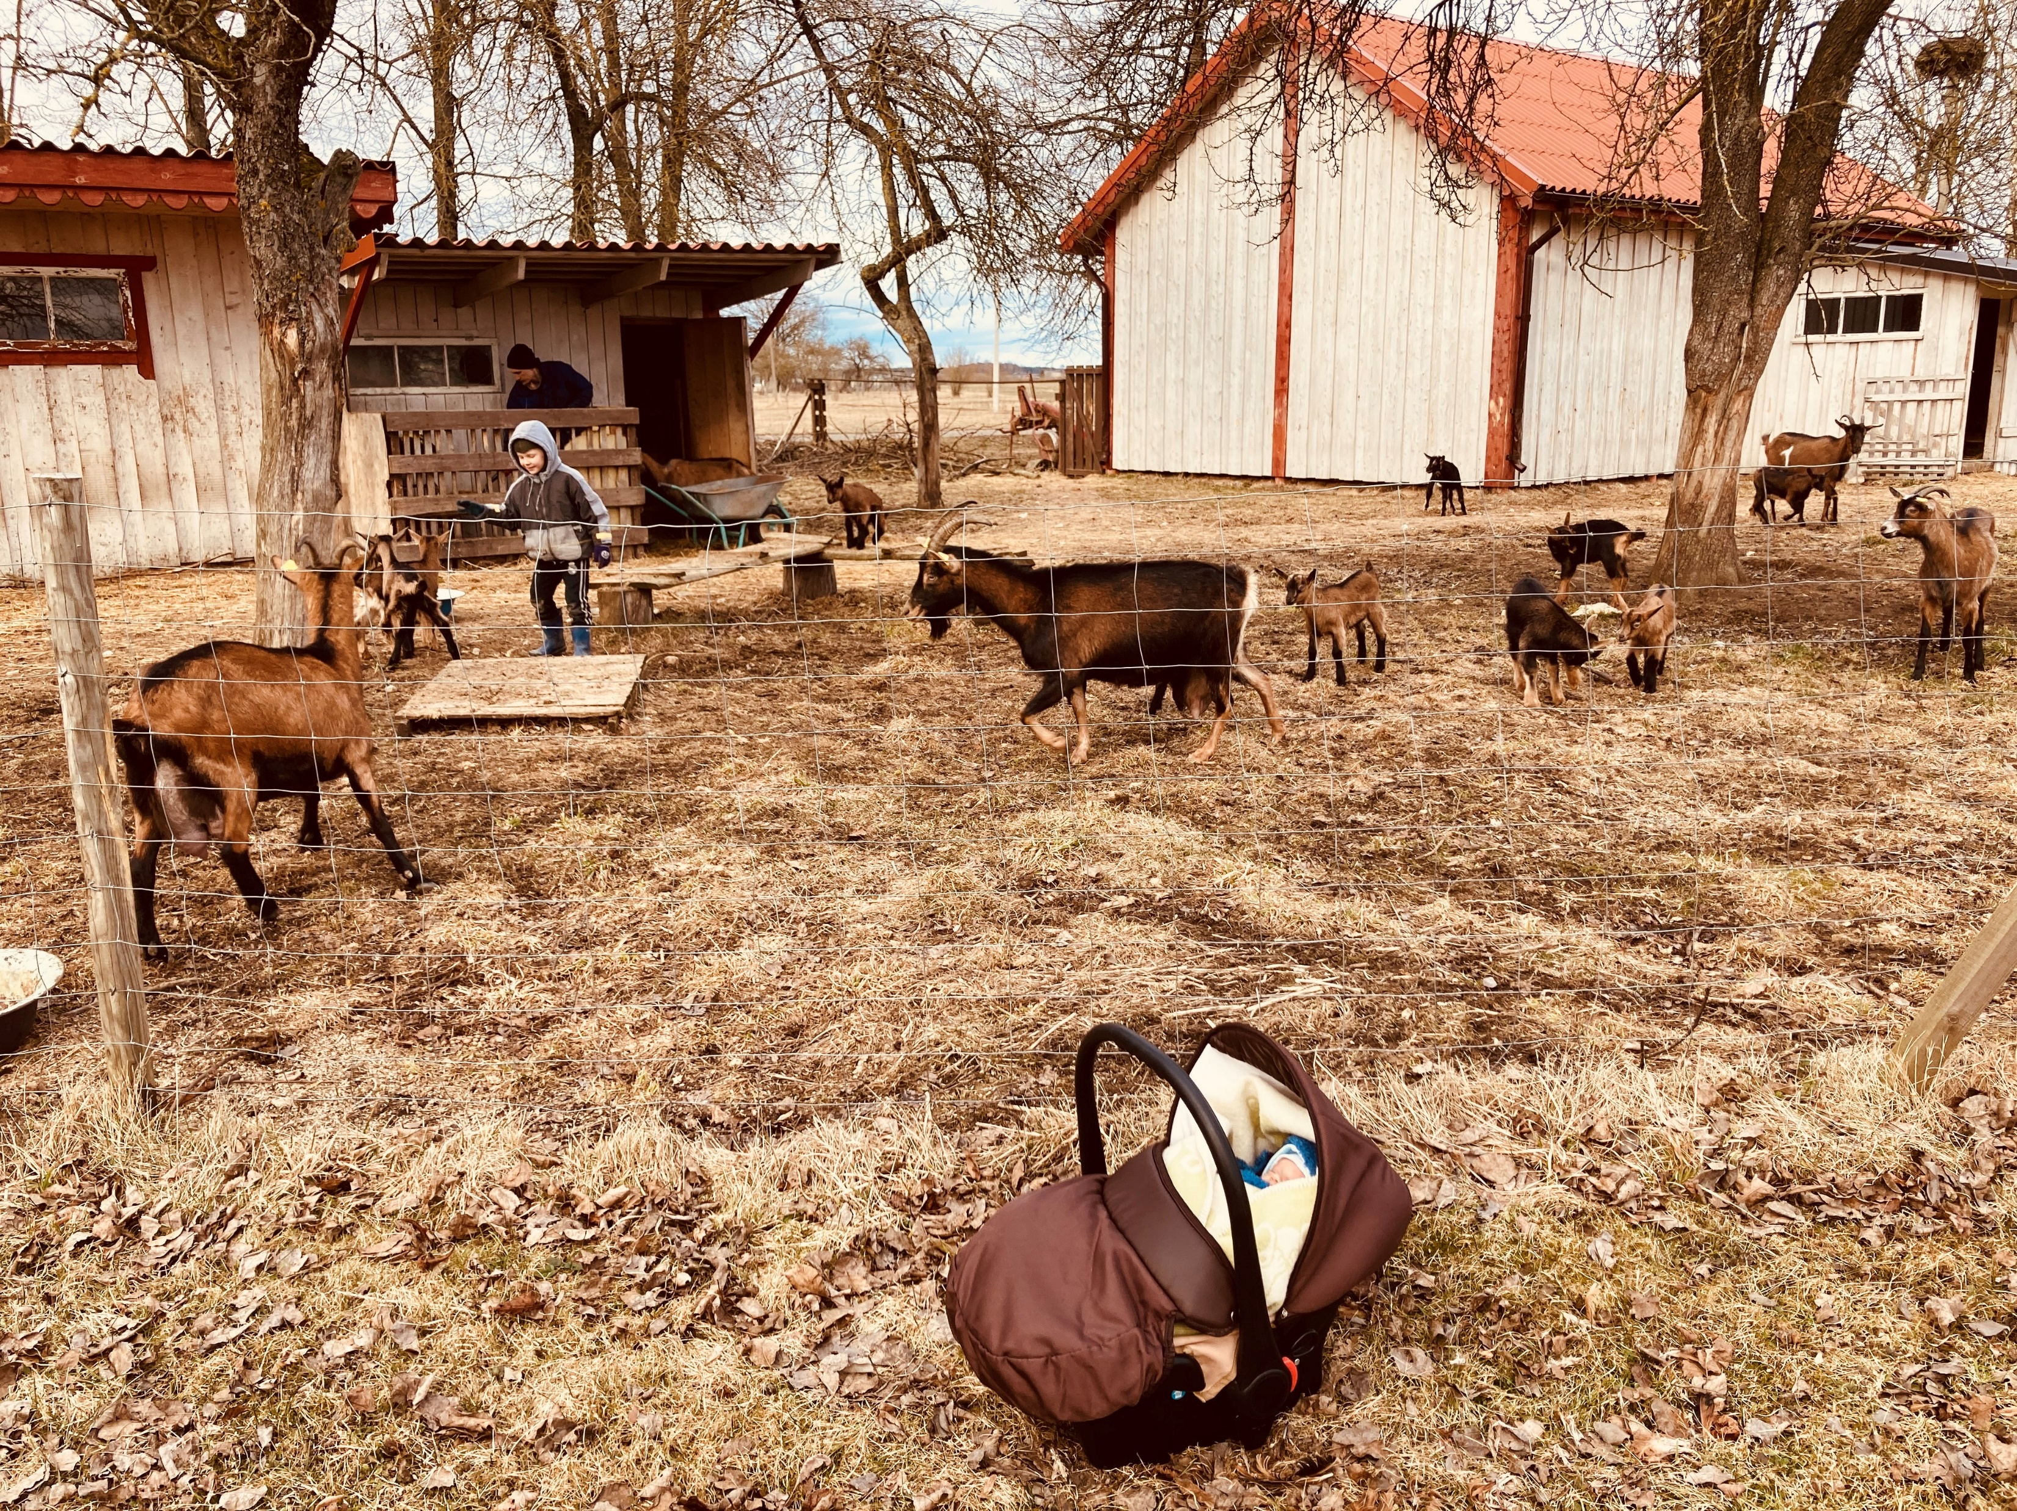

Slide 6
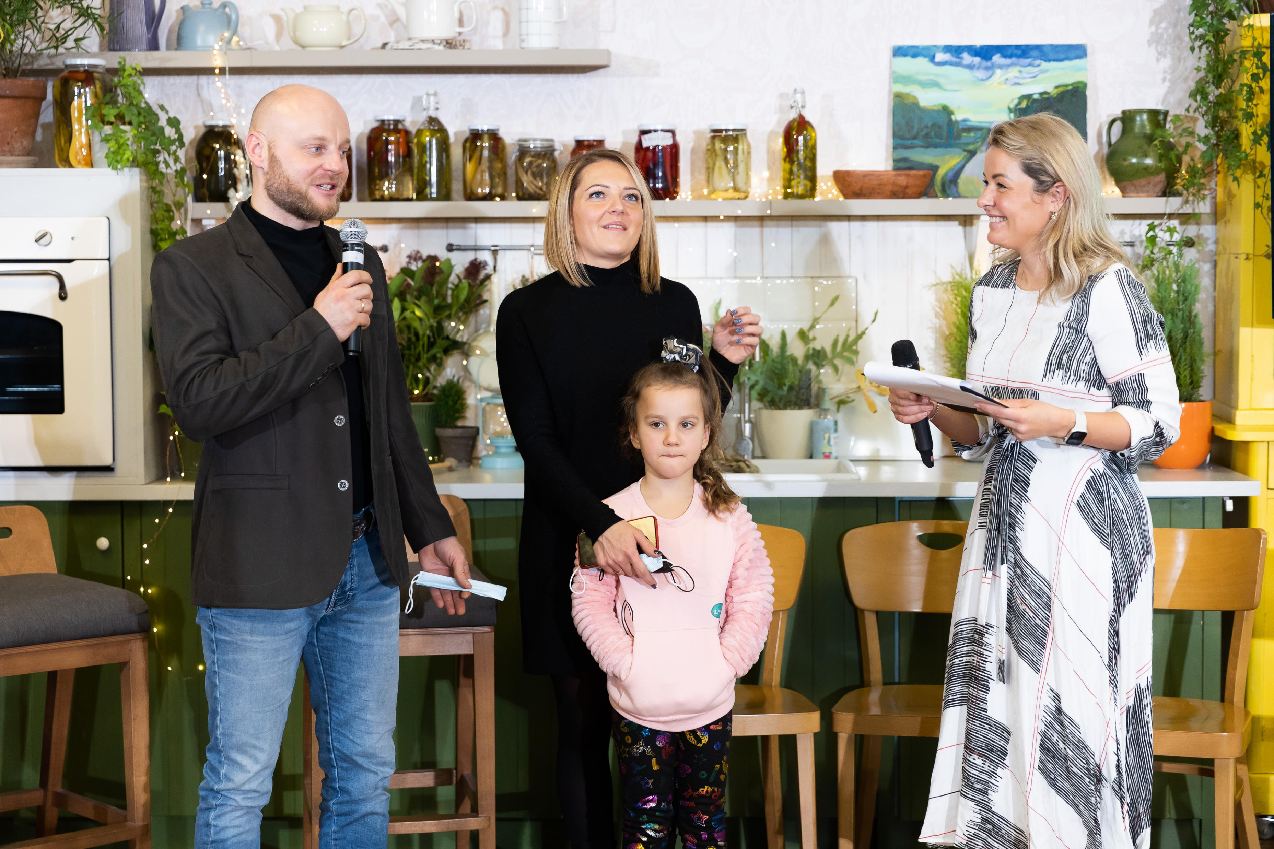
Some tips
Involvement of society by public voting for their favorite farmer;
Involvement of famous chef, culinary specialist and influencer Beata Nicholson. Helped to get more attention from media channels and allowed to use her own social media. Relation between nature-friendly farms and good quality food is worth to use.
Use of promoted posts in Facebook gained a big reach. Farmers were competing among themselves and inviting friends to vote.
Take into consideration quality of voting system because the biggest enthusiasts tend to cheat.
Notes:
Our goal for the next season is to find an informational partner in advance and to organize the main promotion and voting through that channel. Special website of the Championship is also being created at the moment. It is going to contain not only information about the competition and the winners, but also provide useful advice about nature-friendly agriculture and agri-environmental measures.

Slide 7
Voluntary works for business enterprises in protected areas

Slide 8
Voluntary works for business enterprises in protected areas
To promote “Natura 2000” network, to help and strengthen relationships with the directorates of protected areas and to establish connections with socially responsible enterprises.
Win-win initiative where employees of companies can have a teambuilding in nature and to get more knowledge about protected areas and endangered species, while directorates of protected areas can get a valuable help for nature management and other needs.
Protected areas are important players reaching people on the ground and spreading the messages face to face.

Slide 9
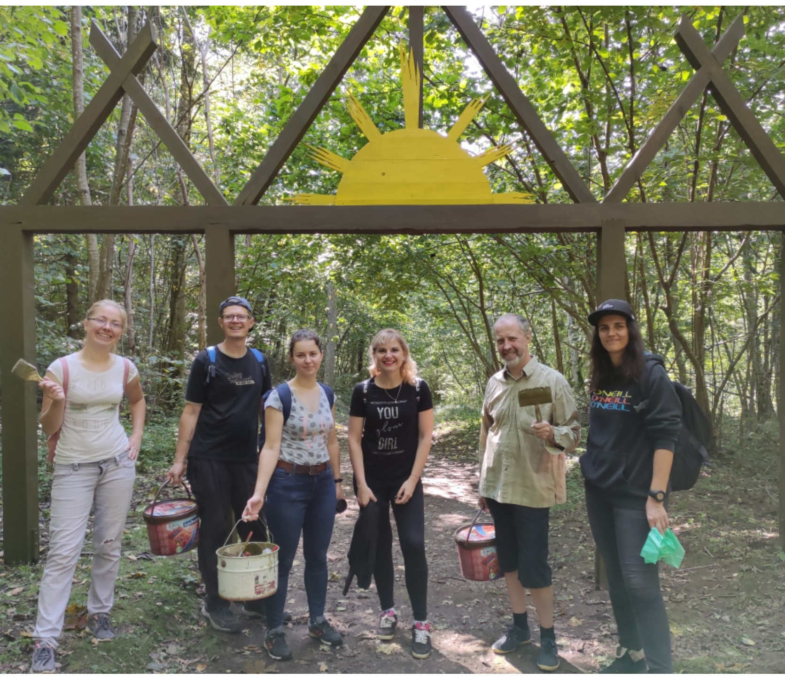
Results of the first season
13 voluntary works in 6 protected areas of Lithuania
145 volunteers
Works‘ total value was approximately 20 000 Euros
Different works from the restoration of Natura 2000 habitats to the renewal of infrastructure, creation of beetles‘ hotel or barefoot path.

Slide 10
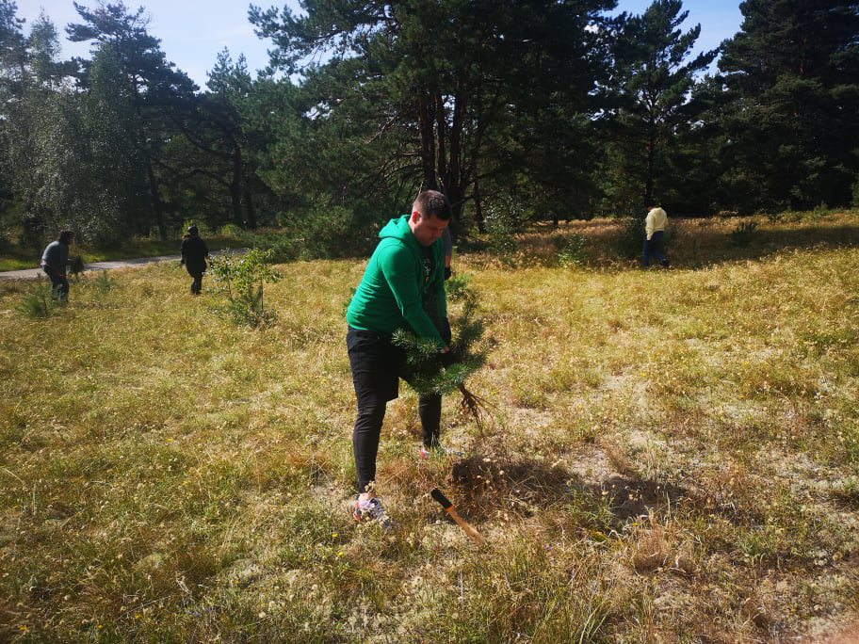
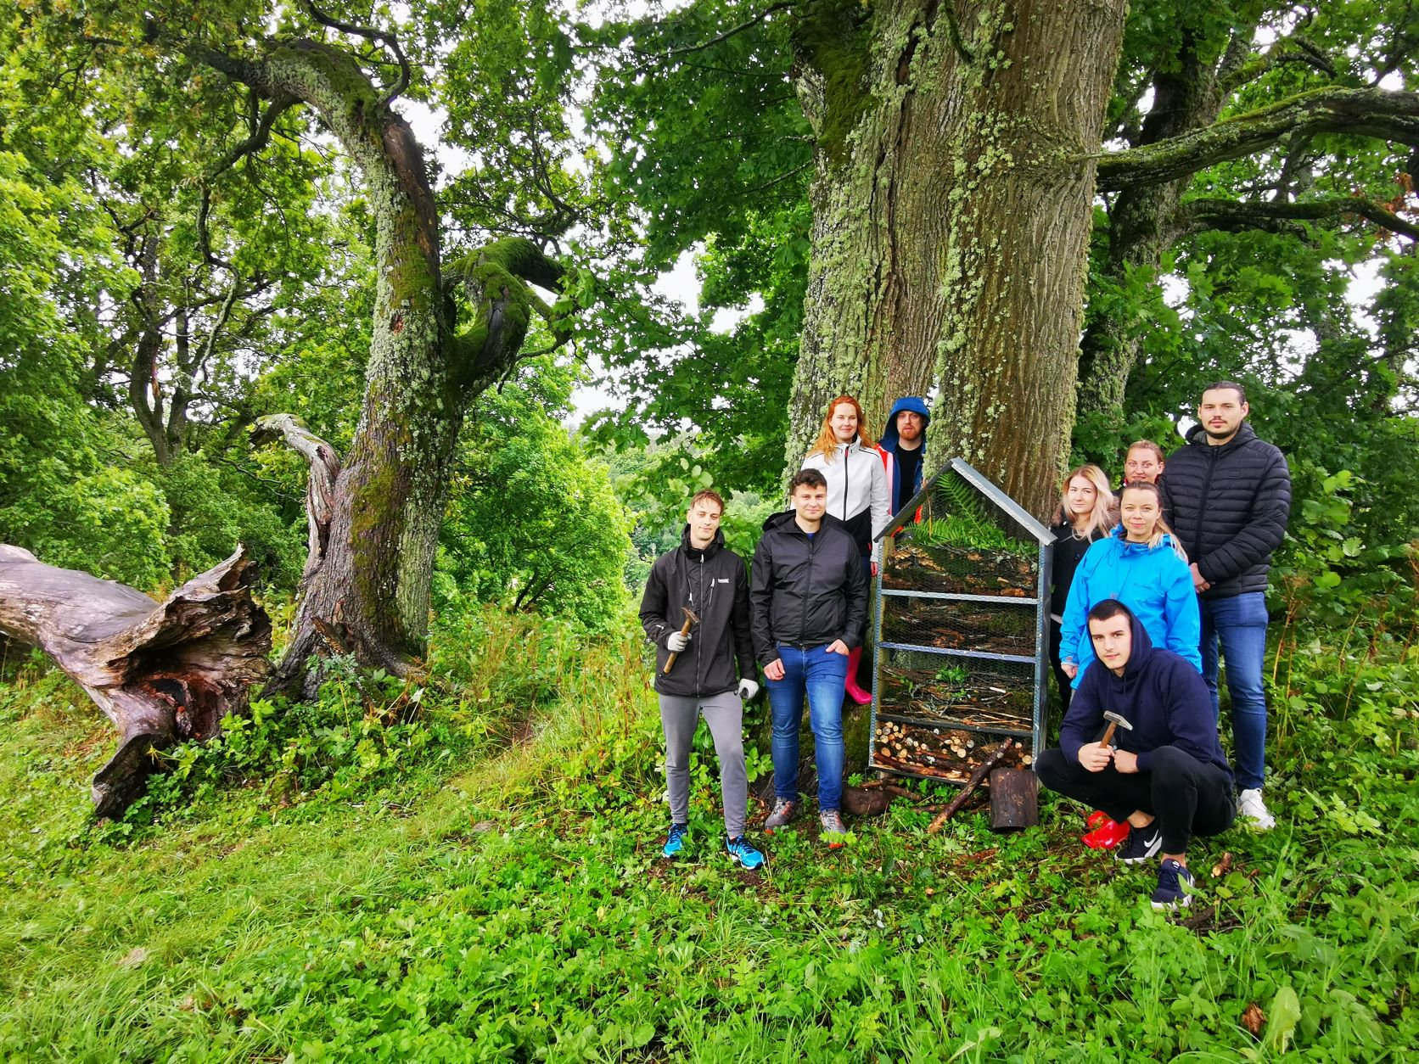
Voluntary works in protected areas

Slide 11
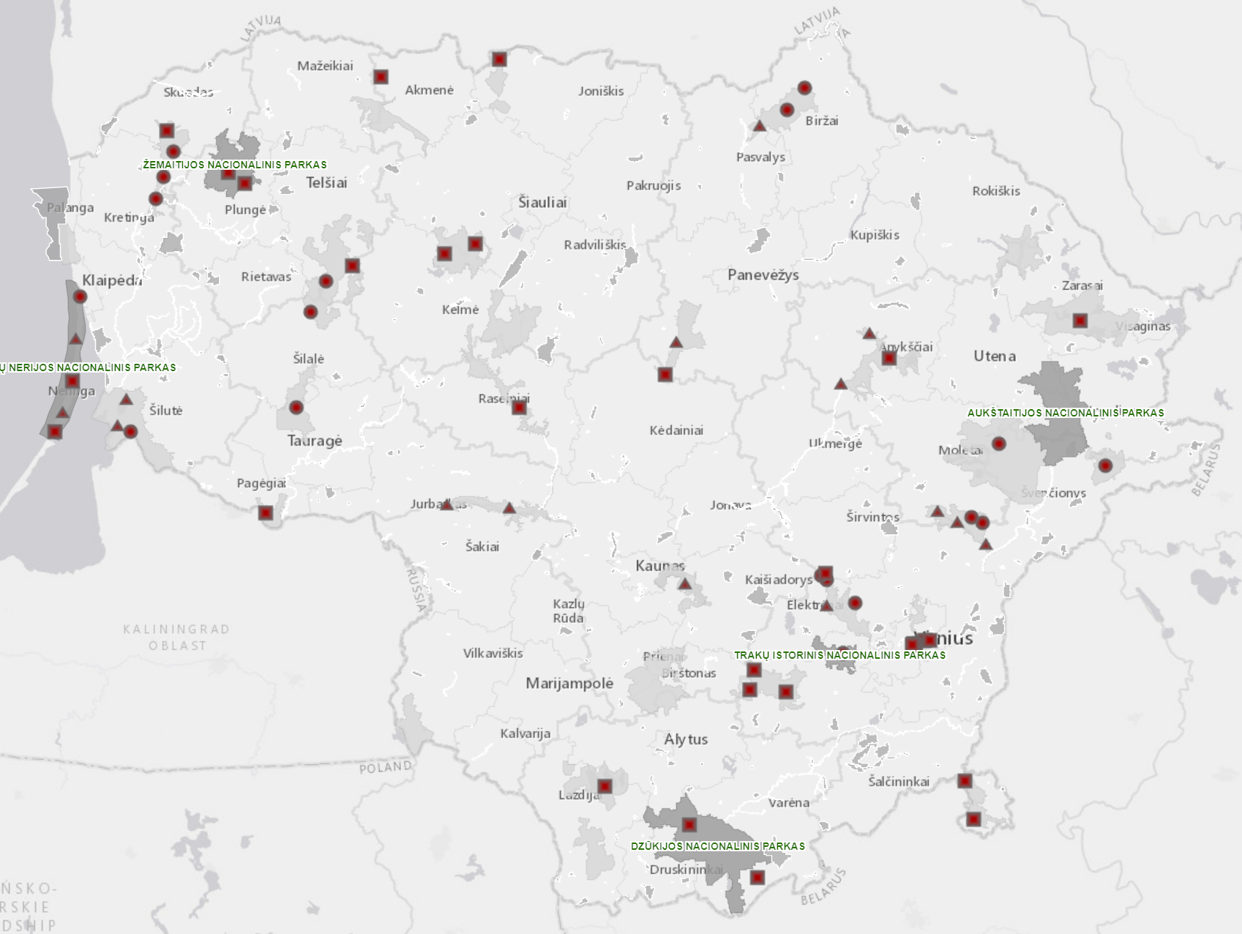
Plans for the next season
To involve more business enterprises from different regions of Lithuania. Target group – socially and environmentally responsible business enterprises with more than 100 employees.
Convenient map where business enterprises can see all needs of protected areas with a detailed information.
Already 70 voluntary works proposals are got from almost all protected areas in Lithuania.

Slide 12
People get people
Notes:
We use the principle that people get people. Participants of Good Farmer‘s Championship or voluntary works in protected areas get valuable personal experience, they get in touch with environmental challenges and then become ambassadors of the topic to their friends and relatives. It can be even more effective way rather than escallation of problems via media channels.

Slide 13
Let‘s get in touch
In case of any questions, please contact me:
Tel. no. +370 678 22052
Email: monika.vysniauskiene@apva.lt
Website of the project: www.naturalit.lt/en/home/

