Slide 1
Efficiency for Berlin Properties Investment Programme
Christoph Blaschke, Energy Efficiency Manager

Slide 2
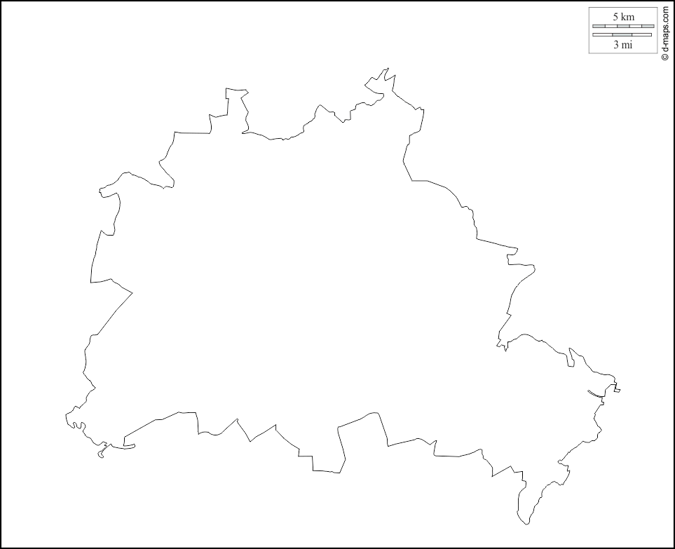

Berliner Immobilienmanagement GmbH BIM
Owner representative of the real estate assets of the Berlin Senate
BIM GmbH portfolio - state-owned real estate, various asset groups, including the
  SILB* (Special property of the state of Berlin)
  Heterogeneous use - around 5 million m²GFA
  approx. 380 building complexes
Energy efficiency measures in the area of technical building equipment
including electrical systems
Payback period < 10 years
Maximum CO₂ savings
SILB
* Portfolios of SILB:
Fire stations, schools, courts, correctional facilities, cultural sites, police stations, external tenants, accommodation for refugees & general stock (tax offices, administration buildings, etc.)

Slide 3
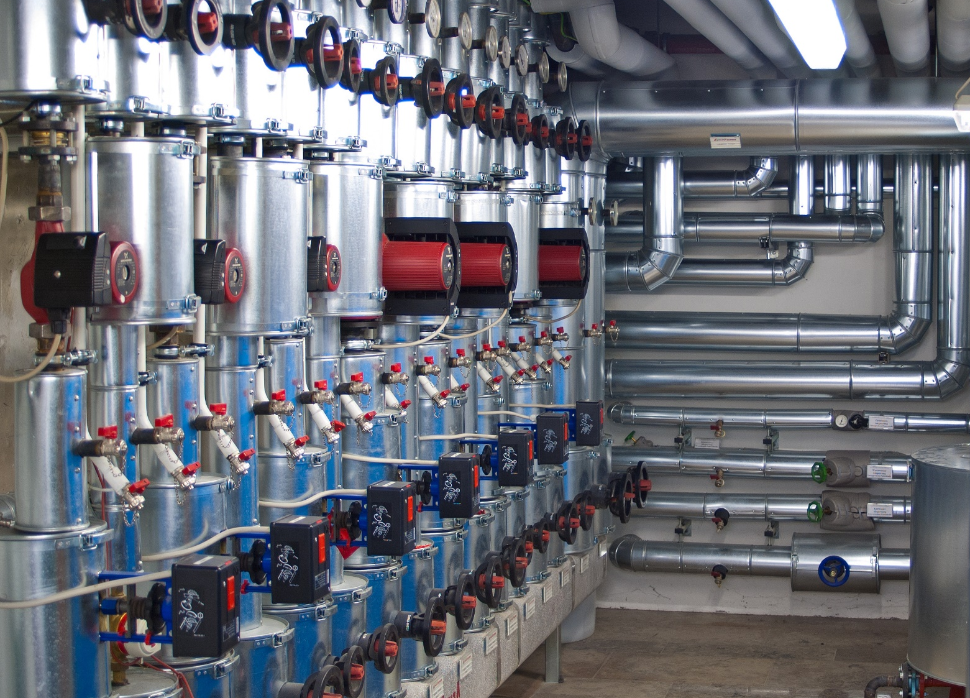


Scope of the „B.E.M. Energy Team“
100% subsidiary of
technical building equipment
including
electrical systems
Heating
Artificial lighting
Cooling & Ventilation
Smart Monitoring & Control
High-efficiency CHP
Photovoltaics & Storage

Slide 4
Focus areas of the investment programme
Heat package
Combination of heating control optimization, hydraulic balancing and pump optimization
Individual room temperature control
Efficiency optimization of room-by-room heating. Installation of intelligent single room thermostats
Intracting projects with general contractor model
Holistic and cross-discipline implementation of property-specific efficiency measures in the area of technical building equipment
Development of CHP plants
in cooperation with the Berliner Stadtwerke
Development of PV+Storage plants
in cooperation with the Berliner Stadtwerke
Conversion to LED
Efficiency optimization of artificial lighting. Substitution of conventional fluorescent materials on LED
Digitalization
Development of a cross-property building management system as well as an energy monitoring and controlling system
Energy Communities / Quarters
Shared use of decentralized energy generation
  in customer facilities (BIM properties)
  in urban quarters
Voltage management
Optimization of the power grid quality, regulation of the supply voltage

Slide 5
Intracting example: Berlin Secondary College for
Information and Medical Equipment Technology
OSZ IMT college was founded in 2002 and is the biggest school of its kind in Berlin with around 3.000 students and 160 teachers. The students are, on average, between 16 and 22 years old.

Slide 6
Concept-based contract award
(General contractor model / internal funding)
Heating technology – CHP
Heating technology - further measures (e.g. optimization of the system hydraulics)
Ventilation technology
Artificial lighting
Measurement and control equipment
Various measures (e.g. optimization of the central refrigeration system)
Controlling and monitoring system (web-based building management system)
Concept of user motivation

Slide 7
Performance incentive agreement
EPC arrangement using an internal fund model
A simpler contractual guarantee making a portion of payment conditional on performance (Energy Performance-Related Payment)
The contractor's right to remuneration is made up of the following components:
  Investment share: 80% of the total investment
  Performance share: 20% of the total investment
If less than 70% of the savings target is achieved, the contractor is no longer entitled to compensation for the performance share
If the CO₂ emissions are reduced by 70% of the savings target, the contractor will receive 40% of the performance share. With savings of over 70%, the entitlement to remuneration for the performance share increases in a ratio of 1:2

Slide 8
Selection of buildings for technology rollouts
With the internal energy efficiency fund, in addition to the holistic energy modernisation of large property complexes a series of technology rollouts were initiated for a large number of small and medium-sized properties (annual energy costs below 100,000 euros):
  Heating system optimisation in cultural and policy properties
  Individual room temperature control in school buildings
  Conversion to LED in all property segments
  Smart Heat pump program for selected properties
  Real-time energy management systems in all property segments
As part of the selection strategy, organisational requirements had to be taken into account when clustering properties
This applies, for example, to those properties that are subject to special security requirements both in terms of the analysis phase/inspections and the implementation phase, such as those of the police and fire brigade.

Slide 9
Experiences with fund financing mechanism
The clustering of technology-specific investments in a large number of properties allows a technology-specific financing strategy to be applied. This is particularly useful in rollout projects, for which in many cases technology-specific subsidies or lease financing can be used
However, the most important financing pillar in each case was the dedicated internal fund which represents pre-agreed financing while adhering to the agreed refinancing horizon, usually 10 years for own funds (=first funding pillar)
These own resources could in many several cases be supplemented by investment grants, as far as applicable for clustered projects (=second funding pillar)
Particularly for the decarbonisation of electricity generation through photovoltaics and CHP modules, it was also possible to access lease models with the Berlin public utilities for the financing (=third funding pillar)

Slide 10
Lessons learned and replicability
ELENA co-financing for project development of the various projects has complemented very well with B.E.M./BIM's flexible investment financing strategy
In the case of a large number of existing buildings, the great heterogeneity and the evolved building and organisational structures require a considerable effort in the initial building analysis and project structuring
Fast technological progress, especially regarding comprehensive decarbonisation through near-building photovoltaics and real-time analysis and control through IoT technologies, requires continuous further development of measures to tap new potentials and avoid lock-in effects
An important insight from the measures already completed is that without a focused property-specific analysis, both in terms of the technological starting point and the organisational boundary conditions, delays and obstacles can occur that can eat up the cost-reducing effect of serialising the measure.
Accordingly, in the new rollout projects, a stronger focus was placed on the match between technology, building characteristics and users of the property

Slide 11
Conclusions regarding efficiency finance
Shared Savings for complex projects: Performance share motivates to put effort into maximizing the savings (often by tuning the installation post-commissioning)
Supply of Capital: Ready-to-call financing in the internal fund reduces financing costs and implementation time
Size and Duration of Contract: Using an Internal Fund enables shorter contract terms and more flexible financing options
Flexible Procurement Options: In addition to the Internal Fund, partner financing is available through equipment lease models
Multi-stage financing: Preparatory ELENA project development funding ideally complements technology-specific funding for individual investment packages (capital investments)
Numbering-up and Scale-up are two successful models to accelerate energy efficiency investments depending on the size of the property
Tenant-landlord model for public buildings enables institution of Internal Fund model for the entire managed building portfolio

Slide 12
Christoph Blaschke
Energy Efficiency Manager
+49 30 90166 - 2420
christoph.blaschke@bem-berlin.de

