Slide 1
Showcasing how to phase out fossil fuels from urban heating & cooling

Slide 2
about us
Urban Innovation Vienna
Energy Agency & competence center for future urban issues in Vienna
Innovative strategies for diverse and complex challenges facing modern cities today
Working closely with international partners
Sharing experience and expertise
Learning from other cities
Notes:
In cooperation with decision makers from politics, administration, businesses and research, we develop innovative strategies for overcoming the diverse and complex challenges facing modern cities today.

Slide 3
About today
Why Decarb City Pipes project rationale & goals
Who we are The cities, consortium & people
How we work Our method & our approach
What we‘ve been up to so far Activities & results
Where next Plans & progress
Your questions

Slide 4
Transition roadmaps to energy efficient, zero-carbon urban heating and cooling
Horizon 2020 – Energy Call 2019
Topic: Supporting public authorities to implement the Energy Union
Duration: July 2020 to August 2023
Budget: 1,9 Mio Euro
www.decarbcitypipes2050.eu

Slide 5
Why decarb city pipes
It‘s complicated, it‘s urgent and we‘re not prepared
Climate urgency requires more stringent and faster action
Transitioning urban heating and cooling is key
Long life-cycles mean urgency to start planning NOW
Many uncertainties (technical, legal, process-related, social)
High-level of skills, knowledge and planning capacity required
Cities are ill-equipped for this challenge

Slide 6
What are we going to do about it
Equip cities with the know-how, capacity and mandate to act
build-up planning and implementation capacity
Identify decarbonization options for different urban typologies
address the “hot potato” of phasing out natural gas in building sector
understand potential and limitations of “green gas” for urban H/C
Break challenge down into manageable, concrete steps
Show-case how local authorities can succeed in this challenge
… and spread the word
make a valuable contribution to European climate action

Slide 7
Who we are – the cities
City | Bilbao | Bratislava | Dublin | Munich | Rotterdam | Vienna | Winterthur
Country | ES | SK | IR | DE | NL | AT | CH
Capitol | No | Yes | Yes | No | No | Yes | No
0-emission | 2050 | 2050 | 2050 | 2035 | 2050 | 2040 | 2050
Gas grid | Yes | Yes | Yes | Yes | Yes | Yes | Yes
DHC grid | Not yet | Yes | Not yet | Yes | Yes | Yes | Yes

Slide 8
Who we are – other partners
Project coordinator:
Urban Innovation Vienna (AT)
Scientific partners:
University Utrecht (NL) Dpt. for Human Geography & Spatial Planning
University Halmstad (SE) Dpt. for Construction & Energy Engineering
Capacity-building & dissemination:
Energy Cities (FR)

Slide 9
How we work – concept & method
Cities learning from cities, guided by scientific partners
7 cities to represent different stages of development and socio-technical characteristics
City-driven: „Local Working Groups“ as essential engagement format
Peer-to-peer learning between cities and local utilities/DSOs
Two scientific partners to guide cities on
techno-economic decarbonisation options (Halmstad University)
process-related, governance framework and transition management (Utrecht University)
Energy Cities network to disseminate and replicate
Distinguished Advisory Board to challenge and strategically guide the cities work!

Slide 10
How we work – thinking big & small
Mega trends (global, EU)
Local circumstances (city, region)
decreasing demand for heat
increasing demand for cooling
green electricity --> sector coupling
heat pumps: range of use?
green gas: how much, which sectors ?
energy storage (including seasonal)?
low temperature grids etc.
existing energy infrastructures
heat densities (spatially differentiated)
local RES and waste heat potentials
legal competences to orchestrate the transition of H/C market
(political) will of stakeholders
administrative capacities

Slide 11
How we work – questions we’re tackling
Solutions for different urban areas
Procedures, instruments, partners
Where to establish new DHC? Where not?
What role, if any, for „Green Gas“?
How to unbundle gas and DHC grids?
What role for (decentral) heat pumps?
How to accomodate for sector coupling?
How to decarbonise existing DHC?
How to set up data-based H/C planning?
What regulatory or financial instruments?
How to transform incumbent institutions?
How to overcome path depency and vested interests?
How to team up with new market participants?
How to get citizens on board?

Slide 12
How we work – it‘s all connected ☺
Heating & Cooling Outlook 2050
techno-economic pathways
Transition Roadmaps
Analysing, mapping,
context
demand & supply, data access, design approaches
spatial zoning, potential, demand & infrastructure
Local socio-technical framework condition
learning, exchanging, empowering
Scientific partner support & guidance
Know-how transfer p2p between cities and utilities
Change management, brokering agreement
Developing, agreeing, performing
Cities develop H/C Outlook
Cities develop H/C plan
Cities develop Transition Roadmaps

Slide 13
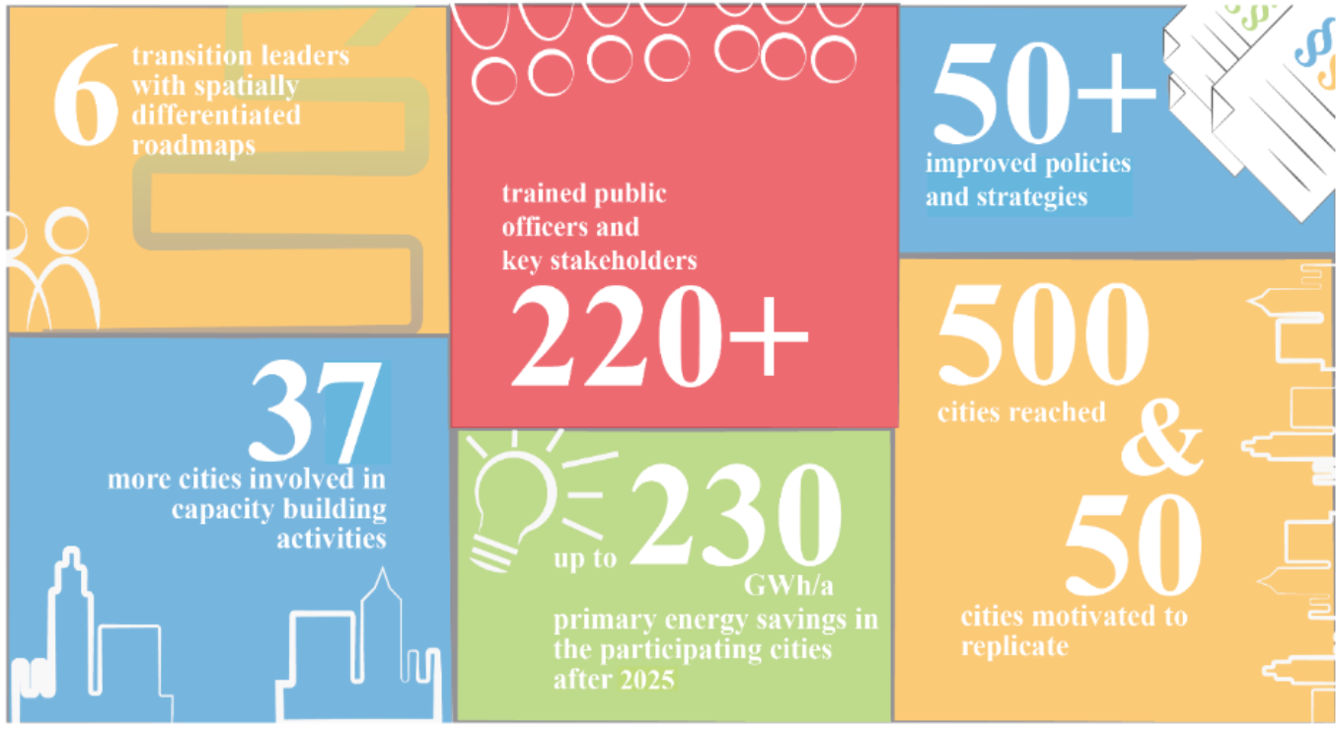
Expected impacts

Slide 14
What we‘ve been up to
Notes:
Shorten to 2 Minutes max!

Slide 15
never waste a good crisis
Getting started during a pandemic
surfing the climate wave
Kick-off delayed and moved online
diligent preparation key
investment in team building paid off
Not all bad:
adjusted formats to meet more frequently (as it‘s easier to do online)
keeping the conversation going instead of meeting only twice-yearly
Digital learning curve massive
These things will be here to stay
EU kept up climate ambition
Dynamic increased since project proposal
Adjusted project schedule to make the most of it
City targets & timelines more ambitious
both good and bad
strengthened political support
overwhelmed staff
not all cities stayed on climate course
Notes:
Good and bad – but mostly good
overwhelmed staff sometimes to the degree of incapacity to learn and benefit from project
Generally risk of overwhelming cities staff

Slide 16
Cities planning the transition locally
Cities set up local working groups
Supported by project partners
Set-up of local working groups to develop Transition Roadmaps
Getting relevant actors on board and onto the cause
Setting a common target and a vision towards which to plan and prepare for
Developing and agreeing an agreed Heating and Cooling Outlook 20XX
Work has started in all Cities
scientific partner Halmstad on :
what to expect for energy demand and supply situation
techno-economical system correlations and feasible decarbonisation options
Urban Innovation Vienna on:
stakeholder & power analysis
process and management
topics mapping
Kees van der Leun, Guidehouse, AB:
- Feedback on draft outlooks by Cities
Notes:
HU: different possibilities and combinations for participating cities to explore, with respect to technical and economic strengths and weaknesses of the different low-carbon H/C supply choices available for (dense) urban areas.
UIV: How to set up functioning, lasting and robust local working group
Kees:

Slide 17
Cities planning the transition locally
Agreeing on a common goal
Plausible, desirable H/C vision in each city
Outlook of demand & supply to reach zero-carbon H/C in target year (2035 to 2050)
CO2-reduction pathways
renovation rates
heating system exchange scenarios
Agreement among the key actors!
Foundation for next planning steps

Slide 18
Driving Changes in Dublin
Impacts so far:
Creation of Local Working Group - highlighting local challenges to be addressed in the project
Developing a heating & cooling outlook for Dublin within the Local Working Group
Knowledge sharing with local stakeholders through group sessions/webinars – data management, geothermal etc.
Consortium members (ROT, VIE) speak with local authority spatial planners to inspire them and show what's possible based on work in other regions

Slide 19
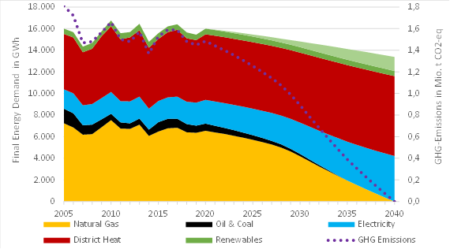
Vienna‘s H/C outlook 2040
Notes:
Local Working Group convended 5x in plenum, plus technical sub-groups
Agreement among the members of the working committee on a plausible zero-carbon supply and demand outlook has been reached, including:
CO2-reduction pathway
energy demand scenario
thermal renovation activity & heating system exchange rates
break-down of potential renewable energy sources
expected market share between DH or all-electric solutions (albeit rough)

Slide 20
Peer to peer learning and knowledge transfer
Supporting each other and getting competent help where needed
Identification of topics of interest with City partners
Development of workplan for capacity building activities 2021
Now: implementation in monthly online-meetings in fixed slots since February
Later: different formats (presentations, smaller working groups, study visits, etc.)
Includes utility perspectives (e.g. Deep Geothermal Energy, grid transformation, funding schemes) for some sessions
Additional cities from outside the project consortium participate
Participation averaged between 20 and 50 persons per session
Programme adjustable – city driven!

Slide 21
Highlights from the capacity-building
Risk mitigation strategies for cities around green gas & hydrogen
Lisa Fischer, E3G
Project Advisory Board:

Slide 22
Highlights from the capacity-builidng
The role of geothermal energy for heat decarbonisation
Sarah Blake, Goelogical Survey Ireland / Dublin
Caroline Steiner, Geologisches Bundesamt Österreich / Vienna
Annelieke Vis, City of Rotterdam
Annecatrin Theis, Stadtwerke Munich

Slide 23
Where to next
Cities getting real about phasing out fossil fuels from heating and cooling
Moving planning activities from the quantitative to the spatial level
Next up : H/C Maps in each City
Start looking at process and change-management questions
Next up: mission by scientific partner Utrecht University to explore situation in each city
Changing the multi-level governance framework
Next up: City & national, EC consultations
Finally meeting everyone in person!

Slide 24
Your questions

