Slide 1

Background to the LIFE BEST call &
Scope of LIFE-2021-BEST call
Small Grant Facility on Biodiversity (BEST) Info session
18 January 2022/ Brussels
Notes:
Introductory remarks:
The present call ‘LIFE-2021-BEST –Grant Scheme for Biodiversity in Outermost Regions and Overseas Countries and Territories’ builds on the results and lessons learnt from previous BEST Programmes.
The call states explicitly that the proposed project should build on the experience of past programmes that supported a small grant scheme for biodiversity action in the EU’s ORs and OCTs.
In the 1st part of this presentation I will therefore give you an overview of past BEST projects and highlight some key insights with a focus on how they worked and lessons learnt.
The 2nd part of this presentation will focus on the scope of the activities to be funded under the small Grant Scheme to be established through under this call.

Slide 2
Part I: Background to the LIFE BEST call
Small Grant Facility on Biodiversity (BEST) Info session
18 January 2022/ Brussels

Slide 3
BEST: origins
The BEST initiative started as a follow up to the 2008 ‘Message from La Reunion Island’ that called for a dedicated funding mechanism to support the conservation of EU Overseas’ biodiversity.
Following up on this recommendation, the EC in collaboration with the EP set up a draft concept with general objectives and basic principles.
It resulted in the BEST Initiative that started in 2011 with the BEST Preparatory Action as a «Voluntary scheme for Biodiversity and Ecosystem Services in Territories of European Overseas»

Slide 4
BEST initiative’s overall objectives
To facilitate access to EU funds for actors in the EU Outermost Regions (ORs) and EU Overseas Countries and Territories (OCTs) so as to unlock initiatives and potential in the fields of biodiversity conservation and the sustainable use of ecosystem services, including ecosystem‐based approaches to climate change adaptation and mitigation, as a basis for sustainable development.
To increase the capacity of ORs and OCTs actors to access and effectively manage EU funds.
To increase the visibility of EU ORs and OCTs as key contributors to the achievement of EU and global biodiversity targets and strategies.

Slide 5
BEST Preparatory Action (1)
was first adopted by the EP in 2010, then resubmitted twice in 2011 and 2012, with an overall budget of 6 million Euros.
16 projects were funded through 2 open calls for proposals;
Projects involved organisations in the ORs, OCTs and, in Member States, including NGOs, public bodies, regional and international organisations and research institutes for the implementation of activities at local and regional levels
supported activities for:
  the designation and management of terrestrial and marine protected areas; combatting invasive alien species; establishing synergies using ecosystem services for climate change adaptation and mitigation; the valuation of ecosystem services; increasing knowledge, networking, education, capacity building and outreach activities.

Slide 6
BEST Preparatory Action (2)
3rd and last year of the BEST PA was implemented through an open call for tender for ‘Measures towards sustaining the BEST PA’ and helped build BEST as:
An open partnership;
A field-based and participative approach;
A science-based action strategy;
A networking instrument.

Slide 7
Recommendations from BEST PA re: open calls for tenders
Target small and local organisations to unlock the local potential through more accessible small grants;
Organise regional calls to mitigate potentially unbalanced competition between regions and between ORs and OCTs with different capacities and situations;
Invest in capacity building to enable, empower and strengthen local authorities and (particularly small) civil society organisations in their competences to develop and deliver relevant and effective projects;
Clearly define rules for eligibility, duration and maximal budget and selection criteria.

Slide 8
Recommendations from BEST PA re: grant execution
Invest in capacity building for preparing, managing and reporting on projects and provide sufficient resources for capacity-building for potential applicants & beneficiaries;
Provide readily understandable/ accessible and comprehensive information; from project application to final reporting for potential beneficiaries;
Ensure that the feasibility of the project timelines is properly assessed during the evaluation of proposals and provide an opportunity prior to the signature of the grant agreements for timelines to be extended if required;
Keep financial reporting simple; explore the possibility of lump sums and results based payments;
Make provisions that unused budget can be used for next calls for proposals to fund additional biodiversity action and projects in the ORs and OCTs
Make sure that projects with a policy focus have the necessary support for project conception and are implemented with tangible activities on the ground and in partnership with local actors.

Slide 9
Initial follow-up projects (1): BEST 2.0
  Launched in 2014 drawing on lessons of the BEST PA.
  Objective was to enable, empower and strengthen local authorities and civil society organisations committed to local development and biodiversity conservation and sustainable use of ecosystem services in the OCTs to implement actions on the ground.
  The programme established a grant facility for small (up to 100,000 Euros) and medium-sized (up to 400,000 Euros) grants for biodiversity action in OCTs.
  3 calls for project proposals; 60 projects awared in the five regions

Slide 10
Initial follow-up projects (2): BEST RUP
  RUP = Régions Ultrapériphériques Françaises
  3 year project launched in 2017
  implemented the pilot project ‘inventory of species and habitats and environmentally sensitive areas in the French Outermost Regions (ORs)’ adopted by the EP in 2015.
  conceived as a further element to build a sustainable partnership to promote the conservation of biodiversity and the sustainable use of ecosystem services including ecosystem-based approaches to climate change adaptation and mitigation, and nature-based solutions in the EU’s ORs and OCTs.

Slide 11
Recent follow-up projects (2020):
LIFE4BEST & BEST 2.0
LIFE4BEST: direct follow up of the LIFE RUP programme, covers ORs – funded through the LIFE Programme, OFB & AFD.
BEST 2.0+: direct follow up of BEST 2.0, covers OCTs – funded by DG INTPA
Both programmes support field actions, which aim to: enable, empower and strengthen local authorities and civil society organisations committed to local development, biodiversity conservation and sustainable use of ecosystem services, through the implementation of grant schemes accompanied by capacity building activities.
Notes:
In 2020, Life4BEST and BEST 2.0+ programmes took over following the end of BEST RUP and BEST 2.0, respectively covering the ORs and the OCTs.

Slide 12
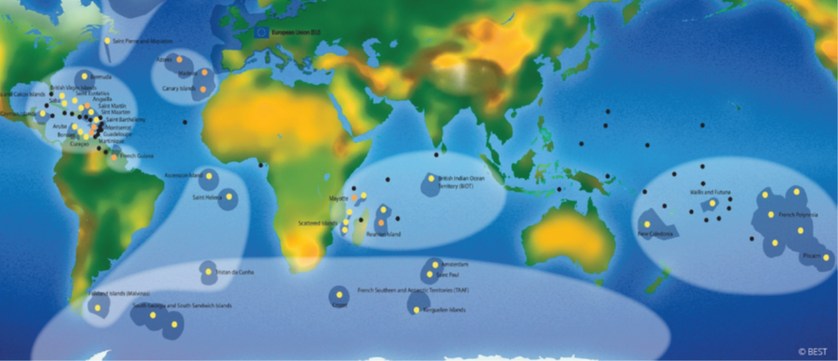
Results (2021)
BEST programmes supported field actions to empower and strengthen local stakeholders committed to local development, biodiversity conservation and sustainable use of ESS;
Over 100 projects were supported by BEST in 6 regions: Amazonia, Caribbean, Indian Ocean, Pacific, Polar and Subpolar, and South Atlantic;
7 regional ecosystem profiles: 400 new key biodiversity areas (KBAs) & ecological corridors identified;
7 regional investment strategies with 450 ready-to-be funded projects identified.
Source: IUCN (2020) BEST Global Impact Factsheet 2015-2019

Slide 13
Results overall figures (2015-2019)
Source: IUCN (2020) BEST Global Impact Factsheet 2015-2019

Slide 14
Project results (2015-2019)
Source: IUCN (2020) BEST Global Impact Factsheet 2015-2019

Slide 15
Project results (2015-2019)
Source: IUCN (2020) BEST Global Impact Factsheet 2015-2019

Slide 16
Conclusions from BEST implementation (2017)
BEST Initiative increased awareness of the global importance of the EU Overseas biodiversity.
Activities funded laid the foundations for establishing a sustainable grant scheme for small and medium sized biodiversity actions in the ORs and OCTs.
The need for this funding and readiness of local actors has been demonstrated by the response to the calls for proposals launched to date.
Future grant schemes should:
  respect the principles of effectiveness, efficiency and good governance;
  provide opportunities for collaboration across OCTs & ORs + development of regional initiatives, which pool resources and expertise to address common issues eg. impacts of climate change and IAS.
Source: https://ec.europa.eu/environment/nature/biodiversity/best/pdf/Best_PA_Web.pdf

Slide 17
Key lessons learnt from BEST 2011-2020
Small grants can have an important impact not only locally but as well at the EU and international levels. They have a multiplier effect;
Diversity of needs and capacities requires a diversity of approaches grants and mechanisms that can play in synergy and complementarity;
When empowered, local stakeholders and citizens can make a difference: they are key for the EU Biodiversity strategy implementation
Presence on the ground and regional expertise to assess/monitor is key
Capacity-building and Monitoring activities are a must and should not be underestimated;
Participative preparation of a pipeline of projects is fundamental;
Source: Presentation to European Parliament by Carole Martinez, IUCN, March 2021

Slide 18
Part II:
Scope of LIFE-2021-BEST call
Small Grant Facility on Biodiversity (BEST) Info session
18 January 2022/ Brussels

Slide 19
Activities that can be funded (1): Aim & purpose
Aim of proposed project: to implement a small grant scheme for biodiversity action in the EU’s ORs and OCTs.
Purpose:
  to further unlock the local potential for biodiversity action in the EU's ORs and OCTs;
  to foster the implementation of concrete conservation activities in those areas aiming at protecting nature and reversing the degradation of ecosystems.
Proposed project should build on experience of past programmes that supported a small grant scheme for biodiversity action in the EU’s ORs & OCTs.
In particular Ecosystems profiles and regional investments strategies for each region of the ORs and OCTs provide guidance (=> https://ec.europa.eu/environment/nature/biodiversity/best/regions/index_en.htm )

Slide 20
Activities that can be funded (2): the approach
Calls for proposals & the selection of the grants should be based on a strategic intervention logic and clear mechanism that guarantees:
  the maximum level of coordination and coherence between the individual small grants (especially when operating in the same geographical area),
  logical continuity of interventions and
  maximal long term impact.
A preliminary description of the criteria to be used for selection of small grants should be described in the project application.

Slide 21
Each small grant should inter alia: (1)
“implement outcome-oriented effective measures that lead to direct and sustainable improvements of the status of wildlife species and natural habitats in terrestrial, inland water, coastal and or marine areas; introduce and apply nature-based solutions; and/or strengthen the policy framework for nature restoration and conservation and/or promote sustainable use of ecosystem services
implement and/or ensure coherence with the relevant National Biodiversity Strategies and Action Plans (NBSAPs) and other applicable national biodiversity plans and strategies
(…)

Slide 22
Each small grant shall inter alia:(2)
(…) increase the extent, connectivity and effective management of protected areas (e.g. developing and implementing management plans for the sites) when targeting site related activities, contributing to the development of a network of protected areas on land and at sea;
engage local authorities and civil society organisations which are committed in local development and biodiversity conservation, ecosystem restoration and sustainable use of ecosystem services;
introduce measures to improve knowledge, and/or financing and/or investments in biodiversity conservation, restoration and sustainable us.”

Slide 23
Useful links
BEST INITIATIVE =>
https://ec.europa.eu/environment/nature/biodiversity/best/index_en.htm
BEST Preparatory Action =>
https://ec.europa.eu/environment/nature/biodiversity/best/pdf/Best_PA_Web.pdf
BEST 2.0. => www.iucn.org/theme/protected-areas/our-work/eu-overseas/best-20-grant-programme
BEST RUP => www.iucn.org/fr/theme/aires-protegees/best-rup-project
LIFE4BEST => www.life4best.org
BEST 2.0+ => www.best2plus.org/

Slide 24
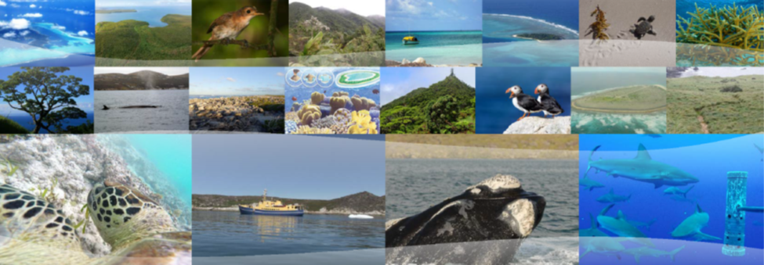
Thank you!

