Slide 1
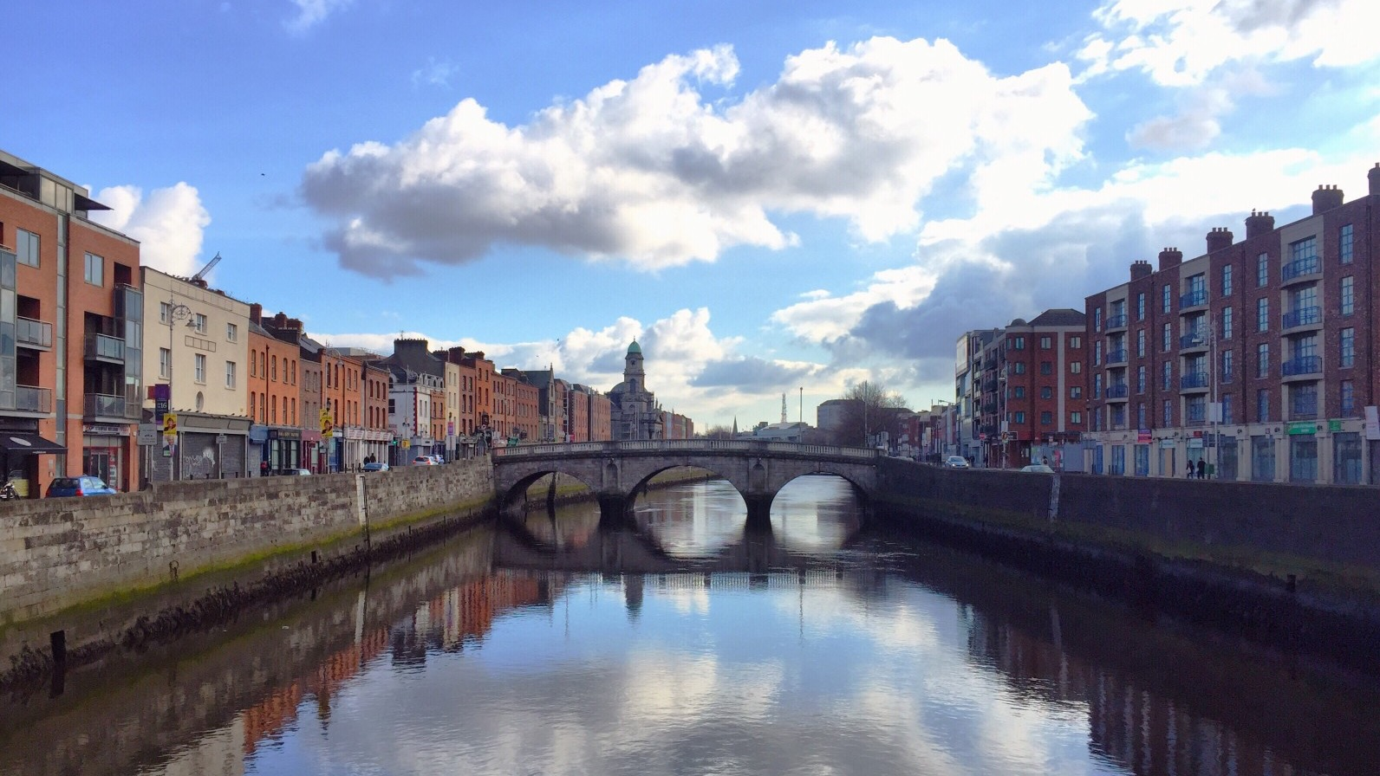
#BUILDUPON
BUILD UPON² A Multi-level Energy Renovation
Impact Framework
Covenant of Mayors Investment Forum -
Energy Efficiency Finance Market Place 2021
15.06.2021
WWW.WORLDGBC.ORG/BUILD-UPON

Slide 2
#BUILDUPON
THE BUILD UPON² PROJECT
1. Project description
2. The Impact Framework
3. The work with pilot and follower cities
4. The experience of Padova as pilot city
WWW.WORLDGBC.ORG/BUILD-UPON

Slide 3
#BUILDUPON
1. The project
Raquel Díez Abarca
Green Building Council España
WWW.WORLDGBC.ORG/BUILD-UPON

Slide 4
#BUILDUPON
BUILD UPON²
Supporting public sector's capacity and leadership in decarbonising Europe's building stock, through the development of a multi-level renovation impact framework
WWW.WORLDGBC.ORG/BUILD-UPON
Notes:
STANDARD SLIDE FOR TEXT PRESENTATIONS

Slide 5
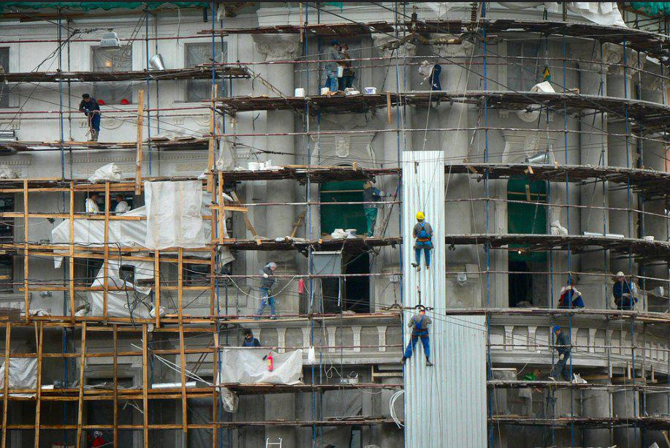
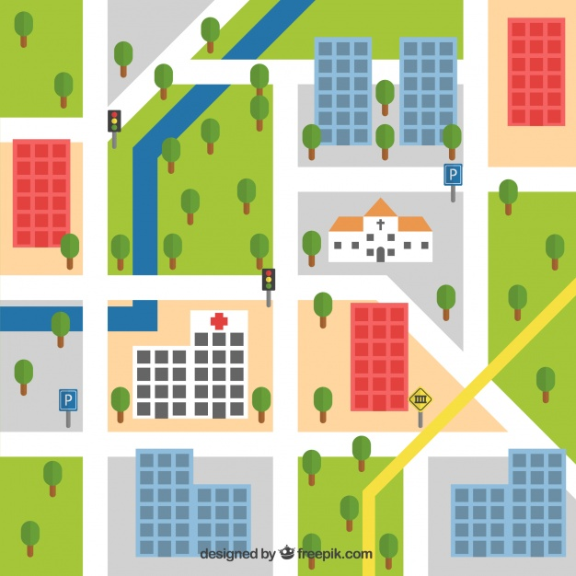
Why BUILD UPON²
#BUILDUPON
FIRST BUILDUPON
METRICS
CITY SCALE
WWW.WORLDGBC.ORG/BUILD-UPON
Notes:
On one side and continuing with what we began with the first BUILD UPON, Buildings renovation is crucial for the decarbonisation objective in 2050 as they are responsible for 36% of the overall CO2 emissions
Related to this all the countries of the EU have a mandate to create and update Long Term Renovation Strategies, an obligation derived from the Energy performance of buildings directive (EPBD). So the Long-Term Renovation Strategies are the key instrument at national level to achieve the decarbonization of our building stock
At the same time, Cities are the protagonists where the real action takes place, so we understand that working at local and municipal scale is key
Finally, we have a pending issue in tracking progress through monitoring and reporting the progress and effects of Long-term Renovation Strategies, something that is mandatory since the last update of the EPBD

Slide 6
#BUILDUPON
Develop and test a
MULTI-LEVEL RENOVATION IMPACT FRAMEWORK
What
monitoring and tracking LOCAL action
incorporating procedures to municipal administrative structure
LINKING local, regional and national policy
a blueprint for EPBD implementation and CITIES’ efforts to tackle their building stock renovation
Aligned with SECAP / SEAP from the Covenant of Mayors
WWW.WORLDGBC.ORG/BUILD-UPON

Slide 7
Who is involved?
#BUILDUPON
WWW.WORLDGBC.ORG/BUILD-UPON

Slide 8
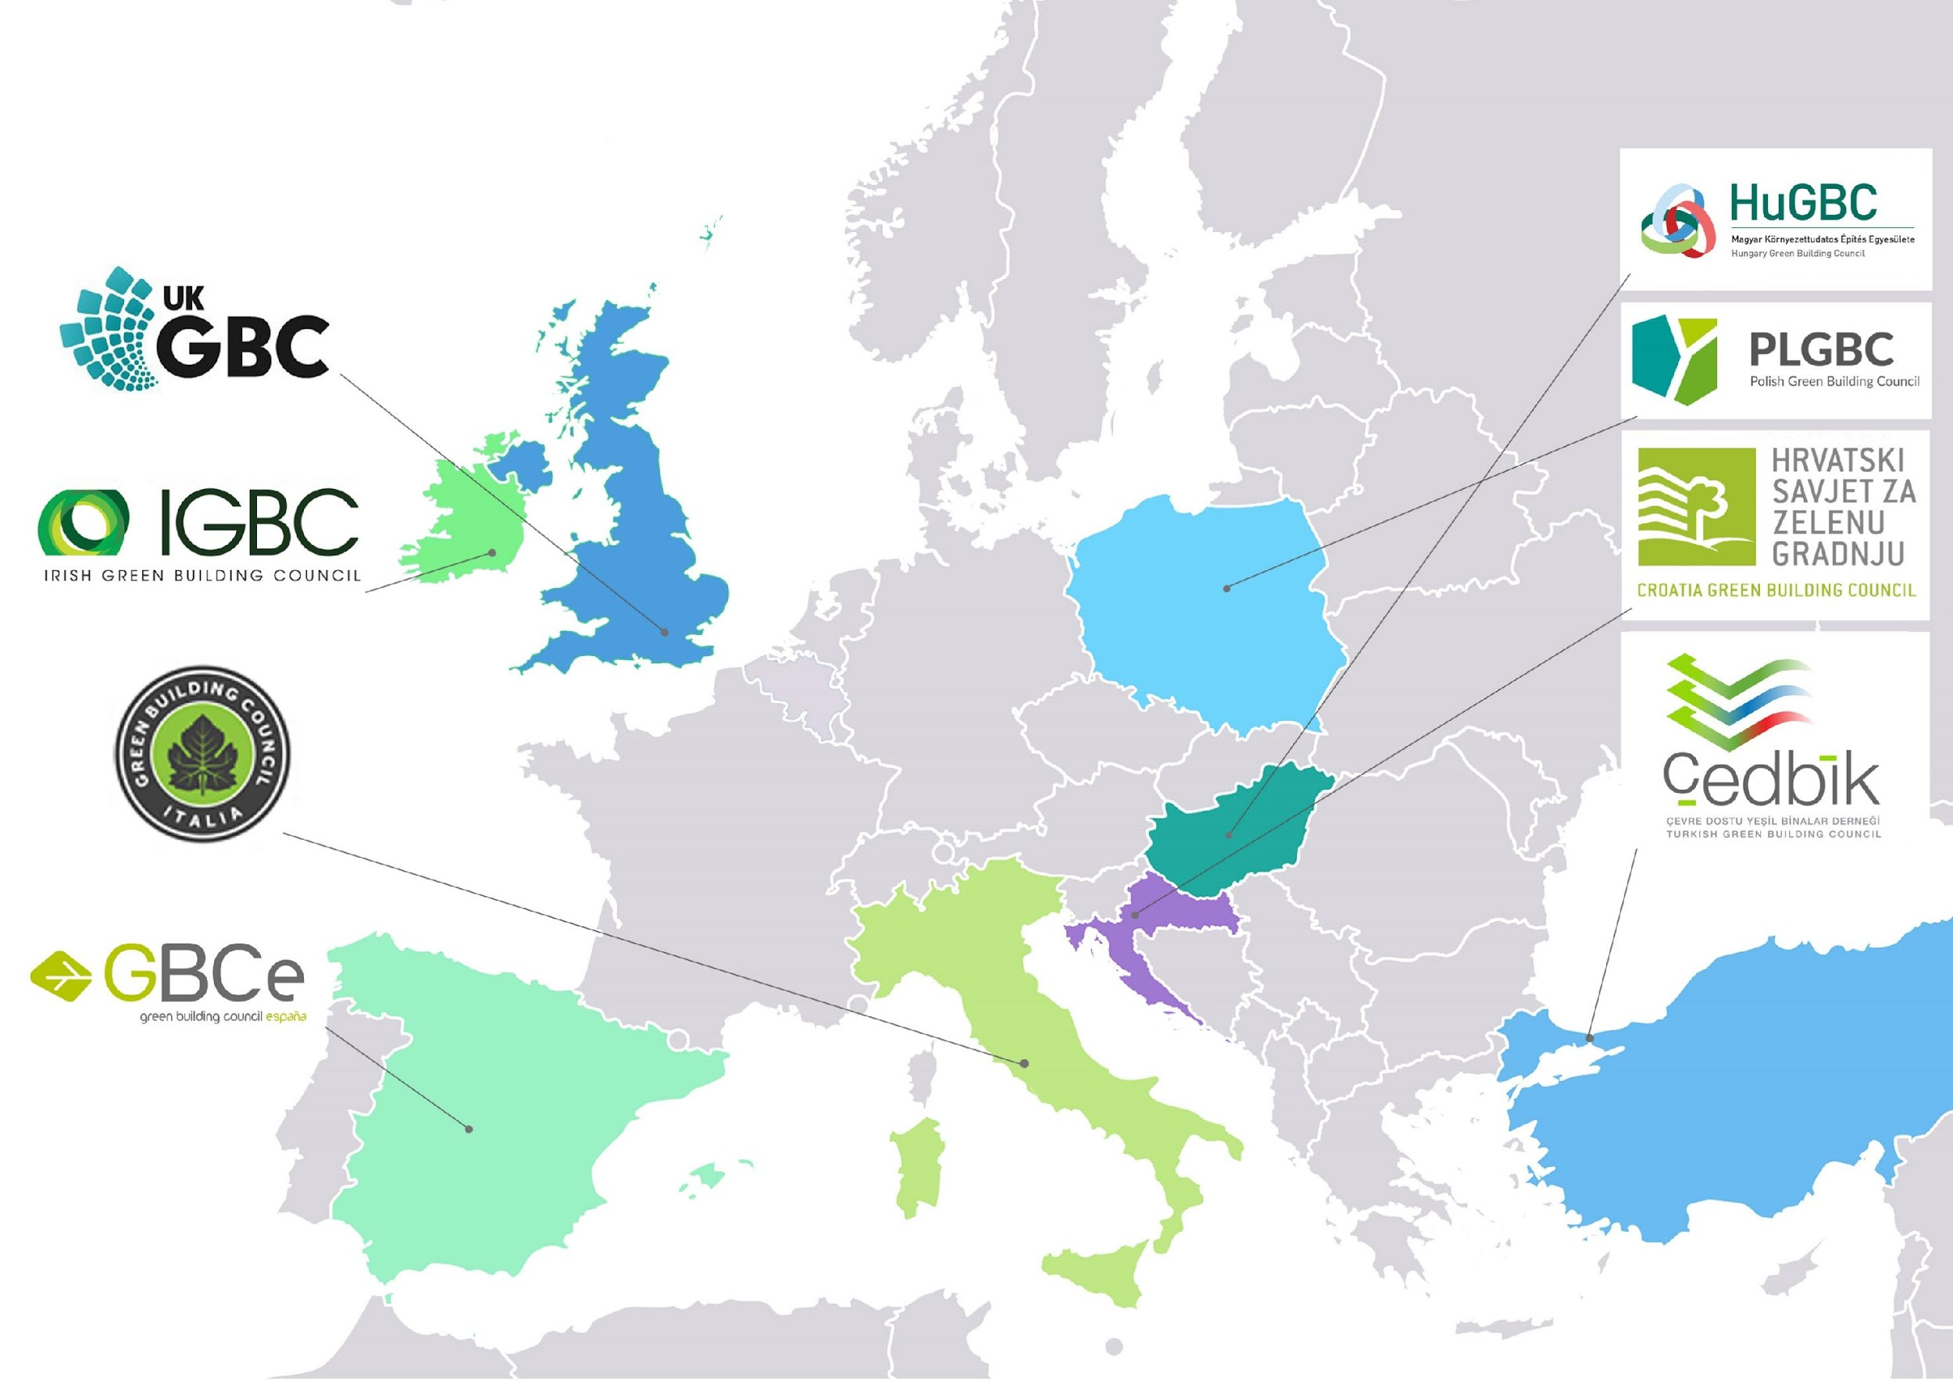
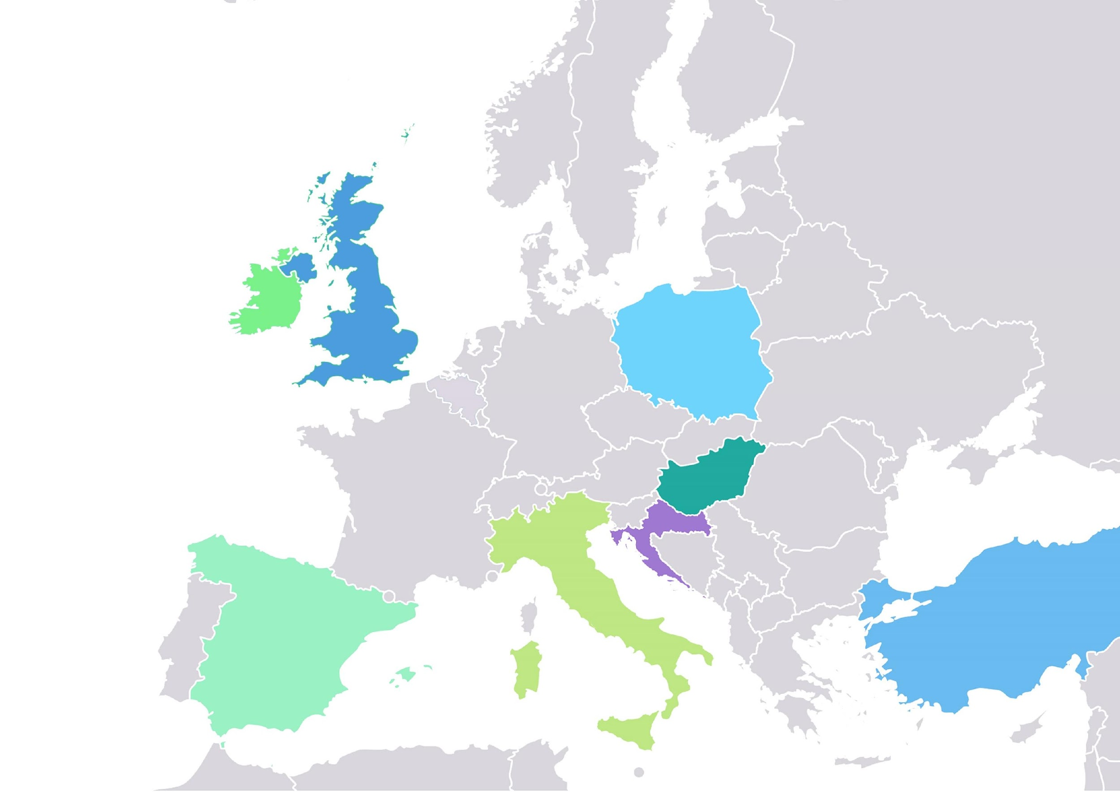
Who is involved?
8 countries (GBCs)
8 pilot cities
24 follower cities (3 per country)
RYBNIK
Notes:
Also 8 pilot cities will be collaborating in this Project, where the Impact Framework has been tested.
Mention NSG
And you, the 24 follower cities (3 per country), still to be completely defined

Slide 9
#BUILDUPON
2. The Impact Framework
Marion Jammet
Irish Green Building Council
WWW.WORLDGBC.ORG/BUILD-UPON

Slide 10
#BUILDUPON
OBJECTIVES
Better align local and national retrofit initiatives by ensuring that data is collected in a consistent format
Enable the capturing of sound data and knowledge at the local level in a structured way.
Be able to better evaluate the success of local renovation initiatives, to better identify best practice and to make a valuable contribution for the design of national policies.
Better capture and use data on the co-benefits of energy renovation, hence providing useful information to policy decision-makers.
WWW.WORLDGBC.ORG/BUILD-UPON

Slide 11
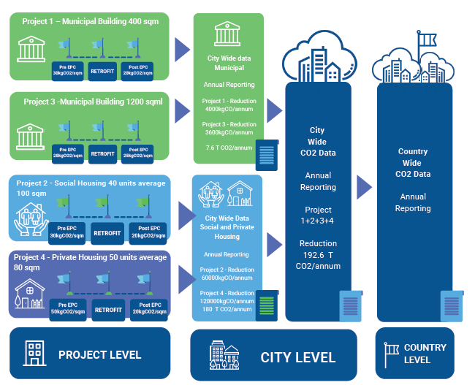
#BUILDUPON
FROM LOCAL TO NATIONAL
WWW.WORLDGBC.ORG/BUILD-UPON

Slide 12
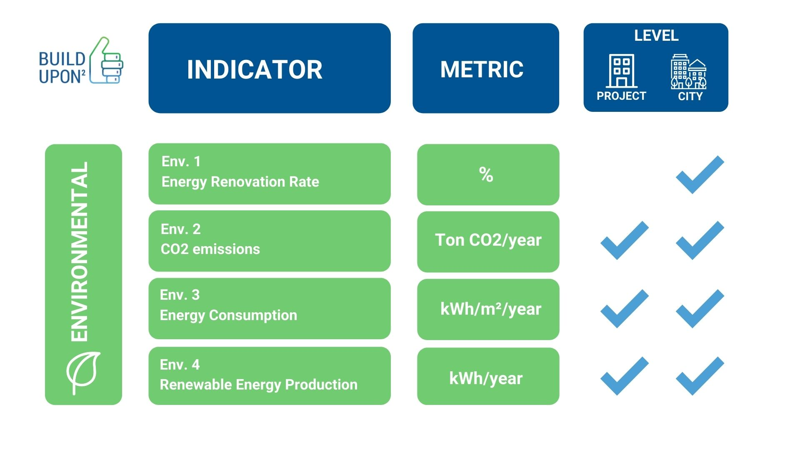
#BUILDUPON
WWW.WORLDGBC.ORG/BUILD-UPON

Slide 15
#BUILDUPON
3. In dialogue with cities: Lessons learnt and toolkit
Anuschka Ruge
Climate Alliance
WWW.WORLDGBC.ORG/BUILD-UPON

Slide 16
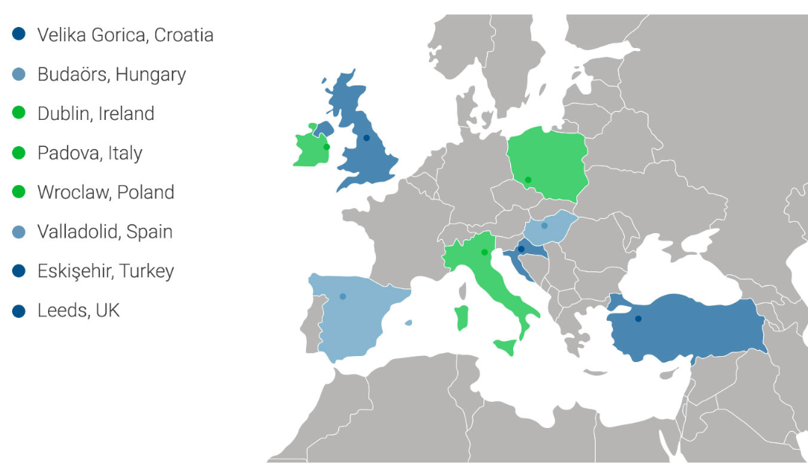
Our Pilot cities
Rybnik, Poland
WWW.WORLDGBC.ORG/BUILD-UPON

Slide 17
#BUILDUPON
Setting a Roadmap for the implementation of the Framework
WWW.WORLDGBC.ORG/BUILD-UPON

Slide 18
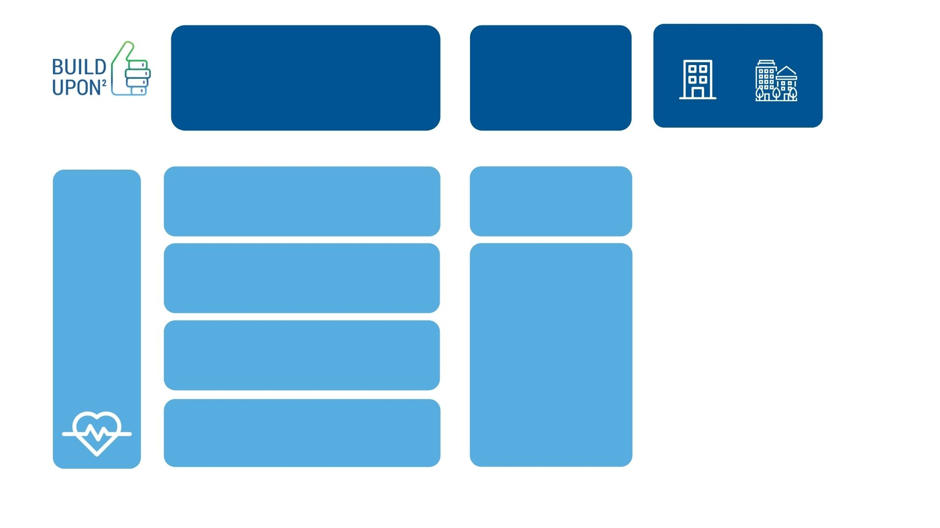
KEY STEPS
Considerations
Setting the key conditions for the Framework to be put into practice
City and/or project level
Define City Council’s structures supporting the implementation of the Framework
Dedicated staff members
National bodies / agencies / private actors
Dedicated guidance
ROADMAP xx
Establishing partnerships agreements or liaisons with other administrative levels
Identifying the conditions for the Framework to be included in existing strategies and / or SECAPs

Slide 19
#BUILDUPON
Using the Framework on existing building renovation projects
WWW.WORLDGBC.ORG/BUILD-UPON

Slide 20
KEY STEPS
Responsibilities
Create data collection and reporting templates
Collaboration between municipality and experts
Develop contract and occupant questionnaires
Collaboration between municiaplity and experts
Municipality
Municipality
Develop contract and occupant questionnaires
ROADMAP xx
Identify all data sources and staff responsible for the data collection
Ensure buy in from contractors, project managers and occupants

Slide 21
Ingredients for success
Inclusiveness and flexibility
Progressive Roadmap/Approach
Consistent data collection
Strategic partnerships
Digitalised monitoring system
Dedicated staff
Technical assistance
Political support
Internal communication
Synergies with SECAP and existing strategies
WWW.WORLDGBC.ORG/BUILD-UPON

Slide 22
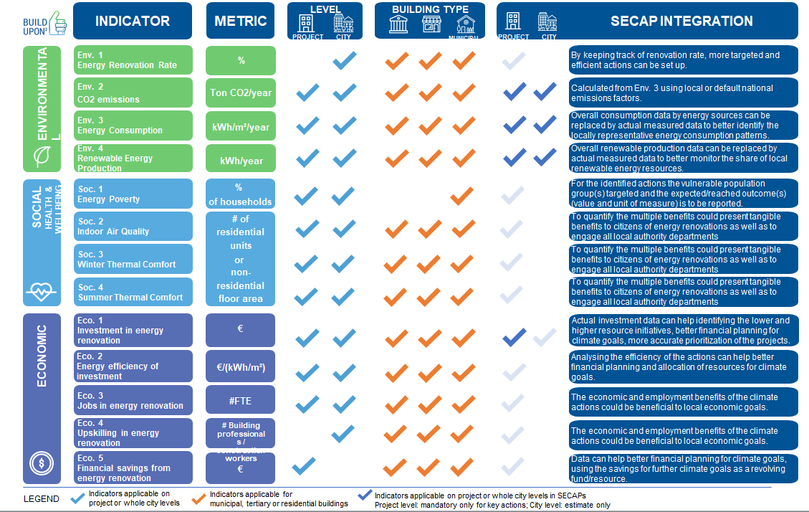
#BUILDUPON
Toolkit at city level
WWW.WORLDGBC.ORG/BUILD-UPON

Slide 23
#BUILDUPON
Toolkit at city level
WWW.WORLDGBC.ORG/BUILD-UPON

Slide 24
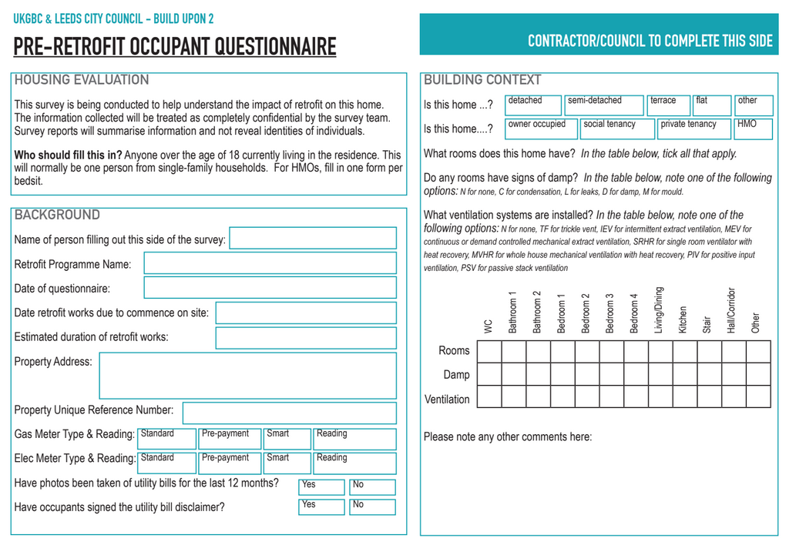
#BUILDUPON
Toolkit at project level
WWW.WORLDGBC.ORG/BUILD-UPON

Slide 25
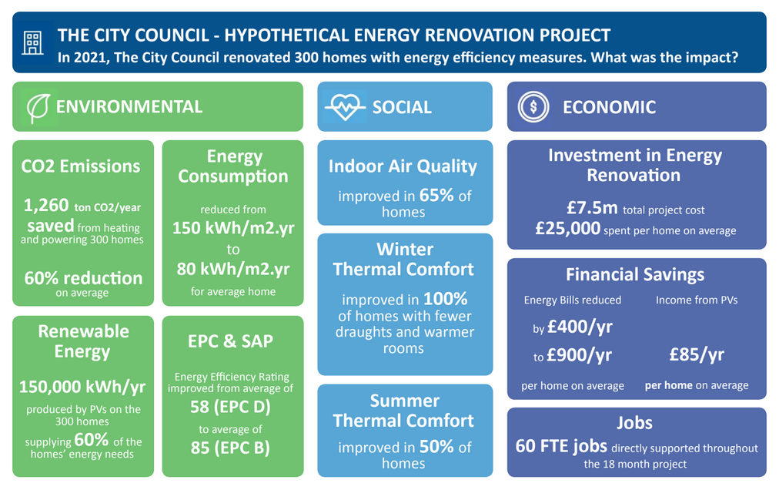
#BUILDUPON
Toolkit at project level
WWW.WORLDGBC.ORG/BUILD-UPON

Slide 26
#BUILDUPON
4. The experience of Padova
The integration of the Build Upon2 framework into the SECAP of the Municipality of Padova
Giovanni Vicentini
Comune di Padova – Settore Ambiente e Territorio
WWW.WORLDGBC.ORG/BUILD-UPON

Slide 27
From SEAP to SECAP
1999
2004
2009
2011
2016
2021
Municipal Energy Plan (P.EN.CO)
SEAP. Sustainable Energy Action Plan.
SECAP. Sustainable Energy and Climate Action Plan.
Guidelines for the Adaptation Plan
Energy Efficiency Plan
Target year = 2020
Target year = 2030
Energy Operational Plan
WWW.WORLDGBC.ORG/BUILD-UPON
Notes:
STANDARD SLIDE FOR TEXT PRESENTATIONS

Slide 28
SECAP: the six pillars
A city with new energies Promoting the production of energy from renewable energy sources A more efficient city Increase the efficiency of public and private building structures A city with smart networks and services Promote more efficient public and private services A city that moves better Promoting more sustainable mobility A city with a low-emission economy Promoting sustainability policies in business choices A more resilient city Increase the resilience of the territory and encourage the adaptation of the city to climate change
WWW.WORLDGBC.ORG/BUILD-UPON
Notes:
STANDARD SLIDE FOR TEXT PRESENTATIONS

Slide 29
RESULT INDICATORS
Monitor the implementation status of each individual measure Two (2) are identified for each measure They are monitored on an annual or biennial basis
IMPACT INDICATORS
Monitor the implementation status of the group of measures as a whole Limited number to allow for manageability of monitoring They are monitored on a two-year basis
WWW.WORLDGBC.ORG/BUILD-UPON
Notes:
STANDARD SLIDE FOR TEXT PRESENTATIONS

Slide 30
KEY ASPECTS IN THE MONITORING PROCESS
Monitoring should be based on quantitative data to identify a trend
Data sources are essential to have a clear data flow and a standardized process. Three types have been identified:
internal data sources, such as municipal departments 🡪 internal working group
external data sources directly involved in the SECAP, such as the University 🡪 participatory process
external data sources not involved in the SECAP but data-owners, such as national agencies 🡪 memorandum of understanding
WWW.WORLDGBC.ORG/BUILD-UPON
Notes:
STANDARD SLIDE FOR TEXT PRESENTATIONS

Slide 31
A more efficient city
Actions | RESULTS Indicators | Unit of measurement | Data source | Frequency of data collection | Framework BuildUpon2
Energy efficiency measures in municipal buildings: offices, schools, sports facilities, etc. [actions 1,2,3,4] | > Interventions carried out in buildings | - | Public Works Department | Annual basis | Indicators: Env.1
 | >Pre- and post-intervention energy consumption >Avoided emissions | MWh Tons CO₂ | Public Works Department | Annual basis | Indicators: Env.2, Env.3, Env.4
Energy efficiency measures for non-municipal public buildings: provincial buildings, etc. [actions 5,6,7,8,12] | >Interventions carried out in buildings | - | Building owners/managers | Every 2-years | Indicators: Env.1
 | >Pre- and post-intervention energy consumption >Avoided emissions | MWh Tons CO₂ | Building owners/managers | Every 2-years | Indicators: Env.2, Env.3, Env.4
Support for energy efficiency measures in private buildings and introduction of environmental sustainability requirements [action 9] | >Number of interventions carried out/year and savings achieved >Avoided emissions | MWh Tons CO₂ | National Energy Agency | Annual basis | Indicators: Env.1, Env.2, Env.3, Env.4, Soc.8, Soc.10
 | >Investments made | € | National Energy Agency | Annual basis | Indicators: Eco.1
Implementing a One-Stop-Shop (OSS) for the energy refurbishment of the building stock (PadovaFIT Expanded European project) [action 10] | >Number of refurbished buildings and interventions carried out | n. | One-Stop-Shop | Annual basis | Indicators: Env.1, Env.5, Soc.8, Soc.10
 | >Annual savings achieved and production by RES >Avoided emissions | MWh Tons CO₂ | One-Stop-Shop | Annual basis | Indicators: Env.2, Env.3, Env.4
Key aspects to be considered in the monitoring process
WWW.WORLDGBC.ORG/BUILD-UPON
Notes:
STANDARD SLIDE FOR TEXT PRESENTATIONS

Slide 32
A more efficient city
Actions | RESULTS Indicators | Unit of measurement | Data source | Frequency of data collection | Framework BuildUpon2
Promotion of boiler replacement [action 11] | >Number of boilers replaced | n. | Environmental Department | Annual basis | -
 | >Ex ante and ex post installed power of replaced boilers/year >Avoided theoretical emissions | MW Tons CO₂ | Environmental Department | Annual basis | Indicators: Env.2, Env.3
Energy efficiency interventions, in private condominiums, carried out by ASE [action 13] | >Interventions carried out in buildings | - | ASE – private company | Every 2-years | Indicators: Env.1
 | >Pre- and post-intervention energy consumption >Avoided emissions | MWh Tons CO₂ | ASE – private company | Every 2-years | Indicators: Env.2, Env.3, Env.4
Energy efficiency in supermarkets: the SUPERHEERO project [action 14] | >Number and volume of stores involved in the project | n. m² | Environmental Department | Annual basis | Indicators: Env.1
 | >Interventions carried out/achievable and energy savings achieved >Avoided emissions | MWh Tons CO₂ | Environmental Department Rina Consulting | Annual basis | Indicators: Env.2, Env.3, Env.4
Analysis, evaluation and monitoring of the building stock of the University of Padova [action 15] | >Annual monitoring of energy consumption | MWh | University of Padova | Every 2-years | Indicators: Env.3
 | >Number of buildings certified and/or energy-diagnosed | % on total | University of Padova | Every 2-years | Indicators: Env.5
Notes:
STANDARD SLIDE FOR TEXT PRESENTATIONS

Slide 33
A more efficient city
Actions | RESULTS Indicators | Unit of measurement | Data source | Frequency of data collection | Framework BuildUpon2
Thermal plants revamping in the buildings of the University of Padova [actions 16,17] | >Annual gas consumption and % comparison with baseline >Avoided emissions | smc % compared to baseline Tons CO₂ | University of Padova | Every 2-years | Indicators: Env.2, Env.3
 | >Annual electricity consumption and comparison with the average consumption in summer and winter >Avoided emissions | kWh % variation Tons CO₂ | University of Padova | Every 2-years | Indicators: Env.2, Env.3
 | >Energy consumption per unit area | kWh/m² | University of Padova | Every 2-years | Indicators: Env.3
Activation of energy poverty policies [action 18] | >Number of families/individuals involved in the project | n. | SOGESCA | Every 2-years | Indicators: Soc.1
 | >Economic contributions for payment of energy bills | € | Social services Department | Annual basis | Indicators: Soc.1
WWW.WORLDGBC.ORG/BUILD-UPON
Notes:
STANDARD SLIDE FOR TEXT PRESENTATIONS

Slide 34
A more efficient city
IMPACT Indicators | Unit of measurement | Data source | Frequency of data collection | Framework BuildUpon2
>Reduction of final energy consumption from energy refurbishment measures (civil sector) | MWh/year € saved/year | National Energy Agency Environmental Department | Annual basis | Indicators: Env.1, Env.3, Eco.5
>Reduction of direct CO₂ emissions from energy refurbishment measures | Tons CO₂/year | Environmental Department | Annual basis | Indicators: Env.2
>Average energy saving by typology of intervention | MWh/intervention | National Energy Agency | Annual basis | Indicators: Env.3
> Energy produced from renewable sources as a result of energy refurbishment measures | MWh/year | National Energy Agency Enel Distribuzione/GSE | Every 2-years | Indicators: Env.4
>Investments realized | € €/kWh saved FTE | National Energy Agency Environmental Department | Annual basis | Indicators: Eco.1, Eco.2, Eco.3
WWW.WORLDGBC.ORG/BUILD-UPON
Notes:
STANDARD SLIDE FOR TEXT PRESENTATIONS

Slide 35
A more resilient city
Actions | RESULTS Indicators | Unit of measurement | Data source | Frequency of data collection | Framework BuildUpon2
Support for actions to increase the resilience of the territory through the Building Regulations: the interventions on the building stock [action 1] | >Number and volumes of rainwater recovery tanks realized/year | m³ | Private Buildings Department | Every 2-years | Indicators: Soc.6
 | >Extension of roofs and green facades realized | m² | Private Buildings Department | Every 2-years | Indicators: Soc.6
Support for actions to increase the resilience of the territory through the Building Regulations: the interventions in the open spaces [action 2] | > Extension of parking lots/ squares/pedestrianized areas made of permeable materials | km² | Public Works Department Town Planning Department | Every 2-years | -
 | >Number of trees planted/hectare in car parks, lots of new urbanization | n. | Green Department | Every 2-years | -
Urban policies for the reduction of land consumption [action 3] | >Monitoring of soil consumption status | Ha/year | Town Planning Department | Every 2-years | Indicators: Env.8
 | >Changes in agricultural landuse | Ha/year | Town Planning Department | Every 2-years | -
WWW.WORLDGBC.ORG/BUILD-UPON
Notes:
STANDARD SLIDE FOR TEXT PRESENTATIONS

Slide 36
A more resilient city
Actions | RESULTS Indicators | Unit of measurement | Data source | Frequency of data collection | Framework BuildUpon2
A project for regeneration of productive areas [action 4] | >Surface of empty and reused warehouses | m² | Assindustria VenetoCentro | Every 2-years | Indicators: Env.8
 | >Number of industrial buildings with environmental certification systems | n. | Assindustria VenetoCentro | Every 2-years | Indicators: Env.5
The new Urban Town Plan 2030 [action 5] | >Volumes underused and de-abandoned subject to recovery | m³ | Town Planning Department | Every 2-years | Indicators: Env.8
 | > Building credits for the reduction of land consumption | m³ | Town Planning Department | Every 2-years | Indicators: Env.8
Water consumption: improvement of the accounting and initiatives to reduce consumption [action 28] | >Number of digital meters installed | % on total | AcegasApsAmga | Every 2-years | Indicators: Env.7
 | >Water consumption/year | m³/year | AcegasApsAmga | Every 2-years | Indicators: Env.6
WWW.WORLDGBC.ORG/BUILD-UPON
Notes:
STANDARD SLIDE FOR TEXT PRESENTATIONS

Slide 37
The effectiveness of the measures
All SECAP measures will ensure a reduction of about 374,000 tons of CO₂ between 2017 and 2030, allowing the Municipality of Padova more than halving its climate-changing emissions by 2030
(-55%) compared to 2005 (BEI).
The Municipality has also set the ambitious goal of achieving climate neutrality by 2050, i.e. a zero net emissions of climate-changing gases.
-37,5%
-55,3%
BEI
MEI
Target year
WWW.WORLDGBC.ORG/BUILD-UPON
Notes:
STANDARD SLIDE FOR TEXT PRESENTATIONS

Slide 38
The effectiveness of the measures
Reduction of climate-changing emissions (ton CO₂)
WWW.WORLDGBC.ORG/BUILD-UPON
15 actions
19 actions
10 actions
23 actions
16 actions
33 actions
Notes:
STANDARD SLIDE FOR TEXT PRESENTATIONS

Slide 39
Comune di Padova
Settore Ambiente e Territorio
Ufficio Informambiente
venetoadapt@comune.padova.it
Notes:
‹#›

Slide 40
Thank you!
This project has received funding from the European Union's Horizon 2020 research and innovation programme under Grant Agreement No 840926. The sole responsibility for the content of this material lies with the authors. It does not necessarily reflect the opinion of the European Union. Neither the EASME nor the European Commission are responsible for any use that may be made of the information contained therein.
WWW.WORLDGBC.ORG/BUILD-UPON
Notes:
STANDARD SLIDE FOR TEXT PRESENTATIONS

