Slide 2
Energy renovation by
g
FRAME
Delegated mission by the Walloon government Incorporated within B.E.Fin s.a. (49% owned by SRIW Environment and 51% by the Walloon region) Financed by the European Investment Bank
Financed by the Walloon Region
g
GOALS
Renovate public buildings
Reduce energy consumption in public buildings Strive for European CO2 targets (2030 - 2050)
Promote local employment and training Improve the indoor comfort of buildings
Combat fuel poverty
g
MISSIONS
Realization of energy studies
Creation of buildings pools
Identification of possible financing options
Call for bids, creating tender specifications and negotiation
Initiation of Energy Performance Contracts (EPC) and D&B

Slide 3
Support local public authorities in their energetic retrofitting projects through a one-stop-shop
SWOT Renowatt- QUANTITATIF
LOCAL PUBLIC AUTHORITIES
Adhesion
BUILDINGS SCREENING
Selection of buildings based on potential energy savings
Subsidized loans
Public subsidies
Tax incentives
FINANCING
Tendering procedure
SELECTION OF ESCO

Slide 4
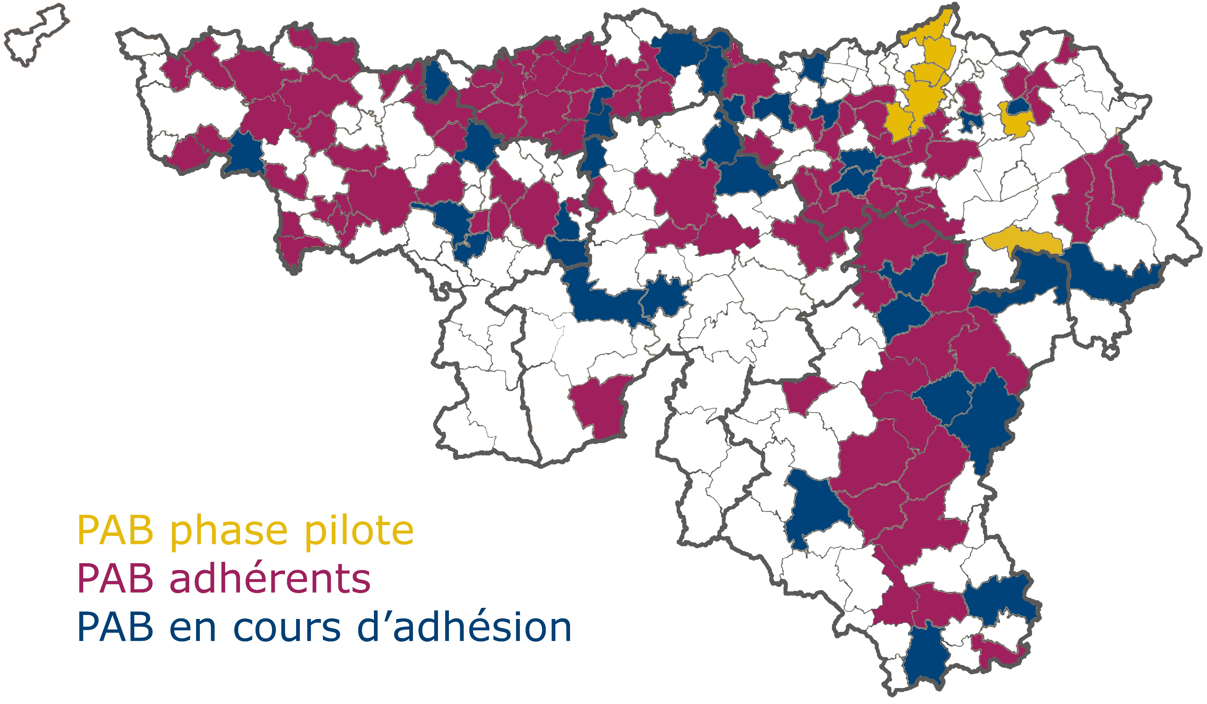
MEMBERSHIP CARD
Local public authority having joined RenoWatt : 113 Local public authority wishing to participate in RenoWatt : 52 Local public authority running (pilot phase 2014-2017)

Slide 5
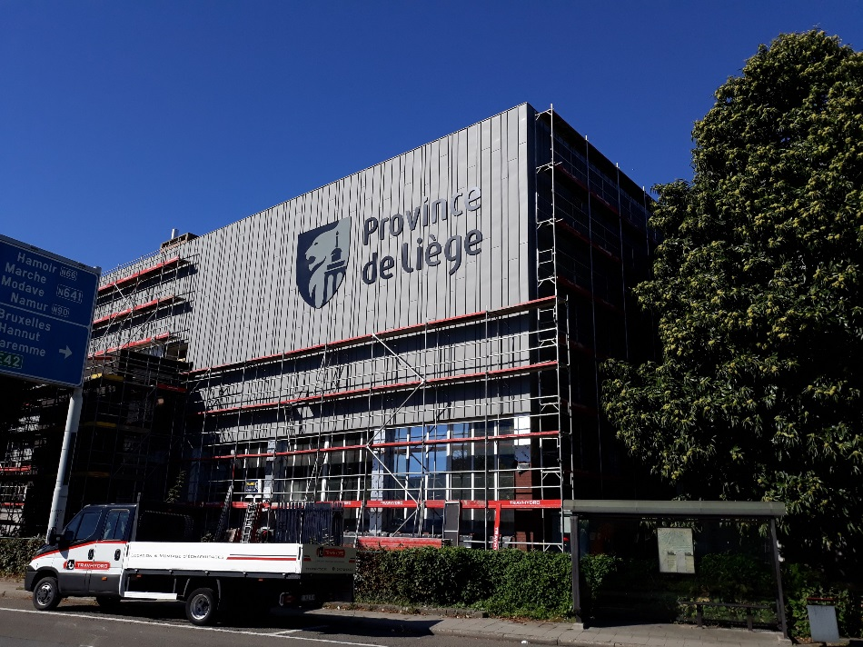
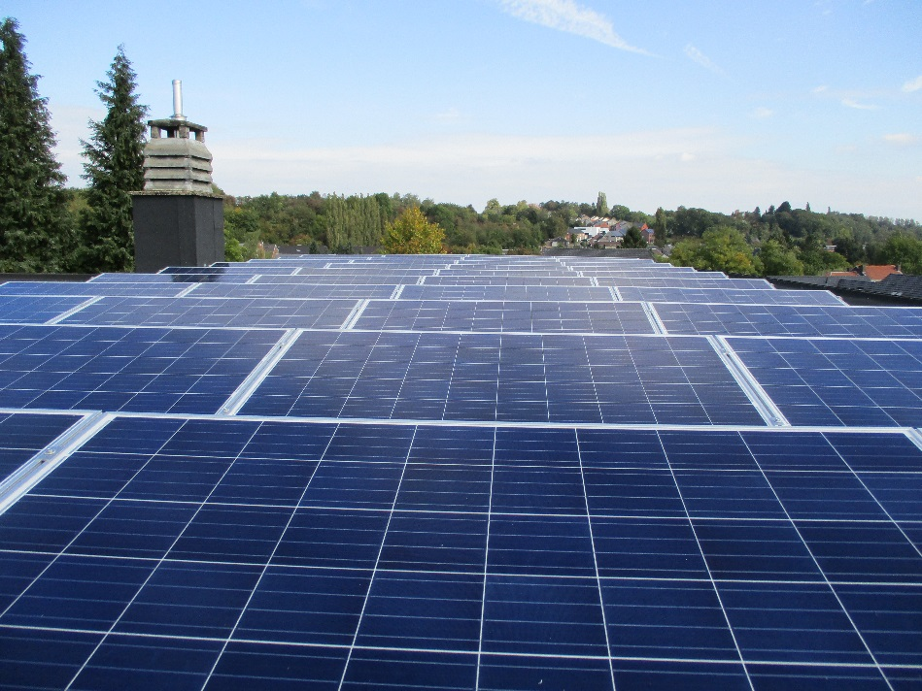
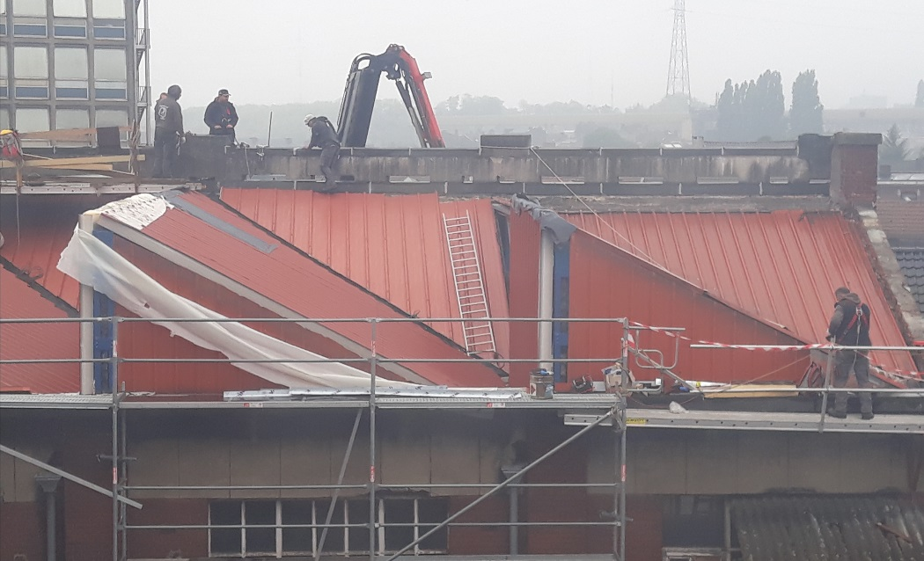
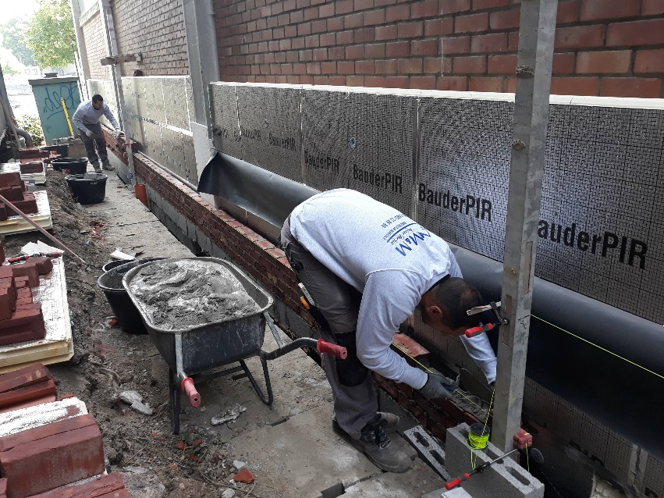
OBJECTIVES
OBJECTIVE 2030
55% reduction in CO2 emissions vs 1990
Carbon neutral
OBJECTIVE 2050

Slide 6
Energy renovation by
Description | ELENA EIB – INITIAL GOALS | 👍 RENOWATT RESULTS 👍
Investments (million Euros) | Min 70 (optimal 104) | 176 – 225
Leverage factor | 20 | 50 - 64
Number of local public authorities | 40 – 50 | 113
Energy savings | 53 GWh | 59 GWh
Renewable energy production | 3,15 GWh | 3,38 GWh
CO2 emmision reduction | 15 600 t CO2 | 17 000 t CO2
Heated surface to renovate | 650 000 m² | 785 000 m²
Training hours | 27 000 | 52 000

Slide 7
RENOVATION WORK BREAKDOWN

Slide 8
STEPS IN THE PROCESS
STEP 1
Energy Cadastre
Buildings’ selection based on global data
STEP 2
Buildings’ selection based on detailed data
STEP 3
Quickscans
STEP 4
Financial analysis
STEP 5
Customized solution for each building
STEP 6
Launching Procurement

Slide 9
STEP 1
Energy Cadastre
Buildings’ selection based on global data
STEP 2
Buildings’ selection based on detailed data

Slide 10
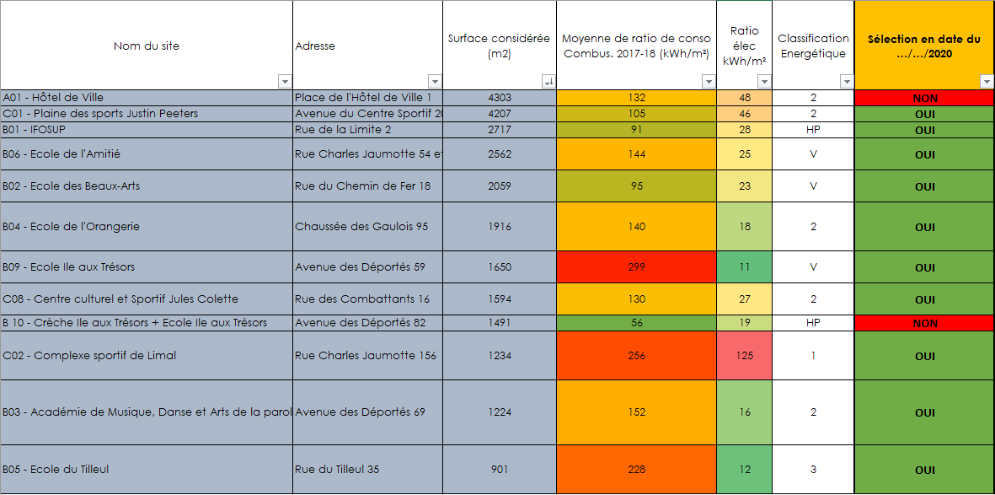
Buildings’ selection
Energy use Intensity (EUI) (kWh/m².an)
3
1
170 kWh/m²
100 kWh/m²
2
1,000 m²
Heated surface (m²)

Slide 11
STEP 3
Quickscans

Slide 12
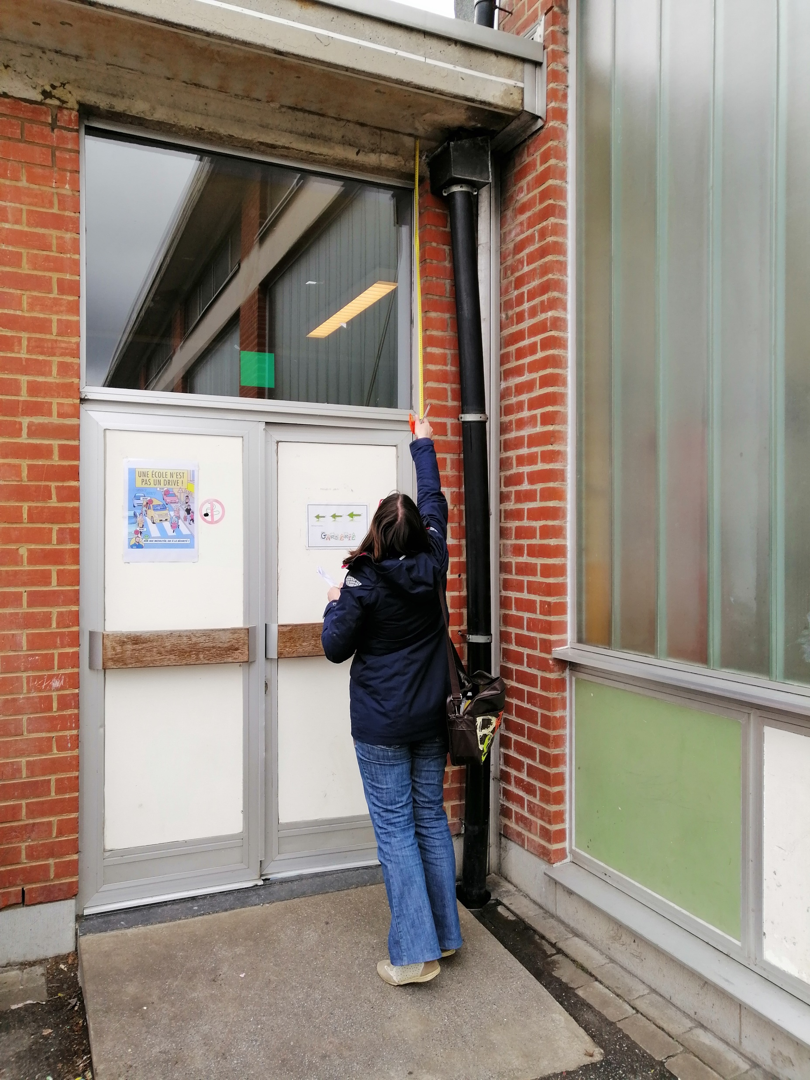
Building’s envelop assessment
Walls
Wall composition
Insulation thickness and type
Windows
Type of glazing
Type of frame
Roofs
Type de roof
Roof composition
Floors
Type of floor
Floor composition
Unit of measurement (U-value)

Slide 13
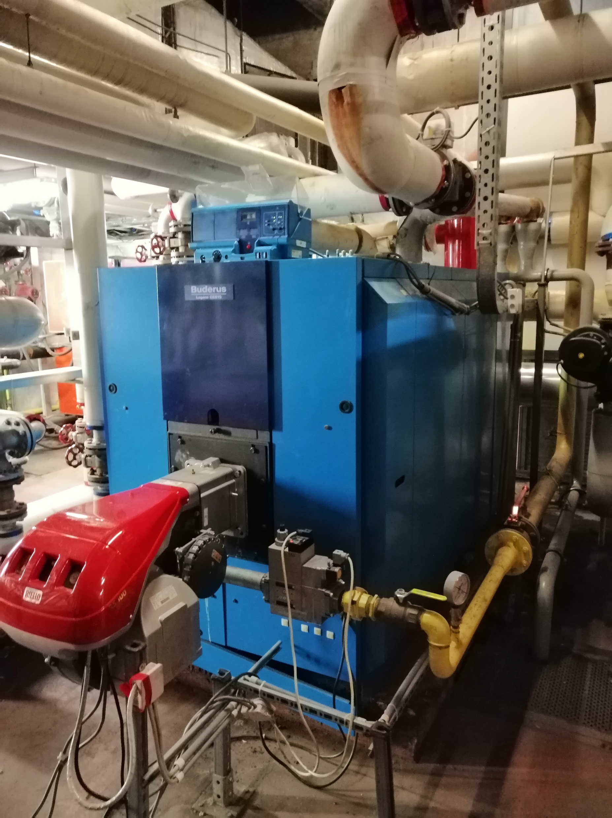
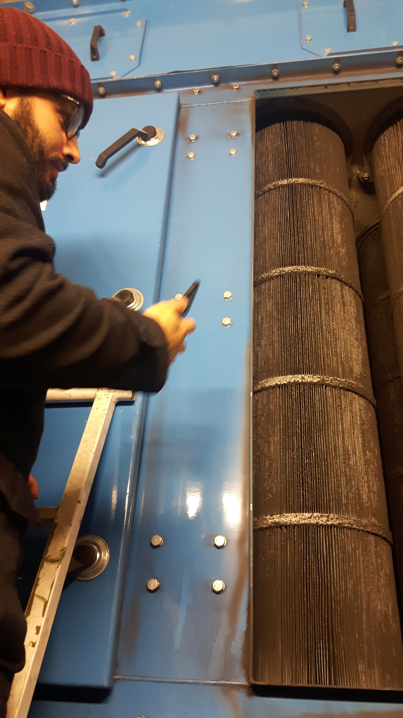
Systems assessment
Heaters
- Heat generator
Components of the distribution circuit (insulation of pipes, circulators, valves)
Emitter's condition (radiators, air heaters, convectors)
Regulation (centralized technical management system)
Domestic hot water production
Ventilation system
Onsite renewable resources (photovoltaic, solar thermal, CHP, biomass)
Unit of measurement (Efficiency)

Slide 14
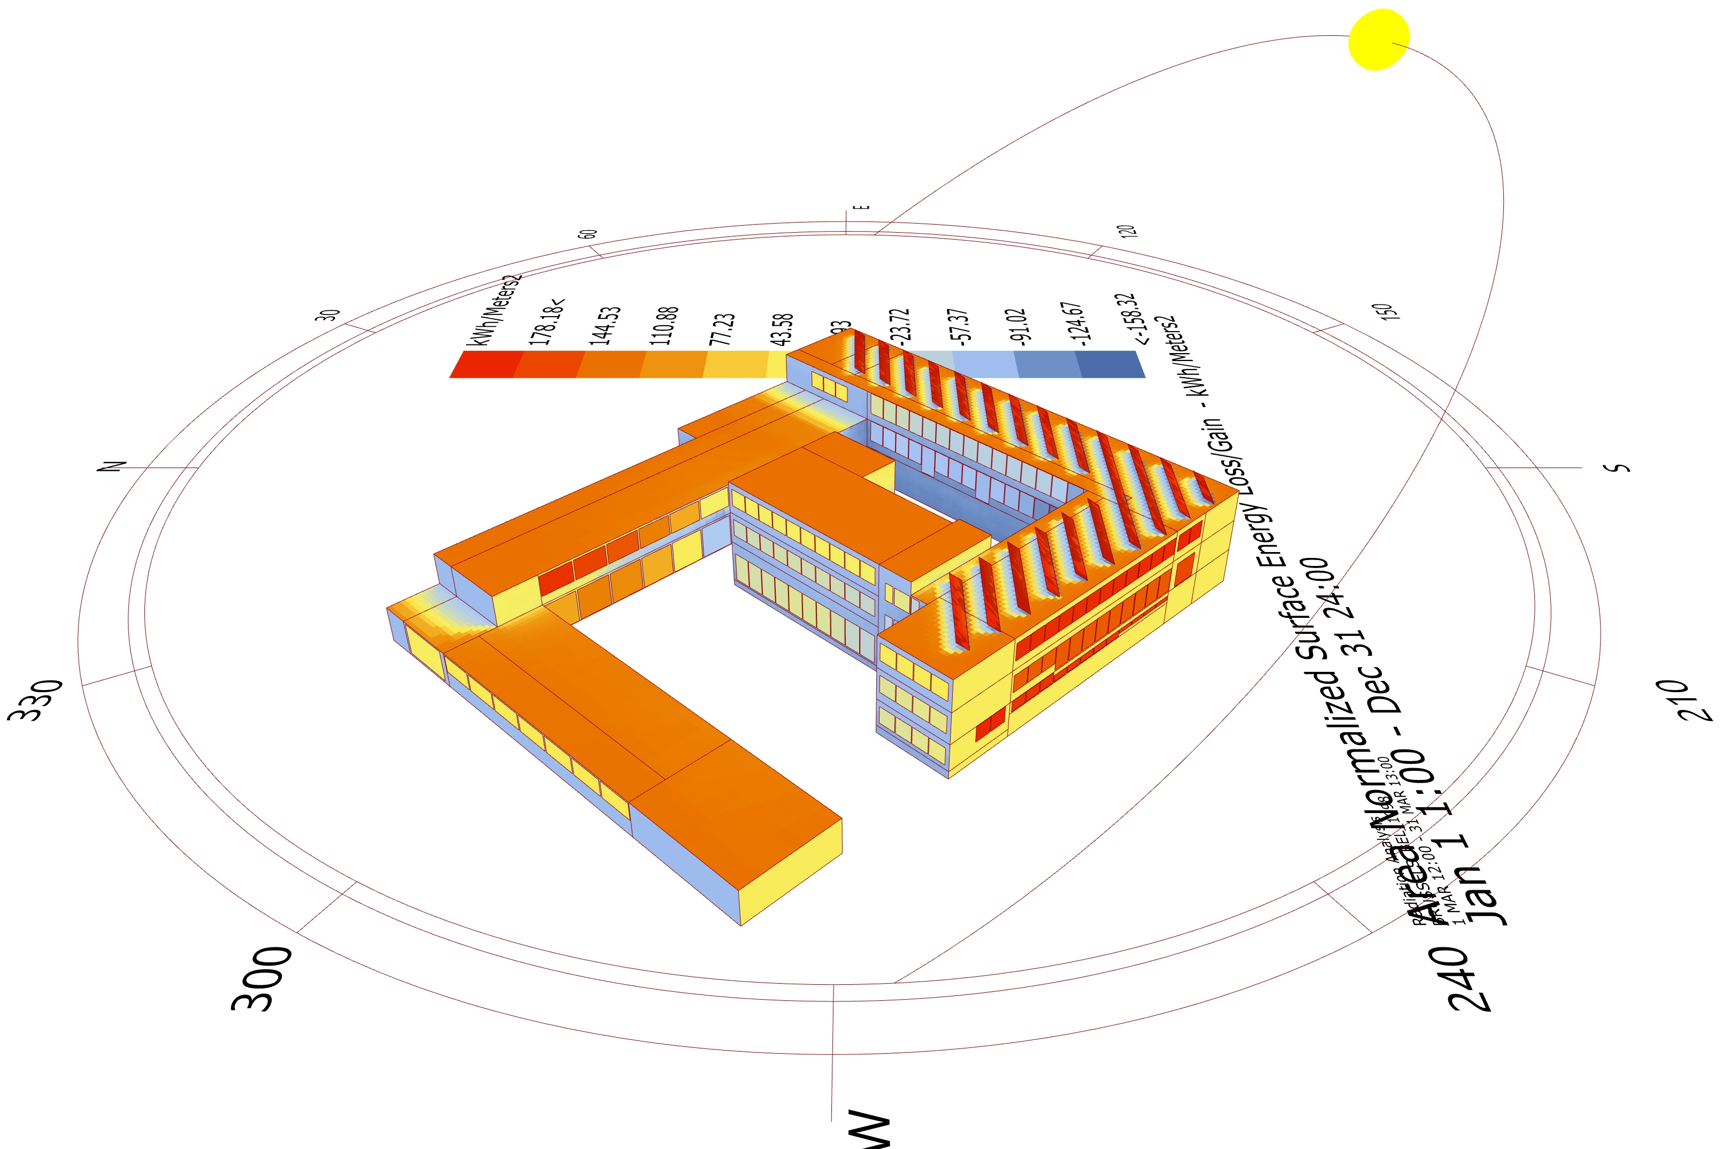
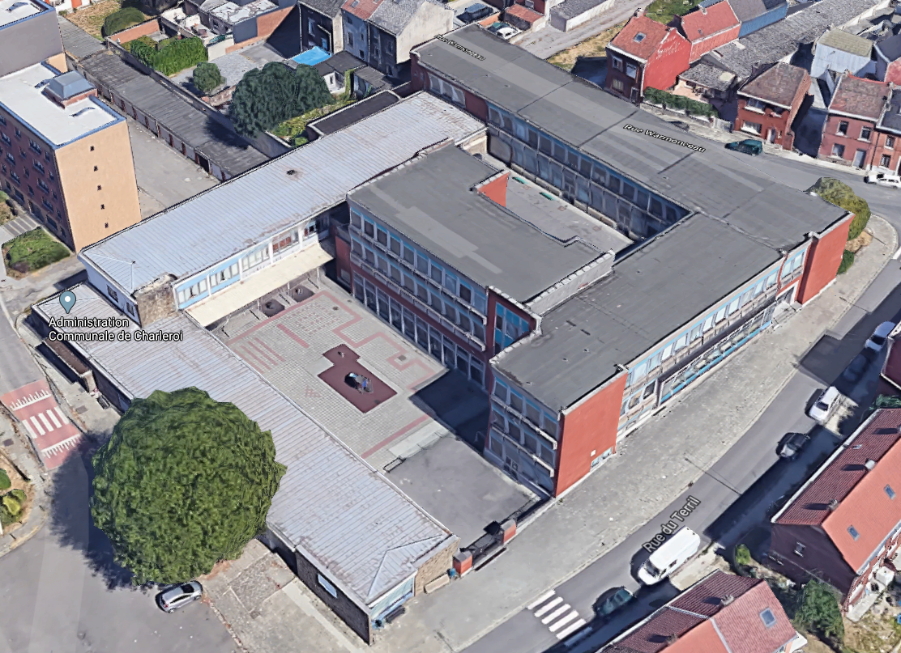
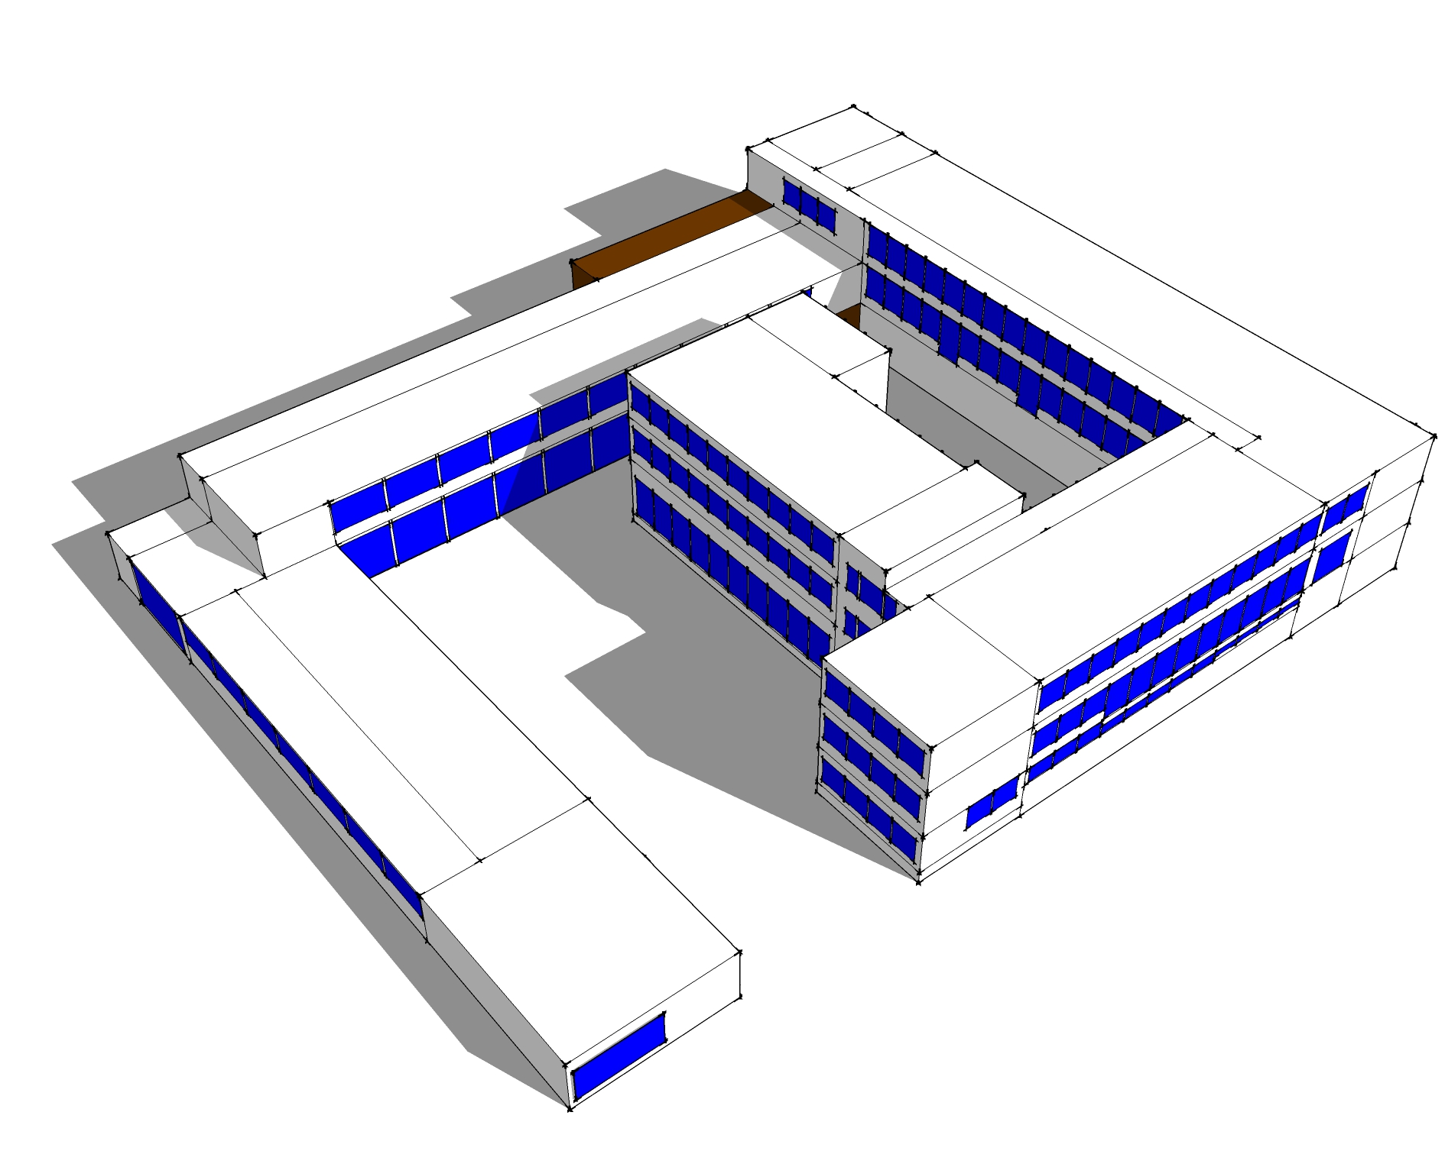
Simulation & Calibration
Real Project
Geometric 3D modelling
Thermal dynamic simulation

Slide 15
Simulation : ECM (Energy Conservation Measures)
Step 1
Model calibration
Step 2
Calculation of gains and costs of ECM
%

Slide 16
ENERGY ACCOUNTING
COLIBRI

Slide 17
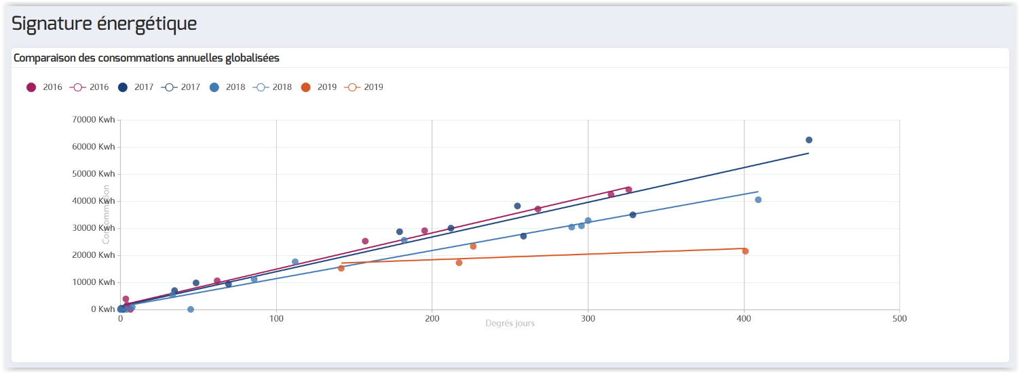
Energy monitoring

Slide 18
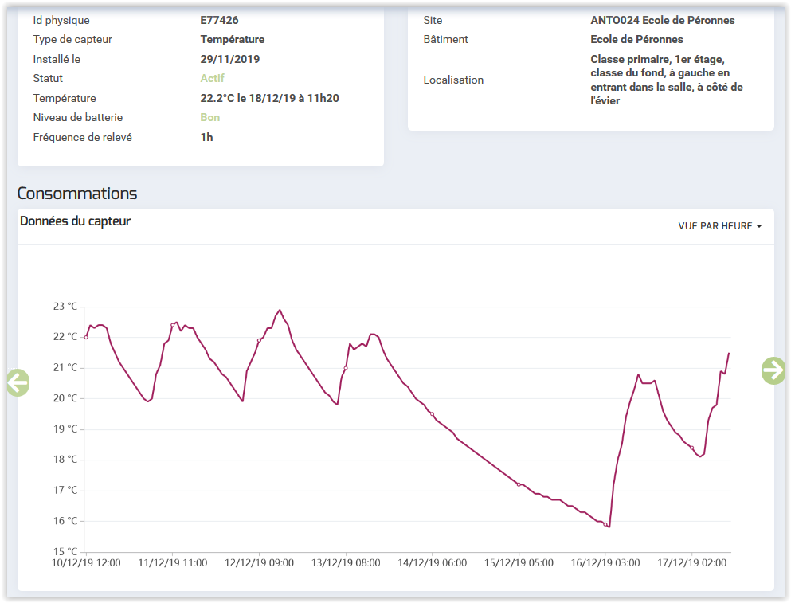
Temperature monitoring

Slide 19
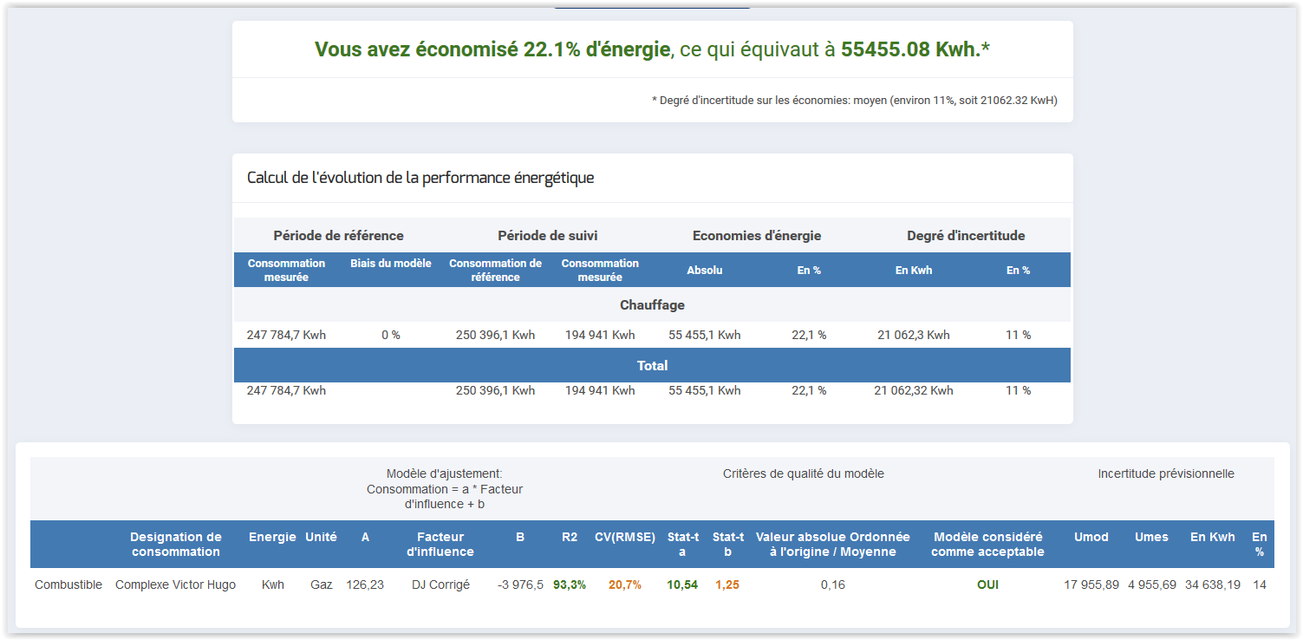
Energy performance

Slide 20
STEP 4
Financial analysis

Slide 21
Financing the renovation projects
RenoWatt co-financed by EIB and Belgian Walloon Region
RenoWatt free support through studies and public tendering
Costs of renovation projects supported by adhering Walloon Public Entities
Technical team (project leaders in charge) identifies
Required actions on buildings
The cost of each action
The action plans on the building (Quickwin / Deep renovation)
The historical energy cost (electrical and combustible)
The expected energy savings

Slide 22
Financial analysis establishes
A global budget The cost of each action
A cash flows forecast on 20 or 30 years
The rentability of the project (= Net Asset Value)
Per site
Globally per local authority
Global budget includes
Costs of works and studies
Additional costs included in the EPC contracts
Maintenance
Total warranty
Measurement & Verification (M&V)

Slide 23
Financial analysis process
Cash flows forecast on 20 – 30 years includes
Yearly costs (works are financed by a classical bank financing on 15, 20 or 30 years) a
Yearly gainsa a
Comparison between costs and gains a
Incorporating the yearly evolution cost in cash-flows (inflation and macro-cost evolution on electricity and combustibles) a
Cumulative cash-flows (= NAV) to identify the profitability of projects a
Assessment of the investments’ coverage by the expected gains on 20 – 30 years (can be between 40 and 300%)

Slide 24
Constraints & Difficulties
Advantages & Opportunities
Public authorities’ low budget
→ Self-financing is impossible
Strong dependance on public subsidies
Additional costs involved in the EPCs
Difficulty to compare historical and EPC maintenance cost due to the lack of information on actual historical cost
Renovation on buildings’ envelope is not profitable at short or medium term, but rather on the long term (more than 20 years)
Adapting bank financing duration to conventional Lifecyle of technical equipment
Bank financing remains the most convenient financing solution in terms of cost and practicability, compared to third-party investors (lower cost, public authority remains the owner of the equipment)
Free energy studies by RenoWatt
Reduce energetical costs
Conform to local, national and European regulations
Increase building’s indoor comfort
Revive the architectural quality of buildings
Lead by example

Slide 25
STEP 5
Customized solution for each building

Slide 26
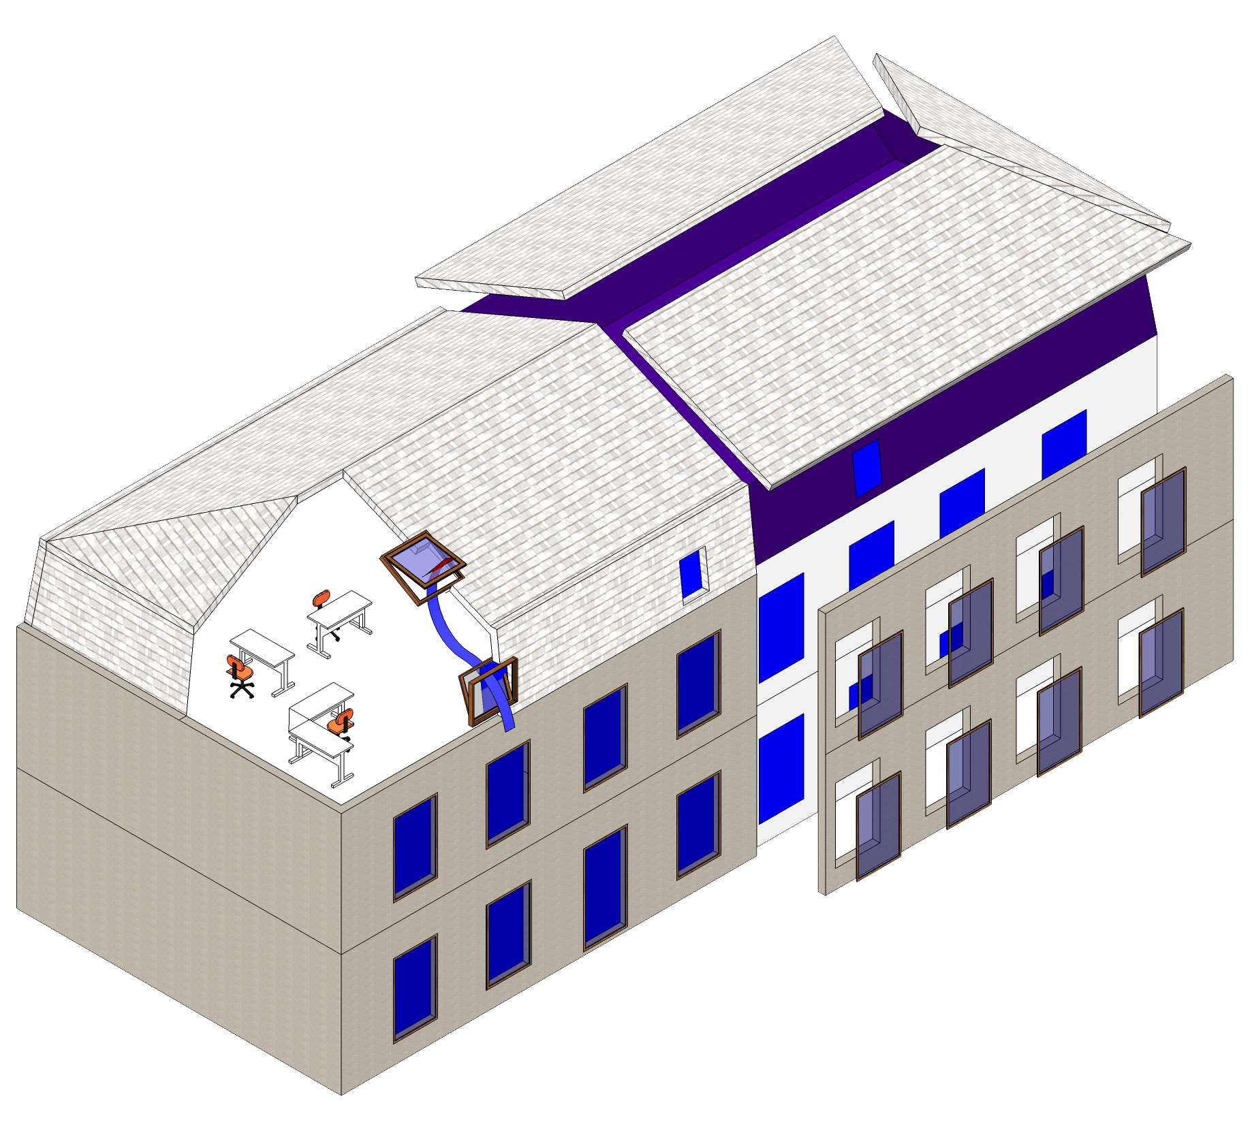
Partial approach
Minor renovation strategy
Holistic approach
Deep renovation strategy
↑↑ Air quality
↑↑ thermal comfort
↓↓ thermal bridges
↓↓ heating demand
↑↑ condensation
↑↑ heading demand
↑↑ thermal bridges
Better coordination
Adequate systems sizing
Adapted cost
Energy monitoring
Optimal solution
Poor coordination
Oversized systems
Overvalued works

Slide 27
Guidelines
Building’s envelope element | PEB requirement (W/m².K) | QZEN requirement (W/m².K)
Wall | 0.24 | 0.20
Roof | 0.24 | 0.15
Window | 1.5 | 1.5
Improving the thermal performance of building’s envelope (higher requirements than those of the PEB regulations)
Valorizing carbon balance in the choice of insulation materials
Mineral and bio-based sustainable materials (wood wool, wood cladding with natural patina)
Renovating HVAC systems while promoting for renewable resources
Heat pumps, centralized heating (biomass boilers, CHP)
Improving the efficiency of the systems and regulation
Heat recovery, regulation optimization, installing smart valves
Reducing the environmental impact of electricity consumption by promoting for renewable energies
Photovoltaic panels
Improving thermal comfort and reducing overheating risk
Double-flow controlled mechanical ventilation with heat recovery
Valorizing building stock
Integrated architecture and urbanism

Slide 28
STEP 6
Launching Procurement

Slide 29
Contracting prioritization : choosing criteria
SWOT Renowatt- QUANTITATIF
Scenario 1
Swimming pools, sports halls and similar buildings
LONG EPC
Characteristics
High energy consumption (> 30.000€ annual energy cost)
High technical complexity
Need for a maintenance contract
Knowledge of the energy consumption of buildings
d Solution
Detailed QuickScan
ECM and integrated optimization phase
CTM allowing monitoring via RenoWatt tool
IPMVP managed by the ESCOs
Scenario 2
Large municipal schools, municipal administrations and similar buildings
SHORT EPC
Characteristics
Average energy consumption (annual energy cost between 10.000€ and 30.000€)
Medium technical complexity
Optional maintenance contract
Knowledge of the energy consumption of buildings
Solution
Detailed Quickscan
ECM
CPE - GREI
Automatic or manual consumption monitoring
IPMVP and energy countability via RenoWatt tool
Scenario 3
Small schools, oil-fired buildings (without energy metering) and similar buildings
DESIGN & BUILD
Characteristics
Low energy consumption (annual energy cost < 10.000€)
Low technical complexity
No maintenance contract
Solution
Detailed Quickscan
ECM
D&B carried out directly with specialized local companies
Automatic or manual consumption monitoring
IPMVP and energy countability via RenoWatt tool

Slide 30
EPC phases
SWOT Renowatt- QUANTITATIF
ENERGY CONSUMPTION
Study and construction period
Commissioning and adjustment phase
Stabilization phase
Building’s Operational phase
Measured performance
Increasing and boosting energy savings throughout the EPC
Provisional works acceptance
Provisional work acceptance (building)
Energetic Performance Reception
TIME
GREi PHASE (2-3 years) (Inital Guaranteed savings)
GREe/o PHASE (rest of EPC) (Operational Guaranteed savings)
EPC (10 – 15 years)

Slide 31
Procedures on Public Procurement
Choice of Procedure : Competitive Procedure with negociation (Article 28 Belgian Law of 17/06/2016 on Public Procurement)
Why ? Complexity level of contract, technical and financial risks (specific constraints of local public authorities)
Procedure with 2 phases :
Call for competition with qualitative selection : list of tenderers
Tender process : initial tender on basis of the procurement documents, negociations, final tenders, award decision (Board of Directors BEFIN)

Slide 32
CONCLUSIONS

Slide 33
Lessons learned by
Challenges to convince public authorities to adopt ambitious energetical policies
Thorough energy monitoring and data collection is required for each building before starting the studies
Holistic approach through deep renovation is the one and only way to achieve long term goals
Partial approach generates technical locking that hinders achieving long term goals
Additional qualities are needed to be included in the renovation process (e.g. architectural, heritage, aesthetical, etc.)
Local authorities need to commit to the project
EPC is not the only solution – check different types of contracts for different types of buildings
Tendering procedure is expensive … technical assistance is a great help – Averaged sized local authorities do not have the capacity to conceive such contracts and need to be guided by a non-profit facilitator
Local authorities are needed to be trained to follow up the execution of the projects

Slide 34
MEASURING
IS
KNOWING
KNOWING
IS
ACTING

Slide 35
THANKS FOR YOUR ATTENTION

