Slide 1
One Nature Project
Radka Broumová & One Nature Project Team

Slide 2
LIFE17 IPE/CZ/000005 – LIFE IP: N2K Revisited
Implementation period: from January 2019 to December 2026
Overall budget: € 20 369 945, of which 60 % is funded by the EU through the LIFE Programme
Project partners:
Ministry of the Environment of the Czech Republic
Czech Nature Conservation Agency
Global Change Research Institute of the Czech Academy of Sciencies (CzechGlobe)
Charles University Environment Centre
Biology Centre of the CAS, Soil & Water Research Infrastructure (SoWa)

Slide 3
Management of the Natura 2000 sites brings benefits to nature and people.

Slide 4
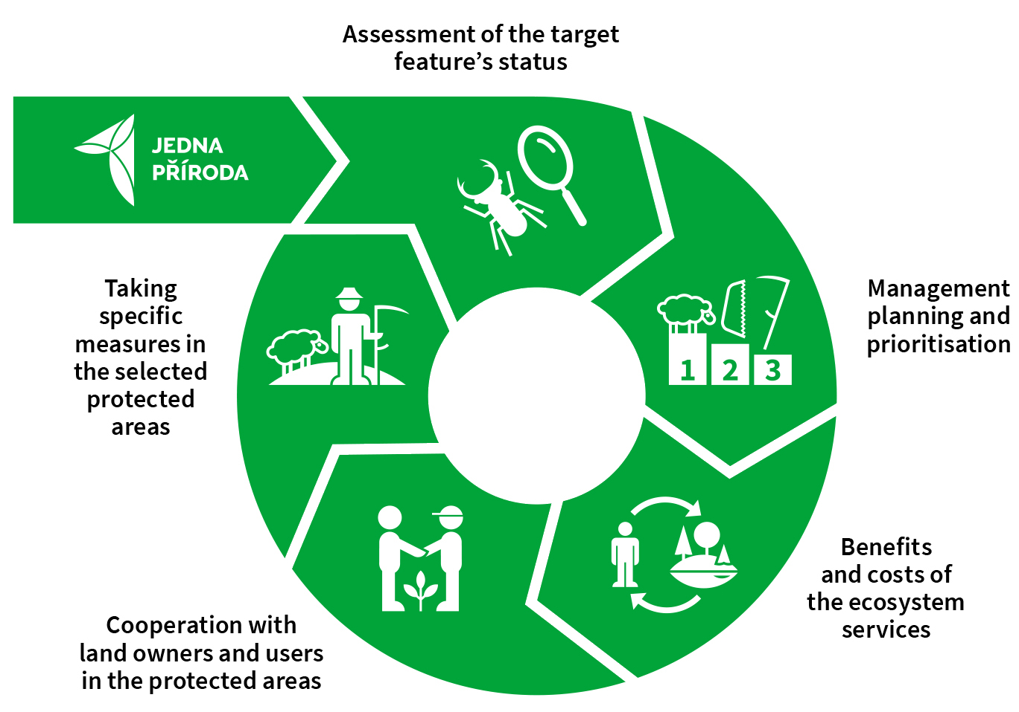
Effective Management System of Natura 2000
The main objective of the Project is to establish a more effective management system of the Natura 2000 sites, which links appropriate management with corresponding planning, based on
accurate assessments of status and trends of the target features, accompanied by cooperation with land users, and which effectively utilizes advanced knowledge of benefits provided by natural capital
within the sites to society and takes into account relevant costs.

Slide 5
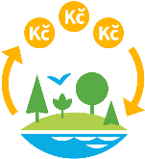
Specific Project Goals
1. Assessment of the status of protected animal and plant species and of natural habitats at individual sites.
2. Setting management priorities for the particular species and natural habitats.
3. Cooperation with the major land owners and land users.
4. Implementation of appropriate measures to maintain or improve the status of habitats and species.
5. Introduction of a management effectiveness evaluation at selected sites.
6. Updating the management plans.
7. Assessment of the benefits provided by the protected areas of the Natura 2000 network and of the costs associated with the conservation efforts in these areas.
8. Providing examples of good practice in site management.
9. Effective use of funding resources available for site management.
10. Providing the project outputs to public administration in the form of recommendations for practice.
11. Informing the public about the objectives and methods of protected area conservation, its benefits and costs.

Slide 6
Achievements
Main website of the Project (jednapriroda.cz) and Twitter @Jednapriroda
Consolidated Layer of Ecosystems – GIS map output – 1st update
Analysis and identification of key stakeholders
System of priorities setting
Semi-automatic system to evaluate the target features status in the NCIS (National Conservation Information System)
Methodological guidelines for communication with land users
4 types of courses and e-learning courses prepared for nature conservation employees

Slide 7
Achievements
Establishing National Platform for Ecosystem Services
Update of NCIS (National Conservation Information System) included tools developed in Project
A total of 210 contracts for restoration management in 2020 and 195 contracts in 2021, with an annual financial volume of EUR 780 000,
434 public law contracts with land owners (76 long-term or complex)
4 types of courses and e-learning courses prepared for nature conservation employees

Slide 8
Expectations
Consultation with key stakeholders and involving them in the process
Management of Natura 2000 sites according to the principles of adaptive management cycle
Intense communication with land users
Training of (all) NPA staff in professional and communication skills
Assessment of benefits provided by Natura 2000 to the society (incl. ecosystem services)
up-to-date data and methods, wide stakeholder involvement
tools for decision making on natural capital management on local scale
national ecosystem services assessment

Slide 9
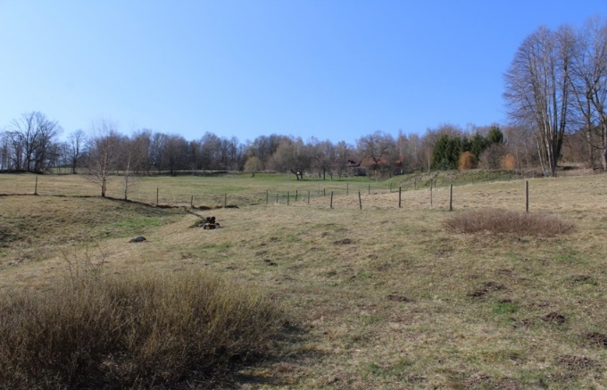
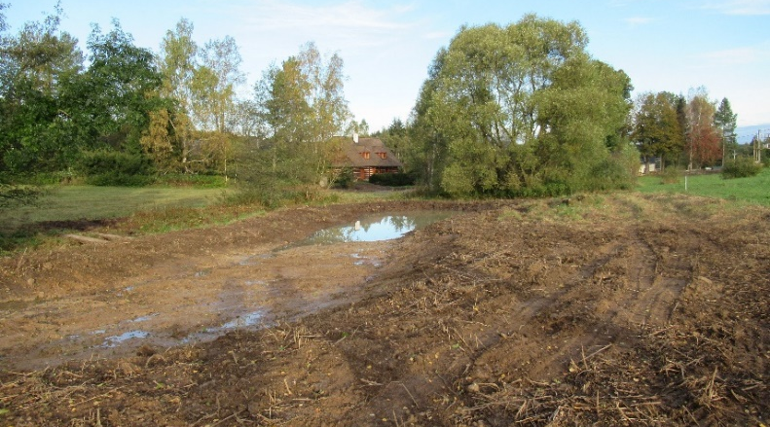
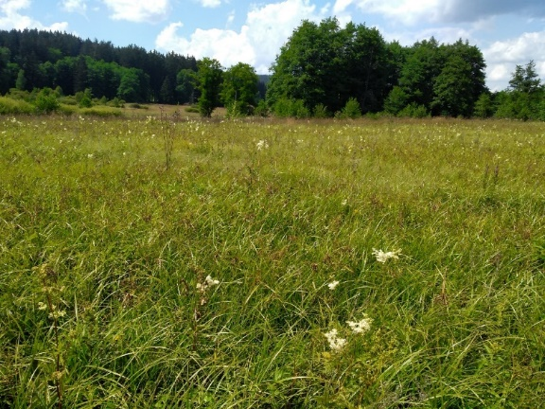
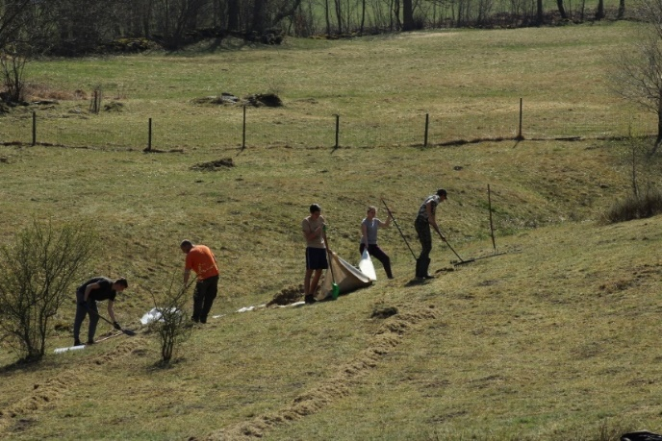
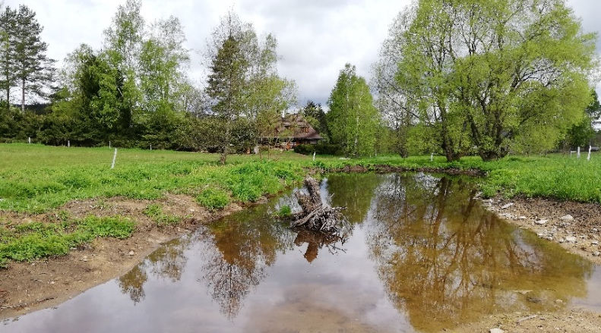
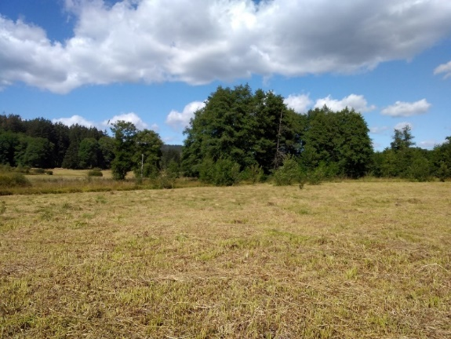
Restoration management in Project
Photographs
M. Černý, K. Marková

Slide 11
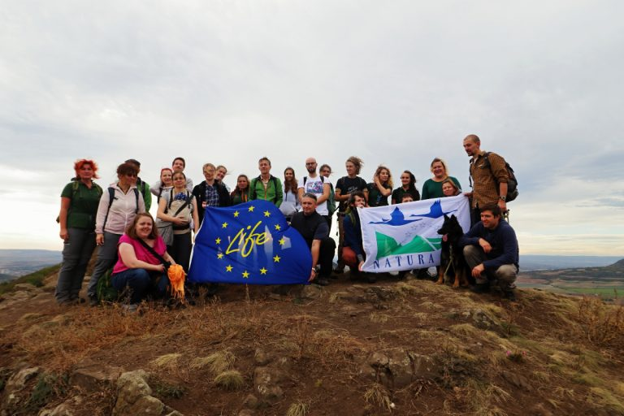

Slide 12
Find out more at: jednapriroda.cz
@Jednapriroda
https://www.youtube.com/channel/UCbujNShp4tgsEaGWAOPG1Ug
Keep in touch: jednapriroda@mzp.cz

