Slide 1
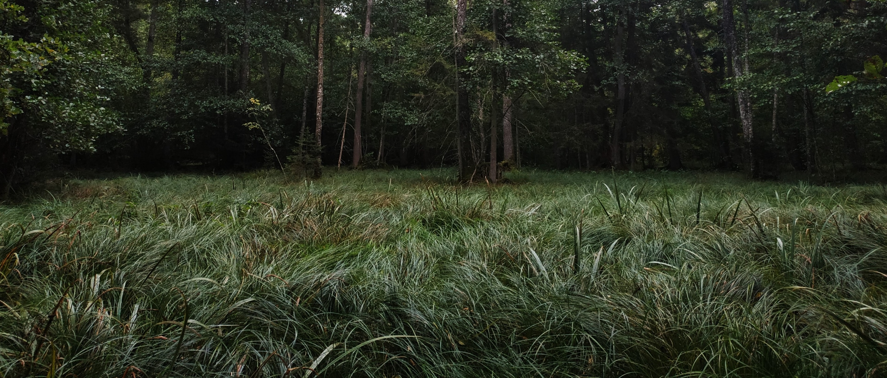
LIFE Integrated Project OPTIMIZING THE MANAGEMENT OF NATURA 2000 NETWORK IN LITHUANIA
Birutė Valatkienė
Project manager
Environmental Projects Management Agency (APVA), Lithuania
birute.valatkiene@apva.lt

Slide 2
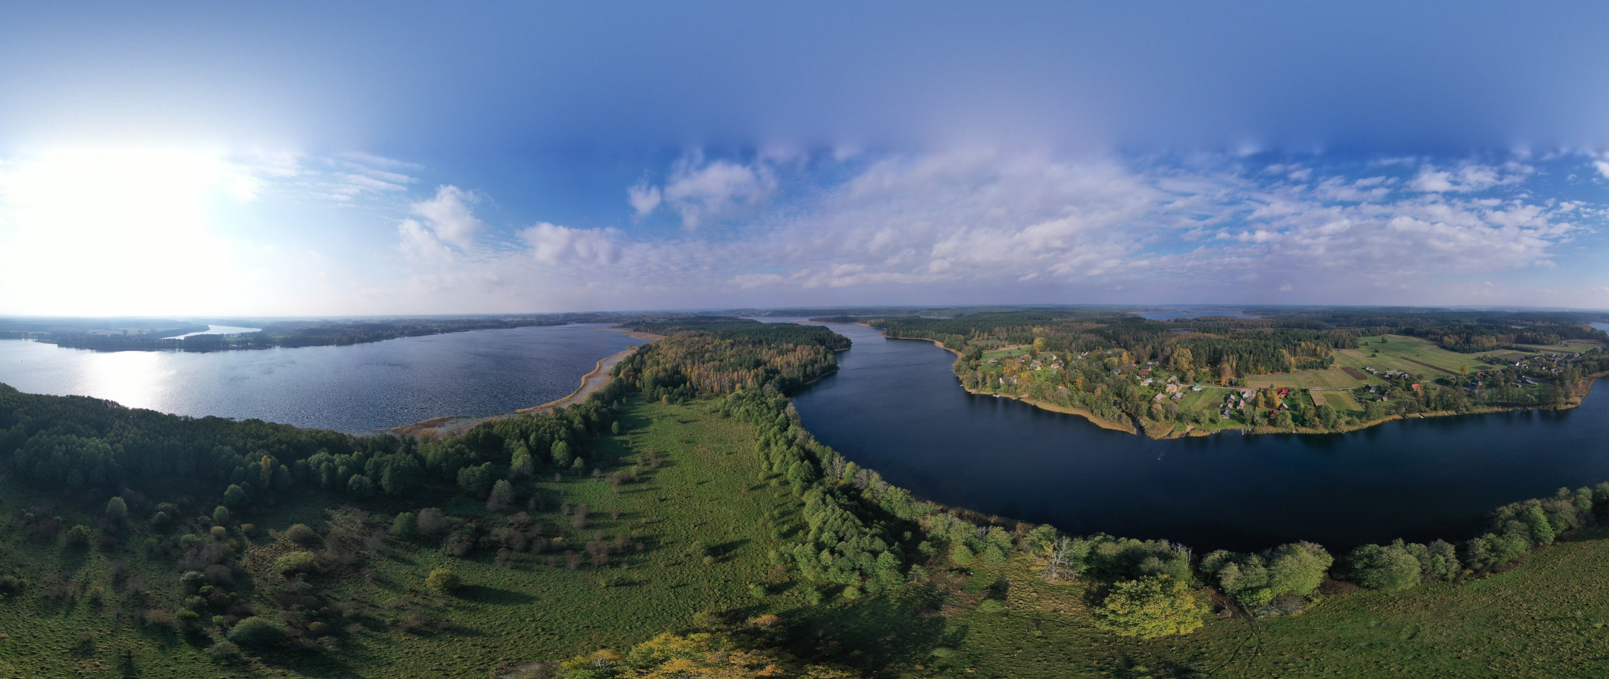
LIFE IP Naturalit:
National scale project / area of NATURE;
Protection of biodiversity / Natura 2000 network;
Contribution to the achievement of the :
objectives of the EU Birds and Habitats Directives;
target 1 of the EU Biodiversity Strategy.
Prioritized Action Frameworks (PAF)

Slide 3
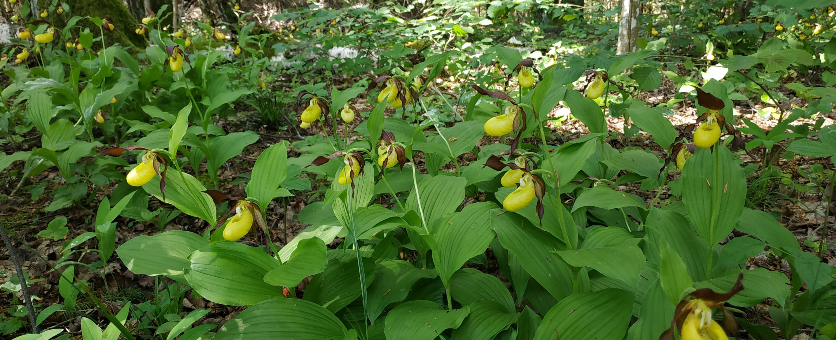
NATURA 2000 NETWORK ?
Network of protected areas covering Europe's most valuable and threatened species and habitats.
The largest coordinated network of protected areas in the world / all 28 EU countries / both on land and at sea.
Natura 2000 network in Lithuania - INSUFICIENT!

Slide 4
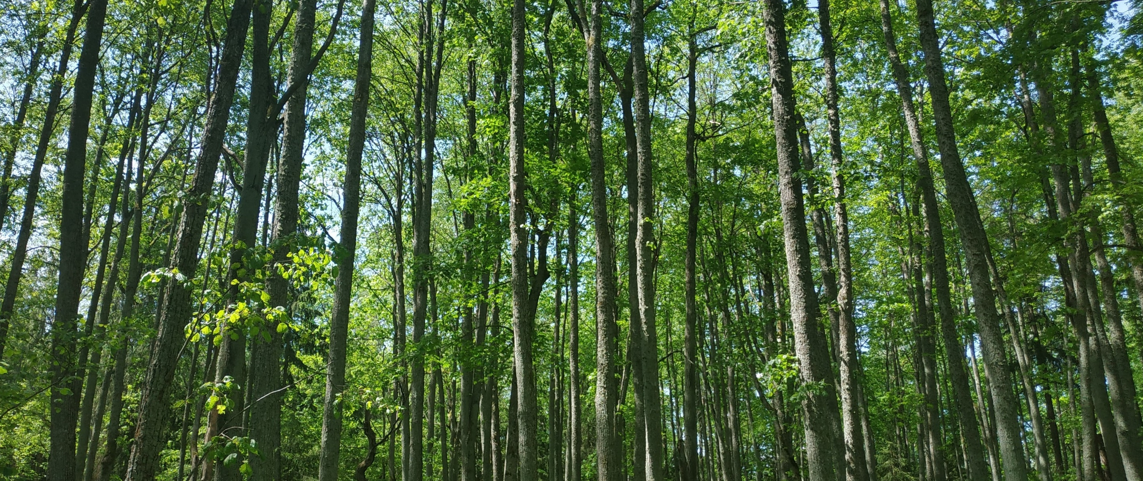
MAIN GOALS
Natura 2000 network - fully completed (all insufficiencies-resolved);
Conservation objectives for Natura 2000 network - agreed at national and site level, necessary conservation measures are in place;
Conservation aspects of Natura 2000 network - fully involved into forest management planning as standard part of the process;
Rural Development Programme involves necessary variety of specific biodiversity support measures;
Appropriate level of Natura 2000 network management capacities of competent authorities is assured.

Slide 5
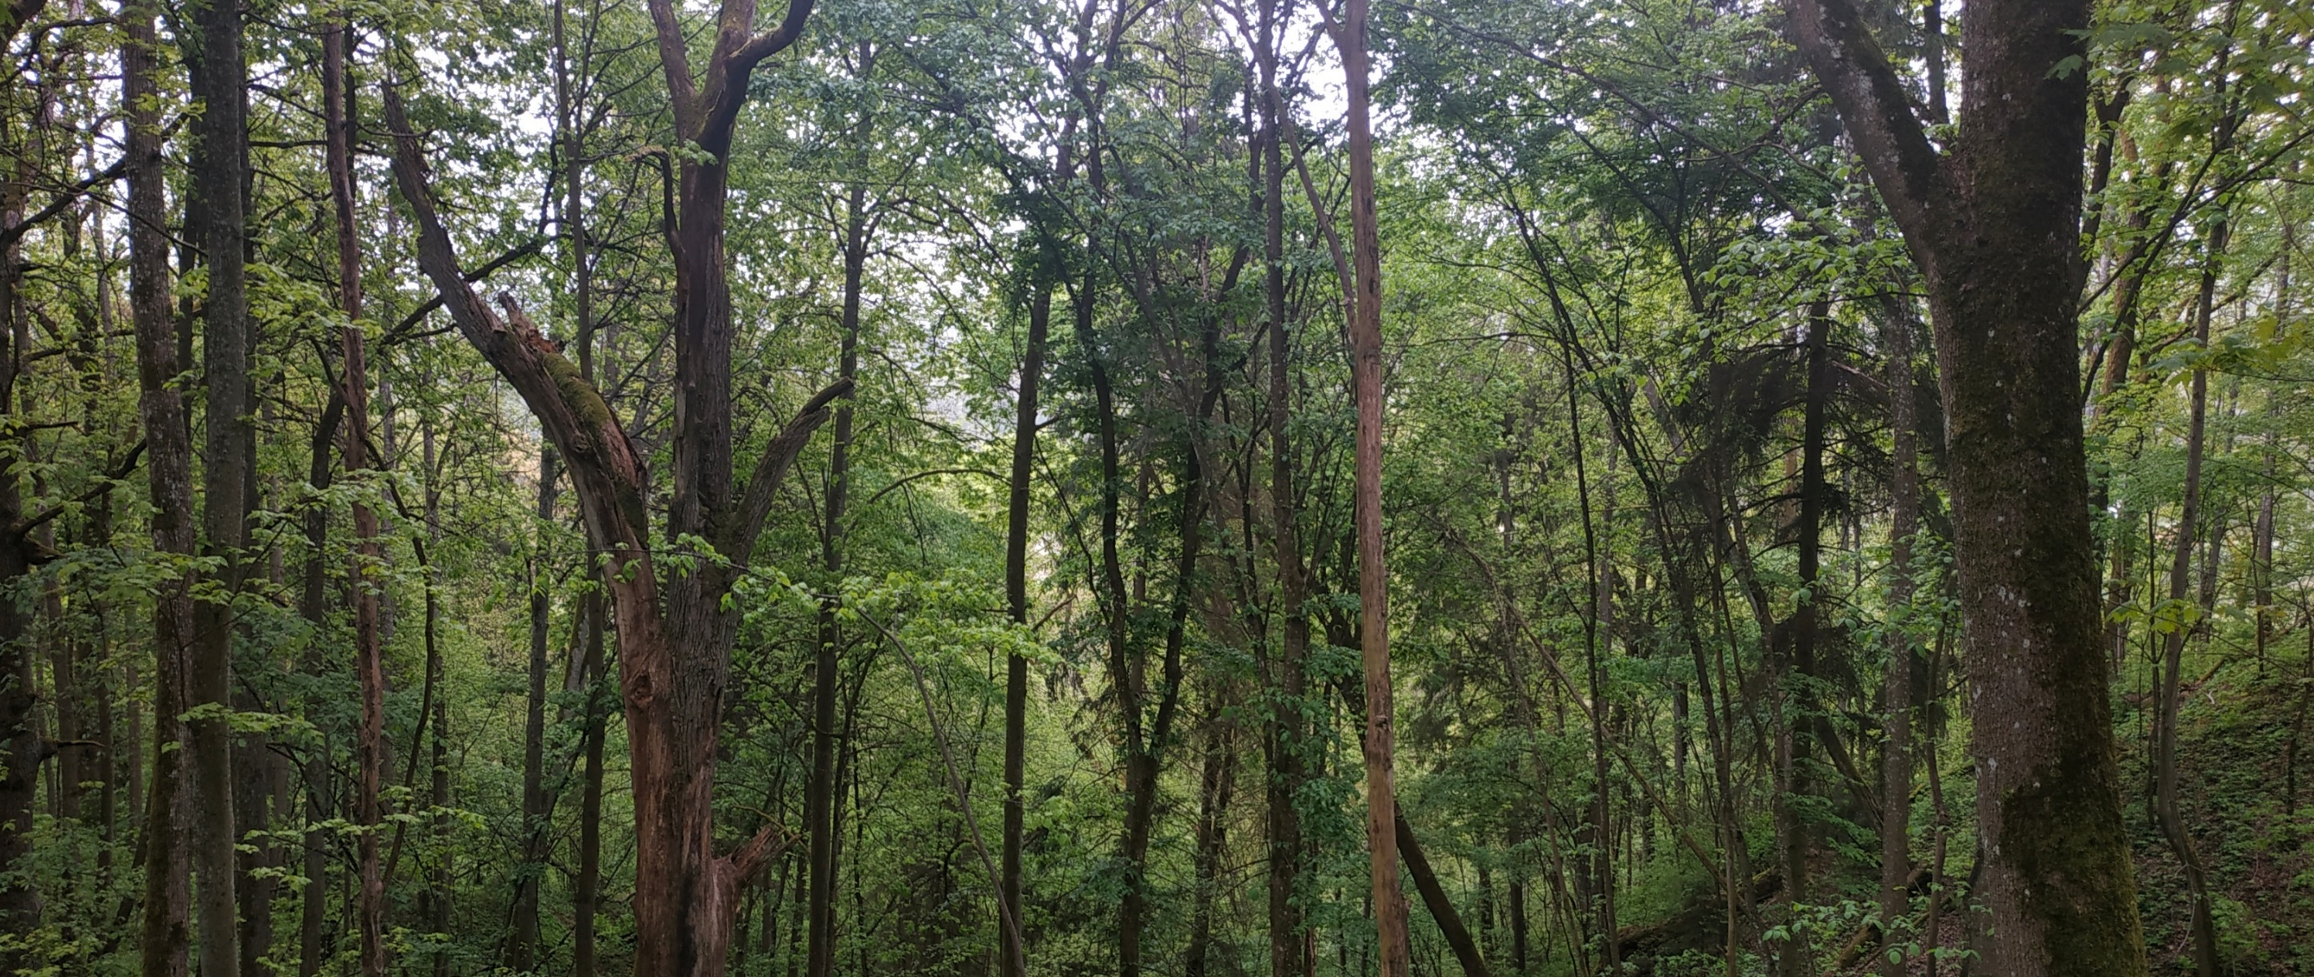
NATURALIT and PAF ?
Insuficiencies of Natura 2000 network
Conflicts of nature conservation and forestry aims
Agriculture sector and specific biodiversity support measures
Institutional capacity building
Green infrastructure
Invasive species
Climate change and biodiversity
Fishery
Sea

Slide 6
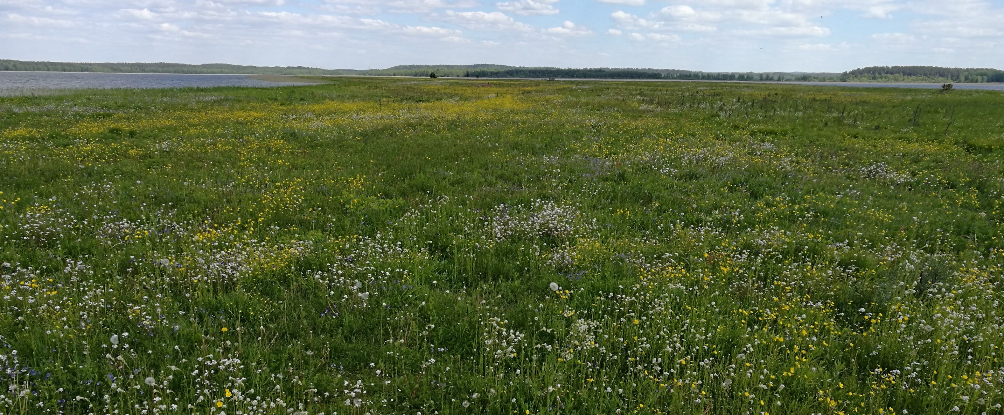
OUR APPROACH
- Implementation of everything set out in the PAF through 1 project ?
- Elimination of essential shortcomings ?
- Elimination of systemic barriers?
NO
YES
YES
Identification at the stage of Proposal preparation
!

Slide 7
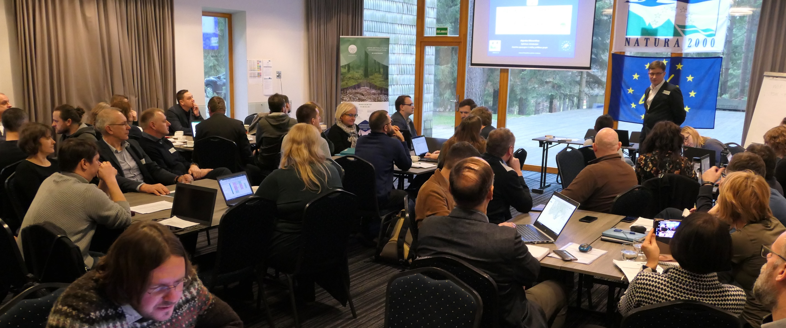
DOES IP WORK ?

Slide 8
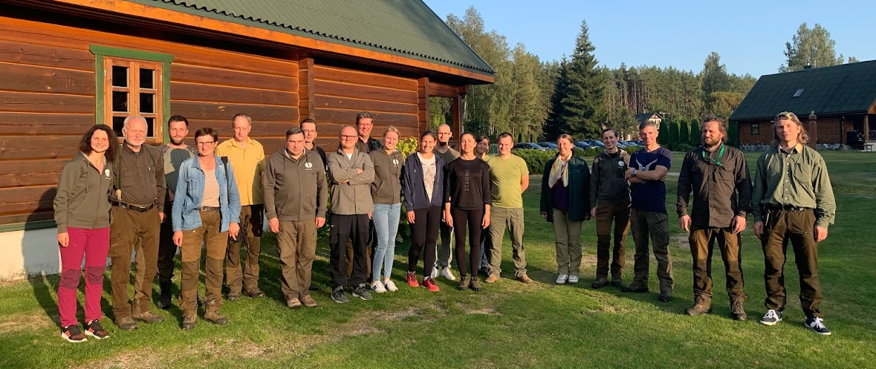
MAC – Methodical Analytical Center
under State Service for Protected areas (2018)
14 experts
(botanists, ornithologists, GIS, lawyer ..)
Example

Slide 9
MAC :
Elimination of Natura 2000 network insuficiencies;
Essential input into actions of strategic importance (PAF, ...);
Methodical and expert support for specialists of MoE and institutional system of Protected Areas (PA);
Unplanned tasks of national scale – support for institutional system „here and now“;
- Forming of groups of specialists in the system of PA for various tasks and further training.
- Already now - much less dependence on outsourced services.
!

Slide 10
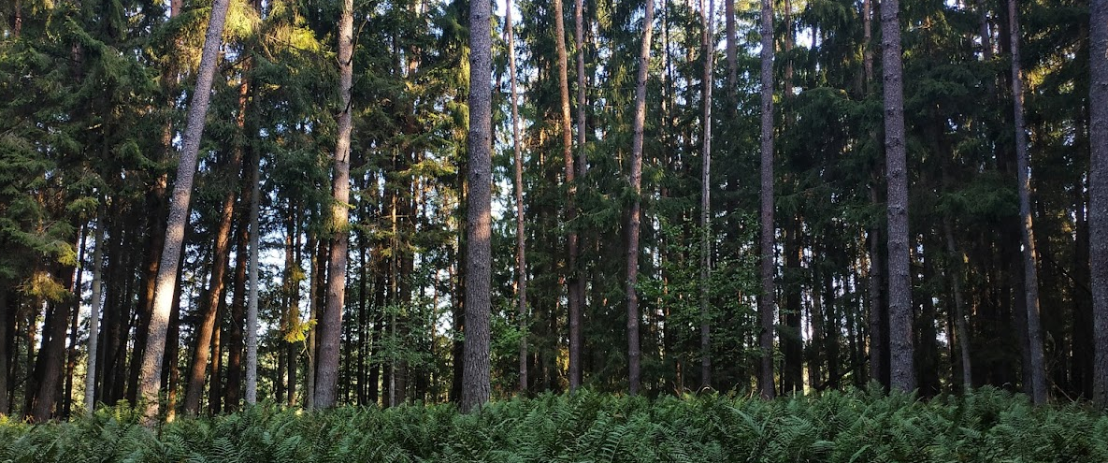
Integration of nature conservation measures
into forestry management planning process
Example

Slide 11
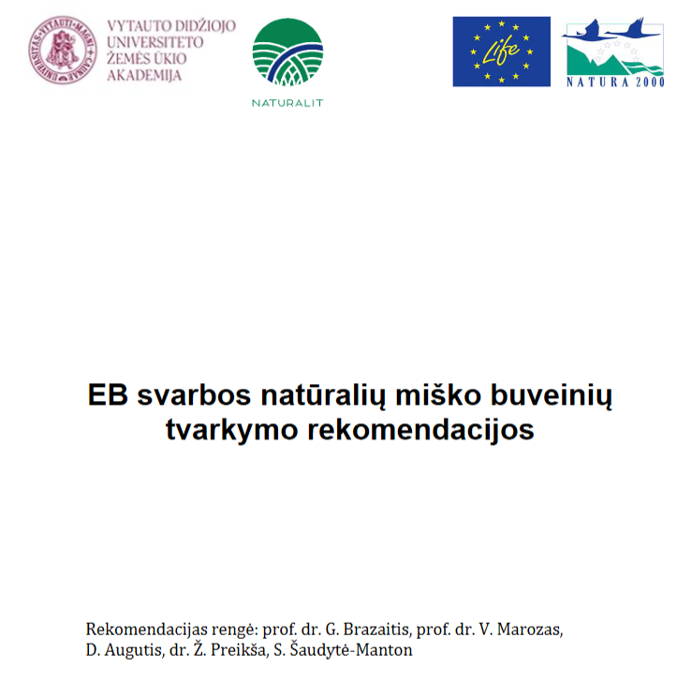
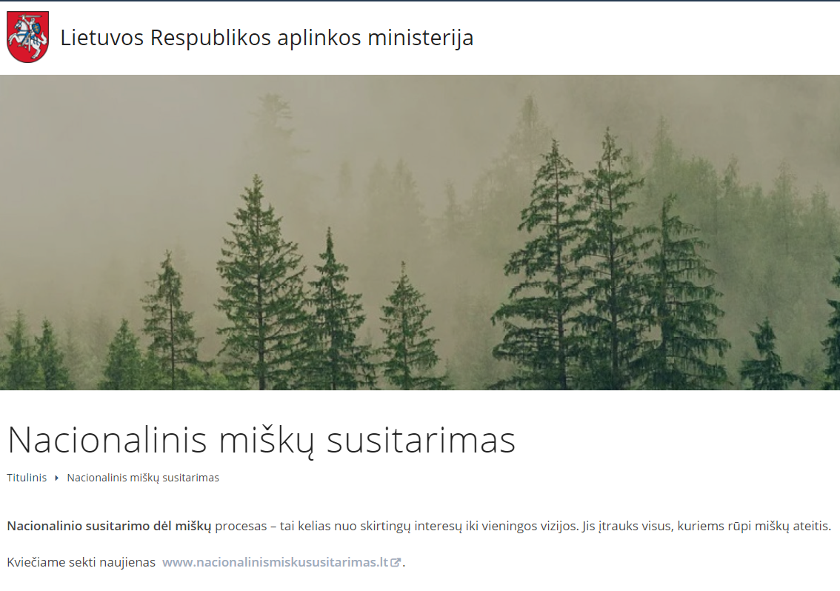
Guidelines for the management of natural forest habitats of EC importance
National Forest Agreement
Revision of the regulation on management rights on the forest land and potential legislative adjustments preparation

Slide 12
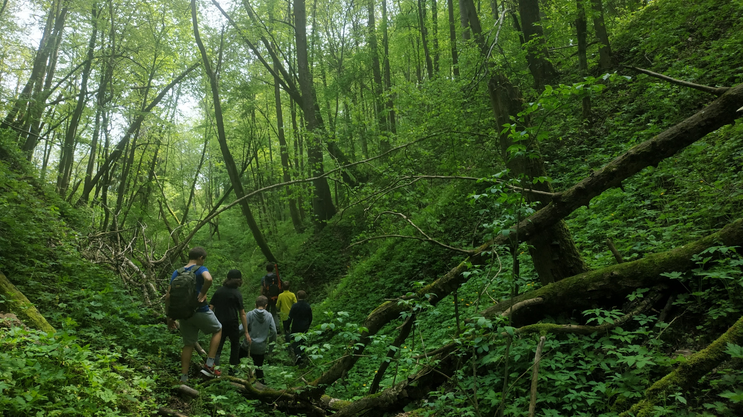
We seek to ensure the full protection of the NATURA 2000 network, the most valuable natural areas in the EU.
Thus, we will preserve the ancient woods, wetlands, grasslands, other habitats and their naturalness, which has surrounded Lithuanian people from ancient times.
www.naturalit.lt

