Slide 1
Waste management in Finland – video case
Katja Lepistö Communications specialist Finnish Environment Institute SYKE 9 March 2022

Slide 2
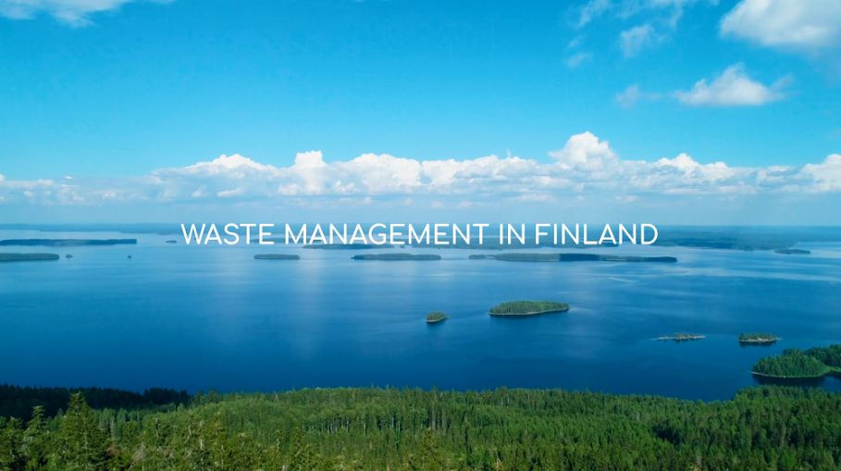
What was it about?
Lets start by watching 2 minutes of the video!
https://youtu.be/6i1EoqMTRaY

Slide 3
Aim and goals
We are often asked: ”Why is Finland so good at waste management? How do you do it?”
To present Finland’s waste management system, laws and best practices to other countries, especially Russia and China were identified sources for ”most frequently asked questions” to us.
Other target groups identified: research, students, policy makers, international audience in general.
To work together with different researchers and waste actors in Finland.
To include visually interesting waste facts and storyline.
Plastic was chosen to be the hero of the story and to narrow the broad theme a little.

Slide 4
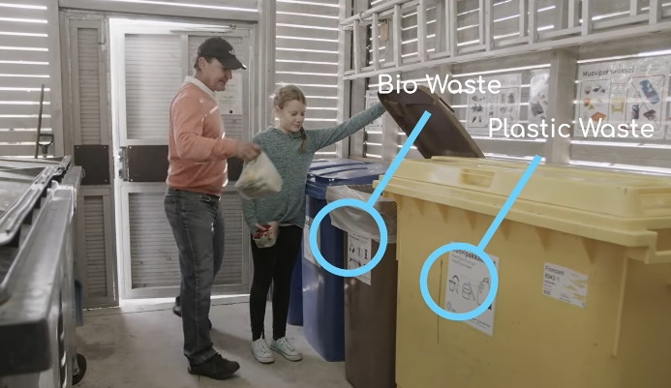
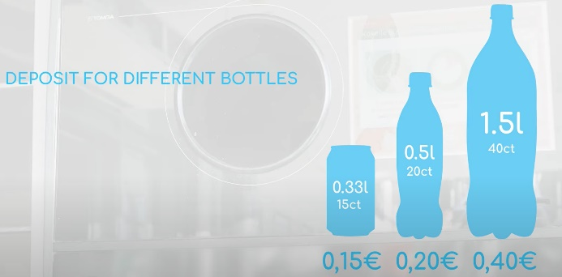
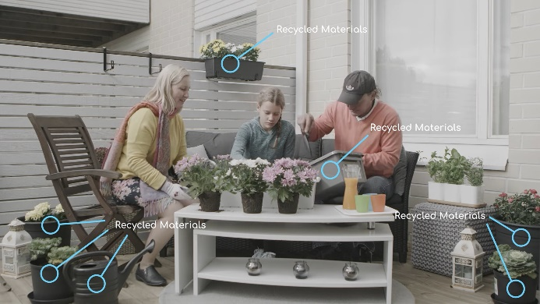
Plastics’ journey
The video tells the story of plastic. How it goes through a normal family’s consumption, ends up recycled and reused as a new product.
We also explain the bottle deposit system that is not familiar to all countries.
A real family was used as actors, and in addition to everyday life locations we chose some beautiful locations too to represent Finland’s nature and clean waters.

Slide 5
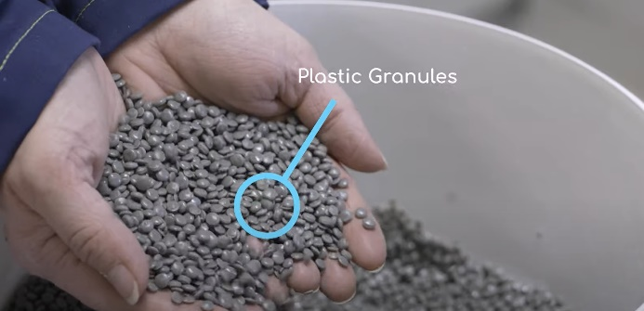
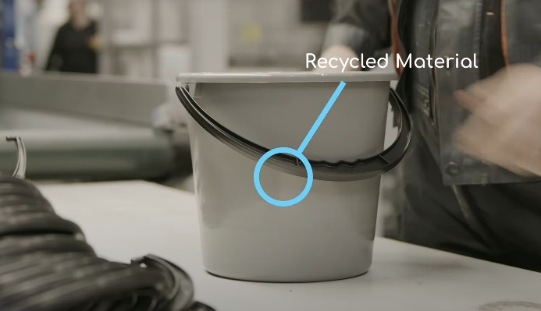
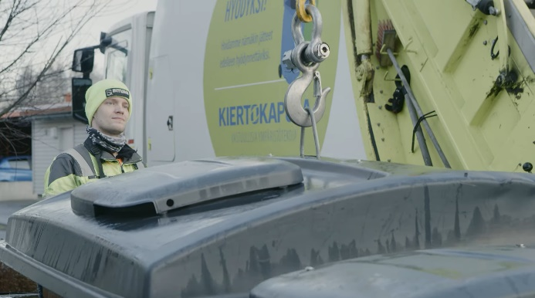
Working together
Many waste management companies were interested in to participate in our video.
We got to film for example inside a recycling plant and plastic refinery, who made some buckets just for us!
And we followed a ”garbage man” for a day, even though he had hurt his leg that morning, he didn’t want to cancel the photo shoot!

Slide 6
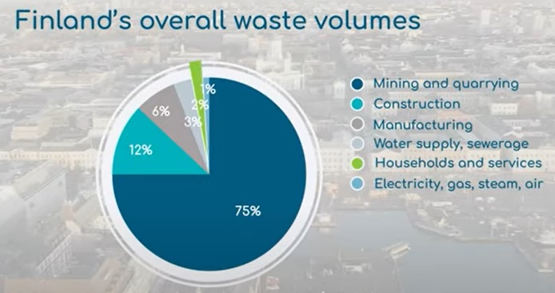
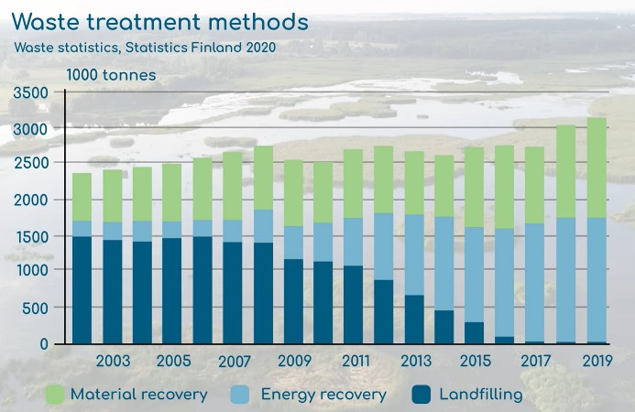
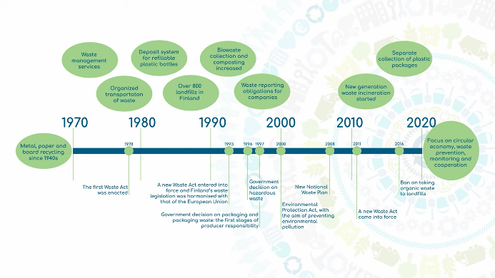
Waste facts and visuals
We worked together with several researchers to compile waste facts and data – that was the hardest part!
We even managed to draw the whole history of waste management in Finland on a timeline!
We chose an expert video makers to visualize our video.
Circwaste project’s visuals come through nicely!
Real voice actor was used as a speaker.

Slide 7
A success!
Video was launched on Circwaste website, social media and newsletter and it has been showcased in some webinars or conferences too.
Video was translated into Finnish, English, Swedish, Russian and Chinese + automatic YouTube translations are available in all languages.
It has gotten a lot of attention and we have had good comments from our network.
Over 5.000 views and 220 hours watched on Finnish Environment Institute’s YouTube channel.
Most watched video on our YouTube last year and second most watched in all-time history! (We are not usually known for our videos…)

Slide 8
Thank you!

