Slide 1
BundleUp NEXT
NEXT-LEVEL PDA METHODOLOGY TO ENHANCE PUBLIC AND PRIVATE SUSTAINABLE ENERGY PROJECTS
This project has received funding from the European Union’s Horizon 2020 research and innovation programme under grant agreement No 101033809

Slide 2
Value proposition
Put together in a single place all the stakeholders for sustainable energy
PROMOTERS
Public and Private Organizations with sustainable energy projects
SPECIALISTS
Engineering companies, ESCOs, PV Installers, etc.
INVESTORS
Organizations specialized in project financing

Slide 3
PIXEL VISION
SLIDE SECTION
THE bundle up project (2018-2021)
62
41
44
Implemented Projects
M€ of Investment raised
GWh/year of energy savings
3,4
2
18
MW of installed PV for self-consumption
M€ in Private Funding from crowdlending
Kton CO2 avoided/year
Notes:
A Mariana tá a fazer os cálculos de pipeline agregado

Slide 4
1. The consortium

Slide 5
2. what motivates us
Many projects, with high savings potential and economic viability do not reach the implementation phase
FINANCING
Hard to find in traditional sources
SCALE
Insuficient to attract professional investors
BUROCRACY
Restrictive procedures, lack of capacitation and support

Slide 6
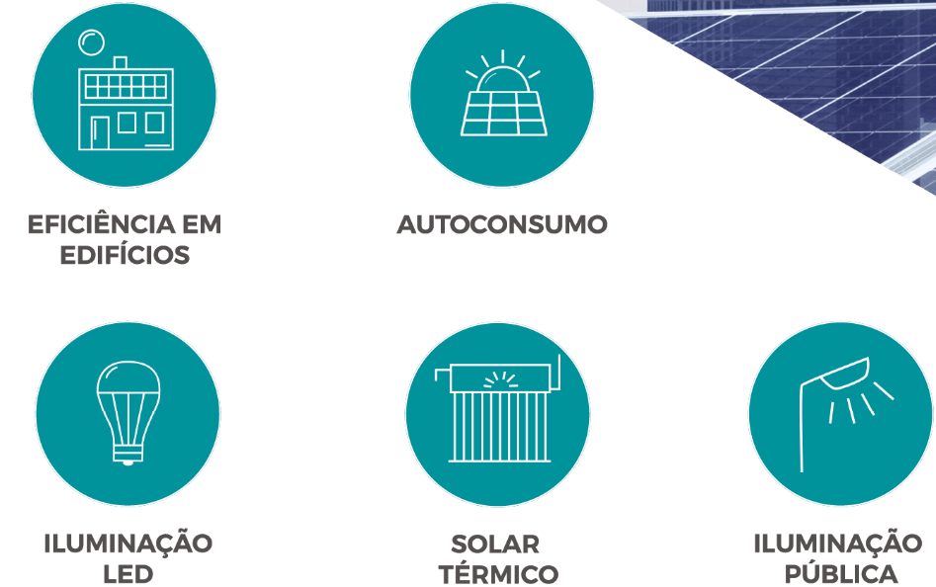

Slide 7
3. methodology

Slide 8
3. Constraints and needs
TECHNICAL
Lack of technical skills, in promoter entities, able to perform the energy assessments and plans and evaluate the associated potential savings
Lack of awareness of the top management and technical bodies about the potential economic/environmental benefits of sustainable energy investments
Lack of awareness of the top management and technical bodies as well as of the co-benefits of sustainable energy investments (e.g., health, productivity, synergies with other needed interventions (e.g. asbestos) and water efficiency)

Slide 9
3. Constraints and needs
LEGAL
Lack of specialized skills regarding public procurement and the contracting of energy efficiency works, products or services
Specifically, regarding the EPC there are legal (perceived) obstacles related to public procurement rules, as there is uncertainty or lack of know-how about the essential elements of these contracts, as well as the registration of these contracts in national public accounts, despite the Eurostat and EIB clarification initiatives.

Slide 10
3. Constraints and needs
FINANCIAL
Limited financial resources available for energy renovation purposes
Lack of budget provision for energy renovation investments, requiring planning routines that must be introduced and maintained
Significant cost of feasibility studies and business model definition - whereas larger projects (2M€ and above) might be able to encompass these costs, for smaller projects it is much more difficult to include it in the cost structure of a project and still make it financially attractive
High-interest rates, transaction costs, long amortization periods and credit risks, or their perception, associated with investments in energy efficiency
The dispersion of financial mechanisms and lack of an integrated approach to financing energy efficiency
The complexity in preparing applications for funding instruments has proved to be a constraint both for public and private entities

Slide 11
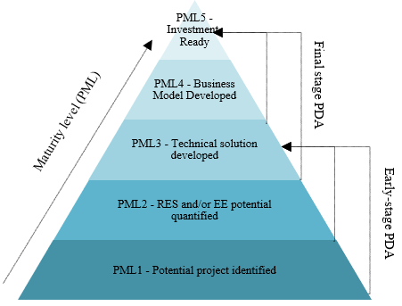
4. PDA Maturity scale and Methodology

Slide 12
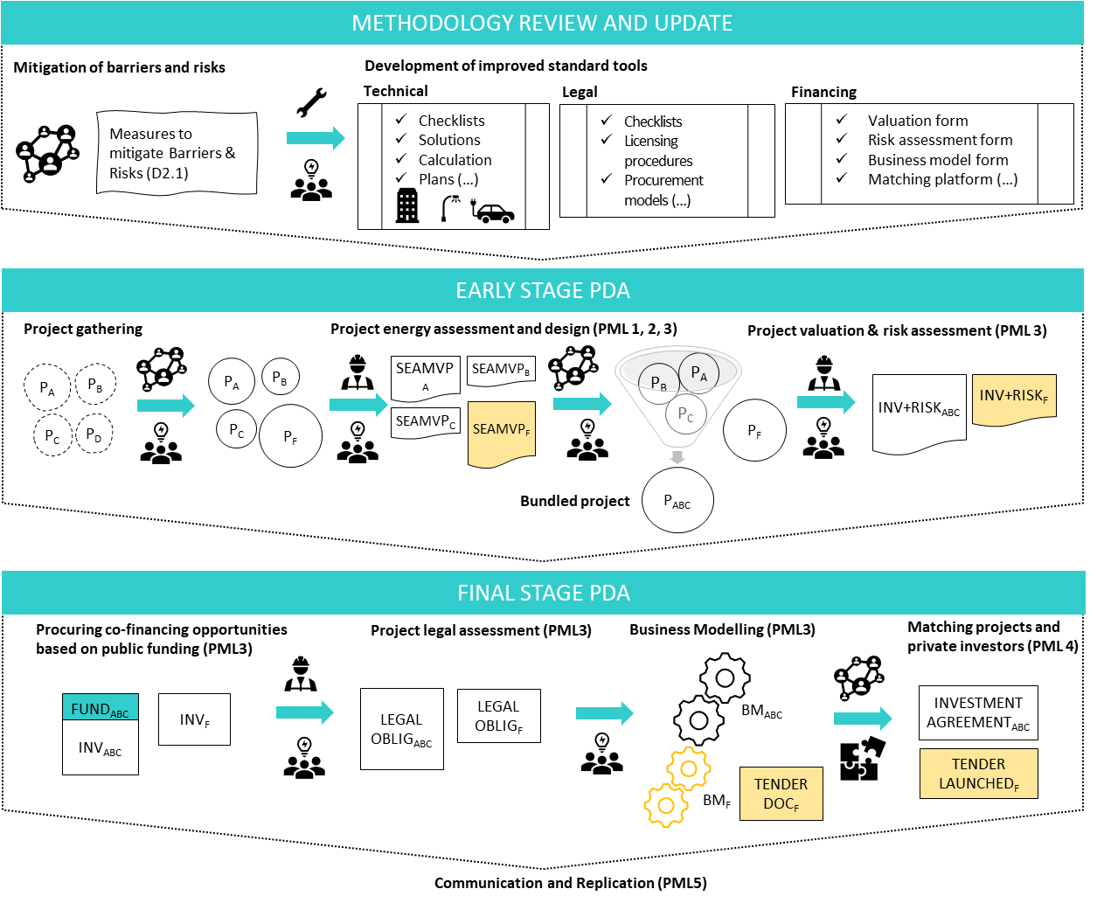

Slide 13
Financing projects
Own funds
ERDF and RRP funds
ESCOs
Bank loans / Renting / Leasing
Investor funds
Crowdlending

Slide 14
5. Our starting point
56
49
100%
PROJECTS
With 45,4 GWh/year of energy saving potential
M€ OF INVESTMENT
Selected from an initial pipeline of over 107M€
NATIONAL COVERAGE
Public and private projects from all areas of Portugal are elegibile for support

Slide 15
5. Our starting point

Slide 16
6. Project impact
=
=
Annual energy savings of 45.433 GWh
9 112 Ton CO2 avoided each year
Equivalent to planting 414 182 trees each year
Annual RES production of 16.145 GWh

Slide 17
THANK YOU
manuelnn@goparity.com
This project has received funding from the European Union’s Horizon 2020 research and innovation programme under grant agreement No 101033809

