Slide 1

Bundling sustainable energy projects by seven municipalities in the Athens Metropolitan Area
Eva Athanasakou, Euditi Energy and Environmental Design
Argyro Giakoumi, Centre of Renewable Energy Sources and Saving
Covenant of Mayors Investment Forum – Energy Efficiency Finance Market Place
Brussels, 15 and 16 June 2021

Slide 2
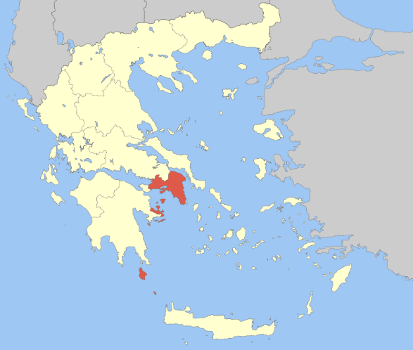
PRODESA in a nutshell
7 municipalities located in the metropolitan area of Athens join forces to:
develop showcase energy efficiency projects of
  20.2 m€ total investment
  116 municipal buildings
  22,000 luminaires of streetlighting
bundle energy efficiency interventions in larger projects
pool financing resources and leveraging private investments through energy performance contracting
PRODESA is financed by the ‘Project Development Assistance’ instrument of H2020

Slide 3
The Consortium (1/2)
Five municipalities are developing projects and will proceed with tendering and contract signing:
ALIMOS (Project Leader)
AGIOS DIMITRIOS
GLYFADA
VARIS - VOULA – VOULIAGMENI
AGII ANARGIRI – KAMATERO
Two municipalities are participating as replicators
PALAIO FALIRO
AMAROUSSION
Results to be disseminated to all municipalities in Greece via
CENTRAL UNION OF MUNICIPALITIES OF GREECE

Slide 4
The Consortium (2/2)
EUDITI Energy and Environmental Design LTD | Project management & coordination support Technical support
CRES Centre for Renewable Energy Sources and Saving | Support on regulatory issues Technical support
ENFINITY NV | Support on project financing issues
ECN European Crowdfunding Network | Support on crowdfunding issues
Kelemenis & Co. Law Firm | Legal support

Slide 5
PRODESA is contributing to resolving barriers such as:
Lack of financing of Project Development
  Due to the economic crisis, resources were allocated to more pressing needs, and investing in energy efficiency project development was ranked as a second priority;
  PRODESA supports the project development which is the most difficult phase to be financed
ESCO market at a very early stage
  Only few projects with involvement of ESCOs have been carried out in Greece
  PRODESA will result in real large-scale examples with data evidence that will increase confidence in energy performance contracting
Reluctance in adopting new paths
  Municipalities are reluctant to adopt new financing mechanisms such as energy performance contracting
  PRODESA develops examples of new approaches and templates of tender documents that support the implementation and replication of the proposed new financing mechanisms

Slide 6
Project Structure
Detailed design of energy efficiency projects
Comparative assessment of economic schemes
Application of innovative financial tools
Public – Private Dialogue
(ESCOs – financial institutions – municipalities – government)
Validation of energy savings and cost
Preparation of technically acceptable projects by ESCOs
Selection of complementary financial resources
Bridge the gap
Resolve issues and make projects attractive
Project Bundling
Financial engineering
Tender documents
Capacity Building – Prepare Replication
Communicate – Disseminate
Make sizeable projects
Maximize private funds
Pool together complementary financial resources
Launch Tenders
Sign Contracts
SHOWCASE EXAMPLES

Slide 7
Investments and
Financing Schemes

Slide 8
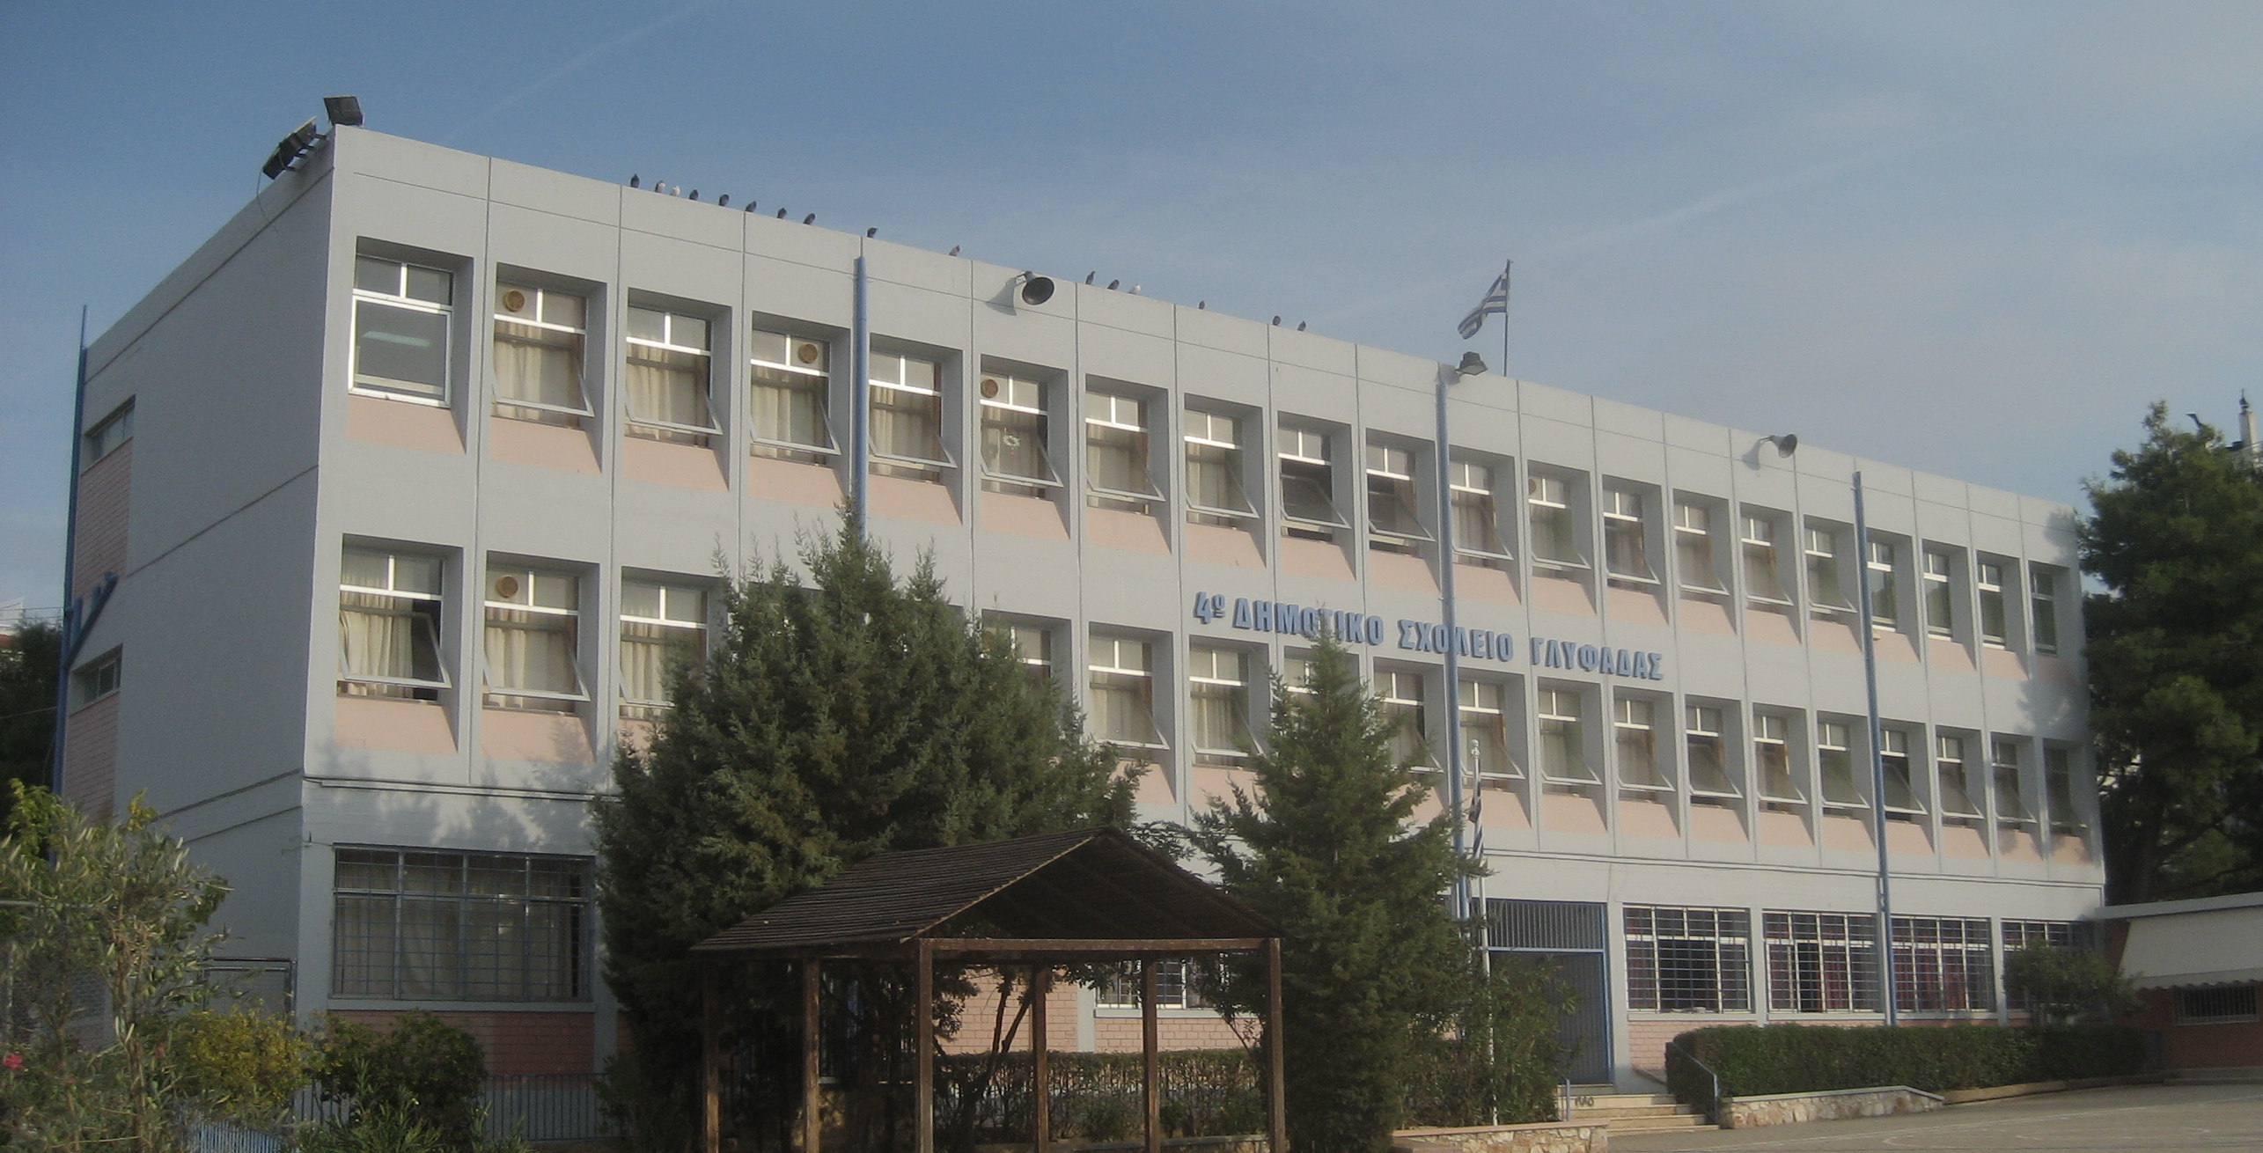
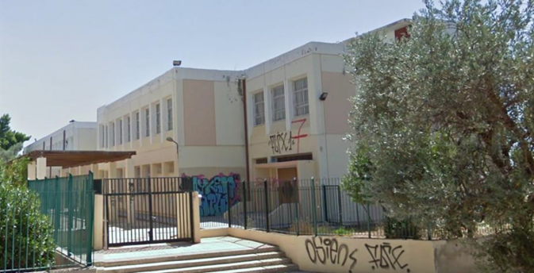
Key features of the municipal building stock
Main building types
  schools (mainly)
  office buildings
  open care centres for the elderly
  cultural centres
Most buildings are about 30
years old
Thermal protection needs improvement for the majority of the buildings
Most of the heating systems are inefficient and need replacement
Only a couple of buildings have photovoltaic system

Slide 9
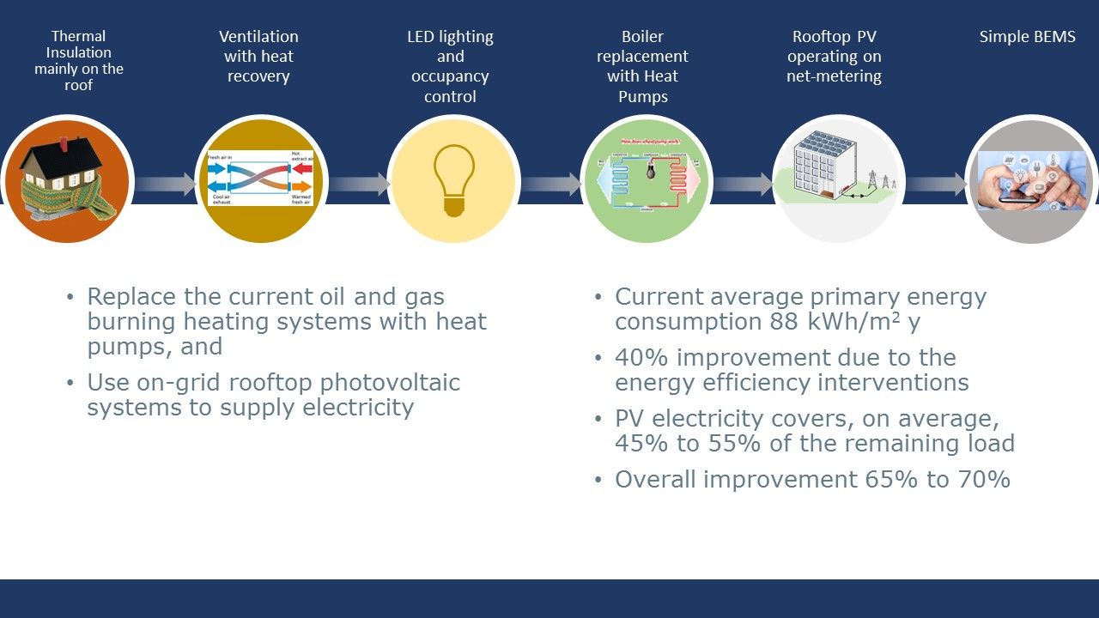
Building energy efficiency interventions

Slide 10
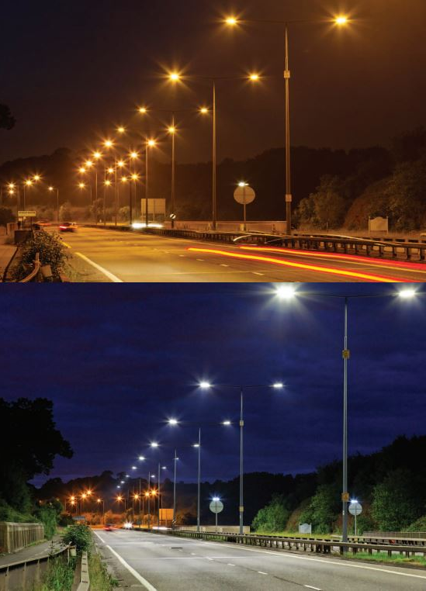
Streetlighting energy efficiency interventions
3 Municipalities
6.3 MW or 22,000 luminaires to be replaced with LED and monitoring system
Current primary energy consumption 60 GWh/y
Estimated primary energy savings of app. 63%

Slide 11
Expected Energy Impacts and Job Creation
Primary energy savings (MWh/year) | 54.3
Renewable energy produced (MWh/year) | 6.9
CO₂ emission savings (t/year) | 18,300
Expected new jobs | 330
68.7%
100%

Slide 12

Eight bundles of 25.5 m€ total investment
Alimos
5.3 m€
20 bldg, 2.3 m€
Streetlighting 0.85 MW, 3.0 m€
Ag. Dimitrios
2.4 m€
35 bldg., 2.4 m€
Glyfada
6.8 m€
Streetlighting 3.2 MW, 5.7 m€
26 bldg., 1.1 m€
Voula
1.5 m€
28 bldg., 1.5 m€
City of AAK
9.5 m€
27 bldg., 4.8 m€
Streetlighting 3.2 MW, 4.7 m€

Slide 13

Financing schemes
Municipalities | Buildings
Alimos | 37% Public Grant, 42% EPC, 21% Equity
Ag. Dimitrios | 100% EPC
Vari Voula Vouliagmeni | 100% EPC
City of AAK | 24% Public Grant, 76% EPC
Glyfada | Under evaluation
Mix of public and private financing resources
Green Fund Grant
Regi-onal Grant
Crowd-funding
EPC
Debt financing
Equity
Municipalities | Streetlighting
Alimos | 100% Debt Financing, EPC with 10-year guarantee of energy savings
City of AAK | 70% equity, 30% EPC
Glyfada | Under evaluation

Slide 14
Points of attention and difficulties in mixing public and private resources
Mixing depends on the concurrency of the resources
(e.g. public grants )
Must identify early and plan accordingly for the terms and requirements imposed by each financing entity such as:
  economic e.g.
    subsidy caps
    grants allocated to specific interventions as opposed to an overall energy savings target
  technical e.g.
    energy efficiency evaluation method i.e. asset method as opposed to real energy consumption

Slide 15
Contribution of PRODESA
A template of a tender document for the procurement of the energy efficiency interventions design that includes terms facilitating both the award of public grants and private financing
An economic assessment tool that also guides the formulation of a financing plan with assumptions acceptable by the financing entities
Cooperation with the Public Consignments Deposits and Loans Fund to provide guarantee of payments to the ESCOs during the whole energy performance contract duration
  The Fund is empowered to do so by Law 4643/2019, article28, but currently, only for a specific financing instrument with funds from the Public Investment Fund and EIB
  It will potentially be extended, in the future, to cover all municipal EPC projects
Templates of tender documents and contracts for the implementation of the investments with EPC and mixed financing

Slide 16
ESCOs and Energy Performance Contracting (EPC) is one of the main pillars of the financing sources brought together in the PRODESA project

Slide 17
EPC and ESCO Market in Greece
ESCOs and Energy Performance Contracting (EPC) is one of the main pillars of the financing sources brought together in the PRODESA project
The ESCO market in Greece
Market is still in an early stage
Many companies are registered as ESCOs, but only few EPC projects have actually been implemented only in the private sector (i.e. tertiary and industry)
Especially in the public building sector some attempts have been made in the past, but implementation of EPCs has not been deployed yet
Only recently there are few examples in street lighting projects
Notes:
Before starting with the presentation I would like to give you a quick insight in the Greek ESCO market.
Given this immature market, it was very important to examine how municipalities and ESCOs were willing to embrace this solution.

Slide 18
ESCO Dialogue
WHY:
- Establish a communication line & understand difficulties from both sides in implementing EPC in the public sector
WHO:
Participating Municipalities
ESCO companies
Financial institutions
Directorate of Energy Policy and Energy Efficiency of the Ministry of Environment & Energy (YPEN)
WHAT:
Tendering procedures
EPC model contracts
Measurement, Monitoring &Verification methods
Financing models
Guarantees
2018➔ 1st Dialogue – Generic Dialogue: Set all the different approaches under discussion and obtained the point of view of stakeholders on the different topics
2019➔ 2nd Dialogue - a focused Dialogue : A specific approach was then set to discussion with the market and their point of view was obtained.
https://www.prodesa.eu/downloads/?lang=en
2nd Focused Dialogue
1st Generic Dialogue
Cooperation with Municipalities
Conclusions
Notes:
Οι εταιρείες βλέπουν θετικά μία προσέγγιση όπου ο Ανάδοχος κάνει τις δικές του μετρήσεις, προσδιορίζει τη βάση αναφοράς, προτείνει τα μέτρα, τα υλοποιεί, έχει τη συντήρηση και Μέτρηση & Παρακολούθηση του Αποτελέσματος.
Κάτι τέτοιο θα απαιτούσε κάποια Ανταγωνιστική Διαδικασία (π.χ. Ανταγωνιστικό Διάλογο ή Διαπραγμάτευση), το οποίο δεν ήταν διατιθέμενες οι Αναθέτουσες Αρχές να υποστηρίξουν καθώς δεν υπάρχει σχετική εμπειρία.
Προκήρυξη ως υπηρεσία και όχι ως μεικτή σύμβαση➔ δεν είναι συμβατό με τις «παραδοσιακές επιδοτήσεις» που χρησιμοποιούνται ως πηγή χρηματοδότησης.
Έλλειψη αναλυτικών δεδομένων ενεργειακής κατανάλωσης καθιστούσε πολύ δύσκολη σε κάποιες περιπτώσεις την κατάρτιση γραμμής βάσης.

Slide 19
The approach followed in PRODESA
One-step procedure Vs two-step procedure
In the PRODESA project, the contracting Authority has specified the baseline consumption and the energy efficiency measures and has carried out the design before initiating the procurement procedure.
Buildings
Open procedure (one-step procedure)
Mixed contract of supply, services and works
Award criteria based on the most economically advantageous tender (not based on price only, but takin into account weighting factors attributed to the technical aspects of each intervention)
Street-lighting
Mixed contract of supply & services
For replication
In cases where the Authority doesn’t have the means to perform such a preliminary work, the specification and design should be lead by the ESCO by utilizing a two-step procedure, e.g. a competitive dialogue.

Slide 20
EPC model
Shared savings vs Guaranteed savings model
Guaranteed level of energy savings
The ESCO guarantees to achieve a minimum level of energy performance over the duration of the contract
Savings are determined by means of engineering calculations of baseline and reporting period energy use, based on measured values of specific key performance parameters.
- Energy consumption savings are expressed in kWh but also in monetary terms using an agreed energy price
The EPC makes it clear that the ESCO is responsible for ensuring that the design, construction, installation and performance of the EPC measures (including those specified and designed by the Authority) meet the standards set out in the EPC
Fixed operational payments towards the ESCO, given that the guaranteed levels are met (energy savings, RES production)
If there is a shortfall in actual achieved savings, then the ESCO pays the difference between the guaranteed and achieved savings to the Authority

Slide 21
Prerequisites for contracting authority
Set already in public subsidy programs:
Clear legal ownership of the buildings
Permission documentation depicting the current status of the building (e.g. additions, refurbishment)
Primary Seismic Control Bulletin, showing adequate seismic capacity (macroscopic inspection of the building)
Energy Performance Certificate (energy class of the building)
Additional:
Energy Audit (Baseline consumption)
Identification of the technical solution and the energy upgrade that will improve the building class level (e.g. from class D to B+)
Identification of the actual energy savings based on real consumption data

Slide 22
Prerequisites for contracting authority
The contracting authority:
Provides the baseline consumption, sets the targets to be achieved (energy saving and RES production) and sets minimum requirements of the M&V plan (e.g. option of IPMVP)
Sets the lifetime of the contract (e.g. 12 years), taking into consideration that the level of savings guaranteed should be equal or greater than the sum of all economic liabilities of the Authority during the lifetime of the contract (e.g. Operational payments to the ESCO, Loan installment, energy invoices)
Asks the Tenderer to implement the specific technical solution already defined which will upgrade the building class to a certain level according to the national building code (ΚΕΝΑΚ 2017)
Sets the Award criteria based on the most economically advantageous tender (not based on price only)
Sets minimum technical requirements for the equipment. The Tenderer can provide more advanced equipment, taking into account that his offer will be scored based on the weighting factors set by the Authority and not only based on price
Expresses the budget based on market prices and not listed prices

Slide 23
Measurement and Verification (M&V)
Measurement and Verification (M&V) is the process of using measurement to reliably determine actual savings created.
M&V is the cornerstone of an EPC
Reporting, quality assurance
Meter installation calibration and maintenance
Data gathering and screening
Computation based on measured data and acceptable estimates
Third party verification of reports

Slide 24
Measurement and Verification (M&V)
Energy Performance Certificate
Upgrade of Energy Class of the building (based on National Energy Building Regulation - KENAK)
Measurements
Key performance parameters
Monitoring
Benchmarking
Historical trending
Determined Savings based on measured and estimated values
Penalty if guaranteed level of performance not met
Remote monitoring
Key Performance Indicators (KPIs)

Slide 25
Partnership
There is a need for an independent third party to verify the savings achieved
Centre for Renewable Energy Sources & Savings (CRES) is the national energy agency of Greece
CRES has already undertaken this role in the case of street-lighting projects funded by the program of ‘Consignment and Loans Fund’
CRES acts as the Technical Advisor of the Fund and verifies the savings achieved
ESCO
Municipality
EPC
Guaranteed savings
verification
Independent third party

Slide 26
Major outcomes
Standardization of the steps & procedures
(study, economic appraisal, procurement, contract)
Mixing private & public funds
Establishing a replication network
Uptake of refurbishments through EPCs
Show real case examples of EPC projects

Slide 27
Thank you
www.prodesa.eu

