Slide 1
Energy efficient Mortgages Action Plan (EeMAP)
&
Energy efficiency Data Protocol and Portal (EeDaPP)
&
Energy efficient Mortgage Market Implementation Plan (EeMMIP)

Slide 2
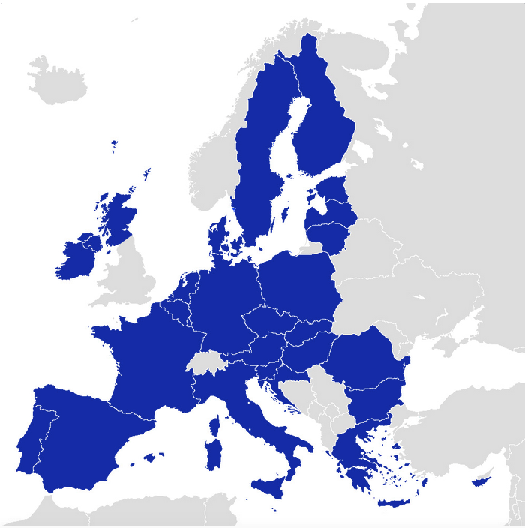
Bring Energy Efficiency to the EU buildings stock: Banks can Play a Game Changing Role
In the EU 27 there are…
247
million dwellings
447
million people
more than 220 million dwellings were built
before 2001
Buildings account
for 40% of
EU energy use
€180 BN OF YEARLY INVESTMENTS IS NEEDED TO REACH EU TARGETS
A significant share of it must come from the private sector
June 2021
Energy Efficient Mortgages Initiative
2

Slide 3
Underlying Business Case: Key Drivers for Banks
BETTER RISK PROFILE
leads to a reduction in the impact of energy costs to income = reducing borrowers‘ probability of default (PD)
Lower PD and LGD entails lower RWA and reduced capital charges
ENHANCED PROPERTY VALUE
impacts positively on property value ensuring wealth conservation & loss mitigation against energy transition risks
Better value leads to lower LGD and better Loan to Value (LTV) ratio
Efficiency and sustainability:
key features to incentivise energy efficiency investments AND financing
POSITIVE MARKET RESPONSE
CONSUMERS
INVESTORS
Responding to the increasing demand for green investments
Increase customer retention and enhanced borrower relationship
New business opportunities and diversified financing options
Broader Investor base
Lower funding costs
June 2021
Energy Efficient Mortgages Initiative
3

Slide 4
Underlying Business Case: Key Drivers for Customers
HOME
IMPROVEMENT
Getting extended advice and turnkey solutions for home improvements
FINANCE
Getting a lower mortgage interest rate
Saving money in the long term
ENERGY
Bringing down the cost of bill energy
Make your home warmer and more comfortable
PROPERTY
Increasing value of property
Make it easier to sell the property
A wide variety of different aspects drive appeal (and consumers agree the benefits would be realised)
BEING GREEN
Reducing your carbon footprint
Signalling “ I am green”

Slide 5
The Energy Efficient Mortgages Initiative
The Energy Efficient Mortgages (EEM) Initiative is a pan-European private bank financing mechanism that aims to stimulate and finance investment in energy efficient buildings, energy saving renovations in order to secure a greener and more sustainable future for all.
It is the concrete and tangible market response to the Action Plan on Sustainable Finance adopted by the European Commission.
Its ultimate objective is delivering a standardised European framework and data collection architecture for energy efficient mortgages.
The EEM Initiative consists of three EU funded projects under the H2020 Programme:
The Energy Efficient Mortgages Action Plan (EeMAP) Initiative
The Energy Efficiency Data Portal & Protocol (EeDaPP) Initiative
The Energy Efficient Mortgage Market Implementation Plan (EeMMIP)
https://energyefficientmortgages.eu/

Slide 6
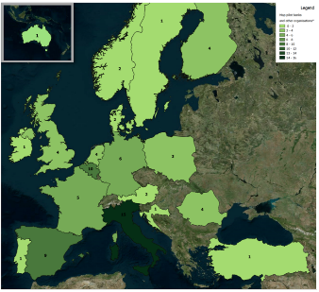
Energy Efficient Mortgages Pilot Scheme
In June 2018, after engaging in a market consultation period, including a series of national roundtable events with banks, building energy performance experts, property valuers and utilities, the EEM Initiative launched the:
Energy Efficient Mortgages Pilot scheme
Milestone
Composed of:
Lending Institutions: committed to testing the implementation of the final energy efficient mortgages framework into their existing product lines and processes
Supporting organisations: committed to provide technical support and energy efficiency expertise
Mandate
Advisory Council: committed to facilitate dialogue between policymakers and stakeholders from the financing and banking communities property and construction sectors at local, European and global levels
Structured in
National Market Hubs: to achieve coordination at national level and ensure market consensus and implementation.
Workstreams:
Product
Data
Partnerships
Source: Energy Efficient Mortgages Initiative
June 2021

Slide 7
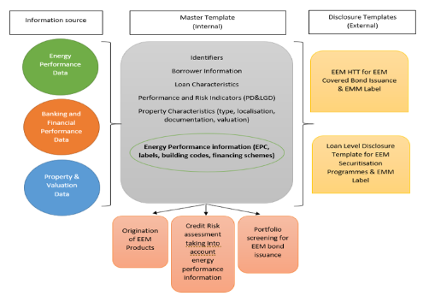
Energy Efficient Mortgages Pilot Scheme: Achievements
1
2
PRODUCT
DATA
EEM Definition
EeDaPP Master Template
In December 2018, a common definition of energy efficient mortgage was announced:
EEMs are intended to finance the purchase/construction and/or renovation of both residential (single family & multi-family) and commercial buildings where there is evidence of: (1) energy performance which meets or exceeds relevant market best practice standards in line with current EU legislative requirements and/or (2) an improvement in energy performance of at least 30%. https://eemap.energyefficientmortgages.eu/eem-definition/
June 2021

Slide 8
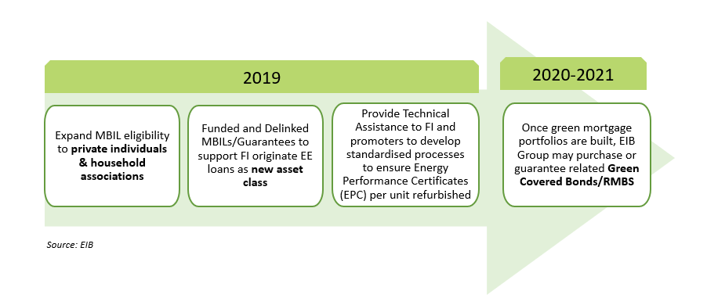
Energy Efficient Mortgages Pilot Scheme: Achievements
3
Advisory Council solutions and institutional support
EIB / EeMAP Financing Scheme
PARTNERSHIP
June 2021

Slide 9
Energy Efficient Mortgages Pilot Scheme: Achievements
4
CORRELATION ANALYSIS
The econometric analyses carried out within EeDaPP proves the existance of a negative correlation between asset’ s energy performance and credit risk: the «greener» the asset, the lower the credit risk
A negative correlation between PD & EE (A-rated dwellings) exists
Degree of Energy Efficiency matter
June 2021

Slide 10
EEM for all!
Policy and Market Recommendations
Stage | Lending Institutions | Government | Industry
Asset screening | Match loan portfolio to EE (e.g. by using EPC data) | Make EPC database accessible to banks Improve data quality in EPCs | Work with lenders to ensure high quality EPCs Certifications can be mapped to loans
Origination of EEMs for new build | Offer green mortgages to new builds that meet EEM criteria | Enforcements and guidelines on NZEB standards | Partner with lenders to develop new builds which meet EEM criteria
Origination of EEMs for renovation | Advise clients on options, benefits and different sources of finance | Develop quality assurance schemes; building renovation roadmaps; incentives to drive demand | Partner with lenders to streamline delivery for consumers
Energy Efficiency Bonds | Issue energy efficiency bonds against EEMs | Green Bond standards Disclosure rules | Performance/compliance monitoring
EEMs for all | Fully account for EE in affordability checks | Energy efficiency/sustainability in prudential requirements | Offer training to banks/brokers
June 2021

Slide 11
EEM for all!
Market Development Roadmap
Partnership with builders and developers
Analysis of non-financial benefits
National best practices and thresholds
Mapping and risk weighting of existing assets
Asset
Screening
Origination of EEMs for new build
EEMs
for all
Energy Efficiency Bonds
Origination of EEMs for renovation
Mobilising investor base
Learning curve and delivery partnerships performance
Performance Monitoring
Integrating EE in valuation
Build EE asset pools
June 2021

Slide 12
Energy Efficient Mortgages Initiative: Next Steps and Goals
EeMMiP
Energy Efficient Mortgages Market Implementation Plan
Market Implementation:
Consumer Insight
Operational testing
Institutional sandbox
EEM
Label
Building on the success of the ECBC Covered Bond Label
EEM Label
June 2021

Slide 13
Energy Efficient Mortgages Initiative and the national hubs
EeMMiP: The EEMI market hubs
The EEM national market serves as a demonstration of the end-to-end customer journey and EEM life-cycle that enable the development of a solid blueprint for market scale up of EEMs. EeMMIP places emphasis on the practical implementation of the EEM framework throughout the whole mortgage lifecycle, from origination to asset eligibility and risk assessment as well as dedicated EEM bond issuance.
National hubs: EEMI national market hubs are active in Belgium, Hungary, Italy, the Netherlands, the Nordics, Spain and the UK (Scotland).
Exploring the implementation of the ‘ecosystem’ throughout the whole customer journey and mortgage lifecycle.
Closing the information gap and supporting financial decision making and mortgage underwriting with consistent, robust and easily accessible data.
Ensuring value chain integration to streamline administrative costs, data management, liabilities, performance guarantees, etc.
The objectives:

Slide 14
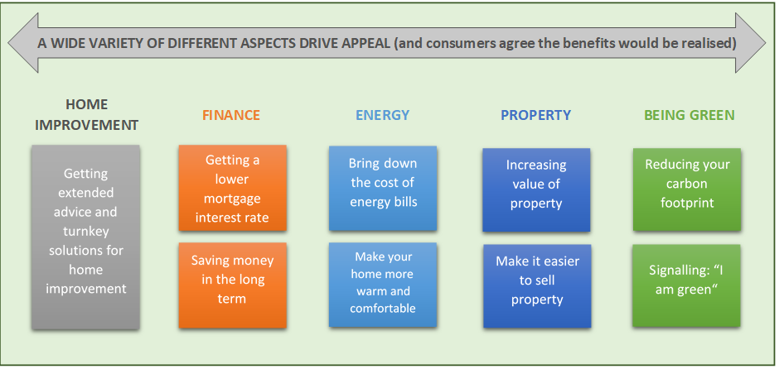
Energy Efficient Mortgages Initiative and the consumer research
The consumer research conducted under the EeMAP in Germany, Italy, Portugal, Spain, Sweden and the UK has generated key insights that formed the basis of EEM market development.
The EeMMiP has extended the consumer research to Hungary, Romania and the Netherlands
and conducted a comparative analysis across the countries already studied in the EeMaP project
with a view of testing propensity to engage with an EEM product and elasticity of demand.

Slide 15
Energy Efficient Mortgages Initiative: EEM Label
Regulatory alignment
The objectives:
To maximise regulatory alignment with the main legal and policy developments such as the EU Taxonomy, Mortgage Credit Directive, CRR or equivalents at international level.
To establish the benchmark for Energy Efficient Mortgages (EEM) for a global audience (following the lead of the Covered Bond Label)
To provide more information on the portfolios of energy efficient loans as assets to be included in green covered bonds
To provide better evaluation of financial performance relative to inefficient alternatives
To improve the tracking of EEM performance
To allow easier access to energy efficiency financing, green bond markets, better tracking of EEM performance and to provide greater transparency regarding climate risks and portfolio resilience.
To adopt disclosure best practices (Harmonised Disclosure Template)
Improve awareness of EE
Asset Resilience
Transparency

Slide 16
The Energy Efficient Mortgage Label Launch
The Energy Efficient Mortgage Label Launch event was on 12 February 2021 in the presence of Mr João Galamba, Deputy Minister and Secretary of State for Energy, Portuguese Presidency of the European Council and Ms Kadri Simson, European Commissioner for Energy.

Slide 17
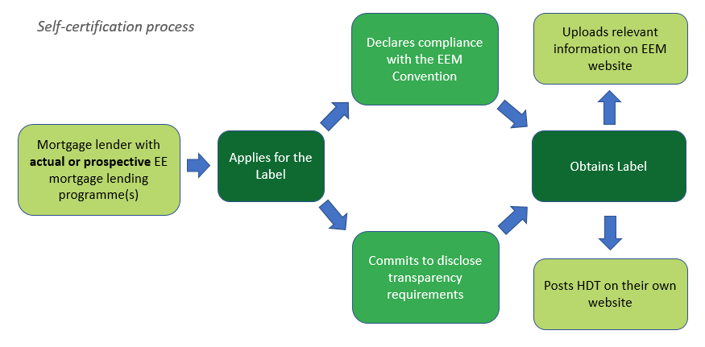
EEM Label in numbers and the self-certification process
The EEM Label distribution
28 Products (+ 2 complementary products)
23 Lending institutions (banks, residential mortgage service providers, alternative investment funds etc)
11 countries

Slide 18
Communication Room
Market Best Practices - Technical Reports
Since its launch, the EEMI has produced many publications and technical reports containing valuable and insightful information on a various range of topics related to energy efficiency, such as:
Technical report on existing green reporting criteria
Technical report on market needs and gaps
For additional information > www.energyefficientmortgages.eu
Events, media and newsletter
Throughout the years, the EEMI has organised several events to raise awareness:
Early Pilot Banks Meeting in Venice
Green/EEM day at ECBC Plenary meeting
National Hubs Meetings
Institutional meetings
June 2021

Slide 19
APPENDIX
June 2021

Slide 20
EEMI – EeDaPP Master Template and EEM Label

Slide 21
Home, ‘Expensive’ Home
Source: Eurostat – 2017 EU-SILC survey
Around 42% of disposable income of poorer households (below 60% of median income) is spent on housing costs
June 2021

Slide 22
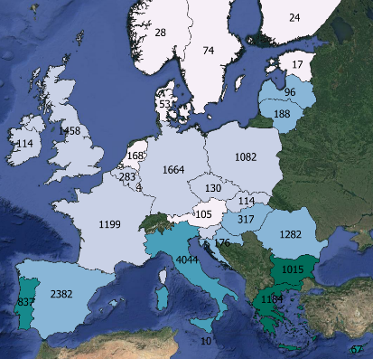
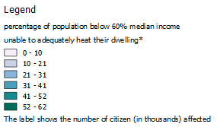
‘Heat or Eat’ Dilemma
21% of EU population that earns 60% or less than median income in their respective countries, over 18 million people, live in a household which they cannot adequately heat
This issue has different degrees of relevance according to country
Source: Eurostat EU-SILC survey 2017 *according to the Survey definition
June 2021

Slide 23
Owners or Tenants
In EU breakdown of how citizens live is reflected by their income group
Poorer part of population in Europe (around 86 million people earn less than 60% of their respective Member States’ median income) typically live as tenants
These individuals are also more than two times less likely to have a mortgage than the rest of the population
Source: Eurostat – 2016 figures
June 2021

Slide 24
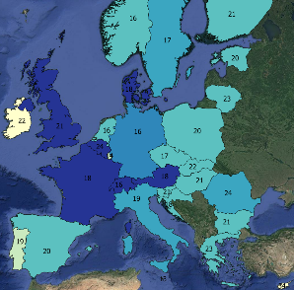
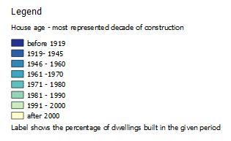
Houses with History
June 2021

Slide 25
Energy Efficiency Savings – Danish Case
EPC Label | Energy Consumption (kWh/m²/y) | Energy Costs* (€/year) | Energy Savings from class G (€/year) | Additional Market Value from Class G (€)
A | 55 | 600 € | 3.050 € | 64.000 €
B | 81 | 850 € | 2.800 € | 58.000 €
C | 117 | 1.250 € | 2.400 € | 50.000 €
D | 167 | 1.800 € | 1.850 € | 38.000 €
E | 217 | 2.400 € | 1.250 € | 27.000 €
F | 274 | 3.000 € | 650 € | 14.000 €
G | 335 | 3.650 € | - € | - €
Source – Copenhagen Economics (2016) average energy price of 0,10€ per kWh and considering a 100m² house
June 2021

Slide 26
EEMI Consortium Partners
Visit: http://www.energyefficientmortgages.eu/
Contact:
Luca Bertalot - Secretary General of the EMF-ECBC lbertalot@hypo.org
The EeMAP, EeDaPP and EeMMIP projects have received funding from European Union’s Horizon 2020 research and innovation programme under the Grant Agreement No 746205, 784979 and 894117

