Slide 1
Investment strategy for climate change adaptation

Slide 2
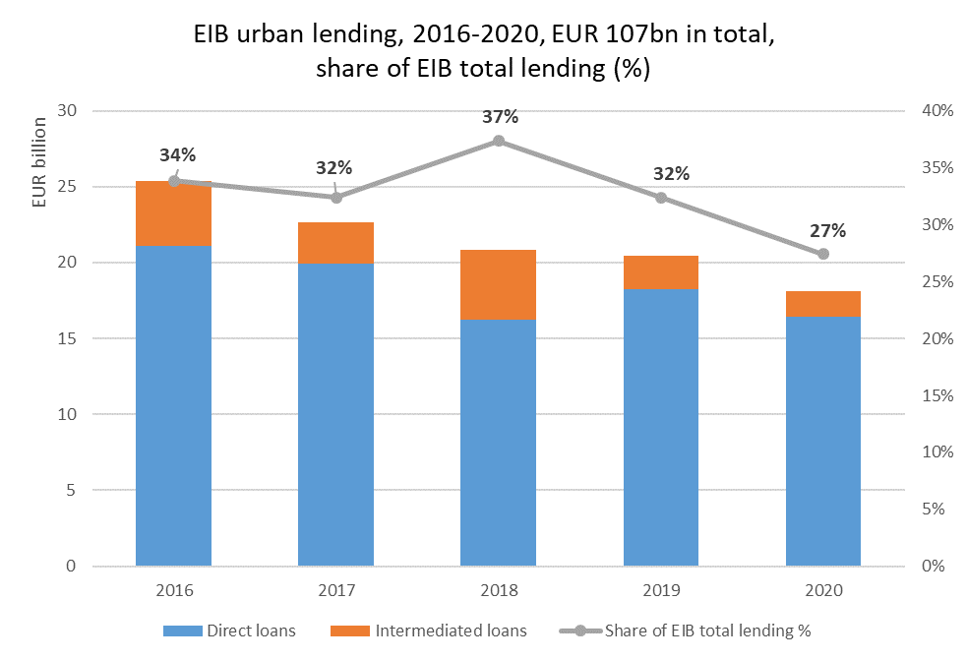
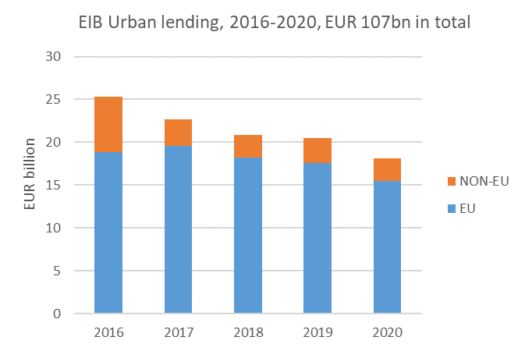
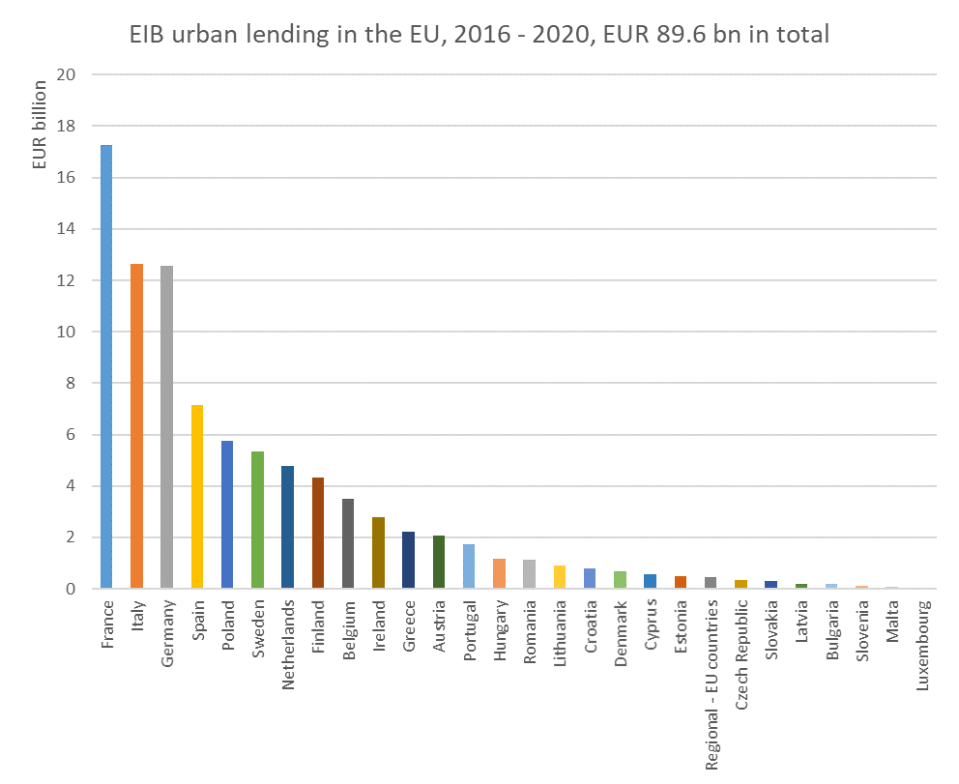
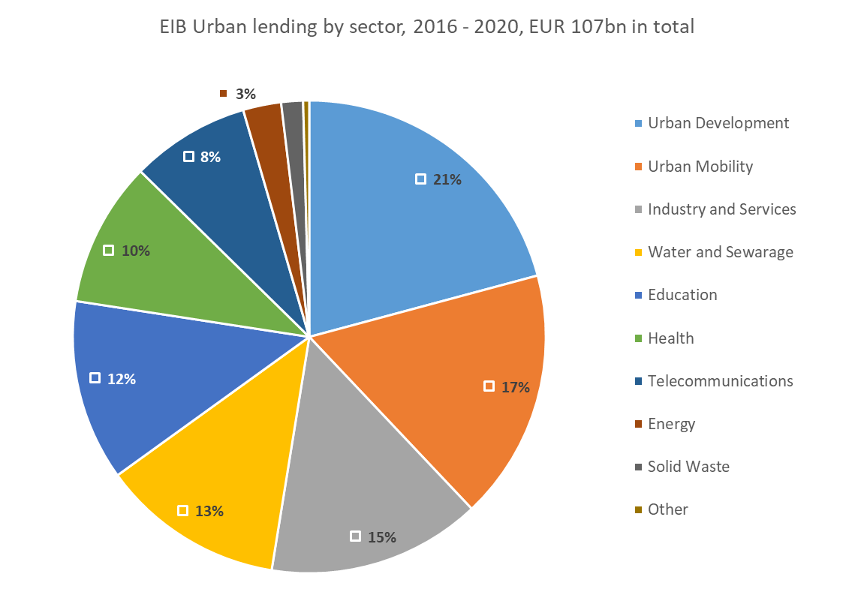
EIB urban lending in numbers

Slide 3
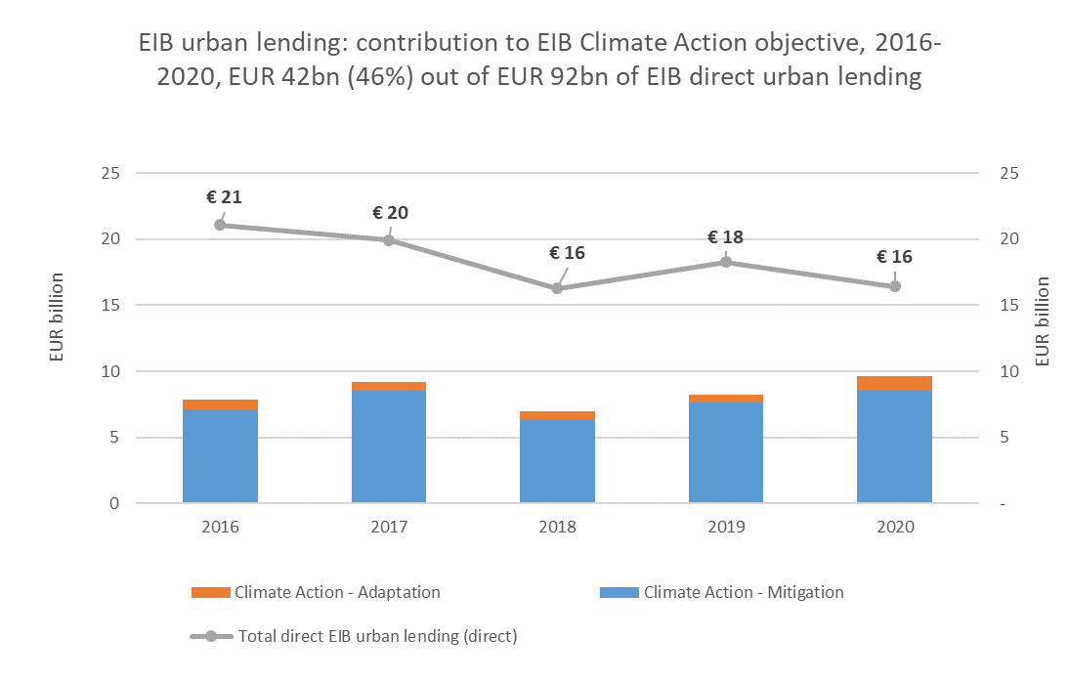
EIB urban lending - climate action

Slide 4
EIB products for municipalities
Investment Loan
Framework Loan
Program Loan
Intermediated lending
EIB Loan up to 50% of Project Investment Cost
For Climate Adaptation – 75%

Slide 5
EIB approach to climate risks and adaptation/resilience
Assessment of climate risk for every operation
Climate Action and Environmental Sustainability targets (% of lending volume)
Determination of share of adaptation measures in the Project Investment Cost:
Client data
Proxy based on project typology / policy / committment

Slide 6
Climate Adaptation - Linkages
Climate Adaptation
Urban Agenda
Natural Capital Investment Facility -> Invest EU
Air Quality
Climate Adaptation Strategies
Climate Risk Assessment
EU Taxonomy

Slide 7
Climate Adaptation - examples
Florence coordinated with two smaller municipalities on its borders and developed a project that utilises a park around the banks of the Ema for a nature-based solution to the problem. Instead of building concrete tanks to collect flood water, they built hills and valleys in a park that can absorb the flood and, when there’s no flooding, double as a place for recreation, including bike paths.
Growing grass or trees in the south of Spain is a challenge, because of low rainfall. In Malaga, it wasn’t feasible to plant trees to provide shade for citizens. So the municipality put up large parasols in pedestrian areas. The result: people go out even in the sunshine, which is good for business, tourism and social life.
Barcelona saved a lot on climate adaptation measures for social housing projects, just by finding the right orientation of the buildings to create cross-ventilation and to maximise the exposure to the sun at the right time.
In Paris, air-quality measures were presented to residents less as a climate issue and more as a matter of health, which made them popular even with people who would have been unwilling to accept them just for the sake of climate action
Rotterdam is taking away paved areas of the city. Those impermeable surfaces, which do not allow water to drain away fast enough, are being replaced with sand, soil and plants. The aim is to use the city as a sponge, retaining water for later use.

Slide 8
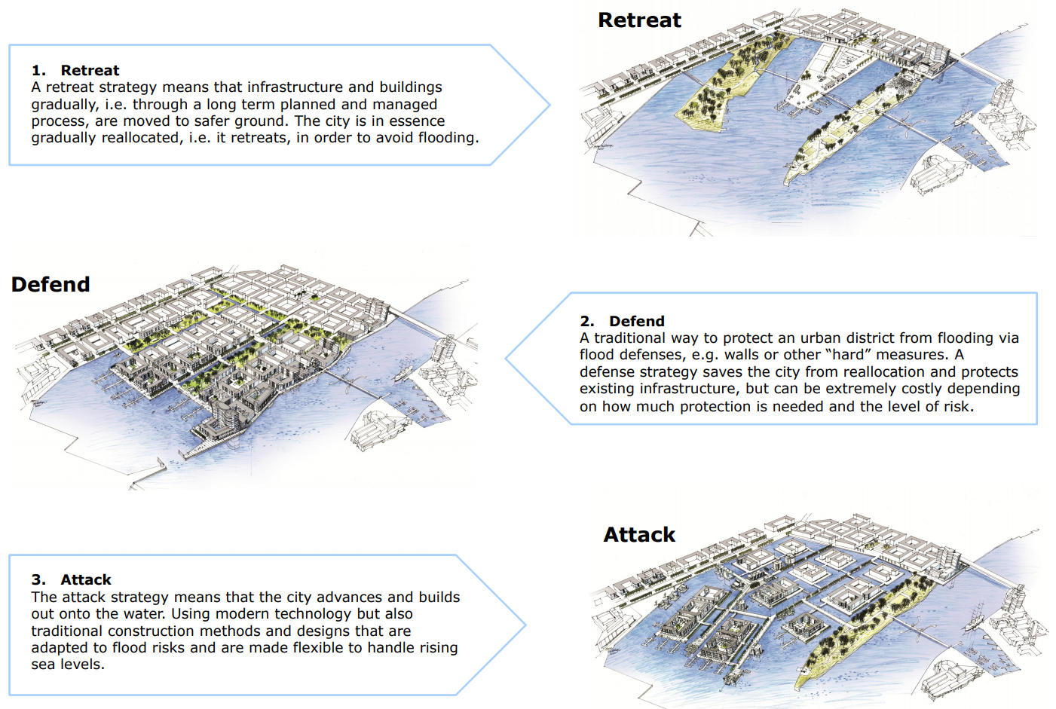

Slide 9
Mongolia – holistic urban-rural approach
ADB-led, with EU, EIB and GCF as main cofinanciers
USD 735 milion
Economic value chain built on animal husbandry
Overgrazing resulting from climate change
Creation of green resilient and sustainable economic environment:
SMEs
Coops
Self-regulation
Urban infrastructure

