Slide 1
Nature and the City: Finance and Procurement of Nature-based Solutions for Urban Climate Change Adaptation
These projects have received funding from the European Union’s Horizon 2020 research and innovation programme under topic SCC-2-2016-2017: Smart Cities and Communities Nature based solutions

Slide 2
Financing and Procurement of NBS
Key research insights
Ernesta Maciulyte
This project has received funding from the European Union’s Horizon 2020 research and innovation programme under Grant Agreement No. 730052 | Topic: SCC-2-2016-2017: Smart Cities and Communities Nature based solutions

Slide 3
The context of UNaLab research
Cities need to engage in public procurement process to purchase goods, services or works associated with NBS
How does the procurement process look like?
What barriers and opportunities could derive from the public procurement of NBS?
NBS governance challenges imply a need for alternative financing approaches
What public and private financing options exist?
What role can private sector play in funding and financing NBS?
How can private capital be attracted to NBS projects?
Public procurement
Financing strategies

Slide 4
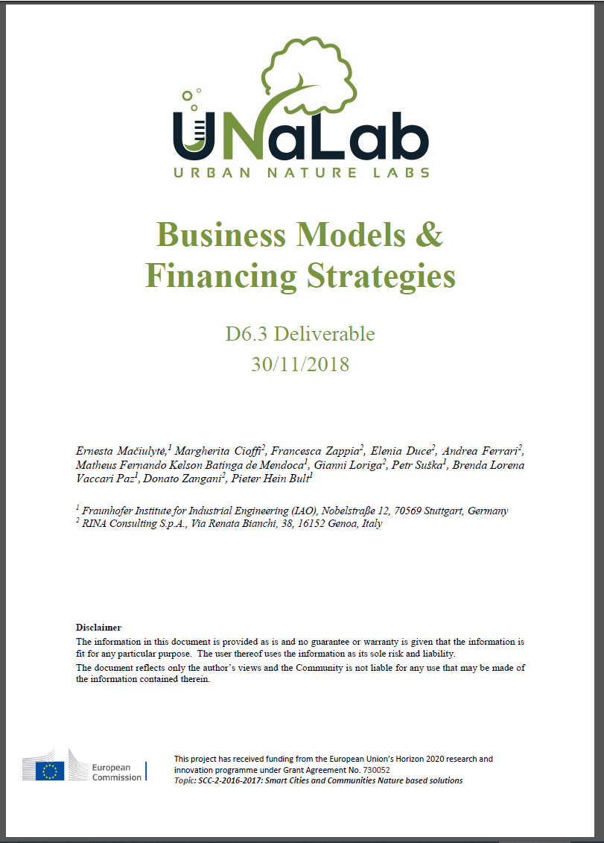
Financing Strategies: methods
Engagement with the UNaLab project partners, and desktop research to develop and overview of potential NBS business model components and financing strategies
5 broad financing strategies have been identified

Slide 5
Financing strategies: results
Innovative municipal financing approaches
PPPs
Mandatory requirements and taxes
Municipal funds
Incentive programmes
Storm water fee, charges
Cross-departmental budgets, green municipal bonds
Revolving fund, guarantee fund
Green barter, BID, contractual PPPs
Community management, grants, credits, parks trust

Slide 6
Procurement of NBS: methods
Research integrated in EC H2020 NBS Task Force 3: Governance, Business Models, and Financial Mechanisms
One of six Task Forces for NBS
Cluster of approx. 20 H2020 NBS projects
Focus on collaboration and joint outputs

Slide 7
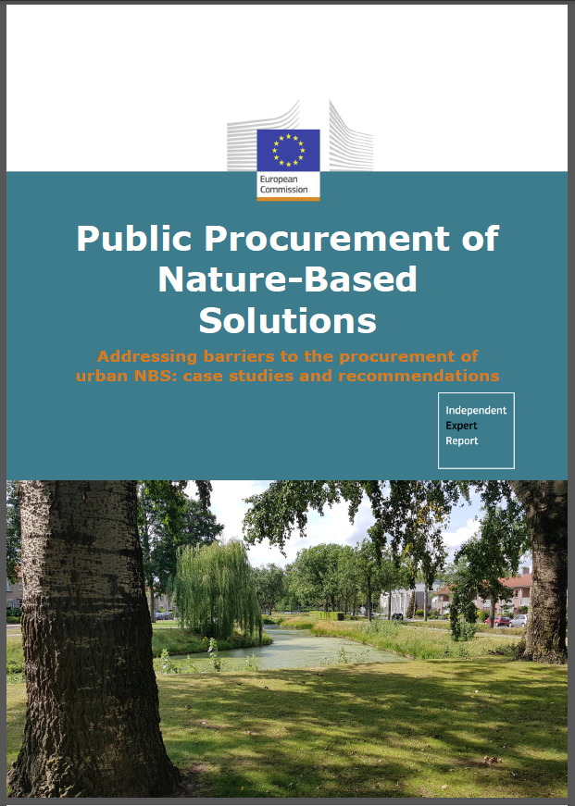
Joint output: Report on the Procurment of NBS
Overview of the nine case studies of cities procuring NBS, including UNaLab cities
Barrier and opportunity analysis for NBS procurement
Providing broad recommendation for the EU, national level, city, and procurement officer levels

Slide 8
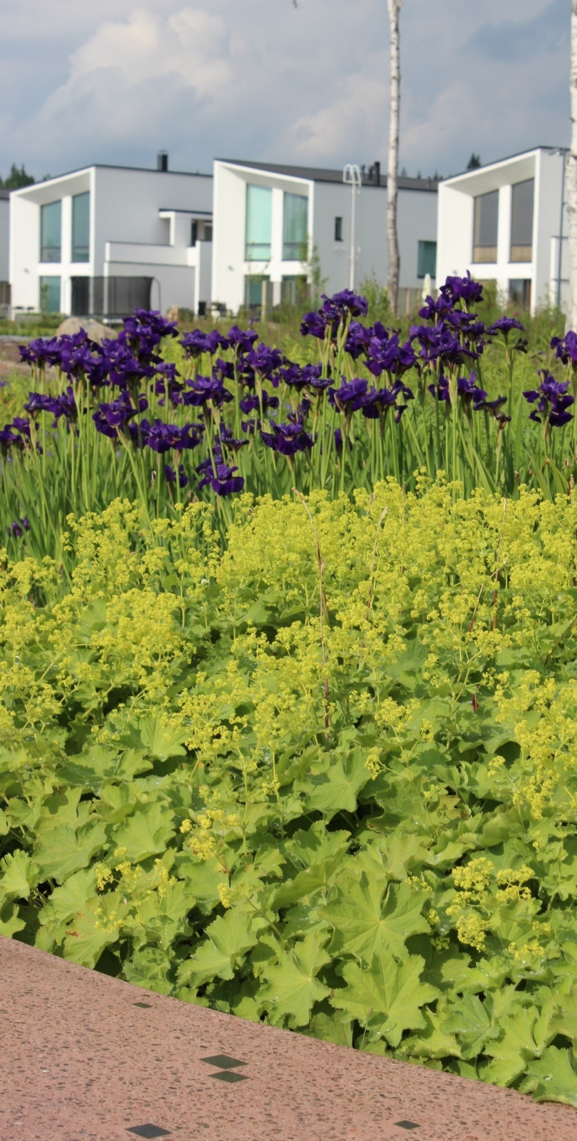
Public Procurement of NBS: Identified barriers
Lack of knowledge and experience with NBS
Lack of NBS typology
Difficulty finding skilled suppliers
Challenges in community engagement
Institutional and legal barriers
Perceived reputational risk
Limited access to funding
© UNaLab

Slide 9
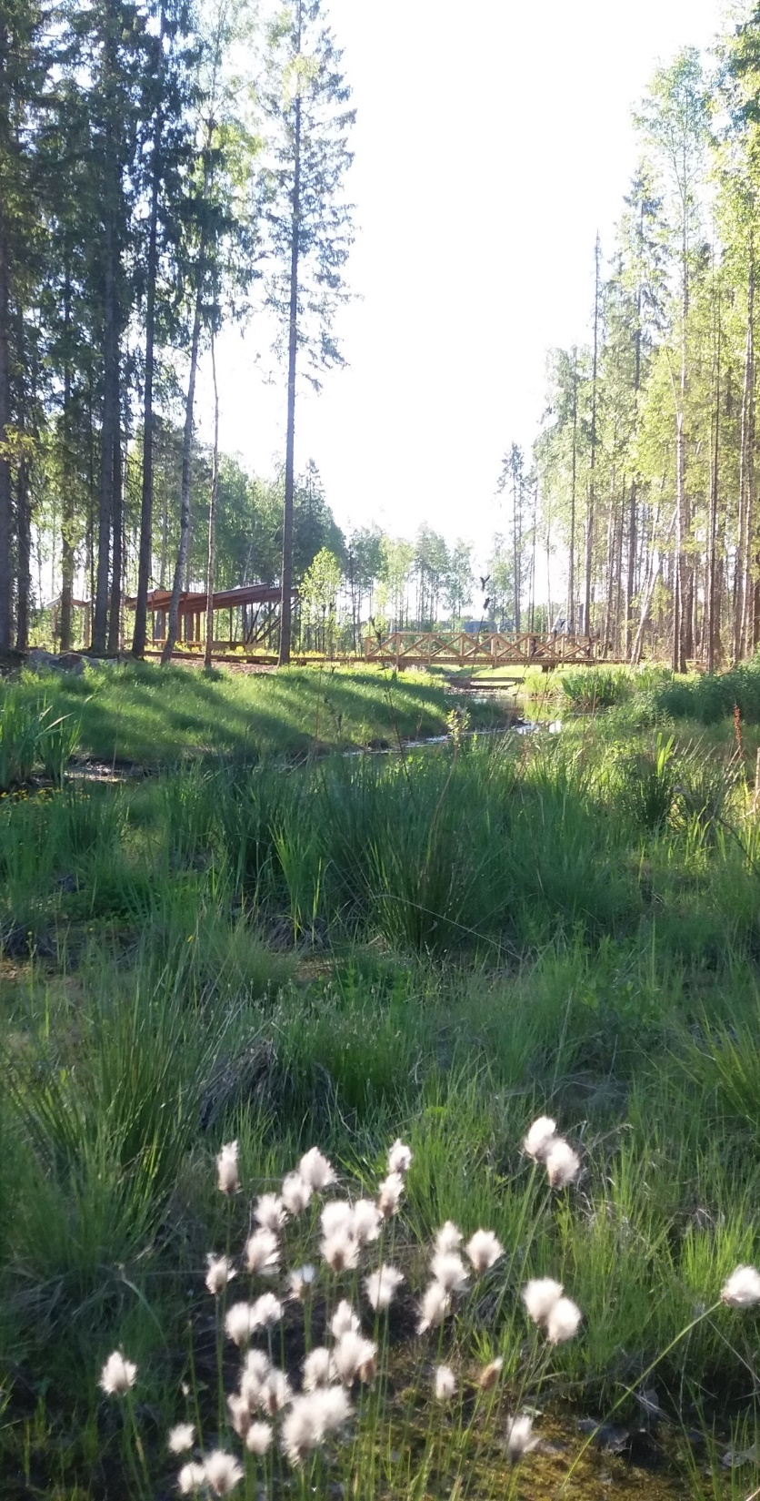
Public Procurement of NBS: Potential solutions (selection)
Knowledge and awareness raising
H2020 project activities and outputs such as technical handbooks, impact evaluation handbooks
Network platforms (e.g. NBE platform)
Adjusting tender requirements
Challenge-based specifications, etc.
Lifecycle costing
Pilot projects (demonstrating short-term success)
“Alternative delivery routes”
© UNaLab

Slide 10
Key recommendations
EU
Continue financial support for NBS
National
Establish Centre of Excellence
City
Promote cross-dept. exchange
Procurement office
Project bundling
Challenge-based thinking
Report provides broad differentiated recommendations on multiple levels:
© UNaLab

Slide 11
Thank you!
UNaLab report on financing strategies is available on the UNaLab website
The Public Procurement of NBS report is available on the
Publications Office of the EU website

Slide 12
Addressing NBS Financing Needs
These projects have received funding from the European Union’s Horizon 2020 research and innovation programme under topic SCC-2-2016-2017: Smart Cities and Communities Nature based solutions

Slide 13
URBAN GreenUP –
Success stories - addressing NBS financing needs
Key financial needs identified
1. Public-private collaborations
2. Extra co-financing with municipal budget
3. Third party/stakeholder involvement
Legal agreements for ongoing maintenance with hosts of NBS
placing of many NBS on third party land/building
4. Council approach
Use of short term establishment dowry with tree planting
Benefits on council maintenance budgets through changes in land use.
Community engagement

Slide 14
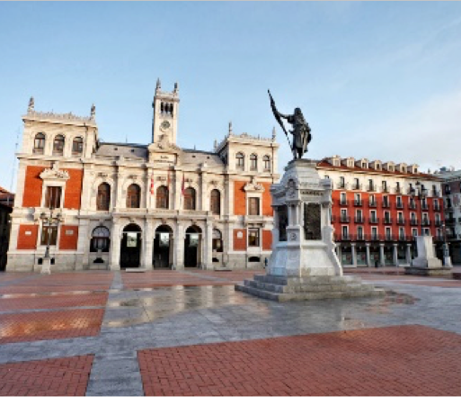
URBAN GreenUP –
Success stories - addressing NBS financing needs
VALLADOLID

Slide 15
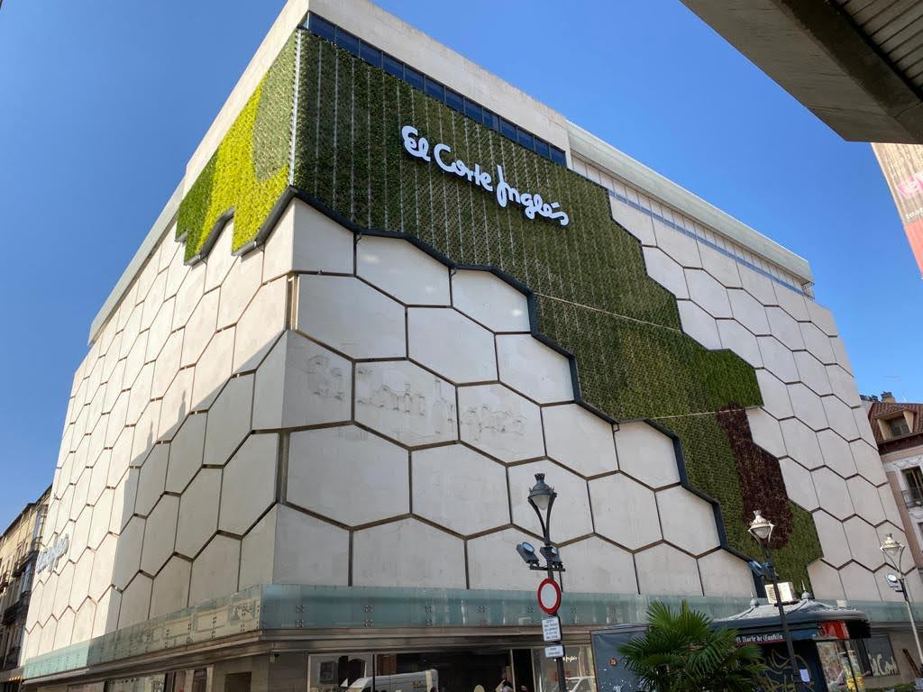
VAc25 GREEN FAÇADE
PUBLIC-PRIVATE COLLABORATION
Vac25- Green façade.
Public-private collaboration through the signature of an agreement.
Installed on June 2020.
El Corte Inglés
department store
Green façade
Green area 551,05 m²
Designed by SingularGreen architects.
Agreed between Valladolid City Council and El Corte Inglés
The Green Façade in El Corte Inglés Department Store building in Constitución St (June 2020)
Notes:
(P1) El Corte Inglés finished their works (3rd February – 5th March)
(P2) Tierra Ingeniería y Paisajismo started the works (9th February)
Works stopped for COVID-19 crisis -> Construction resumed on the 4th May – 15th June
Tierra Ingeniería y Paisajismo continued the works on COVID crisis
The builder asked for 2 extensions: delays on the plants supply.
Works finished on the 29th June 2020.

Slide 16
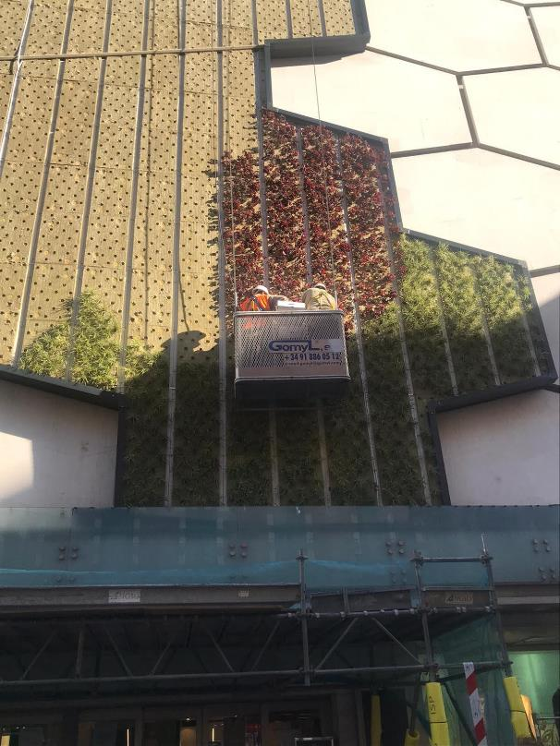
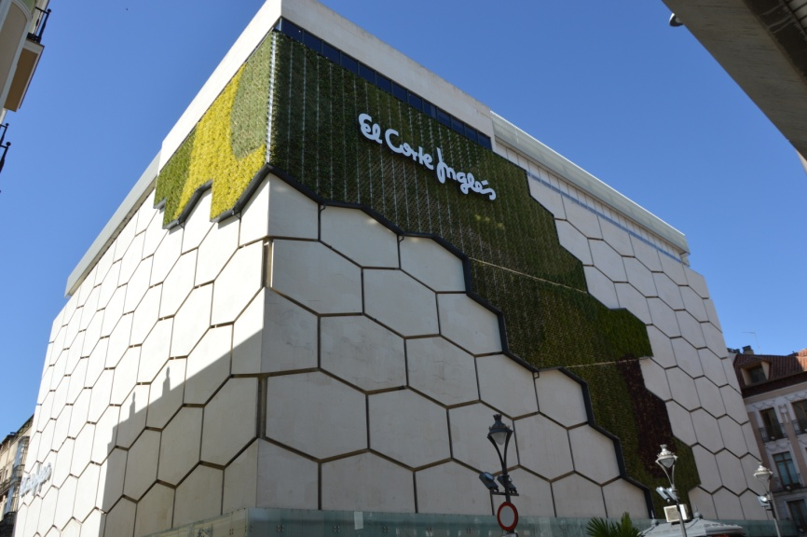
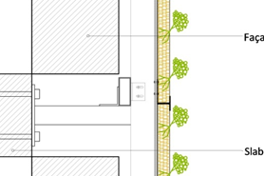
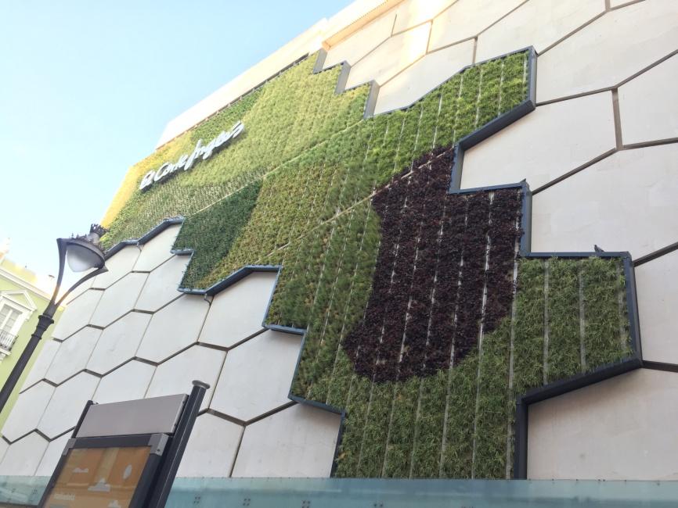
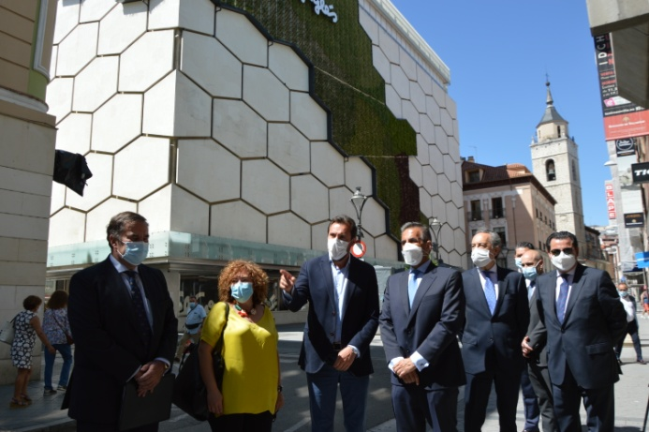
VAc25 GREEN FAÇADE
PUBLIC-PRIVATE COLLABORATION
Sub-project 1: El Corte Inglés built the clamping structure and are in charge of the maintenance.
Sub-project 2: Valladolid City Council installed the vertical garden.
Public-private collaboration (Agreement signed on May 2019)
Vac25- Green Façade
P1 clamping structure to the building and work indoor.
▪ Maintenance.
P2 vertical garden and outdoor work.
▪ Monitoring.
The vertical garden in El Corte Inglés Valladolid
Constructive details
Variation of plant species adapted to the local climate. Adaptation of the design to the characteristics of the façade.
Planting the Green Façade (11th June 2020)
Green façade
Green area 551,05 m²
Location in the historical city centre of Valladolid, without green areas.
El Corte Inglés has 121 shopping centers only in Spain.
Mayor
Managing Director
Councillor
Green façade in Constitución Street (City Center)
Political public presentation (7th July 2020)
Notes:
Public-private collaboration through the signature of an agreement on May 2019.
Sub-project 1: El Corte Inglés built the clamping structure and are in charge of the maintenance.
Sub-project 2: Valladolid City Council installed the vertical garden.
(P1) El Corte Inglés finished their works (3rd February – 5th March)
(P2) Tierra Ingeniería y Paisajismo start the works (9th February)
Works stopped for COVID-19 crisis -> Construction resumed on the 4th May – 15th June

Slide 17
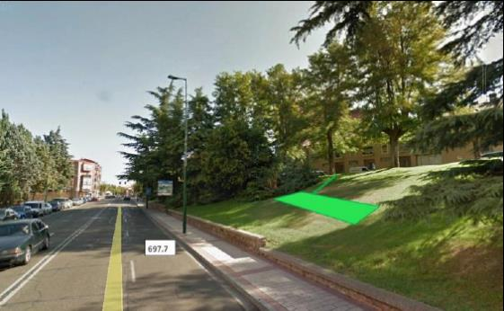
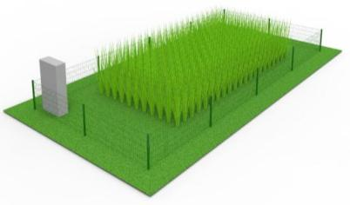
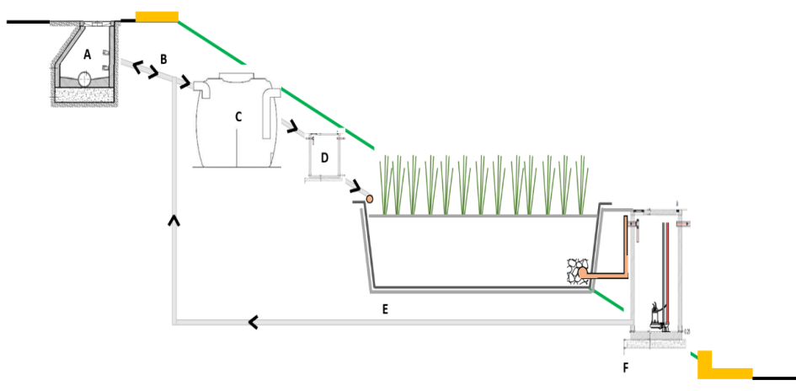
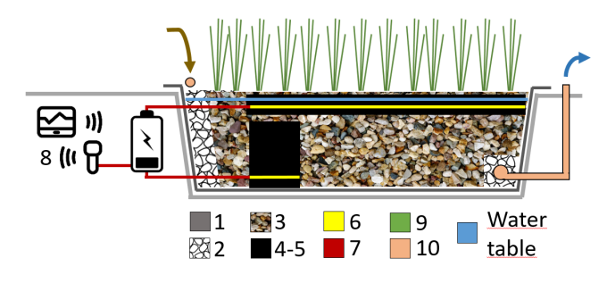
LEITAT ELECTRO WETLAND
PUBLIC-PRIVATE COLLABORATION
Partners of the European project
works
agreement
COLLABORATION AGREEMENT
The City Council grants
temporarily the public plot
to LEITAT for the construction.
LEITAT:
Design, Proyect, Construction, Operation.
Manteinance.
Valladolid City Council:
Transfer of public land.
Co-manteinance.
EW is highly technological.
Real-world pilot test in an urban environment.
Valladolid City Council temporarily transfer public space for the construction and operation of the EW system.
EW located in a sloping garden
in a municipal park
PUMPING SANITATION WATER
Waste water
quality analysis
SEPTIC TANK
Monitoring: Temperature and humidity (remote sensing).
EW SYSTEM
EW DESIGN
CONTINUOUS PUNPING
ELECTROWETLAND
TREATED WATER TANK
TREATED WATER
Notes:
What? We change the location to a place where we can avoid using a wastewater pump.
Where? Alternative locations analysis (7 new locations)
Aquavall: Municipal water management company

Slide 18
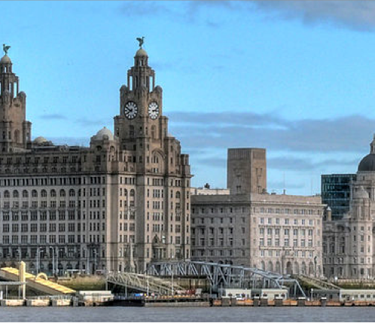
URBAN GreenUP –
Success stories - addressing NBS financing needs
LIVERPOOL

Slide 19
Addressing NBS Financing Needs
Ongoing Establishment and Maintenance
Liverpool, UK

Slide 20
Third Party and Stakeholder
Financial Involvement
Involving external organisations in the ongoing aftercare of NBS is important for several reasons:
Removal of ongoing financial maintenance costs for poorly funded city municipalities
Encourages external host ownership and places a value on the NBS
Demonstrates corporate social value; commitment to climate change action and facilitates learning for external NBS hosts
Allows external organisations to also help pioneer NBS as solutions.

Slide 21
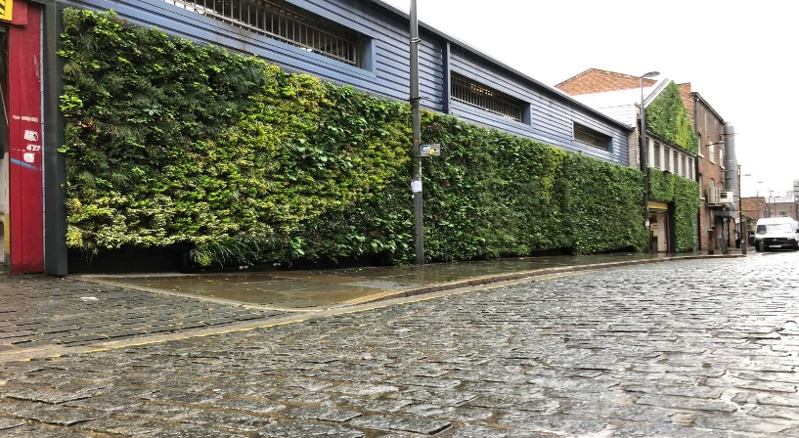
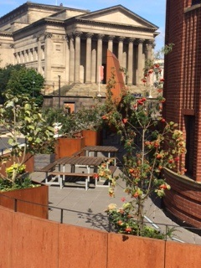
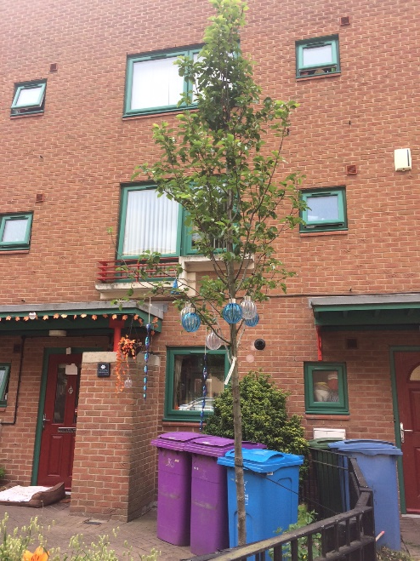
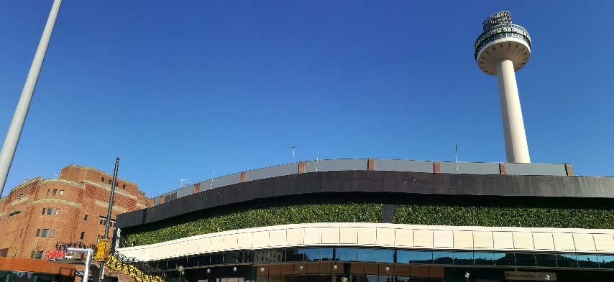
Examples from Liverpool, UK
Legal agreement templates
Flexible template agreement developed for NBS hosts to outline ongoing risk, responsibilities, ownership and maintenance obligations after initial establishment.
Deliberate location of NBS on third party land/buildings
Transfers financial maintenance of the NBS to the land or building owner .
Green walls on business premises
Tree planting with registered providers
Pollinator roof on theatre balcony
Notes:
2 approaches used in Liverpool
Development of a flexible legal agreement template that detailed the required level of aftercare and commitment from the NBS host.
Deliberate location of NBS onto third party land/buildings so they have the ongoing costs. This is also useful because other partners and stakeholders are the seen to also be promoting and delivering these works.
Examples in Liverpool are the tree planting in registered provider gardens (areas of need, but maintained by them). Pollinator roof planting – incentive for NBS host to provide ongoing care as site is also theatre drinks balcony and green walls both on private buildings and so ‘represent’ those organistaions

Slide 22
Liverpool City Council
Financing NBS Maintenance
Options being implemented:
Integrating NBS into key city schemes
Use of short term tree establishment dowry to ensure success and continued benefits
Business case studies on NBS implementation: Maintenance on SuDs ponds is less than annual flood clear up costs
Changes in land management from amenity grass to pollinator planting has reduced cuts
Active community engagement in design and ongoing aftercare and adoption of sites (pollinator planting and trees in containers etc).
Notes:
In Liverpool we have tried to integrate NBS into key city centre schemes where the future maintenance is already agreed and we have replaced trees with SuD trees. We have also included a small dowry for establishment in first 2-3 years to ensure care and success and then integration and adoption into city programme of works etc
Business cases are emerging as we monitor but some are obvious such as immediate cost savings or slightly longer term savings – actual values are still being gathered
Involving community can reduce costs, increase ownership, raise awareness and support co creation. They can take on areas of responsibility

Slide 23
Green cities for climate and water resilience, sustainable economic growth, healthy citizens and environments
Manchester
Scaling up and scaling down NBS

Slide 24
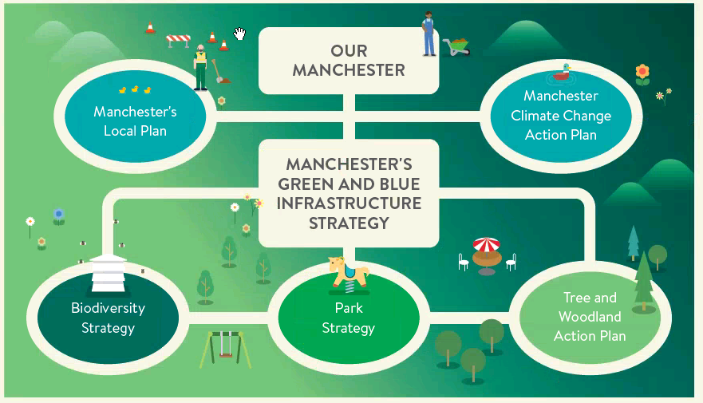
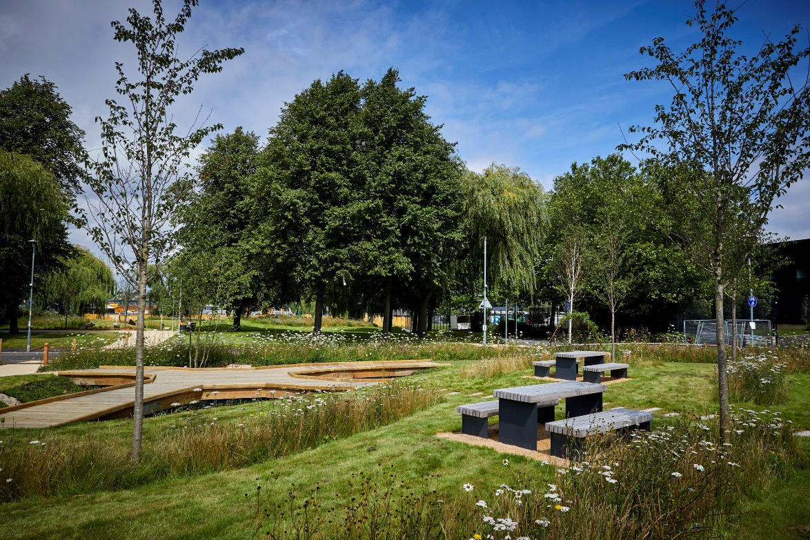
Manchester
Well-established policy context
+
Demonstration project
= catalysation of further discourse / scaling up of implementation

Slide 25
Manchester – scaling up
Scaling up…
West Gorton
Mayfield
Northern Gateway
3 ha ‘local park’
H2020 Grant + local regeneration funding
Local Authority led
6.5 acre mixed housing /business development
Developer + UK Government repayable finance
Developer led
155 ha housing development
Developer + UK Government grant
Developer led

Slide 26
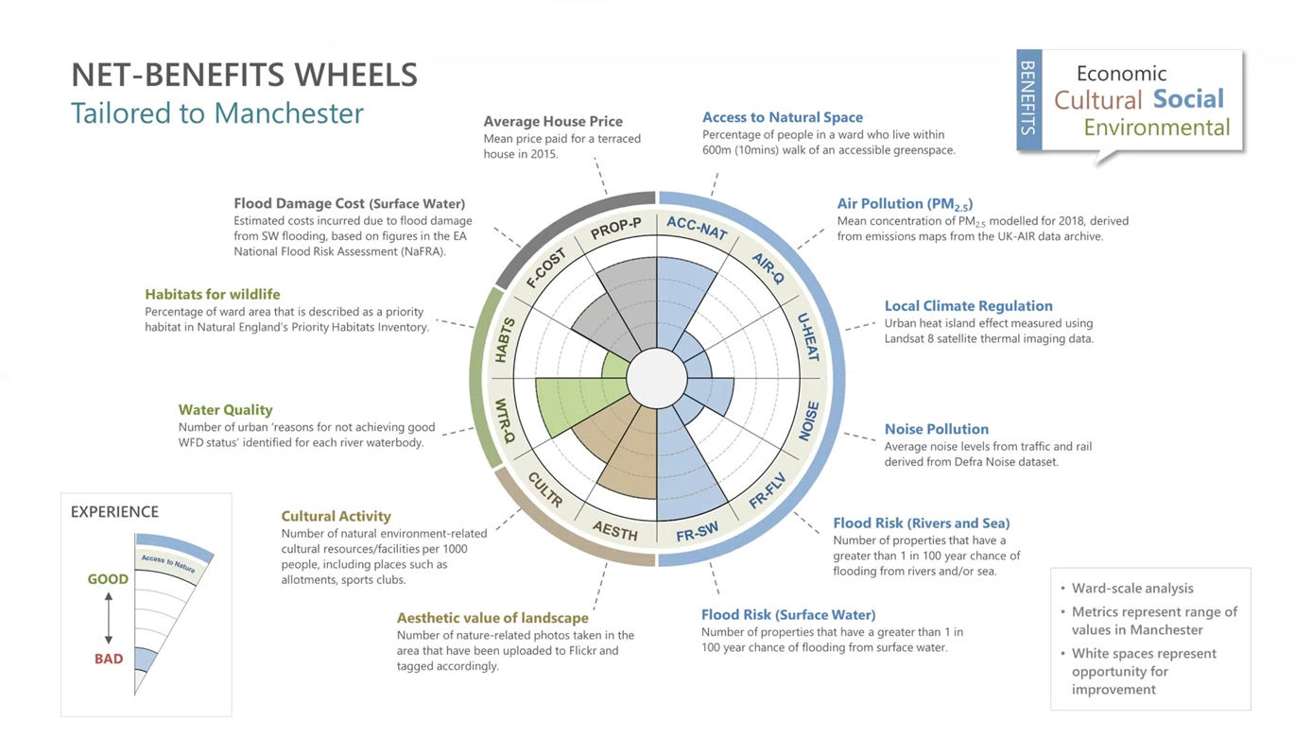
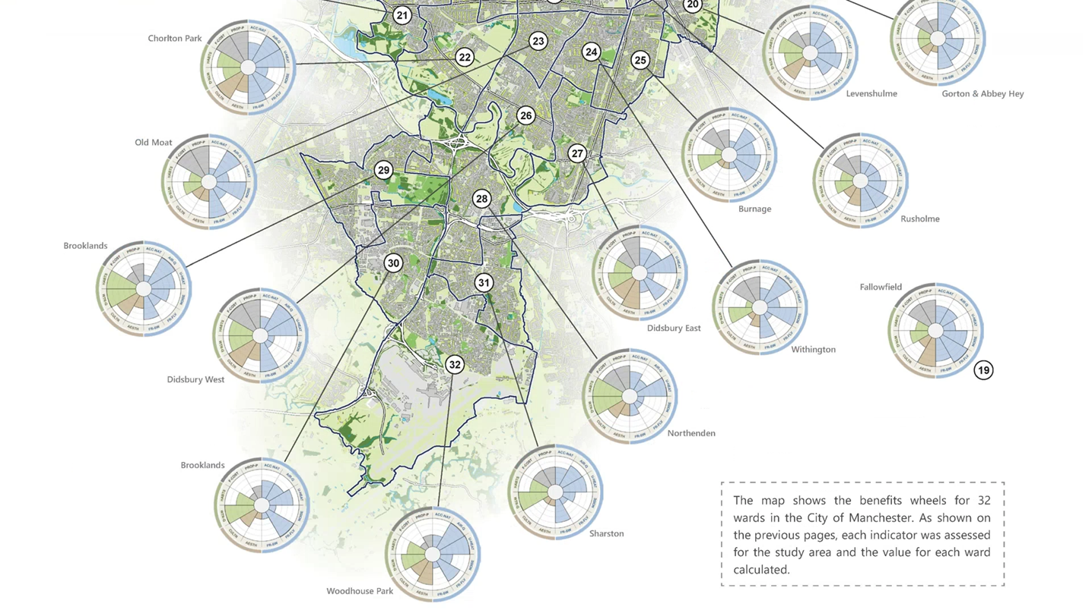
Manchester – scaling down

Slide 27
Innovation vouchers
Maarit Särkilahti, City of Tampere, Finland

Slide 28
Innovation vouchers to fund small scale nature based solutions
City of Tampere is a fronrunner city in NBS project Unalab
One of the NBS demos is small scale NBS funded via innovation vouchers
How we used innovation vouchers
Funding call on City web site
Information event in Vuores school
3 x 10 000 €
Focus on greening, biodiversity, water management and social connectivity
3 applications
All received funding
New city district Vuores is urban living lab, where innovation vouchers were tested

Slide 29
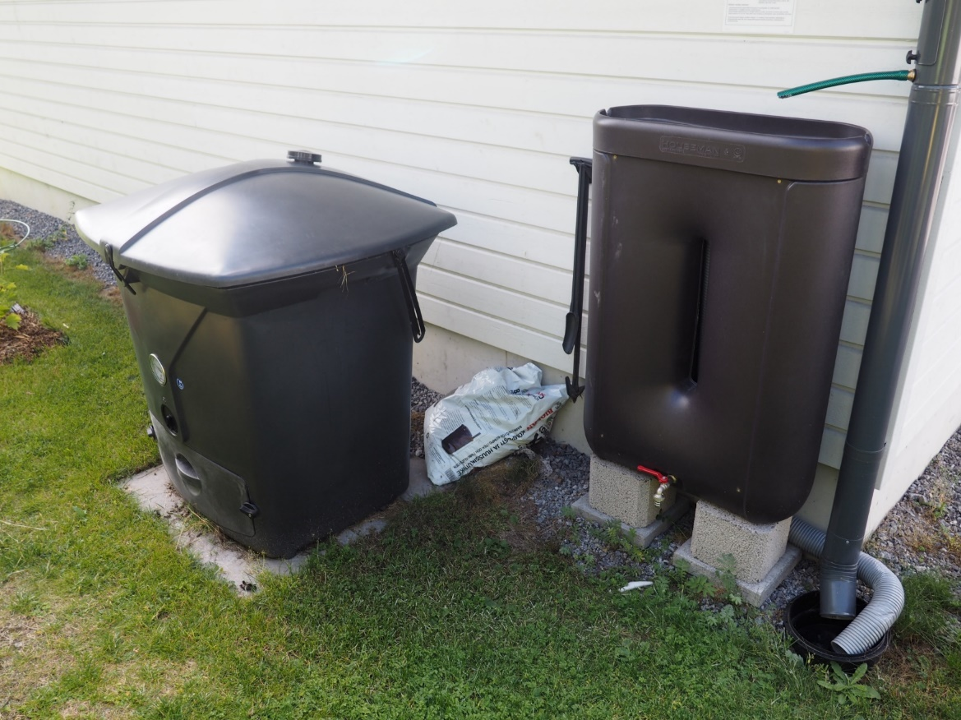
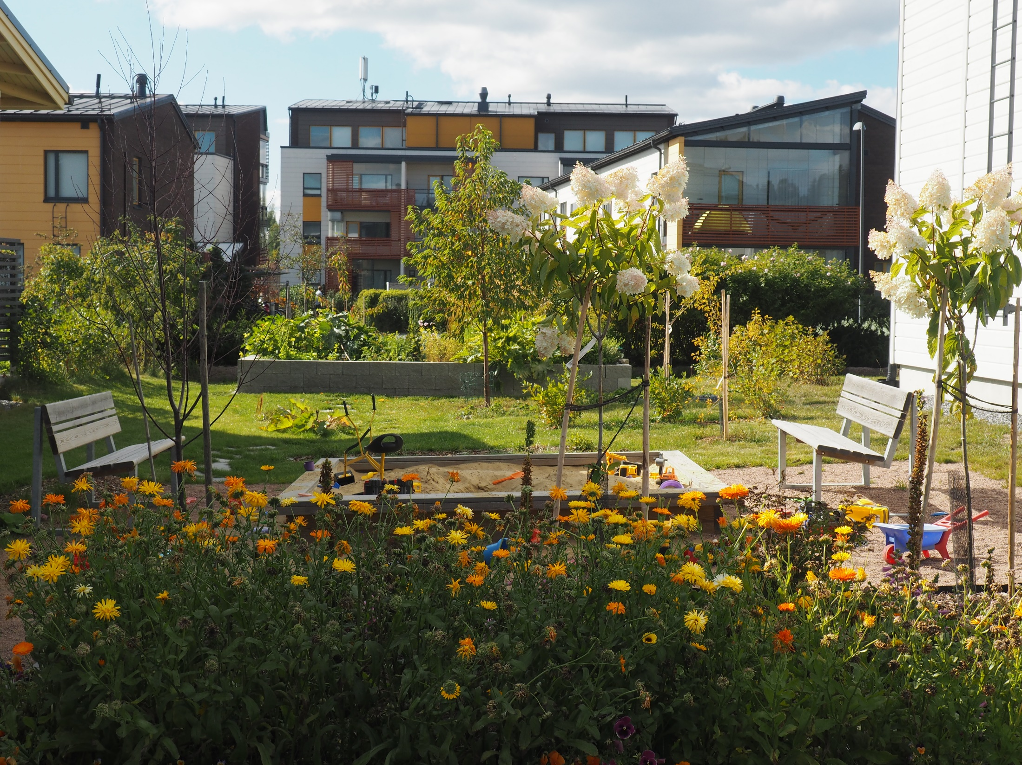
Innovation voucher 1: Common garden of two apartment houses (was dry grass)
Perennials, fruit trees, berry bushes, gardening boxes, compost, roof water harvesting for irrigation
Unalab funding 6500 € for materials. Implementation and maintenance: voluntary work by residents

Slide 30
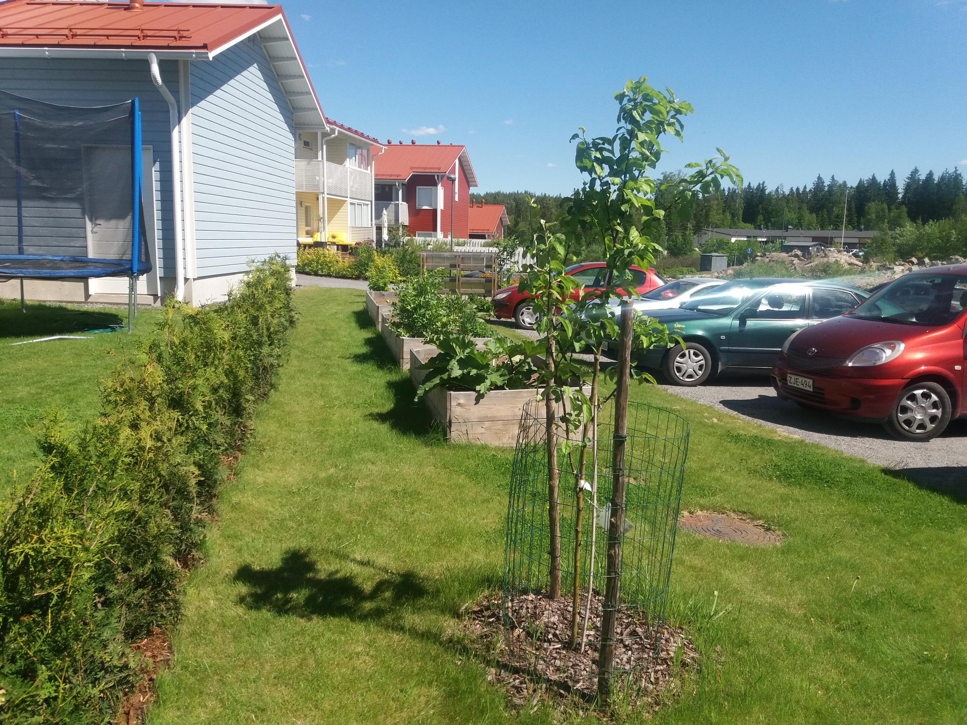
Innovation voucher 2: Edible garden of a apartment house
Fruit trees, berry bushes, gardening boxes
Applied also funding for waste management, but it was left out, because too far from NBS
Unalab funding 1000 € for materials. Implementation and maintenance: voluntary work by residents

Slide 31
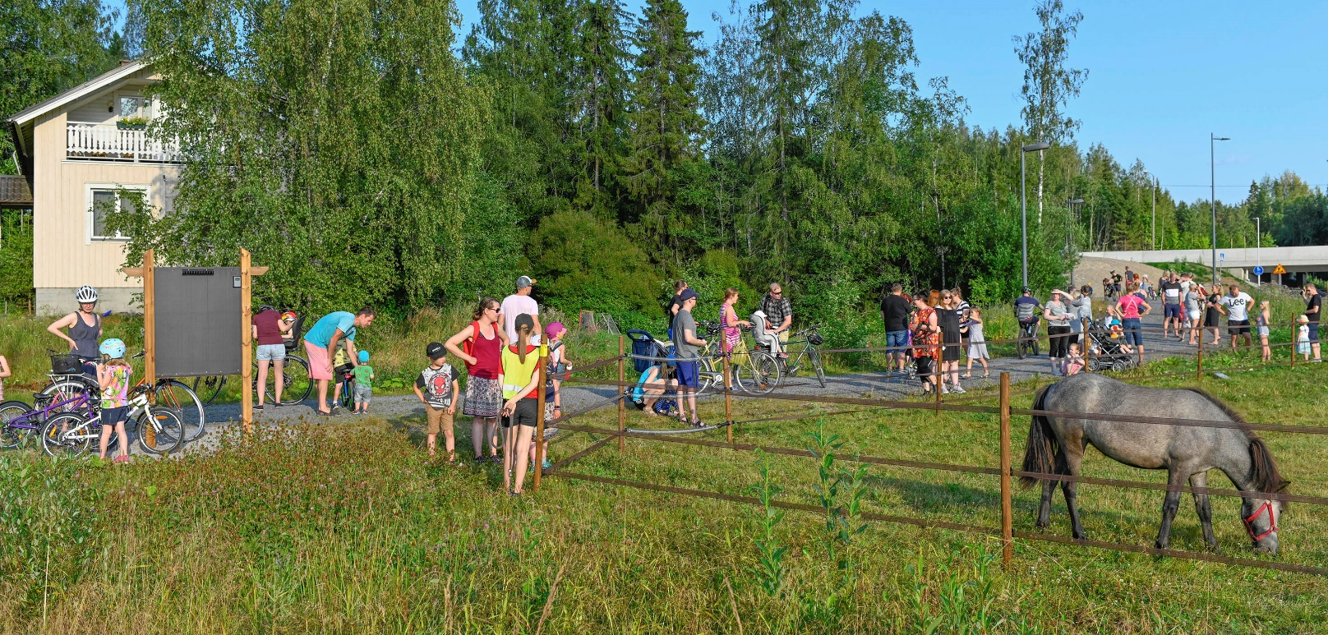
Innovation voucher 3: Horse paddock
Local farm built a fence in the central park of Vuores, next to a school. They bring ponies to meet families in Vuores, organise events and interact in social media.
Monitoring: resident survey, biodiversity counts, water quality monitoring in a ditch next to the paddock
Unalab funding 16 364 €

Slide 32
Reflections
Innovation vouchers encourage residents and other city actors than municipality ideate and implement novel nature based solutions to city
Nature based solutions created were feasible: DIY-type rather than professional/engineered solutions
Participants enjoyed working with neighbours – social aspect was highlighted
Our living lab is new area and we didn’t receive many applications. In future, targeting such funding to older/more dense areas with less nature and resources is recommeded.

Slide 33
Kiitos!

Slide 34
Barriers Encountered & Lessons Learned
These projects have received funding from the European Union’s Horizon 2020 research and innovation programme under topic SCC-2-2016-2017: Smart Cities and Communities Nature based solutions

Slide 35
Barriers and Lessons Learned
What have been the barriers and lessons learned during the installation of the Demonstration projects of GrowGreen, UrbanGreenUp and UnaLab?
Capital vs Revenue funding
Which comes first – strategy or finance?

Slide 36
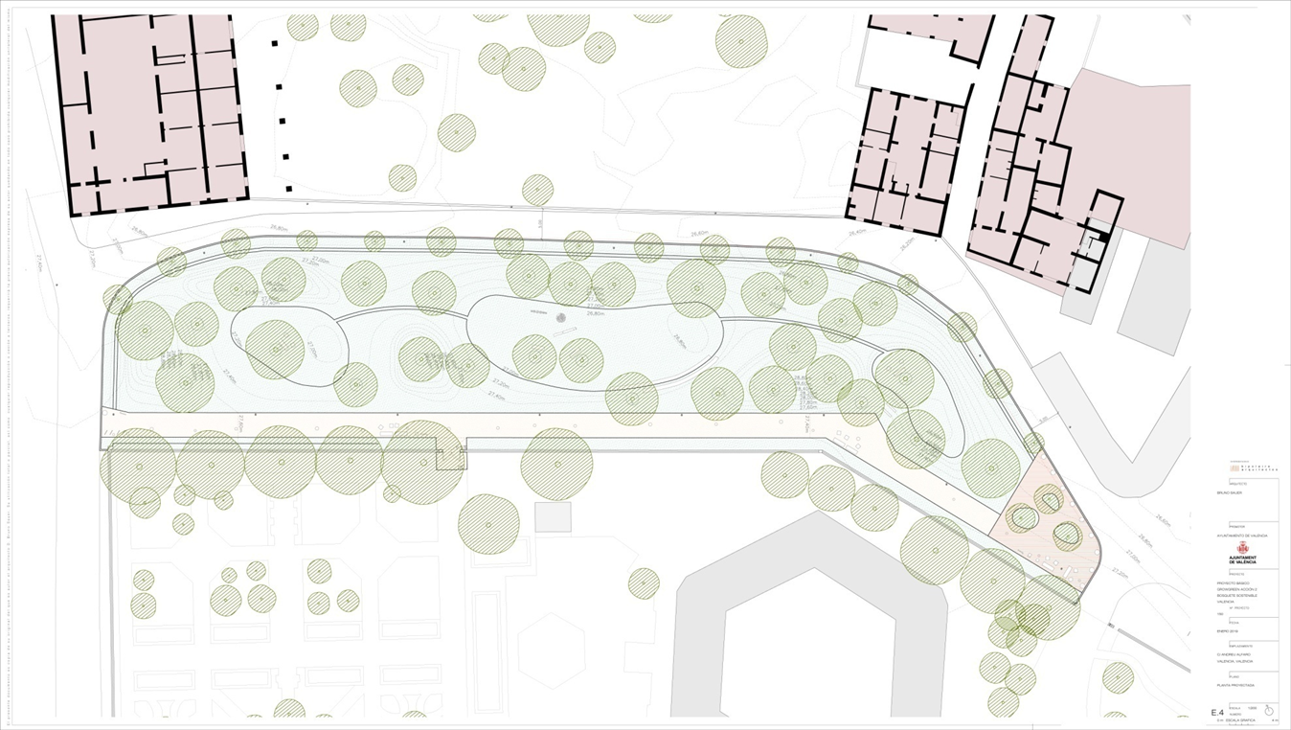
Before implementation :
Procurement
Frameworks
Tenders
Local and political support
Planning and permissions
Objections to planning
Heritage areas

Slide 37
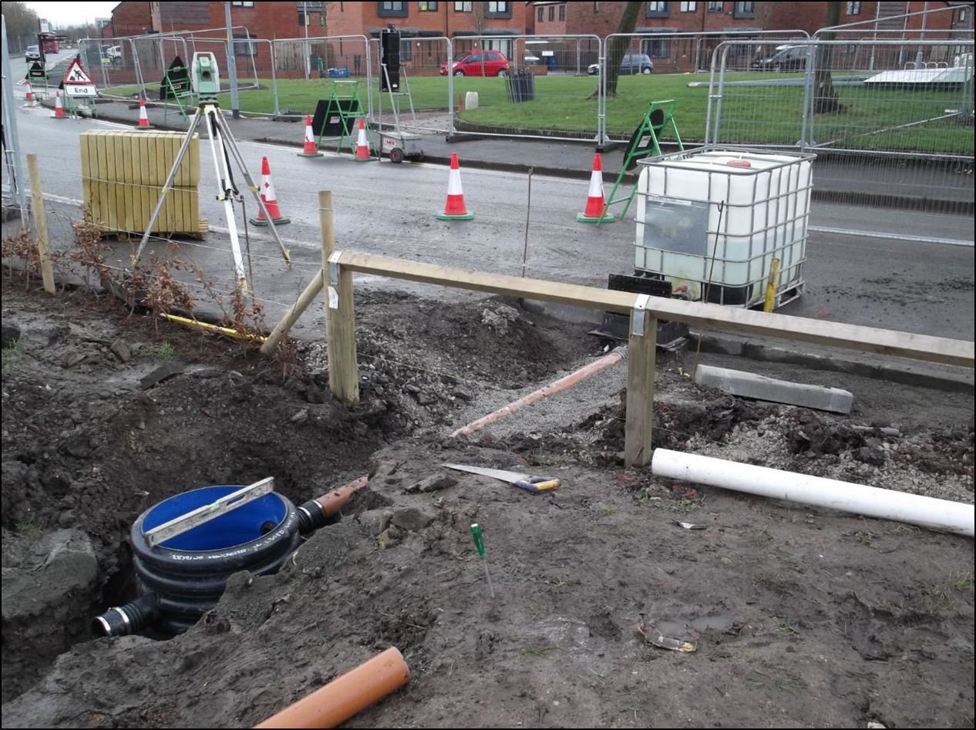
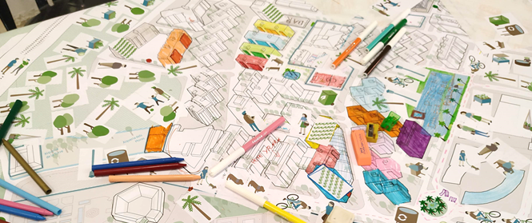
During implementation:
Skilled contractors
Level of co-design involved

Slide 38
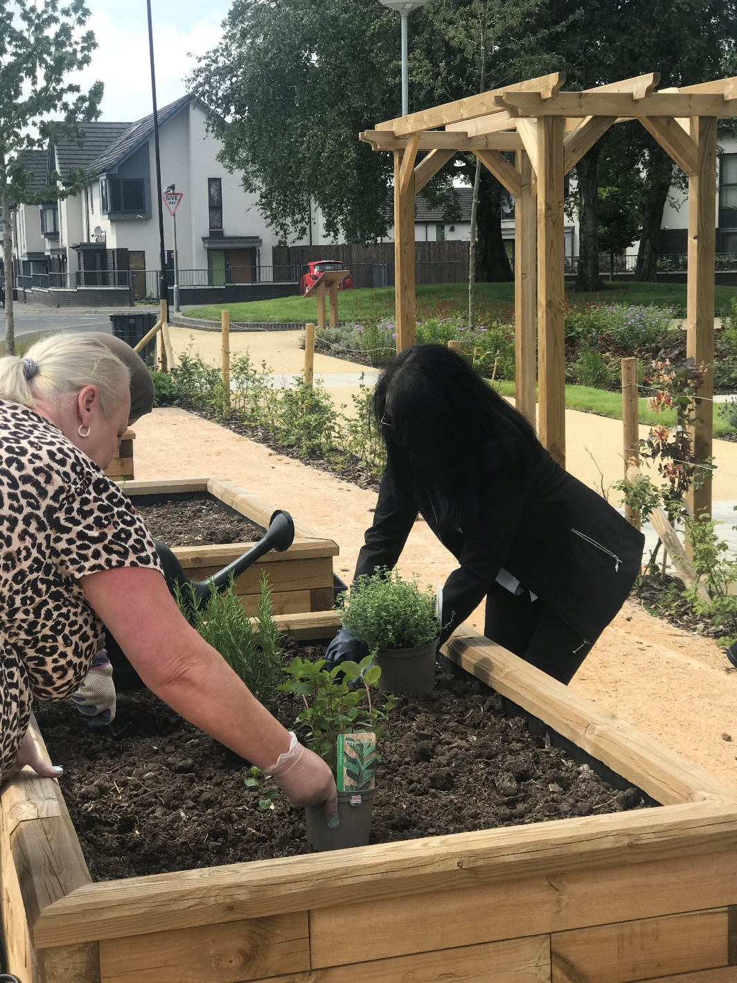
After implementation:
Responsibilities at handover
Finance for ongoing maintenance

Slide 39
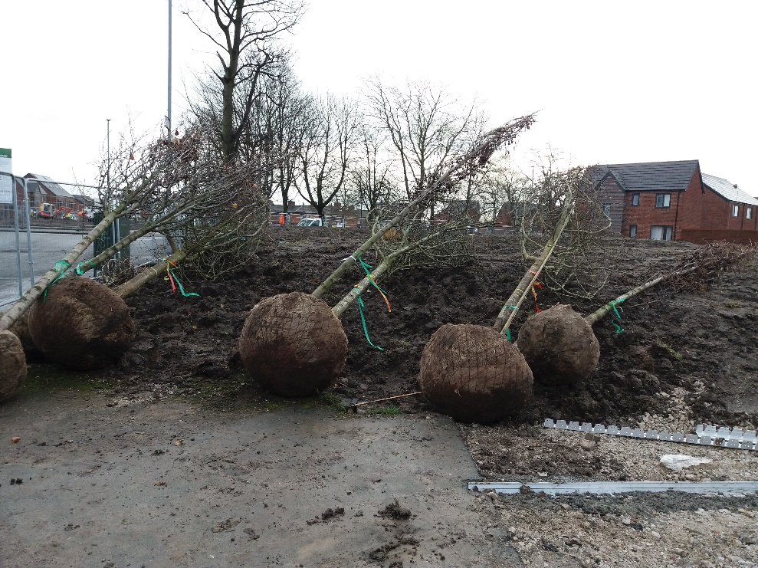
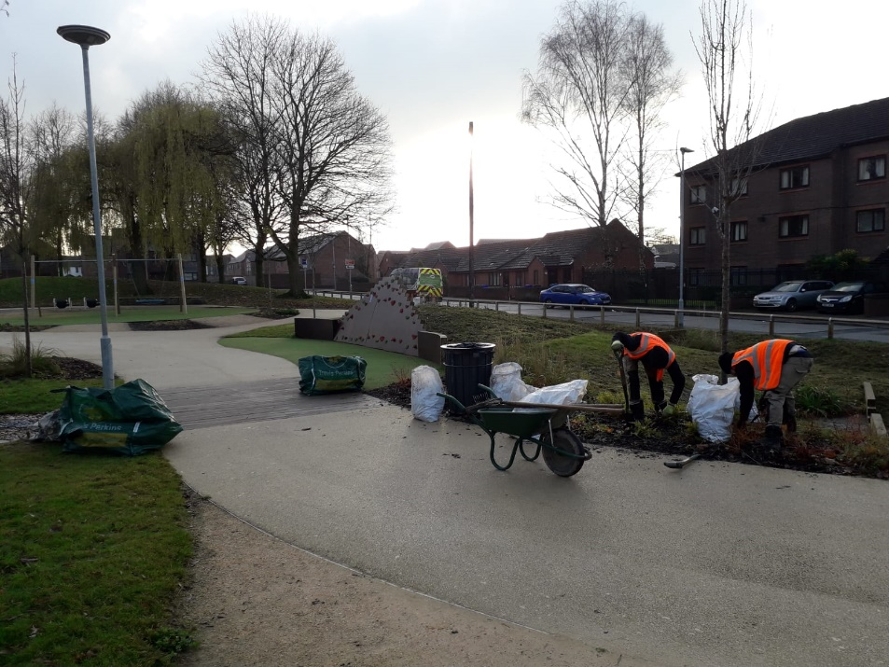
Capital vs Revenue funding
Capital Funding
Revenue Funding
Can be easier to come by – via national and international grants
Municipalities have access to low cost borrowing
BUSINESS CASE is key
Some NBS generate savings but often there are additional maintenance costs
Municipalities have no additional budget

Slide 40
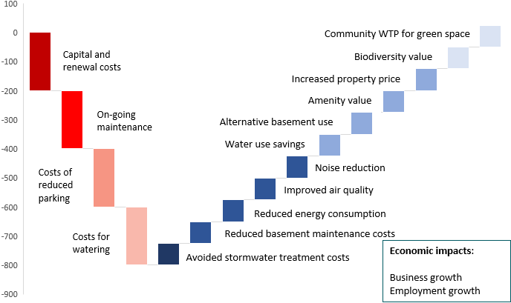
Benefits of NBS
Demonstration projects produce many benefits
Monitoring data helps us track costs and benefits
Use of monitoring data to quantify and monetise these benefits
Illustration of costs and benefits from Wroclaw demonstration project
Informs the development of business cases

Slide 41
What comes first, strategy or finance?
Notes:
What comes first

Slide 42
URBAN GreenUP –
Barriers encountered and lessons learned
Key barriers identified
Barriers in procurement NBS
Community/stakeholder consultation and opposition to plans
Necessary Surveys (utilities/environmental/highways)
Approvals (city council services/political/stakeholder), Permissions (Planning) and Licences (legal), fire regs etc

Slide 43
URBAN GreenUP –
Barriers encountered and lessons learned
VALLADOLID

Slide 44
PROCUREMENT BARRIERS
PUBLIC TENDERING PROCESS
Key stages
1. Preparation and planning
2. Initiation (tender)
3. Evaluation of proposals
4. Awarding
5. Contract implementation
Defining the scope.
Engage stakeholders.
Market studies.
Technical conditions and technical project.
Administrative conditions.
Procurement method.
Financial plan and budget allocation.
Public notice.
Select evaluation criteria.
Tender documents preparation, specifications.
Publishing (advertising)
Requisition and enquiries.
Submission of tender.
Receipt and opening.
Selection of suitable procurers.
Tender evaluation process and assess.
Scoring.
Awarding process.
Get procurer documentation.
Notify procurers and publish the award.
Contract signature.
Contract administration.
Control of costs.
Monitoring.
Project updates and modifications.
Amendment.
Closing.
Technical project:
Adapted to the location.
Procurement documents.
Division in lots.
Evaluation criteria: % scoring.
Lowest economic proposal (price) €: average 50%-70%.
Quality and experience of the procurer: 0%-70%.
Increase in scope: 10%-60%.
Reduction in the execution time: 0%-20%.
Suitable bidders:
Evaluate and find suitable bidders are also challenges for the cities.
procurement file
Technical project
Administrative conditions
Technical conditions
Financial report
Legal report
INPUTS
Public procurement process
Schedule: Long tendering and implementation periods.
Average schedule for implementing NBS: 4-5 months up to 12 months.
Tendering: From 3 to 5-6 months.
Execution: From 5 to 12 months.
Contract closure: Add 1 month.
TENDERING
IMPLEMENTATION
(Works execution)
CLOSURE
Minimum 3-5 months
Average 4 months
Between 5 - 12 months
Average 7 months
+1-2 months
Average 1 month
Works management
Total Min.12 months
D1.9: Guidelines to tendering process specification (download the report in www.urbangreenup.eu)
Notes:
Key stages: The key stage for the cities in procurement is the definition of the technical project, as this is one of the main documents of the tender, which directly influences the tender and the construction process. Another key stage is the selection of the evaluation criteria, and considering the best scoring allocation for the quality/price proposal. Finally, in some cases evaluate and find suitable bidders are also challenges for the cities.
Evaluation criteria: The weighted criteria for the evaluation of NBS tenders usually include the price, typically favouring the lowest economic offer. The weight of this criterion varies from 60-100% to only 20%, with an average of 50%-70%. This wide range is due to the fact that this report has become evident that not all cities give greater weight to the criterion of price. In some cases, they give more value to sustainability or quality criteria of the proposal.
In this way, there are also other criteria used to evaluate NBS proposals, which seek improvement in quality, efficiency, and support delivery of other non-economic criteria. Among the non-economic criteria that can be used are the quality and experience of the procurer (from 0% to 70%), the increase in scope (10% to 60%) and the reduction in the execution time (0% to 20%).
In simpler contracts, such as the Minor Contract, the price is usually the only criterion.
Division in lots: In some cities, according to regulations or normal operations, the division of the contract into lots is not recommended, for reasons of economic and time efficiencies. However, in other cities, the division into lots is mandatory or recommended in order to make the tender more accessible to SMEs. Each Council should be aware of the local rules on public procurement.
Schedule
The average schedule for implementing NBS in the cities can last from 4-5 months up to 12 months, depending on complexity, approvals, and challenges. The execution of the contract depends heavily on the type of execution; however, it can take between 5 and 12 months. Contract closure can add another month. This means that the total execution time of a NBS in a city, from the time the tender is prepared, executed and closed, can take at least a full year.

Slide 45
PROCUREMENT BARRIERS
BEST TIPS AND LESSONS LEARNT
The following tips are based on the experience gathered by URBAN GreenUP cities.
1. Plan the implementation of NBS according to a schedule which has been adapted to match the duration of the procurement processes. Administrative processes take more time than expected.
2. Carefully plan the annual financial elements for the implementation of NBS, to ensure budget execution within the same fiscal year or in a mid-term basis.
3. The technical project is one of the key documents in the whole process, affecting both tendering and execution.
4. You may need more than one tender for only one NBS implementation. A tender may be required for the elaboration of the technical project and another tender for the construction/execution.
5. Rely on the support of experts in each discipline: technical, legal, procurement.
6. Create a multidisciplinary team in the Council.
7. Coordination among the Council departments with different responsibilities and priorities is not easy.
8. Make tenders easier for companies. Public tendering can discourage smaller organizations.
9. Tender scoring criteria must be clear, easy and preferably mathematically quantifiable.
10. Allow time and resources (including financial resources) for the unexpected.
D1.9: Guidelines to tendering process specification (download the report in www.urbangreenup.eu)
Notes:
Best tips and lessons learnt
The implementation of NBS in public administration systems is a complex and long process, with many barriers and challenges to be overcome along the way. The following advice is a product of the experience gathered by URBAN GreenUP cities.
Plan the implementation of NBS according to a schedule which has been adapted to match the duration of the procurement processes. Administrative processes take more time than expected.
Carefully plan the annual financial elements for the RUP, to ensure budget execution within the same fiscal year or in a mid-term basis.
The technical project is one of the key documents in the whole process, affecting both tendering and execution.
A tender may be required for the elaboration of the technical project and another tender for the construction/execution.
Rely on the support of experts in each discipline: technical, legal, procurement.
Create a multidisciplinary team in the Council.
Coordination among the Council departments with different responsibilities and priorities is not easy.
Make tenders easier for companies. Public tendering can discourage smaller organisations.
Tender scoring criteria must be clear, easy and preferably mathematically quantifiable.
Allow time and resources, (including financial resources), for the unexpected.

Slide 46
URBAN GreenUP –
Barriers encountered and lessons learned
LIVERPOOL

Slide 47
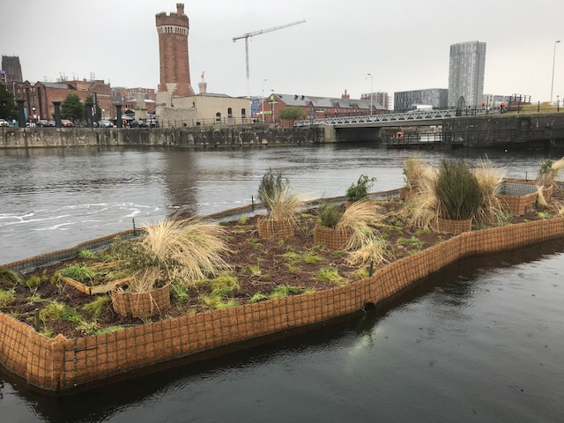
Consultation and Opposition to NBS
Not everyone wants an NBS near them. Many concerns exist including:
Potential failure and aesthetics (poor implementation)
Long term commitment to maintenance (poor aftercare)
Change of land use/aesthetics (pollinators can look ‘messy’ in the autumn)
Loss of facilities (parking spaces)
Nuisance factor (leaf fall, loss of view etc.)
In Liverpool there was some opposition about the saltwater floating ecosystem island.
Loss of open water space and the start of potential planning ‘creep’
Aesthetics and impact on other water users
Attraction of antisocial behaviour.
None of these concerns materialised and the island has been the source of enquiry from Seattle, Romania, Australia and First American Indian tribes.
Notes:
Consultation is critical but not everyone understands NBS or embraces the idea.
Some people are opposed to NBS as it removes car parking spaces or they perceive a nuisance factor. Island example has not seen the issues of concern – others are more recent – still waiting to see if new pollinator areas attract illegal parking …

Slide 48
Surveys (Environmental, Utilities, Others)
We expected to undertake:
Underground utility surveys
Vision splays at junctions
General environmental surveys e.g. bats/voles/plants
Tree surveys
But we also required some specialist surveys :
Topographical surveys (water retention ponds)
Water DNA analysis and site surveys for newts (water retention ponds)
3 stage Road Traffic Safety Audit (NBS adjacent to roads)
Noise surveys for city centre construction (green wall construction)
Stress testing surveys for lamp posts (smart pollinator pillars)
Water outflow surveys and design (water retention ponds)
Structural surveys (rain garden/planting in squares)
Percolation surveys (trees, raingarden)
It is not always possible at the start to identify all the surveys required
Existing desk top data is often inaccurate
Some environmental surveys e.g. newts are limited to a few weeks/year
Some surveys are not common or widely known (Road Traffic Safety Audit)
Surveys will both inform and delay project delivery
Notes:
Surveys are crucial to success but information and knowledge is held across different service areas. Desk top surveys are not up to date. Some surveys reveal need for further surveys. Surveys also take money from budget and sometimes restrict what you can deliver.

Slide 49
Approvals, Permissions and Licences
Approvals
Stakeholder approvals (third party, utility, community groups)
Political (ward members, cabinet members)
Permissions
City Council (financial, legal, senior managers, scrutiny committee, procurement, internal partner)s
Planning permissions for both green walls and 2 of the art sculptures
Landowner permissions
Licences
External NBS hosts licence agreements
Highway licences (green wall)
Others
Fire Regulations post Grenfell (green walls)
Every process is different and each has a its own timescale
Notes:
Approval, permissions, licences etc are often an administrative burden that cant be rushed. Some are ‘hoop jumping’ and others are important but they all have to be done. There is often an order to completing them and having planning permission and licences in place will speed up internal final approvals for schemes.

Slide 50
Lessons learned NBS and finances
UNaLab
Eindhoven Luuk Postmes

Slide 51
A few examples of the interaction of finances and (NBS) projects
Cost of maintenance for an extra layer :3rd dimension like vertical green which introduces extra m² to maintain
Investing in public space: Victoriapark, Clausplein
Investing in own terrain not being core business (mental health)
Combining multiple projects with different financial sources causes delays
Creating a more attractive and healthier environment: who is benefiting and who is paying?

Slide 52
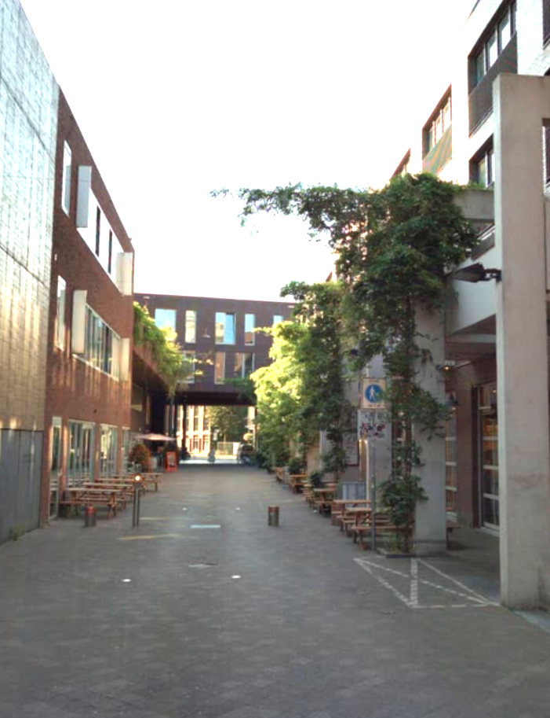
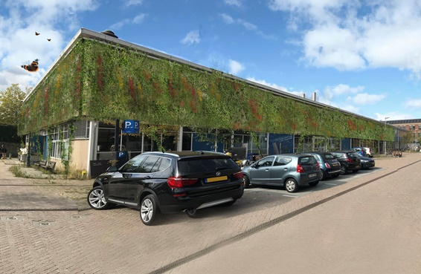
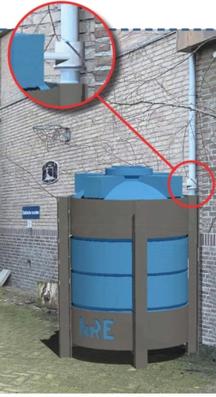
Green facades and green above the streets as well as special construction are more expensive to maintain then (most) green on the surface
Cost of maintenance for an extra layer :3rd dimension like vertical green which introduces extra m² to maintain

Slide 53
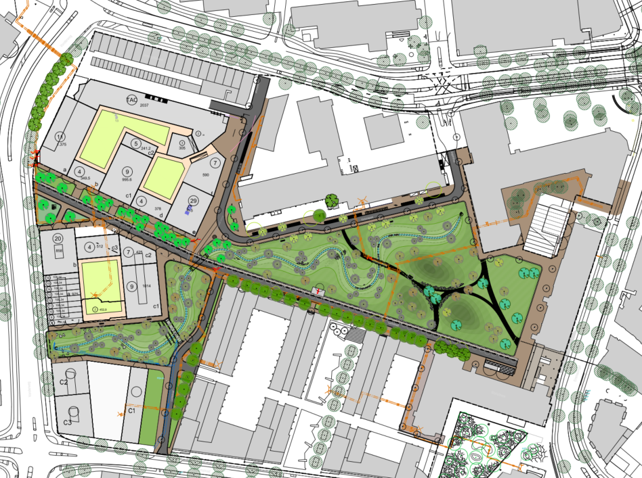
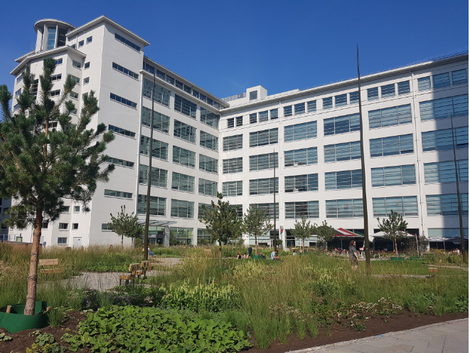
Victoriapark; private property, transformation from parking to park then transferred to municipality
Investing in public space: Victoriapark, Clausplein
Clausplein; public space, transformation from a stony square towards a small park. Partly paid by the owner of the “Witte Dame”

Slide 54
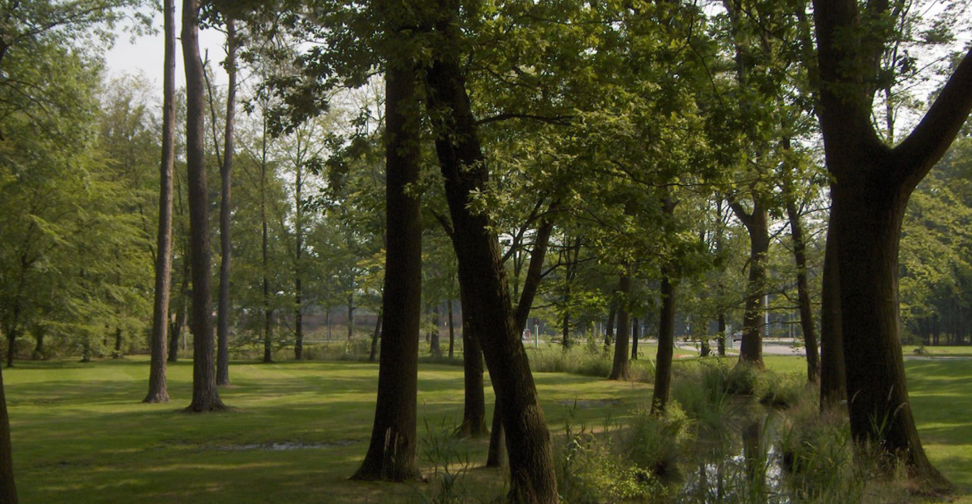
Private property. Area is already green and looks nice. Still improved is possible
Investing in own terrain not being core business (mental health)

Slide 55
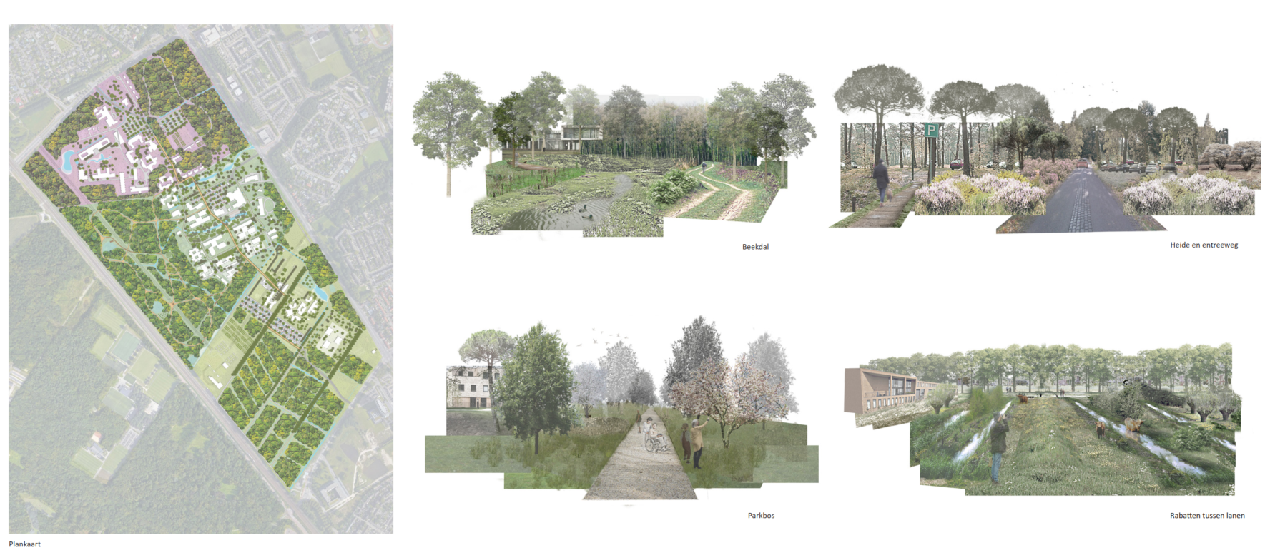
Daylighting stream on private property. Core business of the owner is mental health. Priority of transformation is low. External finances with deadline may push project forward
Investing in own terrain not being core business (mental health)

Slide 56
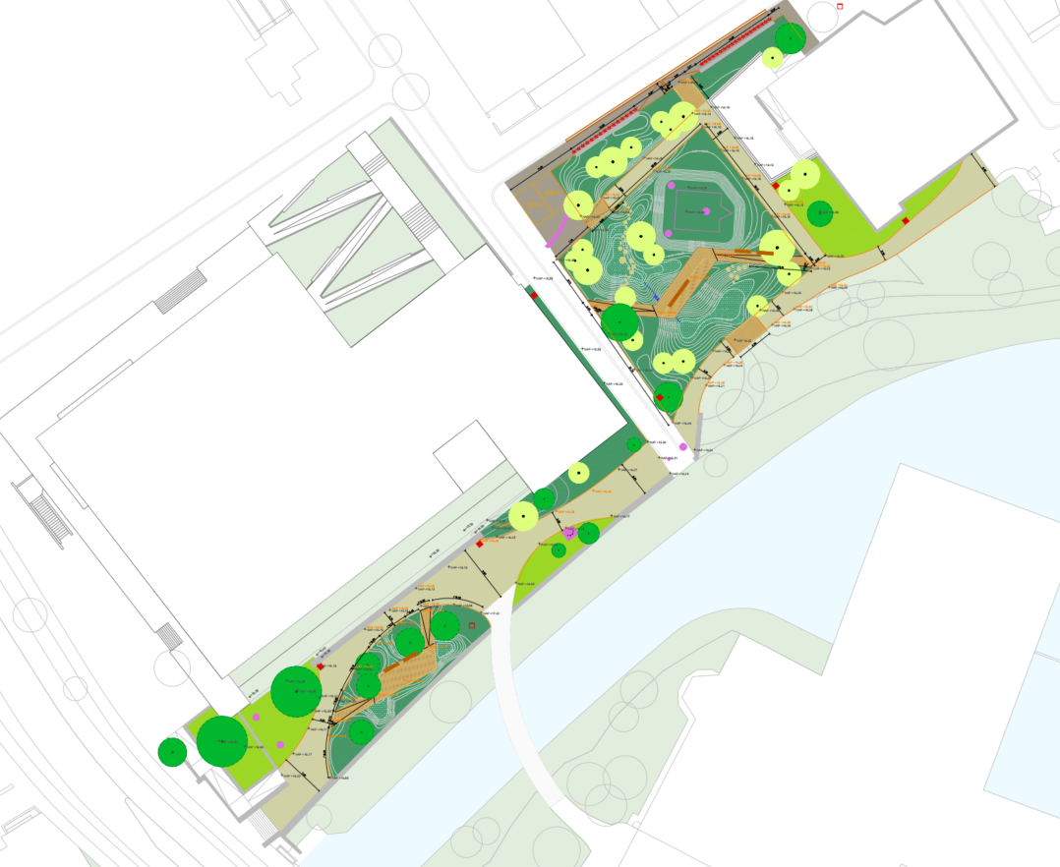
Different projects with separate goals and funds are hard to combine if there is a deadline
Combining multiple projects with different financial sources causes delays
City hall

Slide 57
Key References Dumitru & Wendling, Eds. (2021). Evaluating the impact of nature-based solutions: A handbook for practitioners Dumitru & Wendling, Eds. (2021). Evaluating the impact of nature-based solutions: Appendix of methods EEA (2021). Nature-based solutions in Europe: Policy, knowledge and practice for climate change adaptation and disaster risk reduction. Mačiulytė, E. & Durieux, E. (2020). Public procurement of nature-based solutions. Addressing barriers to the procurement of NBS: case studies and recommendations IEEP (2021). Nature-based solutions and their socio-economic benefits for Europe’s recovery Wild, T., Freitas, T., Vandewoestijne, S. (2020). Nature-based Solutions: State of the Art in EU-funded projects + individual expert reports from the ‘Valorisation of NbS Projects Initiative’
These projects have received funding from the European Union’s Horizon 2020 research and innovation programme under topic SCC-2-2016-2017: Smart Cities and Communities Nature based solutions
More Information
www.unalab.eu
@UNaLab_EU
www.urbangreenup.eu
@urbangreenUP
www.growgreenproject.eu/
@GrowGreenCities

Slide 58
Questions & Discussion
These projects have received funding from the European Union’s Horizon 2020 research and innovation programme under topic SCC-2-2016-2017: Smart Cities and Communities Nature based solutions
Laura Wendling
laura.wendling@vtt.fi
Raúl Sánchez
rausan@cartif.es
Michelle Oddy
michelle.oddy@manchester.gov.uk

