Slide 1
LIFE TECMINE: Innovative techniques for mine restoration
BUILDING OUR WORLD
FOR A MORE SUSTAINABLE MINING
Beatriz Olmo Gilabert
Project manager (VAERSA)
email: olmo.bea@vaersa.org

Slide 2
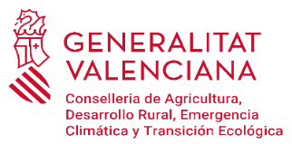
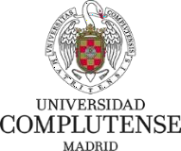
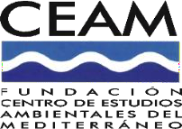
LIFE TECMINE: Innovative techniques for mine restoration
PARTNERS:
LOCATION: FORTUNA mine
Ademuz, Valencia, Spain
DURATION: November 2017 - May 2022 (4 years + 6 months extension)
BUDGET INFO:
Total amount: 1,589,256 €
% EC Co-funding: 59,76 %
LIFE CALL: 2016-Environment and Resource Efficiency

Slide 3
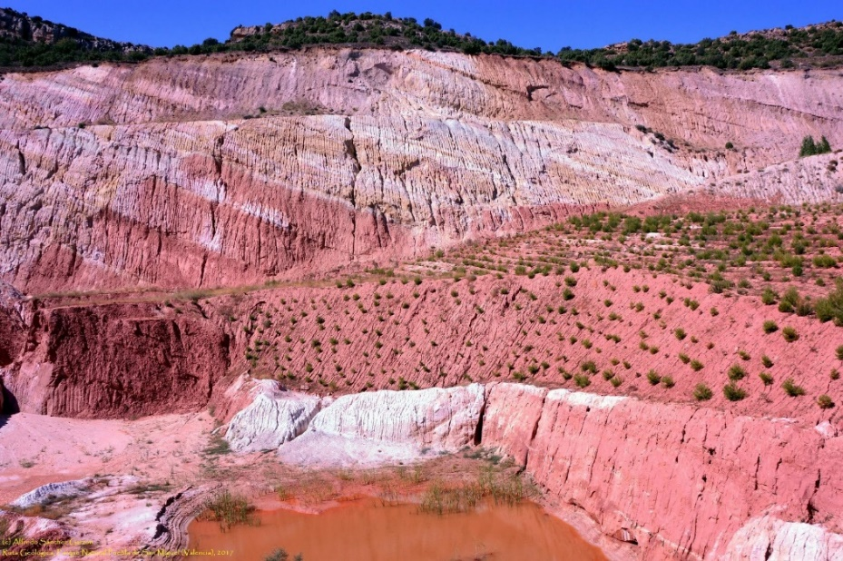
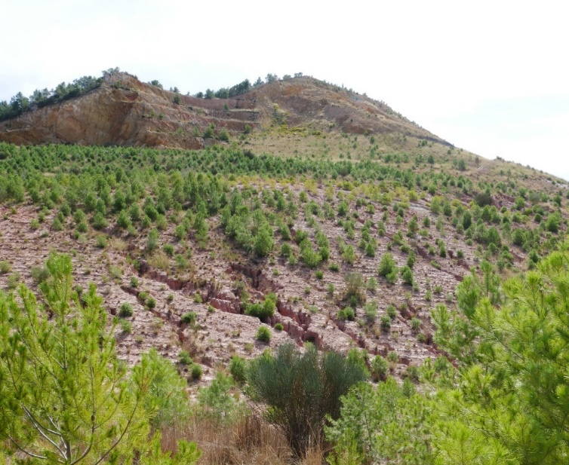
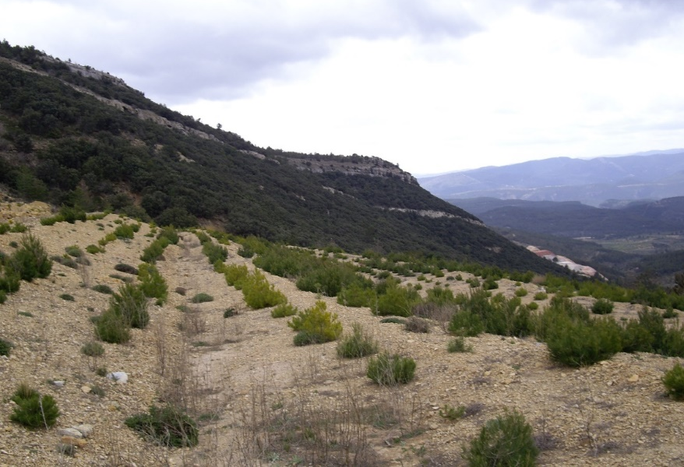
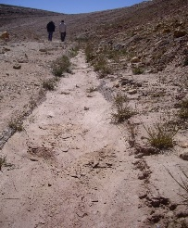
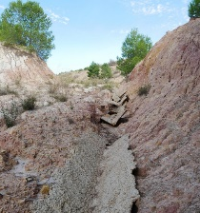
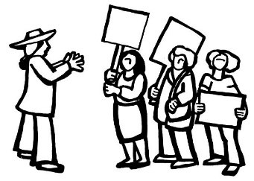
PROBLEM: Current MINE restoration practices are costly and not efficient to solve environmental problems:
Erosive processes, instability, low vegetation cover, scarce biodiversity, landscape impact, high maintenance cost…
Is it possible to increase the quality of restorations in an efficient way?
Notes:
In Spain, since 1982 the restoration is compulsory, although restoration practices started to be implemented later on. Restoration works have to be well-coordinated with mining operations, and it is not that simple. Particularly in Valencia Community, the PA review those projects that so far includes all the same approaches and limitations (slope-berm morphologies, no soil, low biodiversity sp selection). After 15-20 years of supervising them, large amount of money has been spent by the companies, but results were not successful by far.

Slide 4
MAIN OBJECTIVE: IMPROVE MINE RESTORATION
HOW?
Testing other techniques
Transferability / Training
Engaging main actors
Increasing awareness
Notes:
Transferability / Training TO GUARANTEE post life implementation
Engaging main actors: users, mining sector and administrations
Increasing awareness, profesional sectors on the one hand and society regarding the impo. of mining and the way to reduce impacts

Slide 5
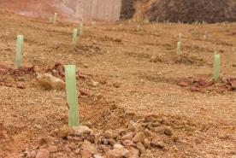
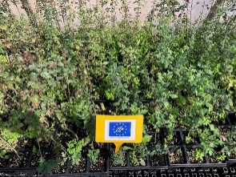
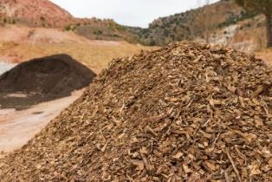
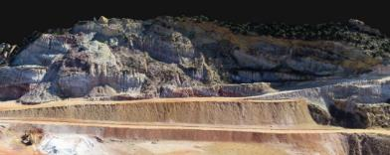
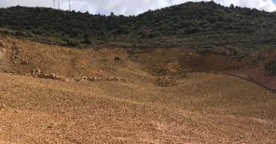
Establishing vegetation
Restoring vegetation cover that provides environmental services (protection, biodiversity and C-stock).
Restoration process
3
Soil reconstruction
Mixture and/or input of
substrates (colluvium, inert and
organic) that rebuild
a functional and
stable soil
2
Micro-catchment
Diversity
Land restitution
The process of designing and building landforms that mimic the morphology and dynamics of natural ones,
where the original relief
is transformed.
1
Creation of suitable substrates
Slope stabilisation and landscape integration
GeoFluvTM
Notes:
Regarding techniques, we count on some of the best experts in the different disciplines that play a role in ecological restoration (topography, soil and vegetation). All of them, equally important.
We selected some innovative techniques tested in the US and Australia and holistic approach for the overall restoration design, considering the best available techniques and resources.

Slide 6
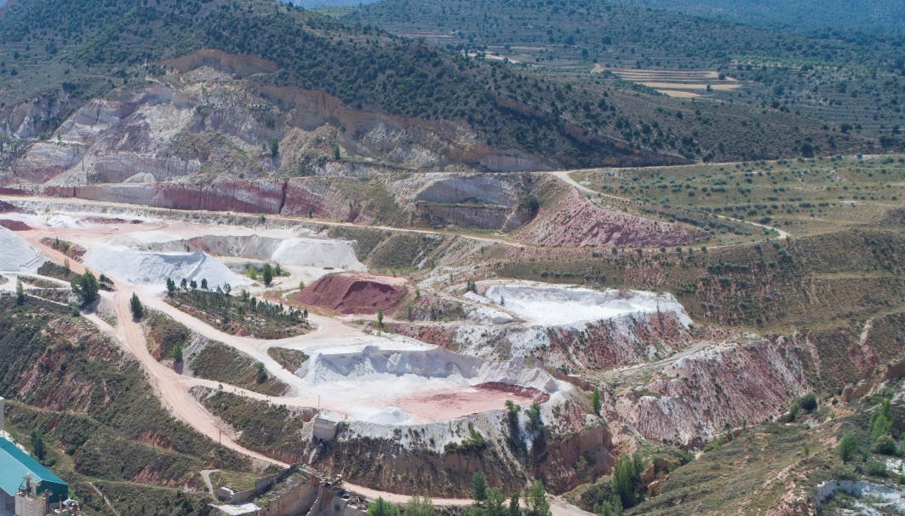
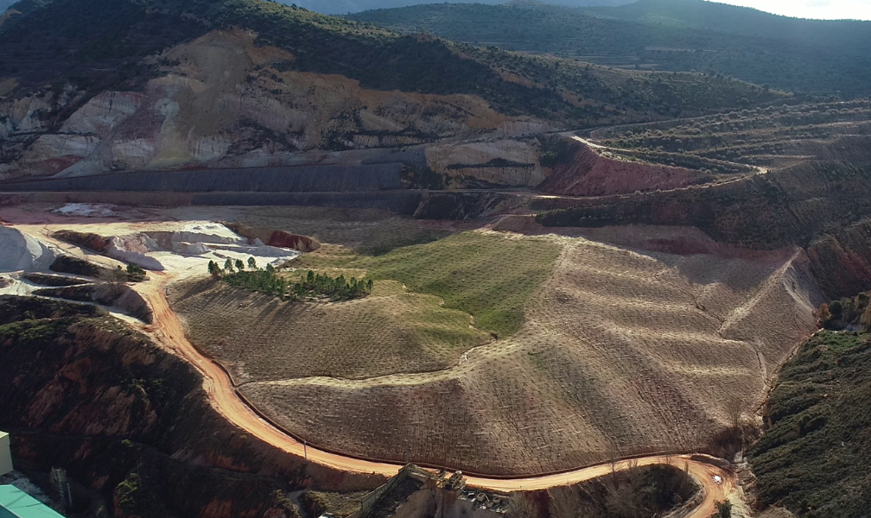
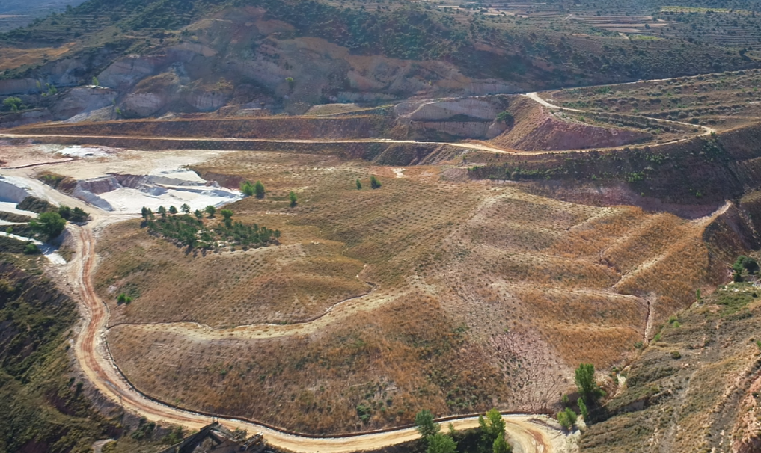
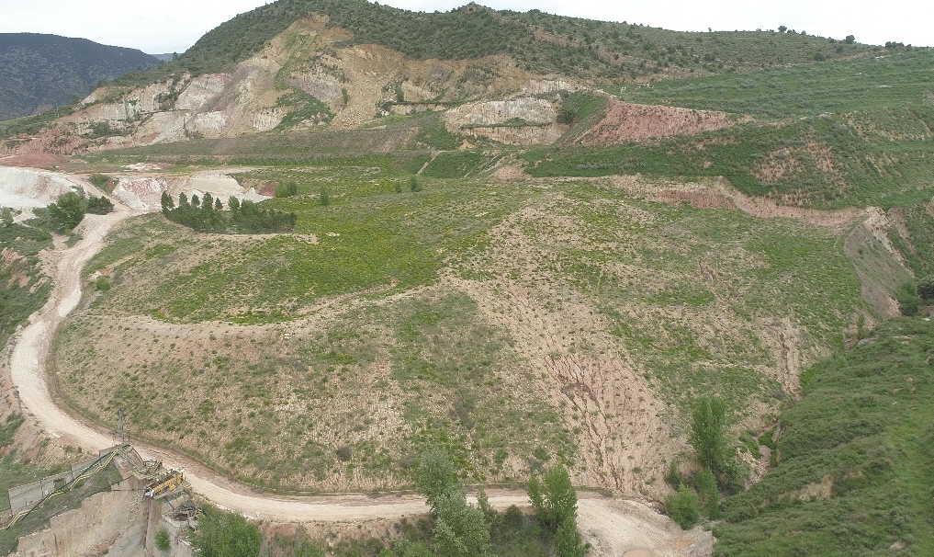
Results (I)
Landscape integration
Overall slope stability
Higher infiltration
Higher soil protection
Better runoff control
Increased soil fertility
Vegetal coverage > 60%
31 different tree and bush species
8 different habitats
Average survival rates of 75%
Increase soil moisture
2018
2019
Increase multiple Ecosystem services: Soil protection, BIODIVERSITY, Cstock, etc.
Control hydrological processes under Mediterranean conditions, optimizing water resource.
Activate ECOLOGICAL PROCESSES
2020
2021

Slide 7
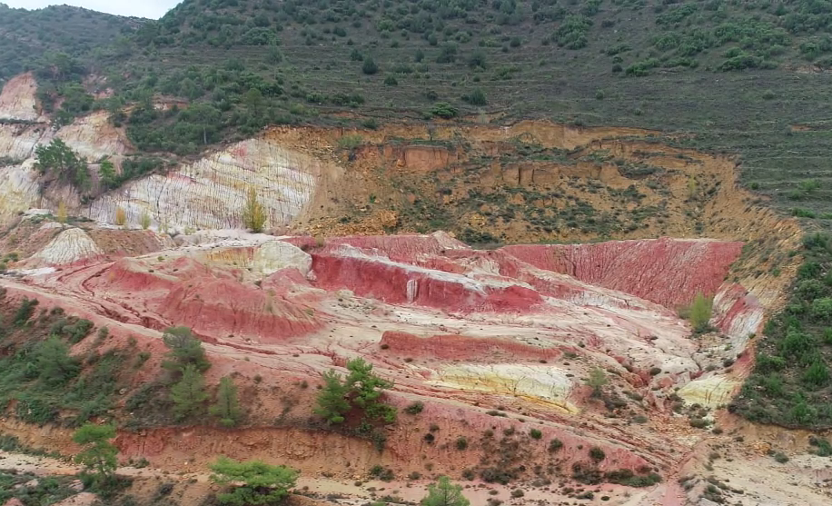
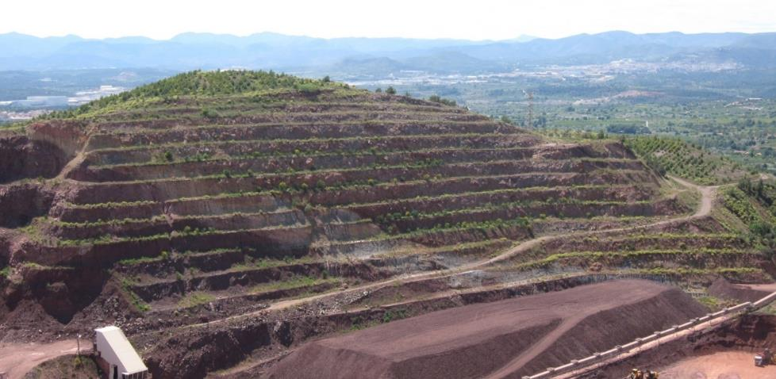
Results (II)
2018
2018
2021
2021

Slide 8
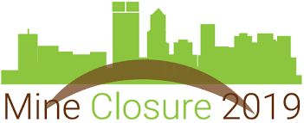
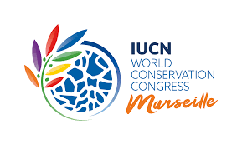
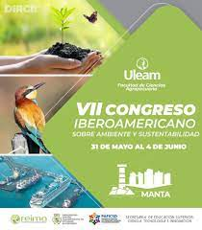
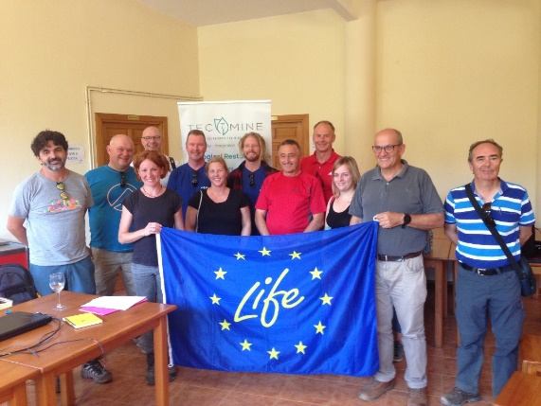
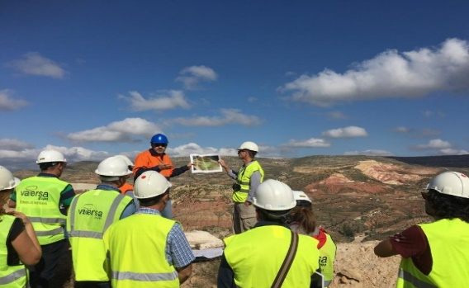
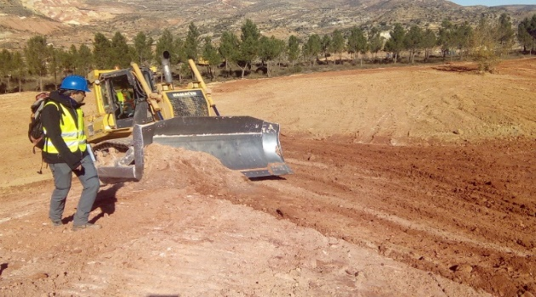
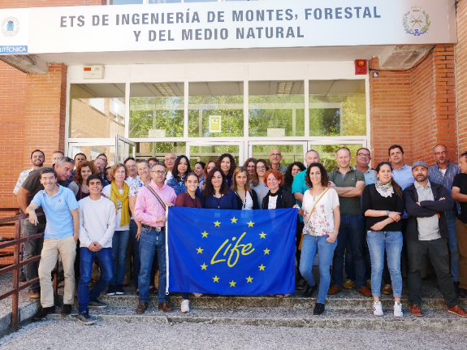
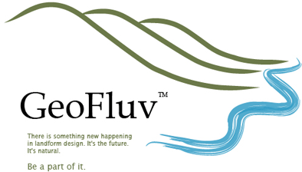
KNOWLEDGE TRANSFER
National and international congresses and conferences
More than 2,500 professionals
National and international training courses

Slide 9
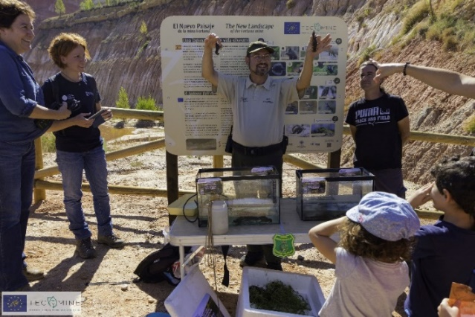
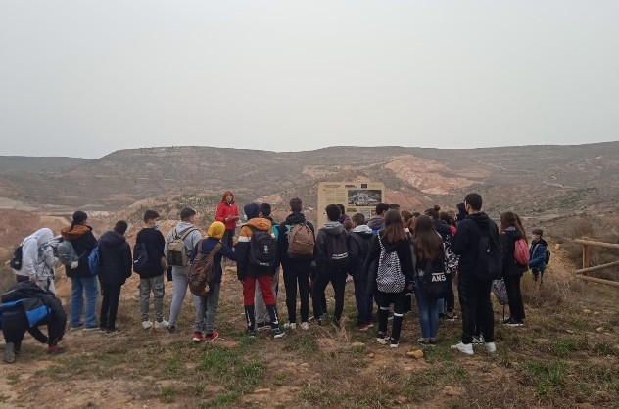
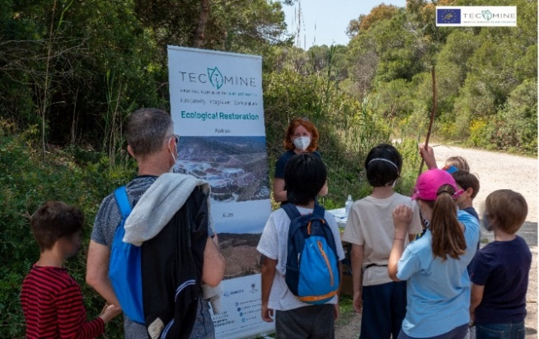
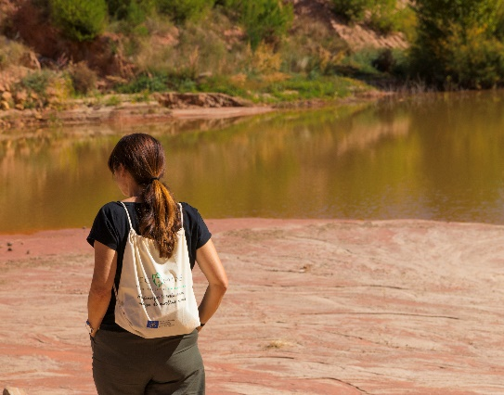
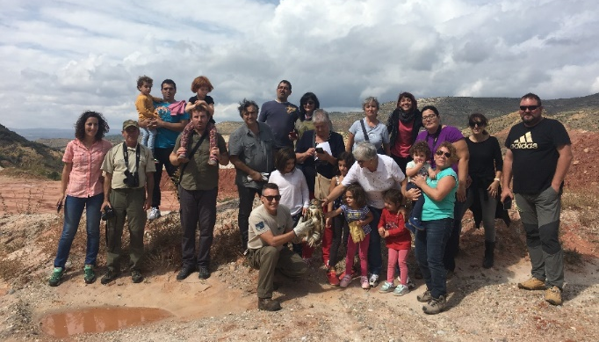
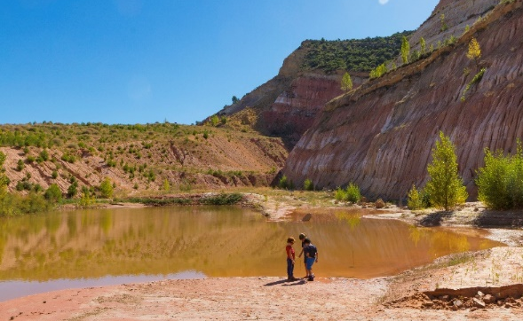
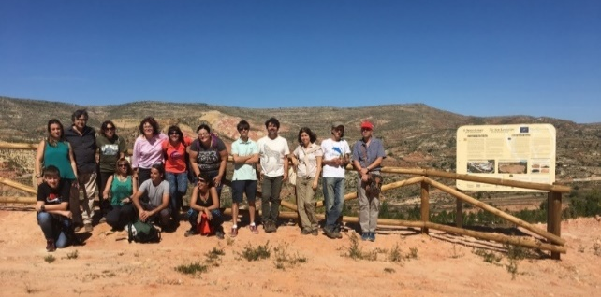
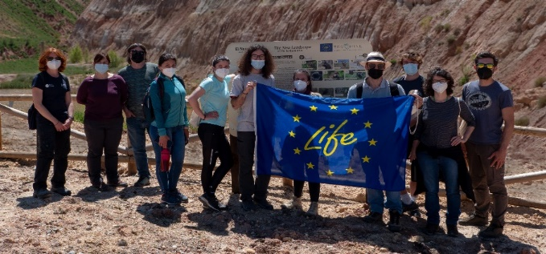
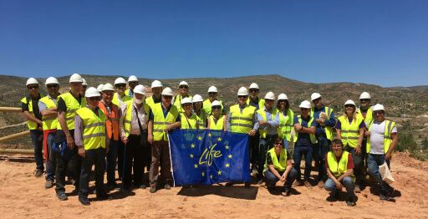
EDUCATION AND AWARENESS

Slide 10
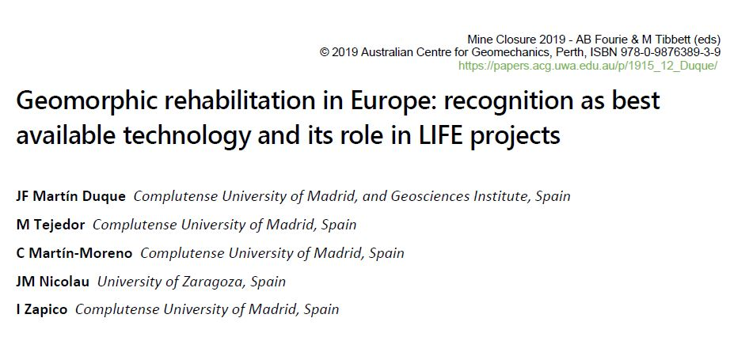
TECMINE CONTRIBUTION
https://agroambient.gva.es/es/web/life-tecmine
Methodological guide for establishing plans and projects for the restoration of forest areas affected by mining activities
Juan Uriol Batuecas (GVA); Beatriz Olmo Gilabert (VAERSA); Sara Rosell Talens (VAERSA); Antonio Javier Ibáñez Lloris (VAERSA)
Guidance for the control and monitoring of mining restoration projects on forest land
Juan Uriol Batuecas (GVA); Cristina Beseler Soto (VAERSA); Cristina Gil Monteso (VAERSA); Ibán Hurtado Picó (VAERSA)

Slide 11
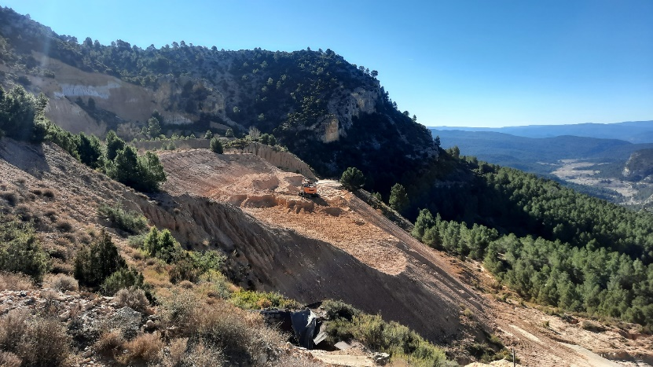
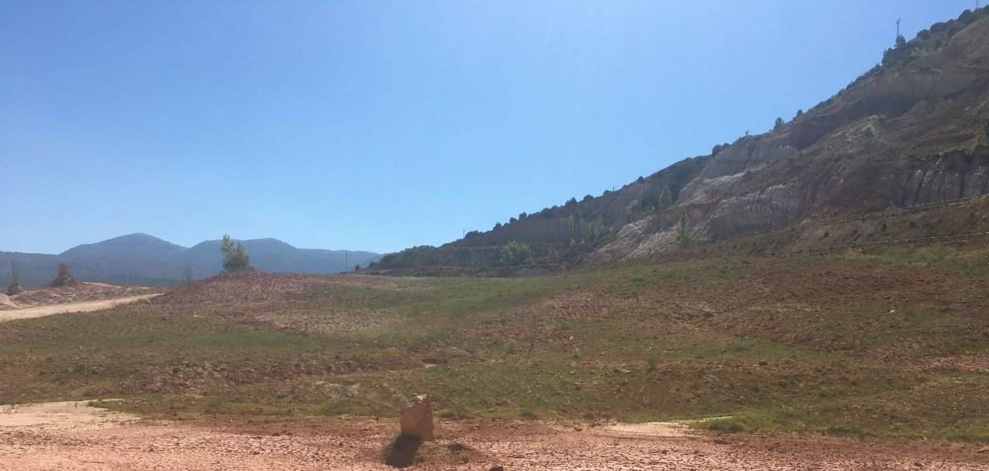
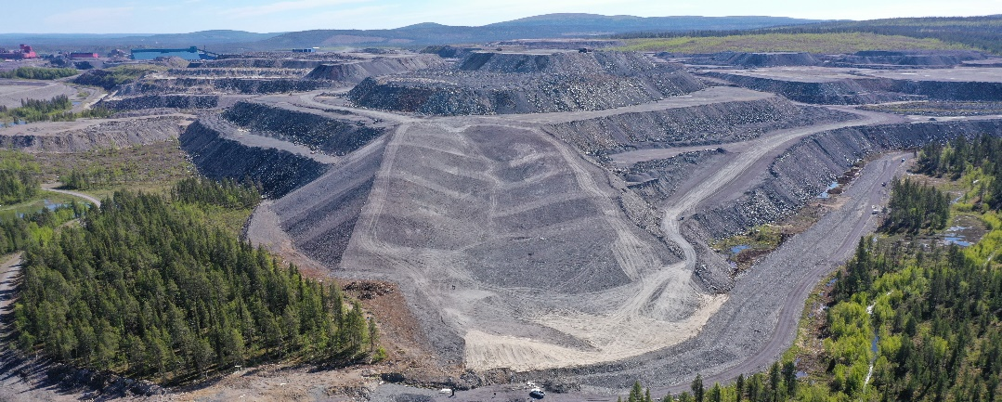
REPLICATION
TECMINE CONTRIBUTION
Cabezo-bis (La Yesa, Valencia)
2 ha
FORTUNA (Ademuz, Valencia)
3 ha
SAN LUIS (Arguisuelas, Cuenca)
9.76 ha
Kiruna , Sweden
4,25 ha
Source: VAST
Photo: M.A. LANGA

Slide 12
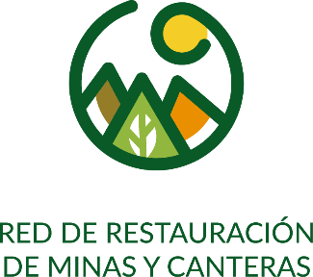
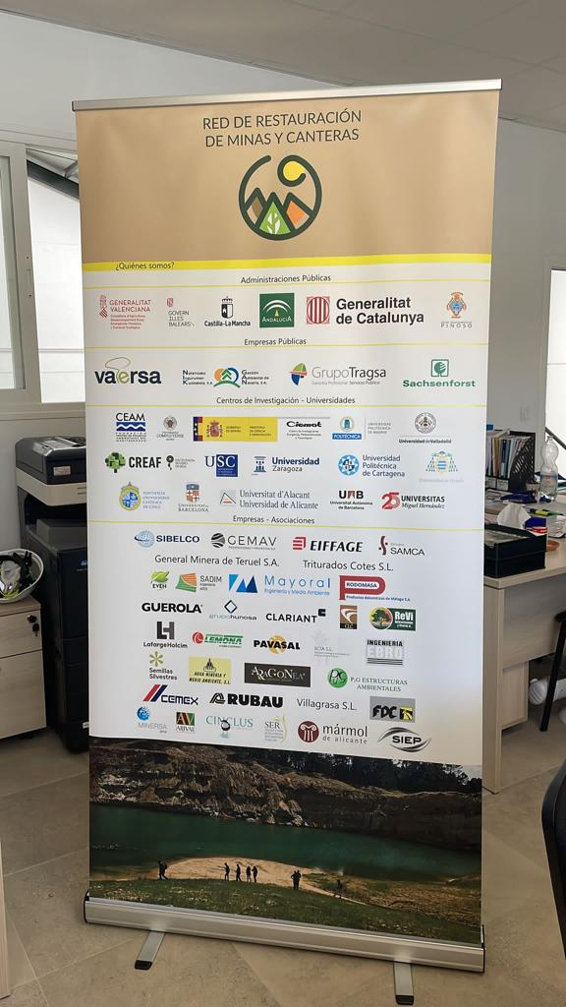
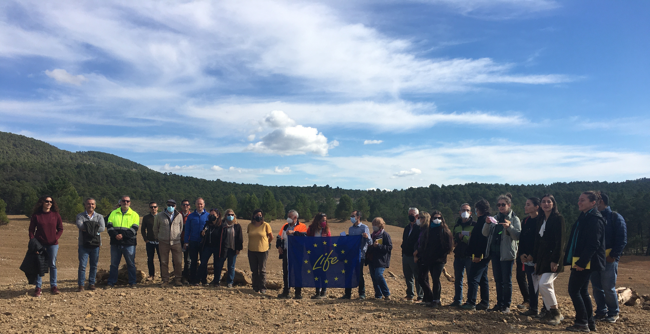
TECMINE CONTRIBUTION
Mine and quarry restoration network
More than 140 experts and professionals in mining and restoration, from private and public companies, research centers, associations, universities and public administrations.
Knowledge exchange
Training
Technical conferences
Successful restorations
R+D
Collaboration
Mines and Quarries Restoration Network
Notes:
Emerges in 2019
Currently more than 140 members.
Experts in mining and restoration, professionals from private and public companies, research centers, associations, universities and public administrations from all over Spain.

Slide 13
KEY MESSAGES
More efficient restoration models are possible.
We can recover ecological functions after a necessary but impacting activity. No need for Greenwashing.
Science involvement in solving environmental issues related to economic activities is crucial.
The engagement of public administrations is key.
Awareness and implication of companies
TRANSFER AND TRAINING to enable replication.
AWARENESS AND EDUCATION to improve public perception.
LIFE projects provide a good scenario to:
Test innovative techniques
Encourage collaboration SCIENCE-ADMIN-BUSINESS.
Facilitate transferability.
Implement MONITORING PROGRAMS.
It is not about a/your project but about PROMOTING A CHANGE AND MOVE FORWARD
Notes:
More efficient restoration models, contributing to more responsible mining are possible.
We have the opportunity to really recover the ecological functions of an ecosystem, after a necesary but impacting activity. No need Greenwashing.
Science involvement in solving environmental issues related to economic activities is crucial.
The engagement of public administrations is key to guarantee the impact, the actual shift and the mainstreaming of the new solutions.
Awareness and implication of companies allow to validate the proposal as feasible, realistic and helpful.
TRANSFER AND TRAINING is the way to enable replication.
AWARENESS AND EDUCATION is needed to improve the perception of mining operations.
LIFE projects provide a good scenario to:
Test innovative techniques with the risk that this may entail.
Encourage collaboration SCIENCE-ADMINISTRATION-BUSINESS.
Facilitate transferability.
Implement MONITORING PROGRAMS large enough to obtain relevant and useful results.
It is not about a/your project but about PROMOTING A CHANGE AND MOVE FORWARD, that is why huge role of dissemination package.

Slide 14
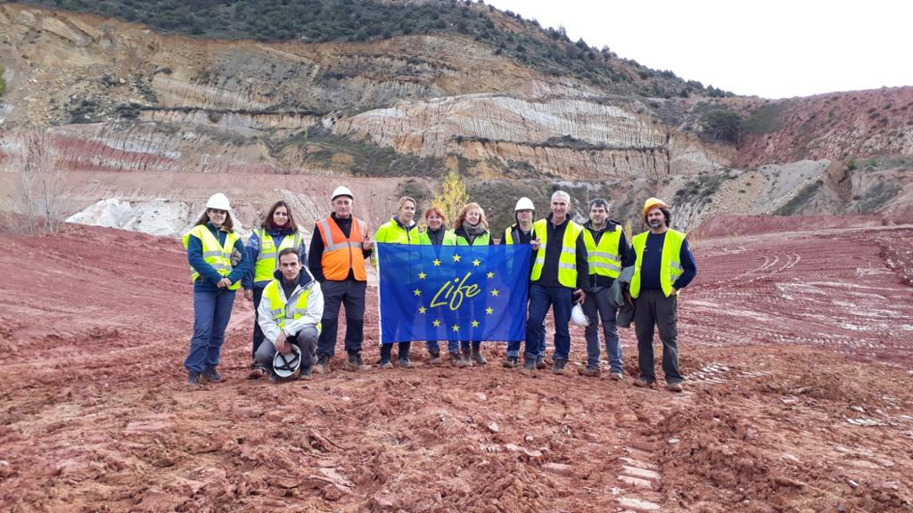
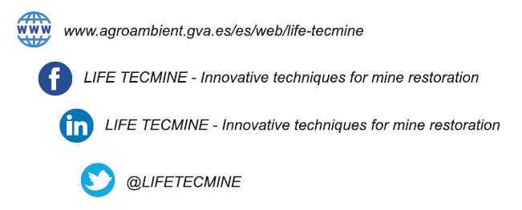
Thank you for your attention
Find out more at: https://agroambient.gva.es/es/web/life-tecmine
Keep in touch: lifetecmine@vaersa.org
Notes:
Wrap-up conclusions
Thank-you (LIFE projects, technical team, SERE organisers, audience).
Reply to our feedback form on sli.do (#LIFEforEcoRestoration)
Follow-up on social media (info-session videos available in YouTube) and visit our website

