Slide 1
Experiences in standardising energy efficiency projects to access secondary markets:
LAUNCH & PROPEL H2020
Covenant of Mayors
15 June 2021
This project has received funding from the European Union’s Horizon 2020 research and innovation programme under grant agreement No 847048.
$$©$$
2021 LAUNCH

Slide 2
Large scale aggregation of Sustainable Energy Assets
About Joule Assets
Who we are and what we do
Joule supports the access to financing for energy efficiency and renewables projects, catalysing the marketplace for project developers and investors to overcome the market barriers that limit financing of sustainable energy projects.
PROPEL →
SEFA
2016
2018
2019
2021
2021
This project has received funding from the European Union’s Horizon 2020 research and innovation programme under grant agreement No 847048.
1
Notes:
Joule’s story and vision

Slide 3
Large scale aggregation of Sustainable Energy Assets
Key Barriers to Energy Efficiency Investments
SUITABILITY
Opportunities need to be located in the right country, at the right time, with the right technology, matching the risk appetite – financing is not only a struggle for the project developers!
CREDIT RISK
The KEY risk category for investors, usually assessed only towards the end of the due diligence process, and often representing an unsurmountable hurdle.
INVESTMENT SIZE
Single projects of <100k€ rarely get financed, as the due diligence costs quickly outweigh the investment returns. Standardization enables project aggregation.
CONTRACTUAL TERMS
Investors require protection from the end-client contract (change in control, occupancy, etc.). Standardization could reduce due diligence costs significantly.
DEBT BURDEN
Many contract types (EnPC, BOOT, ...) transfer ownership of equipment to the end-client, increasing their balance sheet debt. Off-balance sheet solutions address this e.g. through servitization (EaaS, HaaS, ...).
This project has received funding from the European Union’s Horizon 2020 research and innovation programme under grant agreement No 847048.
2
Notes:
Joule’s story and vision

Slide 4
Large scale aggregation of Sustainable Energy Assets
LAUNCH H2020
Aggregation of Sustainable Energy Assets as tradable securities, accelerated deal closure, and market growth at scale.
Standardised risk assessment protocols
Project developer and pipeline growth
Investor-grade Energy-as-a-Service contract
Securitization of EE projects
Scalability
Accelerated deal closure
Market growth
This project has received funding from the European Union’s Horizon 2020 research and innovation programme under grant agreement No 847048.
3
Notes:
Talk about the material

Slide 5
Large scale aggregation of Sustainable Energy Assets
Key achievements
12bn+ € AUM
360+
25+
12bn+ € AUM
Stakeholders engaged
Members of the
Investor Board
Represented in the
Investor Board
15-20m €
9
50m+ €
Projected investments
triggered
Sisters projects
Project volume impacted by LAUNCH materials
6
> 30
500
Languages in which LAUNCH material is available
Events attended
& (co)organized
Twitter followers
This project has received funding from the European Union’s Horizon 2020 research and innovation programme under grant agreement No 847048.
4
Notes:
Talk about achievements

Slide 6
Large scale aggregation of Sustainable Energy Assets
Pilot Map
12bn+ € AUM
Investor
Project Developer
Association
This project has received funding from the European Union’s Horizon 2020 research and innovation programme under grant agreement No 847048.
5

Slide 7
Large scale aggregation of Sustainable Energy Assets
Case Study A
LAUNCH contract and “as-a-service” business model
Transport trucks (Austria) and public buses (Poland)
July/August 2021
Initial pilot size: 11,4m€ - total current pipeline: 335m€
Green mobility: transforming diesel vehicles to electric vehicles
Current stage: Origination (down to the final details of the agreement - duration of the contract, price/km, etc.)
This project has received funding from the European Union’s Horizon 2020 research and innovation programme under grant agreement No 847048.
6
Notes:
Joule’s story and vision

Slide 8
Large scale aggregation of Sustainable Energy Assets
Case Study: B
LAUNCH sales material
Tertiary sector and C&I clients in the UK
Q2-Q3 2021
Initial pilot size: 1m€ - total current pipeline: 7m€
Deal closure 2018-2020: 160k€
Increased sales volume 10x, deal closure 6x in Q2/Q3 of 2021 alone
Critical mass a key criteria for refinancing their pipeline with a new investor
This project has received funding from the European Union’s Horizon 2020 research and innovation programme under grant agreement No 847048.
7
Notes:
Joule’s story and vision

Slide 9
Large scale aggregation of Sustainable Energy Assets
Case Study: C
LAUNCH Risk Assessment Protocol
Public and private sector, with a focus on UK and Italy
Throughout 2021
Initially 2-10m€, now 100m€+ of funds earmarked for sustainable energy assets
Using the credit risk module from the RAP as the in-house pre-qualification tool on their deals.
Very engaged in the RAP development and dissemination
Seeing clear value in its widespread adoption by project developers
This project has received funding from the European Union’s Horizon 2020 research and innovation programme under grant agreement No 847048.
8
Notes:
Joule’s story and vision

Slide 10
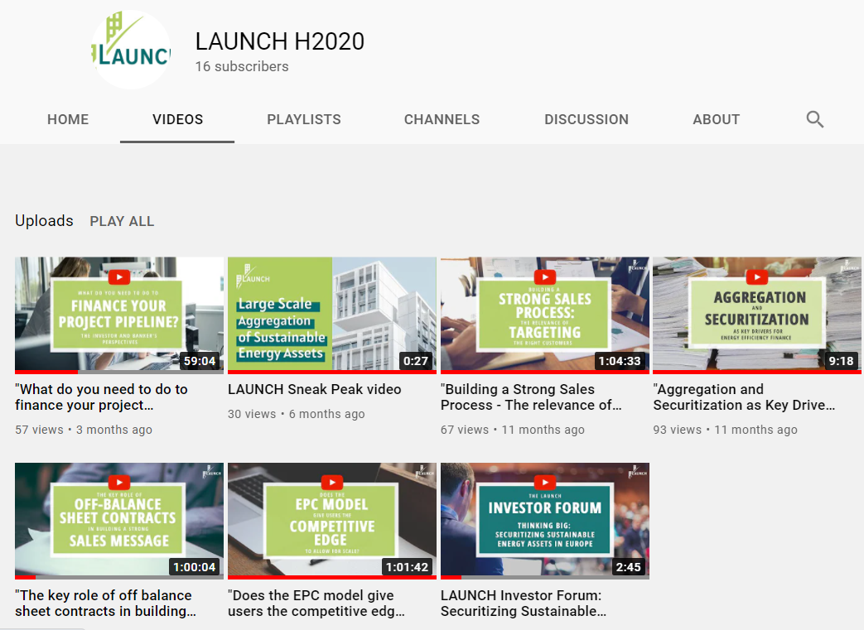
Large scale aggregation of Sustainable Energy Assets
12bn+ € AUM
Education as a project pillar
This project has received funding from the European Union’s Horizon 2020 research and innovation programme under grant agreement No 847048.
9

Slide 11
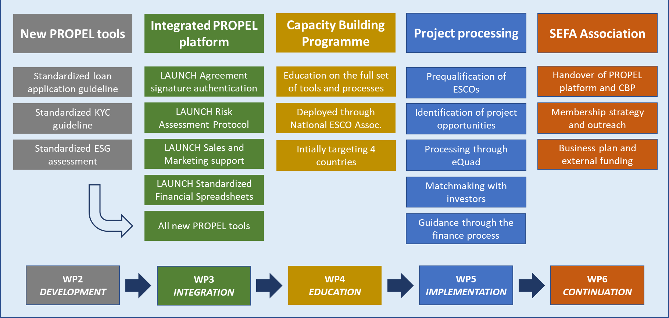
Large scale aggregation of Sustainable Energy Assets
12bn+ € AUM
PROPEL H2020
Energy Efficiency Finance
PROPEL will build on existing tools developed in LAUNCH to create an eco-system for energy efficiency projects deployment.
Its mission is to ensure long-term exploitation through incorporation into the SEFA association
This project has received funding from the European Union’s Horizon 2020 research and innovation programme under grant agreement No 847048.
10

Slide 12
Large scale aggregation of Sustainable Energy Assets
12bn+ € AUM
SEFA
- the Sustainable Energy Finance Association
End-client representatives
Standardised collateral
Representation of the industry at EU level
ESCo associations
SEFA
Training opportunities
Partner banks
Accreditation of project developers
Financial funds
Matchmaking of stakeholders and projects
Project developers
Custodian and mediation services
This project has received funding from the European Union’s Horizon 2020 research and innovation programme under grant agreement No 847048.
11

Slide 13
Thank you!
Michael Pachlatko
European Director
Joule Assets Europe
mpachlatko@jouleassets.com
$$©$$
2021 LAUNCH
2019 LAUNCH
$$©$$

