Slide 1
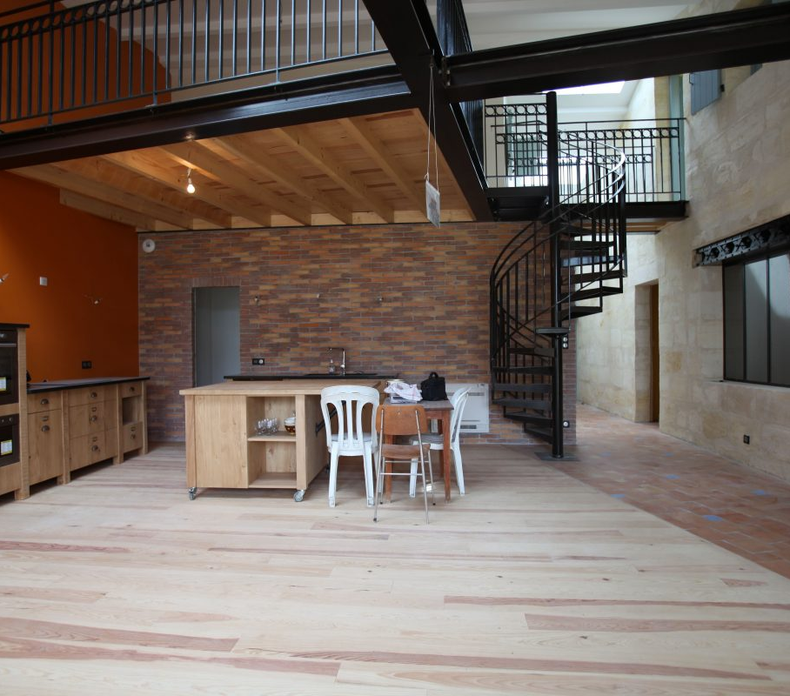

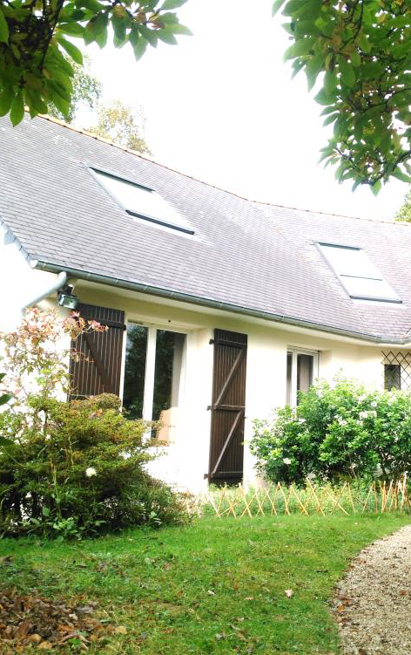


Originating
Retrofits and Financings for
Energy
Efficiency
Pouget Consultatns
ORFEE
MO : Paris Habitat OPH – Architecte : NP2F

Slide 2
Agenda
  Third-Party financing companies in France
  ORFEE objectives
  ORFEE works in progress
    A shared data base
    An Energy-efficient renovation quality and compliance control framework
    A guarantee of compliance and quality of renovation works
  Stakeholders feed-back
2021 June 15
orfee-project.com/
2

Slide 3
Third-Party financing companies in France
Legislative definition and implementation

Slide 4
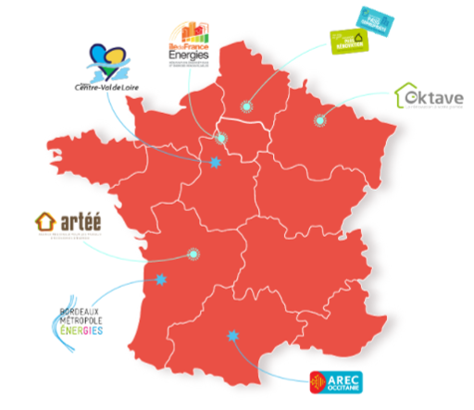
Third-Party financing companies
Concept defined by law in 2013 and further specified in 2015
    Sociétés de tiers-financement have to include:
      a technical assistance for energy renovation works
      a financing offer
      They may issue renovation loans if they are controlled by local authorities
… are typical integrated home renovation services
2021 June 15
orfee-project.com/
4

Slide 5
Third-Party financing companies
French context
Regions initiatives suported by ministry and State agencies as experimentations
But…
national incentive scheme conducive to step-by-step renovations
The ability of Tird-Party financing companies to offer direct financing, as an exception to the banking sector, is not well accepted
Shift in 2020 with the Citizen’s Climate Convention?
Climate and resiliency law under discussion brings a focus on deep refurbishments and an obligation to use technical assistance to benefit from incentives
… may become more favourable to deep EE renovations
2021 June 15
orfee-project.com/
5

Slide 6



H2020 Project:
  Building the
  Office for Renovations and Financing for Energy Efficiency
  The resource center to strengthen third-party financing companies
Build a resource center (ORFEE) for third-party financing companies
Optimise the financing offered by third-party financing companies for energy renovations
Define a frame of reference for the quality of renovation works
2021 June 15
orfee-project.com/
6

Slide 7
ORFEE works
A shared database
The architecture of a common FTS database is being defined under a call for projects by ADEME
Take-over by
An ongoing reporting tool
Energy performance and credit risk analyses
Feed national and European databases (DEEP)
A key asset for ORFEE resource centre
Converging on shared methodologies
from definition of data
to reporting formats
Consistency checks
2021 June 15
orfee-project.com/
7

Slide 8
ORFEE works
An Energy-efficient renovation quality and compliance control framework
The main goal of the quality and compliance control framework, is to keep in balance :
Cost
Competence
Legal responsibility
Quality = confidence
Compliance = performance
2021 June 15
orfee-project.com/
8

Slide 9

ORFEE works
An Energy-efficient renovation quality and compliance control framework
The idea is not to redefine construction standards and practices, but to design the framework upon them, make it a “minimum viable checklist”
In order to drive safely, you need to know how to:
Perform a regular inspection of your car vital aspects (tire wear, oil level, lights, …)
Respect the road safety rules
What you don’t need to know:
The torque needed to secure the cylinder head’s screws
The correct diameter of your windshield washers
etc.
2021 June 15
orfee-project.com/
9

Slide 10
ORFEE works
An Energy-efficient renovation quality and compliance control framework
The framework brings together controls that are linked to different existing regulations, accepted practices, etc:
ORFEE’s quality and compliance framework
Regulations
Official accepted practices
Guidelines
Product Technical Evaluation
Business tools
etc.
Insulation
HVAC
Roofer
Etc.
2021 June 15
orfee-project.com/
10

Slide 11
ORFEE works
An Energy-efficient renovation quality and compliance control framework
A risk oriented approach…
…in order to identify the causes…
…and design the
associated control framework
Energy perform.
SF
MF
There are numerous existing quality and compliance control initiatives, that are recognised as reference.
The aim of ORFEE’s framework is to implement and gather them in an holistic approach covering the whole lifecycle of a renovation project.
Cause 1
Technical & Patrimonial
Health
Cause 2
Cause 3
Feas. | Engineer. | Tendering | Constr. | Commi. | Maint.
✔ | ✔ | ✔ | ✔ | ✔ | ✔
…
…
General approach
2021 June 15
orfee-project.com/
11

Slide 12
ORFEE works
An Energy-efficient renovation quality and compliance control framework
IDENTIFY THE CAUSES
15 causes identified, covering
3 cause types which are most critical :
Technical causes
Coordination causes
Use causes
2 cause types which were judged less critical (as potential risks), and will be addressed later on, in a possible 2nd version of the framework :
Financial causes
Legal causes
QUALIFY THE CAUSES
3 levels of risks and the 3 levels of control associated, determined through :
potential risk magnitude
risk frequency
DESIGN THE CONTROLS
For each qualified cause, we determine the associated controls, at each stage of the renovation project :
Level 1 control : direct for each project
Level 2 control : indirect or direct & sampled or supervised autocontrol
Control # | Feas. | Engineer. | Tender. | Constr. | Commi. | Maint.
#1 |  |  | 2 | 2
#2 |  | 1 | 1 | 1
#3 | 1 | 1 | 2
Magnitude
 | Minor | Signific. | Major | Critical
Frequent | 3 | 2 | 1 | 1
Possible | 3 | 2 | 1 | 1
Rare | 3 | 3 | 2 | 1
Frequency
Detailed methodology
2021 June 15
orfee-project.com/
12

Slide 13
ORFEE works
A guarantee of compliance and quality of renovation works
The guarantee will derive from the compliance and quality framework, particularly on the key risk indicators and their associated thresholds
Its main issues are to :
  enable Third-Party Financing Companies to take out a bundled contract
  use the compliance and quality framework as a lever to design an attractive performance guarantee
Marsh is currently testing these proposals with interested insurance companies
2021 June 15
orfee-project.com/
13

Slide 14
ORFEE works
Stakeholders feedback
Orfee launched an enquiry to evaluate service offers from various One-Stop Shops and Third-Party Financing Companies
What are the criteria that make one energy renovation service offer more attractive than another?
How can they be improved?
Proposals for adapting public policies that are crucial for guiding supply and demand
and enable FTS to play their role of Integrated Home Renovation Services
Findings available in English on ORFEE website
Communication and Prescribers
Commitments & labels
Sustainable business model

Slide 15
Thank you for your attention
Francoise.refabert@energie-demain.com
+33(0)6 70 79 19 99
antoine.herve@pouget-consultants.fr
+33(0)2 40 12 21 22
2021 – May 05
https://orfee-project.com
15

