Slide 1
EERAdata DATA-DRIVEN DECISION-SUPPORT TO INCREASE ENERGY EFFICIENCY THROUGH RENOVATION IN EUROPEAN BUILDING STOCK
Covenant of Mayors Investment Forum Energy Efficiency Finance Market Place 2021
Sebastian Botzler
Coordinator, Technical University Munich

Slide 2
EERAdata Project
EERAdata will operationalises the EEfP on a municipal and regional level
It assesses the multiple benefits that arise through energy efficiency measures applied on single buildings
It will create a software solution and related database which helps municipalities and regions to perform these assessments

Slide 3
Energy Efficiency First Principle
Energy efficiency is an energy source in its own right
The IEA called energy efficiency the “first fuel” in 2013
It showed that energy savings from efficiency measures exceeded the output of every other fuel in 11 IEA countries from 1974-2010

Slide 4
Is the Energy Efficiency first Principle the right approach?
… there is need to gather the evidence on the benefits of EE in ecological and socio-economic terms as well as on its interactions with the broader policy context and energy market
Notes:
Is the energy efficen

Slide 5
EERAdata in a Nutshell
We assist municipalities with the collection of their building stock data from different sources,(merging data) and analysis and assessment of this data by ecological, economical and environmental criteria.
We’re developing a tool to ease the process of guiding sustainable renovation activities for portfolio managers, city planners and related stakeholders
This results in long-term renovation strategies, focusing on energy efficiency, socio-economic benefits and ecological quality of existing buildings

Slide 6
EERAdata Methodology

Slide 7
Outputs of EERAdata
Scientific calculation methodologies to assess EE in the economic, social and environmental sectors
Parameter and indicator list for socio-economic and LCA assessment
Semi-automated assessment tool
Comprehensive database with default and proxy values
Implementing Guidelines and Long-Term strategies

Slide 8
EERAdata Consortium

Slide 9
EERAdata Implementation
Partner municipalities will participate to the design of the tool and test its application in regional pilots.
3 Clusters for Implementation
Strong Stakeholder network
Collaboration outside the consortium
Workshops
Symbiosis with other projects
The pilots will be part of a wider process of stakeholder engagement aimed at ensuring the usefulness of the different instruments, their applicability across different geographical and economic contexts, and its adoption beyond the life-span of the project.

Slide 10
EERAdata Integration

Slide 11
Collecting data
USERS EERAdata Municipalities/ Regions
Municipal data (statistics, etc)
Scientific data
EERAdata DST
Metadata
User data
Algorithms
Renovation measures
Calculation methods
Reporting functions
GIS
Building stock data
Models and simulations
Link to database
Data collection Onboarding
Socio-economic data
Statistical data
Manual entry
Environmental data
Experimental data
Policy and regulation data
Knowledge data

Slide 12
Data collection support
Iterative improvement, indicating desired data
semi-automated
transfer into Template
accompanying
guidelines
Data situation in municipalities is often scattered
Minimum Requirements
Indication of error and precision of input data
Notes:
We provide semi-automated templates, how-to guidelines and calculations to estimate data to collect the data
It defines which data is desired to improve the results
And it delivers infromation with which data the result can be improved and how big the error is

Slide 13
Collecting data
Real data (From Municipality)
Data describing the project building
e.g. coordinates, building materials, geometry, fuel source, heating system, ventilation system, window size, occupancy, lighting system, energy use, electricity use, building age, internal termperatures, etc.)
Default data (from EERAdata)
We define defaults for all datasets, in case the municipality does not monitor or assess the parameters. Defaults are based on international values or scientific models and will be adjusted to the local characteristics and building types

Slide 14
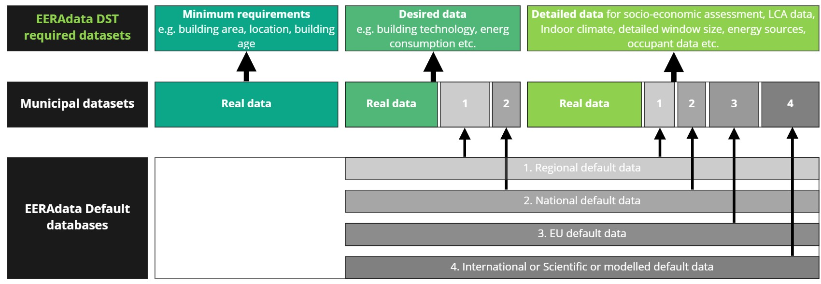
Data gaps and default data
Notes:
Data situation in municipalities is often scarce
If all minimum requirements for a building have been collected
We can fill the gaps in the real data with defaults, estimates and statistically adapted values from the ever expanding EERAdata database. This database is also available as a single unit.
When the gaps a filled with for example regional or national defaults the assessment can be performed and the precision of the result is communicated

Slide 15
What do we assess?
Life-Cycle-Assessment
Data preparation
Energy demand and consumption calculation
Environmental impact
Embedded energy
CO2 emissions
LCA of building technology
Socio-Economic Assessment
Supply Side Assessment
Indoor Climate -Assessment
Simplified supply-side model
Counterpart
Energy-efficiency vs. Supply side
Cleaning
Development of database
Validation
Static modelling
Building specific
Energy consumption
Energy demand
Energy sources
Quantification and monetisation of wider benefits
Bayesian network approach
Knowledge based
Rankings and factors
Productivity effects
Well-being
Health effects
Monetisation of indoor climate effects

Slide 16
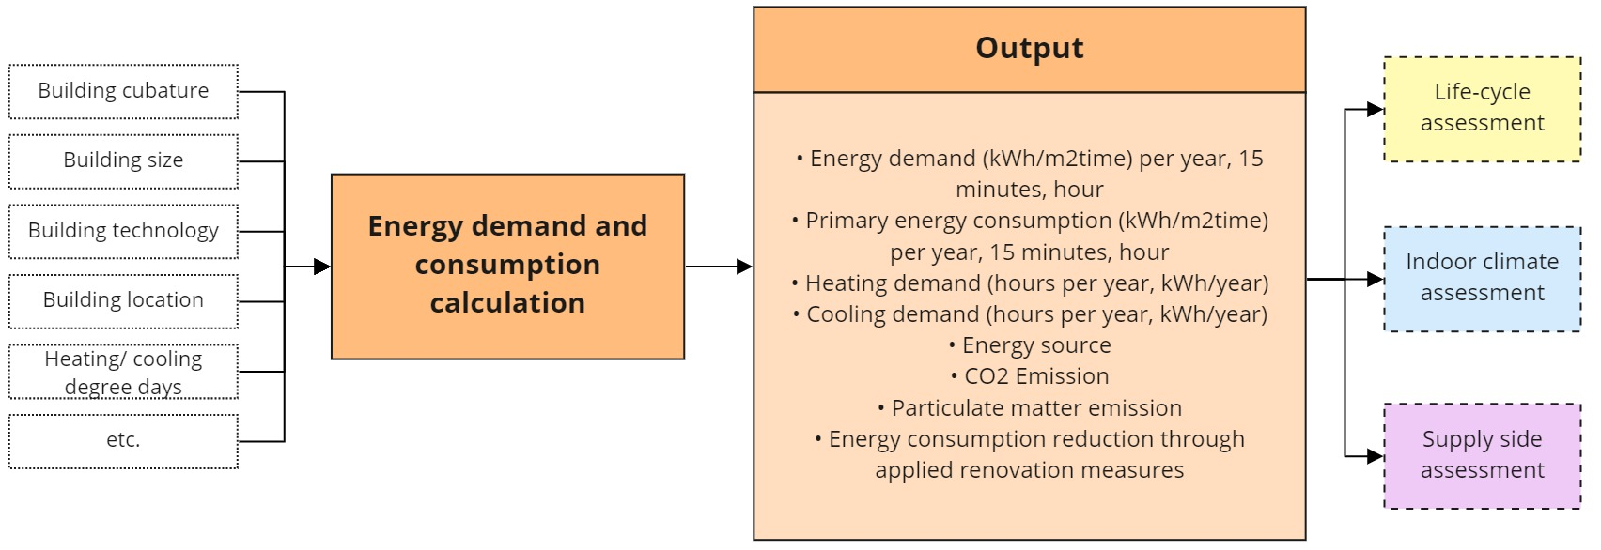
Energy demand module

Slide 17
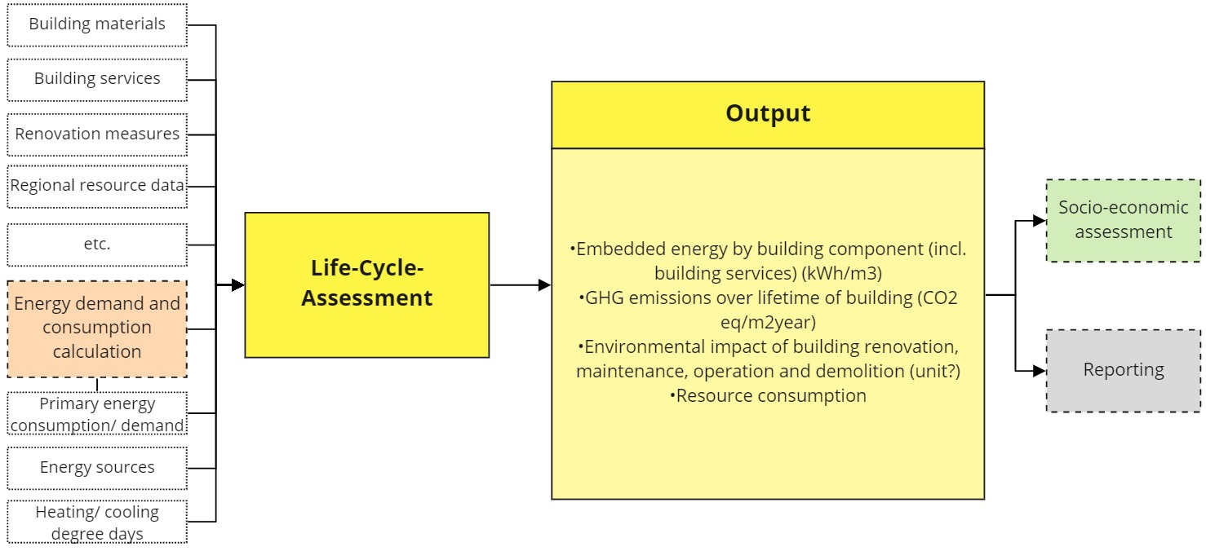
Life-cycle-assessment module

Slide 18
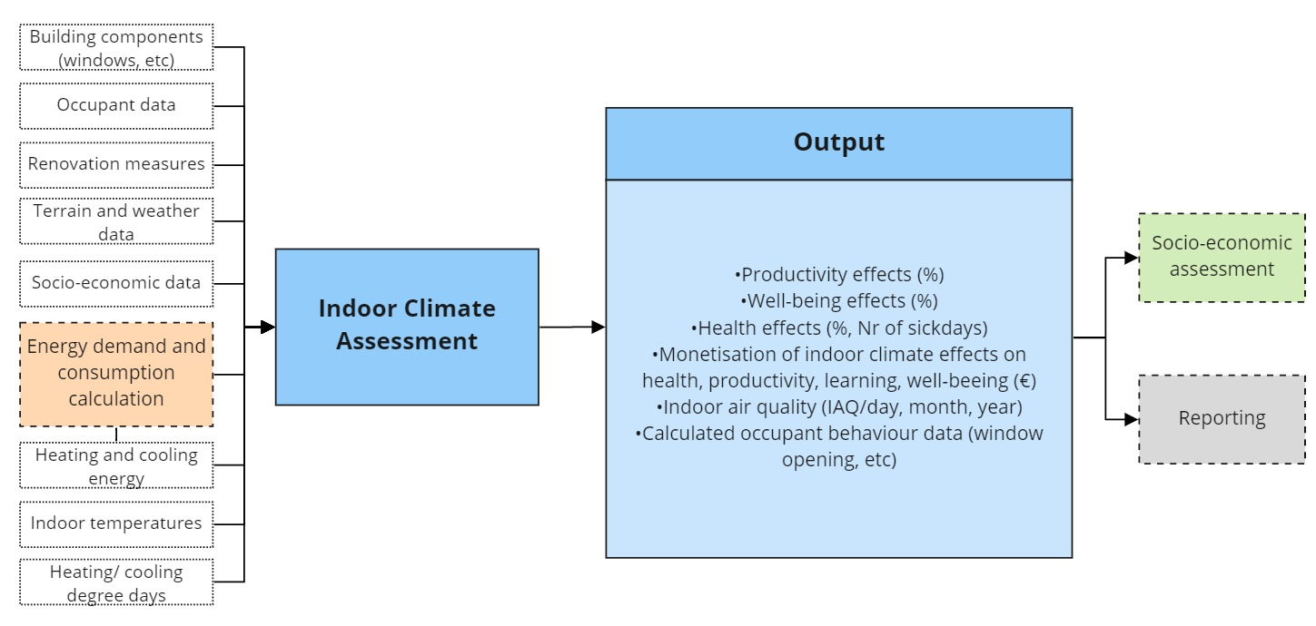
Indoor climate module

Slide 19
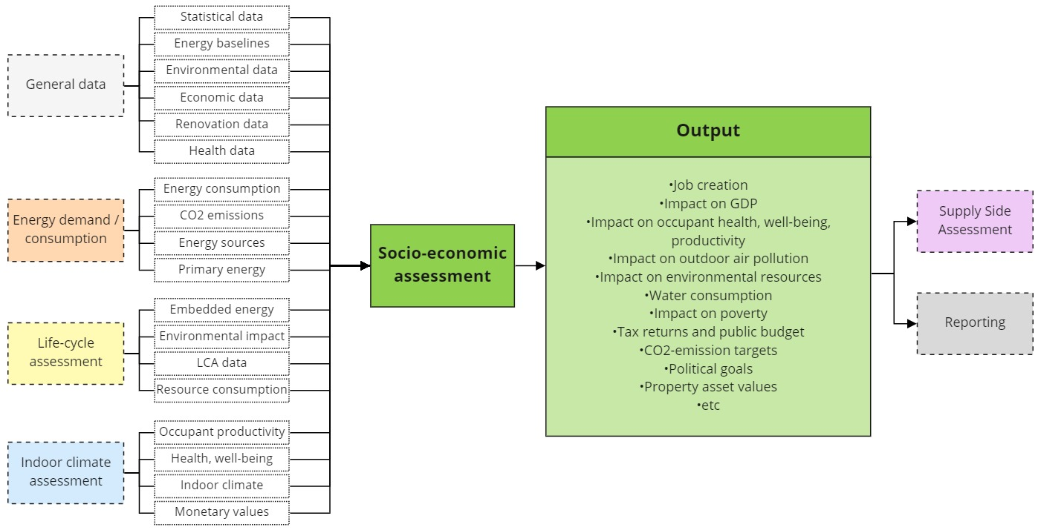
Socio-economic module

Slide 20
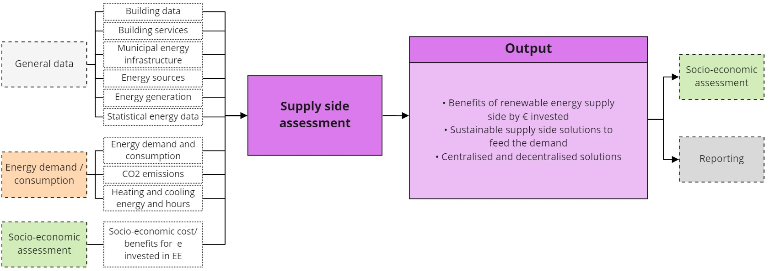
Supply-side module

Slide 21
Tool architecture

Slide 22
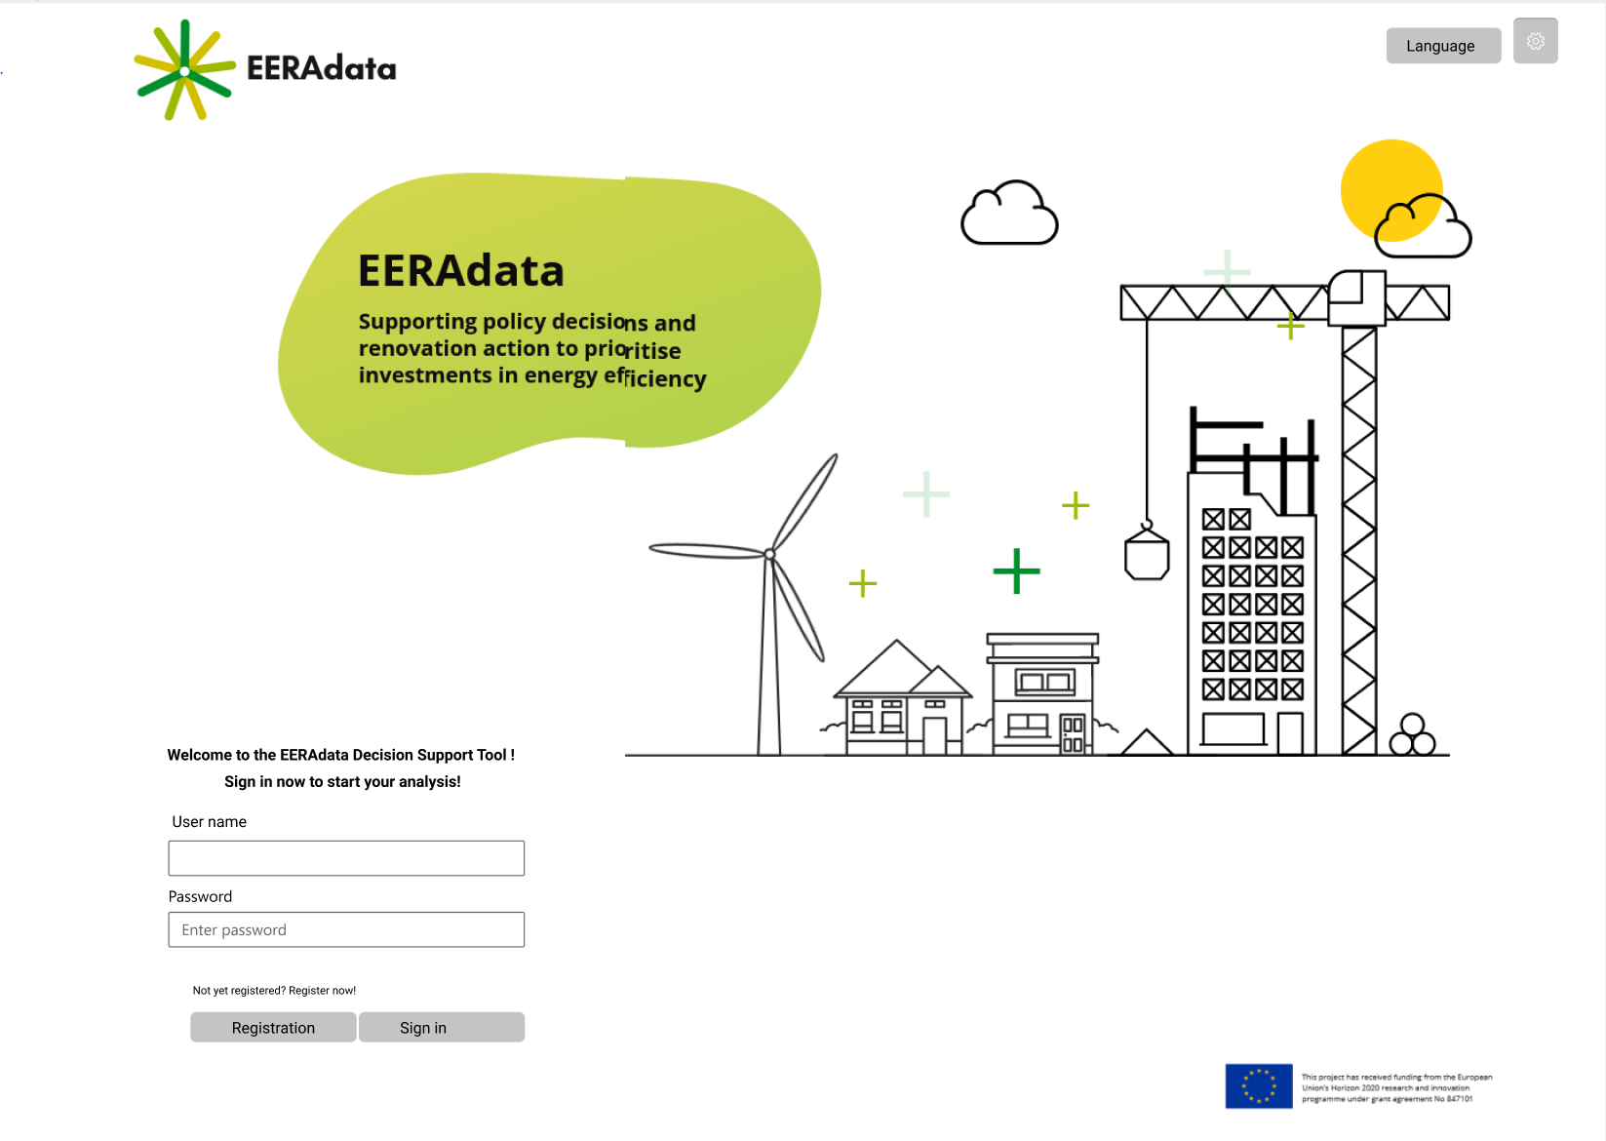
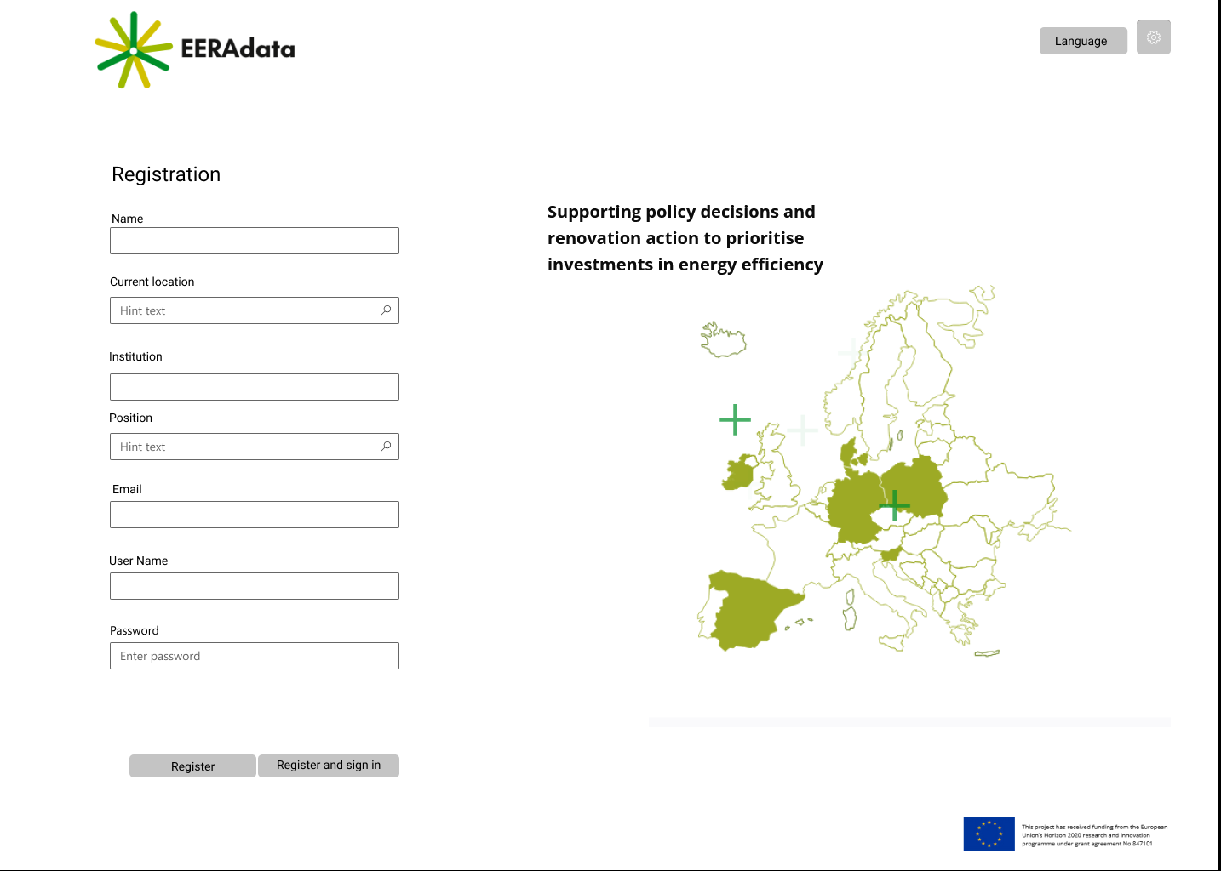
Interface

Slide 23
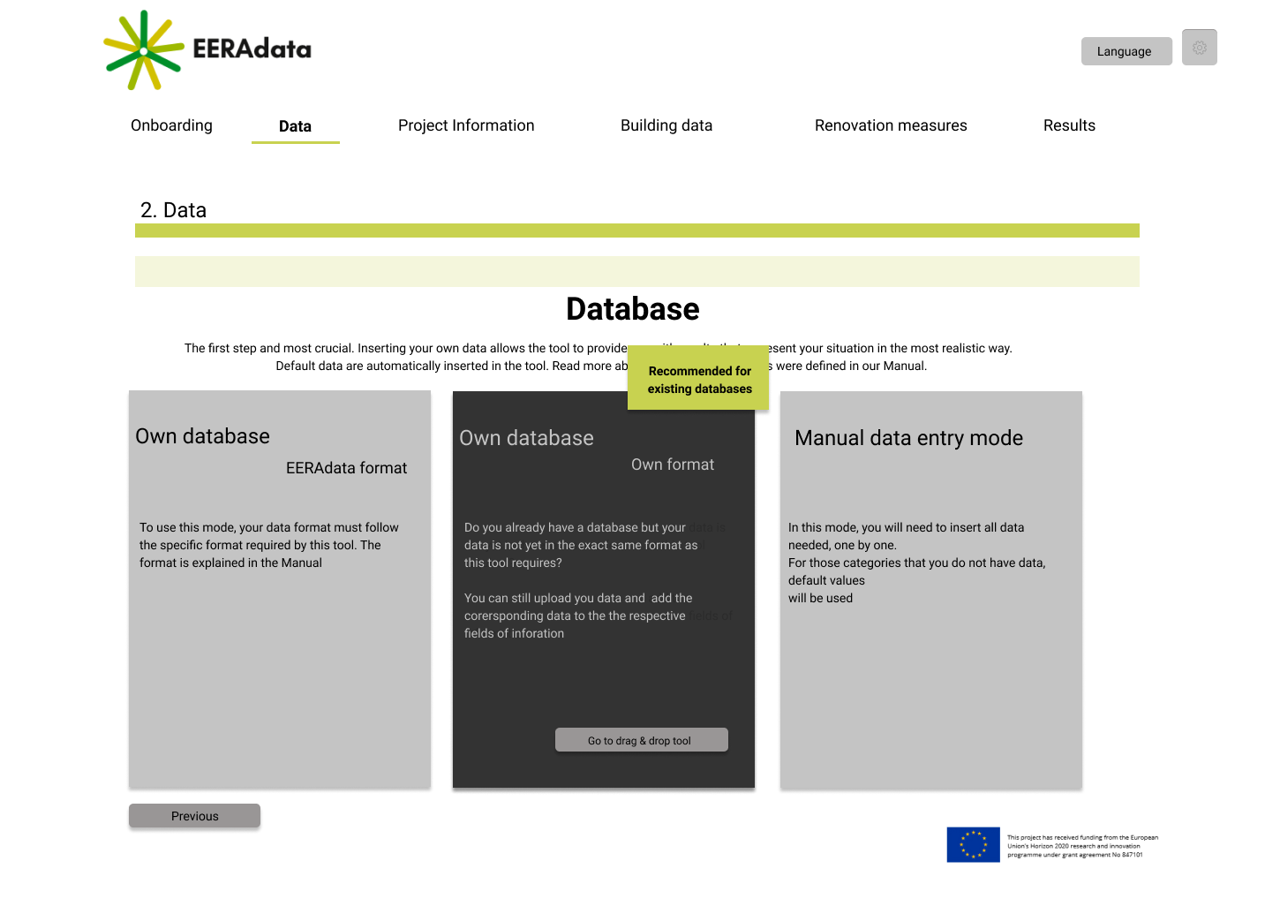
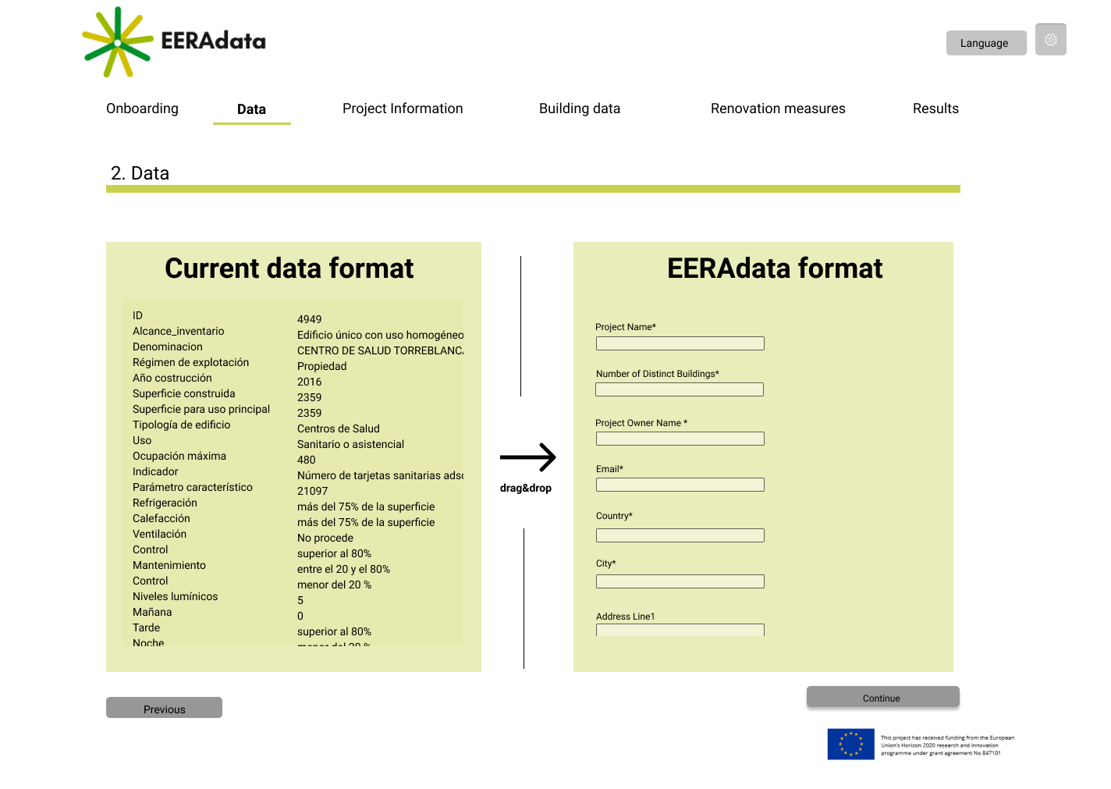
Interface Integration of database

Slide 24
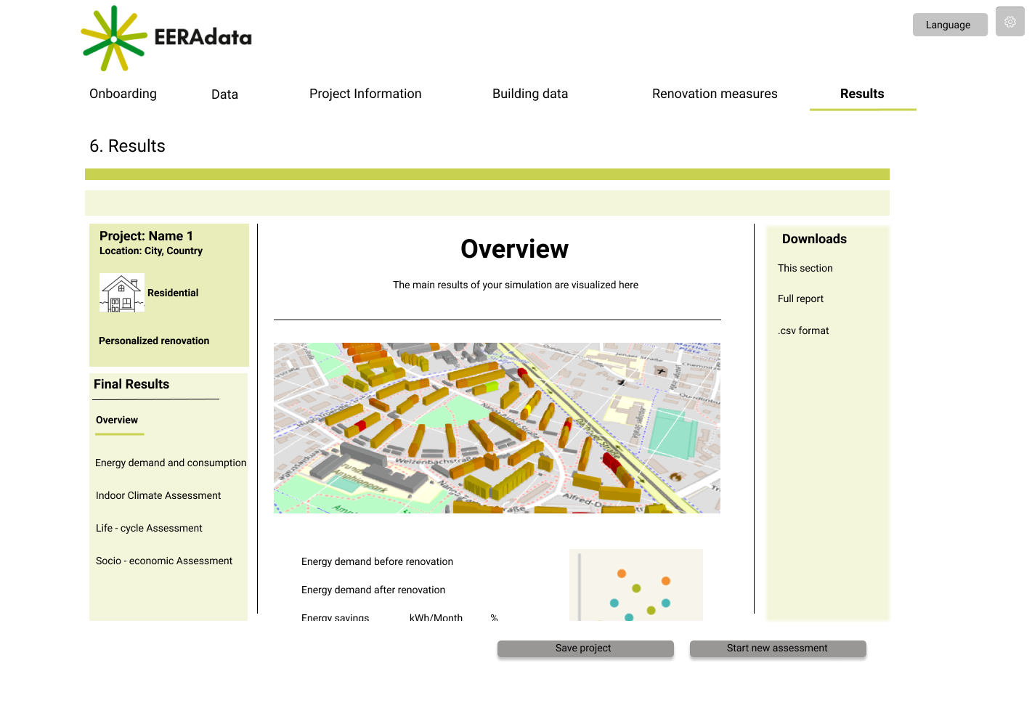
Interface Results page

Slide 25
How to engage
EERAdata goes public: Introducing the EERAdata Decision Support Tool We are delighted to invite you to our public webinar on June 2, 2021 at 11:00 CEST.
Registration link: https://tum-conf.zoom.us/webinar/register/9416183923936/WN_0Ly7DxzJT9qrwD0Fs6f4xw
1st national training sessions and DST showcase In our regional networks in Spain, Denmark and Slovenia: June 22, 2021
More information:
https://eeradata-project.eu/

Slide 26
Thank you
Contact:
Sebastian Botzler
Technical University Munich
botzler@tum.de

