Slide 1
One-Stop Shop
for Efficient Renovation
in the Grand Est Region
Notes:
Good afternoon ladies and gentlemen / Hello everyone
My name is Matthieu FLAHAUT and I am the operational manager of Oktave. I have been working on the Oktave project for over 7 years now
I am very pleased to be able to present Oktave to you today and I I thank the conference organizers for providing me with the opportunity to do so.
I am with Gabriel QUENTIN, our technical manager, who is as well part of the projet for a long time now.
Our presentation will last about 30 minutes and then we will answer your questions.
With that, let’s start the presentation

Slide 2
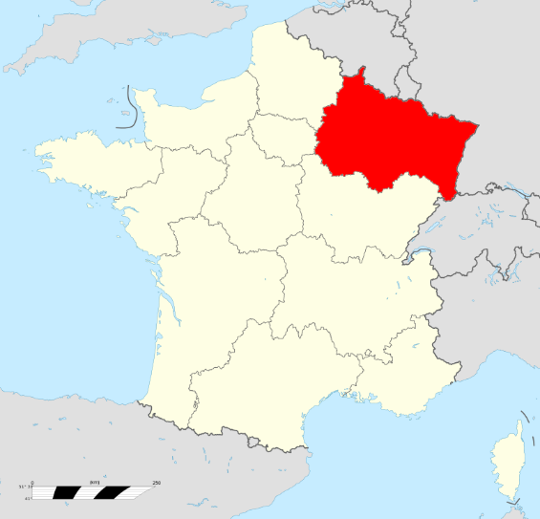
WHO IS OKTAVE ?
One-stop shop for efficient renovation of housing
Semi-public company
Created in June 2018
Shareholders :
Local authorities of Grand Est
Notes:
First I propose a short presentation to set the context.
Oktave is a project created by the Grand Est region in 2014 as an experiment for conducting housing renovations.
The Grand Est region, the one you can see red on the map, is a local authority and one of the 10 administrative regions in France, more or less equivalent to the German länders or the Spanish autonomous communities.
The French Regions are particularly responsible for Territorial Development and Environment
Oktave was designed as a one-stop-shop for the energy renovation of housing. Oktave is there to provide citizenZ / with appropriate answerZ / to renovation issueZ.
In 2018, Oktave became a semi-public company whose majority shareholder is the Grand Est region. The 3 private shareholders are 2 banks, whose one of them is public, and a real estate company. The commercial activity of the company really started mid-2019,

Slide 3
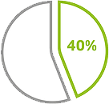
WHY OKTAVE ?
LTECV, SNBC, SRADDET
Housing = 40% of final energy consumption in Grand Est
Legislative commitment : low consumption renovation of the french housing stock by 2050
45 000 housing to be renovated per year by 2050
Notes:
Oktave was created as a tool to respond to energy and climate issues related to housing.
Housing is one of the most energy-intensive sectors. It represents nearly 40% of final energy consumption in the Grand Est.
Most of the residential stock was built in before the 80s and is inefficient in terms of energy. Nearly 45% of housing have energy class E, F or G and only 10% of housing have energy class A and B.
inally, the last reason is the necessity to comply with the commitments of the Paris Agreement, and with several national laws and regional plans. These commitments require all housing to be renovated to a low consumption level by 2050, which represents nearly 45,000 housing units to be renovated for the Grand Est per year.

Slide 4
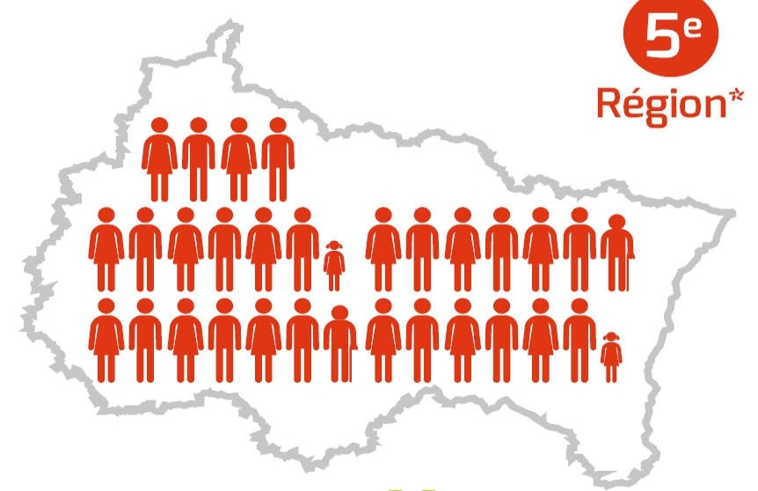
WHY OKTAVE ?
TODAY
TOMORROW
Heating expenses : 2.5 billion €/year
(~2000€/house/year)
1.3 million houses
45 000 renovations/year
Works contrats :
2 billion €/an
Notes:
As I said, the main goal of Oktave is to reduce energy consumption but it is also to turn energy spending into renovation investments.
You may ask, what are the local economic benefits of renovation projects ?
First, employment. In the building sector/ it iZzz estimated that € 60,000 (Sixtee thousand) turnover / usually generates 1 job.
Second, economic dynamism. The energy renovation market iZz / indeed / a breeding ground for economic activity.

Slide 5
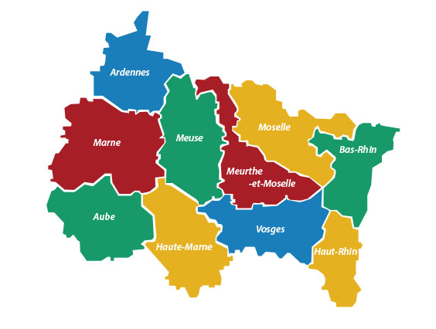
OKTAVE TEAM
26 employees
Head office (Strasbourg)
General, operational and technical management
Financing advisor
12 individual housing renovation advisors (hosted by local authorities)
8 condominium building renovation advisors (by sept. 2021)
Notes:
Who embodies Oktave on the ground ?
The Oktave team currently has 26 people. The organization is mainly decentralized as you can see on the map.
The head office is based in Strasbourg and brings together general management and technical and financial support.
Renovation advisers are located throughout the region and are generally located in the premises of local authorities, to be identified as a trust third party.
To mobilize local ilected representatives, / Oktave relies on two leverZ:
First : the local economic benefits of renovation projects
SeKond : The territorial organization of the company Oktave
Many local authoritieZ/ implement financial incentiveZ / for the renovation of housing
The serviceZ /offered by Oktave / complement theZe aidZ.
And Oktave advisors are immediately available at the local authoritieZ.

Slide 6
OUR SERVICES
Individual housing
Building and
real estate professionnals
Local authorities
Condominium buildings
Copropriétés
Notes:
Oktave offers different support services for different audiences:
support for the renovation of single-family homes and condominiums, which is our main activity
A valuation service for energy saving certificates for local authorities
Training for building and real estate professionals.
I will now give the floor to Gabriel who will present more specifically what we do for individual housing, which is the first mission delegated to Oktave by the Grand Est Region, and the one for which we have the support of an ELENA assistance.

Slide 7
INDIVIDUAL HOUSING
TECHNICAL SUPPORT
DEEP RENOVATION ALL IN ONE
ADMINISTRATIVE AND FINANCING SUPPORT
Notes:
Oktave offers services to owners to renovate their house the most efficiently as possible.
The most efficiently in terms of energetic gain, with solutions to get to deep renovation, and also in terms of time they have to spend for their project.
So we developed for that a turnkey support, deployed in 2 main parts :
- technical support to garanty the quality of the works,
- administrave and financial support to facilitate the realisation of the project.

Slide 8
INDIVIDUAL HOUSING
For thermal work PACKAGES
Definition of the renovation project (work packages, cost estimate, energy assessment)
Administrative work authorization
Consultation of craftsmen and construction companies (quotes)
Works monitoring and management
* Management of non thermal work packages also possible (specific pricing)
Définition du projet de travaux
Consultation des entreprises
Suivi et pilotage des travaux
TECHNICAL SUPPORT
Notes:
On a technical level, Oktave sets A to Z energetic refurbishement processeZ, as a contractor.
So Oktave take the responsability for getting the most ambitious renovation and for checking the quality of the work.
With the owner, we define his project : what he wants to do in terms of energetical works but also in terms of home improvment. This is really important because if we don't consider the entire project of the owner, we are losing him because we are not responding to his entire need.
As a specialist of energetic renovation, we of course give advice for the best works to do and try to convince the owner to do the most ambitious project as possible. But we have to consider his entire project because people generally don't call us only for thermal work.
Once the project well defined, we consult craftsmen to get quotes that the owner can chose and then we organize and manage the renovation works.
That is it for the technical part of our support. At the same time, we provide administrative and financial support for the project so that the work can take place.

Slide 9
INDIVIDUAL HOUSING
ADMINISTRATIVE AND FINANCING SUPPORT
Optimization of the financing plan
Production of grant files
Interest-free grant prefinancing
Banking intermediation for financing of the remainder to be paid (several banking partners and brokers)
Notes:
Our administrative and financial support starts very early in the process.
Once our support contract has been signed, our financing advisor contacts the owner to find out about his personal situation and determine the financing solutions that would suit him.
These financing solutions are the aid that he can obtain but also the type of loan from which he could benefit. To do this, we put them in touch with our financing partners (banks or broker, depending on his situation).
This funding optimization work is handled with our technical support in order to be continuously updated.
On the one hand, the owners can benefit from /an administrative assistance /to prepare both grant fileZ and a financing plaaan.
On the other hand, they may receive grants’ advanceZ from Oktave and adapted financing solutionZ like a zero-interest eco-loan or a renovation loan from our financing partners.
So Oktave is both in contact with technical stakeholders and financing stakeholders of the project.

Slide 10
INDIVIDUAL HOUSING
INTERFACE BETWEEN STAKEHOLDERS
TRUSTED THIRD PARTY
FLAT-RATE PRICING INDEPENDENT OF THE COST OF THE WORK
Notes:
It is one of the key aspects of what is Oktave.
We build relationships among all the stakeholderZ, including
Ownerz,
Craftsmen
Funders
And City council elected officialZ….
and, in doing so, to build trust.
To give confidence to all these stakeholders, we also practice transparent fixed prices which reinforce our role as a trusted third party since our remuneration does not depend on the amount of work carried out.

Slide 11
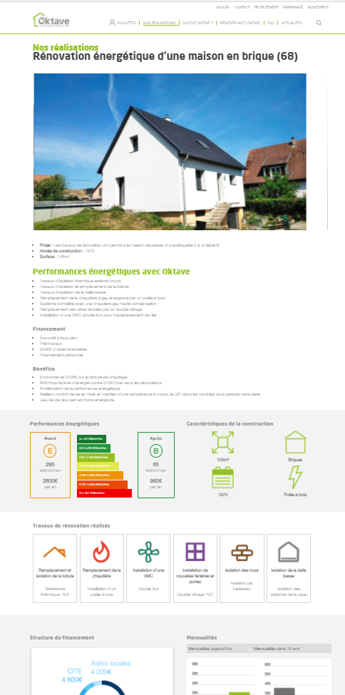
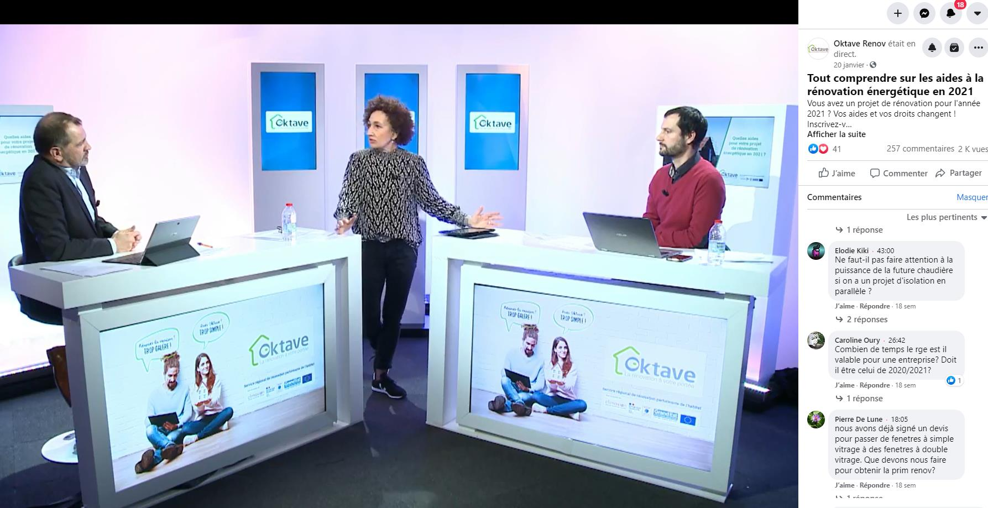
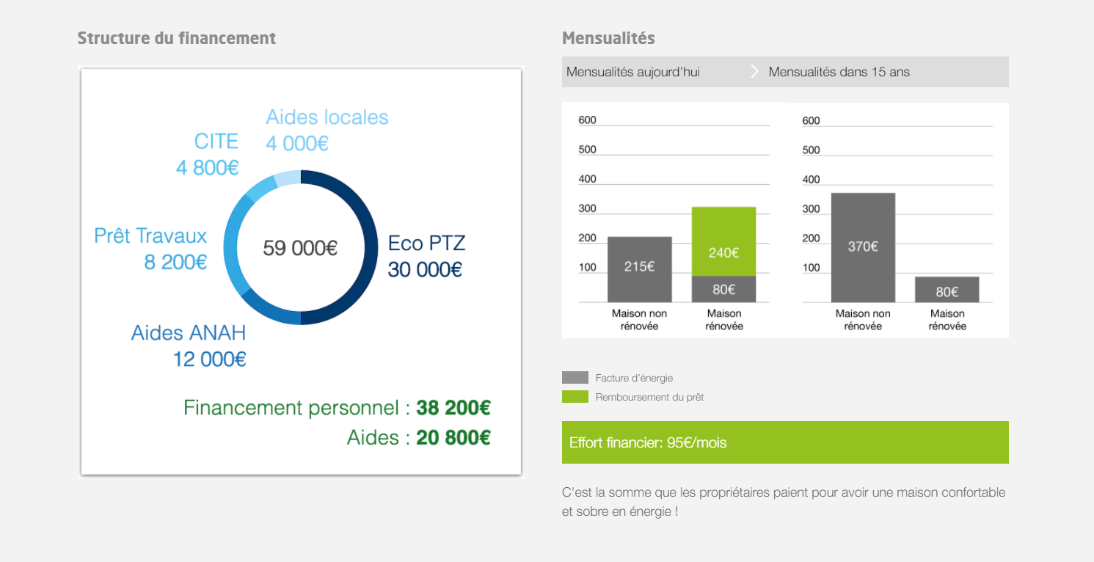
COMMUNICATION
Notes:
But being a trusted third party is not enough to get people calling us directly
So we set up a communication campaign ..
targeting different audiences
and based on different communication aids/tools such as / radio programmes, web series, social networks actions, press reviews and articles.
BUT
the central aspect was conveyed by the tone of the campaign.
INDEED, / It was deliberately self-deprecating as it pointed out the small faults we all have,
like …..
- postponing big and minor decisionZ / especially when Ms (Miz) X and Mr Y do not agree / OR / when they express different needs.
In a renovation project, people often:
do not want to ask for help,
do not want to trust others,
do not want to lag behind,
The tone was neither dramatic nor too formal but rather focused on :
curiosity,
novelty
… and the small faults we all have, ….as I said before.
Also,
what was important / was NOT to provide technical information BUT to anchor the name OKTAVE / in people’s mindZ.

Slide 12
PROJECT QUALIFICATION
1st contact
Phone call with the householder
Technical visit on site
Efficient renovation project
Oktave support contract
Technical and financial visit report
Notes:
We would like to end by briefly introducing our contact qualification process to show you how important our pre-contractual phase is to building trust with owners.
Before signing a contract, the owners generally have a first contact with our assistant, then a telephone meeting with an advisor then an on-site visit by an advisor who finally gives them a financial and technical report of what their project could be.
All this is free for the owners and is necessary to build trust in Oktave, but also in their capacity to manage an ambitious energetical renovation project that they generally haven't thought before.
They only contract with us after that to start directly the study phase of their project.

Slide 13
KEY FIGURES (2020)
2 116 incoming contacts (~500 in 2019)
504 pre-contract technical visits (~100 in 2019)
94 efficient renovation in progress (7,6 M€ of works)
54 efficient renovation completed (4,3 M€ of works)
122 white certificates contracts (118 GWhcumac)
Energy savings : 2 858 MWh/year
GHG emissions avoided : 466 TeqCO2/year
350 partners companies
Notes:
Finally, here are some Oktave balance sheet figures for the year 2020, the first full year for Oktave.
54 projects completed. 94 other projects signed and currently underway.
The start of 2021 is very encouraging since in May we signed as many contracts as in 2020.

Slide 14
One-Stop Shop
for Efficient Renovation
in the Grand Est Region
Contact :
Matthieu FLAHAUT – operational manager / + 33 3 88 10 04 82 / + 33 7 71 54 00 36 / m.flahaut@oktave.fr
Gabriel QUENTIN – technical manager / + 33 6 29 48 82 71 / g.quentin@oktave.fr
Oktave is the regional service for the efficient renovation of housing created at the initiative of the Grand Est Region. Oktave fulfills a mission of general interest by supporting energy renovation in order to reduce energy consumption and aim for carbon neutrality of the residential stock by 2050.
Oktave supports homeowners in the Grand Est region in their renovation project by offering them a set of administrative, technical and financial services.
www.oktave.fr
Notes:
Thank you for your attention.
We are also happy to try and answer any questions you might have.

