Slide 1
Developed & implemented by:
Supported by:
GEFF Romania programme presentation
Covenant of Mayors Investment Forum: Energy efficiency finance market place
16th of June 2021
Yucel INAN – Principal - EBRD
Anamaria STROIA-TILLEY – Sustainability Consultant - Tractebel Engineering

Slide 2
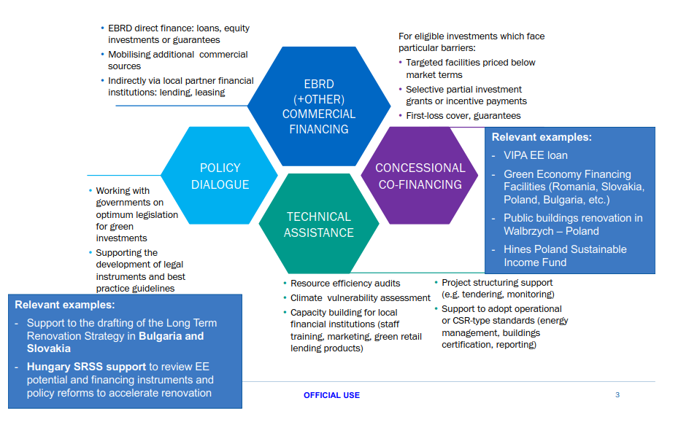
The EBRD business model

Slide 3
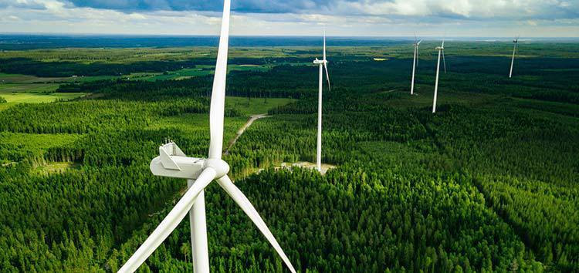
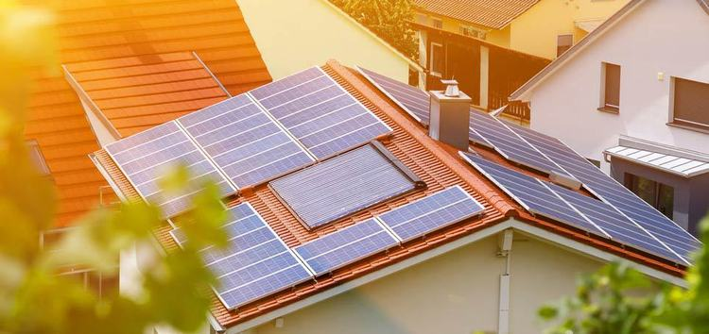
EBRD Green Economy Transition (GET) approach
€35 billion in 2,000 green projects since 2006
GET aims to accelerate the transition to a green, low-carbon and resilient economy and to contribute to achieving a net zero carbon world by 2050.
GET eligible financing to achieve over 50% of the Bank’s annual investments by 2025;
at least 25 million tonnes of emissions to be avoided over the same period.

Slide 4
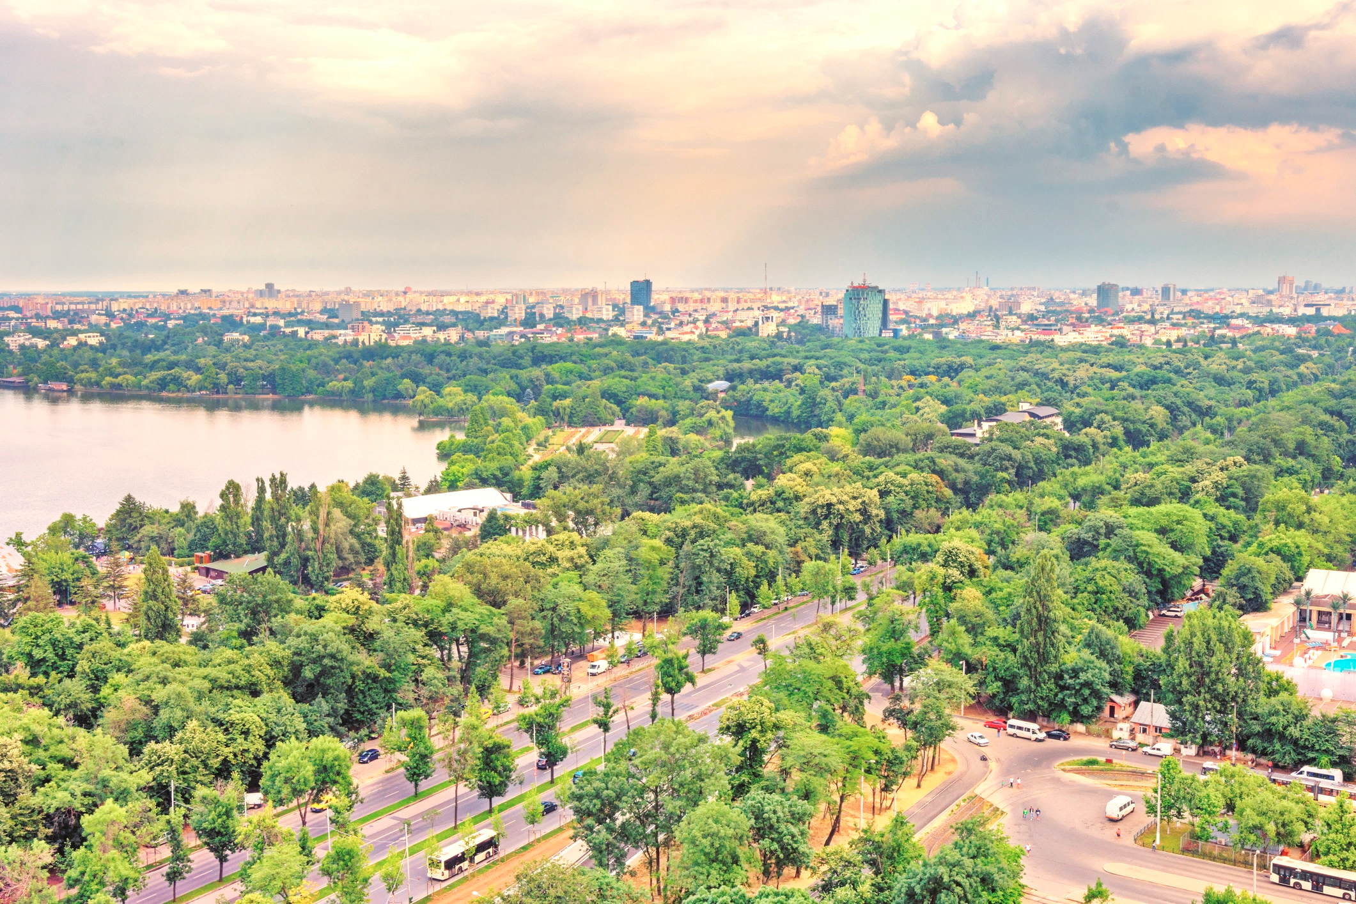
EBRD Energy and Climate Action Cumulative Results 2006 – 2021 YTD – all COOs
FINANCED
2,130+
green projects
600+ credit lines to
local financial institutions
for on-lending to smaller projects.
SIGNED
€37.8 billion
of green financing
For projects with a total value of €235 billion. Average green financing share was 30% reaching 46%
of EBRD’s total business in 2019.
AVOIDED
106 million
tonnes of CO₂/year
More than the annual energy use related emissions of Romania
+ since 2013, helped reduce 430 million m³ in water consumed/year = >1/2 of London’s annual water use.

Slide 5
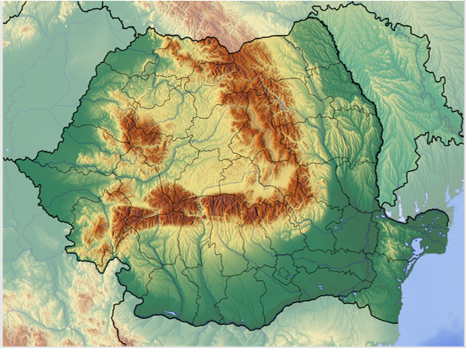
EBRD’s Focus in Romania
Country of operation since 1992
€9.0 billion invested in Romania in more than 460 projects
66% of the EBRD’s cumulative investments in Romania in the private sector
19% of the EBRD’s current portfolio in Romania in equity
€1.9 billion current portfolio of projects, comprised of 168 active operations
Team of 20 bankers in Resident Office in Bucharest

Slide 6
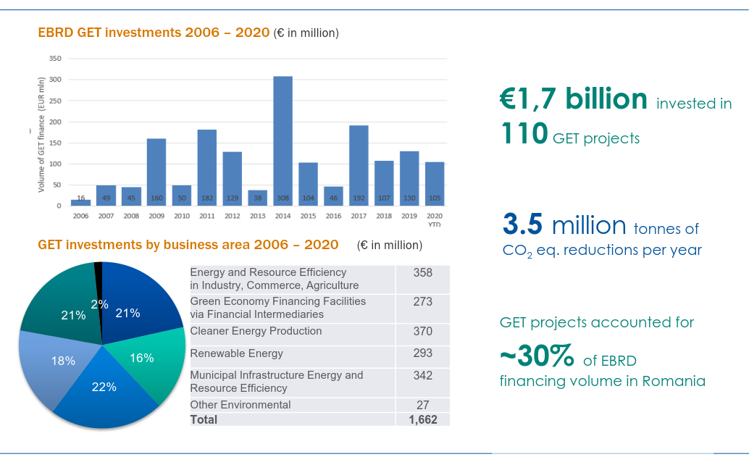
Green Economy Transition Investments in Romania

Slide 7
EBRD Financing in buildings

Slide 8
Introducing EBRD's Green Economy Financing Facilities (GEFFs)
GEFF programmes combine:
Technical know-how transfer through dedicated Technical Assistance:
Capacity building: training staff to recognise green opportunities,
Project development support: direct assessment of larger-scale projects; online databases of pre-approved technologies for small-scale projects
Green finance through credit lines for on-lending to sustainable activities to support end-borrowers’ investments in green projects,
Thus leveraging the reach and network of EBRD’s Participating Financing Institutions, GEFFs can reach Mid-Caps, SMEs and households for green investments.
Guidance and quality assurance management
Credit line with eligibility criteria
EBRD
Technical expertise
Client outreach and project assessment support
Financial institution
Beneficiaries
Project development and optimisation tools
Commercial finance opportunities

Slide 9
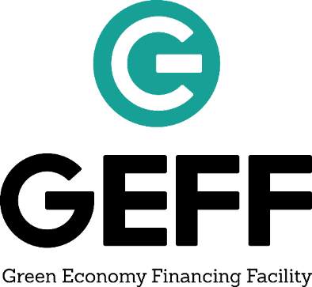
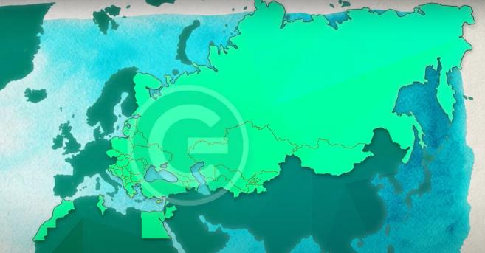
GEFF is a successful regional franchise
155
participating financial institutions
GEFF financing in
27 countries
More than
202,000
Investments financed*
Nearly
€5 billion
Of finance provided
Almost
33 million
MWh of energy saved
per year*
Reduced almost
9 million
tonnes of CO₂ emissions
saved per year*
*The figures correspond to finance provided by the EBRD and its co-financing partners (April 2021)

Slide 10
GEFF Romania at a glance
EUR 100 million credit line facility, available to three Romanian financing partners for on-lending to households, 85 million already disbursed;
Primary energy and CO2 savings (stand 31.03.2021): 37.28 GWh/y and 8,471 t CO₂/y
Organization / participation in promotional events (conferences, fairs) and trainings for PFIs and relevant stakeholders
Donor funded blended concessional co-financing from the TaiwanICDF;
Free technical assistance co-funded by GEF;
Green economy investments in energy efficiency, renewable energy, and water efficiency;
Digital tools to support operations: GEFF website and the Green Technology Selector allow for fast-track approval of loans for purchase and installation of eligible technologies.

Slide 11
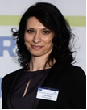
Facility Consultant team
Project Manager
Mark Velody
Project Director
Elena Novac
PFI Relationship Manager Cristina Iliescu
Team of Tractebel engineers
The team will be actively supporting sub-borrowers, partner financial institutions and the EBRD
Senior Energy Efficiency Expert
Anamaria Stroia-Tilley
Lead Engineer Daniela Leonte

Slide 12
GEFF Romania eligibility criteria
Eligible sub-borrower | Individuals, housing associations, businesses (SMEs, corporates), service providers, technology vendors, technology producers that provide eligible goods or services to households EBRD exclusion list applies Private ownership, not majority-owned or controlled by the government
Eligible sub-project | A large scope of green economy investment: not only energy efficiency and renewable energy but also climate resilience measures such as water efficiency Purchase of equipment listed on the Green Technology Selector or eligible equipment as assessed by Facility Consultant (TC) In compliance with Romania’s national legislation
Eligible loan or lease | Investment loans or finance leases Maximum loan / lease amount ≤ EUR 100000 to individuals or group of individuals and ≤ EUR 5 million to housing associations, service providers, vendors. Multiple loans / leases to one client are possible Loans may be used to fund 50% of the Investment Cost of an Eligible Sub-project for vendors and service providers and 20% for individuals

Slide 13
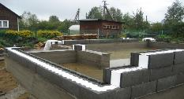
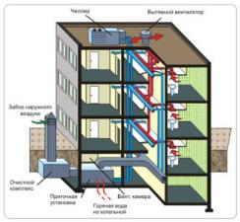
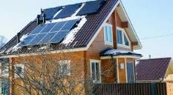
Eligible solutions – Residential and Retail sectors
Construction | Energy efficient residential buildings construction
Building-level measures (residential and commercial buildings) | Thermal insulation of buildings Heating, Ventilation, Air- conditioning and Cooling (HVAC) Renewable energy such as solar water heaters and PV Lighting automation and control Water efficiency solutions
Dwelling-level measures | Insulation of walls, roof and floor Glazing of windows and door Heating system Water efficiency solutions
Businesses in the retail sector | Equipment replacement (chillers, boilers, HVAC)

Slide 14
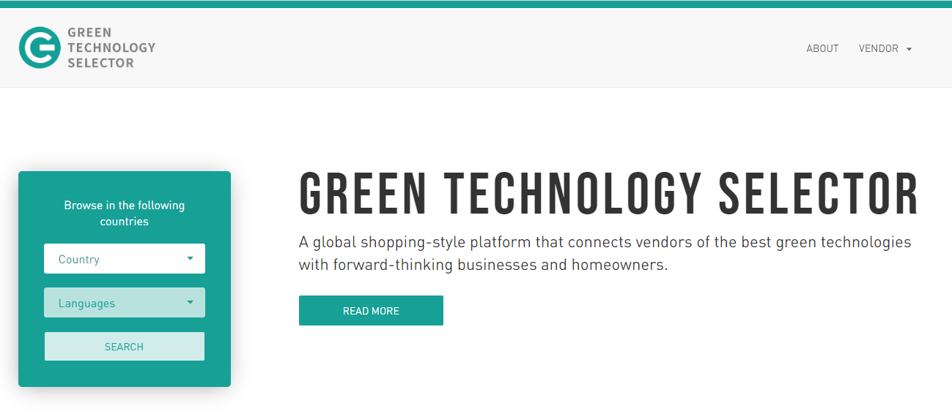
Green Technology Selector (GTS)
An on-line database of best-in-class green technologies, local vendors and manufacturers of eligible technologies
Products listed in the country-specific Green Technology Selector meet technical performance criteria (“pre-approved”) and are considered pre-approved for green financing via local financial institutions
Local vendors of eligible products are encouraged to register for free their technologies with this tool to make the best ones more visible to prospective local clients.
The Green Technology Selector was developed by the European Bank for Reconstruction and Development (EBRD) and supported by the Austrian Federal Ministry of Finance.​

Slide 15
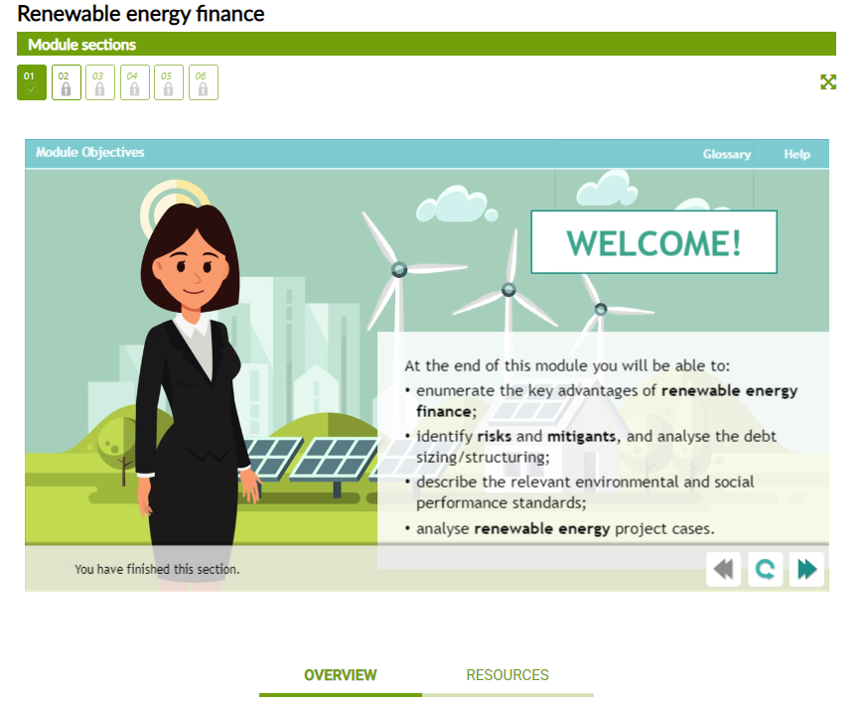
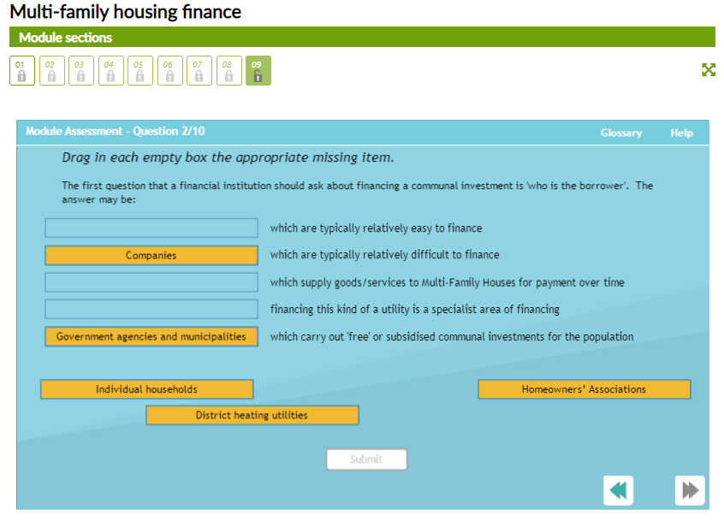
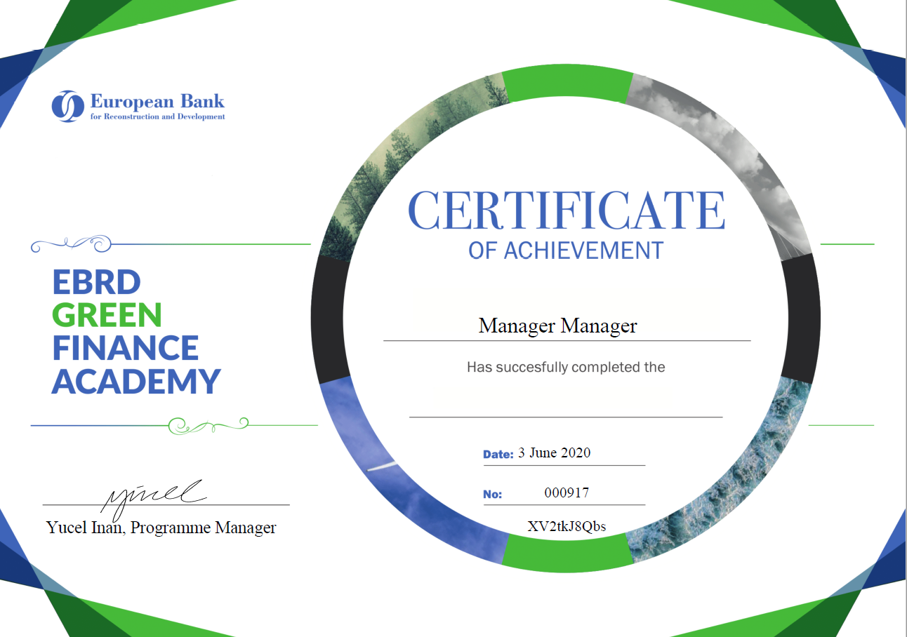
EBRD Green Finance Academy
Free online education platform for partner banks
draws on the extensive EBRD green finance knowledge and experience
online animated modules that are easy to understand and provide an interactive learning opportunity for the audience.
Courses cover green finance opportunities, sectors for financing, marketing messages, etc.
e-learners obtain their personalized EBRD Green Finance Academy Certificate.
PUBLIC

Slide 16
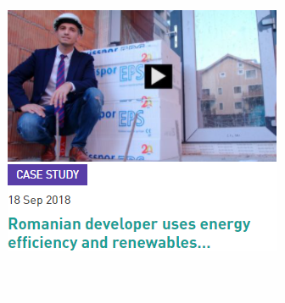
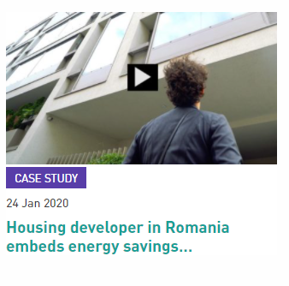
Are you willing to get a green loan for your apartment building?
Please visit our websites:
Official Website of the Facility: https://ebrdgeff.com/romania/
Green Technology Selector: https://techselector.com/romania-ro/
GEFF Resources: http://ebrdgeff.com/romania/projects/
Video case studies:

Slide 17
Supported by:
Thank you for your attention!
Please contact us at:
6, Alexandru Constantinescu Str., Bucharest
031 224 8104
romania@ebrdgeff.com

