Slide 1



Introducing Energy Performance Contracting in Latvia - a Case Study
Claudio Rochas
Nicholas Stancioff
This project is funded by the Horizon 2020 Framework
Programme of the European Union under grant agreement No. 754080

Slide 2

  Deep renovation of 41,300m² of PB
  Deep renovation of 132,000m² of MFB
Deep renovations
of Public Buildings and Multi-Family buildings using long term
Energy Performance Contracting
  Approximately €20.5m in MFB
  Approximately €6.7m in PB
  20.9 GWh/year of primary energy savings in MFB
  6.5 GWh/year of primary energy savings in PB
To rollout the Latvian Baltic Energy Efficiency Facility
Ecosystem development
Net Zero at Net Zero Cost
It is feasible to reduce the European Union’s emissions 55 percent by 2030 compared to 1990 levels and reaching net-zero by 2050.
Decarbonizing Europe can have broad economic benefits, including GDP growth, cost-of-living reductions, and job creation
MFB: Multifamily buildings
PB: Public Buildings

Slide 3
Latvia - a “lab” of the challenges to succeed
Challenges
Business case
Subsidies
Regulatory
Financial

Slide 4
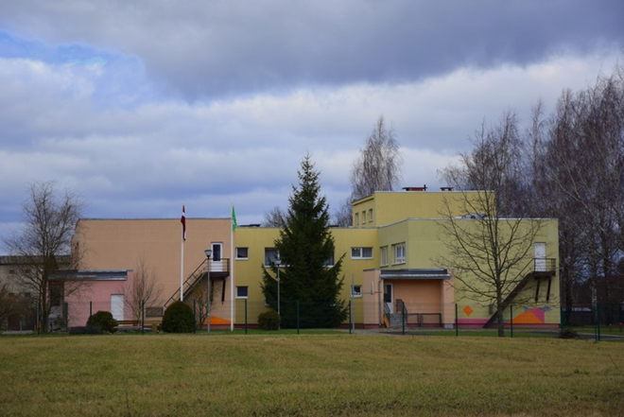
Energy Efficiency in the public sector
Kindergarten built in the 70ies
Renovated in 2015 using CCFI funding
Ex-ante energy consumption
  Metered normalized – 206 kWh/m² a
Planned energy consumption after renovation
  From energy audit – 99 kWh/m² a
Ex post energy consumption 4 years after renovation
  Metered normalized – 180 kWh/m² a
Problems with overheating and ventilation
Heating automation switched off
Yearly losses ~ €5000 (€20k in 4 years)
CCFI: Climate Change Financial Instrument (CCFI) was a Government budget program of Republic of Latvia.

Slide 5
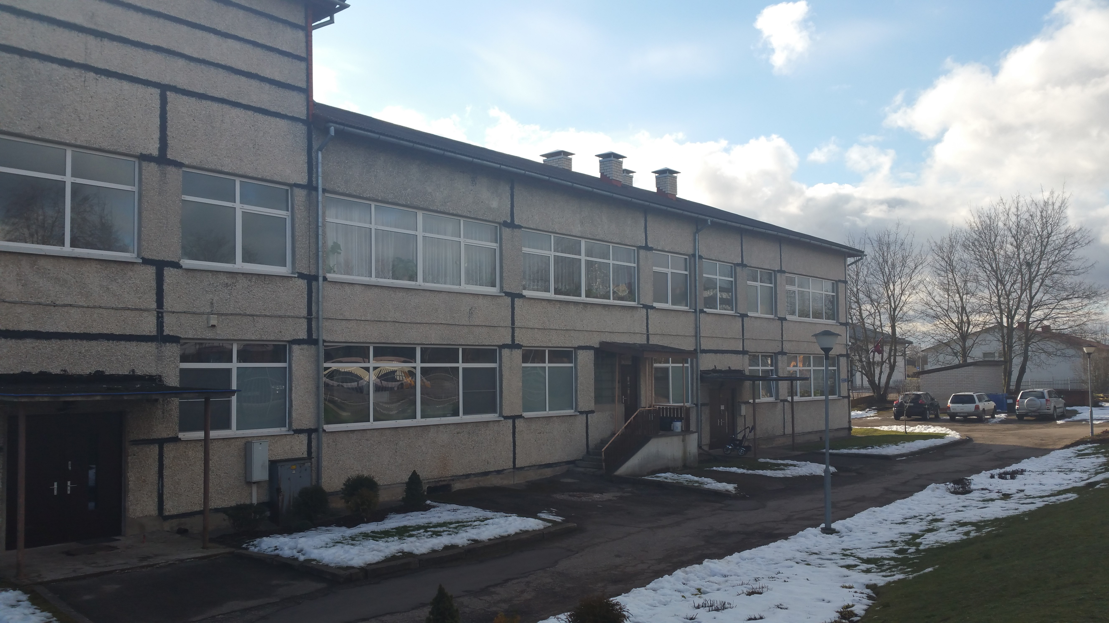
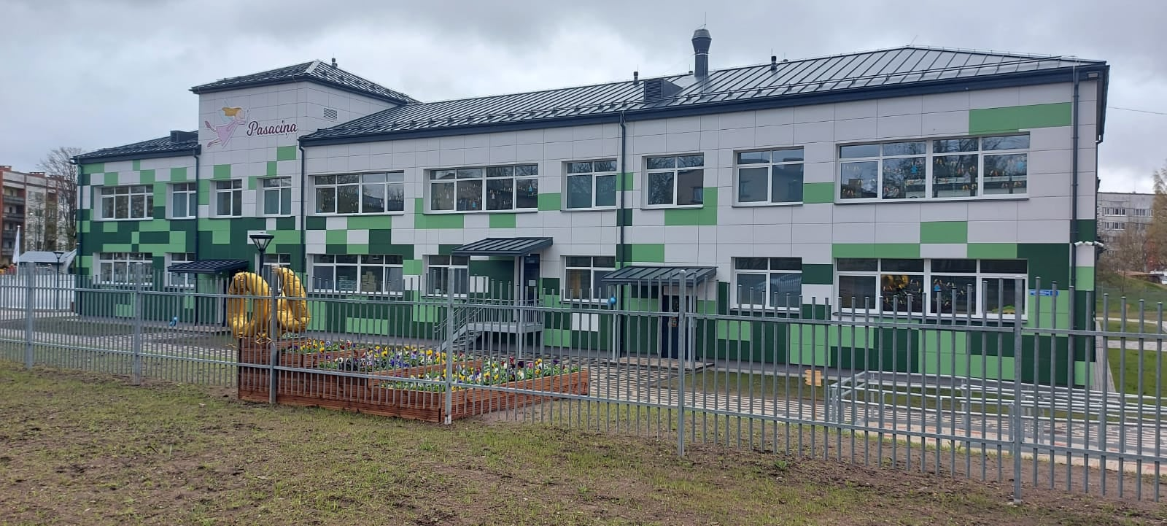
Business case
Deferred maintenance
Technical problems
High energy consumption
Low indoor comfort
Building dilapidation
€
Lower energy consumption
Better indoor comfort
Long-term preservation of the building
Asset enhancement
Savings
Policy targets
Security of supply
Economic development
Supports the achievement of national energy efficiency targets
Supports the objectives of the European Green Deal
Creates jobs
Improves security of supply
BEFORE
AFTER

Slide 6


    ENERGY SAVINGS
    O&M SAVINGS
    DEBT SERVICE and INTEREST
The implemented energy efficiency measures generates revenue
Building owners pay back their debt obligations

Slide 7
€
90
Savings
180
90
BEFORE
AFTER
180 kWh/m² a
90 kWh/m² a
0.55 €/m² month
Savings
Energy tariff:
56 €/MWh
Energy savings:
5.00 €/m² a | 0.42 €/m² month
Saving on maintenance:
1.50 €/m² a | 0.125 €/m² month
Total Cost savings:
6.50 €/m² a | 0.55 €/m² month
https://www.sprk.gov.lv/content/tarifi-4

Slide 8
280 €/m²
1.82 €/m² month
Debt service cost
Loan>
Interest – 2.0%
15 years
Costs:
21.8 €/m² a
1.82 €/m² month

Slide 9



Savings
0.55 €/m² month
Costs
1.82 €/m² month
Investments at 280 €/m²
Loan maturity 15 years
Energy savings 90 kWh/m² a
Lack of assessing externalities
Lack of monitoring over the life of the building

Slide 10
More sensitivity
Investments at 280 €/m²
Energy savings 90kWh/m² a
Heat tariff
Interest rate
Loan maturity
Investments at 100 €/m²
Energy savings 90kWh/m² a
Heat tariff
Interest rate
Loan maturity

Slide 11
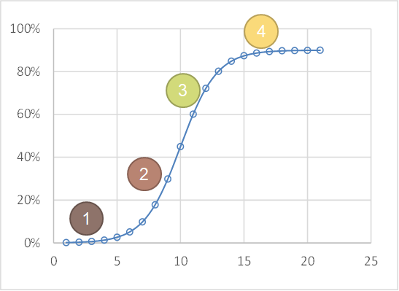
Challenging sides effects of subsidies
The adoption or acceptance of a new product or innovation typically follows a S-shape curve.
Innovation stage
Syndication stage
Diffusion stage
Substitution stage
[Technology Management, Growth and Lifecycle, Shahid, 2009]

Slide 12
Latvia in the last 10 and more years
2009
2020
Support programme, investment grant | KPFI |  |  |  |  | EU Structural funds
Maximum Investment grant | ~85% of eligible cost with cap on max grant |  |  |  |  | ~85% of eligible cost with cap on max grant
Type of procurement | Design−Bid−Build |  |  |  |  | Design−Bid−Build
Investment costs for building renovation (comparable projects) | ~120 €/m² | ~180 €/m² |  |  |  | ~280 €/m² | ~300€/m²
Heat tariff - Cesis | 85.9 €/MWh |  |  |  |  |  | 61.2 €/MWh
Heat tariff – Sigulda | 73.8 €/MWh |  |  |  |  |  | 68.2 €/MWh
Heat tariff – Riga | 67.2 €/MWh |  |  |  |  |  | 44.5 €/MWh
Project bundling | no |  |  |  |  |  | as in 2009
Open to EPC | no |  |  |  |  |  | as in 2009
stop&go

Slide 13
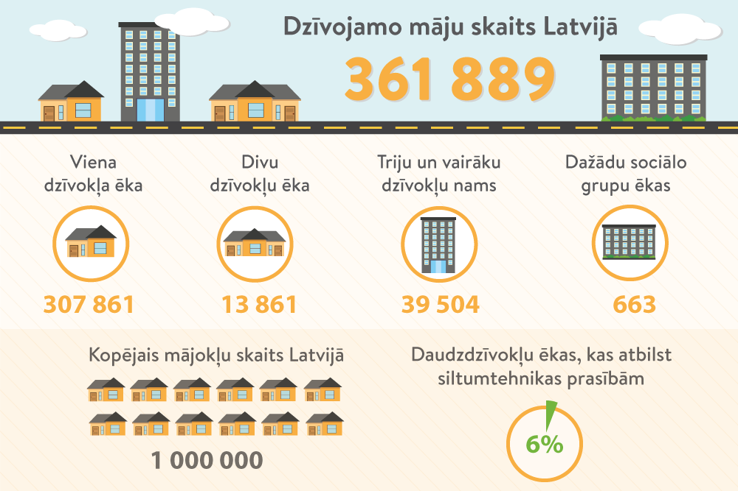
S-shape curves
[Lvportals]
Example:
In 14 years ~1500 buildings for €0.52b
In 280 years ~30000 buildings for ??

Slide 14
Regulatory issue
Business as usual
Energy Performance Contracting
85% grant and available state budget
Standardized application and approval process
Available and approved contract templates
One building one project approach
Design-Bid-Build
Trained/accustomed municipal staff
No grants
Max 5 years contract terms or application process based on PPP law for contract extending 5 years terms
Proved contracts templates and guidelines were not available
Unprepared municipal staff
For off-balance sheet | EUROSTAT green light

Slide 15
Identifying the split incentives
Authorities
Procurement vs Policy Makers – complexity of assessment of a simple concept
Existing Practices of reactivity versus a culture of monitoring, prevention and maintenance.
Ownership of district heating
Industry
Knowledge of Existing procurement methodology
Buildings Owners
Users of buildings are not the owners or responsible agency

Slide 16
The Conclusion: Carbon Free by 2050 – no way?
Regulations
Policies
Leadership
Split incentives
Lack of standards and clear offer
Mismatch between Assets and Liabilities.
Procurement reflexes and ”special traditions”
Cross subsidies to energy producers
Subsidies to energy efficiency preventing more innovating models (EnPC)
Stakeholders waiting for the State/Grants
Single measure low hanging fruit high margin Industry bottleneck

Slide 17
Achievements
Energy saving guarantee
Investment pipeline
Regulatory
Financial
Latvia - a “lab” of the challenges to succeed

Slide 18
Energy Savings Guarantee
Real
energy
savings
Contractor will compensate for the missing energy savings (backed-up by performance bond)
An undertaking to answer for the payment or performance or obligation in the event of a default by the person primarily responsible for it
Missing
BASELINE
GUARANTEE
M&V
Before
renovation
After
renovation
Energy
Savings
Guarantee
Real
energy
savings
Municipality keeps the extra energy savings
BASELINE
GUARANTEE
Extra
BASELINE
GUARANTEE
M&V
Energy Savings Guarantee (energy class to be achieved) indicated in the Building construction Contract
Measurement and Verification
Settlements of accounts during guarantee period

Slide 19
Energy performance contract
Energy efficiency guarantee
Operation and maintenance activities
Civil engineering and installation works
Third party financing
Energy efficiency guarantee
Operation and maintenance activities
Civil engineering and installation works
Client financing
What we wanted
What we could
Included as annex to a standard construction contract
Service agreement – 20 years
Construction contract - 5 years

Slide 20
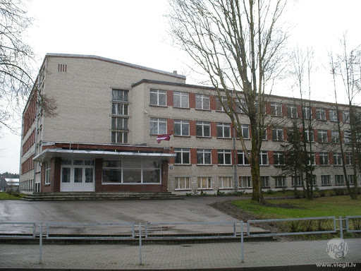
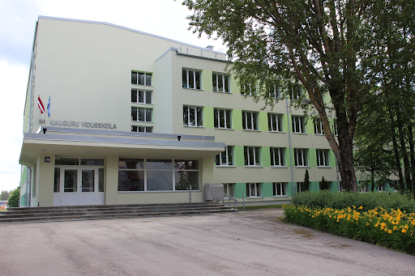
Investment pipeline
Signed contracts | 7 projects | €14.7m investments
Procurement phase | 4 projects | €5.6m investments
Multifamily buildings
Signed contracts | 1 project | €743k investments
Projects triggered by Accelerate SUNShINE
Multifamily building renovation projects triggered by Accelerate SUNShINE in the four target municipalities:
Procurement phase | 11 projects | €7.0m investments
Energy savings | 2.9 GWh/year | 3.5 GWh/year
Energy savings | 2.8 GWh/year | 3.2 GWh/year
19 projects | €7.6m investments
Energy savings | 3.2 GWh/year | 3.9 GWh/year
Contract negotiation | 2 projects | €860k investments
Public buildings

Slide 21


















Financing Model
Standardized EnPC agreement
Financing
agreement
BUILDING OWNER
Renovation and guaranteed savings
ESCO
Financing
BANK
(< 2 years)
Fixed payments
Fixed payments
BEEF
ESCO
BANK
Energy audits
Project development
Financing
Project/construction site management
Construction / installation
Standardization
Isn’t energy the same everywhere?
Do we have “French Gas” and “German 95 petrol”?
Let’s do the same for Energy Savings
Banks
BEEF
Forfaiting of successful implemented projects
(after M&V)
DEVELOPMENT BANKS SUSTAINABLE FUNDS
BEEF (> 2 years)
Long term financing
Standardization / Scaling Quality guidance Transparency
IT Platform
ESCOs are not financial institutions

Slide 22
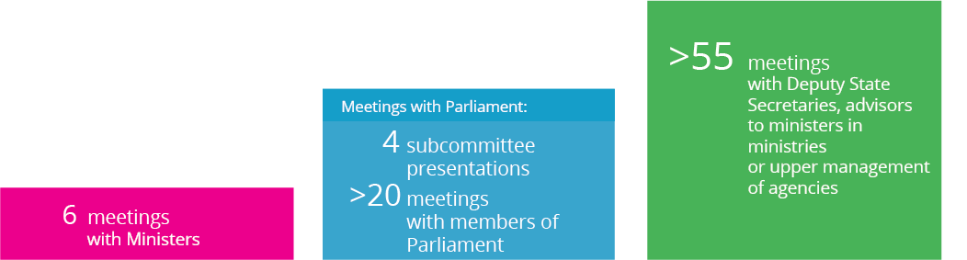
Regulatory framework
Achieved
Cooperation with the European Investment Bank within the framework of JASPER, together with ministries, industry associations and entrepreneurs
Off-Balance sheet EnPC model contract
ALTUM introducing 20 years debt instruments
Ongoing effort
Accepted guidelines for EnPC in public sector
Law on energy efficiency – financing versus financial risk
Allow tenor to match building life cycle for Integrated Renovations
Define dEEp renovations – directives use different terms and CHRN
Carbon pricing - externalities
Procurement training and fair pricing – cheapest is always most expensive
Regulations regarding maintenance
Market inertia
The implementation of renovation projects including an energy efficiency guarantee in the construction contract triggered a constructive dialogue on Energy Performance Contracting, increasing awareness on current regulatory barriers

Slide 23
Leadership on Energy Efficiency and Climate
“Upgrading the energy performance of buildings is one of the fastest and most effective ways to reduce energy costs, cut pollution, and create jobs in the construction and energy sectors”
– President Obama

Slide 24
THANK YOU
CONTACTS
All rights reserved. No part of this presentation may be reproduced, distributed, or transmitted in any form or by any means, including photocopying, recording, or other electronic or mechanical methods, without the prior written permission of the authors
Claudio Rochas | claudio@ekodoma.lv
Nicholas Stancioff | nicholas@fcubed.eu

