Slide 1
LIFE Platform Meeting 2024 – Brescia
The REPowerEU Plan – Heating and Cooling solutions
14 May 2024
The REPowerEU Plan
Objectives and state of play
Pierluca Merola, Policy Officer, Energy Efficiency Unit - ENER.B2

Slide 2
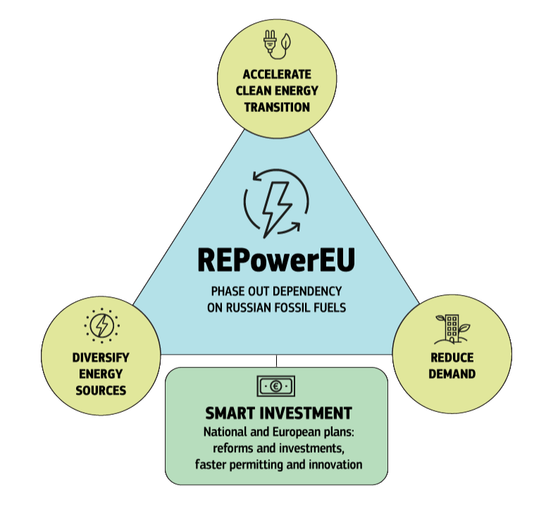
REPowerEU: from goals to actions
Independence from Russian fossil fuels by 2027
Increase imports of liquefied natural gas (LNG) by 50 bcm
Increase pipeline gas imports by 10 bcm
Increase biomethane production by 3.5 bcm
EU-wide energy saving to cut gas demand by 14 bcm
Rooftop solar to reduce gas demand by 2.5 bcm
Heat pumps to reduce gas demand by 1.5 bcm
Reduce gas demand in the power sector by 20 bcm by deployment of wind and solar
Increase the target of renewable energy from 40% to 45% by 2030
Increase the target of energy savings from 9% to 13% by 2030
Complemented by:
EU Save Energy Communication
EU Solar Energy Strategy

Slide 3
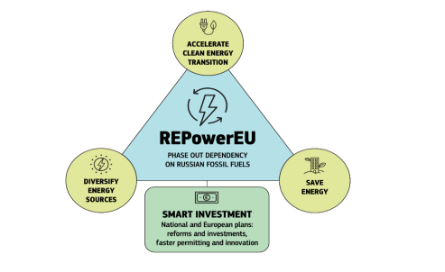
REPowerEU Communication – 18 May 2022
Overall objectives: phase-out EU dependence on Russia’s fossil fuels by 2027
Three axis building on the Fit for 55 package:
Save Energy – short-term energy saving measures and medium-term energy efficiency structural improvements (EU-Save Energy Communication)
Diversify supplies – EU Energy Platform for the voluntary common purchase of gas, LNG and hydrogen
Accelerate the clean energy transition – boost renewable electricity, hydrogen, bio-methane, Solar strategy, accelerate energy efficiency improvements, heat-pumps roll-out
Smart investment Plan: Investment need €210bn by the end of 2027 through anticipated ETS revenues – Innovation fund, RRF Loans, increase to 12.5% Cohesion policy and CAP transfer to RRPs.

Slide 4
REPowerEU – Energy Savings and Clean Energy Transition
Legislative proposals revising upward ambitions in the EED, RED and EPBD proposal 2021:
Increase Energy Efficiency 2030 Targets from 9 to 13% primary and final energy consumption reduction (compared to 2020 reference scenario) in EED;
Increase Renewable Energy 2030 Target from 40 to 45% share of renewables in the energy mix (compared to 2007 reference scenario) + proposal to accelerate permitting: ‘Go-to areas’ and ‘Overriding public interest’ for renewables deployment in RED;
Introduce provisions to ensure deployment of solar energy in buildings (in public and commercial buildings with useful area larger than 250 sqm by 2027, and in new residential by 2029) in EPBD.
Energy efficiency and local/on-site renewables in REPowerEU:
Energy efficiency and behavioral energy savings measures at the junction between energy security and clean energy transition;
Accelerate roll-out of heat-pumps and energy efficiency expected to deliver 37 bcm of natural gas savings for an investment need of 57 billion euro;
Solar rooftop initiative – 58 TWh of additional electricity generated at an estimated investment cost of 26 billion euro, estimates indicate that potentially 25% of the EU’s electricity consumption;
Industry Alliances for solar PVs and heat pumps and large-scale Skills Partnerships.

Slide 5
Diversification of gas supplies – Energy security
April 2021
May 2024
LNG
EU-US Joint Statement and Task Force on European Energy Security
EU Energy Purchase Platform
Trilateral agreement with Egypt and Israel
Increased imports via Japan, Korea, Qatar
Untapped potential in sub-Saharan Africa
Other sources: UK
Russian share of pipeline gas imports
40%
8%
Russian share of total gas imports (LNG + Pipelines)
45%
15%
34%
EU gas imports from Norway
Pipelines
Norway
Algeria
Azerbaijan
EU gas imports from US (LNG)
20 %

Slide 6
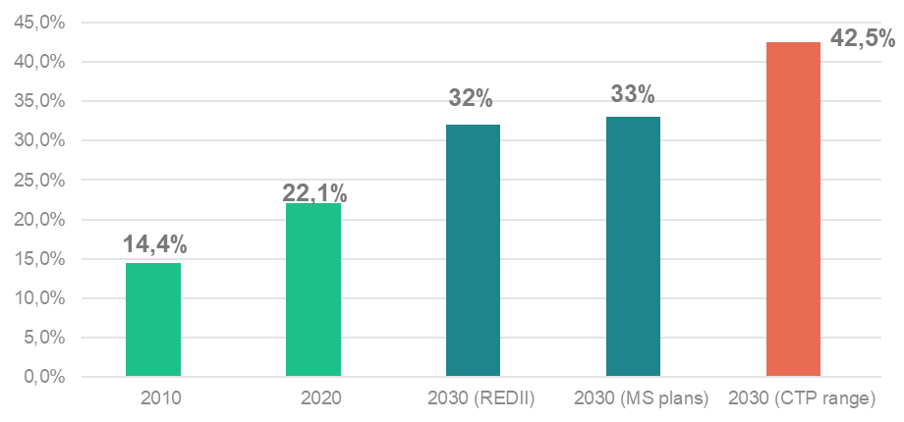
Adoption of Fit-For-55 and REPowerEU amended legislation
Energy Efficiency Directive (EU) 2023/1791
Updated EU energy efficiency targets to 11.7% reduction in primary and final energy consumption.
Streghtened annual national energy saving obligations to 1,49% in average with step-wise approach and exclusion of savings from direct fossil fuels combustion.
Update the definition of energy efficient district heating and cooling, introducing the 2050 trajectory for efficient district heating and cooling system, and introduce local heating and cooling plans for municipalities (over 45.000).
11.7%
Decrease
in energy consumption
Renewable Energy Directive (EU) 2023/2413
Increase RES target by 2030 to 42.5%
Increased renewables ambition in key sectors: heating and cooling (mandatory annual increase of 1.1% RES share), buildings (49% indicative share), transport (reduction of GHG intensity), industry (1.6% annual increase), RES and waste heat in centralised district heating and cooling systems (indicative annual increase of 2.2 p.p.).

Slide 7
Energy Performance of Buildings Directive Recast adopted 12/04/2024
Twofold objective:
→ Contribute to reducing buildings’ GHG emissions and final energy consumptions by 2030
→ Provide a long-term vision for buildings and ensure an adequate contribution to achieving climate neutrality in 2050
Renovation
- Minimum Energy Performance Standards
- National trajectories for the progressive renovation of the residential building stock
- National Building Renovation Plans
Decarbonisation
- Introduction of zero-emission buildings as standard for new buildings
- Solar deployment in buildings
- Calculation of whole life cycle carbon
- Phasing out incentives for fossil fuels and new legal basis for national bans
Enabling framework
- Strengthened Energy Performance Certificates
- Renovation passports
- Sustainable finance & energy poverty
- One-stop-shops
- Deep renovation standard
- National energy performance databases
Modernisation & system integration
- Infrastructure for sustainable mobility
- Smart Readiness Indicator
- Indoor air quality: ventilation and other technical building systems
- Digitisation, data access and exchange

Slide 8
How can the REPowerEU be financed?
EUR 20
billion
Additional grant possibilities under the RRF
Mostly via RRF
Other relevant EU funds:
CEF Innovation Fund ERDF & Cohesion Fund InvestEU (mobilizing private financing) JTF LIFE
EUR 225
billion
Loans available under the RRF
EUR 5.4
billion
Transfer possibility from the BAR

Slide 9
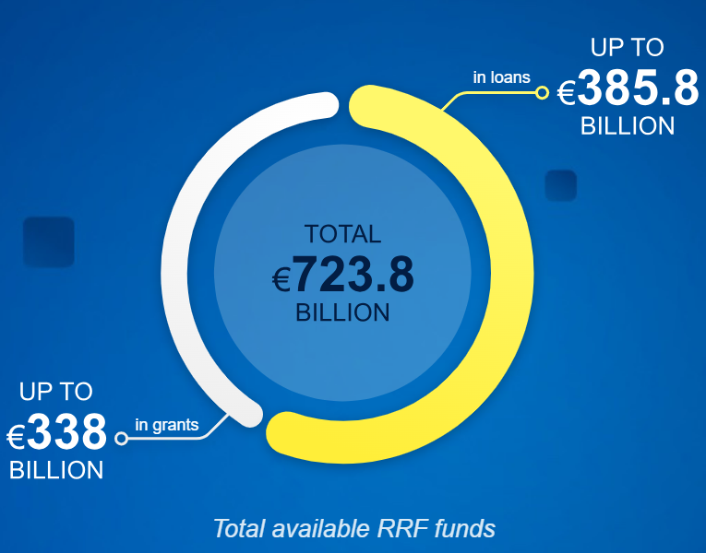
Recovery and Resilience Plans and REPowerEU chapters
The Recovery and Resilience Facility (RRF) is the center piece of the Next Generation EU, providing substantial funding to Member States, based on Recovery and Resilience Plans (RRPs)
The RRF provide the main funding arm in support to the REPowerEU Plan
The RRF is a performance-based instrument implemented via Milestones & Targets
By the deadline of December 2023, 23 out of 27 Member States amended their RRPs to include a REPowerEU chapters (all except BG, DE, IE, LU). CIDs approved by ECOFIN Council on 8 December 2023
Main EU instrument to finance the green and digital transition with mandatory thresholds of 37% of each plan to be dedicated to climate objectives, including the clean energy transition (and 20% to digital transition)
REPowerEU Ch. and 2023 revisions increased committed climate expenditures by 4.1 p.p to 42% of the total RRF.
Recovery and Resilience Facility Scoreboard

Slide 10
The amended RRF Regulation: legal basis for introduction of REPowerEU Chapters in RRPs
REPowerEU Objectives:
Improving energy infrastructure and facilities to meet immediate security of supply needs for gas, including LNG;
Boosting energy efficiency in buildings and critical energy infrastructure;
Decarbonisation: industry; increase production and uptake of biomethane and renewable hydrogen;
b) RES: increasing share and accelerating deployment and integration of renewable energy;
Addressing energy poverty;
Incentivising reduction of energy demand;
Addressing internal and cross-border energy transmission and distribution bottlenecks, supporting electricity storage and zero-emission transport and its infrastructure, including railways;
Supporting the objectives set out in points above through accelerated requalification of the workforce for green and related digital skills, as well as through support of the value chains in critical raw materials and technologies linked to the green transition.

Slide 11
Quick overview
Total RRF funding committed: EUR 653 billion
Grants: EUR 360 billion, Loans (requested): EUR 293 billion
Energy: more than EUR 184bn (28.5% of total RRF), with EUR 108.1bn already committed prior to REPowerEU chapters and recent RRP amendments.
REPowerEU chapters
Reforms: most target renewable energy (32), energy efficiency (16), & improving energy networks & storage (13)
Investments: largest budgets are for energy efficiency (27.5%), decarbonise industry (18.6%), & renewable energy (17.6%)
Fossil fuel infrastructures: only in Croatia, Italy and Poland, and less than 5% of total funds.
2023 (other) amendments
Adjustments in RRPs following the update of the RRF grant allocation
Additional loans (for additional measures, including financial instruments)
Other changes related to inflation, higher costs, disruptions of supply chains etc.

Slide 12
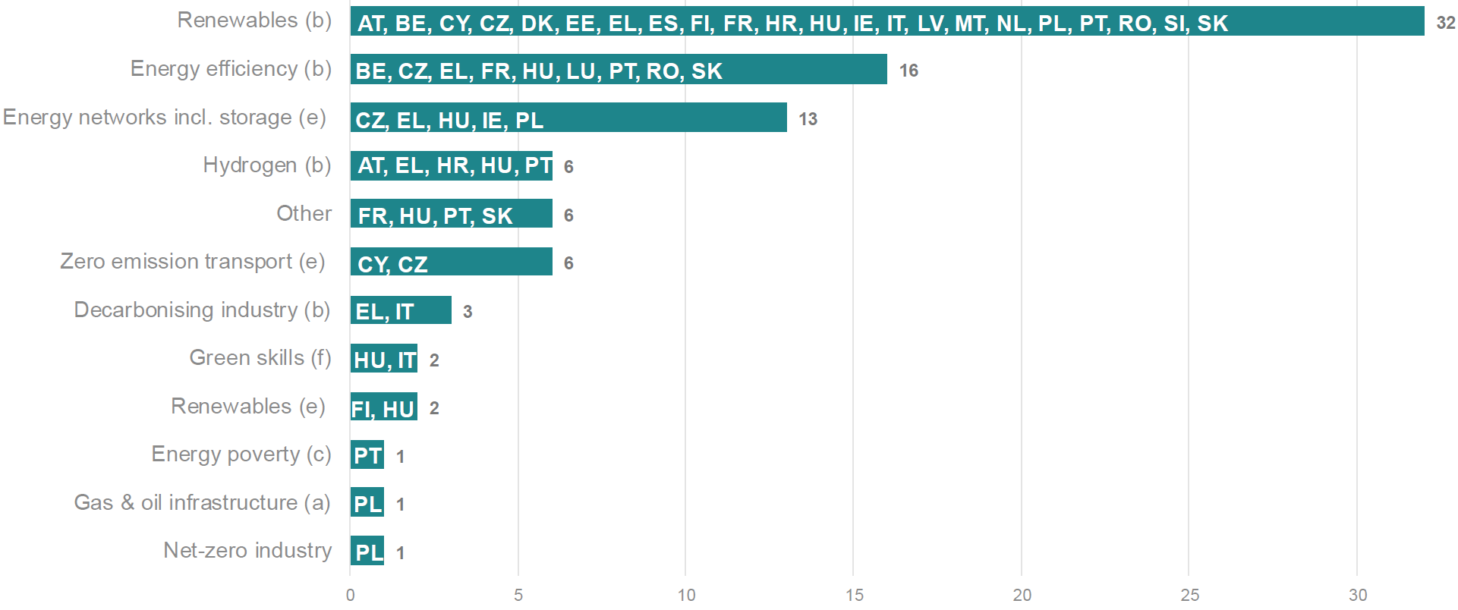
REPowerEU Reforms
89 Reforms by REPowerEU objectives
Not enabling conditions + DDL – infringements not excluded

Slide 13
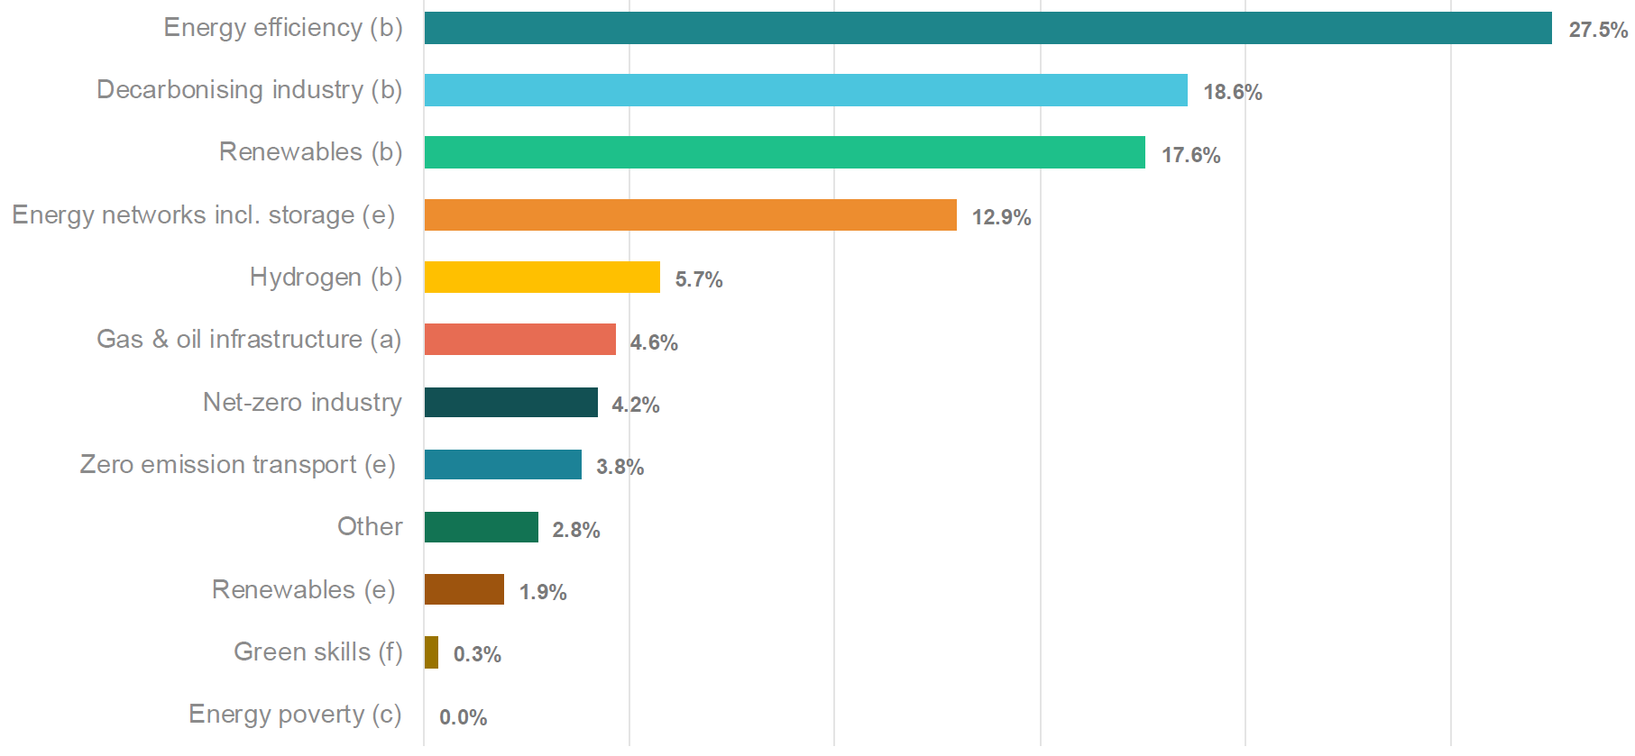
REPowerEU Investments
Costing by REPowerEU objectives
MS address it in buildings renovation (ex. ES, RO).
FR varies share of support if for energy poor

Slide 14
Member States overview – contribution to energy objectives
Countries with at least a reform/investment for objective area
Provisional data, considering 23 MS with submitted REPowerEU chapter.
Renewables is the most present objective, with almost all MS included.
Energy efficiency and Energy networks are also presents in many chapters.
Notes:
Energy efficiency part covers in some cases also energy poverty (to some extent).

Slide 15
RRP contribution to energy policies
EUR 184 bn allocated to energy reforms and investments.
EUR 106.5bn allocated to energy efficiency
EUR 62bn allocated to RES & electricity infrastructure
Production of renewable energy EUR 34.2 bn
Energy networks and infrastructure EUR 27.9 bn
Renewable and low-carbon hydrogen EUR 13.6 bn
More than EUR 60 billion from the 23 approved REPowerEU chapters
Focus on: RES (permitting); EE (renovation, heating & cooling); boosting competitiveness; secure energy networks (grids; gas infrastructure)

Slide 16
Conclusions
Full complementarity between the Fit-for-55 and REPowerEU Objectives in promoting the clean energy transition, achieving the Energy and Climate targets, and phase out the imports and use of Russian natural gas.
The RRF is the largest EU programme providing funding for energy measures, swift implementation of the RRPs is key to foster a successful clean transition and contribute to REPowerEU objectives.
Two years ago, the REPowerEU Plan provides a strong short-term impetus to investments in clean energy transition and energy demand reduction…
…challenge now is to maintain ambition in medium to long-term to the 2030 Energy and Climate Targets and REPowerEU objectives.
Within this context, the transposition and implementation of the FF55 regulatory revisions is now key to provide the correct framework and certainty to market actors.

Slide 17
Thank you
Pierluca Merola, Policy Officer, Energy Efficiency Unit - ENER.B2

