Slide 1

Made to measure: evaluating communication activities
Monitoring
Communicating
Evaluating
European Commission
DG COMMUNICATION

Slide 2
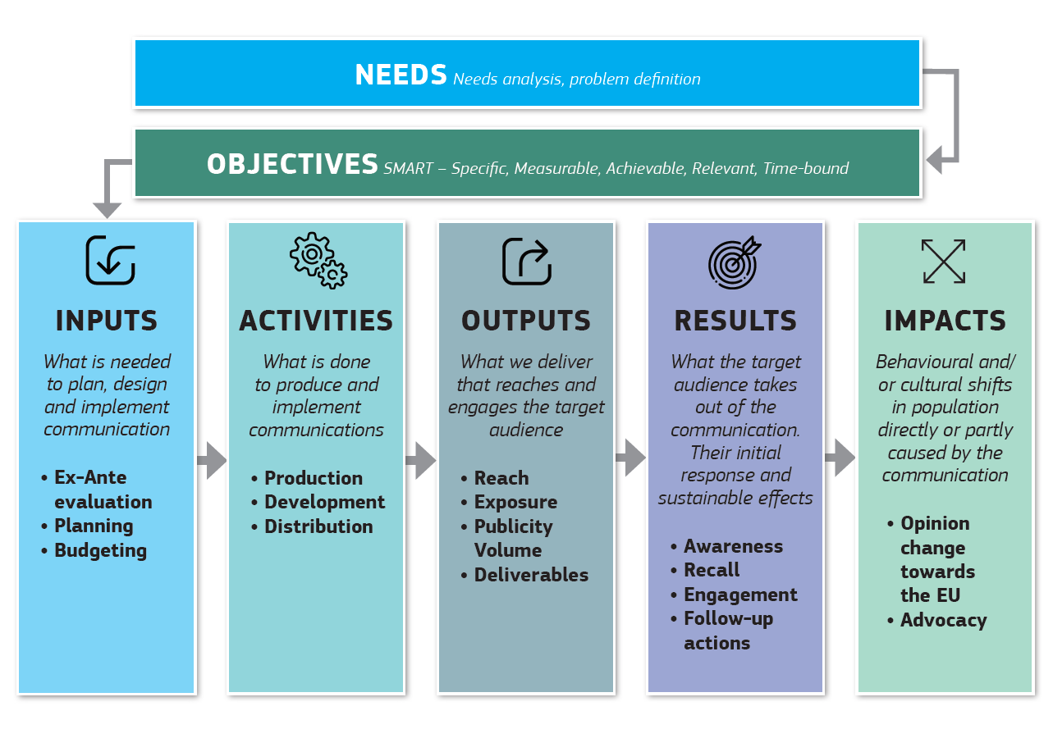
Commission’s Communication evaluation model
https://ec.europa.eu/regional_policy/sources/informing/webinar/ec_common_set_indicators.pdf

Slide 3
Planning communication activities: Needs
How to identify your needs
The identification of the needs requires an exercise both in needs analysis and problem definition.
Tools as Eurobarometer or national/regional statistics can be very useful to provide context indicators capable of validating your needs.
Nevertheless, cross-check points of view with different data:
  Evaluations
  Previous reports
  Literature review
  Data from previous (similar) activities
  Benchmarking, case studies, etc.

Slide 4
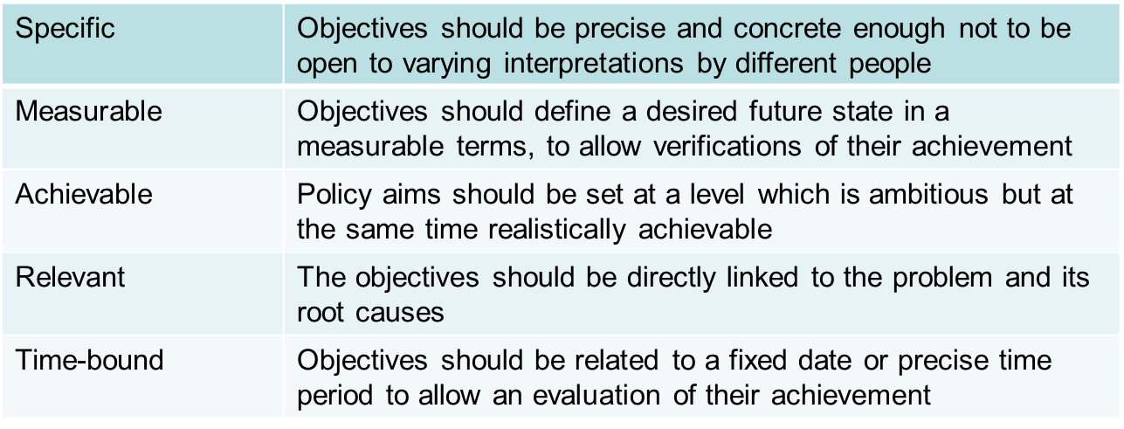
Planning communication activities: Objectives
First condition to be able to monitor and evaluate communication activities is to set SMART objectives
What are SMART objectives?

Slide 5
Planning communication activities: Audiences
Target audiences
When planning a communication activity it is very important to define as clearly as possible the target audience depending on both the objectives and the message to be transmitted
Audience research: what to research
Audience research is a fundamental part of best practice in communication. In addition to basic demographic information:
age
gender
ethnicity
socio-economic status
geographic location

Slide 6
Planning communication activities: Audiences
Important audience insights that inform communication strategy could include:
• Existing awareness related to the topic or issue for communication
• Past experiences related to the topic or issue for communication
• Needs (e.g., products, services or information that audience members require)
• Preferred channels to receive information (which informs media plans)
• Interests (what target audience members are interested in and what they
want to know about)
• Desires (the aspirations, hopes and dreams of audience members)
• Attitudes related to the topic or issue for communication (e.g., political, social
or cultural views, biases, or prejudices)

Slide 7
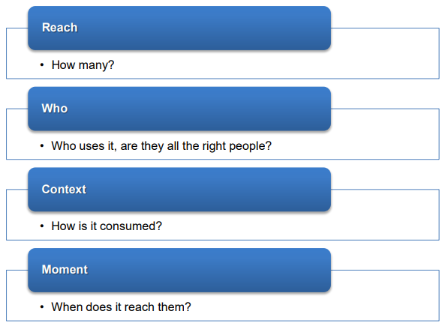
Planning communication activities: Activities and channels
Each activity/ channel has its own characteristics which can help or hinder your message reaching your audiences.
Aspects to be considered when selecting your activities/ channels

Slide 8
Planning communication activities: Indicators
How to choose your indicators
A first step in this process is to go back to your (SMART) objectives
determine in your own view what would be a factor of success
pick your indicator(s)
The indicators should allow to check:
If implementation is on track;
If context elements have evolved;
How to collect the data we need to measure whether the activity has achieved its objectives.
Out of the selected indicators, a limited number of Key Performance Indicators (KPIs) should be used as a key metrics to evaluate the progress/ success of a particular activity.

Slide 9
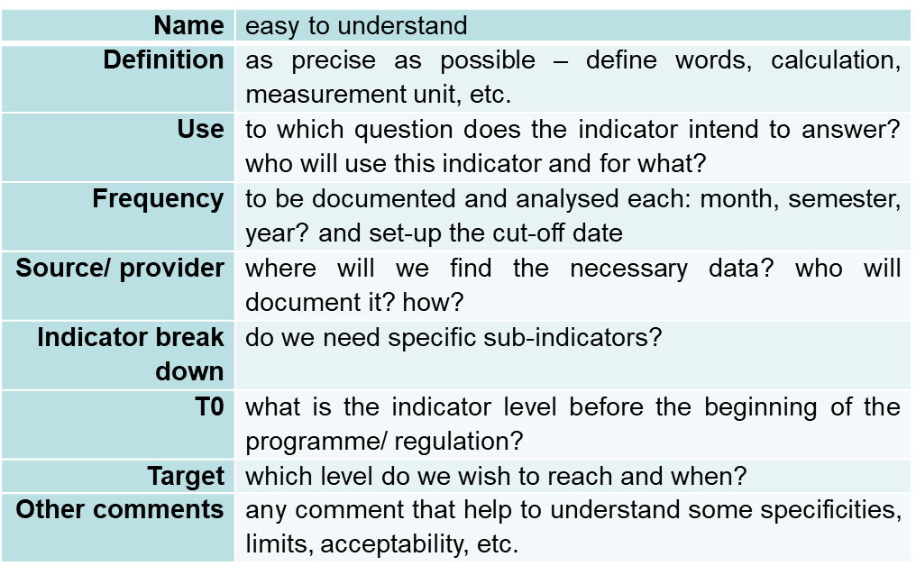
Defining reporting needs: Indicators
When defining your indicators, you could take into consideration:

Slide 10
Define reporting needs: Baselines
What is a baseline?
A baseline is a measurement of the situation before the action starts (could be zero if a new action);
It is used to measure change and monitor progress;
It is advisable to define a baseline for all your indicators before the start of the action;
Use existing data where possible, but check reliability;
If you need to collect your own data, collect baseline data early in order to use the info in the planning phase.
When setting baselines you should know that:
The exercise requires a minimum level of information (can imply complexity & costs);
It would be useful an analysis of costs/benefits of different options for collecting information (if necessary).

Slide 11
Define reporting needs: Targets
What is a target?
A target is the desired end point for each indicator
Disaggregated where relevant e.g. by sex/ age/ rural-urban
Should be time specific (i.e. clear when the target is expected to be met)
When setting targets you should know that:
It is necessary to have a reference value (baseline)
SMART approach remains valid for setting good targets
Where possible: quantity, quality, time should be specified
Targets should be as realistic as possible
Imply a rhythm of progression (and accountability)

Slide 12
Monitoring communication activities
For assessing the real results of our communications, we need good monitoring systems to collect relevant data and to provide objective feedback.
These monitoring systems should be based on a common set of indicators used in a consistent way – the same indicators being used to measure the success of similar communication activities – setting the basis for comparability and benchmarking.
In 2018, the Commission streamlined the common indicators it uses for monitoring its communication activities, bringing its number down from 160 to 61 indicators, a 62% reduction.

Slide 13
Monitoring system
A good monitoring system will help you to observe:
Physical progress (means, activities, obtained results) and quality of the process (stakeholders participation and capacity building)
Financial progress (budget and expenses)
Preliminary reactions/ feedback after initial activities performed (evolution of knowledge, perceptions and attitudes)
Reasons for any unexpected reaction or not supportive for target groups and remedial

Slide 14
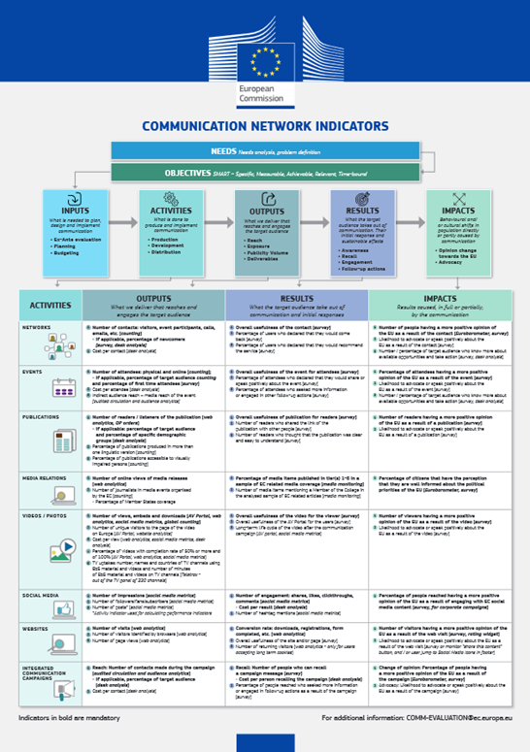
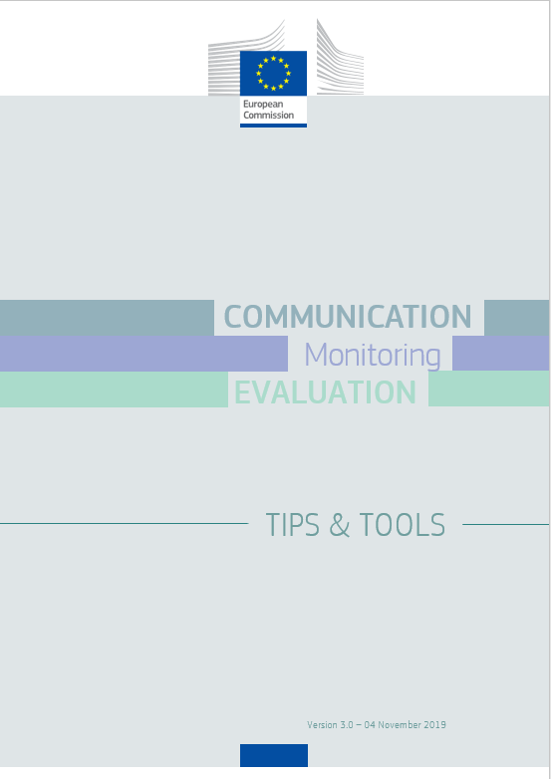
Indicators for communication activities
https://ec.europa.eu/regional_policy/sources/informing/evaluation_toolbox_en.pdf

Slide 15
Indicators for communication activities
For which purpose?
  Planning: CN indicators facilitate the planning of communication activities in the Commission.
  Contracting out: When contracting out campaigns and other communication activities, Commission services should request contractors to use CN mandatory indicators as Key Performance Indicators.
  Monitoring/ Data collection: CN Indicators should become a common basis for collecting data on a systematic and consistent way.

Slide 16
Monitoring versus Evaluation
 | Monitoring | Evaluation
What? | Daily management activity (piloting the activity) | Analysis for in-depth assessment
Who? | Internal management responsibility – all levels | Usually external evaluators (objectivity - independence)
When? | Continuous | Ex-ante, mid-term, ex-post
Why? | Keep track, Check progress, take remedial actions, update plans | Programme/project management lessons learned, accountability
Focus? | What is happening? | Why and how is it happening?

Slide 17
Evaluation of communication activities
Evaluation looks for evidence of causality, seeking to link changes in a situation to the Commission's action / intervention.
The establishment of these causal links in relation to communication actions is sometimes difficult, but it is necessary and feasible with the use of the right skills and tools.
Evaluation is a scientific process based on triangulation of different methods, typically going through the following criteria:
effectiveness
relevance
efficiency
coherence
EU-added value

Slide 18
Evaluation of communication activities
Activities | Evaluation tools
Networks | Focus group Customer journey mapping
Events | Focus group Observation at an event
Publications | Online consultation Focus group consultation Expert workshop
Videos/Photos | Focus group
Social media | Analysis of qualitative and quantitative monitoring data
Websites | Focus group direct target audiences Web-visibility mapping
Integrated campaigns | Ex-ante evaluation or preparatory study Focus group
For more information, please check the Toolkit for the evaluation of the communication activities (non exhaustive list of options). The document is available at the following address: https://ec.europa.eu/info/sites/info/files/communication-evaluation-toolkit_en.pdf

Slide 19
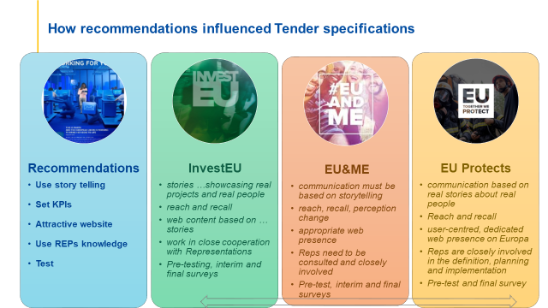

Slide 20


Evaluation of communication activities: Lessons learnt
guidance materials about how to integrate measurement and evaluation into communication activities;
clearer and more technical requirements for monitoring and evaluation into requests for services for communication;
more systematic external evaluations of communication activities and a growing demand to apply techniques specific to the communication field;

Slide 21

Thank you
European Commission - DG Communication
Unit D1 – Planning, Budget and Evaluation
COMM-EVALUATION@ec.europa.eu
© European Union 2020
Unless otherwise noted the reuse of this presentation is authorised under the CC BY 4.0 license. For any use or reproduction of elements that are not owned by the EU, permission may need to be sought directly from the respective right holders.
Slide xx: element concerned, source: e.g. Fotolia.com; Slide xx: element concerned, source: e.g. iStock.com
Notes:
Update/add/delete parts of the copy right notice where appropriate.
More information: https://myintracomm.ec.europa.eu/corp/intellectual-property/Documents/2019_Reuse-guidelines%28CC-BY%29.pdf

Slide 22
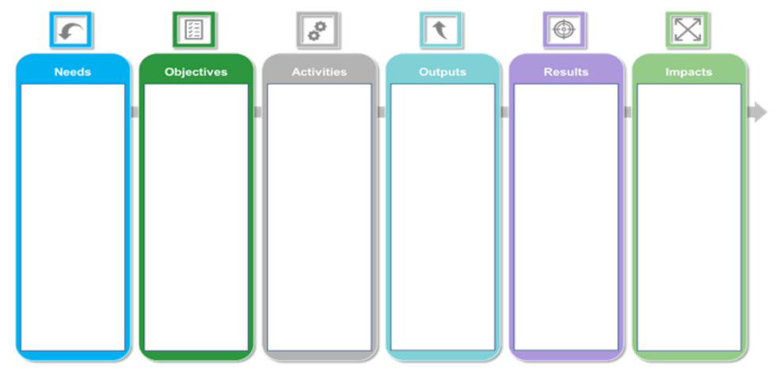
Practical exercise

Slide 23
CN Indicators
Videos/ Photos
ACTIVITIES | OUTPUTS What we deliver that reaches and engages the target audience | RESULTS What the target audience takes out of communication and initial responses | IMPACTS Results caused, in full or partially, by the communication
VIDEOS / PHOTOS | 1 Number of views, embeds and downloads [AV Portal, web analytics, social media metrics, global counting] 2 Number of unique visitors to the page of the video on Europa [AV Portal, website analytics] 3 Cost per view [web analytics, social media metrics, desk analysis] 4 Percentage of videos with completion rate of 50% or more and of 100% [AV Portal, web analytics, social media metrics] 5 TV uptakes: number, names and countries of TV channels using EbS material and videos and number of minutes of EbS material and videos on TV channels [Teletrax - out of the TV panel of 220 channels] | 1 Overall usefulness of the video for the viewer [survey] 2 Overall usefulness of the AV Portal for the users [survey] 3 Long-term: life cycle of the video after the communication campaign [AV portal, social media metrics] | 1 Number of viewers having a more positive opinion of the EU as a result of the video [survey] 2 Likelihood to advocate or speak positively about the EU as a result of the video [survey]

Slide 24

CN Indicators
Websites
ACTIVITIES | OUTPUTS What we deliver that reaches and engages the target audience | RESULTS What the target audience takes out of communication and initial responses | IMPACTS Results caused, in full or partially, by the communication
WEBSITES | 1 Number of visits [web analytics] 2 Number of visitors identified by browsers [web analytics] 3 Number of page views [web analytics] | 1 Conversion rate: downloads, registrations, form completed, etc. [web analytics] 2 Overall usefulness of the site and/or page [survey] 3 Number of returning visitors [web analytics - only for users ac- cepting long term cookies] | 1 Number of visitors having a more positive opinion of the EU as a result of the web visit [survey, rating widget] 2 Likelihood to advocate or speak positively about the EU as a result of the web visit [survey or monitor “share this content” button, and / or user jump to Social Media icons in footer]

Slide 25

CN Indicators
Social Media
ACTIVITIES | OUTPUTS What we deliver that reaches and engages the target audience | RESULTS What the target audience takes out of communication and initial responses | IMPACTS Results caused, in full or partially, by the communication
SOCIAL MEDIA | 1 Number of impressions [social media metrics] 2 Number of followers/fans/subscribers [social media metrics] 3 Number of posts* [social media metrics] *Activity indicator used for calculating performance indicators | 1 Number of engagement: shares, likes, clickthroughs, comments [social media metrics] Cost per result [desk analysis] 2 Number of hashtag mentions [social media metrics] | 1 Percentage of people reached having a more positive opinion of the EU as a result of engaging with EC social media content [survey, for corporate campaigns]

Slide 26








Keep in touch
ec.europa.eu/
europeancommission
europa.eu/
@EuropeanCommission
@EU_Commission
EUTube
@EuropeanCommission
EU Spotify
European Commission
Notes:
Delete/update as appropriate

