Slide 1
Towards large-scale roll out of "integrated home renovation services" in Europe
The contents of this presentation must be accompanied by their oral explanation
Christophe MILIN, Adrien BULLIER
European Climate, Infrastructure and Environment
Executive Agency (CINEA)
European Commission ¹
16 June 2021
¹ The sole responsibility for the content of this presentation lies with the authors. It does not necessarily reflect the opinion of the European Climate, Infrastructure and Environment Executive Agency (CINEA) or the European Commission, which are not responsible for any use that may be made of the information contained therein.

Slide 2
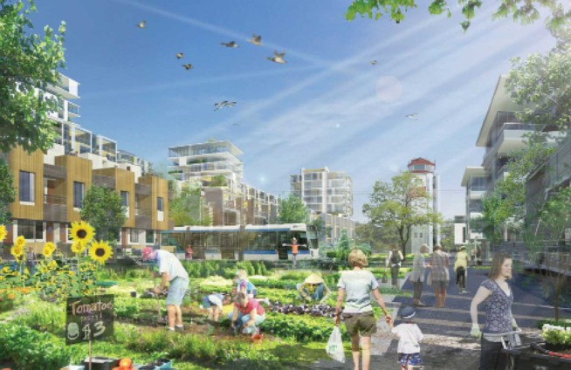
Collective ambitions…
Climate neutrality by 2050
For buildings:
Doubling renovation rates
Mainstreaming low energy renovation
Additional EUR 90 billion to be invested every year over the next 30 years

Slide 3


… require individual decisions
All our hopes depend on homeowners decisions…
Is it realistic to expect a spontaneous change in their current practices?
Why do people NOT renovate their home?
https://www.youtube.com/playlist?list=PL5FyMp1eGjUDpY34trvdZ-2dsgzgfo--g

Slide 4

The windy journey of home energy renovation

Slide 5
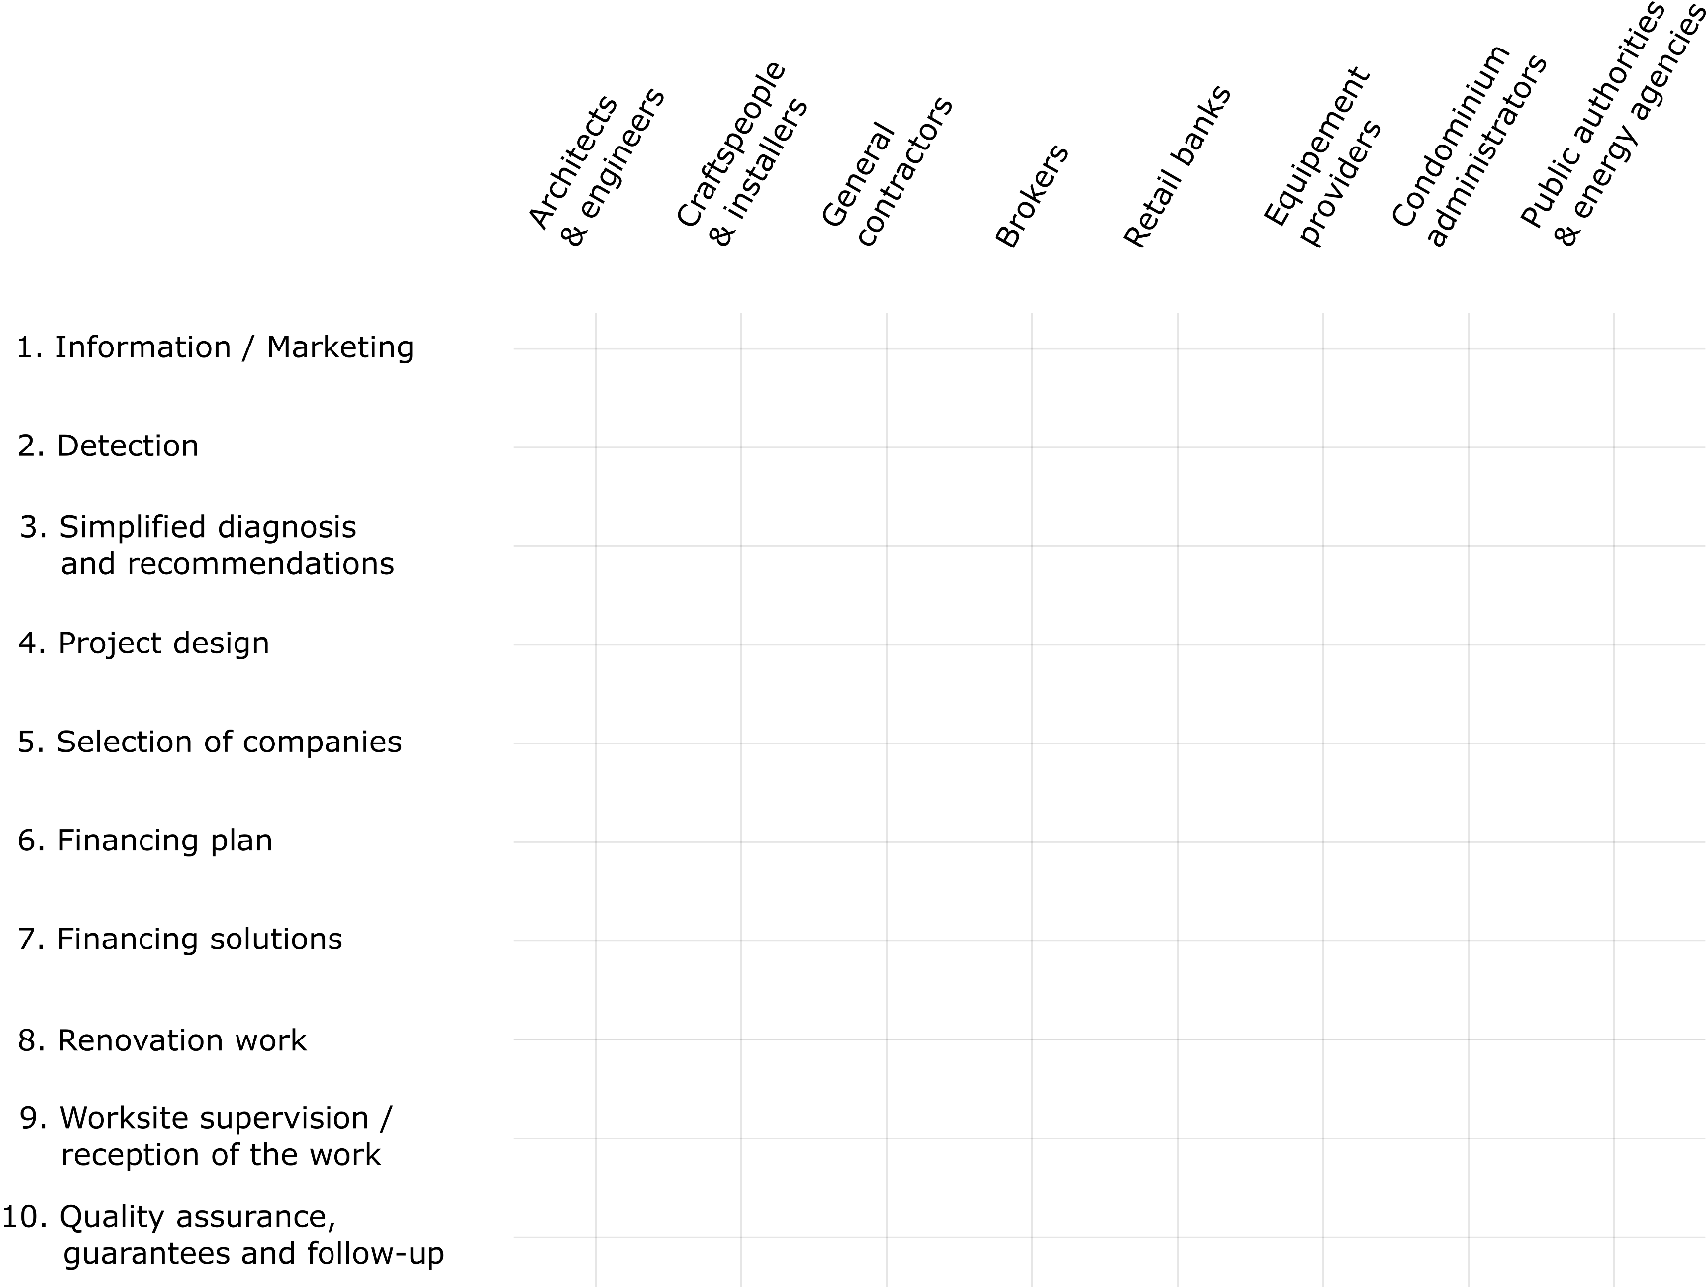
The windy journey of home energy renovation

Slide 6
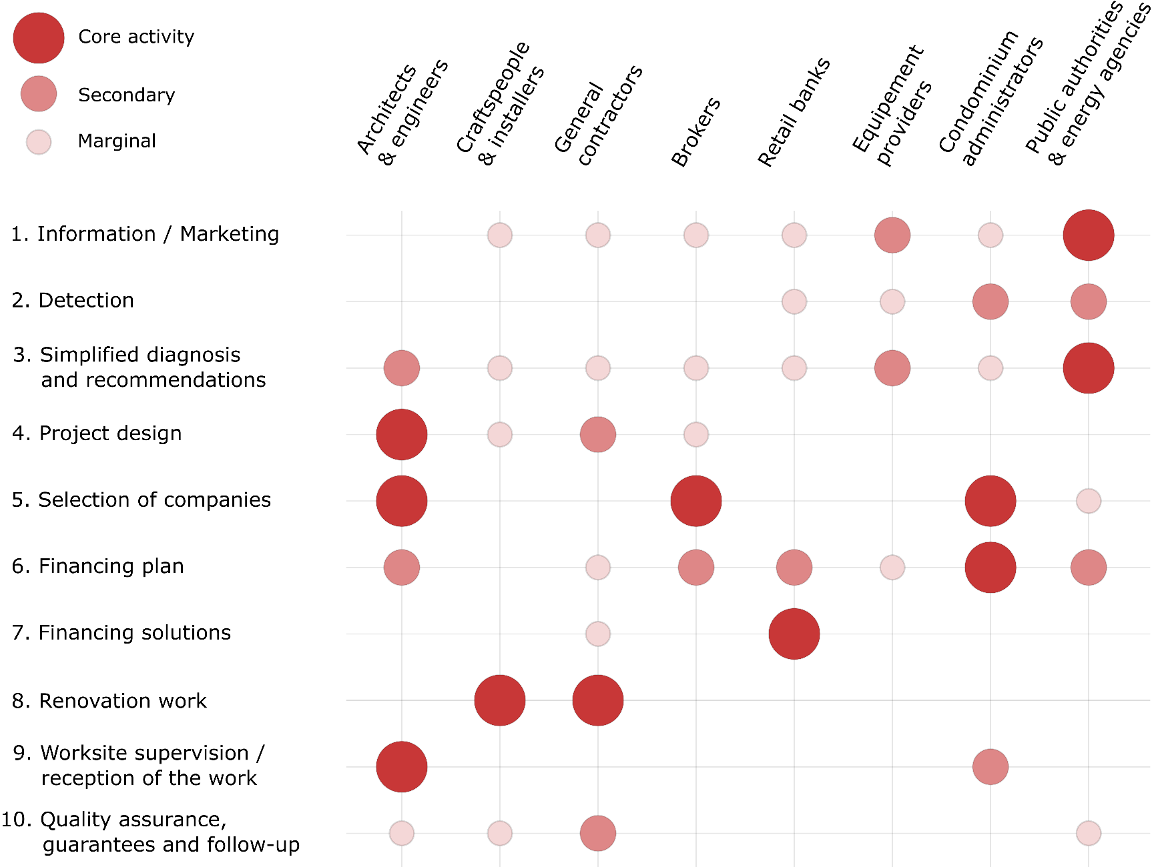
The windy journey of home energy renovation

Slide 7
The windy journey of home energy renovation

Slide 8

How to reduce the burden on homeowners?
Take on tasks for which homeowners are not well equipped
Catalyse the evolution of market practices by developing:
Integrated
Home
Renovation
Services

Slide 9
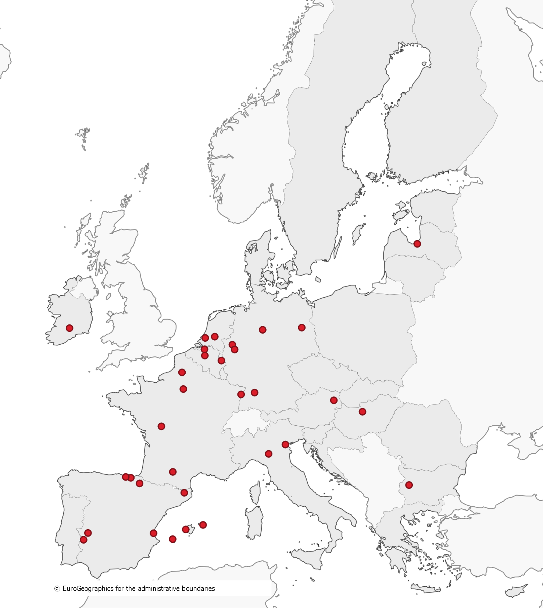
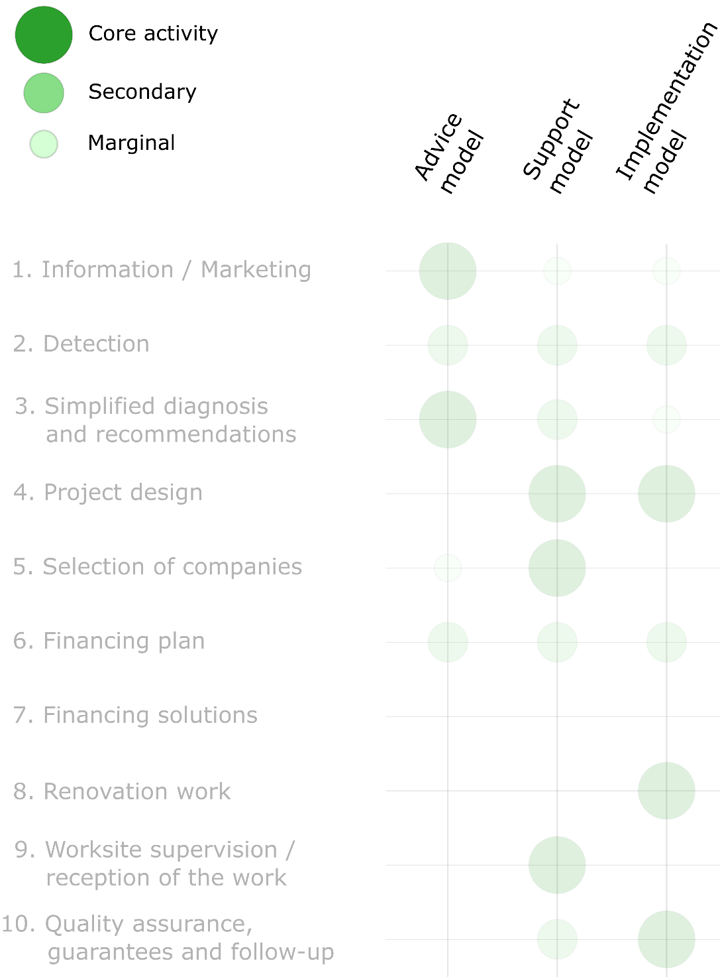
Promising local experiments along the customer journey

Slide 10
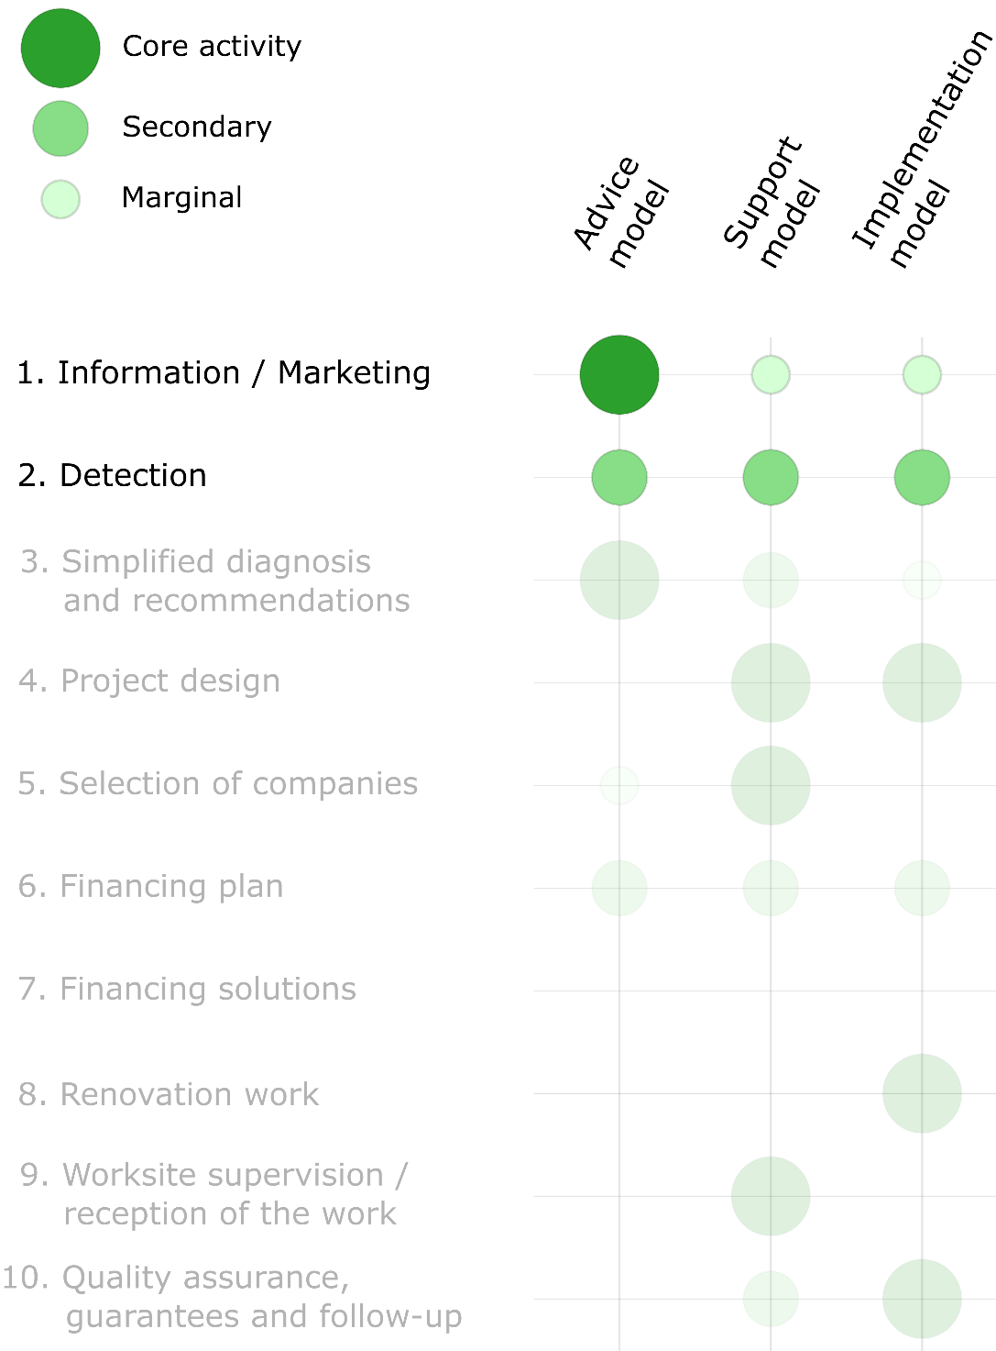
Promising local experiments along the customer journey
Information / Marketing
  Largest audience,
  messages not specifically tailored
  Raise homeowners’ awareness,
  Disseminate new social norms
  Greater impact if linked to follow-up services
Detection
  Identify homeowners most likely to perform work (e.g. house buyers)

Slide 11
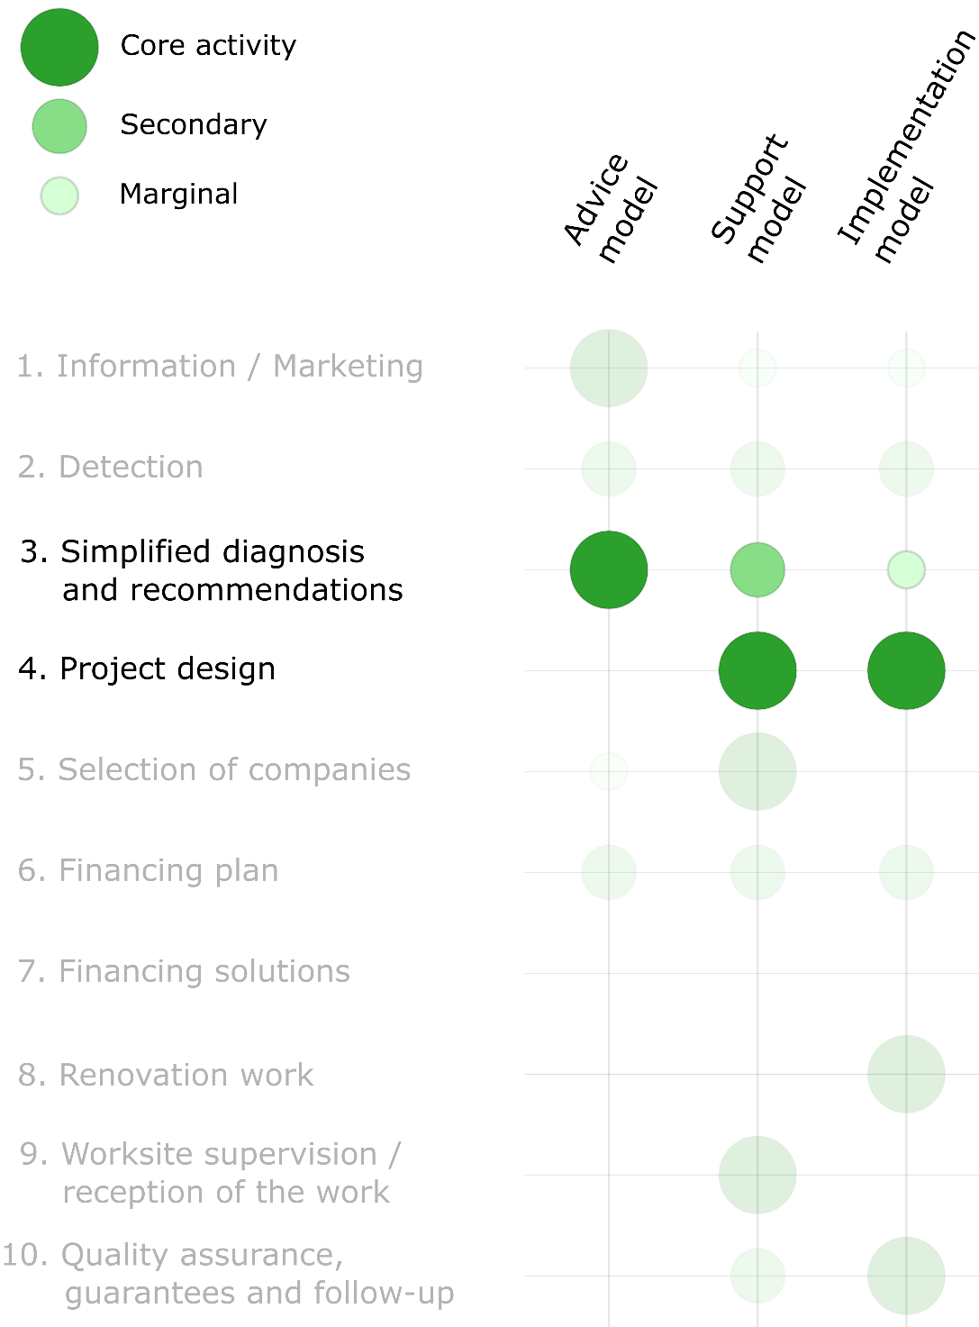
Promising local experiments along the customer journey
Simplified diagnosis & recommendations
  Key elements for 1st decision (go / no-go)
  But excludes going into design details
Project design
  Detailed design and operational support
  Engage in market activities,
  incurring professional liability
  Tipping point between the “advice” and
  the “support” (and “implementation”) models
  Materialised by a service contract?

Slide 12
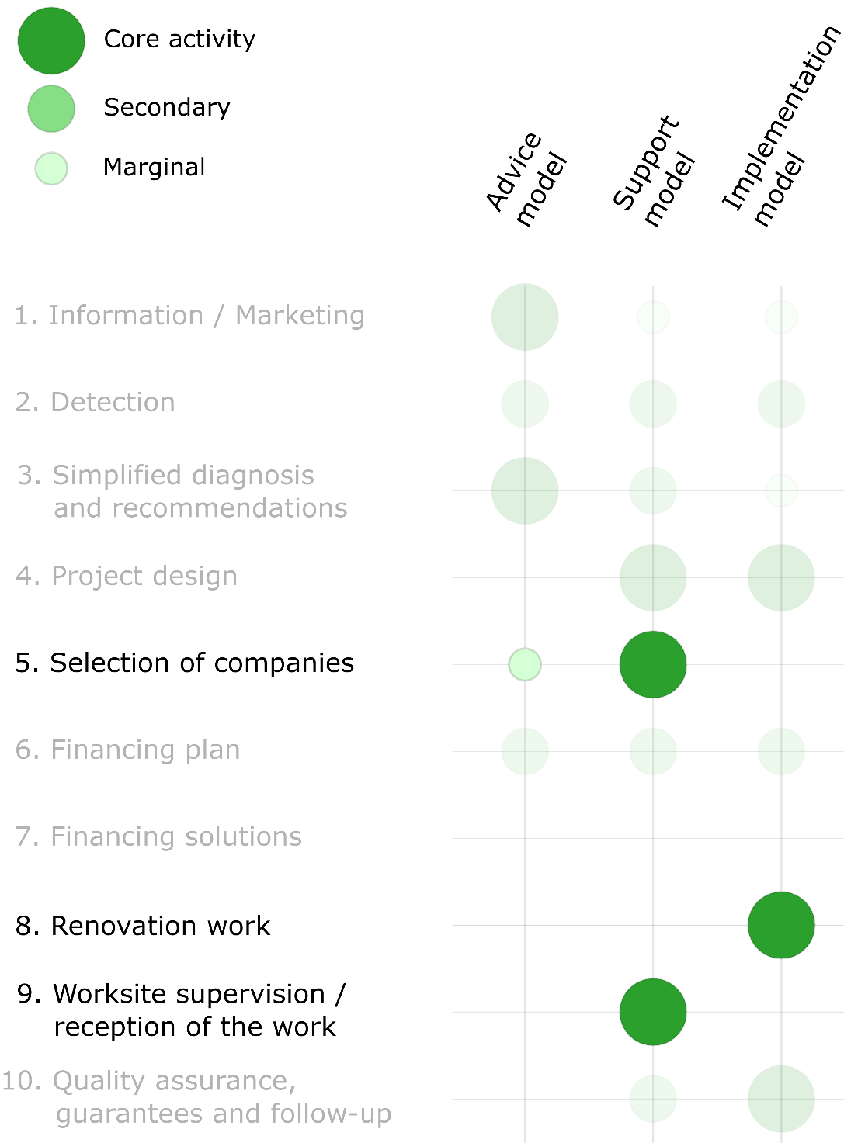
Promising local experiments along the customer journey
Selection of companies
  Assistance
  Delegation
  General Contractor (tipping point)
Renovation / Supervision
  Services positioned either
  on the homeowners’ side or
  on the builders’ side (diverging interests)

Slide 13
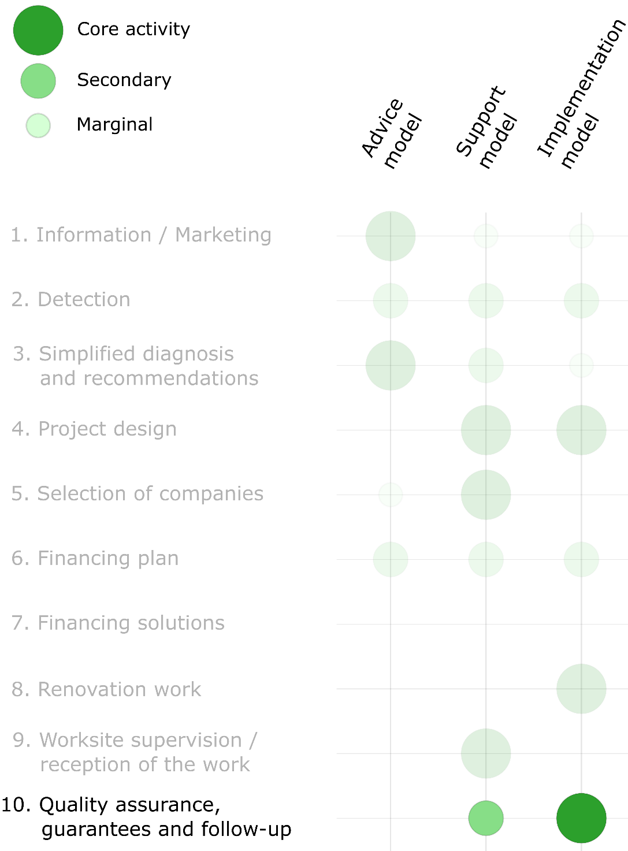
Promising local experiments along the customer journey
Lack of market maturity
(especially for low energy renovations)
  High risk of poor workmanship
  Not so much who performs the work but
  who is accountable to homeowners for it?
  Building homeowners’ trust is key
Quality assurance
  Should cover all services provided, from initial contact to after-sales
  Intrinsic performance or savings guarantee?

Slide 14
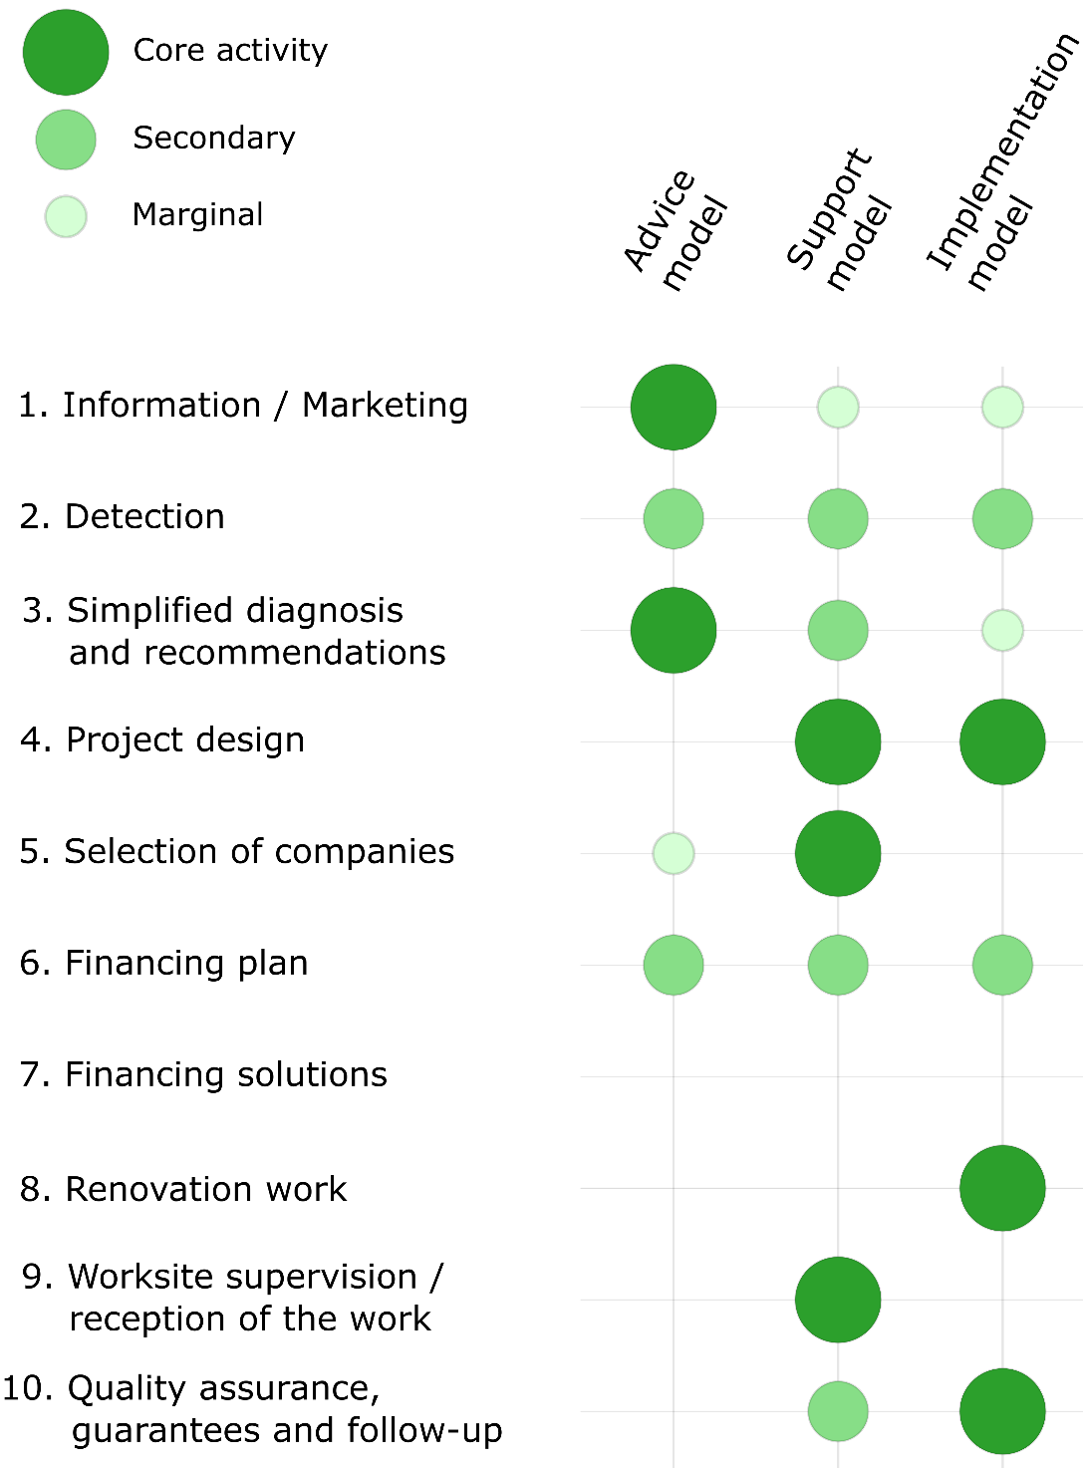
Three models along the
“customer journey”
Based on the observation of pilot initiatives across Europe
Mainly heuristic,
to be adapted to the local context
Easy to distinguish in generic terms…
…but boundaries are much less clear when getting into the details

Slide 15
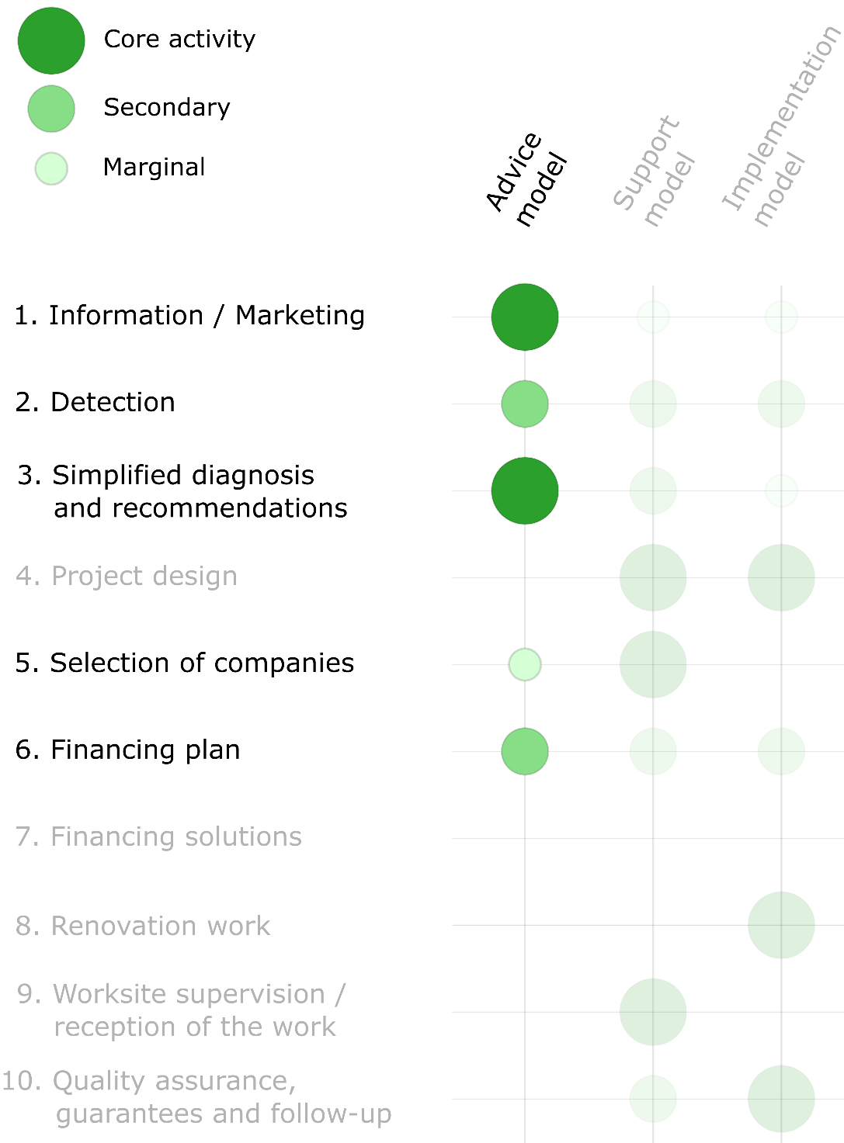
Three models along the
“customer journey”
Based on the observation of pilot initiatives across Europe
Mainly heuristic,
to be adapted to the local context
Easy to distinguish in generic terms…
…but boundaries are much less clear when getting into the details

Slide 16
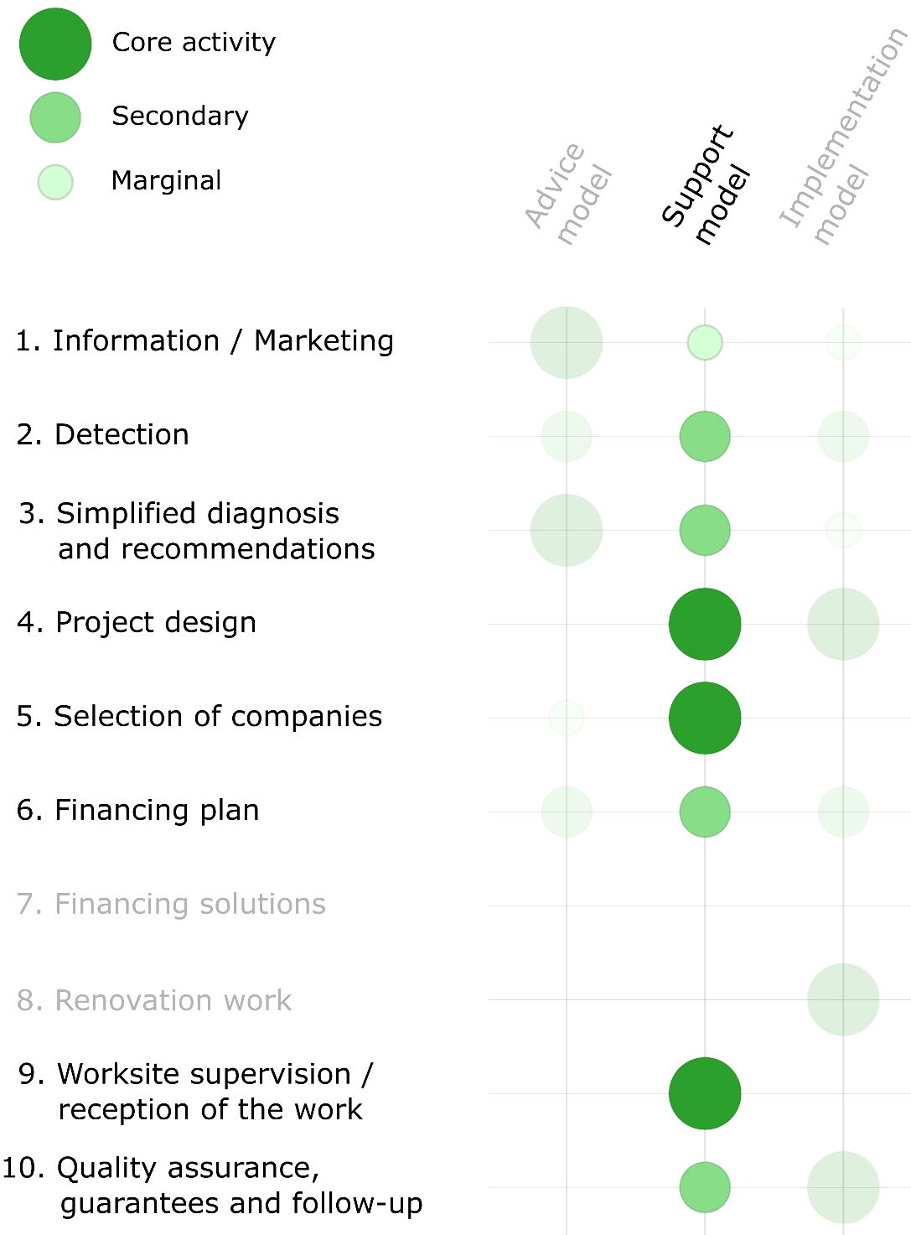
Three models along the
“customer journey”
Based on the observation of pilot initiatives across Europe
Mainly heuristic,
to be adapted to the local context
Easy to distinguish in generic terms…
…but boundaries are much less clear when getting into the details

Slide 17
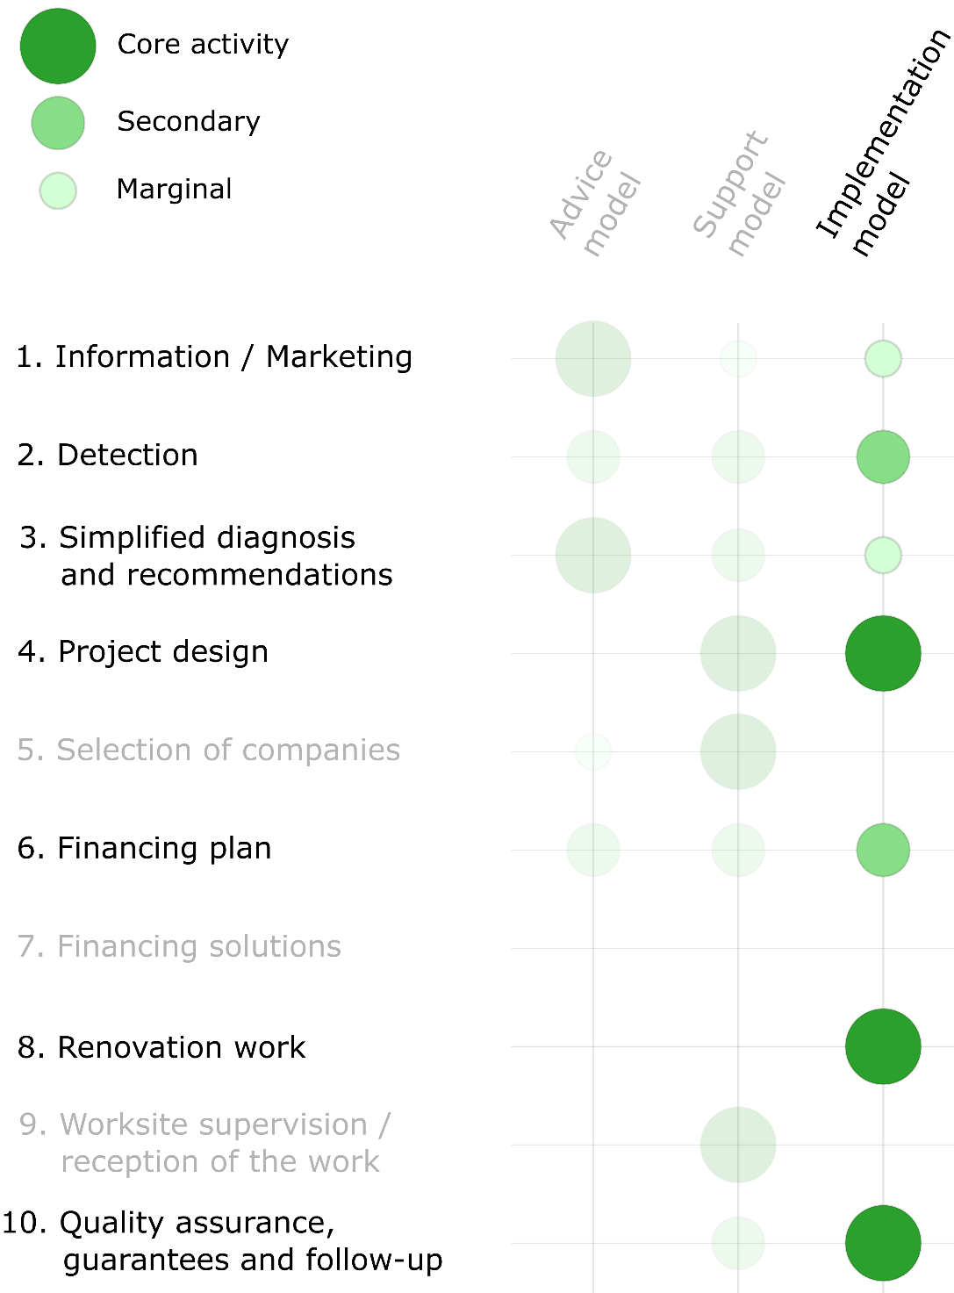
Three models along the
“customer journey”
Based on the observation of pilot initiatives across Europe
Mainly heuristic,
to be adapted to the local context
Easy to distinguish in generic terms…
…but boundaries are much less clear when getting into the details

Slide 18
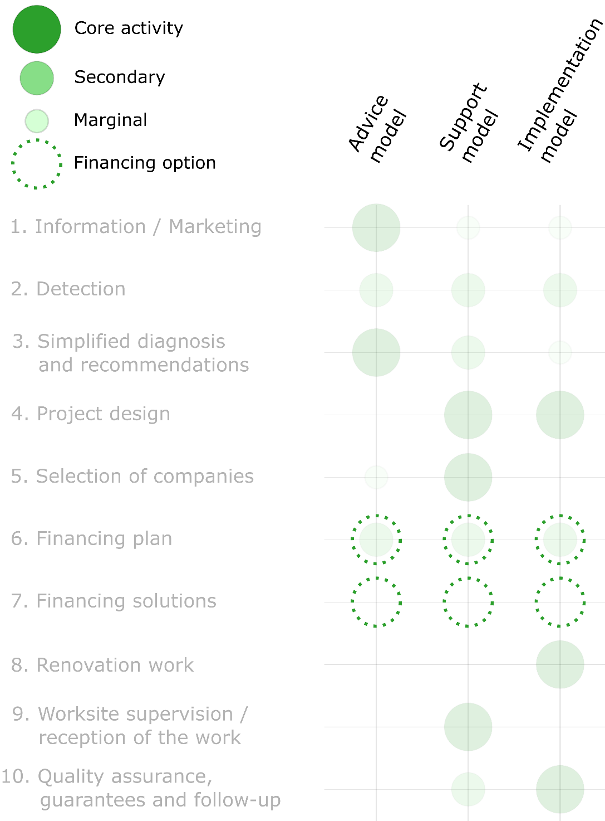
What about financing?
“Option” rather than 4th model
Standalone offer requires appropriate legal framework
Other financing services to consider
  Support in accessing public grants
  Pre-financing of public grants
  Pre-qualification for a retail bank financing offer
Home-based financing is being explored

Slide 19

Not all roads lead to Rome
Different models hardly fit in
one and the same structure
Balance costs with ambition and investment potential
How to best position public action to build homeowners' trust?
The best solution is a compromise, based on local conditions

Slide 20

Should IHRS be economically viable?
4 to 6 years to reach maturity
None of the initiatives has reached
self-sustainability
High leverage factor and demonstrated effectiveness of public support
  effective use of public funds
Special attention should be paid to
legal and regulatory frameworks to facilitate large-scale deployment
Photo by Fred Marie Photographer on Foter.com ⁄ CC BY-NC-ND

Slide 21

Conclusions
IHRS are essential to move towards climate goals
Findings from frontrunners must be further harvested, analysed and debated
Public funds should support the multiplication of initiatives
Build the capacity of local actors to develop and operate such schemes,
on a large scale

Slide 22
To go further…
AnPost (IE): https://www.anpost.com/Green-Hub/Home-Energy-Upgrade-Service
Arec occitanie (FR): https://www.arec-occitanie.fr
Artéé (FR): https://www.artee.fr/
C-real (BE): https://www.c-real.be
Easycopro (BE): https://www.easycopro.be
Energy efficient mortgage initiative: https://energyefficientmortgages.eu
Europace: https://www.europace2020.eu/
Facirénov (FR): https://www.facirenov.fr
Fithome (NL): https://www.fithomeproject.eu
Hauskunft (AT): https://www.hauskunft-wien.at
Hauts-de-France pass renovation (FR): https://www.pass-renovation.hautsdefrance.fr
Holadomus (ES): https://www.holadomus.com
Houseenvest (ES): https://renuevatucasa.eu
Île-de-France énergies (FR): https://www.iledefranceenergies.fr
Innovate: http://www.financingbuildingrenovation.eu/
Oktave (FR): https://www.oktave.fr
Opengela (ES): https://opengela.eus/
Orfee (FR): https://orfee-project.com
Padova fit (IT): https://www.padovafit.eu
Proretro (DE): https://proretro.eu
Reimarkt (NL): https://reimarkt.nl
Renohub (HU): https://renohub-h2020.eu
Renonbill (ES, IT, LT): https://www.renonbill.eu
Save the homes (ES, NL): https://savethehomes.org
Sheerenov (BG): https://sheerenov.eu/
Sunshine (LV): https://sharex.lv
Superhomes (IE): https://superhomes.ie/
Turnkey retrofit (ES, FR,IE): https://www.turnkey-retrofit.eu

Slide 23
Thank you
Notes:
Update/add/delete parts of the copy right notice where appropriate.
More information: https://myintracomm.ec.europa.eu/corp/intellectual-property/Documents/2019_Reuse-guidelines%28CC-BY%29.pdf

