Slide 1


Standardized assessment and innovative (re-)financing of industrial sustainable energy investments (TrustEE)
Innovative Solutions to finance the Green Deal
Covenant of Mayors' Investment Forum – Energy Efficiency Finance Market Place in Brussels on 15 - 16 June 2021
A Horizon 2020 project to finance and realize energy efficiency and renewables in industry

Slide 2
The consortium
www.trust-ee.eu
Contact@trust-ee.eu

Slide 3
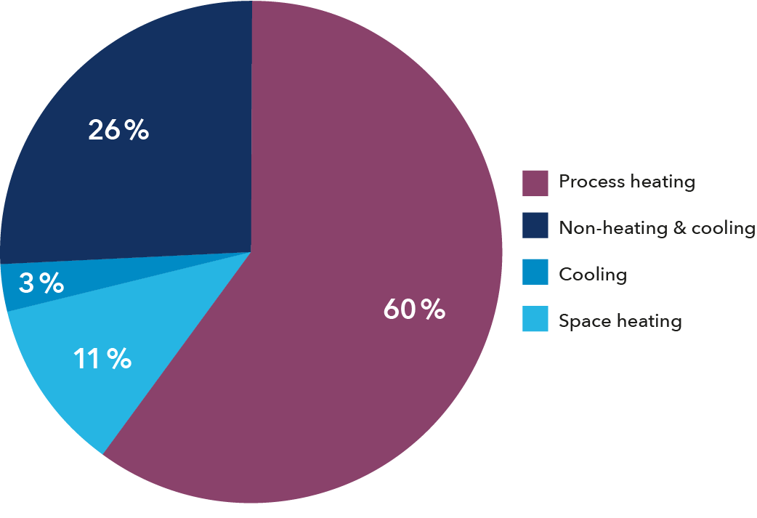

Challenges
  Process heating accounts for 60% of EU industrial energy use
    About 1,920 TWh, 18 % of total EU energy demand¹
  Energy efficiency and renewable energy projects are economically feasible.
  However, even well-designed projects fail to attract viable financing due to:
    Risk mitigation problems with innovative projects due to lack of technical knowhow among banks and investors
    Transaction costs high relative to capital requirements
    Projects developed by or for small and medium enterprises often lack necessary credit and performance guarantees required by financial institutions
    No standardized procedure (technical and economic) and by this time and resource consuming
    No industrial standards (only building area)
Energy use for heating demand in EU¹
Sources: 1 - Fraunhofer et al. 2016.

Slide 4

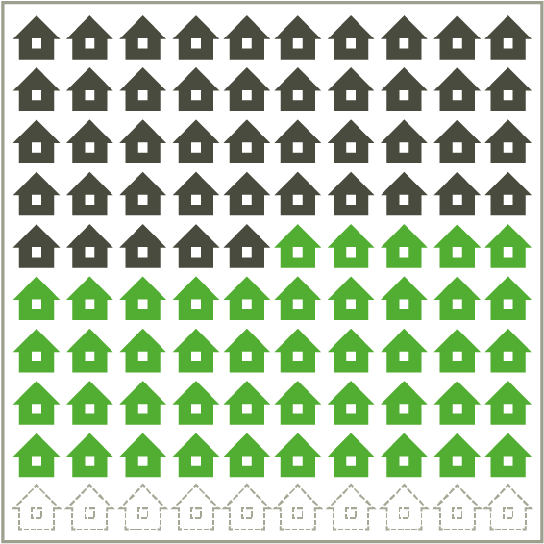
Opportunities
  60% of industrial process heating demand could be supplied by established energy efficiency and state-of-the-art renewables
  Energy efficiency:
  8–10% average savings with 5-year or less payback across industrial sectors¹
  Renewable energy:
  50% of industrial process heat demand could be met by state-of-the-art solar thermal, biogas and biomass technologies²
Dark = fossil sources;
Green = renewable energy;
Transparent = energy efficiency
Sources: 1. “Study on EE and Energy Savings Potential in Industry…” ICF International. 2015
2. Estimate developed based on several sources: “Process heat collectors…” Horta P. 2016; “Process heat in Industry, Suitable Technologies”. Fraunhofer ISE presentation. 2017. “Potential for Solar Heat in Ind. Processes.” Vannoni C. et al. 2008;

Slide 5
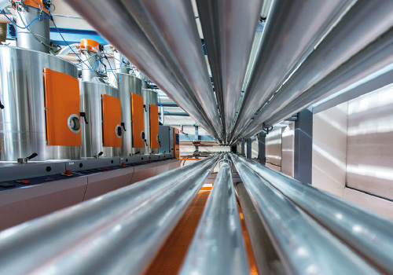
Vision
  Simple and flexible project financing for industrial de-carbonization
  Making sustainable energy investments bankable
  Project developers and technology suppliers use the web- based TrustEE platform to assess technical feasibility and financial viability.
  By addressing technical, performance and credit risks (among other project risks), we expedite due diligence that results in pre-approved sales financing offers from our bank partners.

Slide 6
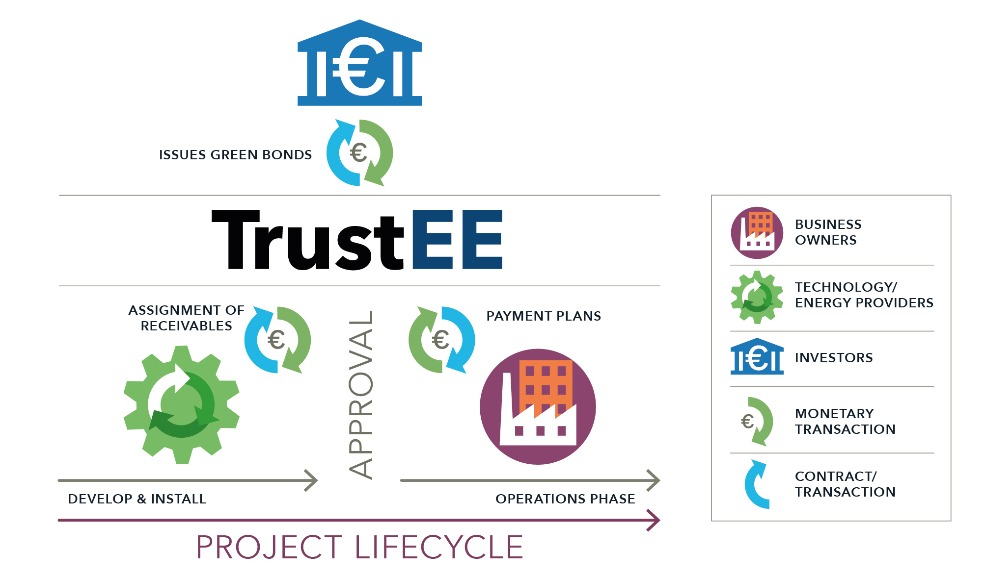
Business model

Slide 7
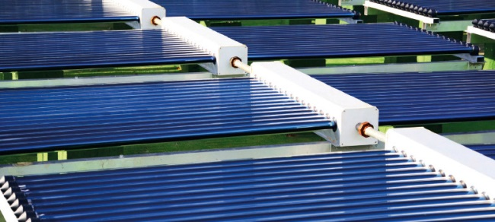
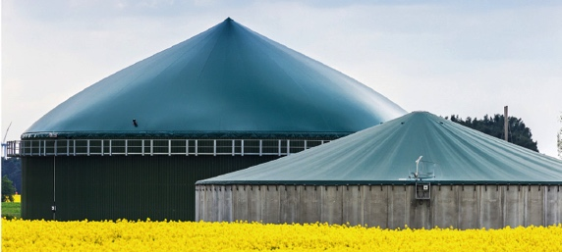
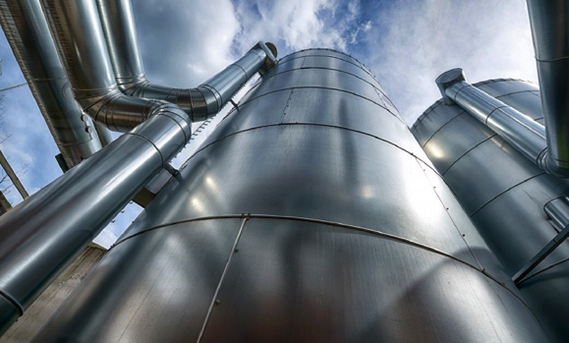
Project focus & scope
  Small to mid-size industrial energy efficiency and renewable energy projects, including:
  Waste heat recovery, solar thermal, biogas, biomass, and heat pumps
  Extended to PV and control optimisation (in progress)
  SME-projects sponsored by owners/end-users, engineers and planners, technology suppliers and manufacturers
  Well-developed projects having attractive amortisation times
  State-of-the-art and innovative projects in industrial sectors
  Performance-based project models, such as energy performance contracts or energy sales agreements

Slide 8
TrustEE platform

Slide 9
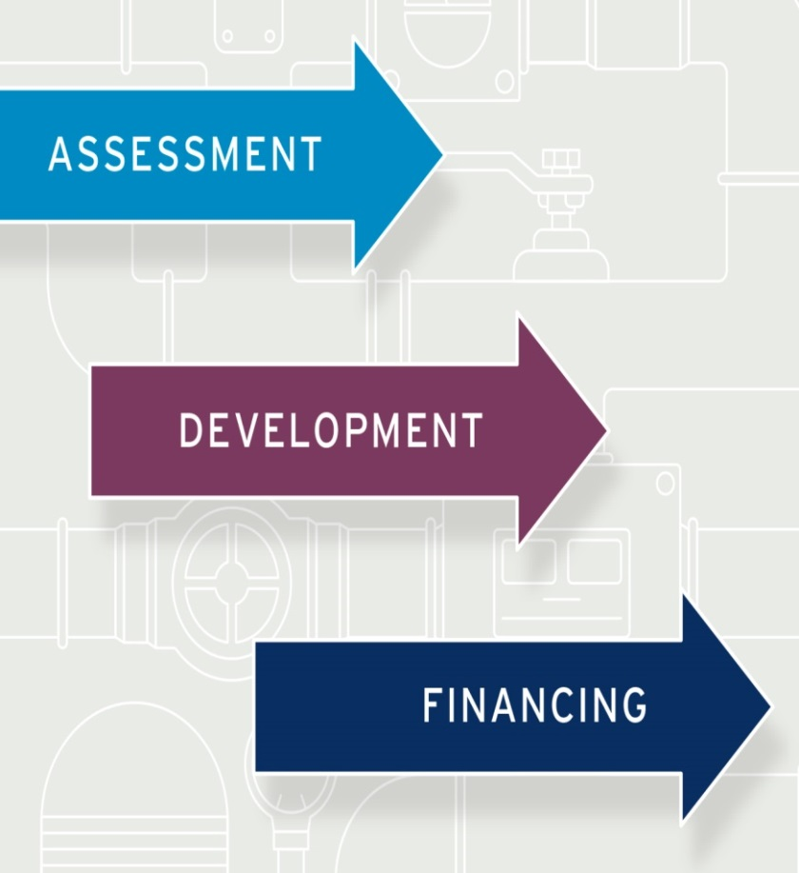
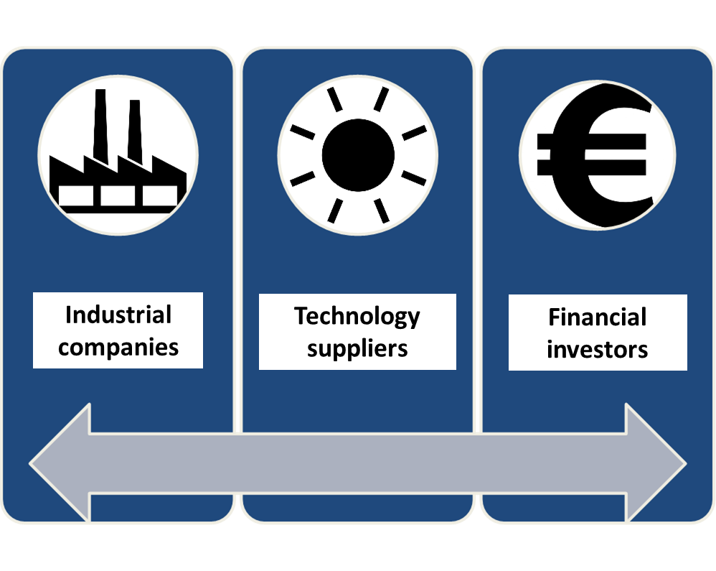
When - for whom?

Slide 10
Propose projects
3 steps
TrustEE Platform
1. Automated project check
Go to
Step 2
3. Consultation
Re-financing
2. Automated measures check
Go to
Step 3
Acceptance
Acceptance
Acceptance
User provides project info:
Technology/measures
Savings (energy, €)
Technical and economic information about end user
Economic information about the technology provider and planner
TrustEE staff discusses project support and optimisation.
Creates basis for:
Risk assessment
Insurance
Re-financing via Securitisation Vehicle
Details provided about type of measures implemented e.g., solar thermal, biomass, biogas, heat pump, energy efficiency/heat recovery
Rejection
Rejection
Rejection
Explanation
Explanation
Explanation

Slide 11
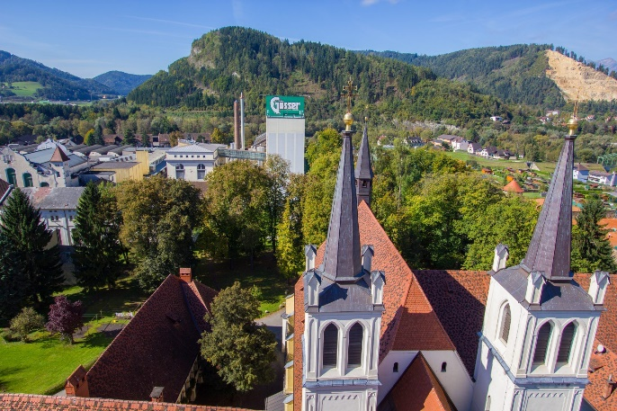
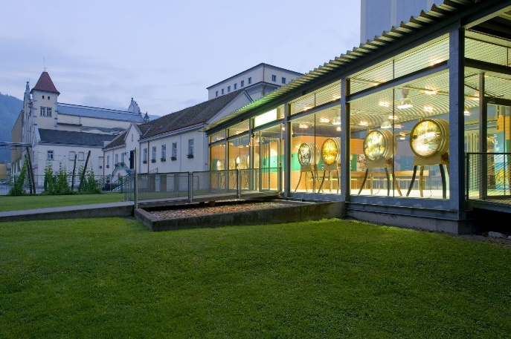
Example – Brewery Gösser
Key data
Company: Brewery Gösser
Location: Austria, Europe
Key data: Installation of a large-scale solar thermal plant at the brewery Gösser to supply the mashing process with solar process heat.
The project was implemented as part of the FP7 project SolarBrew in 2013 and serves as an example for the TrustEE process.
Source: 2019 BRAU UNION ÖSTERREICH AKTIENGESELLSCHAFT

Slide 12
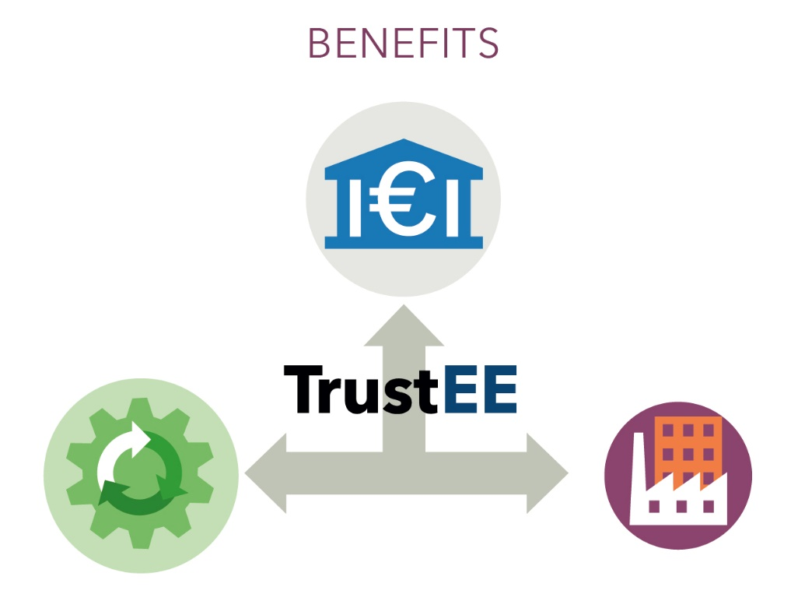
Example – Brewery Gösser
The parties
Financing partner
Technology supplier:
Arcon-Sunmark GmbH
End user:
Brewery Gösser

Slide 13
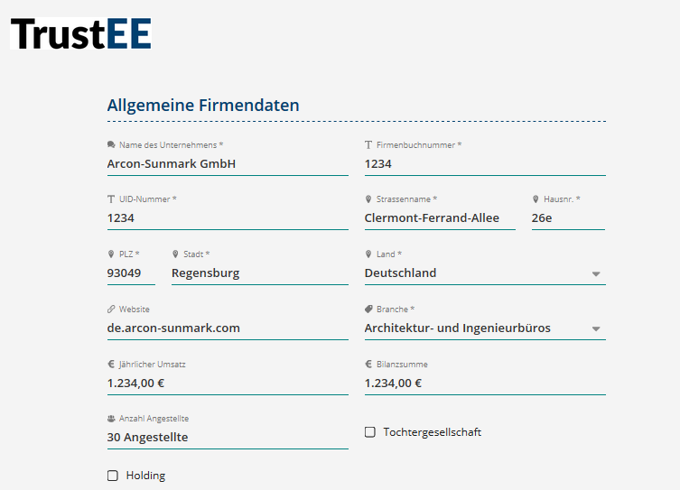
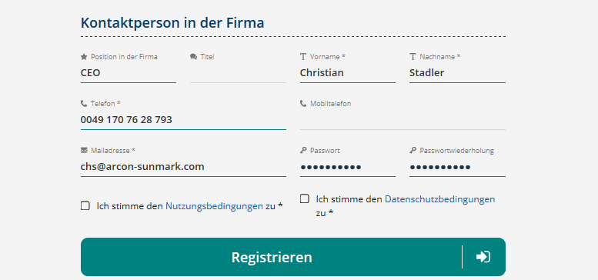
Example – Brewery Gösser
Registration
Solar supplier registered as an applicant at https://finplace.eu/eef/trustee
Company data and contact person details
  Adress
  Branch
  Company register and ID number
  Turnover, balance sheet total
  Employees
  Contact details

Slide 14
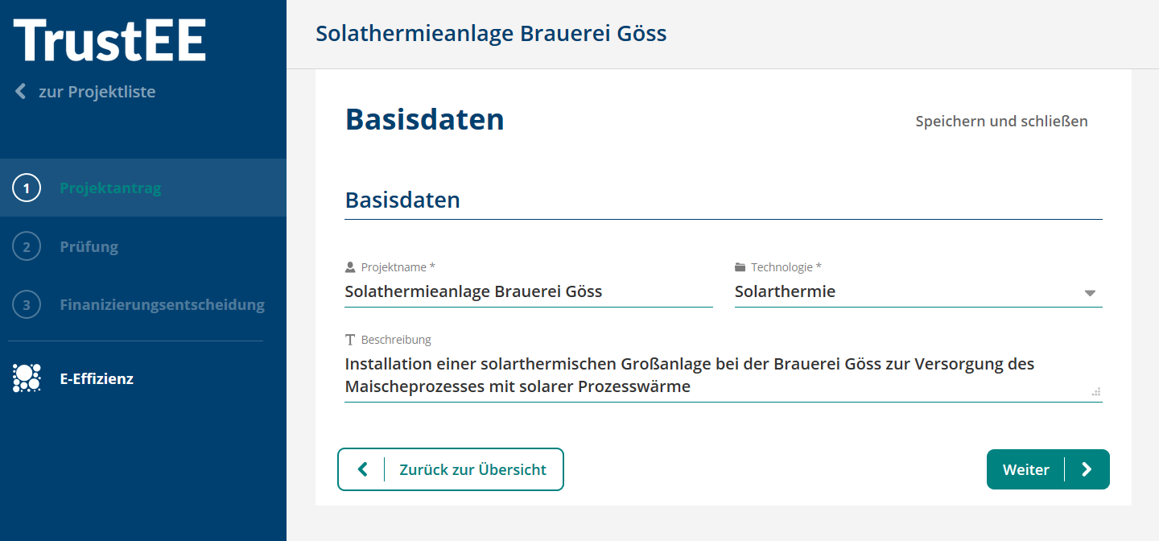
Example – Brewery Gösser
Project data
Basic data
  Project name
  Technology
  Short description
Basic data
Applicant data
Technology supplier data
End user
Economic feasibility
Substituted energy system
Operating details
Solar thermal
Summary

Slide 15
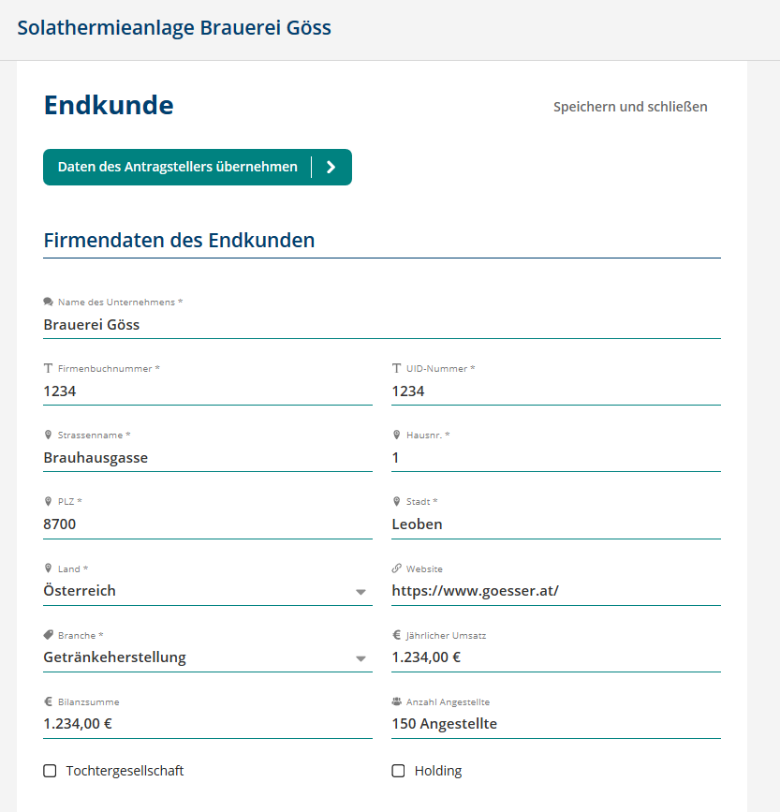
Example – Brewery Gösser
End user
Enter company data / contact details for brewery Gösser
  Address
  Branch
  Company register and ID number
  Turnover, balance sheet total
  Employees
  Contact details
Basic data
Applicant data
Technology supplier data
End user
Economic feasibility
Substituted energy system
Operating details
Solar thermal
Summary

Slide 16
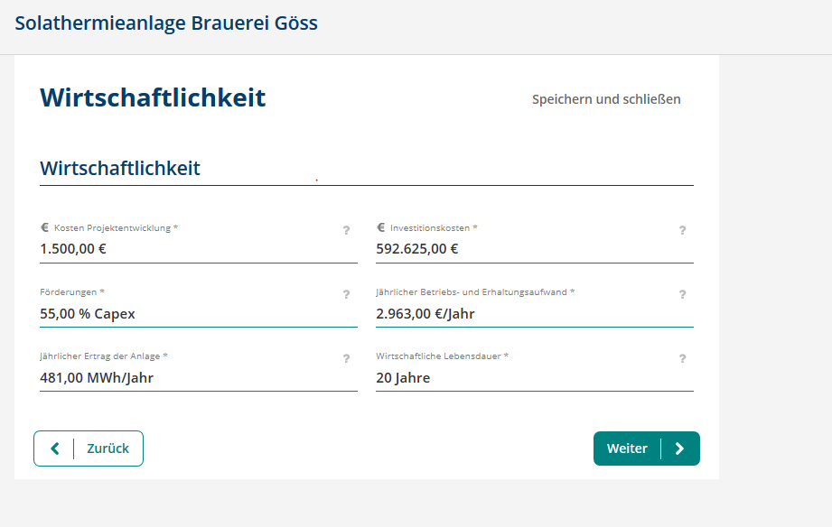
Example – Brewery Gösser
Economic data
Provide economic data of the solar thermal system
  Investment cost
  Funding
  Operating and maintenance costs
  Annual yield of the plant
  Lifetime
Basic data
Applicant data
Technology supplier data
End user
Economic feasibility
Substituted energy system
Operating details
Solar thermal
Summary

Slide 17
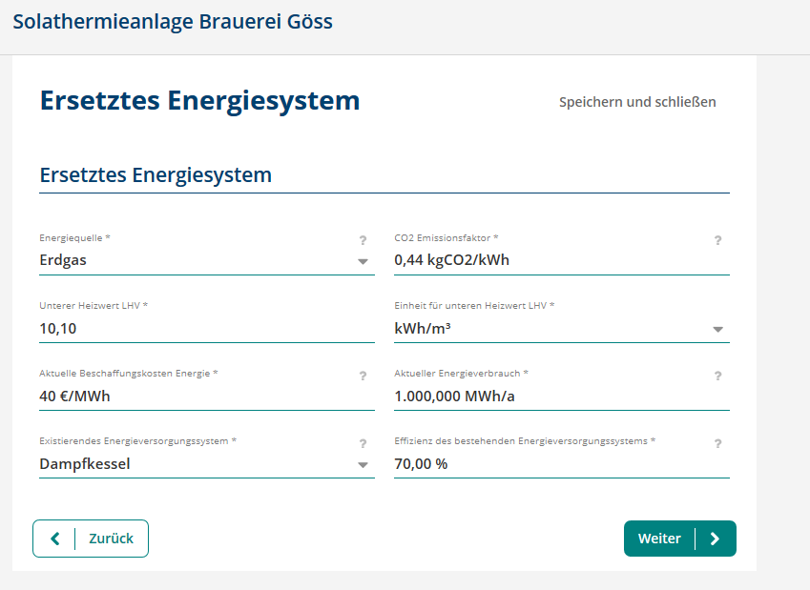
Example – Brewery Gösser
The baseline
Information on the current energy system
  Energy sources
    CO2 emission factor
    Calorific value
    Energy costs
  Energy demand
  Supply system
    Type
    Efficiency
Basic data
Applicant data
Technology supplier data
End user
Economic feasibility
Substituted energy system
Operating details
Solar thermal
Summary

Slide 18
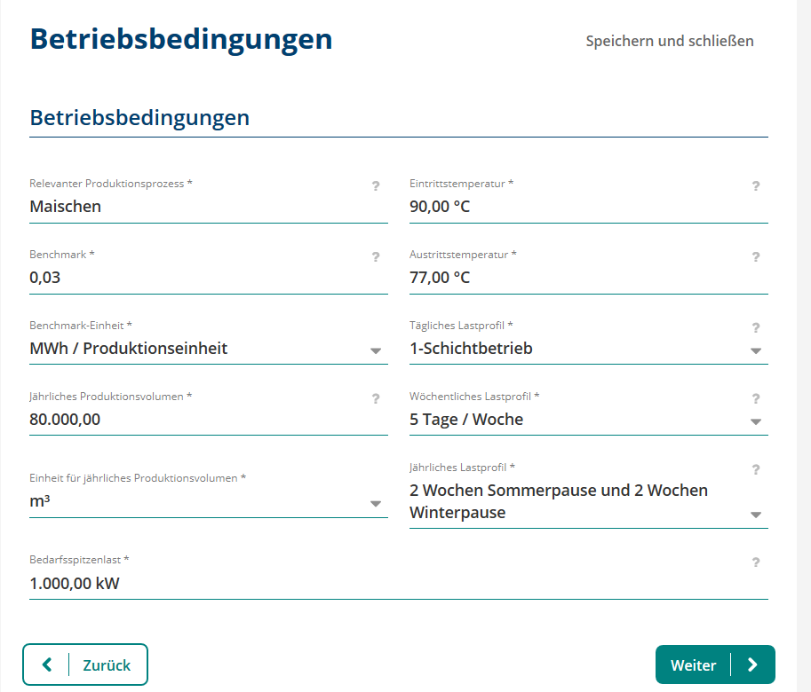
Example – Brewery Gösser
Technical data
Entering of the technical data of the solar thermal system
  Production process
    Temperature
    Capacity
    Load profile
  Platform creates a load profile in the background to check the technical solar data.
Basic data
Applicant data
Technology supplier data
End user
Economic feasibility
Substituted energy system
Operating details
Solar thermal
Summary

Slide 19
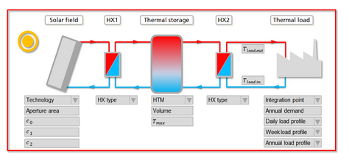
Example – Brewery Gösser
Example SHIP
Entering of the technical data of the solar thermal system
  Solar collector
    Type, collector specific data
  Irradiation
  Collector field
    Size, inclination
  System
    Heat exchanger (Number, type)
    Storage (Size, Type, Temperatur)
    Yield
Basic data
Applicant data
Technology supplier data
End user
Economic feasibility
Substituted energy system
Operating details
Solar thermal
Summary

Slide 20
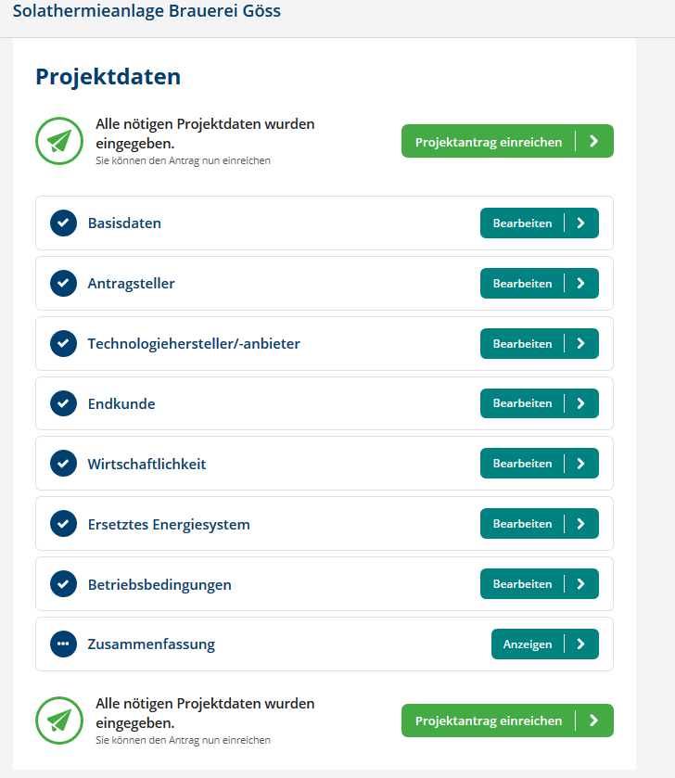
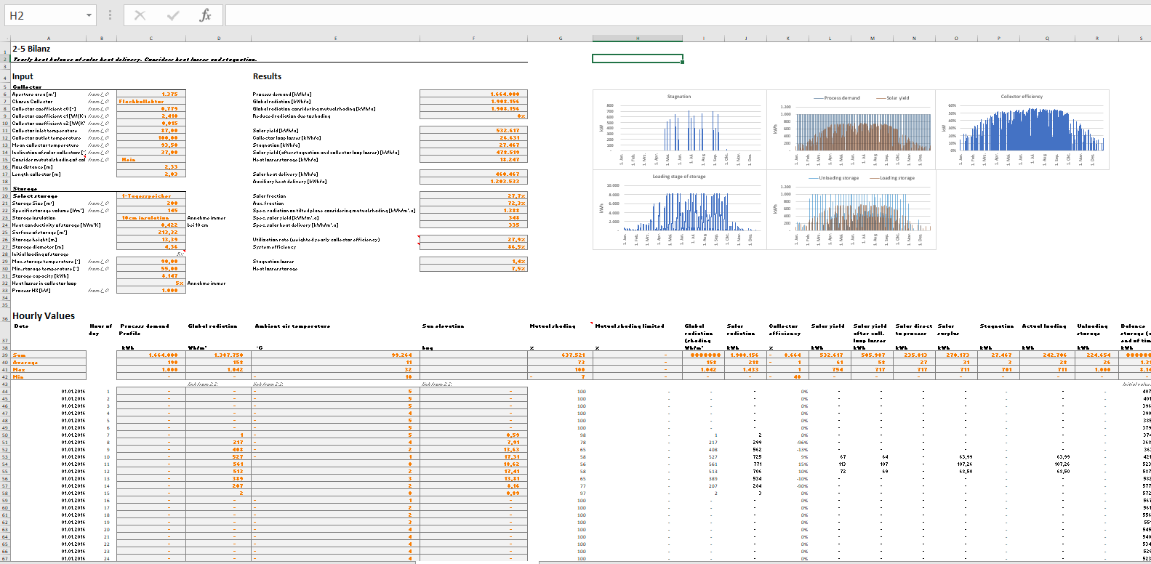
Example – Brewery Gösser
Submission & Review
  After entering all necessary data, the project application will be submitted
  The platform automatically checks the input data (simulation in the background)
Basic data
Applicant data
Technology supplier data
End user
Economic feasibility
Substituted energy system
Operating details
Summary

Slide 21
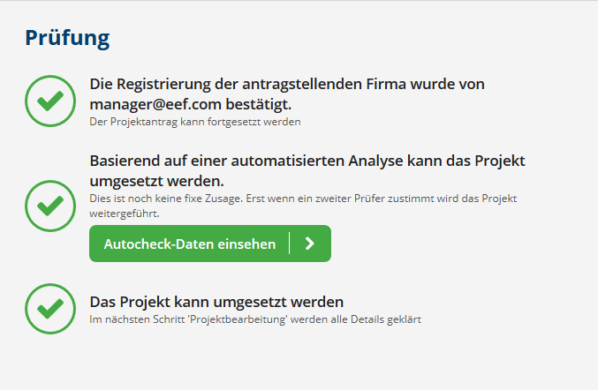
Example – Brewery Gösser Results
  Autocheck file
    detailed comparison of the input data and results of the simulation.
    → negative evaluation, report about
    reason for the rejection
    → positive assessment; the financing
    commitment given to the applicant

Slide 22
TrustEE financing

Slide 23


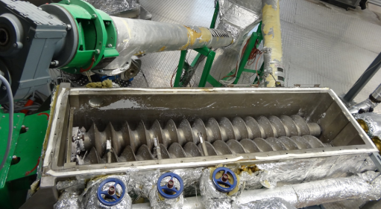
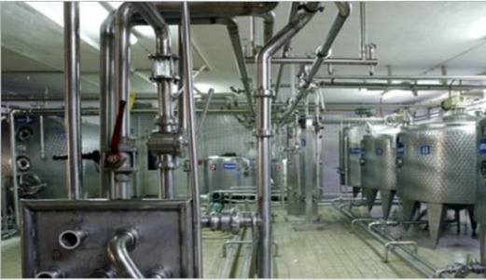
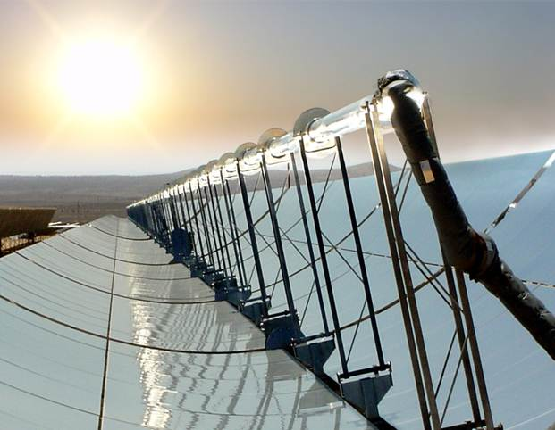
TrustEE’s Objectives of Financing
Development and implementation of an innovative market based third-party financing scheme
Definition and implementation of technical support tools
Lowering IRR requirements
Gathering a portfolio of investments
Market penetration of EE and RE technologies in industry

Slide 24
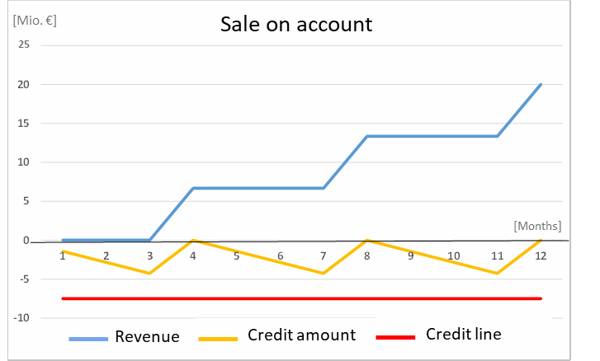
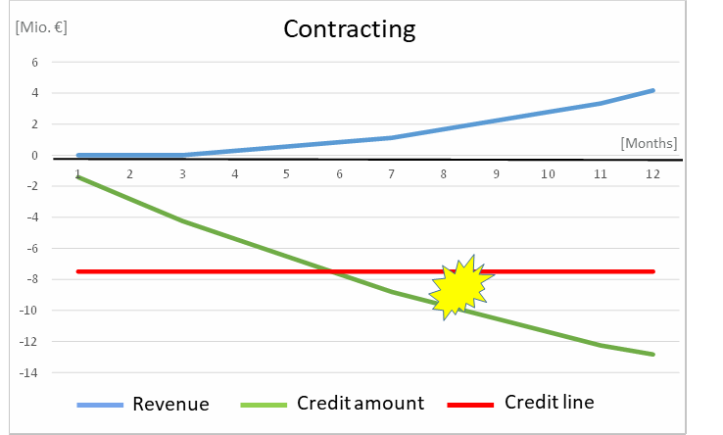
Financial challenges: Decarbonization projects in industry
Either: High upfront investments in non-core assets with long amortization times, if the company would like to invest itself (“decarbonization by CAPEX”)
Or: supplier or ESCO invests; paid off by the industrial company under the title of energy service or energy supply contracts; credit risk and performance risk remains with ESCO and/or financing partner of ESCO “ESCO”-model) and (“decarbonization by OPEX”)
TrustEE focuses on facilitating OPEX approaches:
Energy Performance Contracts
Energy Supply Contracts
Energy-as-a-Service-contracts

Slide 25
TrustEE’s financing approach
Due diligence of suppliers and framework contracts
Products
Contract standards
Standardized financing terms
Framework contract
Technical project assessment
by TrustEE‘s software tool
Compliance with predefined
terms of customer contracts
Creditworthiness of customer
Single project template
Technical, economic and legal evaluation via platform at low cost
Supplier finances construction and takes
technical risk for project completion
Commissioning: confirmation of technical performance
Project realisation and acceptance by end user
Installation
Successful testing
Fixed payment schedule
Refinancing (purchase) of supplier ‘s receivables after commissioning (forfaiting contract)
Revenues used for reducing supplier‘s debt
Receivables can be used for securitization
Purchase of receivables through TrustEE

Slide 26


Current Status
Commercial start – up
Three partners of the H2020 consortium plus a new partner responsible for the IT-related platform development and for the operation of the platform.
Supplier and product registration, assessment and editing of the financing proposal: https://finplace.eu/eef/trustee
Austrian Bank provides financing for forfaiting
Contact with other banks and with energy efficiency funds.
Additional funding for IT and platform development, legal documentation for other jurisdictions and marketing required.

Slide 27
Issues:
Supplier and project acquisition
Due diligence of suppliers and framework contracts
Targets for supplier acquisition: SME-sized technical suppliers looking for sales financing models like leasing offers.
Issues for acquisition:
Weak USP of TrustEE for energy efficiency products (like software solutions, heat pumps, heat exchangers, batteries), compared to mainstream sales leasing-type models.
Competitive edge for Opex-based-offers for other products (like heat storage, solar thermal installations, biogas/biomass boilers etc.), which are more complex and difficult to lease.
But many SME-sized suppliers not able or prepared to turn the traditional product sale business model into the ESCO-type model of an energy service offer.
Framework contract
Products
Contract standards
Standardized financing terms

Slide 28
Issues:
Credit processing cost
Technical project assessment by TrustEE‘s software tool
Compliance with predefined terms of customer contracts
Creditworthiness customer
TrustEE is designed to slash cost and time for the assessment of technical risks, technical performance and for the review of supplier and financing contracts for small projects (100.000 - 500.000 EURO).
However, financing partners (banks, investors) cannot simply take over credit informations provided by TrustEE. They have to do the credit risk assessment using their internal risk management systems. Internal credit processing cost remain.
Therefore small projects still are less attractive for banks and financial investors, even if the technical assessment is provided at low transaction cost.
Framework contract
Single project template
Technical, economic and legal evaluation via platform at low cost

Slide 29
Issues: Credit risk policy of (re)financing partners
Refinancing (purchase) of supplier‘s receivables after commissioning (forfaiting contract)
Revenues used for reducing supplier‘s debt
Receivables can be used for securitization
Forfaiting long-term accounts receivables is not a standard refinancing approach of banks like factoring or leasing.
Forfaiting is treated by banks like a long-term loan to the debtor of the receivables – with all credit risk management procedures attached.
When forfaiting is used by energy efficiency funds, they try to minimize credit risk by purchasing receivables only against debtors with very high credit ratings.
Finding financial investors with an appetite for SME-related credit risk is difficult.
Framework contract
Purchase of receivables through TrustEE

Slide 30
Issues:
Securitization of forfaited receivables
Refinancing (purchase) of supplier‘s receivables after commissioning (forfaiting contract)
Revenues used for reducing supplier‘s debt
Receivables can be used for securitization
For securitization, all credit risk issues relevant for financing forfaiting operations must be resolved in the „warehousing phase“.
Additionally, proof of compliance with the EU taxonomy rules will become nearly mandatory.
The required financing volumes for securitization (> 50 Mio EURO) will be feasible only as energy efficiency financing by forfaiting becomes a mainstream financing technique.
Framework contract
Purchase of receivables through TrustEE

Slide 31
Solutions:
Project aggregation by ESCOs
Aggregation into a comprehensive decarbonization project instead of single incremental energy efficiency measures :
Strategic measure with buy-in of top management : decarbonization is increasingly understood as strategic priority
Investment size favors Energy-as-a-service-solution : High upfront investment in non-core assets with long amortization times cannot be financed on the balance sheet of the customer
Larger refinancing volume facilitates forfaiting solution
A promising business model for strong ESCOs

Slide 32
Solutions:
Guarantees for counterparty credit risk
Timely payment by customers is a critical long-term credit risk.
But the customers who need energy-as-a-service solutions most are SMEs with moderate credit ratings.
The major impediment for OPEX-based financing solutions for decarbonization investments is counterparty credit risk.
Public guarantees needed to cover payment default risks of purchased receivables for the benefit of banks or financial investors.
Export credit guarantees are providing this type of risk cover in most member states already since many years!
Transferring these long-established guarantee systems to OPEX-based business models for decarbonization can boost investment with full buy-in of banks, financial investors and securitization vehicles.

Slide 33
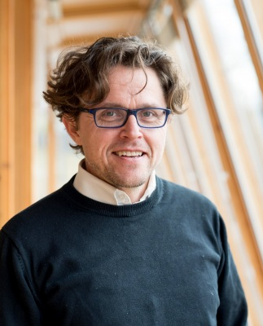
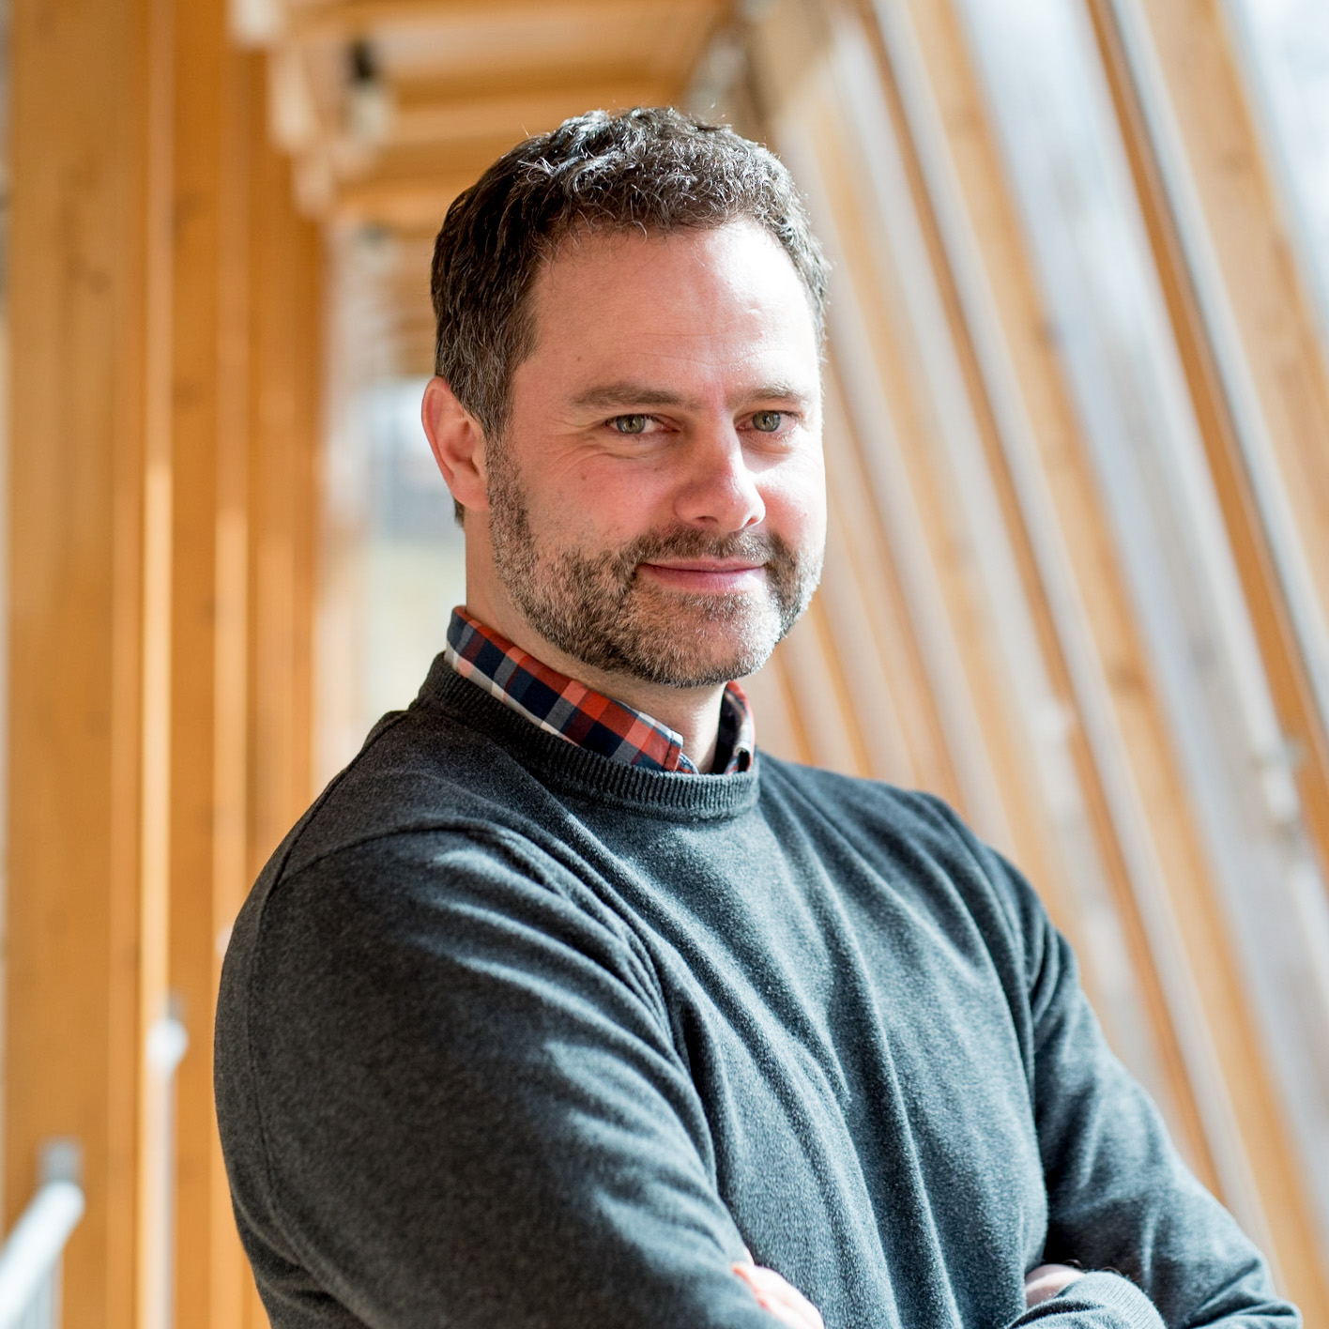
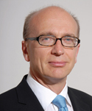
Q&A - discussions with the speakers
DI Christoph Brunner (AEE INTEC)
DI Juergen Fluch (AEE INTEC)
Dr Winfried Braumann (REENAG)

Slide 34
Standardized assessment and innovative (re-)financing of industrial sustainable energy investments (TrustEE)
Innovative Solutions to finance the Green Deal
Covenant of Mayors' Investment Forum – Energy Efficiency Finance Market Place in Brussels on 15 - 16 June 2021
A Horizon 2020 project to finance and realize energy efficiency and renewables in industry

