Slide 1
Programme for the Environment and Climate Action
(LIFE)
Grant Scheme for Biodiversity in the Outermost Regions and the Overseas
Countries and Territories
LIFE-2021-BEST
INFO DAY 18/01/2022
Anita Fassio, Senior Project Adviser
Unit D2 - LIFE Environment (Nature & Circular Economy)

Slide 2
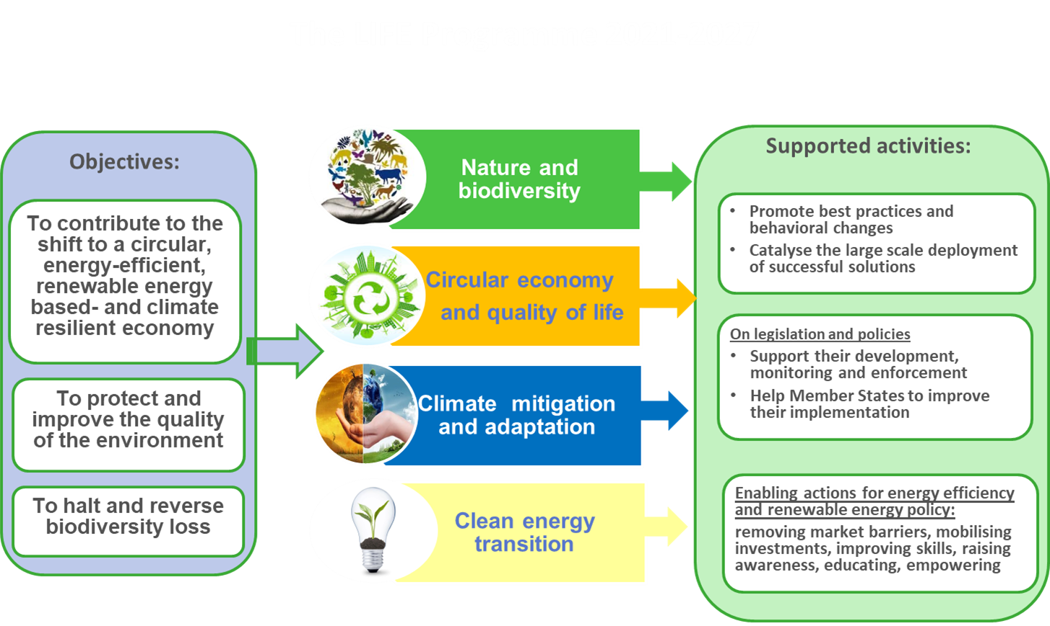
The LIFE Programme 2021-2027
Projects
Develop and demonstrate eco-innovative techniques and approaches
Help to implement and enforce plans and strategies, in compliance with EU legislation.
Promote best practices and behavioral changes
Catalyse the large scale deployment of successful solutions
On legislation and policies
Support their development, monitoring and enforcement
Help Member States to improve their implementation

Slide 3
Sub-programme Nature and Biodiversity
Contribution to:
Typical actions
Halting and reversing biodiversity loss.
Supporting Natura 2000 network and Prioritised Action Frameworks.
Mainstreaming nature and biodiversity objectives into other policies and financing programmes.
Projects supporting nature conservation and restoration in the Natura 2000 network .
Species protection.
Invasive Alien Species
Ecosystem restoration and much more …
SAPs
Integrated implementation of PAF and Biodivesrity Strategy
SNAPs
Financing of small scale grants, particularly in Overseas Countries and Territories and Outermost Regions
BEST

Slide 4
How to apply

Slide 5
Reference documents
All the relevant documents can be found in the ‘Funding & tender opportunities’ portal of the EC https://ec.europa.eu/info/funding-tenders/opportunities/portal/screen/home, at the specific call page LIFE-2021-BEST
Call document
LIFE Work Programme 2021-2024
LIFE Regulation 2021/783
LIFE General Model Grant Agreement (MGA v1.0)

Slide 6
Application forms in the Submission System
  https://ec.europa.eu/info/funding-tenders/opportunities/portal/screen/home
  Standard Application Form:
  Part A (in system): General information
  Participants information
  High level Budget
  Part B (uploaded): Technical description
  Part C (in system): indicators
  Mandatory Annexes:
  Detailed budget table (uploaded)
  Participant information (uploaded)
  Optional Annexes:
  Letters of support
  Cofinancing declaration
PLEASE USE THE OFFICIAL FORMS!

Slide 7
Available budget and timetable

Slide 8
Admissibility and Eligibility Criteria

Slide 9
Admissibility Criteria
Proposals must be submitted before the call deadline
Proposals must be submitted electronically via the Funding & Tenders Portal Electronic Submission System
Proposals (including annexes and supporting documents) must be submitted using the forms provided inside the Submission System
Project acronym — Your project acronym must include the word LIFE
Your application must be readable, accessible and printable
Page limit must be respected - please do not delete the instructions in the application forms to gain more space

Slide 10
Eligibility Criteria
Eligible participants/eligible countries
In order to be eligible, the applicants (beneficiaries and affiliated entities) must:
be legal entities (public or private bodies)
be established in one of the eligible countries, i.e.:
  EU Member States - including Overseas Countries and Territories (OCTs)
  [non-EU countries: listed EEA countries and countries associated to the LIFE Programme (associated countries) or countries which are in ongoing negotiations for an association agreement and where the agreement enters into force before grant signature]*
be active in the areas of nature conservation and climate change
be active in EU’s ORs and OCTs located in the Caribbean, Indian Ocean, Amazon, Pacific, Polar and Subpolar and Macaronesian Regions
Beneficiaries and affiliated entities must register in the Participant Register — before submitting the proposal
Geographic location
Proposals must relate to activities taking place in European Union’s ORs and OCTs
* The UK hasn’t signed association agreement therefore UK participants and OTs are not eligible

Slide 11
Ineligible activities
research;
statutory responsibilities of the competent authority;
activities outside the duration of the project;
activities which are not clearly related to the objective(s) of the project;
compensation measures;
land purchase

Slide 12
Award criteria

Slide 13

Award criteria
4 award criteria matching Part B of the proposal
Each criterion has a maximum of 20 points
« Impact » criterion has weighting of 1.5
Total maximum points: 90
Threshold: 55

Slide 14
Award criterion 1
1. Relevance (0-20 points)
  Relevance of the contribution to one or several of the specific objectives of the LIFE Programme and the targeted sub-programme
  Extent to which the proposal is in line with the description included in the call for proposals, including, where relevant, its specific priorities
  Concept and methodology: soundness of the overall intervention logic
  Extent to which the proposal offers co-benefits and promotes synergies with other policy areas relevant for achieving environment and climate policy objectives

Slide 15
Award criterion 2
2. Impact (0-20 points)
  Ambition and credibility of impacts expected during and/or after the project due to the activities, including ensuring that no substantial harm is done to the other specific objectives of the LIFE Programme
  Sustainability of the project results after the end of the project
  Quality of the measures for the exploitation of project results

Slide 16
Award criterion 3
3. Quality (0-20 points)
  Clarity, relevance and feasibility of the work plan
  Identification and mobilisation of the relevant stakeholders
  Appropriate geographic focus of the activities
  Quality of the plan to monitor and report impacts
  Appropriateness and quality of the measures to communicate and disseminate the project and its results to different target groups

Slide 17
Award criterion 4
4. Resources (0-20 points)
  Composition of the project team - in terms of expertise, skills and responsibilities and appropriateness of the management structure
  Appropriateness of the budget and resources and their consistency with the work plan
  Transparency of the budget, i.e. the cost items should be sufficiently described
  Extent to which the project environmental impact is considered and mitigated, including through the use of green procurement. The use of recognised methods for the calculation of the project environmental footprint (e.g. PEF or OEF methods or similar ones such as PEFCRs/ OEFSRs) or environmental management systems (e.g. EMAS) would be an asset
  Value for money of the proposal

Slide 18
Recommendations

Slide 19
The funding scheme
The calls for proposals and the selection of the grants should be based on a strategic intervention logic and clear mechanism that guarantees the maximum level of coordination and coherence between the individual small grants (especially when operating in the same geographical area), logical continuity of interventions and maximal long term impact
A preliminary description of the criteria to be used for selection of small grants should be provided
Selected small grants should implement concrete conservation activities and capacity building, and their duration should be sufficient to allow the assessment of effects
The calls for proposals should – possibly - be open to all EU ORs and OCTs located in the Caribbean, Indian Ocean, Amazon, Pacific, Polar and Subpolar and Macaronesian Regions
30 April Brussels | #EULife19
Notes:
contribute to the achievement of the post-2020 Global Biodiversity Framework to be adopted at the Fifteenth meeting of the Conference of the Parties (COP 15) of the Convention on Biological Diversity
Contribute to the EU biod strategy

Slide 20
The small grants
implement outcome-oriented effective measures that lead to direct and sustainable improvements of the status of wildlife species and natural habitats in terrestrial, inland water, coastal and or marine areas; introduce and apply nature-based solutions; and/or strengthen the policy framework for nature restoration and conservation and/or promote sustainable use of ecosystem services
implement and/or ensure coherence with the relevant National Biodiversity Strategies and Action Plans (NBSAPs) and other applicable national biodiversity plans and strategies
increase the extent, connectivity and effective management of protected areas (e.g. developing and implementing management plans for the sites) when targeting site related activities, contributing to the development of a network of protected areas on land and at sea
engage local authorities and civil society organisations which are committed in local development and biodiversity conservation, ecosystem restoration and sustainable use of ecosystem services
empower the local stakeholders to define and implement projects tailored to their respective challenges and to address effectively concrete conservation problems
stimulate the inclusion of the conservation and sustainable use of biological resources into decision-making, and mainstream issues across all sectors of the local economies and policy-making frameworks

Slide 21

Good luck!
For questions, contact us at
CINEA-LIFE-ENQUIRIES@ec.europa.eu
https://cinea.ec.europa.eu/life

